Slide 1
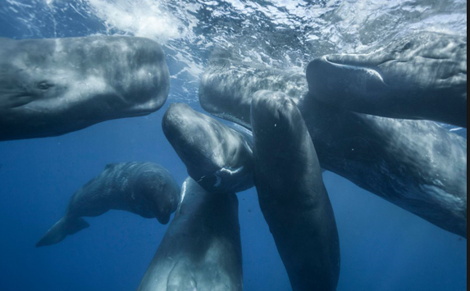
Lesson 1
L.O: I can identify key facts
L.O: I can identify the key features of a non-fiction text.
Text Talk
What is a whale?

Slide 2

Tell your partner: We are going to read a text called ‘What is a whale?’.
What do you think this text is about?
I think the text is about… because...
What type of text do you think it is?
I think the text is…
What do we need to have in a report?
A good report must have...
Facts, headings, subheadings, relevant information.

Slide 3
What is a whale?
Introduction
Whales are amazing and wonderful creatures. There are many different kinds.
Whales are enormous. The blue whale is the largest animal ever to have lived. It is bigger than any dinosaur and its heart is the size of a small car. Whales travel thousands of miles over the oceans in groups called pods.
Whale fact
Some whales can dive very deep. Scientists recorded one whale as deep as 3 kilometres. It held its breath for 137 minutes.
Whale Tails
A whale’s tail has two tail flukes. The flukes move up and down to push the whale through the water. A fish swims by moving its tail from side to side
A pod of sperm whales.

Slide 4
Tell your partner: Which one is correct?
This report is about…
Tigers Snakes
Whales Cats
It is ___________ because it says…
X

Slide 5
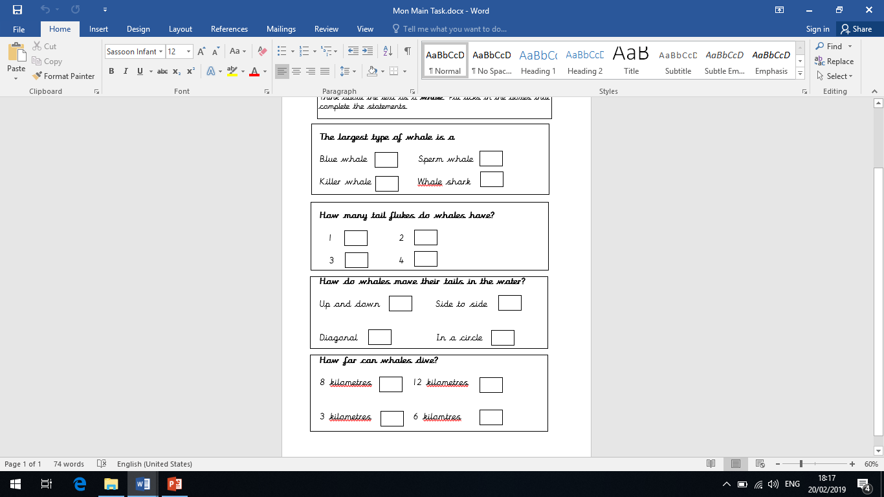
Main task

Slide 6
Sharing answers
X
X
X
X

Slide 7
Lesson 2
L.O: I can explain the meaning of words
Word detectives
What is a whale?

Slide 8
Tell your partner: How can we work out the meaning of a word?
We can use...
Read around the word
Use a dictionary
Use synonyms e.g. happy - excited
When I am reading the text, I want you to think about any words that you do not understand

Slide 9
What is a whale?
Introduction
Whales are amazing and wonderful creatures. There are many different kinds.
Whales are enormous. The blue whale is the largest animal ever to have lived. It is bigger than any dinosaur and its heart is the size of a small car. Whales travel thousands of miles over the oceans in groups called pods.
Whale fact
Some whales can dive very deep. Scientists recorded one whale as deep as 3 kilometres. It held its breath for 137 minutes.
Whale Tails
A whale’s tail has two tail flukes. The flukes move up and down to push the whale through the water. A fish swims by moving its tail from side to side
A pod of sperm whales.

Slide 10
Tell your partner
Find and copy a word that shows the size of whales.
Enormous
What is a whale?
Introduction
Whales are amazing and wonderful creatures. There are many different kinds. Whales are enormous.

Slide 11
Tell your partner
What is a whale?
Introduction
Whales are amazing and wonderful creatures. There are many different kinds.
Whales are enormous. The blue whale is the largest animal ever to have lived. It is bigger than any dinosaur and its heart is the size of a small car. Whales travel thousands of miles over the oceans in groups called pods.
What does the word ‘travel’ mean?
What word could the author use instead of ‘travel?’
Moving around, going to different places
Move, swim,

Slide 12
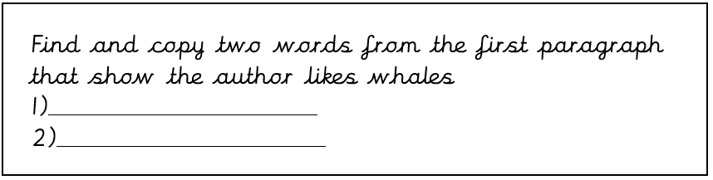
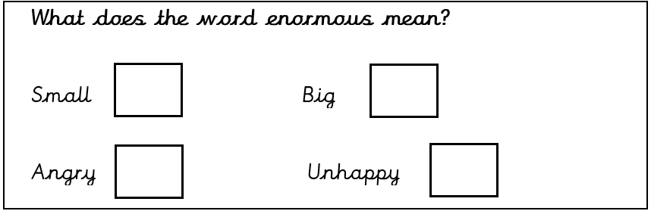
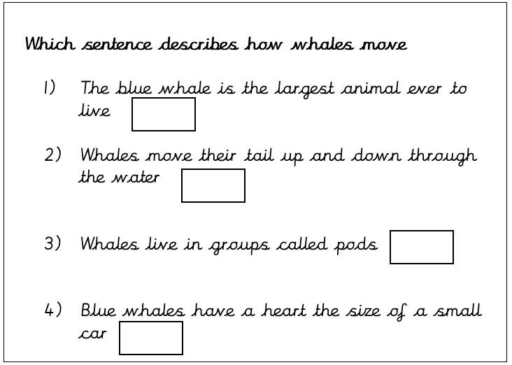
Main task
Amazing
Wonderful
X
X

Slide 13
Lesson 3
L.O: I can retrieve and record information from the text
Rapid retrieval
What is a whale

Slide 14
Tell your partner: How can we retrieve information from the text?
We need to...
Read the text carefully​
Find the important information​
Pick out the information in order to answer questions

Slide 15
What is a whale?
Introduction
Whales are amazing and wonderful creatures. There are many different kinds.
Whales are enormous. The blue whale is the largest animal ever to have lived. It is bigger than any dinosaur and its heart is the size of a small car. Whales travel thousands of miles over the oceans in groups called pods.
Whale fact
Some whales can dive very deep. Scientists recorded one whale as deep as 3 kilometres. It held its breath for 137 minutes.
Whale Tails
A whale’s tail has two tail flukes. The flukes move up and down to push the whale through the water. A fish swims by moving its tail from side to side
A pod of sperm whales.

Slide 16
Tell your partner: How big is a blue whales heart?
What is a whale?
Introduction
Whales are amazing and wonderful creatures. There are many different kinds.
Whales are enormous. The blue whale is the largest animal ever to have lived. It is bigger than any dinosaur and its heart is the size of a small car. Whales travel thousands of miles over the oceans in groups called pods.
The size of small car

Slide 17
Main task
What is the largest whale?
What is a group of whales called?
How long did a whale hold its breath for?
How many tail flukes does a whale have?
How does a whale move its tail when swimming?
A blue whale
A pod
137 minutes
Two
Up and down

Slide 18
Lesson 4
L.O: I can make inferences from the text
Thinking Caps
What is a whale?

Slide 19
Tell your partner: How can we find out why an animal behaves in a certain way?
Use clues from the text​ and make a sensible guess
Think about how the animal acts
Think about how they feel

Slide 20
What is a whale?
Introduction
Whales are amazing and wonderful creatures. There are many different kinds.
Whales are enormous. The blue whale is the largest animal ever to have lived. It is bigger than any dinosaur and its heart is the size of a small car. Whales travel thousands of miles over the oceans in groups called pods.
Whale fact
Some whales can dive very deep. Scientists recorded one whale as deep as 3 kilometres. It held its breath for 137 minutes.
Whale Tails
A whale’s tail has two tail flukes. The flukes move up and down to push the whale through the water. A fish swims by moving its tail from side to side
A pod of sperm whales.

Slide 21
Tell your partner:
Why do you think whales live in groups?
To stay save and look after each other.

Slide 22
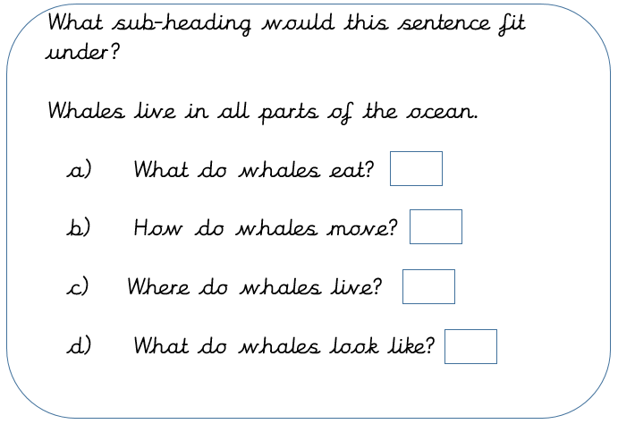
Main task
Why do you think whales move their tails up and down and not side to side like fish?
Why do you think whales have to travel thousands of miles?
They wouldn’t be able to move properly as they are too heavy.
To find food to eat
X

Slide 23
Lesson 5
L.O: I can make links to the text
Question of the Week
What is a whale?

Slide 24
What is a whale?
Introduction
Whales are amazing and wonderful creatures. There are many different kinds.
Whales are enormous. The blue whale is the largest animal ever to have lived. It is bigger than any dinosaur and its heart is the size of a small car. Whales travel thousands of miles over the oceans in groups called pods.
Whale fact
Some whales can dive very deep. Scientists recorded one whale as deep as 3 kilometres. It held its breath for 137 minutes.
Whale Tails
A whale’s tail has two tail flukes. The flukes move up and down to push the whale through the water. A fish swims by moving its tail from side to side
A pod of sperm whales.

Slide 25
Tell your partner:
What subheading could go above this sentence?
Whales move their tails up and down in the water to help them swim.
Whale tails
How do whales move?
How do whales swim?
What do whales use their tails for?

Slide 26
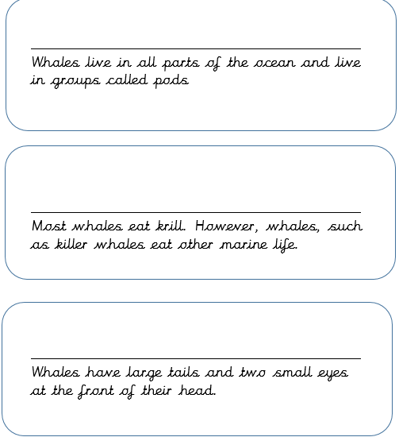
Main task: Add subheadings to these sentences

Slide 27
Sharing answers
Choose children to read out their answers and share with the class.

