Slide 1
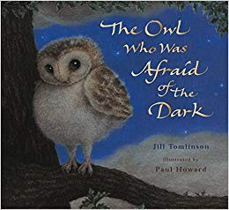
Lesson 1
L.O: I can predict what happens in the story
L.O: I can identify and explain the sequence of events in texts.
Text Talk
The Owl Who Was Afraid of the Dark

Slide 2
Tell your partner: We are going to read a story called ‘The Owl Who Was Afraid of the Dark’.
What do you think this story is about?
I think the story is about… because...
What do we need to have in a good story?
A good story must have...
Beginning, middle, end, characters, events, setting.

Slide 4
Tell your partner: What happens in the middle and at the end of the story?
In the middle of the story…
“Hello!” said Plop. “I’ve come to find out about the dark.”
“Oh!” said the boy. “DARK IS EXCITING, especially tonight. We’re going to have fireworks!”
“Does it have to be dark?” asked Plop.
“Of course!” replied the boy. “You can’t see the fireworks unless it’s dark. Look out for them later!’’
At the end of the story...
“I still do not like it AT ALL! But I will watch the fireworks if you will sit by me.”
“We will sit by you,” said his mummy and daddy. So that is what they did.
When the very last firework had faded away, Mr Barn Owl went hunting. All night he brought food back to Plop, until daylight came and it was time for bed.

Slide 5
At the beginning of the story, Plop is scared of the dark so his mother tells him to talk to a boy.
In the middle of the story…
At the end of the story…

Slide 6
Tell your partner: You’ve got 10 words to sum up this story.
x

Slide 7
Tell your partner: True or False?
True | False
x
Plop does not like the dark.
“I don’t want to be a night bird,” Plop told his mummy. “Dark is nasty.”
“You don’t know that,” she said.
“You’d better find out about the dark before you make up your mind. Look, there’s a little boy down there. Go and ask him.”
It is ___________ because it says…

Slide 8
Tell your partner: What comes first in the story?
“I don’t want to be a night bird,” Plop told his mummy. “Dark is nasty.”
“You don’t know that,” she said.
“You’d better find out about the dark before you make up your mind. Look, there’s a little boy down there. Go and ask him.”
Plop’s mummy tells him to go and ask the boy,
Plop said to his mummy that the dark is nasty.
2
1

Slide 9
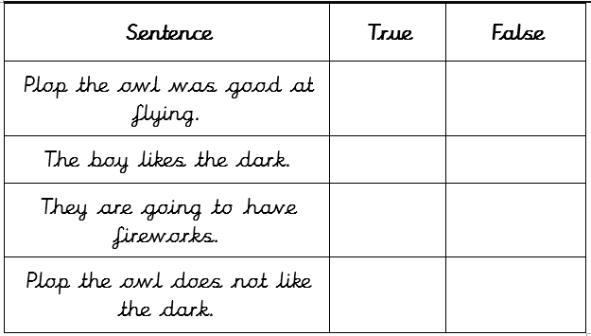
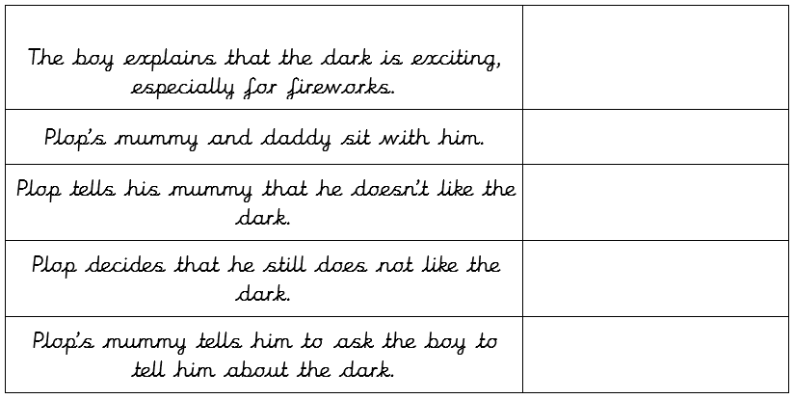
Main task

Slide 10
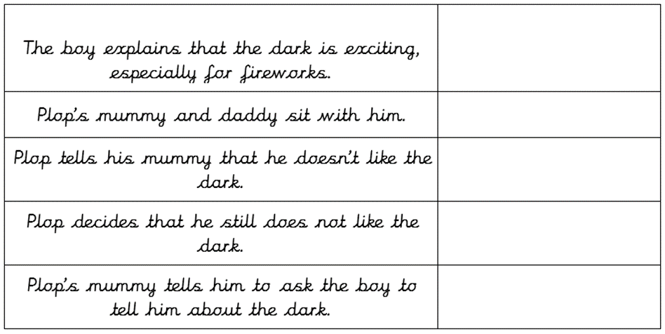
Sharing answers
x
x
x
x
3
5
1
4
2

Slide 11
Lesson 2
L.O: I can explain the meaning of words
Word detectives
The Owl Who Was Afraid of the Dark.

Slide 12
Tell your partner: How can we work out the meaning of a word?
We can use...
Read around the word
Use a dictionary
Use synonyms e.g. happy - excited
When I am reading the story, I want you to think about any words that you do not understand

Slide 14
Tell your partner
Find and copy a word that shows what Plop thought of the dark.
nasty
“I don’t want to be a night bird,” Plop told his mummy. “Dark is nasty.”
“You don’t know that,” she said.

Slide 15
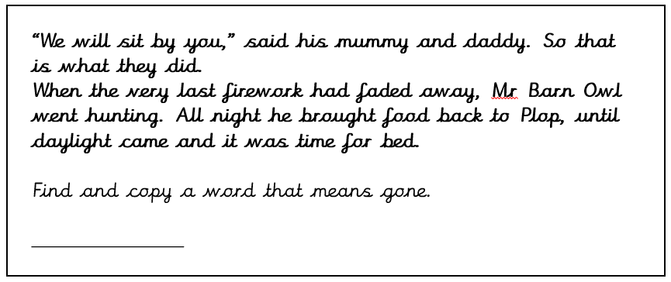
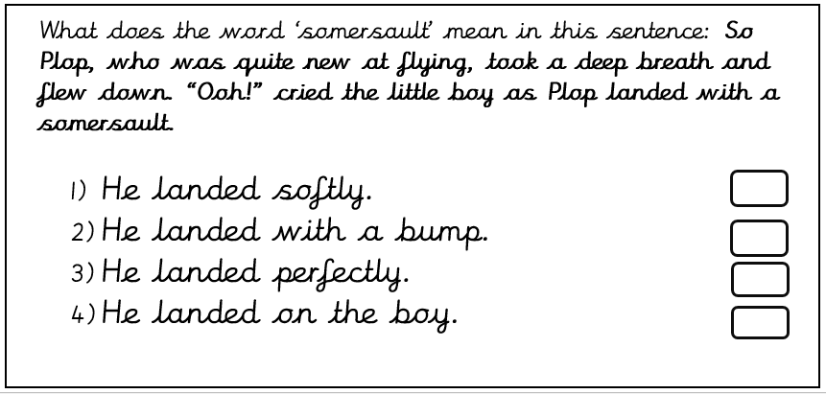
Main task
faded
x

Slide 16
Lesson 3
L.O: I can retrieve and record information from the text
Rapid retrieval
The Owl Who was Afraid of the Dark.

Slide 17
Tell your partner: How can we retrieve information from the story?
We need to...
Read the text carefully​ Find the important information​ Pick out the information in order to answer questions

Slide 19
Tell your partner: Who is the main character in the story?
“I don’t want to be a night bird,” Plop told his mummy. “Dark is nasty.”
“You don’t know that,” she said.
Plop the owl.

Slide 20
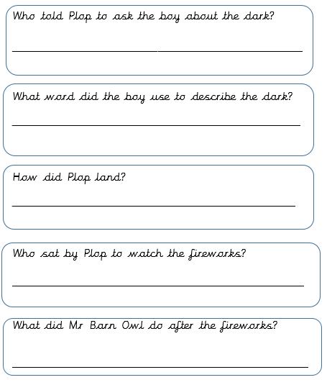
Main task
Plop’s mummy
Exciting
With a somersault
His mummy and daddy.
He went hunting

Slide 21
Lesson 4
L.O: I can make inferences from the text
Thinking Caps
The Owl Who was Afraid of the Dark.

Slide 22
Tell your partner: How can we find out how a character is feeling?
Use clues from the text​ and make a sensible guess
Think about how the character acts
Think about how they feel

Slide 24
Tell your partner:
Why do you think Plop felt afraid?
Plop felt afraid because…
He is a night bird who is scared of the dark.

Slide 25
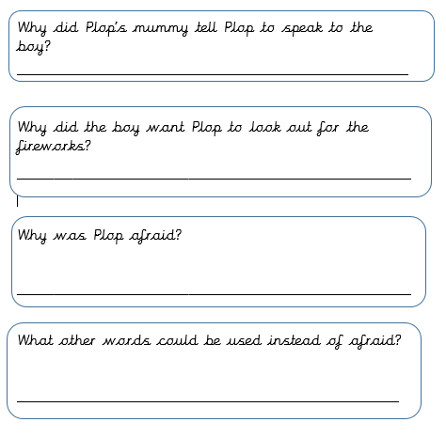
Main task
To find out more about the dark.
He thought he would like them and not be afraid any more.
Because he is only awake in the night, in the dark.
Frightened, scared, fearful, terrified.

Slide 26
Lesson 5
L.O: I can make links to the text
Question of the Week
The Owl Who was Afraid of the Dark.

Slide 28
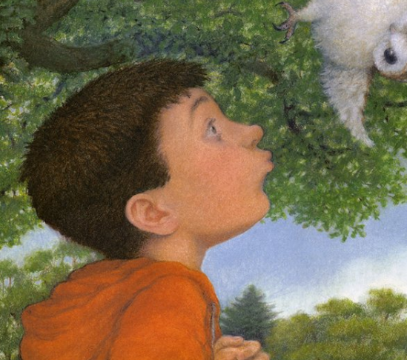
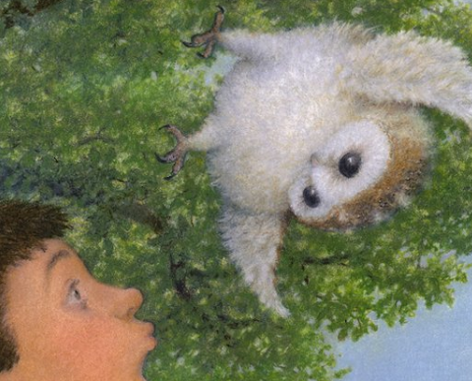
Tell your partner: What do you think each character is thinking when they first meet?
I hope this boy can help me to find out about the dark. I don’t want to crash into him.
Why is this baby owl awake in the day time? I need to help him.

Slide 29
Main task: Fill in the thought bubbles for the two different characters

Slide 30
Sharing answers
Choose children to read out their ideas and share with the class.

