Slide 1
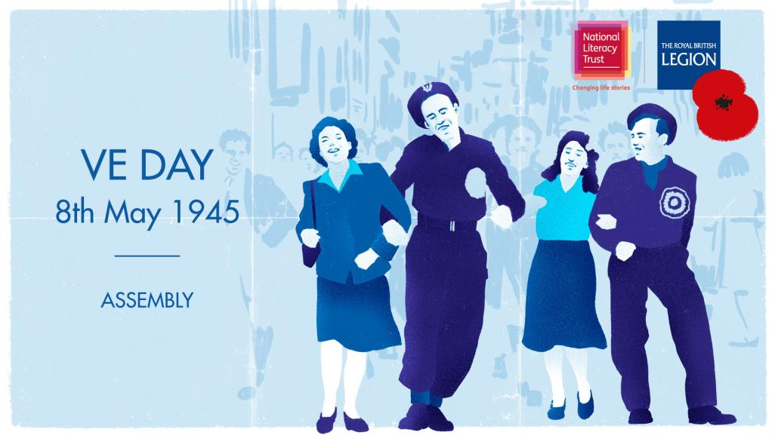

Slide 2
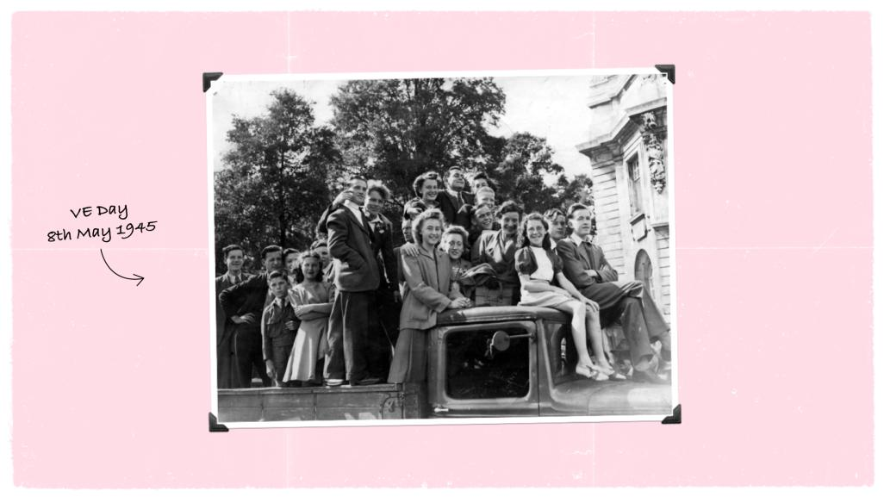
Notes:
Pupils might have learned about or heard of VE Day before. Do they know what it is/why it such a significant day?
VE Day or Victory in Europe Day marked the end of fighting in Europe during the Second World War – which had lasted nearly 6 years.

Slide 3
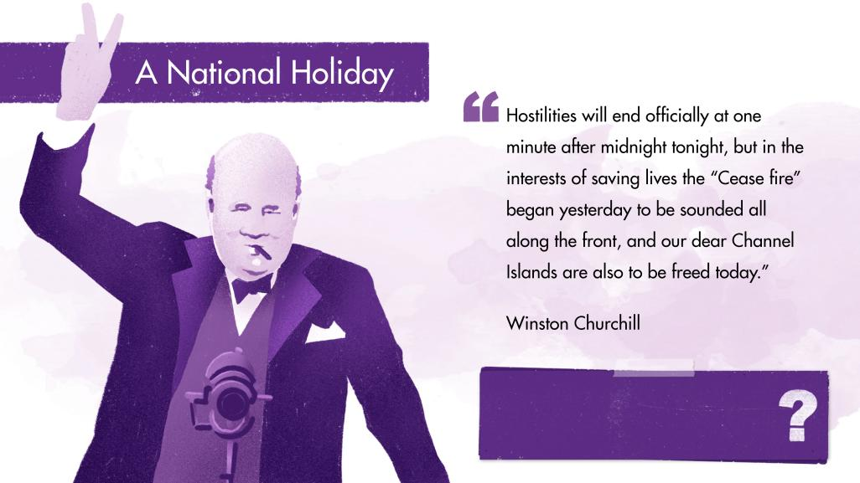
How do you think people felt
hearing those words?
Notes:
On 7th May 1945, Winston Churchill made an announcement on the radio that Germany had officially surrendered. He declared that the next day (8th May) would become Victory in Europe day and a national holiday for everyone.
How do you think people felt hearing those words?
The full speech can be found here: https://winstonchurchill.org/resources/speeches/1941-1945-war-leader/end-of-the-war-in-europe/
In his announcement, Churchill paid tribute to Britain’s allies: “Finally almost the whole world was combined against the evil-doers, who are now prostrate before us. Our gratitude to our splendid Allies goes forth from all our hearts in this Island and throughout the British Empire.” A total of 46 countries fought together in the war.
Note: Even though VE Day marked victory for Europe over Germany, World War Two was still not over. Even after 8 May, many soldiers, sailors and pilots were sent to the east to fight in Japan.

Slide 4
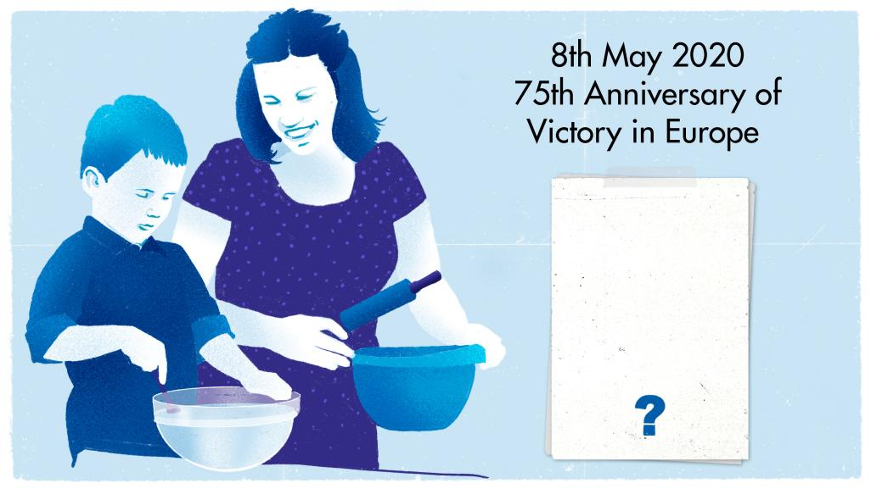
Why do you think it is important that together we remember VE Day?
Notes:
This year it is the 75th anniversary of VE Day. To commemorate the event, the early May bank holiday (usually a Monday) has been moved so that the bank holiday is the same day as VE Day – Friday 8th May. There will be special events taking place on that day and across that weekend when everyone will give thanks to those who served in the war and to remember all those who lost their lives.
Why do you think it is important that together we remember VE Day?

Slide 5
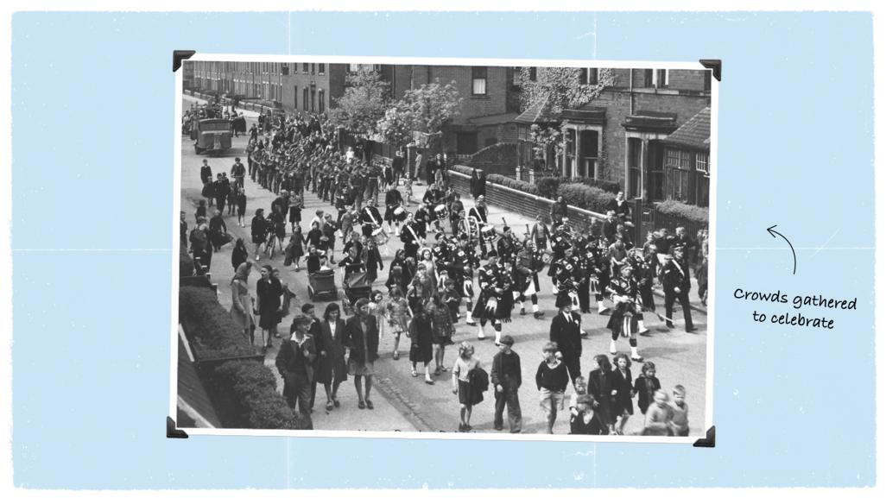
Notes:
Image : © Norman Dunn
On VE Day, people held big celebrations across Britain. Crowds gathered in public spaces for parades or street parties - to dance and celebrate the end of the war in Europe – even with people they had never met before. It was a time where communities came together.
The largest crowds were in London with one crowd reaching up to 50,000 people celebrating into the night. Huge crowds also gathered outside Buckingham Palace where the King and Queen, their daughters and the Prime Minister appeared on the balcony to greet everyone.
The image shows a celebration parade that took place 8th May VE Day Parade in Hebburn, in the North East of England
Ask pupils: Why do you think so many people came together to celebrate VE Day?

Slide 6
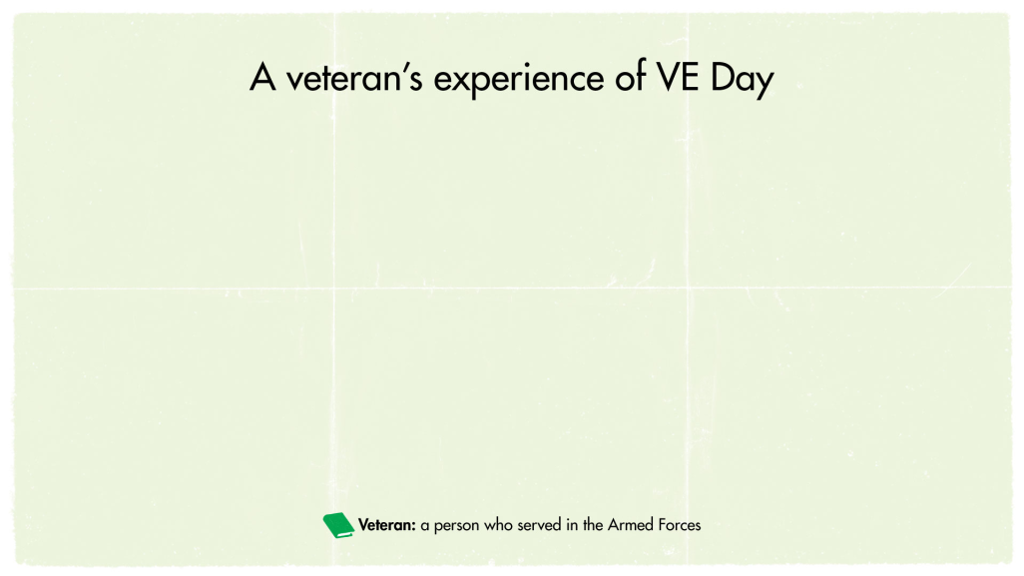
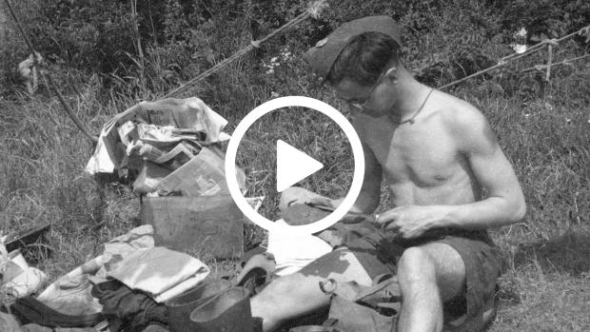

Slide 7
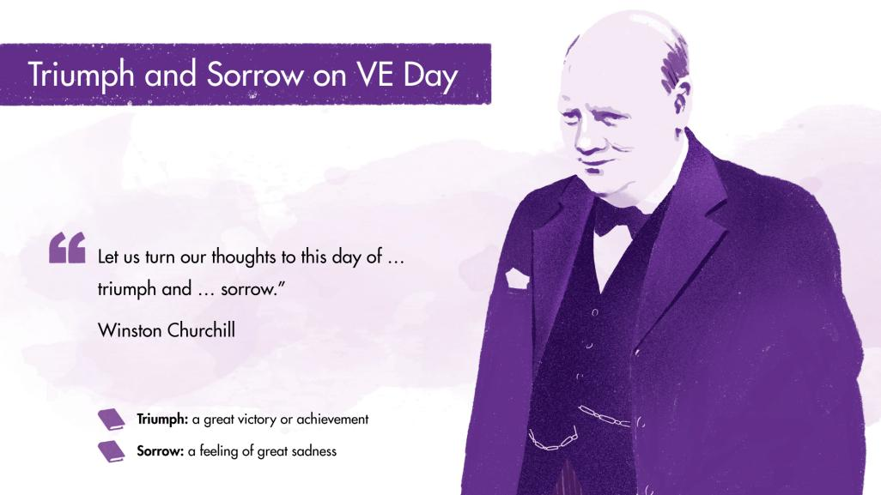
Notes:
On VE day, there was a mix of feelings. It was a time for celebrating the end of the war, but it wasn’t only a celebration.
VE day was one full of triumph, and sorrow.
On the 8th May, Winston Churchill announced the end of the War in Europe with a speech broadcast from Downing St. He said "we may allow ourselves a brief period of rejoicing, but let us not forget for a moment the toils and efforts that lie ahead". King George VI also gave a speech, broadcast from Buckingham Palace. Both men recognised the importance of remembering those who lost their lives.
Despite celebrations and relief that the war was over, for many, it was also a very sad time.
There was a lot of damage after the war, for example many people’s homes were destroyed in the air raids.
Millions of people had lost their lives or loved ones in the conflict.
Soldiers who survived and were able to return home were full of the memories of war and conflict
Many people weren’t home yet - including Prisoners of War or evacuees

Slide 8
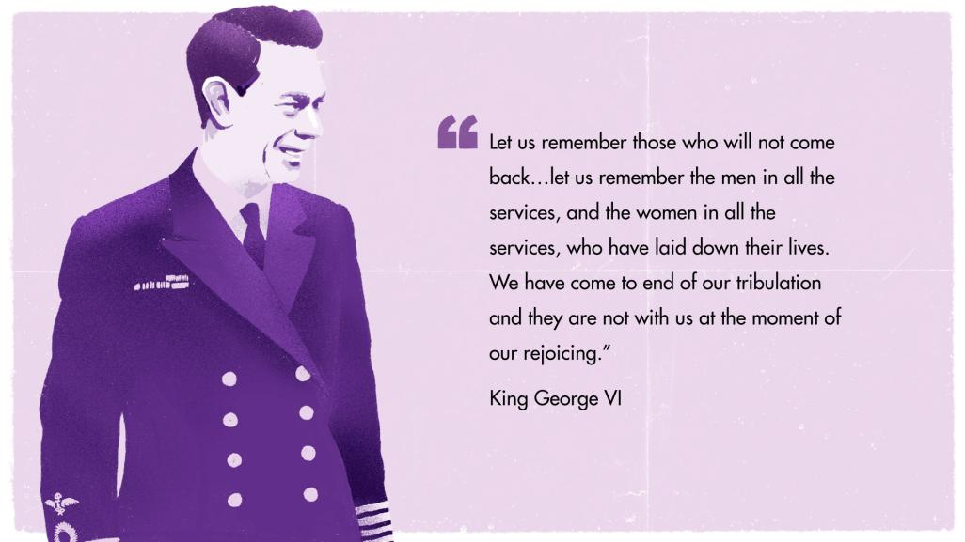

Slide 9
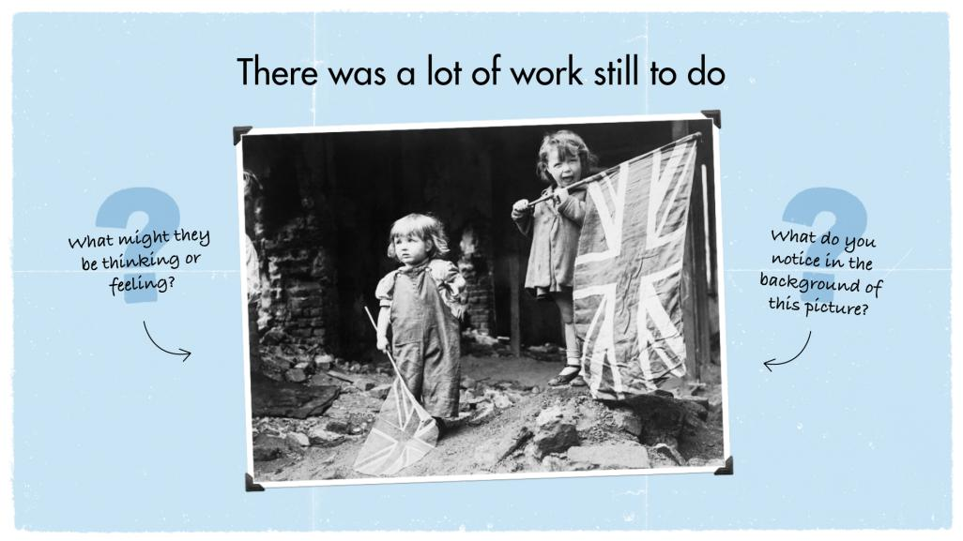
Notes:
© Crown Copyright. IWM
What do you notice about the background of picture? The rubble is evidence of the damage that occurred to many people’s homes and streets in the war.
This image was taken on VE Day - two small girls waving their flags in the rubble of Battersea, London.

Slide 10
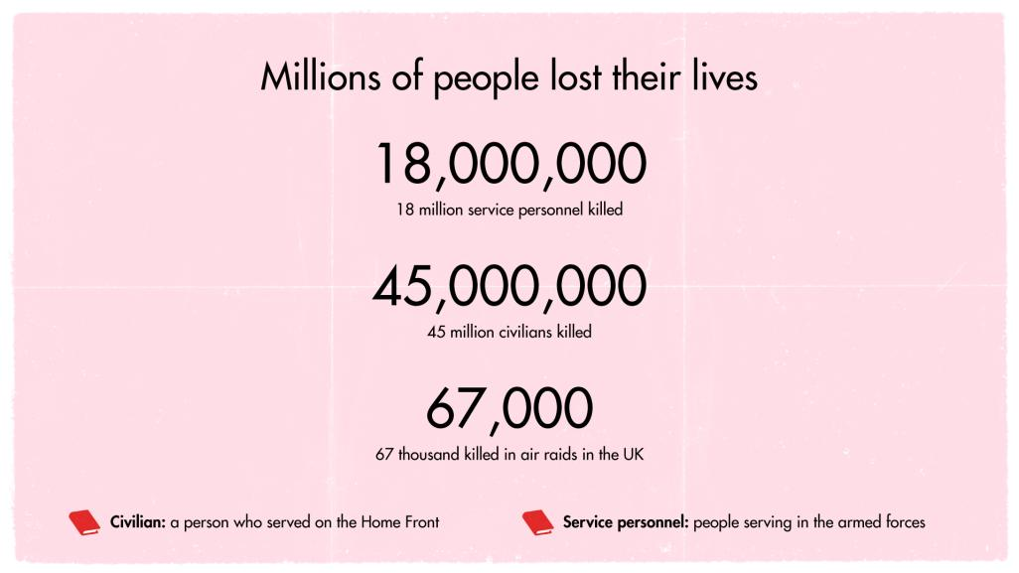
Notes:
Victory in Europe had been costly. Between 50 – 60 million people died in WW2. Out of those deaths, 45 million were civilians (people not serving in the armed forces). It is estimated that nearly 18 million service personnel were killed on the battlefields in Europe, including 11 million Allies.

Slide 11
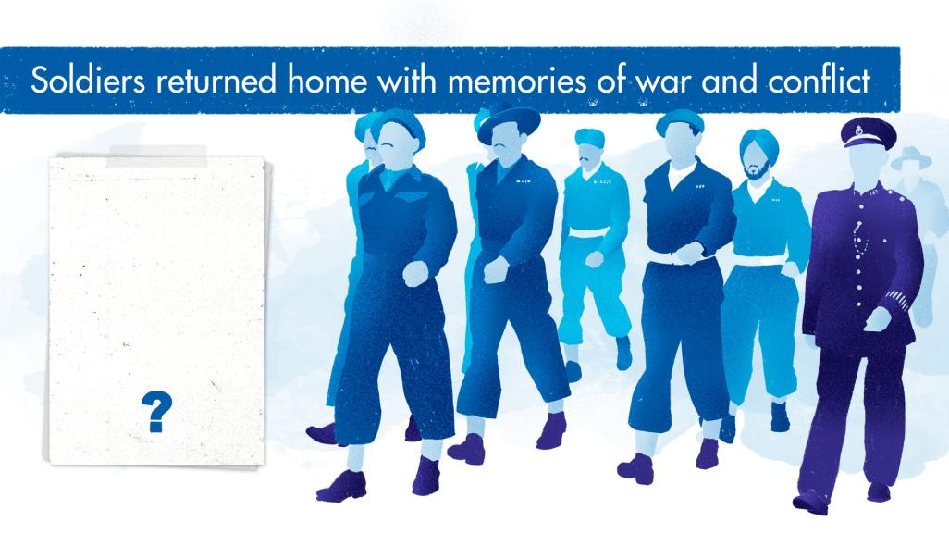
How do you think returning soldiers felt about coming home?
Notes:
How do you think returning soldiers felt about coming home?
For those soldiers who survived and returned home at the end of the war, it wasn’t all about celebration either. Many were traumatised about what they had seen and experienced in the conflict
Those returning home included surviving Prisoners of War – soldiers who had been captured by enemies. 135,000 POWs returned home to the UK from Europe.
Most were not home on VE day – but made it home by Christmas 1945. However, there were still POW returning after this from the Far East.

Slide 12
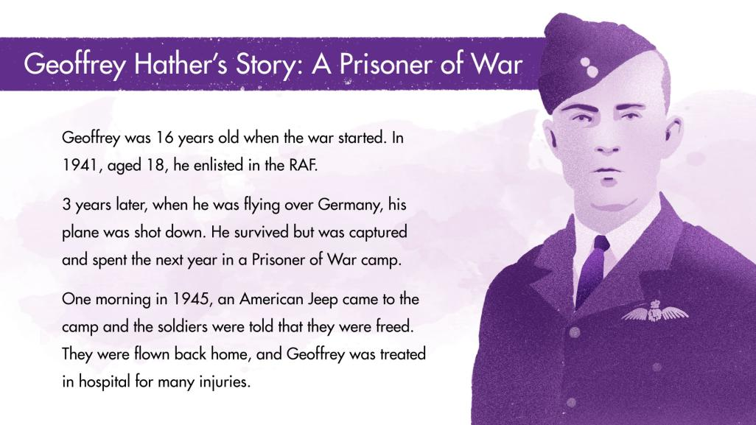
Notes:
Audio recording of Geoffrey Hather: https://www.iwm.org.uk/collections/item/object/80012976
3 years after joining the RAF, Geoffrey and his crew were flying over the Ruhr in Germany, and their aircraft was hit. As the fire took hold, the crew were ordered to bail out, but when the plane suddenly lurched to one side, Geoffrey fell without his parachute. Miraculously, he survived but was badly injured. He was treated in a Prisoner of War hospital. He recovered and then spent the next 9 months in a series of Prisoner of War camps for airmen.
After being freed from the camp, the POWs were flown back to Leighton Buzzard, were deloused and given new uniform. They were then taken to hospital in Shropshire, examined and given leave.
Geoffrey was in and out of hospital for eighteen months after being discharged in Jan 1947.
He spent 6 weeks at a RAF rehabilitation centre where they were helped to settle back home. They were given a book which addressed various issues such as how to deal with returning home, having waited for it for so long and how to deal with people.
It took Geoffrey a while to settle back into civilian life. When Geoffrey was on the train back to Birmingham, his face had healed but he still had a limp. He didn’t dread the reactions to his injuries as much as he dreaded arriving home to celebratory banners and a large crowd. He decided that if he looked down the street and there had been a banner welcoming him home, he would have just turned around and walked away.
He described the first few weeks being home as “quite difficult” – Britain had changed so much.
He had been used to being restricted in small compound with barbed wire and now he was home where he could open doors and go wherever he liked.

Slide 13
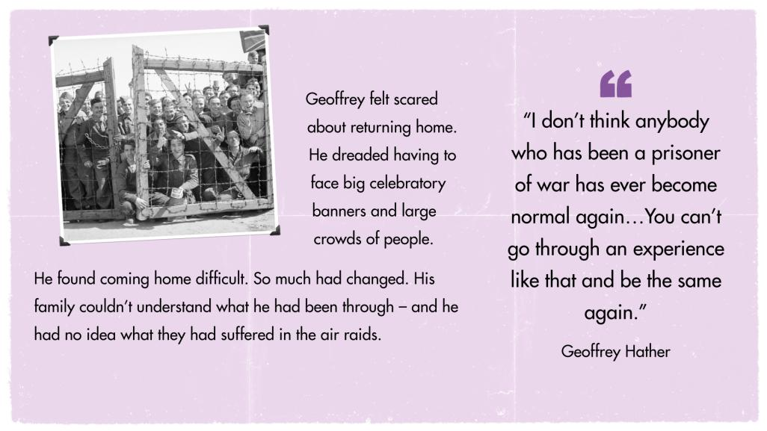

Slide 14
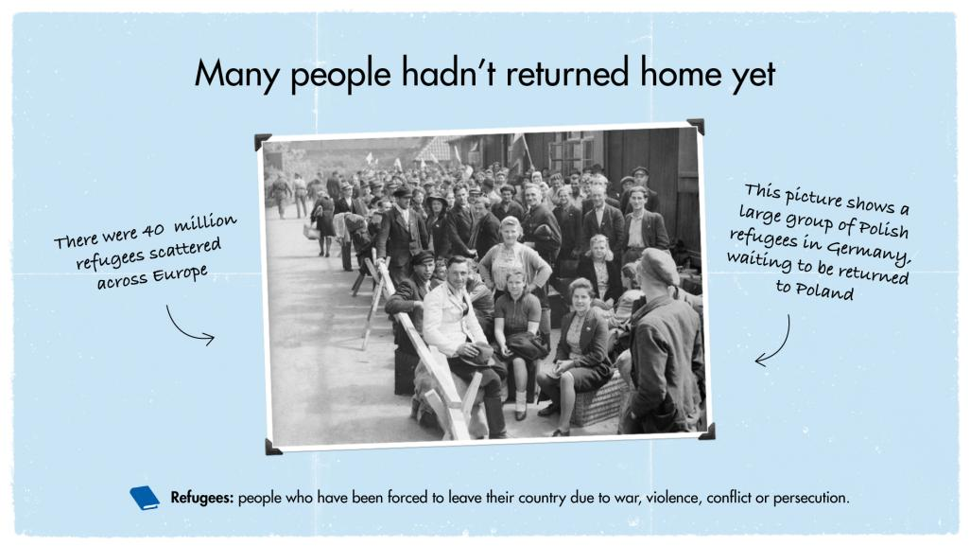
Notes:
Image © Crown Copyright. IWM
On V.E Day, although some were at home taking part in the celebrations, there were still many people who had not made it home yet. There were approximately 40 million refugees scattered across Europe. In Germany there were around 17 million displaced people including approximately 300,000 Jews who had been freed from Concentration camps.
This image shows a group of Polish refugees at The Displaced Persons camp in Hamburg, waiting to be returned to their Polish National Camp
On arrival, displaced persons in Hamburg were organised into groups of 50 for processing through the reception centre. They were dusted with anti-louse powder and given a registration card (D.P.3) bearing such details as their name, nationality and place of residence. All were then allotted a bed in one of the accommodation huts. In times of overflow a large former air raid shelter was used as overspill night accommodation. After a few days at the camp and when transport was available displaced persons were sent to the appropriate 'National Camp' ready for repatriation to their country of origin. On 4 May 1945, the German authorities estimated there were 45,000 displaced persons in Hamburg. This figure was later increased to 120,000.
Millions of people never even returned home at all.

Slide 15
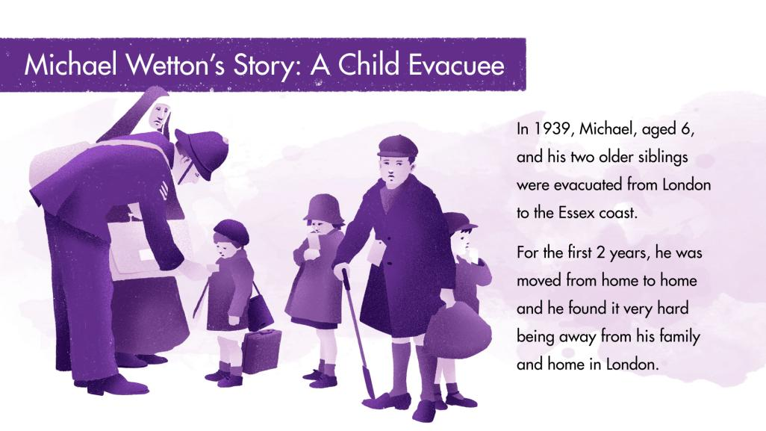
Notes:
Michael was one of many children who were evacuated from London during the war. Evacuees were sent to live with other families in safe areas of the country whilst London was being bombed. Michael and his two older siblings left their home and their parents in 1939, and were sent to live near the Essex coast.
In 1944, many evacuees started to return home. However, in August 1944, Michael’s family home was hit by a Doodlebug (V1 rocket) and so his mother did not feel it was safe for them to come back. Then in January 1945, their house was hit again – this time it suffered a lot of damage. The front door was blown off and the water tank burst, flooding the house. Michael’s mother was at home but miraculously survived. She was recued and taken to hospital before going to her parents house. Unfortunately, there was not enough room in Michael’s grandparent’s house for the whole family, so Michael and his siblings could not yet return home. The war was over, and Michael was now 12 years old. He had been away from his family for 6 years, and yet still could not return.
Michael's experience stayed with him forever, and throughout adulthood he dedicated himself to helping others. In 1953, he trained to be a teacher – and was for 30 years. He also supported charities like Save the Children and Shelter, which focus on helping children and the homeless.

Slide 16
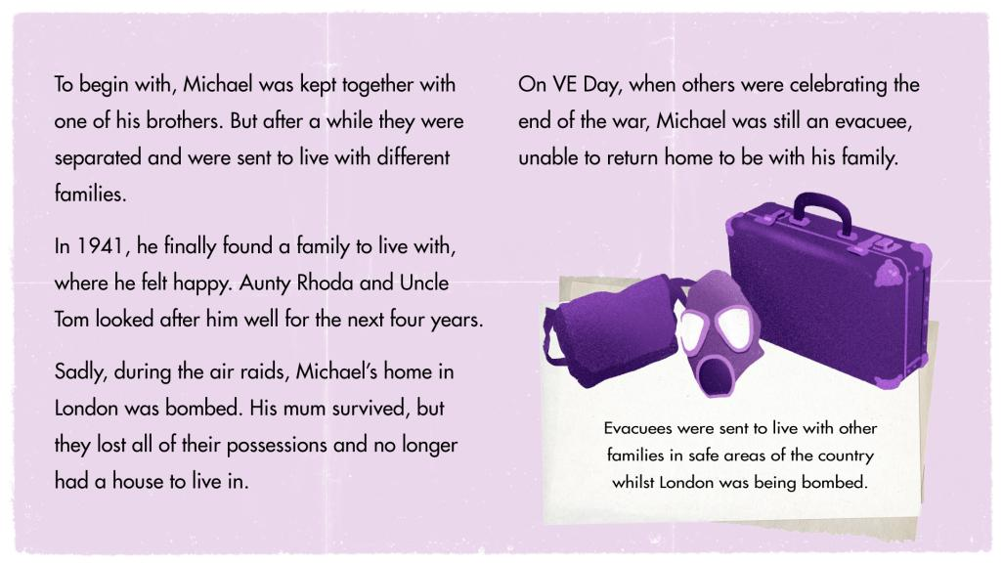

Slide 17
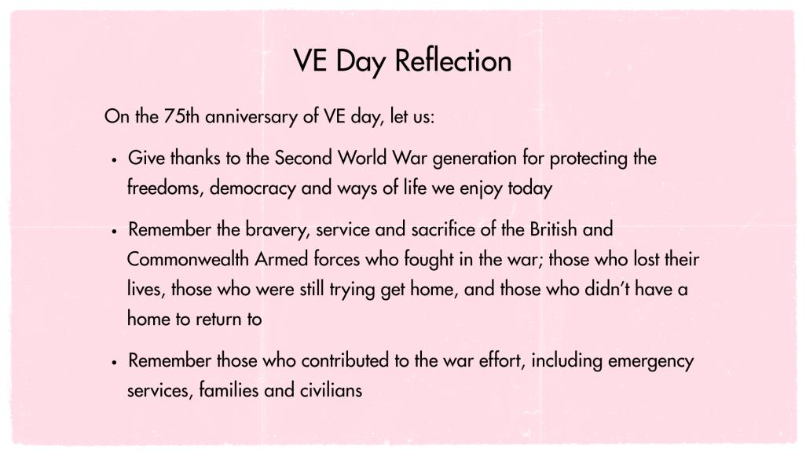

Slide 18
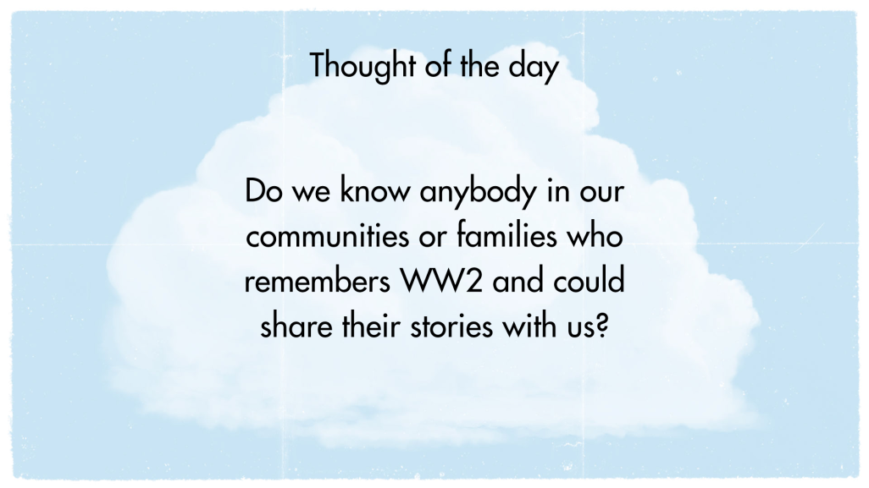
www.rbl.org.uk/remembrance
Notes:
Ask the pupils to reflect on whether they might know anyone in their communities who remembers WW2 and could share their stories? Think about elderly relatives or members of our community. Who could they ask within their families? Do they know anyone who was a child during WW2?

