Slide 1
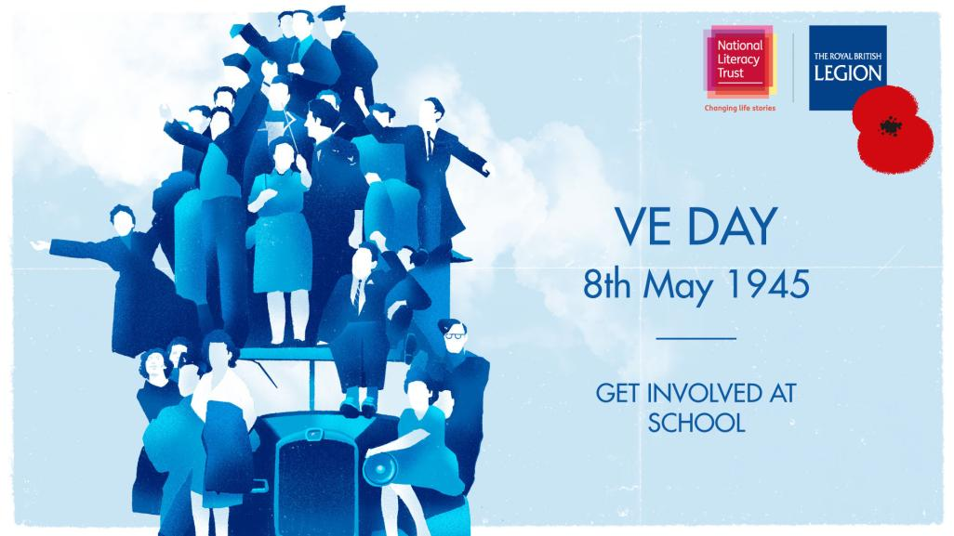
Notes:
Important Message:
At this time, the vital links within our communities are tested. We want to encourage young people to stay connected with the World War Two generation, and even make new connections through their engagement with VE Day. Some of the activities in this presentation focus on sharing their work and asking questions about what VE Day was like. Whilst doing any or all of these activities, it is crucial that official guidelines are followed to ensure the health and wellbeing of everyone. Digital platforms such as email and Skype would be ideal for connecting with others, whilst remaining safe.

Slide 2
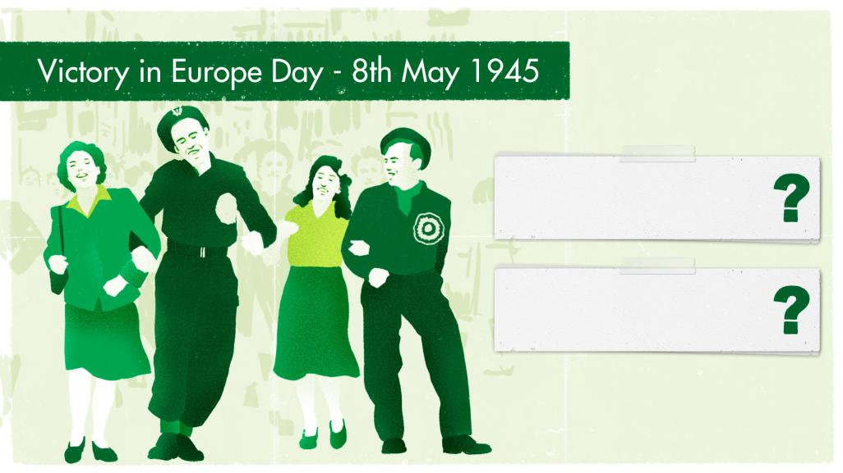
Why is VE Day such an
important day in history?
How did people feel about
VE Day?
Notes:
Ask students what they remember about VE Day (thinking back to the last assembly). Consider:
Why is VE Day such an important day in history?
What happened on VE Day?
Who do we know who might remember VE Day?
VE Day or Victory in Europe Day marked the end of fighting in Europe during the Second World War – which had lasted nearly 6 years. On 7th May 1945, Winston Churchill made an announcement on the radio that Germany had officially surrendered. He declared that the next day (8th May) would become Victory in Europe day and a national holiday for everyone.

Slide 3
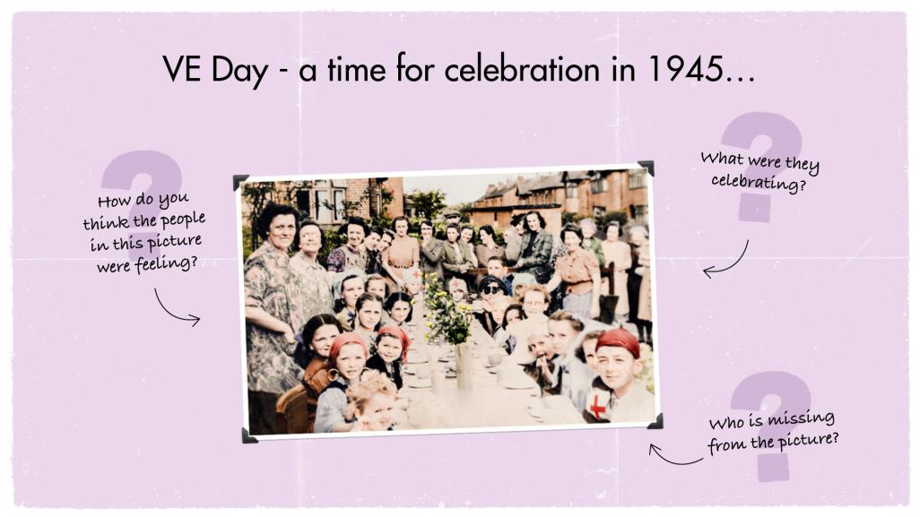
Notes:
Image credit: BBC. Accessed at https://www.telegraph.co.uk/goodlife/11588987/VE-Day-soldiers-memories-and-street-parties.html
VE Day was a huge moment for people across Europe as it marked the end of many years of conflict. It was a moment of great relief and hope for the future – and a day for communities to come together for a period of celebration.
Students might notice that there are predominantly women and children in this photo as lots of men were soldiers and wouldn’t have started their journey home from the front lines yet.
Who did these children grow up to be? Can students work out who in their community may have memories of VE Day based on their current age?

Slide 4
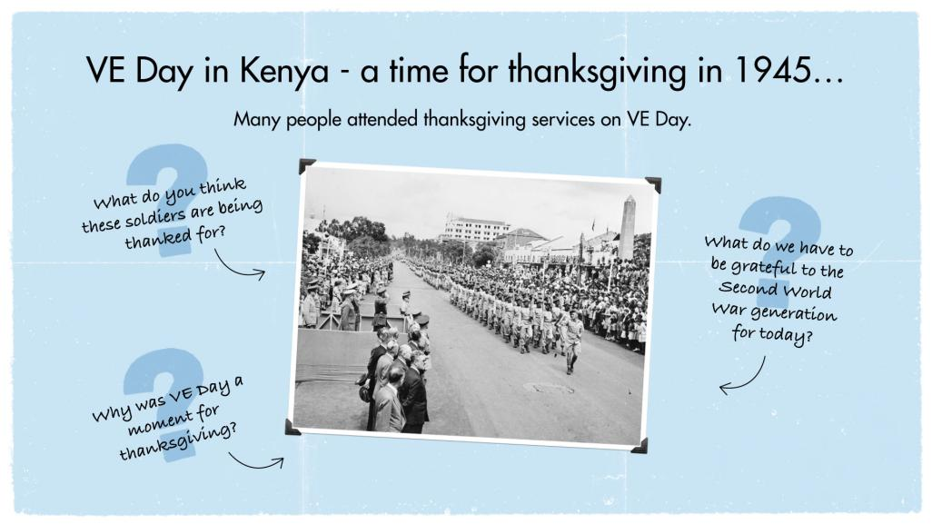
Notes:
Image © Crown Copyright. IWM - VE Day in Kenya - Lieutenant Sir Kenneth Anderson, General Officer Commanding-in-Chief East Africa Command takes the salute - a contingent of the African Pioneer Corps passes the saluting base.
This military parade in Kenya, one of Britain’s allies during the war, recognised the bravery of the soldiers who fought in the war to protect our freedoms and welcomed them home. With nearly 18 million service personnel killed on the battlefields in Europe, not everyone was able to return home.
In addition to the celebrations, VE day was a time of thanksgiving – to show gratitude to all those who served and sacrificed in the war effort such as:
Service personnel including Commonwealth forces and Britain’s allies
Those who served on the Home Front, for example as Land Girls, Home Guard, Women’s Timber Corps, and the like, either as civilians in reserved occupations or with the Armed Forces
Men and women who served in the emergency services
Civillians who took in and looked after evacuees

Slide 5
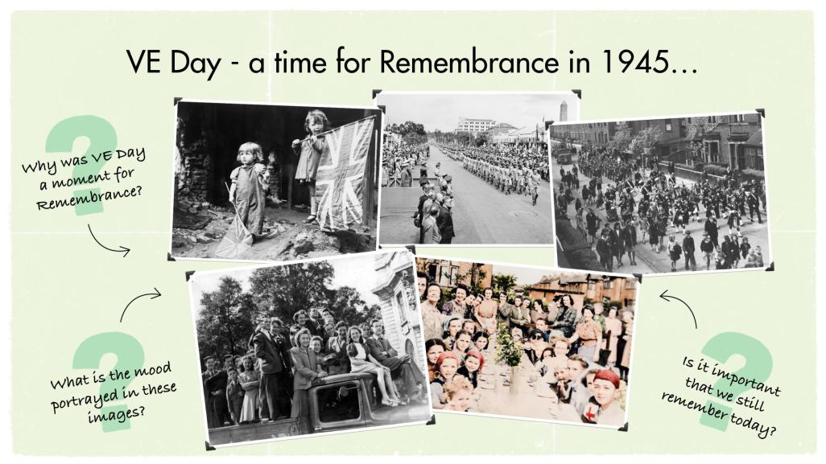
Notes:
Image credit:
The Second World War is sometimes described as a ‘total’ war because of the enormous global devastation. Between 50 – 60 million lives were lost including:
18 million service personnel (including both Allied and Axis forces)
45 million civilians, of which 6 million were Jews
67,000 Britons killed in air raids
In the UK, no life was left untouched by the war. Through acts of remembrance such as a two minute silence or attending a remembrance service, we remember the people who lost their lives, we remember the reasons the war was fought and we remember that nothing so damaging must ever be allowed to happen again. This gives us hope for a peaceful future.
Depending on the class’ prior knowledge, it may be useful to think about some of the actions taken after the Second World War by the countries involved, to ensure that such atrocities were never repeated. These include:
The UN declaration of Human Rights which meant that by law, no-one should be discriminated against because of their religion or any other characteristic again
In the UK, the NHS was established and the government funded new houses to be built as a way to ensure the generation who had contributed to the war effort were able to live healthy lives
Jewish refugees from Europe who had survived the war were allowed to become citizens of different countries including the UK, USA and Israel
Alternatively, discuss with the class small actions we can take every day to demonstrate remembrance and commitment to a peaceful future such as:
Making friends with someone who has a different background to your own
Learning a different language
Performing small acts of kindness to strangers

Slide 6
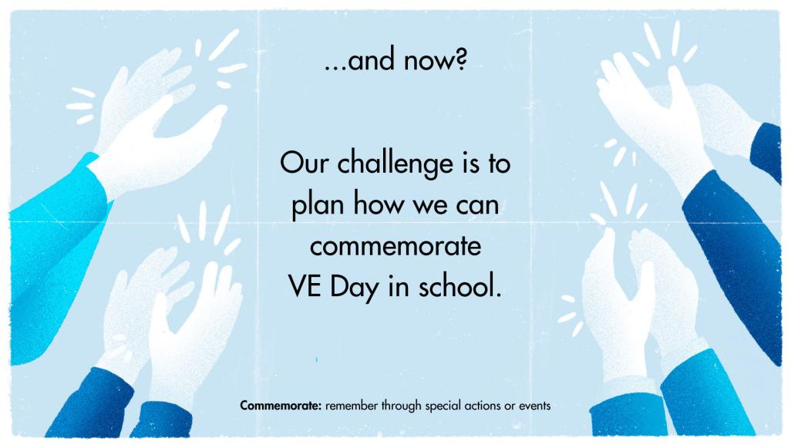
Notes:
Ask students about what ideas they have for celebrating VE Day. There are some suggestions on the following slides – please delete as appropriate for your school context. You might decide that different classes will take on different activities so that each contributes to whole school commemorations.

Slide 7
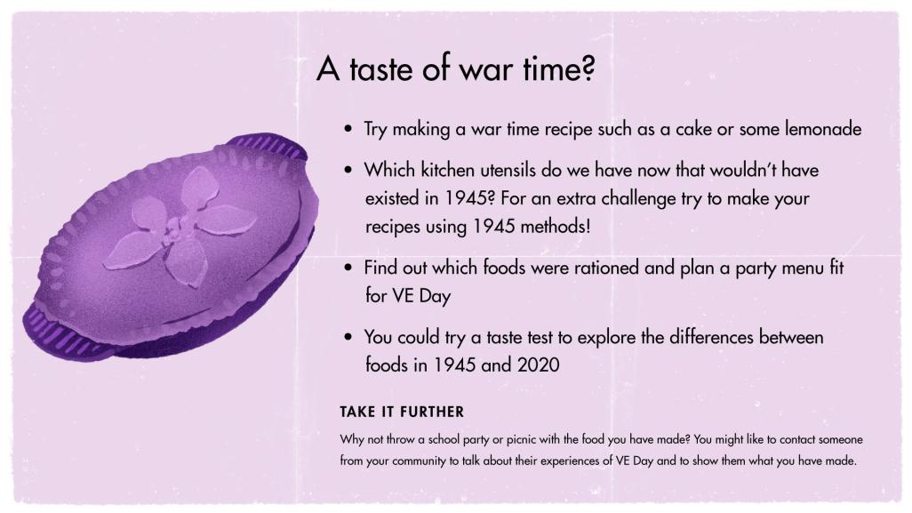
Notes:
Ideas for recipes:
https://www.nationaltrust.org.uk/croome/recipes/wartime-carrot-cake – wartime carrot cake
https://www.english-heritage.org.uk/siteassets/home/visit/ve-day-75/ve-day-pack.pdf – party pack includes recipes for carrot scones, cheese and marmite swirls, lemonade
Further info on wartime rationing https://www.lavenderandlovage.com/2012/11/the-wartime-kitchen-living-of-rations-with-ration-book-cooking-day-one.html including a loaf recipe
http://downloads.bbc.co.uk/history/handsonhistory/ww2_recipes2.pdf – wartime chocolate cake

Slide 8
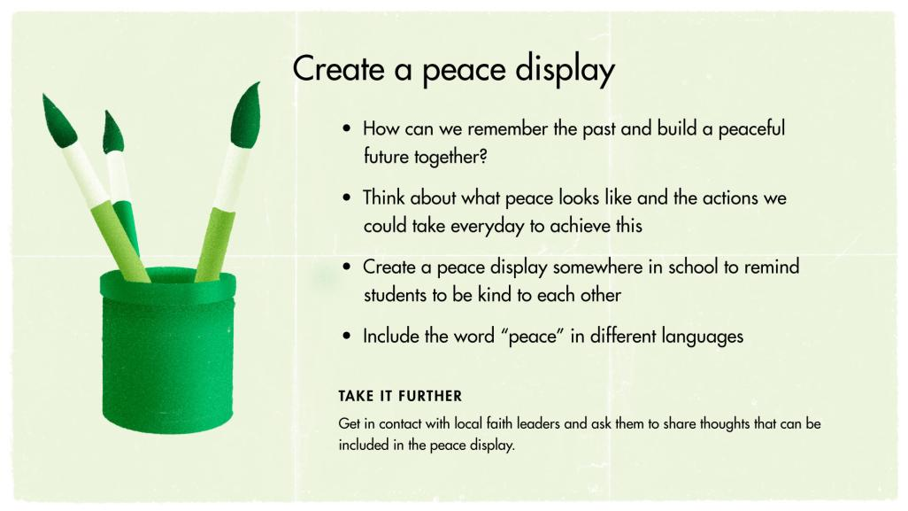
Notes:
Peace in other languages:
Paix – French
平和 – Heiwa - Japanease
Frieden – German
Paz – Spanish
Pokój – Polish
Salam - Arabic

Slide 9
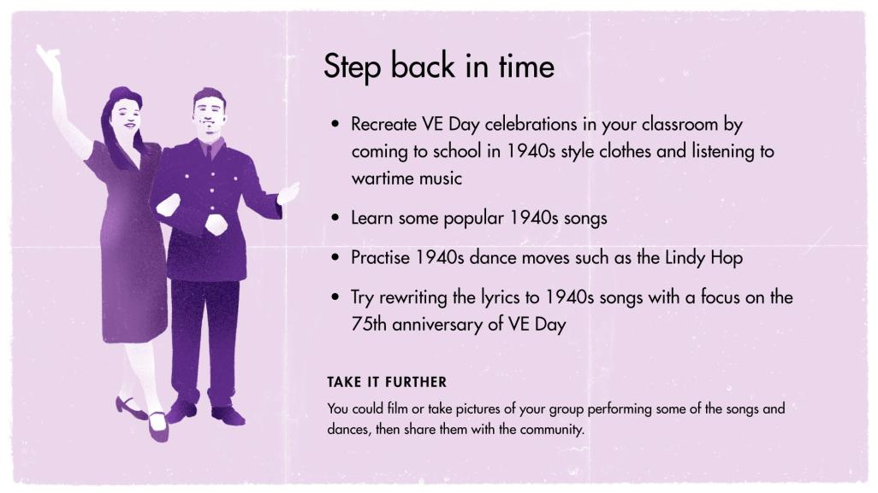
Notes:
Example songs:

Slide 10
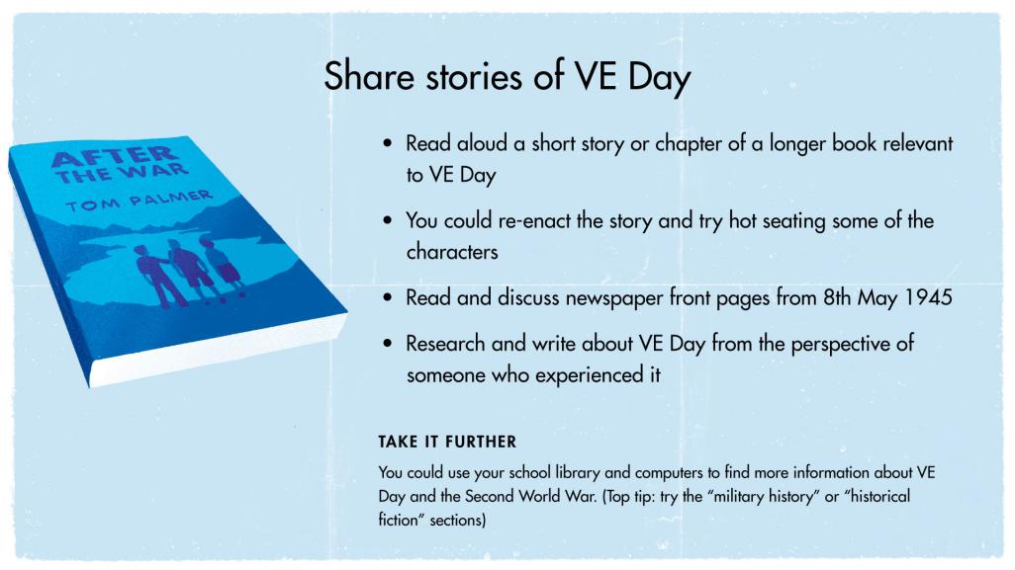
Share stories of VE Day
Notes:
Possible reading materials:
Homecoming by The Royal British Legion
Chapter xx of After the War by Tom Palmer

Slide 11
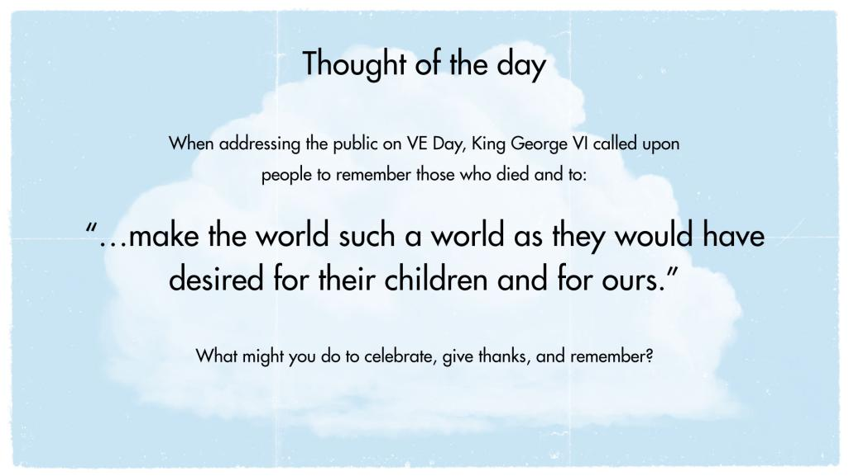
www.rbl.org.uk/remembrance
Notes:
Hold a 1 minute reflection. Ask students to think about some of the ways they can show kindness towards others and take action to help build a peaceful future together

