Slide 1
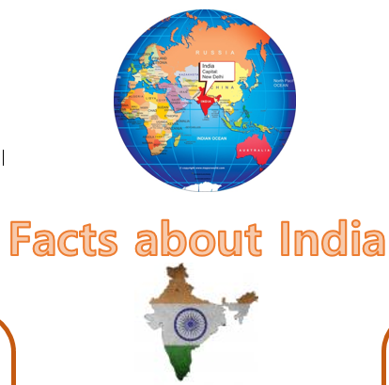
Lesson 1
L.O: I can identify key facts
L.O: I can identify the key features of a non-fiction text.
Text Talk
Facts about India

Slide 2
Tell your partner: We are going to read a text called ‘Facts about India’
What do you think this text is about?
I think the text is about… because...
What type of text do you think it is?
I think the text is…
What do we need to have in a report?
A good report must have...
Facts, headings, subheadings, relevant information.

Slide 4
Tell your partner: Which one is correct?
This report gives the reader…
Facts Jokes
A story A poem
It is ___________ because it says…
X
facts
Facts about India in the heading

Slide 5
Tell your partner: True or False?
India’s flag has three main colours .
It is ___________ because it say …..
True | False
X
true
The Indian flag has three main colours.

Slide 6
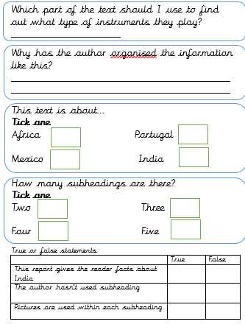
Main task
Music
To make it easier for the reader to find the facts / information
X
X
X
X
X

Slide 7
Lesson 2
L.O: I can explain the meaning of words
Word detectives
Facts about India

Slide 8
Tell your partner: How can we work out the meaning of a word?
We can use...
Read around the word
Use a dictionary
Use synonyms e.g. happy - excited
When I am reading the text, I want you to think about any words that you do not understand

Slide 10
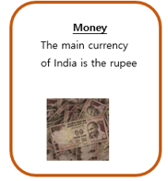
Tell your partner
Find and copy a word that means the most important.
main

Slide 11
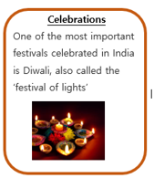
Tell your partner
What does the word ‘celebrated’ mean?
What word could the author use instead of ‘celebrated?’
A party, people gathering together
Party, gathering, event

Slide 12
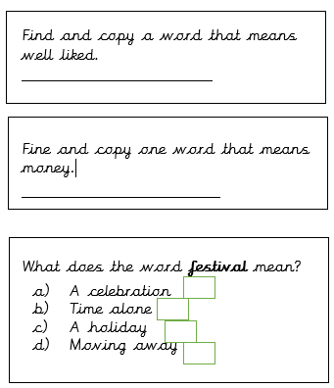
Main task
Popular
Currency
X

Slide 13
Lesson 3
L.O: I can retrieve and record information from the text
Rapid retrieval
Facts about India

Slide 14
Tell your partner: How can we retrieve information from the text?
We need to...
Read the text carefully​ Find the important information​ Pick out the information in order to answer questions

Slide 16
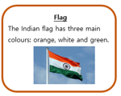
Tell your partner: What are the three main colours on the Indian flag?
Orange, white and green

Slide 17
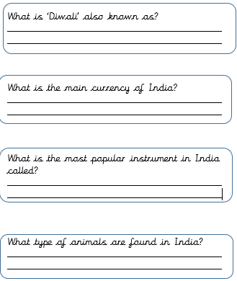
Main task
The festival of lights
Rupee
The sitar
Bengal tigers, elephants, flying foxes, lions and monkeys

Slide 18
Lesson 4
L.O: I can make inferences from the text
Thinking Caps
Facts about India

Slide 19
Tell your partner: How can we find out specific facts.
Use clues from the text​ and make a sensible guess
Use the subheadings and images to help you locate information

Slide 21
Tell your partner:
Why do you think the author has used images for each subheading?
To make it easier for the reader to find and gather the facts, using not only the text but the pictures.

Slide 22
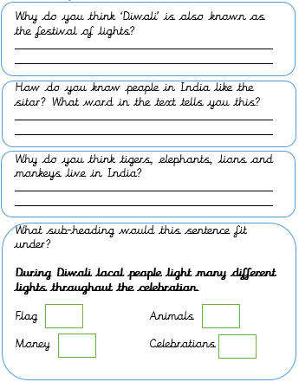
Main task
People light lots of different lights during the celebration.
In the text is says that it is a popular instrument. This shows that people like it.
They like warm places and India is very warm.
X

Slide 23
Lesson 5
L.O: I can make links to the text
Question of the Week
Facts about India

Slide 25
Tell your partner:
Do you think people would like to visit India?
I think people would like to visit India as they could go to the Diwali festival and look at all the different lights. They might also like to go to India to hear people play the sitar and look for the different types of animals that live there, such as the Bengal tiger, flying foxes and lions.

Slide 26
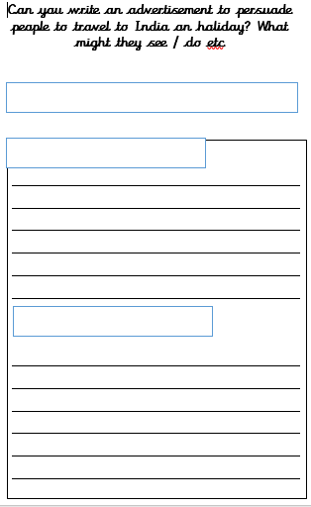
Visiting India
Things to see
Things to do

Slide 27
Sharing answers
Choose children to read out their advertisement and share with the class.

