Slide 2
Aim
To understand and describe what climate change is and how it is affecting our world.
Success Criteria
I can identify the causes of global warming.
I can explain why climate change is not good for the Earth.
I can explain how to prevent climate change.

Slide 3

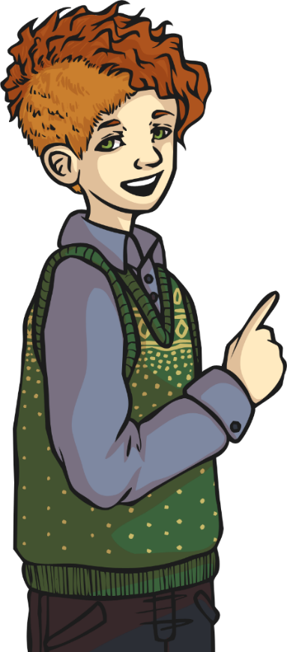
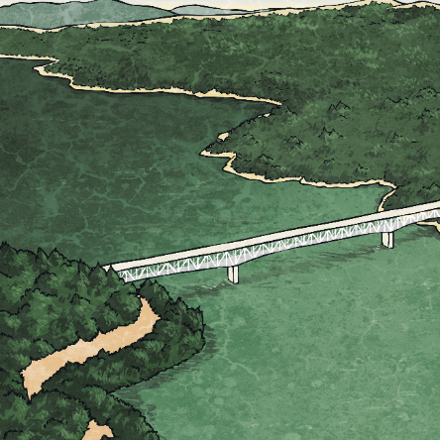
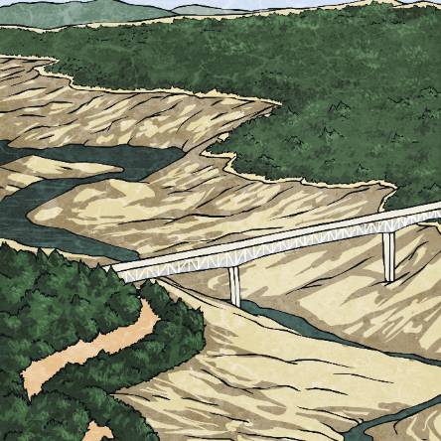
What Is Climate Change?
Climate change is the name given to changes in weather and temperatures that pose a challenge for us now and in the future.
These changes are a result of human activity and are not good for the planet.
Then
Now

Slide 4
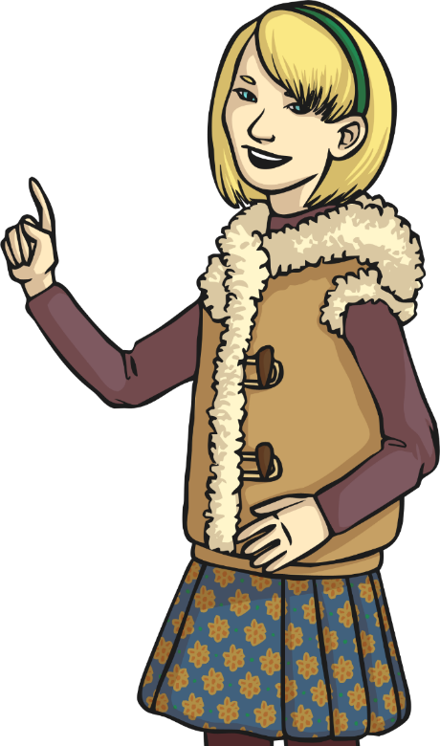
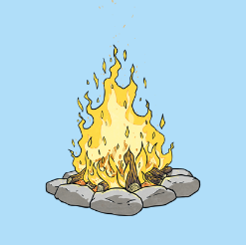
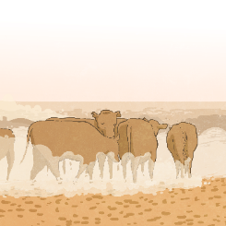
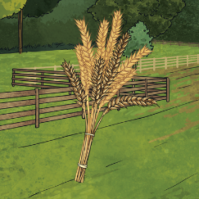

Why Is the World’s Climate Changing?
Over the past 200 years, industrialisation and a huge increase in the world’s population has led to the increase of gases that can lead to rising temperatures around the world.
These include:
1
2
3
The burning of fossil fuels in power stations.
Cattle farming
Agriculture
farming

Slide 5
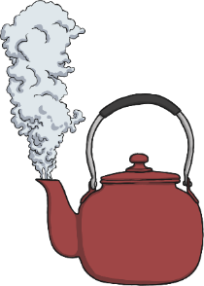
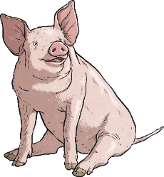
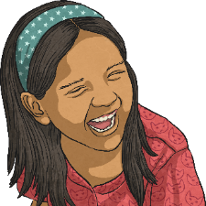
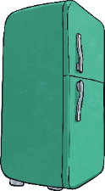
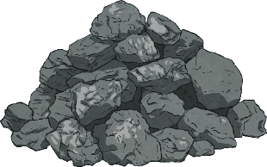
Which Gases Cause Global Warming?
Some of the gases that are created through agriculture and manufacturing are particularly harmful to the planet. These are known as greenhouse gases and include:
Methane (CH₄)
Digestive gases released by cows, pigs and chickens.
Water Vapour (H₂0)
Created through the heating of water.
Nitrous Oxide (N₂0)
Known as laughing gas and used in hospitals.
Carbon Dioxide (CO₂)
Fossil fuels like coal and petrol release CO2 when burned.
Hydrofluorocarbons (HFCs)
Used in fridge freezers and air conditioning units.

Slide 6
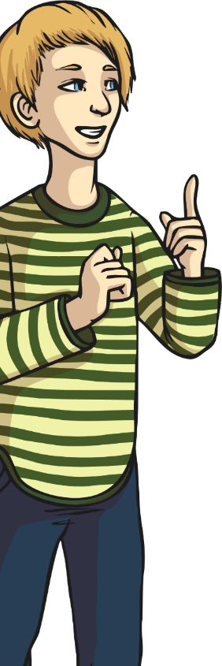
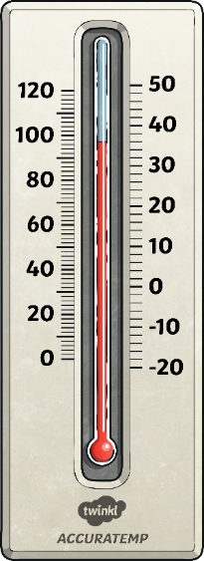

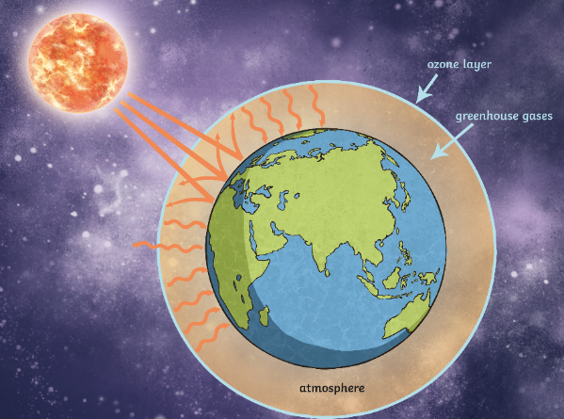
How Do Greenhouse Gases Change the Climate?
Just like a greenhouse, the Sun’s rays can enter the Earth’s atmosphere, but then become trapped inside by greenhouse gases.
This means that temperatures are slowly increasing all over the planet.
This is known as global warming. These small changes can have a dramatic impact on different places.

Slide 7
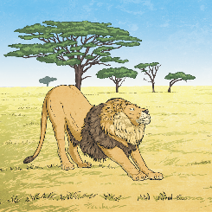

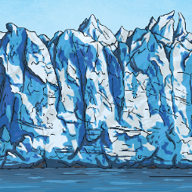
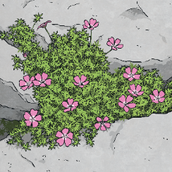


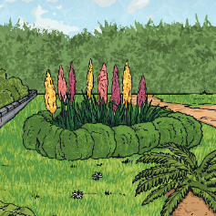
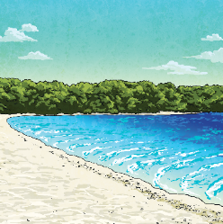

What Is Being Affected by
Climate Change?
Global warming is the main cause of climate change. The effects of climate change include:
Plant species shifting locations
5
1
Animal species becoming endangered
4
Shrinking glaciers
3
Trees and plants flowering much earlier in the year
2
Rising sea levels

Slide 8
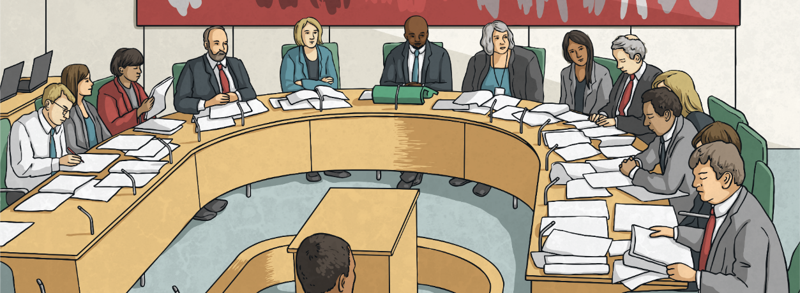
What Is Being Done to Combat Climate Change?
To stop further climate change, global warming must be tackled.
Most major countries around the world have adopted strict laws that are meant to
reduce the amount of greenhouse gases
being produced.

Slide 9
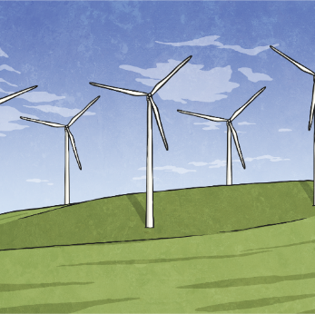
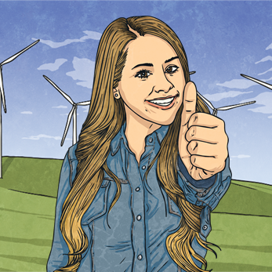
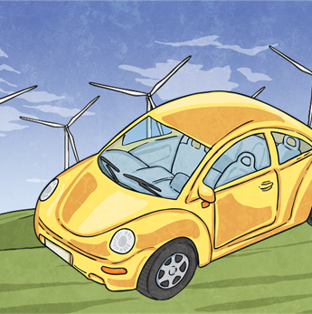
What Is Being Done to Combat Climate Change?
Some important changes have already been taking place around the world. These include:
Building wind farms, solar farms and other means of creating ‘clean’ electricity.
Stopping the manufacture of petrol and diesel powered transport.
Introducing electric vehicles.
Many people think that this is not happening quickly enough to make a difference and more action is needed

Slide 10
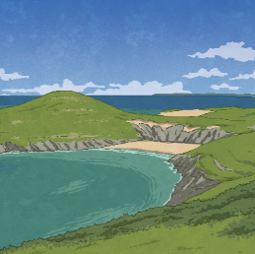
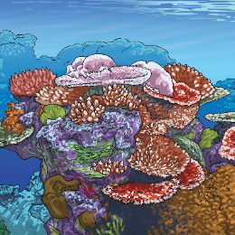
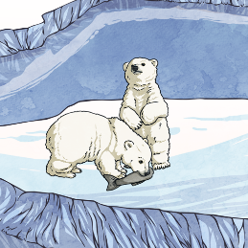
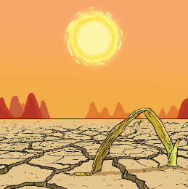
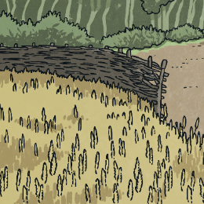
What Are the Consequences of Not Doing Enough?
Unless we slow down global warming, experts have predicted there are some very serious consequences for our planet.
5
2
Up to 90% of the ocean’s coral reefs will become lifeless.
1
4
Low-lying settlements and habitats might become flooded.
3
Up to 30% of the Earth’s wildlife could become extinct.
Droughts and storms become more frequent and extreme.
Crops dependant on rain will halve.

Slide 11
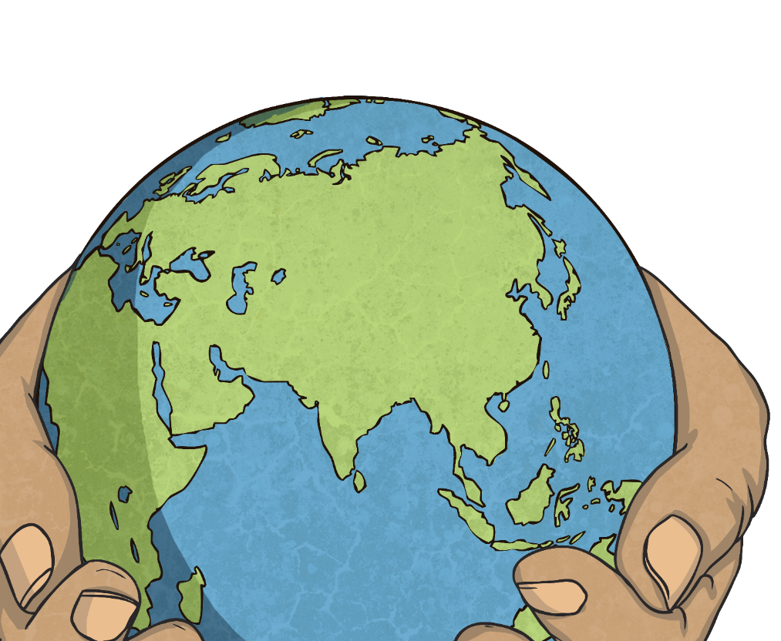
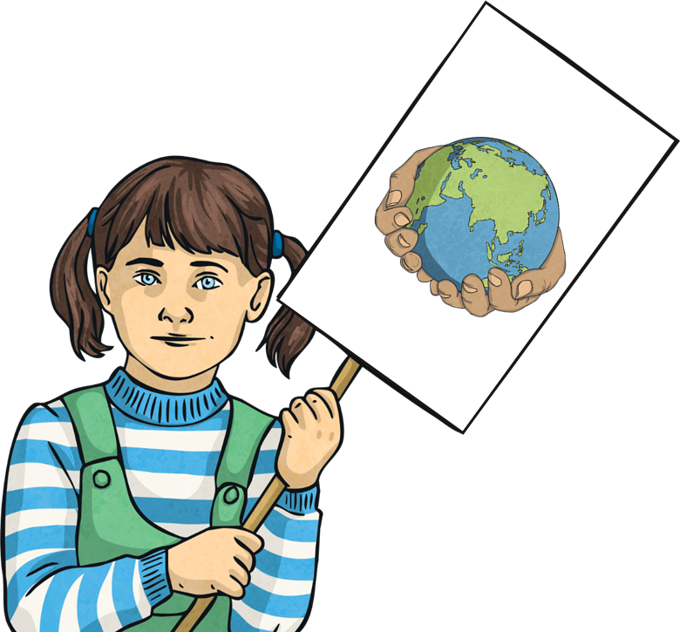
What Is Being Done to Combat Climate Change?
In early 2019, thousands of children refused to attend school so that they could attend organised demonstrations in major cities.
Demonstrations and rallies are an important way of people making their voices heard.
Some people thought it was wrong for children to miss school, but many agreed with their actions.
They wanted to go so that they could show they knew how serious climate change is.

Slide 12
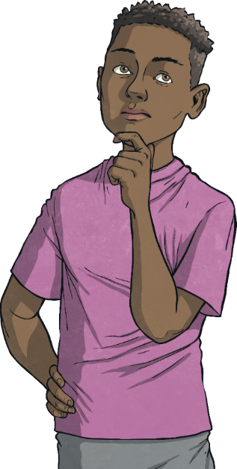
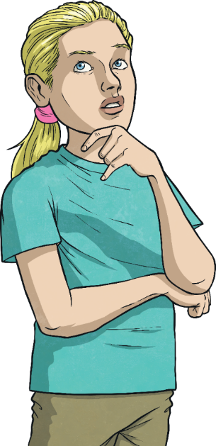
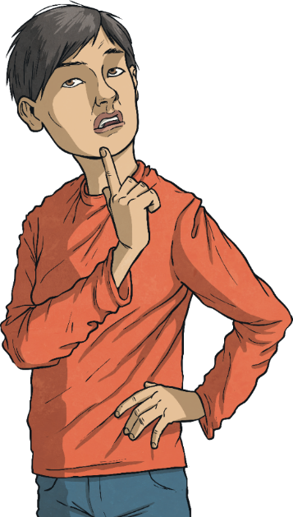
What Do You Think?
Is enough being done in the UK to combat climate change?
Is enough being done across the globe to combat climate change?
Were the school children right to take time out from their learning to protest?
What are you doing in your school to combat climate change?

Slide 13
Keywords
greenhouse gas
carbon dioxide
protest
water vapour
methane
environment
government
nitrous oxide
farming
drought
carbon

