Slide 1
Reading Mastery A Mystery Woman
25.1.21
Lesson four

Slide 5
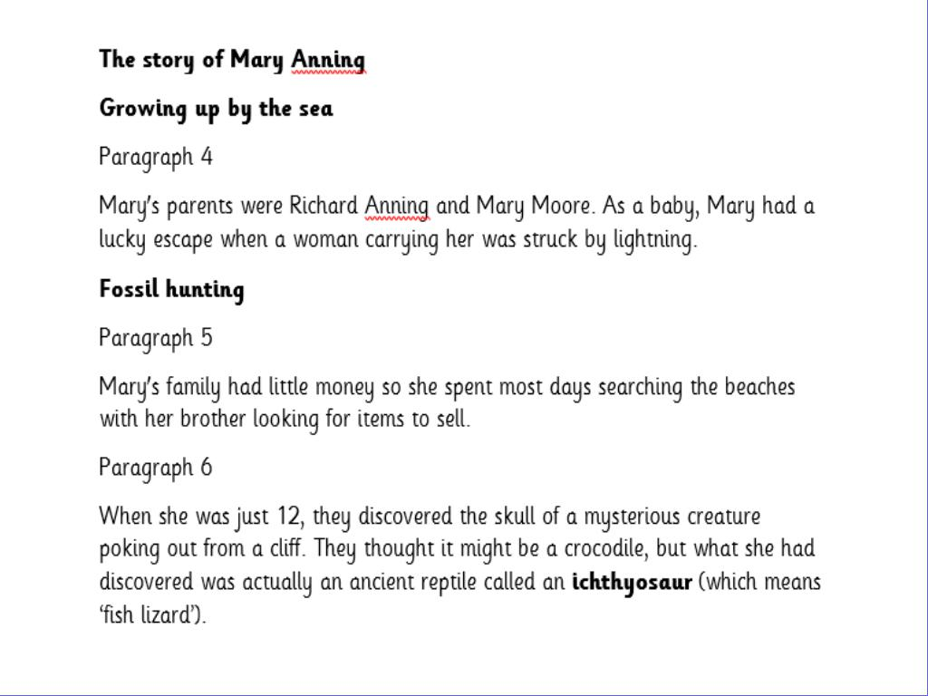

Slide 12
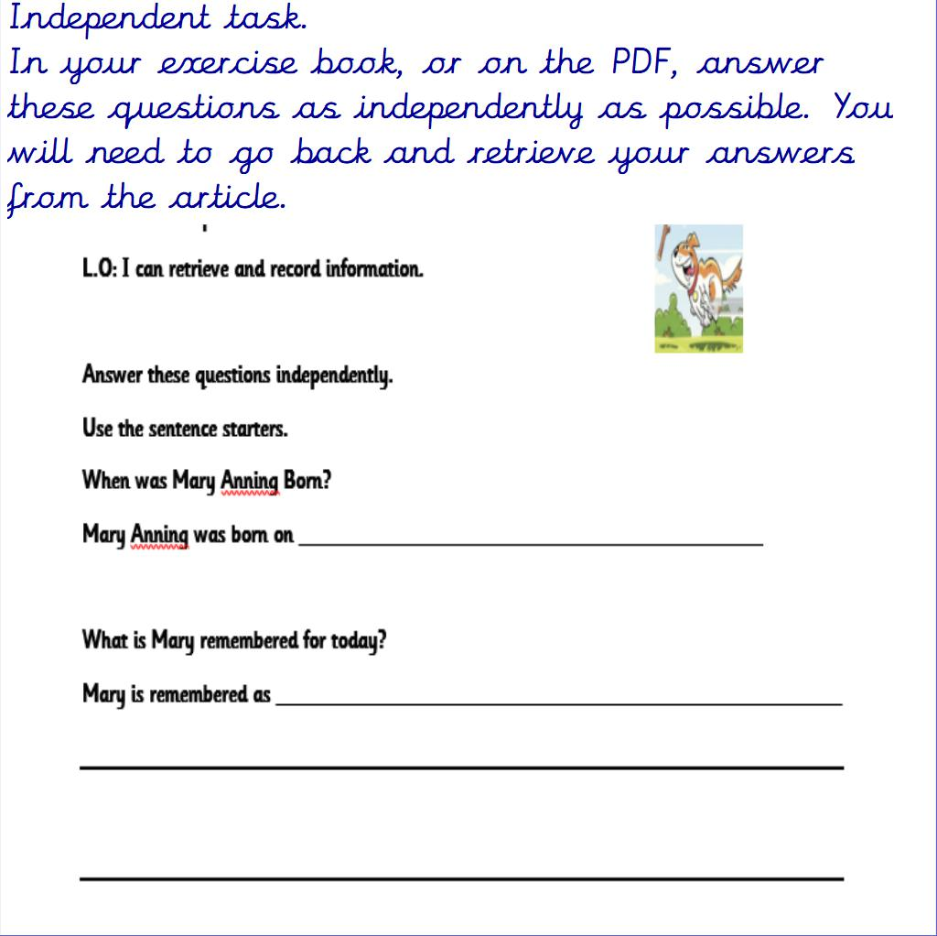

Slide 13
