Slide 1
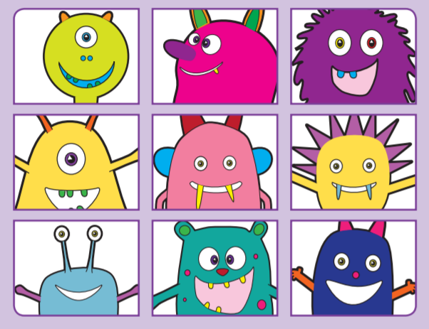

Year 2
Phonics

Slide 2
What we are doing in
Great Crosby…
Due to the missed months of 2019 -2020, we are working to fill the gaps in learning that your child has missed including…
Phonics sessions twice a day- Recapping/teaching the year 1 phonics curriculum whilst also providing the children with year 2 content
Regular opportunities for reading across curriculum subjects
Daily Reading Mastery
Weekly individual reading and book detectives
Daily English lessons
Familiar and Better Reading
Reading homework tasks
Class library
Weekly spelling checks based on Year 1 and Year 2 common exception words

Slide 3
Phonics Screening Check
As the children missed the year 1 Phonics Screening Check they will be required to take this after the October half term.
Here is a video showing an example of the phonics screening check
https://www.youtube.com/watch?v=IPJ_ZEBh1Bk

Slide 4
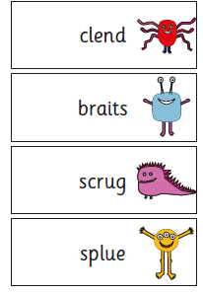
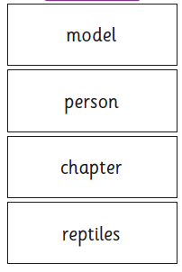
Phonics Screening check.
The Phonics Screening Check is sat 1:1 with either your child’s class teacher or phonics teacher and they will use their phonetic knowledge to read 40 words made up of real and nonsense (alien words) words

Slide 5
Articulation of Phonemes
Please watch the video attached below to familiarise yourself with the correct pronunciation of the phonemes and digraphs the children are learning. It is very important that the children use these correctly in their reading sessions to help them segment and blend the words they are attempting to decode.
https://www.youtube.com/watch?v=BqhXUW_v-1s

Slide 6
How you can help…
Read as often as possible with your child using the books we send home and any they enjoy with you. (Don’t forget to read it more than once.)
After reading, practise reading some extra words or play some games that use the sounds they found tricky in their book.
Use the useful links below to play lots of games that encourage your children to read and apply their phonics knowledge.

Slide 7
Fun ideas
Use some paper, pen and post it notes to play:
Snap
Pairs
Label making
Word sorting
Make their own word search

Slide 8
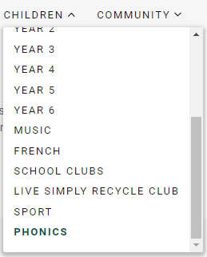
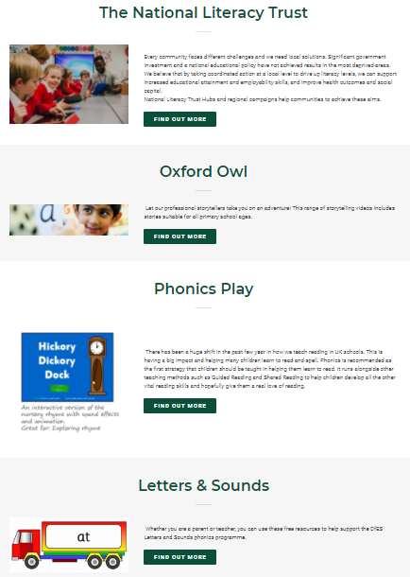
Great Crosby Website
Notes:
8

Slide 9
Games used at Great Crosby
‘Obb and Bob’ – Picnic on Pluto / ‘Trash and Treasure’
Tricky word trucks
Flashcard cars
Acorn Adventures
Reading Robot
http://www.phonicsplay.co.uk/member-only/Phase5Menu.htm
Notes:
9

Slide 10
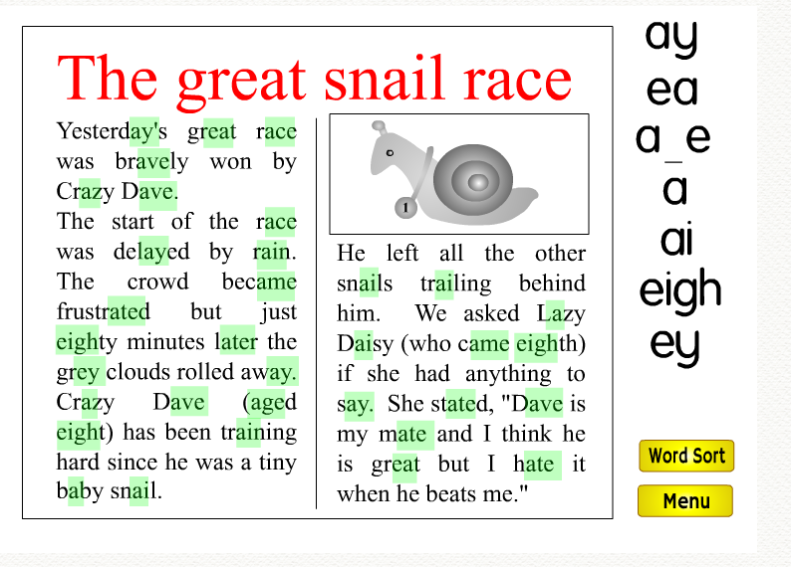
Games used at Great Crosby
Phoneme Spotter
Notes:
10

Slide 11
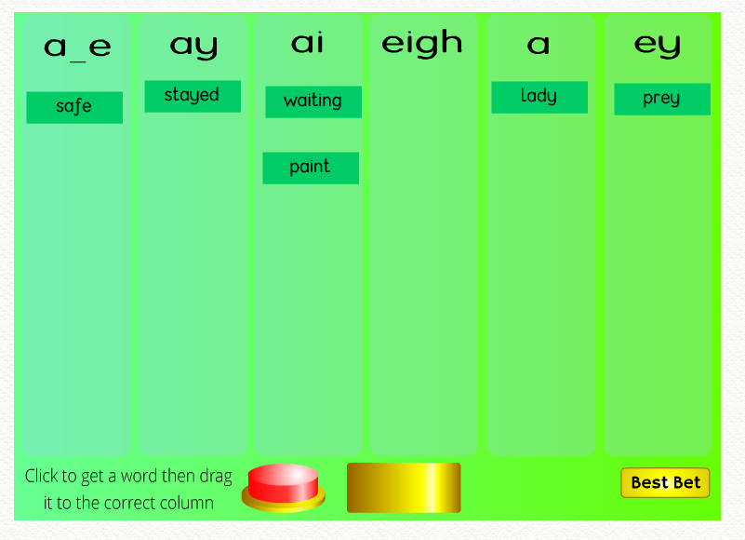
Games used at Great Crosby
Phoneme Sorter
Notes:
11

Slide 12
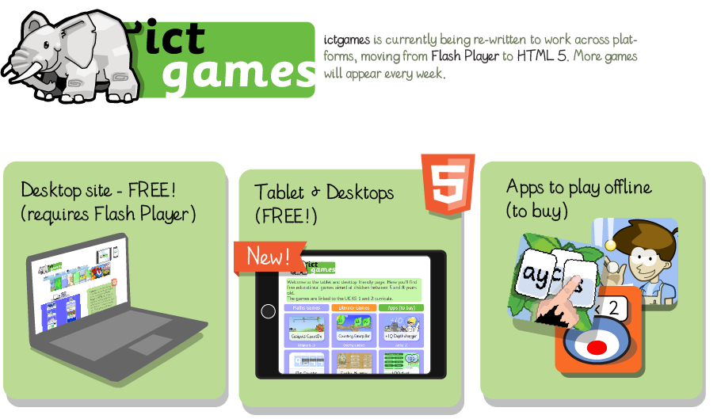
Tablet friendly games – www.ictgames.com

Slide 13
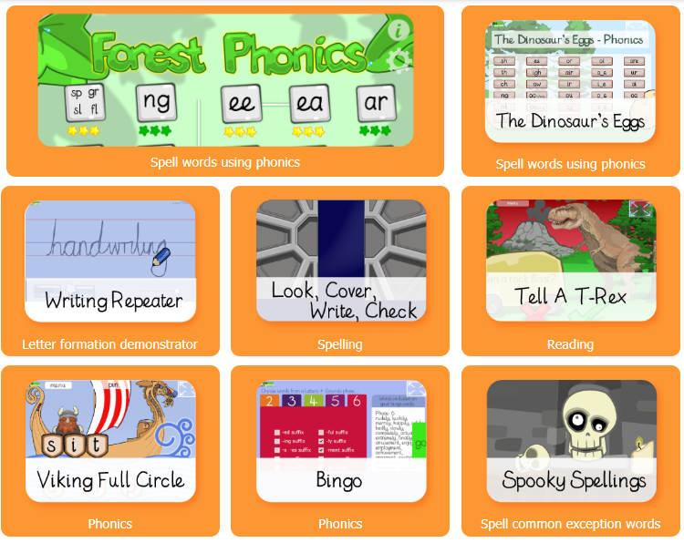
Tablet friendly games www.ictgames.com
http://www.ictgames.com/mobilePage/literacy.html

