Slide 1

Welcome

Slide 2
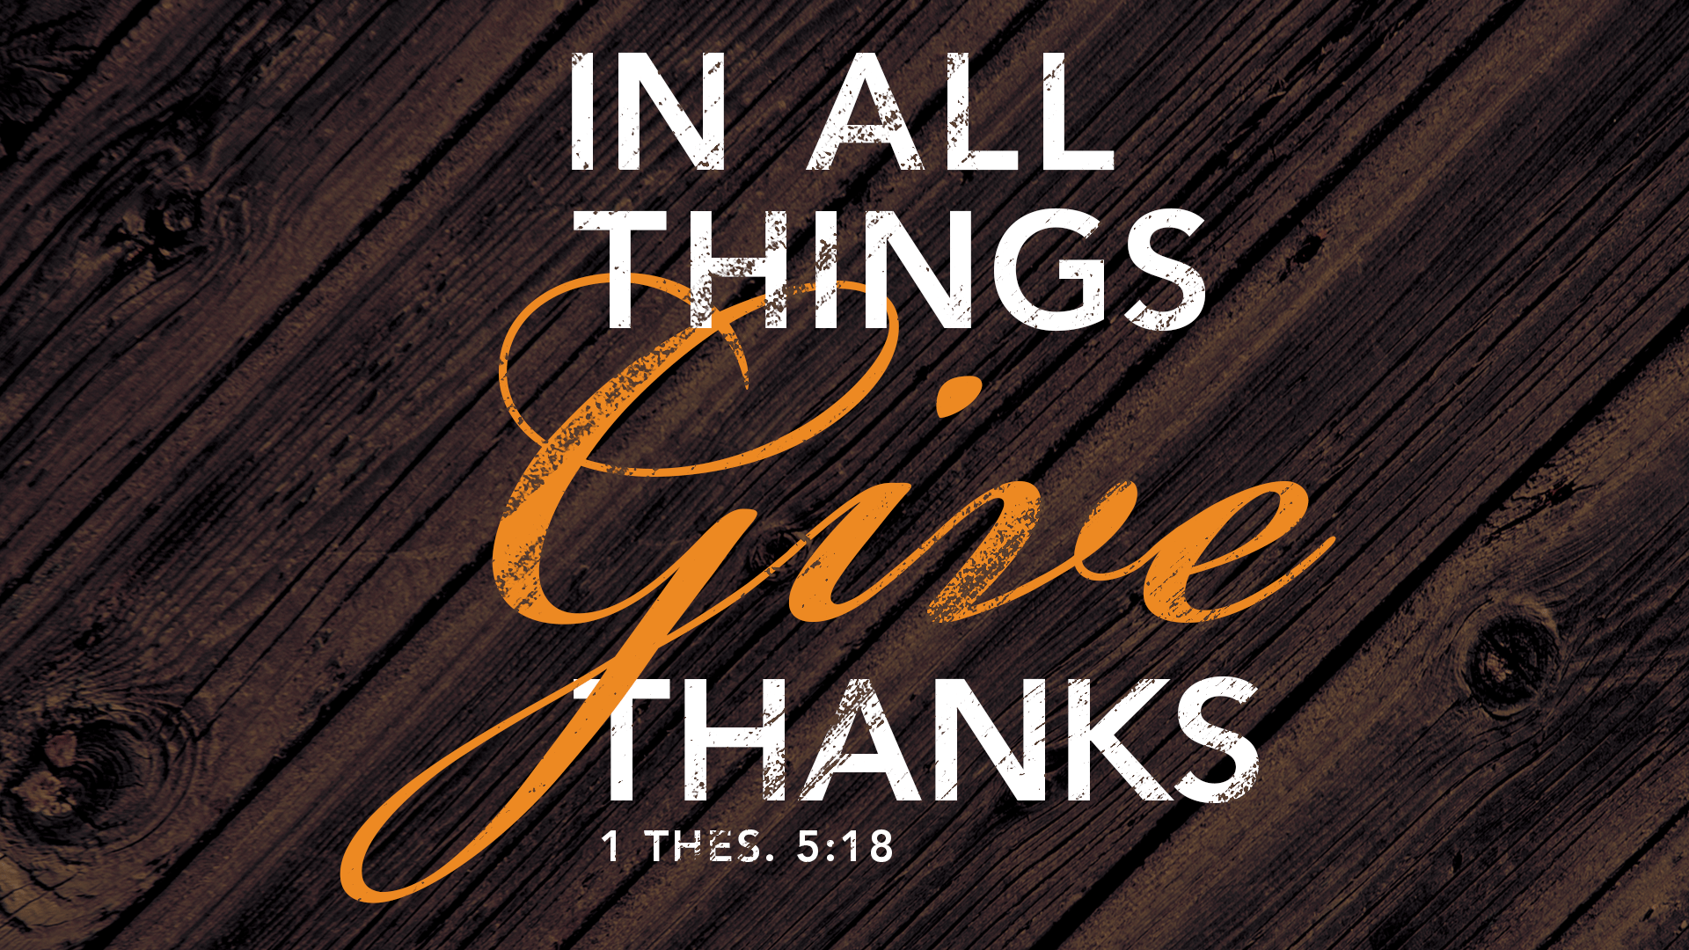

Slide 3
Announcements

Slide 4
This Week we Celebrate the
VOLUNTEER.
Psalm 37:4 Amplified Bible, ⁴ Delight yourself also in the Lord, and He will give you the desires and secret petitions of your heart.

Slide 5
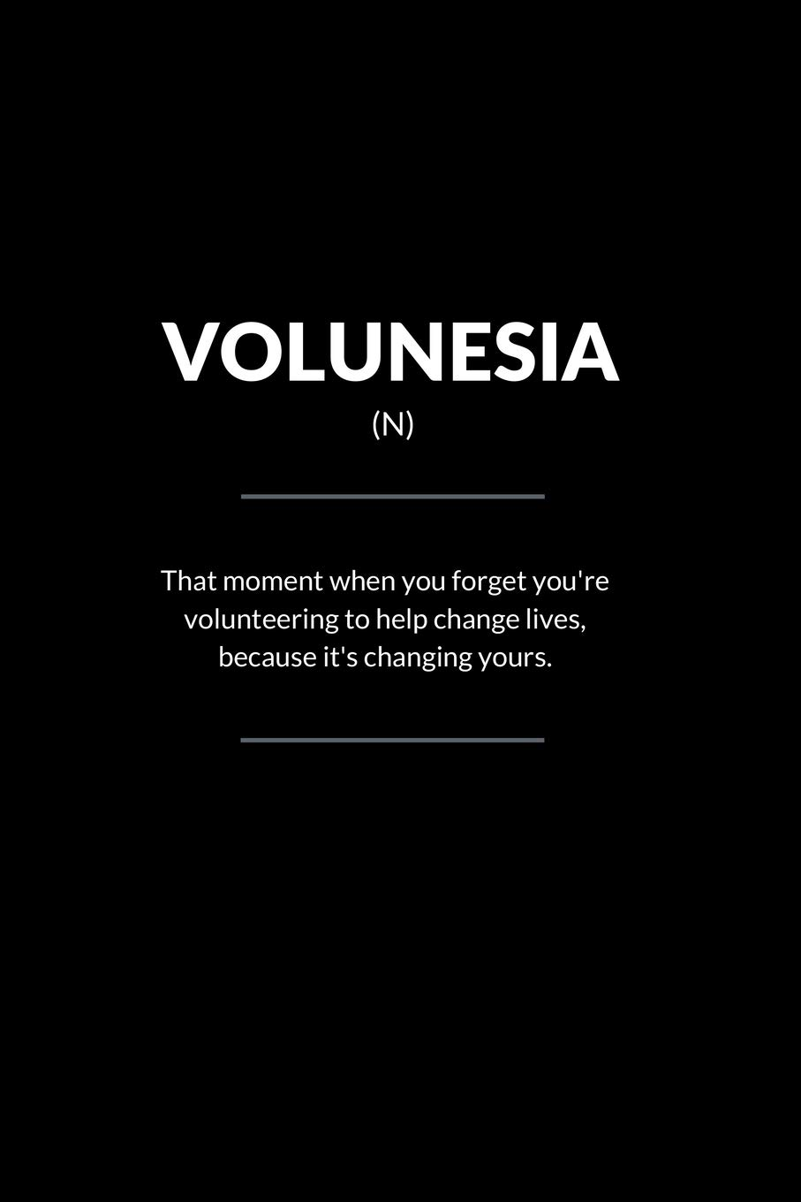
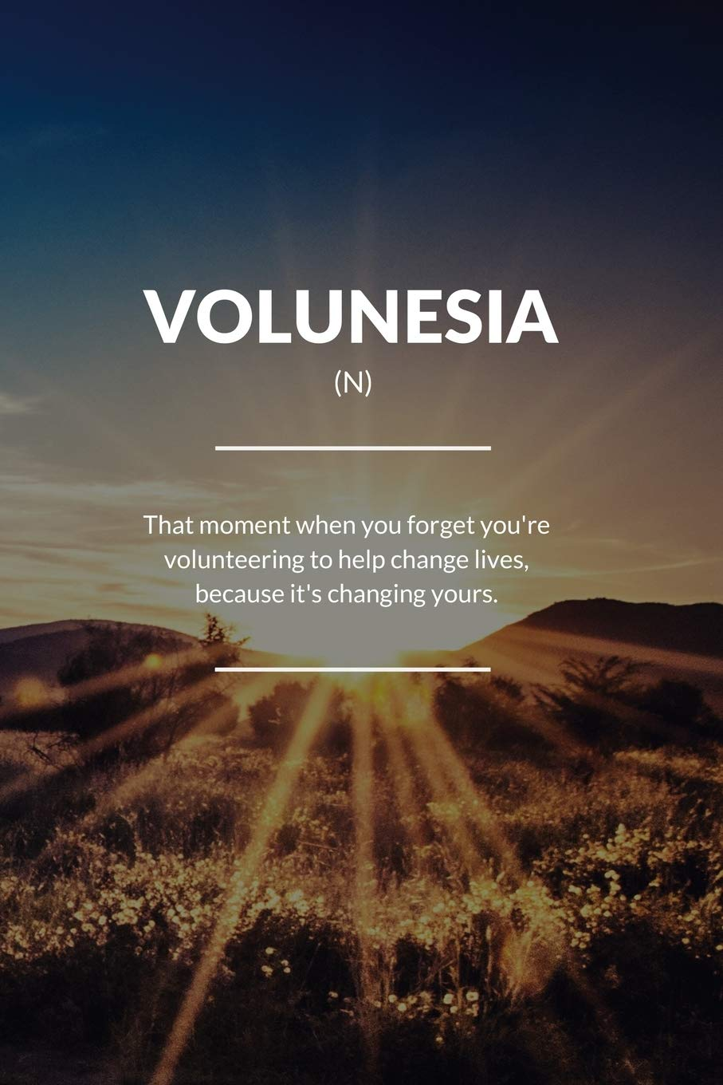

Slide 6

We owe you
bar-ba-que
when?

Slide 7
Celebration Review

Slide 8

REVIEW Living a Life of Celebration
Richard Foster in his classis book, ‘Celebration of Discipline,’ said: “Celebration is central to all the Spiritual Disciplines. Without a joyful spirit of festivity the Disciplines become dull, death-breathing tools in the hands of modern Pharisees.”

Slide 9
It is clear from Scripture that celebration is a spiritual discipline that God desired and there are MANY TYPES of celebrations.
Just as Israel RE-DEDICATED the wall of Jerusalem to God, in Neh. 12 & 13, we find ways to dedicate everything in our lives to him.
A summary of Wealth in the Scriptures.

Slide 10
Neh. 12:²⁷ When the city wall was dedicated, Levites from everywhere in Judah were invited to join in the celebration with songs of praise and with the music of cymbals, small harps, and other stringed instruments. ²⁸⁻²⁹ The Levite singers lived in villages around Jerusalem, and so they came from there, as well as from the villages around. ³⁰ The priests and Levites held special ceremonies to make themselves holy, and then they did the same for the rest of the people and for the gates and walls of the city.

Slide 11
Neh. 12 ³¹ I brought the leaders of Judah to the top of the city wall and put them in charge of the two groups that were to march around on top of the wall, singing praises to God. One group marched to the right in the direction of Garbage Gate. … ³⁸ The second group of singers marched along the wall in the opposite direction, and I followed them, ^{38…} together with the other half of the leaders of Judah. ⁴³ God had made the people very happy, and so on that day they celebrated and offered many sacrifices. The women and children joined in the festivities, and joyful shouts could be heard far from the city of Jerusalem. ⁴⁴ On that same day, some leaders were appointed to be responsible for the safekeeping of gifts for the temple and to be in charge of receiving the first part of the harvest and the ten percent of the crops and livestock that was offered to God.

Slide 13
How do we live a life of celebration?
Practice the discipline of celebration by:
Giving thanks in everything
Planning Celebrations - Daily & Special
Leading with Joy
Participating in Corporate Worship
Continually Confessing Our Sins
Claiming the Promises of God
Investing in the House of God
Being devoted to the Word of God

Slide 14
#1 Practice the Discipline of Celebration by:
Giving Thanks in Everything
The leaders of Israel led the people in “songs of thanksgiving” (v. 27), with the two choirs Nehemiah set up (v. 31).
One of the ways that nonbelievers are characterized in Scripture is by not giving thanks to God.
The Apostle Paul on the pagan world: “For although they knew God, they neither glorified him as God nor gave thanks to him, but their thinking became futile and their foolish hearts were darkened” Rom. 1:21

Slide 15
#1 Practice the Discipline of Celebration by:
Giving Thanks in Everything
1 Thessalonians 5:18-19: “Give thanks in all circumstances, for this is God’s will for you in Christ Jesus. Do not put out the Spirit’s fire.”
Many Christians are walking around without power because they neglect the practice of thanksgiving.
It means that when we are unthankful, we lose the Spirit of God’s power in our lives.
We lose the power to be joyful, the power to do the works he has called us to do.

Slide 16
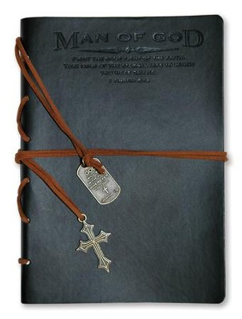
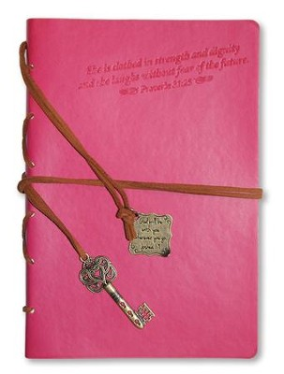
#1 Practice the Discipline of Celebration by:
Giving Thanks in Everything
You can bring the discipline of the Word on You.
There are complainers and worriers, that place water on the Spirit’s fire, affecting both themselves & others.
We are commanded to “Do all things without complaining and arguing” (Phil 2:14)
If you want to live a life of
worship and celebration,
you must put fuel on the fire of God
by living a life of thanksgiving.

Slide 17
#2 Practice the Discipline of
Celebration by Planning
The dedication of the wall of Jerusalem, Israel had set up a special time of celebrating the Lord’s faithfulness by dedicating the wall to him.
It is clear that there was planning involved in this process.
They decided who would come and how they would lead. The celebration was meticulously planned.

Slide 18
#3 Practice the Discipline of Celebration When Leaders Serve Joyfully
Levites were sought out from where they lived and were brought to Jerusalem to celebrate joyfully, BECAUSE they were living in Joy!
It was / is important for the leaders to lead the celebration in order for it to affect everybody.
The sound of rejoicing could be heard far away.- by the Jews and the GENTILES.

Slide 19
#4 Practice the Discipline of Celebration by:
Corporate Worship
The singers had villages of SINGERS for themselves around Jerusalem.
In order to live a life of worship, we must be part of a community of worship.
We need to meet with the people of God to worship.
There are special things that God does when the people of God are gathered together. Jesus said that when two or more are gathered… (Matt 18:20).

Slide 20
#5 Practice the Discipline of Celebration by Confessing Sins
When the priests and Levites had purified themselves ceremonially, they purified the people,..
This reminds us that true joy and celebration comes from right relationship with God – Tell Him!
Ps 32:2-5 Blessed is the man whose sin the LORD does not count against him…
1 John 1:9 “If we confess our sins, God is Faithful and Just to forgive AND Purify us.

Slide 21
#6 Practice the Discipline of Celebration by Claiming God’s Promises
By walking around the wall, they were claiming God’s promise that HE would give them the land.
We have seen this symbolic walking in Bible. Jericho!
There are over 3,000 promises in the Scripture, and we must claim them by faith and be obedient to them in order to live a life of celebration.
How can I? By FAITH!

Slide 22
#7 Practice the Discipline of Celebration by: Investing in the House of God
That day they offered great sacrifices… Our joy is the greatest when we invested in the house of God.
It’s an investment because of how they gave. (V. 43)
Many people struggle with living a life of celebration because they are not really invested in their church or God’s People.
Proverbs 11:25 “Those who refresh others shall themselves be refreshed.”

Slide 23
#7 Practice the Discipline of Celebration by: Investing in the House of God
Jesus said: “Give, and it will be given to you. A good measure, pressed down, shaken together and running over, will be poured into your lap. For with the measure you use, it will be measured to you” (Luke 6:38).

Slide 24
#8 Practice the Discipline of Celebration by:
Being Devoted to the Word of God
In Nehemiah 13:1 “On that day when the Law of Moses was read aloud to everyone, it was discovered…
The dedication of the wall included reading Scripture and obeying it.
This must be true for us as well.
If we are going to lead our lives and the people we serve in celebration, we must lead them to honor the Word of God and to submit to it.

Slide 25
Practice the Discipline of
Celebration
So whether you eat or drink or whatever you do, do it all for the glory of God. 1 Cor. 10:31
Whatever you do, work at it with all your heart, as working for the Lord, not for men.
Colossians 3:23

Slide 26
Practice the Discipline of
Celebration
We dedicate everything to God by thanking him for everything. This means that we recognize that everything is from him and for him.
We dedicate everything to God by working at it with all of our hearts (Col 3:23).
We cannot dedicate our scraps to God—only our best.

Slide 27
Thank you
For joining us

