Slide 1

To Jump or not to Jump, That is the Question.
A Review of Current Concepts of Plyometric Exercise by Davies et al. 2015
By: Bryce Groshek, PT, DPT, C-PS, TPI Level 1 Certification

Slide 2
Presentation Objectives
Provide an overview of plyometrics
  Definitions
  Phases
  In-depth science behind how they work/act
Describe clinical guidelines and contraindications
Be able to generate a sample plyometric program

Slide 3
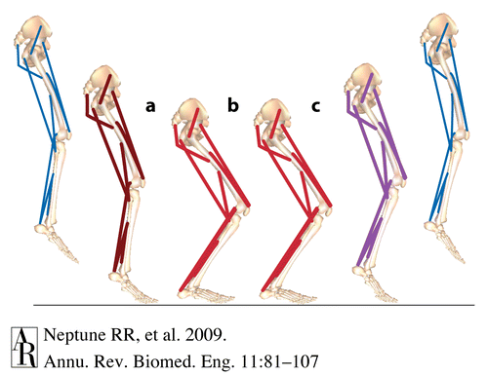
What is plyometrics?
Greek derivates:
  Plythein/plyo: to increase
  Metric: to measure
Exercise involving repeated rapid stretching and contracting of muscle to increase muscle power.
Plyometric training utilizes the stretch-shortening cycle (SSC), using a lengthened movement (eccentric), which is quickly followed by a shortening movement (concentric).
Phases:
  Phase 1: Eccentric Pre-stretch
  Phase 2: Amortization (time to rebound)
  Phase 3: Concentric shortening phase
Notes:
Second bullet point is quoted from the article almost directly.

Slide 4
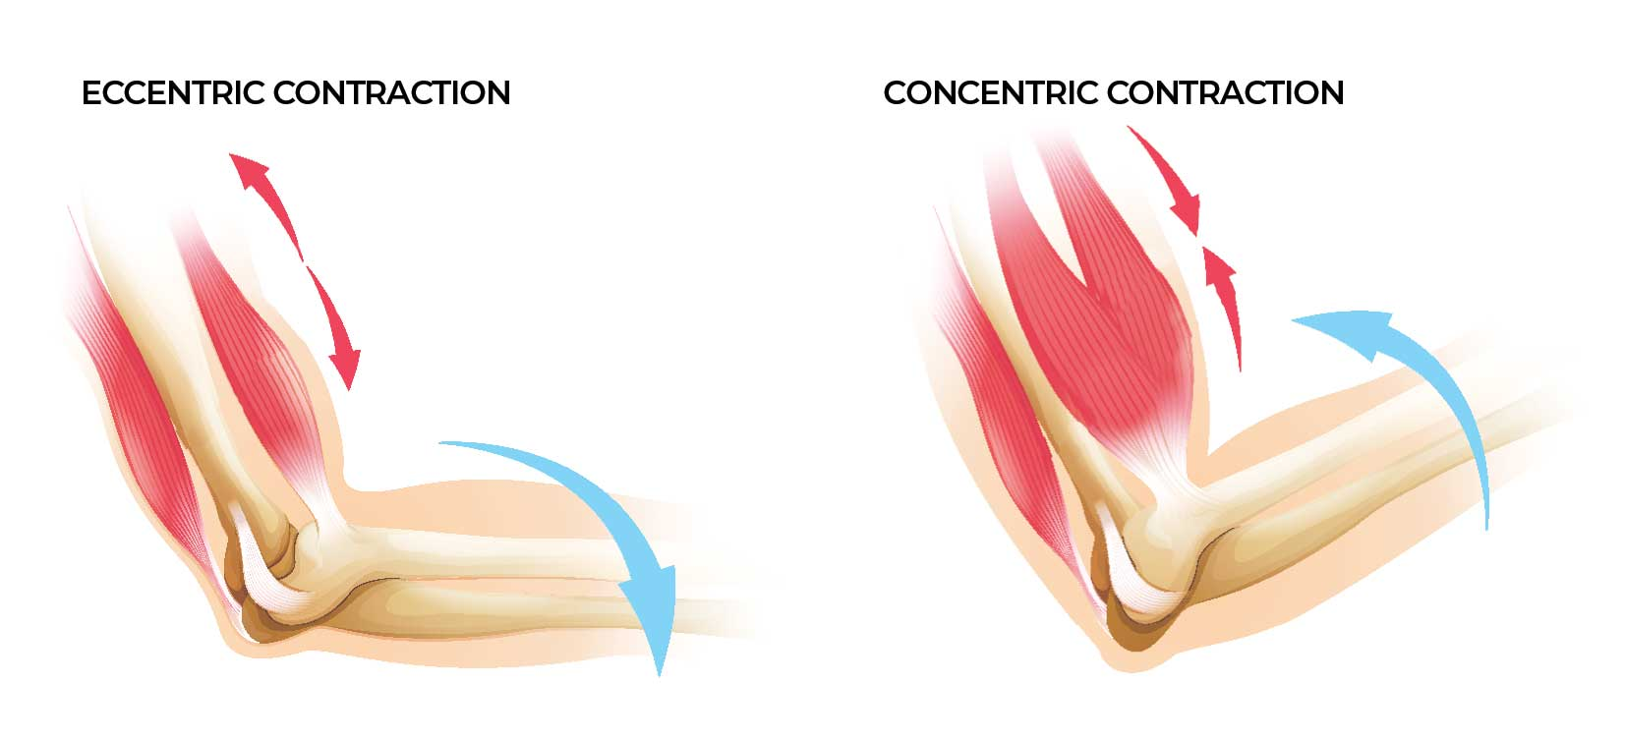
Eccentric Pre-stretch Phase
The readiness, pre-loading, pre-setting, or counter-movement phase.
A stretch is provided to the muscle spindle of the muscle-tendon unit and the non-contractile tissue within the muscle (series elastic components – SEC) and parallel elastic components (PEC).
Research has demonstrated that the eccentric pre-stretch enhances the concentric contraction.
Pre-stretch phase variables:
  Magnitude of the stretch
  Rate of the stretch
  Duration of the stretch
Manipulation of these variables will have a significant impact on the amount of energy stored during the eccentric pre-stretch motion.

Slide 5
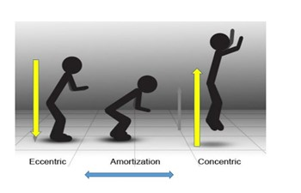
Amortization Phase (Time to Rebound)
The time from the cessation of the eccentric pre-stretch to the onset of the concentric muscle action.
The electro-mechanical delay phase of plyometrics.
The time delay between overcoming the negative work from the eccentric contraction to generating the force production and accelerating the muscle contraction and the elastic recoil in the direction of the movement.
The shorter this phase is the more effective and powerful the movement will be.
  Stored energy is used more efficiently in transition.
  If delayed energy is lost as heat, the stretch reflex is not activated, and the resultant concentric contraction (positive work) is not as effective.

Slide 6
Concentric Shortening Phase
Referred to as the resultant power production performance phase.
There is a biomechanical response that utilizes the elastic properties of the pre-stretched muscles.
The blending of these 3 phases is used to enhance the muscle’s power performance.

Slide 7
If you don’t like nerdy things about how all this exactly works you can skip the next bunch of slides ;)

Slide 8
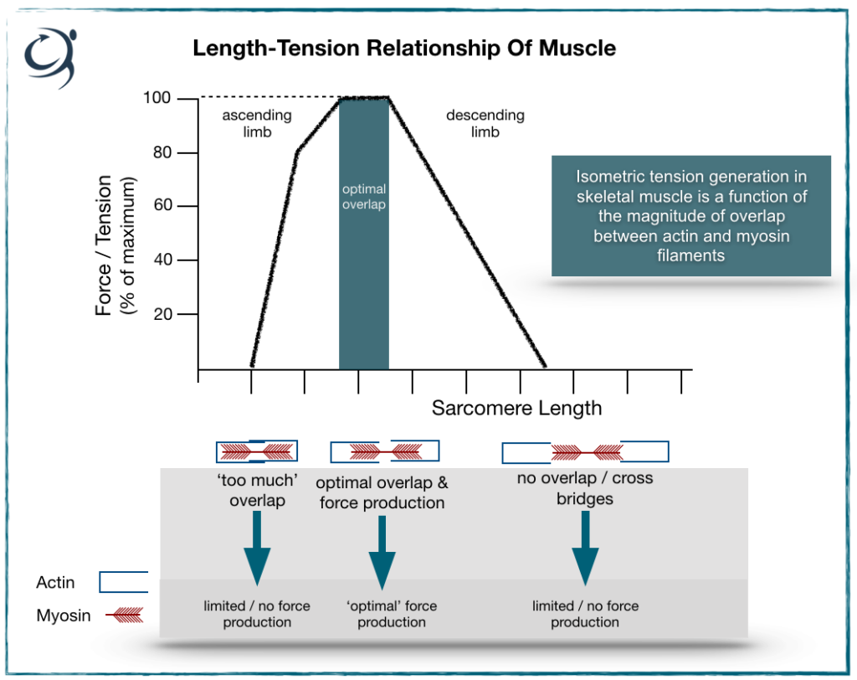
Physiological Basis
Actin-myosin cross bridges w/ the sarcomere plays an important role in motor control and force development during plyometrics.
Plyos use the pre-stretch of the MTU physiological length-tension curve in order to improve resultant force production.
Elftman proposal: eccentric contractions create the most force, followed by isometric contractions, then concentric.
  However, plyometrics create the greatest forces during the concentric power production phase. Demonstrating the importance of the pre-stretch and short amortization phase for optimum power development.

Slide 9
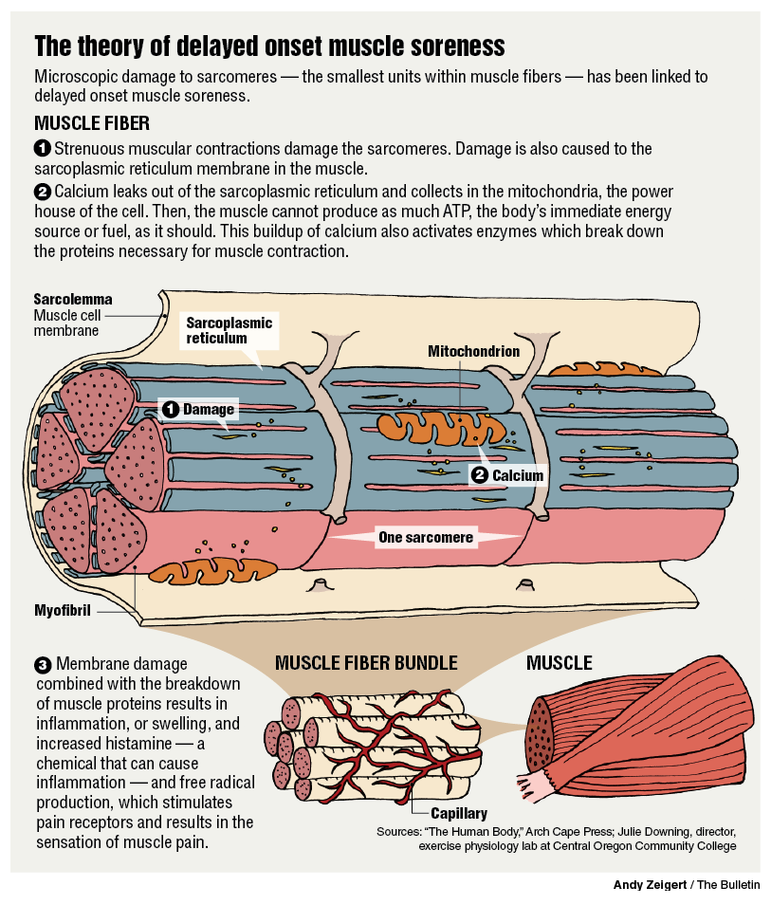
Physiological Basis (Cont. I)
Whenever an eccentric muscle action occurs, there is concern for the development of DOMS.
A maximal eccentric muscle action generates 10-40% more force than concentric contractions.
DOMS occurs d/t the microtrauma to the SEC and PEC releases hydroxypropline which creates a noxious stimulus to the muscles, which creates the perception of the DOMS response.
DOMS is a self-limiting condition and usually resolves in 7-10 days.
  Highly trained athletes may not experience DOMs.

Slide 10
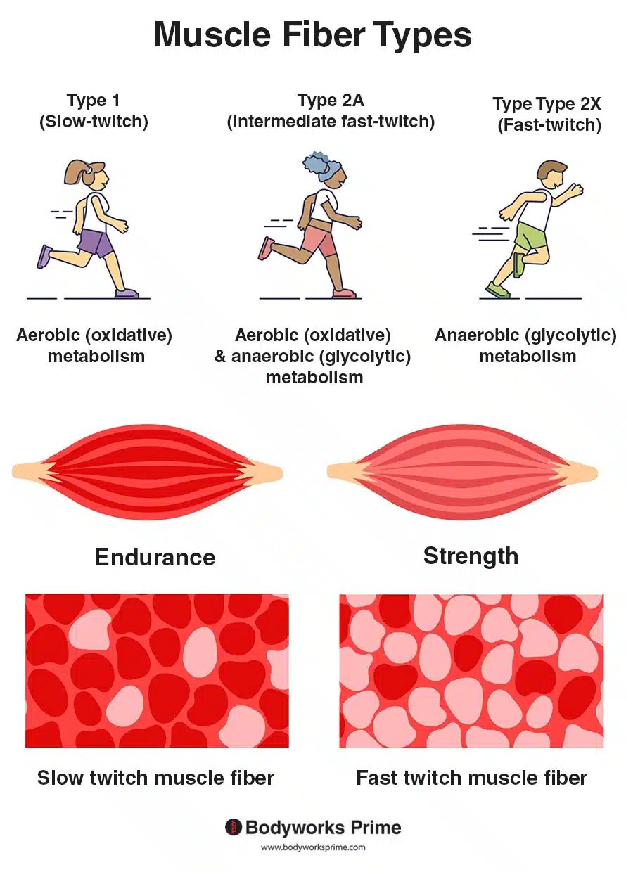
Physiological Basis (Cont. II)
Recruitment of muscle fibers follows an orderly pattern or sequence termed the size principle.
  Slow-twitch fibers are typically recruited @ sub-maximal efforts.
  The greater the intensity the greater the recruitment of fast twitch (IIa) fibers are recruited (30-80% of max intensity).
  At 70-80% type IIa and IIb fibers are recruited.
Thus, plyometrics need to be performed with high intensity efforts, above 80%, to recruit the fast twitch fibers that are crucial to power development.’
There are generally 3 ways to recruit FT fibers:
  Maximum intensity effort
  Electrical stimulation
  Fast movement patterns (plyometrics)

Slide 11
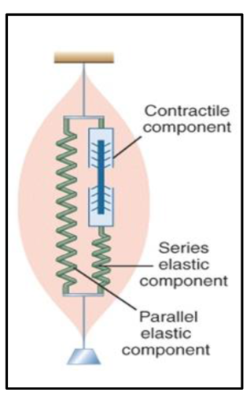
Mechanical Basis
Muscles function in various sporting activities as force production generators, and eccentric decelerators/shock absorbers primarily due to the active and elastic properties within the muscles.
  The elastic properties form the mechanical basis of muscle mechanics and are due to the 3 structural components within the muscles: contractile components, SEC, and PEC.
  All 3 of these components interact w/ one another to produce force output.
During the pre-stretch motion, potential kinetic energy is stored in the SEC.
  This stored energy then contributes to the concentric force production as the muscle returns to its normal length.
  SEC acts like a spring, accounts for 70-75% of the concentric force increases of muscle thereby making the plyometric training very efficient.

Slide 12
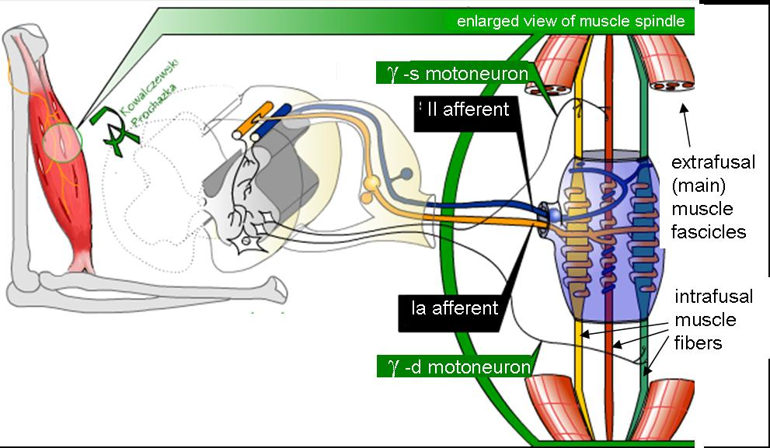
Neurophysiological Basis
Include the proprioceptors of the body:
  Muscle spindle
  Golgi tendon organ (GTO)
  Mechanoreceptors
Stimulation of the receptors can cause facilitation, inhibition, and modulation of both agonist and antagonist muscles.
When spindle is stretched, there is an increase in afferent nerve firing.
  Strength of signal that is sent to the spinal cord is dependent on the rate of the applied stretch.
  The faster the rate of stretch, the stronger the neurological l signal sent from the muscle spindle.
  Thus, the GREATER the efferent muscle contraction (shortening phase).

Slide 13
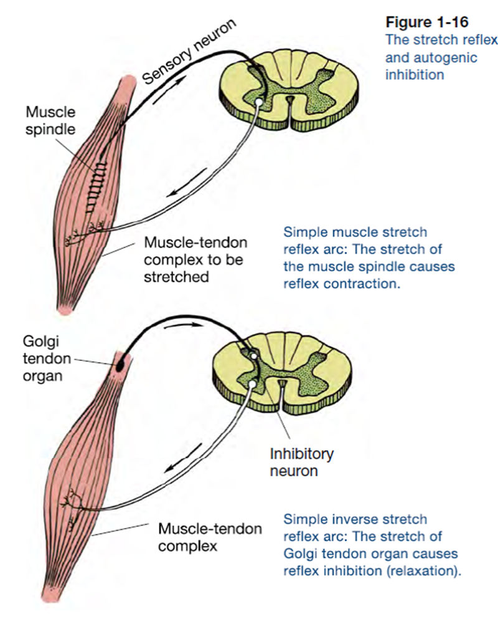
Neurophysiological Basis (Cont. I)
The GTO also plays a significant role in the SSC.
  It functions to act as a protective reflex preventing over-contraction or too much tension in the muscle.
Thus, the GTO assists with modulating force during plyometric exercises.
The purpose of plyometric training is to increased the excitability of the neurologic receptors for improved reactivity, while desensitizing the GTO.
  Explosive plyometric exercises may improve the neural efficiency through enhancement of neuromuscular coordination.
  Plyos increase the set speed in which muscle may act, and therefore enhancing the neuromuscular coordination to become more automatic.

Slide 14

Theoretical Training Benefits
Ability to increase average power and velocity
Increased peak force and velocity of acceleration
Increased time for force development
Energy storage in the SEC
The ability for heightened levels of muscle activation
Ability to evoke stretch reflexes.
By desensitizing the GTO, muscles are allowed to generate force by having the MSK system tolerate increased workloads w/ GTO firing.
Creates automation of of activity, thus improving neural efficiency and increases neuromuscular performance.
  Often occurs w/o concomitant increase in morphological changes within the muscle.
  Occurs first 6-8 weeks then after several weeks, hypertrophic changes start to occur,

Slide 15
Clinical Guidelines When Beginning a Plyometric Program
Things to be considered:
  Patient age
  Injury history
  Type of injury
  Appropriate warmups prior to beginning drills
  Foundational strength
  Resistance training experience
Some merit in training specific movement patterns in isolation prior to working on major compound plyometrics.
  If a muscle can’t function normally in an isolated pattern, then it can’t function in an integrated pattern.
You must have an adequate foundation of strength and flexibility prior to initiating plyometrics.

Slide 16
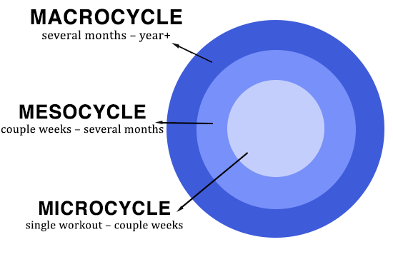
Periodization and Plyometrics
The program should use the principles of progression and overload.
  Can manipulate the volume dosage: reps, sets, weight, etc.
Quality of work is more important than quantity.
To get type II fibers work should be performed at high intensity levels (80-100% max volitional contraction.
  Also rate of stretch is more important than length of stretch.
  If movement quality deteriorates, then the athlete is probably experiencing fatigue and the plyos should be terminated.
More rest is needed after plyometric work, but no evidence exists regarding optimal rest period between plyometric workouts.
  The authors of this review recommend 48-72 hers.

Slide 17
Designing a Plyometric Program
Neuromuscular Overload- Applied loads and distances:
  NM overload typically takes the form of a rapid change of direction of a limb or the entire body w/o external loads.
Spatial Overload- Range of Motion:
  ROM can be performed throughout a larger range via an exaggerated movement pattern.
  Seeks to employ the muscle activation and stretch reflex w/in a specific ROM.
Temporal Overload- Timing:
  Keeping the time to rebound (amortization phase) as short as possible.
  Want to allow for effective force transmission from eccentric stretch to concentric power.
Intensity:
  Actual % of effort required.
Volume:
  Often measured by calculating the load, counting the number of repetitions, sets, etc. of the specific activity.
  50-foot contacts during a training session is low, over 200+ is high for plyos.
Frequency:
  Number of exercise sessions that take place during the training or cycle.
Recovery:
  48-72 hours between exercise bouts.
Specificity:
  Dependent upon the athlete's sport and position.

Slide 18
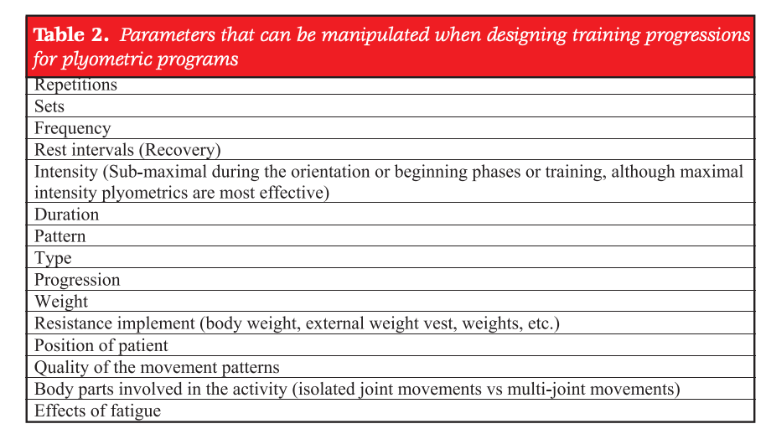

Slide 19
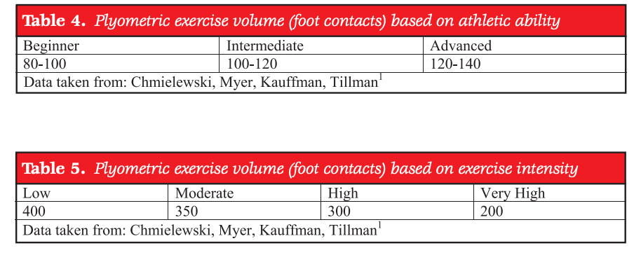
Examples of Volume and Vol in Respect to Intensity

Slide 20
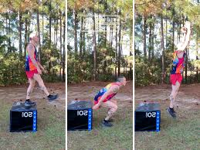
Contraindications for Plyo Training
Pain
Inflammation
Acute or subacute sprains
Joint instability
Soft tissue limitations-based d/t post-op.
Lacking foundational strength or training base
  Lack of motor control/coordination

Slide 21
Variables in Sport Plyos Can Impact
Jump Height:
  1-5 sessions/wk or tallied as total training sessions from 6-greater than 25 sessions.
  Volume of jump training varies from 400-1700 jumps.
  It seems to be that although many variables seem to be/can be manipulated improved vertical jump performance is a consistent outcome after plyo program.
Sprint Speed:
  Volume of greater than 80 jumps/session seem to result in the best benefit.
  One consistent finding is that sprint performance was not found to be significantly greater when plyos are combined with other types of exercise to when they are performed in isolation.
Injury prevention:
  A growing amount of evidence exists indicating thar LE plyometric exercises and training may be help prevent first time non-contact ACL injuries.
  An introduction of a proper plyometric program can increase NM control in all 3 planes, which will subsequently decrease stress on the ACL, and shift it more towards other more capable tissues.

Slide 22
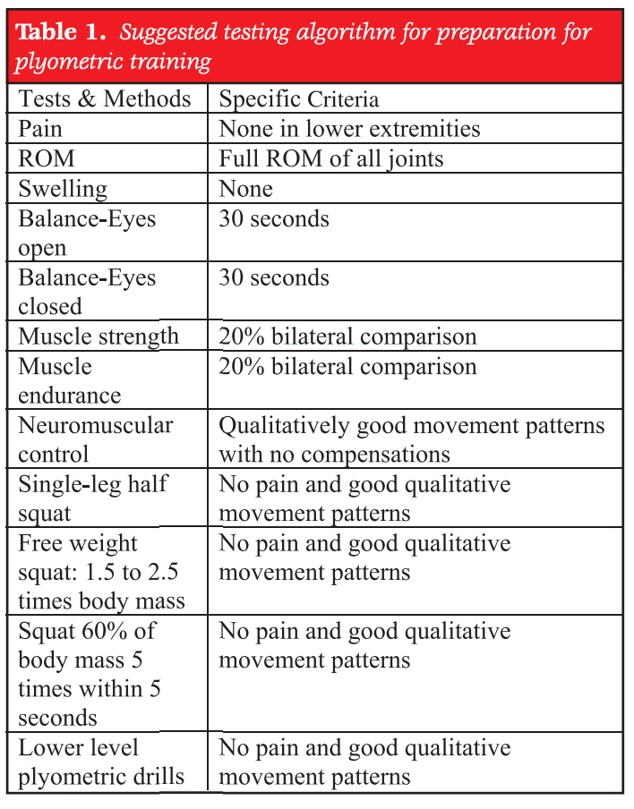
Basic LE Plyo Pre-training Requirements
Before initiating a plyometric exercise program, there should be a systematic functional testing algorithm developed to screen the subject/patient for the ability to participate with LE plyometrics.

Slide 23
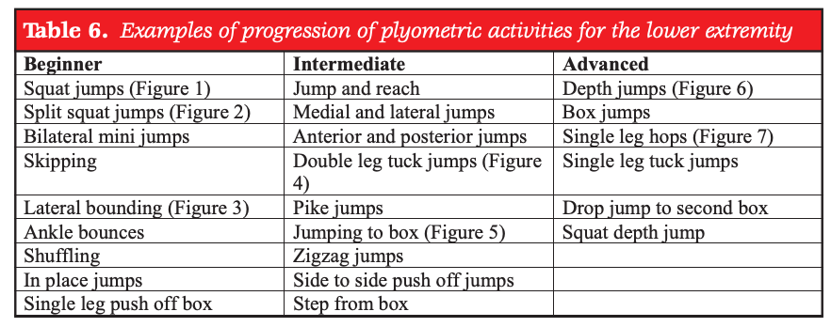
LE Plyometric Progression
A progression of plyometric progression is essential, especially in those patients returning to activity from previous injury.
  Low-Medium-High
  Generally, 2-legged drills are a good start.
  Progressing from general to very specific plyometric exercise.

Slide 24
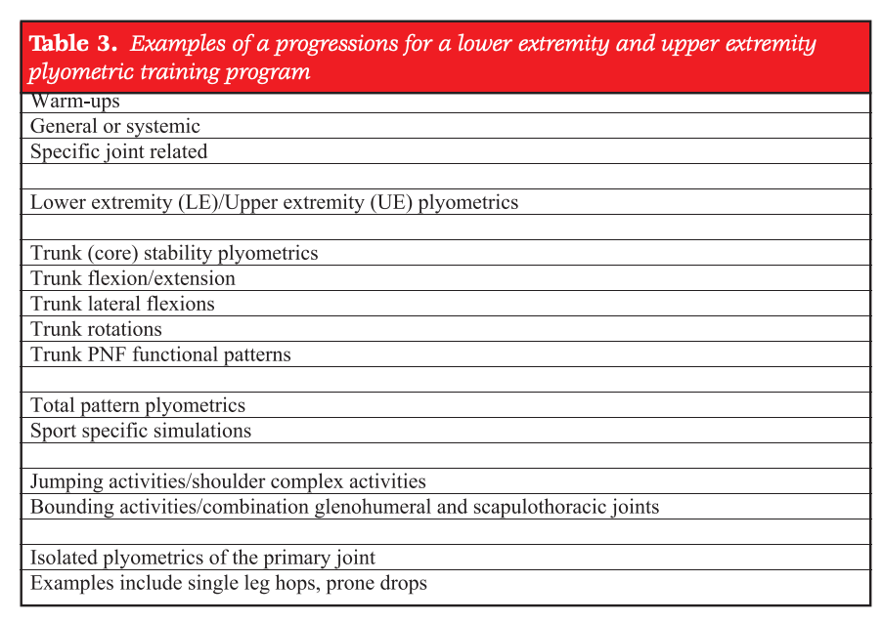
Example of LE and UE Plyo Program

Slide 25
Technique
You should very closely monitor technique.
Acquisition or reacquisition of skill is essential for biomechanical safety.
Poor motor control SHOULD NOT BE ALLOWED.
  Feedback should be given immediately and continuously to increase awareness of faulty mechanics that might put the athlete at risk of re-injury.
  Feedback can be visual, audible, etc.
Athletes may be able to perform the techniques good, initially, but that doesn’t mean they have the endurance to sustain proper motor control.
  When technique declines activity should stop immediately.
  The goal is to increase the volume via reps of exercise while still maintaining good technique.

Slide 26
Sources Referenced
All information in this presentation has come from the article:
  Current concepts of plyometric exercise by Davies et. Al.
Davies G, Riemann BL, Manske R. CURRENT CONCEPTS OF PLYOMETRIC EXERCISE. Int J Sports Phys Ther. 2015 Nov;10(6):760-86. PMID: 26618058; PMCID: PMC4637913.
All references he has for information apply to my presentation as well. This is a concise template of the commentary.

