Slide 1
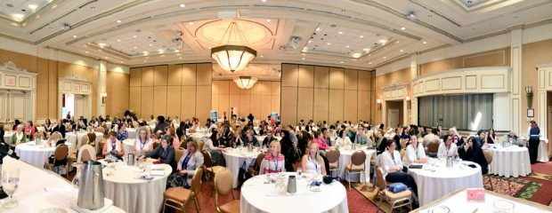
National Institute of Forensic Social Work
Canada's Industry Leader in Forensic Social Work Training and Consulting.
Bridging Professions and Building Competencies in Law and Social Work.

Slide 2
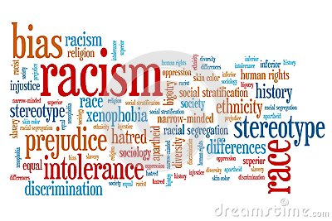

Social Justice - Access to Justice
The Issues

Slide 3
The Need
Collaborative Law & Social Work Practice:
  The need for lawyers to have an understanding of the social issues that impact their clients who experience marginalization, oppression, racism, ageism etc. in the context of the legal issues they are facing.
  The need for social workers to understand essential law for social work practice to better advise, counsel, support and advocate on behalf of the people (clients) they work with.
  The need for specialized training that focuses on the details of the law such as interpretation and application for social workers and lawyers specific to child welfare, youth justice, corrections law, mental health etc.
  The need for social workers and lawyers to learn to work collaboratively to advance the cause of social justice on behalf of clients.
  The need to train social workers and lawyers in cultural competency to better understand the impact of past and current injustices and harms perpetrated on children, and families from a critical race theory, relational theory, complex and historical trauma theory etc.

Slide 4
What is Forensic Social Work?
Forensic social work (FSW)is when the law and social work intersect usually in clinical practice and in the fields of child protection, youth criminal justice, domestic violence, mental health, and corrections (not inclusive list). It is a speciality that requires enhanced professional training.
FSW is an emerging sub-speciality of social work practise. The training in FSW can benefit those in the legal community and social work.
Social workers with the specialized training and certification are hired to work in a variety of environments as part of an inter-disciplinary and inter-professional team.
FSW’ers bring expert evidence into the court room through written reports such as risk assessments, parenting assessments, access assessments, child wishes statements and Inter-generational and trans-generational Impact Reports.(c)

Slide 5

Forensic social workers (FSW) work as part of an investigative team with:
various legal authorities
lawyers & legal aid services
government services (policy, front lines)
police services
corrections
mental health services
forensic psychiatry
hospitals

Slide 6
Job Titles & Wages
Forensic Liaison and Community Social Worker
Forensic Social Worker
Forensic Child Welfare Worker

Slide 7
Our Mission
Our mission at the National Institute of Forensic Social Work is to develop forensic social work as a recognized sub-speciality of social work practice in Canada that will provide professional training and career development to individuals and organizations.

Slide 8
The Goal
To create an organization that will merge the law and social work in theory and in practice.
To bridge law and social work with conscious effort to advance the cause of social justice.
To work collaboratively with other national and International organizations to share strategies and ideas for advanced professional training programs.
To be recognized as the Canadian industry leader in forensic training and skill development for social workers.

Slide 9


Slide 10
Training Recognition & Certification
National Institute of Forensic Social Work (NIFSW)
Certification will be available to registered social workers who hold a BSW and/or MSW( based on program).
Certification will be available to social work diploma graduates who are RSW’s (based on the program.)
Certificates of Professional Training will be awarded to participants of the programs based on the set criteria for each program.
Certificates of Attendance will be issued to attendees for professional development workshops.
More details will be available in the coming months on programs and certification.
NOTE: Compliance with Standards of Practice and Codes of Ethics for each appropriate regulatory body for each province is required. NIFSW is not a licensing body. NIFSW is a private owned business – training, counselling and consulting services.

Slide 11
Membership with NIFSW
The National Institute of Forensic Social Work (NIFSW) offers two categories of membership: General and Premium.
The NIFSW requires the individual or organization to complete an application prior to acceptance at either level.
The NIFSW reviews all applications for membership, at all levels, and reserves the right to refuse membership as it deems fit as a privately owned and operated business.
Please see each category for membership criteria and a list of the associated benefits at www.nifsw.com

Slide 12


Slide 13
Questions?
Contact us at:
National Institute of Forensic Social Work
t. 877 886-4379
w. www.nifsw.com
e. info@nifsw.com
Subscribe to our email list for updates www.nifsw.com.
Our social media platforms can be reached through our website.

