Slide 1
Forensic Social Work: Essential Law for social justice work in the African Canadian community
National Institute of Forensic Social Workers
ABSW Conference
September 26, 2019
Shawna Paris-Hoyte QC,MSW, RSW
This Photo by Unknown Author is licensed under CC BY-SA

Slide 2
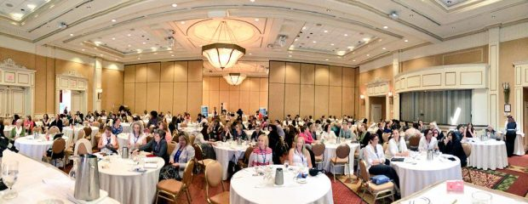
National Institute of Forensic Social Work Canada's Industry Leader in Forensic Social Work Training and Consulting.
Bridging Professions and Building Competencies in Law and Social Work.

Slide 3
The Need
Why Collaborative Law & Social Work Practice?
The need for lawyers to have an understanding of the social issues that impact their clients who experience marginalization, oppression, racism, ageism etc. in the context of the legal issues they are facing.
The need for social workers to understand essential law for social work practice to better advise, counsel, support and advocate on behalf of the people (clients) they work with.
The need for specialized training that focuses on the details of the law such as interpretation and application for social workers and lawyers specific to child welfare, youth justice, corrections law, mental health etc.
The need for social workers and lawyers to learn to work collaboratively to advance the cause of social justice on behalf of clients.
The need to train social workers and lawyers in cultural competency to better understand the impact of past and current injustices and harms perpetrated on children, and families from a critical race theory, relational theory, complex and historical trauma theory etc.

Slide 4
Our Mission
Our mission at the National Institute of Forensic Social Work is to develop forensic social work as a recognized sub-speciality of social work practice in Canada and to provide professional training and career development to individuals and organizations.
Bridging Professions and Building Competencies

Slide 5
The Goal
To create an organization that will merge the law and social work in both theory and in practice.
To bridge law and social work with a conscious effort to advance the cause of social justice.
To work collaboratively with other national and International organizations to share strategies and ideas for advanced professional training programs in law and social work.
We are recognized as the Canadian industry leader in forensic training and skill development for social work and human service work.

Slide 6
What is Forensic Social Work (FSW)?
It is when the law and social work intersect.
It can be usually in clinical practice and in the fields of child protection, youth criminal justice, domestic violence, mental health, and corrections (not inclusive list).
It is a speciality that requires enhanced professional training with a focus on the law.

Slide 7
The Training in Forensic Social Work
The training in FSW can benefit those in the legal community, in social work and in the African Canadian Community as a social justice tool.
Social workers with the specialized training are hired to work in a variety of environments as part of an inter-disciplinary and inter-professional team.
FSW’ers bring expert social-legal evidence to the workplace, to the case, and to the court room:
written reports such as risk assessments, parenting assessments, access assessments,
child wishes statements
Inter-generational and trans-generational Impact Reports.
Race and cultural assessments.

Slide 8
Unlock an Exciting Career
COURSE INFORMATION IN FORENSIC SOCIAL WORK
Current Course: Forensic Social Work: Foundational Law for Social Work and Human Service Practice in Canada
In Collaboration with Dalhousie University School of Social Work Continuing Education
September 23, 2019 ( course Full )
Next Class Commences: February 24, 2020 Contact Karla at coned@dal.ca

Slide 9
WHAT IS IT?

Slide 10
SOCIAL JUSTICE HAPPENS ON A GLOBAL SCALE
Characteristics include:
Race
Age
Gender
Religion
Values of Social Justice
Being in the right relationship
Between and among persons, communities, states and nations
This Photo by Unknown Author is licensed under CC BY-SA

Slide 11
Social Justice(SJ) - A Value Goal of Social Work
SJ lens provides a reframing of issues often viewed as individual in origin. It provides for a broader social, political, economic and cultural understanding.
SJ values encompass the equal worth of citizens which include basic needs, opportunities, and strategies that will reduce unjustified inequalities.
SJ from a social work lens is derived from Western philosophy, political theory and Christian Religious tradition.

Slide 12
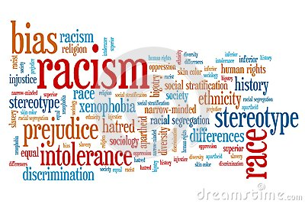
Social Justice - Access to Justice
The Issues:
Anti-Black Racism & systemic discrimination

Slide 13
Social Justice Advocacy
The historical relationship of ACC to the criminal justice system(CJS).
Cultural norms & customs in the racialized communities.
Social construction of racism and the influence on the criminal justice system as lawyers & consumers (stereotypes, labels, white privilege, criminalization of Black males.
Eurocentric standards and models in CJS (guilty until proven innocent).

Slide 14
Tools for the ACC to utilize for Social Justice Work
Statutes
Regulations
Policy

Slide 15
Knowledge of the Law to Guide Your Advocacy for the ACC
Child Welfare Legislation:
Temporary Care Agreements
Consideration of Race, language & Kinship placements
Mediation Services. S. 20
Youth Criminal Law:
Conferencing services. S19
Psychological , psycho-educational Assessments. S. 34
Other legislation
Education Act, Human Rights Legislation, Income Assistance Appeals, Landlord Tennant, IPTA, Adult Protection, Public Housing.
There are many laws and policies that can be utilized to the benefit the ACC. As an advocate, service provider, clinician, and helper you need to be aware of the law.
Notes:
Youth and family services aim for service integrationacross family support program activities, housing,menatl health, legal, financail counselling, disability and family violence. Services are provided in womens centers, schools,health service agencies. For the multichallenged familes services are tailored by offereing outreach services, simpilified information and referral processesand the use of non stigmatising services as a point of referral.

Slide 16
DOING Forensic social work
SOCIAL JUSTICE TOOLS for THE AFRICAN CANADIAN COMMUNITY

Slide 17
Social Work
The Law
Social Justice

Slide 18
Forensic Social Work- Your Role
Support person
Advisors
Advocates
Assessors
Navigators
Witnesses
Experts (child protection, Child Wishes, parental Capacity, Access)

Slide 19
As Forensic Social Workers:
Consider the value of the law to a non-African Canadian.
Charter of Rights and Freedoms
Immigration Law
Human Rights
Child Welfare
Criminal Law

Slide 20
WHAT IF YOUR CLIENT IS AFRICAN CANADIAN- A PERSON OF COLOR?
Now think of the impact in an era of anti- black racism and systemic discrimination.
Consider the impact of the law and the rights of your client:
Charter Rights - arbitrary street checks.
Immigration law- child welfare deportation.
Human Rights - job discrimination.
Child Welfare - over representation.
Criminal Law- innocent until proven guilty - remands

Slide 21
Reforming The Criminal Justice System
Over the last 10 years, the number of federally incarcerated Black males increased by 75%.1
Gladue/Race & Impact Assessments: look for similar opportunities for advocacy in the courtroom.
Consider the interplay of law and the rights of your client: Immigration law, Charter Rights, Human Rights.
Seek out politicians and others in positions of authority.
1. Source: Correctional Investigator Report 2013

Slide 22
DOING THE WORK (Accessing the Law & Legal System)
Community Development and law Reform.
Community Reintegration Programs.
Adult Diversion programs.
Record Suspensions
Community Partnerships- identify stakeholders.
Collections of Data.
Research & Writing.
Public legal Education.

Slide 23
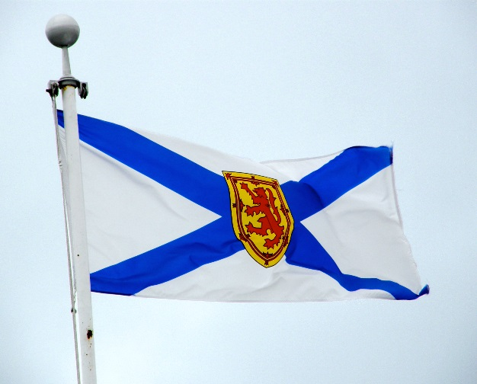
COUNT US IN Nova Scotia Government Action Plan Sept 20, 2019
Provide a framework for government to address concerns facing African Nova Scotians.
To work towards advancing social justice and inclusion policies, eradicating racism and promoting human rights.
Create partnerships and opportunities with the African Nova Scotians, community and government to address inequities in all facets of society.

Slide 24
Discussion Question (Small Groups)
What are the challenges the ACC faces with respect to Social Justice in an era of Anti-Black racism and systemic discrimination.?
How can you as social justice advocate bring about change in the ACC ?

Slide 25
CONTACT US
National Institute of Forensic Social Work
w. www.nifsw.com
e. info@nifsw.com
Subscribe to our email list for updates www.nifsw.com.
Our social media platforms can be reached through our website.

Slide 26
THANK YOU
FIRST UP CONSULTANTS

