Slide 1



Hofstra University
Herbert School of Communication
Course: Advocacy for Nonprofits
One Advocate’s Experience
April 10, 2019

Slide 2

I want to be an advocate when I grow up.
You want to be a what?
Notes:
I doubt anyone thinks about advocacy or lobbying as a profession, certainly not when they are young, but at some point in our lives we are all advocates.
As students, you may not think a grade you received on an exam or project is fair – so you develop your logic and reasons as to why you believe this to be so and present the case to your professor.
Or, maybe you have been moved by student school violence and have participated in rallies and letter writing campaigns. Look what happened after the Parkland shooting. Student activists were successful in getting gun reforms passed in Florida.
Maybe you have dealt with an ill family member and you needed to speak up on their behalf.

Slide 3


ad·vo·cate (noun) /ˈadvəkət/
A person who publicly supports or recommends a particular cause or policy. “She is an untiring advocate of healthcare reform.”
synonym: champion, upholder, backer, promoter, proponent, exponent, protector, patron

Slide 4
Foundational Principles
Research
Commitment
Communication
Notes:
Knowledge is power. How do you get that knowledge – find any and all facts about your cause. Comb through case studies, know the laws affecting your issue, the precedent cases. Talk to policymakers and lawmakers on both sides of the aisle to get the full picture of the issue. Talk to those with lived experience. Build a strong case that is indisputable in your eyes. This fuels your commitment and passion. Use that commitment and passion to then build a solid communications plan with memorable, thought-provoking messaging that leads to desired action.

Slide 5
Awareness
AWARENESS
Notes:
Advocacy is all about awareness. You are competing with hundreds of other causes and the landscape is noisy and crowded. Bottom line is that advocacy is a form of sales or marketing and your goal is to rise above the noise and sell your cause, which is often an abstract idea or concept.

Slide 6
Messaging Frameworks
Communication Theories
  Communication for Development (C4D)
  Communication for Behavioral Impact (COMBI)
Social Science Theories
  Stages of Behavior Change Model
  Communication for Persuasion Theory
Notes:
Behavioral and social science theories seek to analyze and explain how change occurs at the individual, community, and social levels. Change is interdependent on individuals and external factors. Advocacy communications and messaging can draw inspiration from and direction from these theories, leading to campaigns/messaging that are hyper-focused on language/prompts that will elicit desired behavior change – such as a new law, new policy, change in regulations and local ordinances. Theories combine behavioral, social, mass media, and marketing theories.
C4D – emphasizes community ownership and participation. Has roots in developing world. Communications need to take place in society at all levels to achieve individual behavioral and social change. (UNICEF and improving nutrition)
COMBI – based on work at NYU 1994 using integrated marketing communications applied to social development challenges. Uses strategic blend of activities, channels, audience-specific messages to address people’s perceptions, attitudes, behaviors – listens to people and what they believe to be true and important and tailors messages to that. Emphasizes clear, credible and consistent messages to achieve behavior and societal change.
Stages of Behavior Change Model – holds that behavior change goes through different stages (5) with each a different level of motivation and readiness to change – pre-contemplation, contemplation, decision, action, maintenance. Messages can be targeted along the motivational line
Communication for Persuasion Theory – focused on how people process information. 12 interdependent steps person moves through to assimilate a new behavior – such as being exposed to the first, understanding it, think of message in relevant context (meaning to them and their lives) etc.

Slide 7
Capture the Narrative
Cognitive psychologists suggest we are 22 times more likely to remember a fact that comes with a story
Advocates with lived experience increase emotional engagement of lawmakers, policymakers
Social science tells us that those engaged are less resistant to messages and more willing to listen
Less resistance translates into more probable action

Slide 8
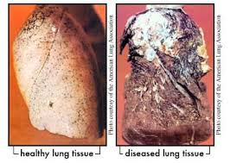
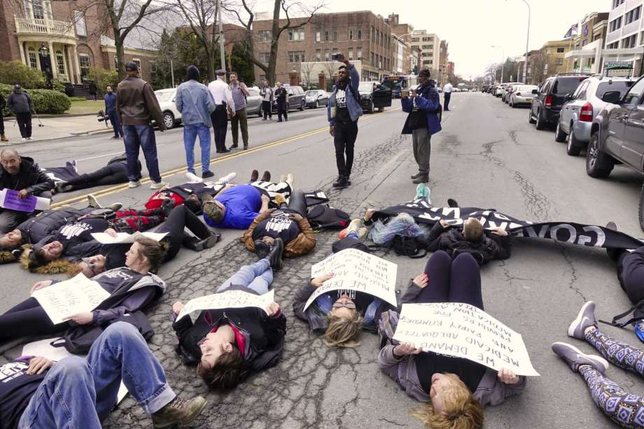




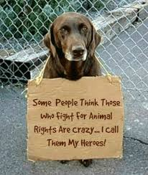

Yes, a Picture (or Snapchat) Is Worth a Thousand Words
Notes:
Your generation understands better than most the power of graphics, images, photos to evoke emotion and action. Use these to build your story, your case for your cause. They are part of the story – the narrative you are constructing.
Photo on upper left – timely. It’s a die-in (held Monday 4/8 in Albany) wherein advocates for reform of federal prescribing restrictions on the drug buprenorphine (suboxone) - a drug used to treat opioid addiction by reducing cravings and blocking painful withdrawal symptoms – stage protest. Federal policy currently limits who can prescribe and how much they can prescribe under the Drug Addiction Treatment Act 2000 – before opioid crisis hit.

Slide 9
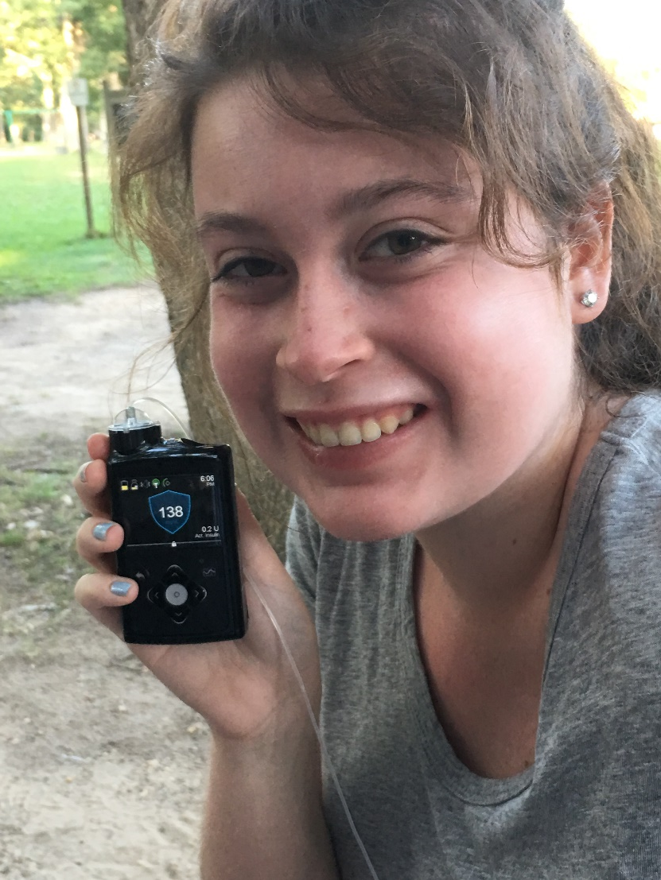
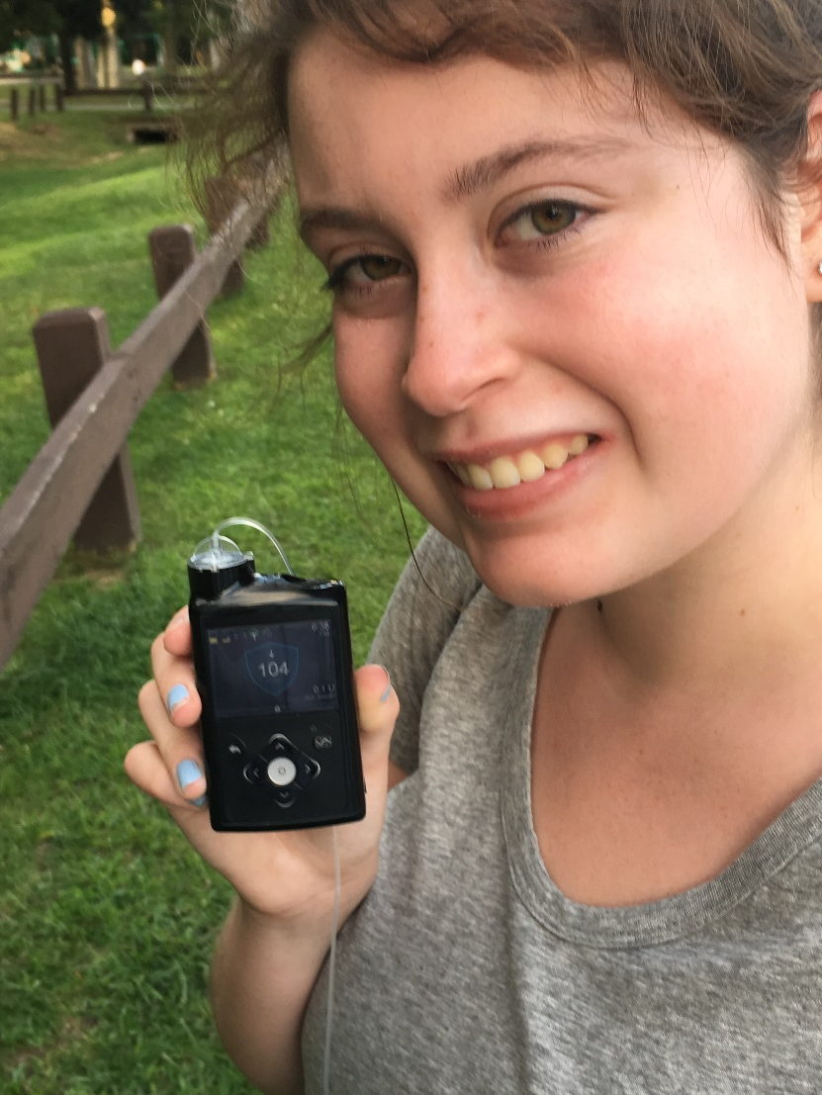
Narratives Tell Compelling Stories
Before walking
After walking
Notes:
Getting a grip on chronic disease through physical activity. Shows the before and after blood glucose readings on an insulin pump that is connected to patient’s continuous glucose monitor. After just a half hour of moderate-paced walking, her blood glucose level dipped 34 points and landed well within target range. Lends credence to the power of walking and vividly illustrates that fact better than any words could convey. Makes you a believer. I used this to advocate for insurance coverage of new generation of insulin pumps and in another instance to promote value of walking.
Lots of research looks at narrative persuasion. Health advocates, especially, are looking to impart often complex and complicated health messages to get people to change their unhealthy behaviors. Always lots of resistance. There is growing body of evidence that suggests that purely evidence-based or data-based approach to communication, especially concerning health issues, is insufficient. But narrative persuasion (telling the story in a humanistic, feature-like way) is a powerful tool to achieving behavior change/desired action – whether that is to institute a new law or policy, raise funds for a cause. The receiver of the message becomes more wedded to the image and/or story and therefore has less resistance. Stories elicit a greater emotional response. Narratives can also resonate with the social values of a particular group, promoting a deeper understanding and a dissemination of a message through the community. Cognitive and behavioral sciences help communicators better understand human thought and motivation and help us better tell the story.
Can measure effectiveness using the Perception of Narrative Performance Scales.

Slide 10
Telling the Story
Define your audience(s) and objective(s)
Present the problem, followed by the solution
Use “put yourself in the shoe” technique
Use vivid but not overly descriptive language
“Thematicize” the messaging
Influences of behavioral economics always at play
  Behavior is directed by emotions and environmental forces, not necessarily by careful calculation of risk and reward
  People tend to stick with default options
End with a Call to Action
  Signatures on a petition; donations; outreach to lawmakers and regulators

Slide 11
Spreading the Message
Assemble an advocacy toolkit with the basics
  Op Ed copy
  Position statement, letters, and testimony
  Leave-behind document
  Flyers and posters
  Short videos and photos
  Social media posts
  Customized landing page within website
  Feature stories and news stories
  Blog copy and other online content
  Public service announcements (print/broadcast)
Select your media platforms (always mindful of budget)
Utilize professional networks
Commit to in-person meetings (legislative offices, rallies, town halls)
Re-work and re-package the basics to fit promotional opportunities

Slide 12
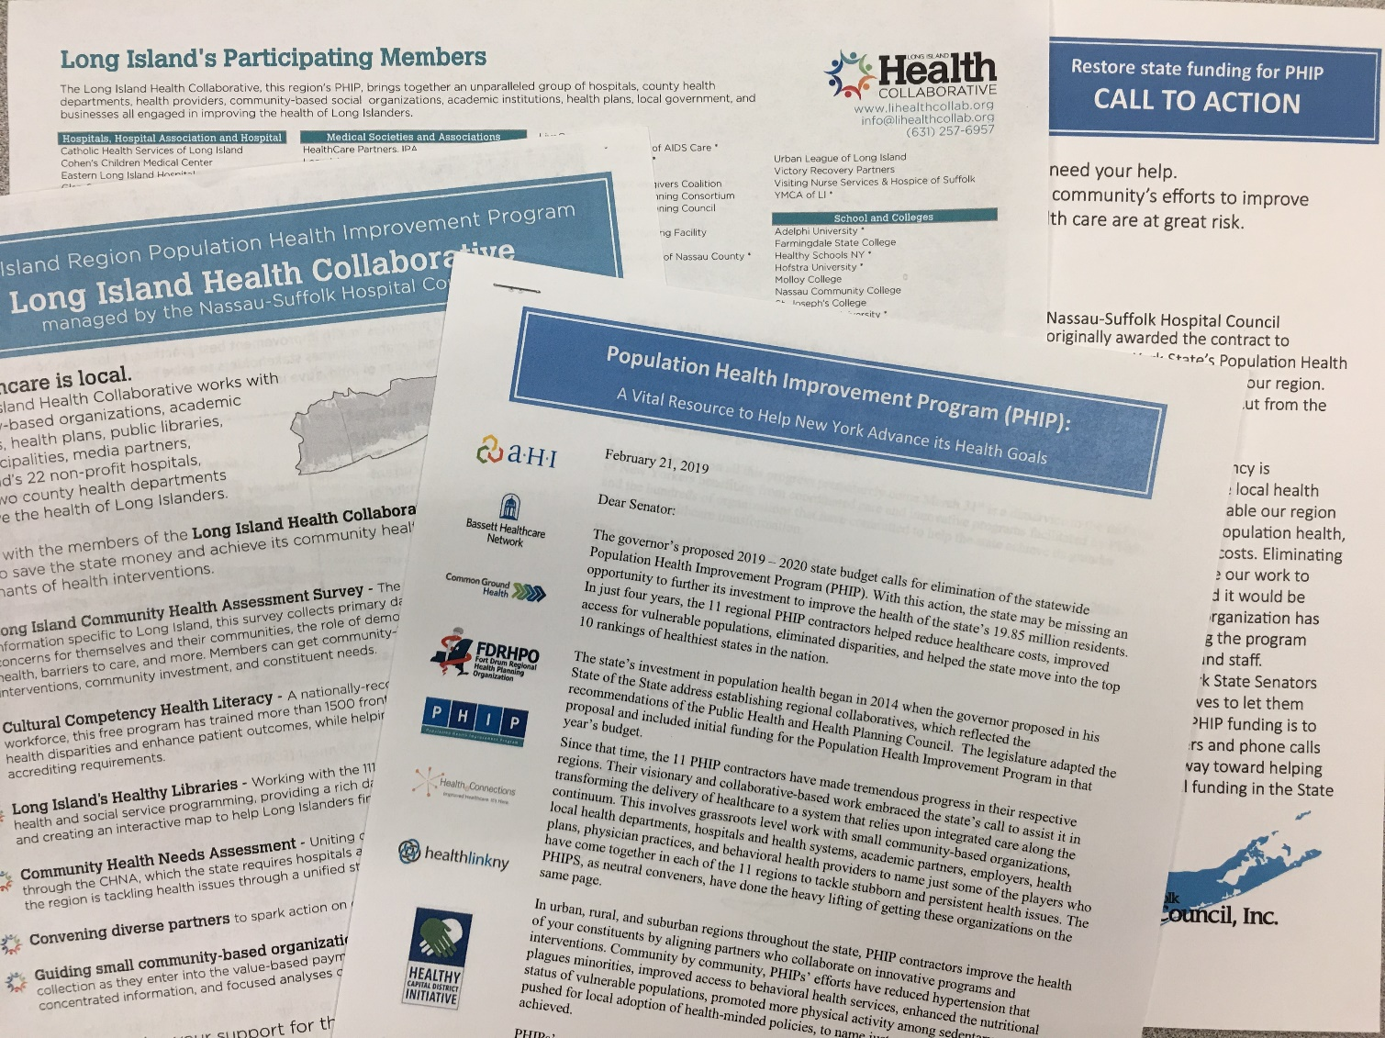


Advocacy in Action
Long Island Health Collaborative - funding proposed for elimination in Governor’s budget January 15, 2019

Slide 13
Advocacy Works
For services and expenses and grants related
16 to the population health improvement
17 program. Notwithstanding any provision of
18 law to the contrary, the portion of this
19 appropriation covering fiscal year 2019-20
20 shall supersede and replace any duplica-
21 tive (i) reappropriation for this item
22 covering fiscal year 2019-20, and (ii)
23 appropriation for this item covering
24 fiscal year 2019-20 set forth in chapter
25 53 of the laws of 2018 (26972) .............. 15,500,000
Language from the
2019- 2020 State Budget
approved March 31, 2019

Slide 14
Advocacy Oversight
New York State Joint Commission on Public Ethics (JCOPE)
  Oversees and regulates lobbying in New York
  Elected officials, candidates, members of legislative and executive branches, registered lobbyists
  Lobbying is an attempt to influence legislation, rules, regs, etc.
Lobbying Act
  NY’s Lobbying Act dates to 1978
  January 1, 2019 revised and updated lobbying regulations effective
  Requires public disclosure about activities and expenses
  Bi-monthly reporting
  Social media communication considered direct lobbying (for registered lobbyists)

Slide 15
Wrap Up
Successful advocacy depends on successful communications
Social science and communication theories guide the process
Many ways and venues to promote advocacy messages

Slide 16
Some Resources
https://www.nih.gov/institutes-nih/nih-office-director/office-communications-public-liaison/clear-communication/clear-simpleData aggregator
Thompson, T and Matthew Kreuter. “Using written narratives in public health practice: a creative writing perspective” Prev Chron Dis 2014, 11:E94, 5 Jun. 2014, doi:10.5888/pcd11.130402
Flynn, T. “How narratives can reduce resistance and change attitudes: insights from behavioral science can enhance public relations research and practice” Research Journal of the Institute for Public Relations vol. 2, No. 2 October 2015.

Slide 17
Thank You and Keep in Touch
Janine Logan,
Senior Director, Communications and Population Health
Nassau-Suffolk Hospital Council
Northern Metropolitan Hospital Association
Suburban Hospital Alliance of New York State and
Director, The Long Island Health Collaborative
jlogan@nshc.org

