Slide 1
Accountable Care Communities: It Takes an Island
September 13, 2018
Presentation to:
Residency Program,
Department Preventive Medicine,
Stony Brook University

Slide 2
Notes:
Illustrates the immediacy of needs in terms of managing chronic diseases and overall health. In a recent survey of CBOs on LI and Hudson Valley conducted by the state department of health – respondents overwhelmingly identified Poverty (78%) as the societal factor that most affects the communities they serve. Comprising the other third were access to health care, health literacy, employment, housing security and stability.

Slide 3
Notes:
CDC director Dr. Thomas Frieden’s health pyramid. We have the opportunity to make greater changes in health, greater changes in patient’s life by working on those factors that affect the patient’s overall environment. Solve for these needs and we solve for better health outcomes.

Slide 4
About LIHC
Funded by NYSDOH Population Health Improvement Program (PHIP) since 2014
Began as voluntary partnership in response to NYS Prevention Agenda mandate
Coalition of CBOs, LHDs, hospitals, academic institutions, health plans, physicians, etc.
Improve health of Long Islanders – chronic disease management and prevention

Slide 5
2013-2018 NYS Prevention Agenda
Pathway to achieve better healthcare
Outlines five priority areas
Hospitals and LHDs required to conduct community health needs assessments jointly every three years
Community-based organizations part of process
Reduction of Chronic Disease – Chosen Priority
reduce obesity in children and adults
enhance access to chronic disease self management programs in clinical and community settings

Slide 6
Updating the Prevention Agenda for 2019-2024
2018 NYS Health Assessment:
Changes in NYS demographics and health status since 2012
Progress to date on Prevention Agenda objectives - state dashboard
Considerations for how to address what influences health
Healthy aging across the life cycle in each priority area
Health-across-all-policies approach including upstream, “non-health” interventions and strategies in each priority area
Racial and ethnic health disparities
Considerations for how to strengthen local action including strength and diversity of local collaboration, across health and non-health agencies, between state and local agencies, among counties, cities and towns, and between public and private organizations
Implementation of evidence based interventions, and regular assessment of local progress
Feedback on proposed Focus Areas and Goals – Winding Down
Notes:
This slide describes four elements that are informing the update of the current Prevention Agenda. Workgroups’ recommendations presented to state later this month and then priority areas for 2019-2014 PA will be adopted by the Public Health and Health Planning Council at December meeting.

Slide 7
Priority Comparison
2013 – 2018 (Current)
Prevent Chronic Diseases
Promote a Healthy and Safe Environment
Promote Healthy Women Infants and Children
Prevent HIV/STDs, Vaccine-Preventable Diseases, and Healthcare-Associated Infections
Promote Mental Health and Prevent Substance Abuse
2019 – 2024 (Proposed)
Prevent Chronic Diseases
Promote a Healthy and Safe Environment
Promote Healthy Women Infants and Children
Prevent HIV/STDs, Vaccine-Preventable Diseases and Antimicrobial Resistance, and Healthcare-Associated Infections
Promote Well Being and Prevent Mental and Substance Use Disorders

Slide 8
Medicine without Walls
Healthcare extends out into the community and is the community
Multiple sectors have stake in keeping individuals and communities well
Social impact model considers health within the context of where one lives, works, plays, and learns
First time U.S. investing significantly in social health
Notes:
Research indicates one’s lifestyle and social factors (housing condition, education level, employment status) account for about 70 percent of one’s health status at any given time

Slide 9
Rx for Health
FVRx vegetable prescription program
http://www.wholesomewave.org/our-initiatives/nationalnutritionincentivenetwork/currentprojects/fruit-and-vegetable-prescription-projects/
Walk with a Doc
http://walkwithadoc.org/
Recommendation for Walking (LIHC)
https://www.lihealthcollab.org/
Health Leads – prescribes basic resources
https://healthleadsusa.org/location/boston/
Exercise Is Medicine – American College of Sports Medicine
http://www.exerciseismedicine.org
Notes:
Primary care physician in Missouri speaking on an NPR program talked about how she spends about 50% of her time tending to the social needs of her patients. Referrals to food assistance programs, housing help, mold and mildew remediators. This was not what she envisioned when in medical school.

Slide 11
Our Role and Checklist
Healthy Eating
Mental Health
Physical Activity
Convening partners
Engaging in primary and secondary data collection and analyses
Conducting consumer and provider-facing public information/awareness campaigns
Supporting adoption of policies related to healthier living
Promoting chronic disease self-care
Providing a wed-based walking initiative for use by the public and organizations seeking a platform in which to engage patients/clients/employees in a walking program
Notes:
Healthy Eating/Food Access and Physical Activity are the pillars upon which the region’s population health activities rest. These components are the two that have the most bearing upon chronic disease. Abundant evidence and research exists confirming that lifestyle changes in these areas can signifacantly improve and/or prevent chronic diseases and ensuing complications. We also know that without sound mental health, there is no good physical health. CHNAs conducted in 2013 and 2016 reflect the community’s need for mental health/substance abuse treatment and prevention services. The need is also manifested by the opioid epidemic and rising rates of depression and anxiety. Mental Health/Substance Abuse intersects all activities. Collaborative partners, especially the hospitals, are becoming more engaged in programming that speaks to the social determinants of health. The collaborative supports these efforts and interacts with a variety of stakeholders, on behalf of hospitals, to ensure programming/interventions/activities are reasonable, rooted in evidence, and lead to meaningful outcome measures.

Slide 12
Three-Pronged Approach
Programming
Public Outreach
Policy Change
Highlights of Achievements/Activities
Are You Ready, Feet? Walkability campaign
Website rich with local data
Cultural Competency/Health Literacy Training
Complete Streets policy work (health asset tie in)
Notes:
LIHC is charged with coordinating population health activities for region.

Slide 13
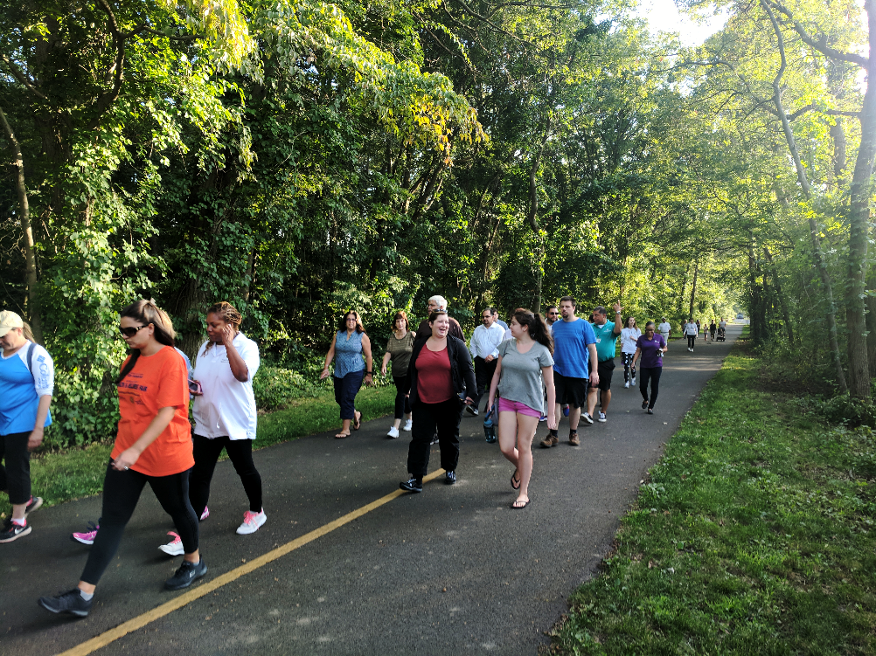
Public Outreach
Walking in the State Parks – Summer 2017

Slide 14
Website

Slide 15
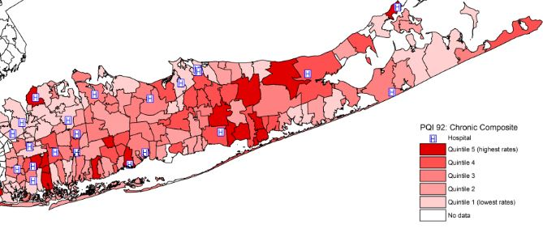
Data Directs Initiatives
Resources:
Vital Statistics of New York State
Statewide Planning and Research Cooperative System (SPARCS)
New York State Community Health Indicator Reports
American Fact Finder from the United States Census Bureau
Behavioral Risk Factor Surveillance System from the CDC
Prevention Quality Indicators from the Agency for Healthcare Research and Quality
Notes:
LIHC analyzes and collects demographic, disease-specific, utilization data that helps regions’ providers make decisions about programming, interventions, prevention needs. What needs to be done clinically and socially to get the cohort of patients and/or individual patient healthier and out of the hospital/ED.

Slide 16
Policies Pushing Population Health
New payment structures that emphasize “accountable communities”
Accountable Care Organizations
Bundled payment arrangements
Patient-centered Medical Homes
State Medicaid reforms and transformation
MCOs/VBP contractors must include one social determinant of health intervention in contracts with Tier 1 CBO (Jan 2018)
Patient satisfaction and transparency
HCAHPS’ influence
Patient satisfaction key at every point of contact
Notes:
Brief details about ACO, etc. States undergoing Medicaid DSRIP transformation besides NY include CA, TX, KS, NJ, similar initiative in MA and NM. Brief details on HCAHPS (Hospital Consumer Assessment of Healthcare Providers and Systems) accounts for 30% of a hospital’s VBP score. Looks at patient experience of care and perceptions of care – docs factor into this since they often lead the medical team in hospitals, employed by hospitals, etc. Medicare readmissions penalties also promote population health – keep people out of hospitals and ERs. Hospitals are dinged every time a patient is re-admitted within 30 days of discharge for selected conditions. This puts pressure on docs in the hospital and even in the community – keep patients well – especially those with chronic illnesses. Legislation goes into effect next month that adjusts for sociodemographic risk factors – this is because there are many factors – SDH – outside of clinical care that affect hospital admissions. Tier one CBO is a non-Medicaid billing entity – so these would be orgs providing housing, transportation, food assistance. Non-medical.

Slide 17
Future Docs: Take Action Now
Go to portal and sign up for the Are You Ready, Feet? walking initiative. www.lich.org
Participate in LIHC meetings and Core Clusters
Commit to uphold the ideals of population health
Write a Recommendation for Walking
Become active on social media #readyfeet #healthcollab
Join our next public walk
Wag and Walk ۰ North Shore Animal League of America
Saturday, September 29 ۰ North Hempstead Beach Park
Team – LI Health “Collabradors”

