Slide 1
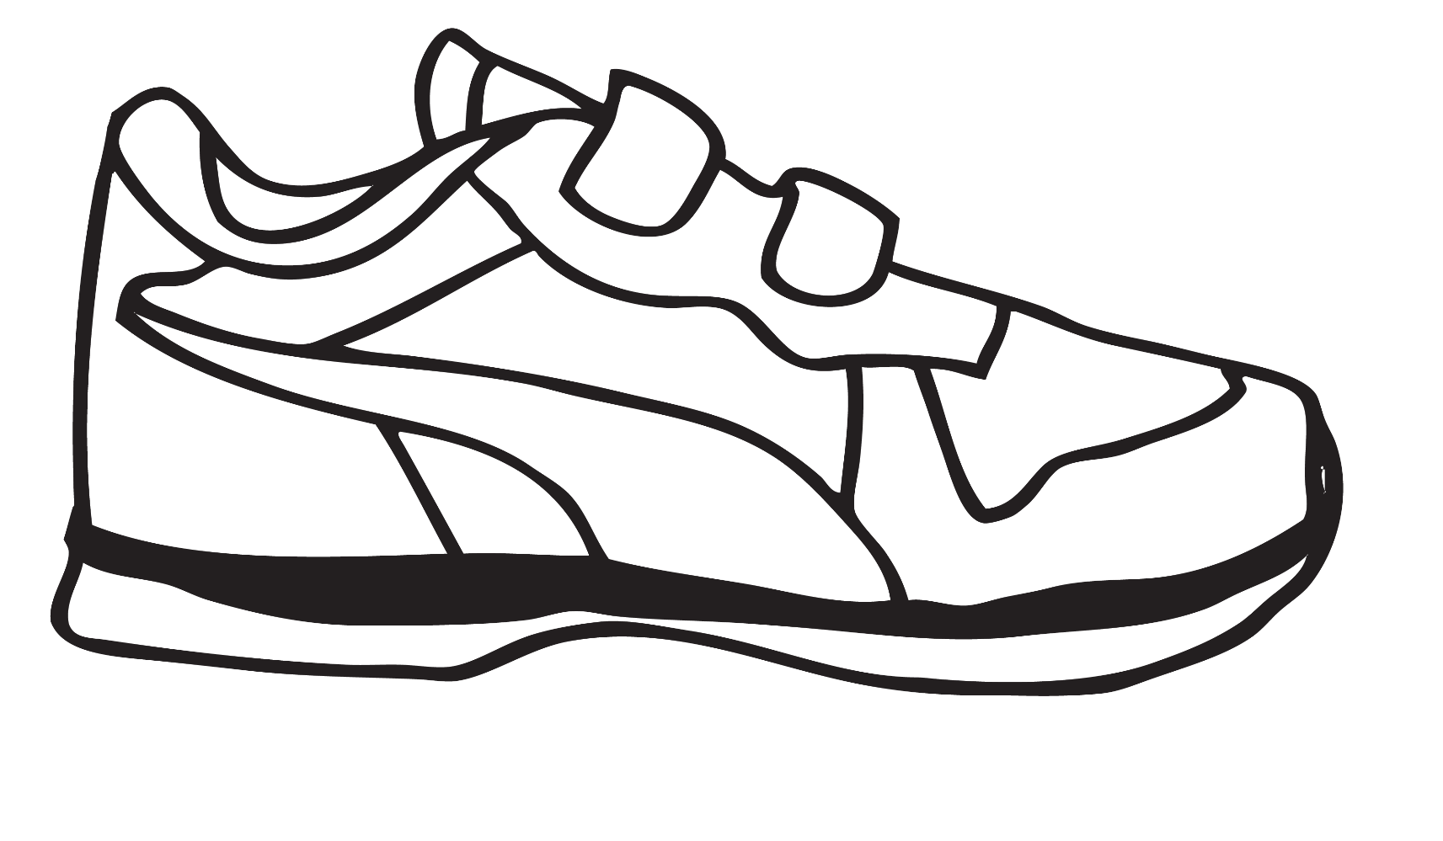
Walk the Talk: A Coalition Laces Up and Steps Out
September 14, 2017
National Walking Summit 2017
St. Paul, MN

Slide 2
Putting Our Best Feet Forward

Slide 3
A Coalition from all Walks of Life
60+ CBOs, 2 LHDs, 23 hospitals, 5 academic institutions, 5 health plans, NYS Parks Regional Office, local municipalities, physicians, business partners
Began as voluntary partnership 2013 in response to NYS Prevention Agenda mandate
Momentum and enthusiasm led to Long Island Health Collaborative (LIHC)
Funded by NYSDOH Population Health Improvement Program (PHIP) since 2014
Managed by the Nassau-Suffolk Hospital Council
Improve health of Long Islanders – chronic disease management and prevention
Notes:
Quick few words on LIHC’s evolution. PA mandate required local health depts and hospitals to jointly conduct a community health needs assessment. NSHC natural convening agency for that. Conducted assessment in 2013 and then completed the 2016 CNHA for second three-year PA cycle. Same priorities revealed.

Slide 4
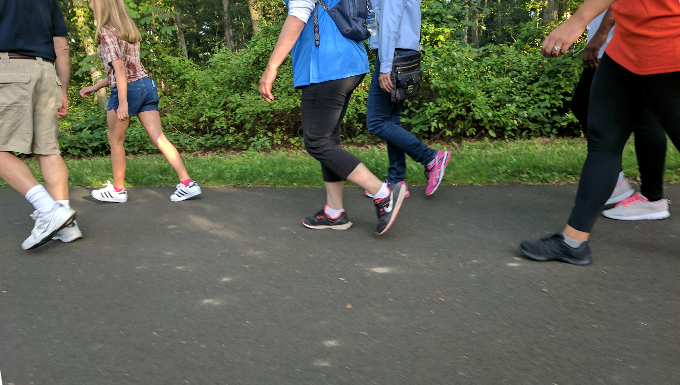
Finding Common Ground
Walking speaks a universal language
Notes:
We are all competitors, beholden to our own organizational priorities, time constraints, etc. But data drove our compromise. Data clear that we needed to do something to chip away at the prevalence of chronic disease – especially those related to obesity. Members embraced walking as a physical activity everyone could promote among their organizations and the constituents they serve Cheap, easy, and can be done any where – just about. Research is definitive about the health benefits of walking no matter how fast or slow you go.

Slide 5
Three-pronged Approach
Programming
Public Outreach
Policy Change
Notes:
Policy change via Complete Streets implementation – successful in two communities – Wyandanch (way signage, crosswalks, curb cuts) East Meadow (Eisenhower Park installed bike lane, improved walking path, lighting) Work with two county planning depts. to ensure complete street concept incorporated into all design and planning when possible. Promote health connection between enhanced built environment improvements. Programming manifested by way of a health promotion campaign LIHC developed. Includes public walks and web-based walking initiative through a portal to record steps and compete for prizes. All ties into public outreach, which is further enhanced by media relations efforts.

Slide 6
Are You Ready, Feet?™
Notes:
Health promotion campaign to encourage walking officially debuted in April 2016 alongside the LIHC’s interactive website. Health communications overarching theme places less emphasis on the word “walking” and favors the word “feet” to impart a less authoritative tone and minimize walking viewed as a chore. Messaging draws upon NIH tenets of clear and simple communication to achieve effective health communication and eventual behavior change. Public communication messages are colloquial, almost conversational in their approach to education and learning. The messaging holds true to NIH clear communication principles and is based on psycho-social science behind human and behavior change dynamics both in individual and social-ecological settings.
Have support of physician community and also depending upon other primary care providers – NPs, PAs – to promote the message and campaign through a Recommendation for Walking slip offered at the patient encounter
Participants can log and track their minutes moved, miles walked, or steps taken through the portal and compete with themselves and others - chance to win prizes offers incentives

Slide 7
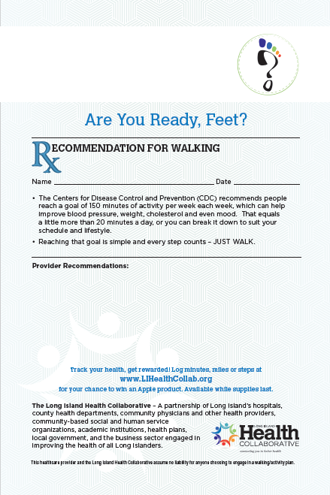
Engaging Providers
Walking Recommendation
Visual prompt
Pads mailed to PCP practices with JAMA article
One hospital embeds in EMR
Notes:
The Recommendation for Walking slip actually pre-dates the formal AYRF health communications campaign. Early in the LIHC’s history, participants were eager to find a way to pull in physicians and other healthcare providers – NPs, PAs, even physical therapists – who would recommend walking to their patients during a visit. The JAMA article was used as a way to lend credibility to the effort. “Making Physical Activity Counseling a Priority in the Clinical Practice.” Noted the research that a person is more motivated to act when given a visual prompt, and the prompt carries greater validity when it comes from a trusted healthcare professional. Increases odds desired behavior change will occur.

Slide 8
www.LiHealthCollab.org

Slide 9
Stats
527 portal subscribers, since April 2016
60,500 total miles walked to date
3,400 visitors to the “Walking Opportunities” page since
Of the site’s almost 60,000 unique pageviews, over 22% of those views were on our 3 most popular blog posts
Some of the Best Dog-Friendly Destinations on Long Island
7 Long Island Adventures You Need to Take This Summer
Kid-Approved Outdoor Fun on Long Island
Notes:
WALKING OPPORTUNITIES PAGE - 4% of our traffic comes to our site after finding our Walking Opps page somewhere else on the web, via popping up on a search engine like google. BLOG POST UNIQUE PAGEVIEWS - Unique Pageviews is the number of times that a new session on our site included THESE specific pages. In simpler terms, these are our most visited pages. The 60,500 total miles represents traversing Long Island 512 times – 60,500 divided by 118 miles (that is length of LI from tip to tip).

Slide 10
Noteworthy Activities
Six walks for the public, since 2015
Two Complete Streets policy projects completed, emphasizing safe walkable communities for exercise and good health
AYRF platform used by CBO for its Healthy Schools initiative
Kohls Cares for Kids grant – lead grantee using AYRF platform for school-based initiative to combat obesity

Slide 11
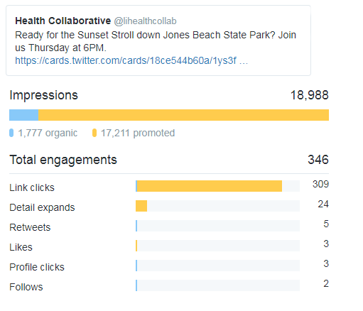
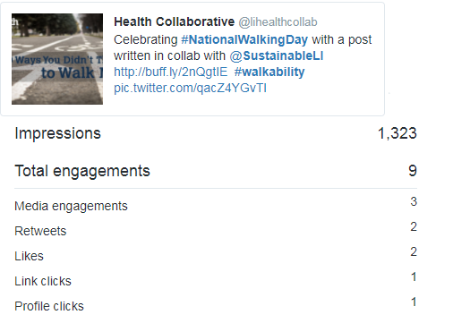
Public Outreach Activities
Social Media efforts #ReadyFeet
Earned media placements
“Easy as a Walk in the Park”
“Long Islanders put their best foot forward”
PSA
Partners’ health fairs and public events
Library partnerships
Notes:
Twitter post shone. One shows almost 19,000 impressions – we put some money into more finely targeting this tweet – via our digital content agency. The 1777 are organic tweets. The other post builds on post of one of our partners.

Slide 12
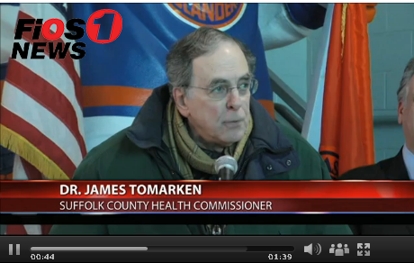
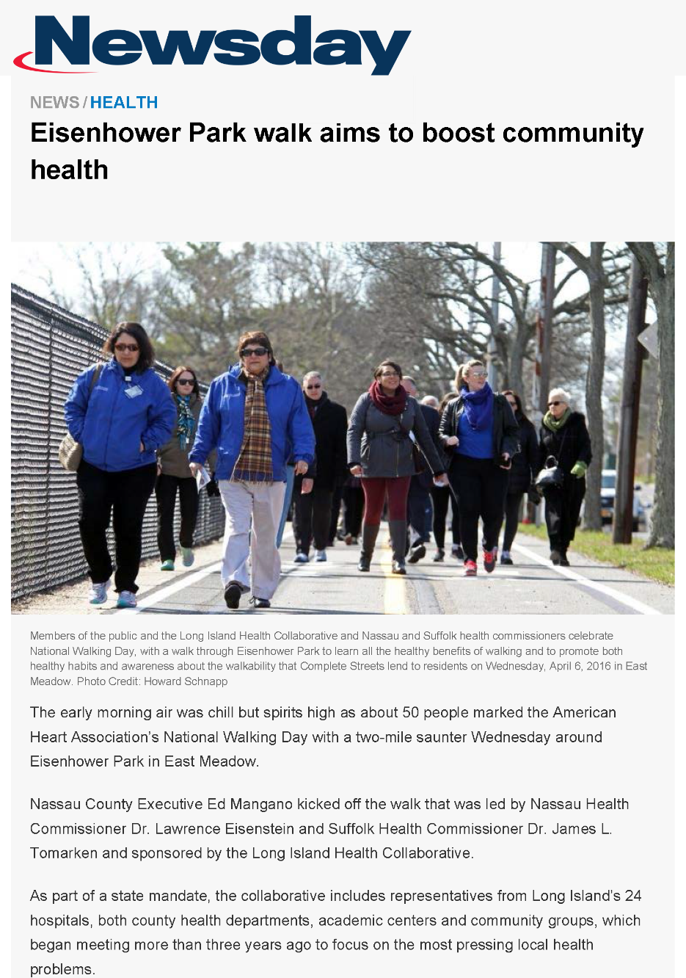
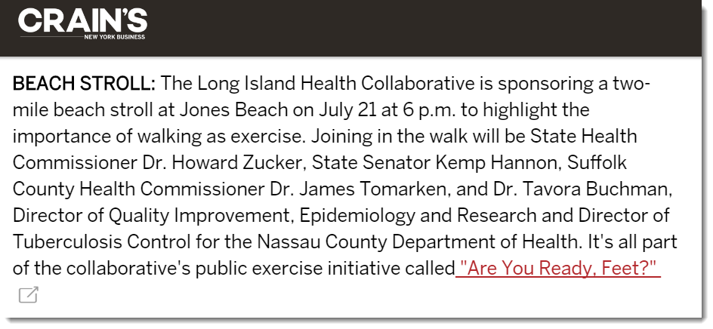
Walking in the News

Slide 13
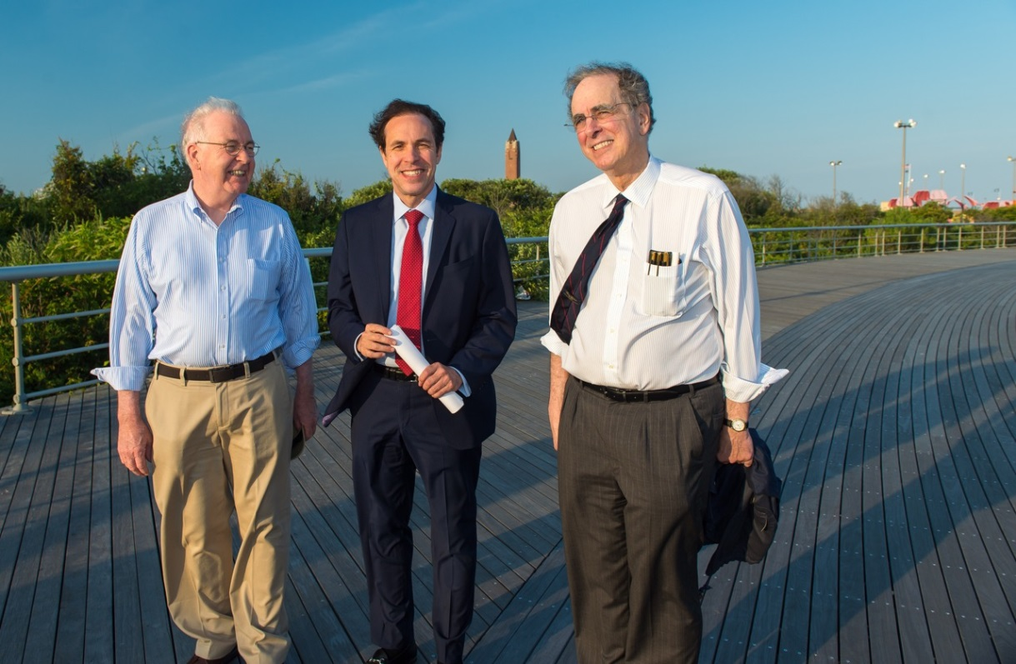
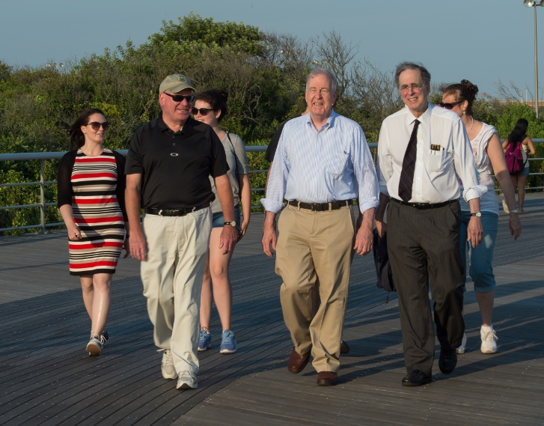
Public Outreach
Sunset Stroll at Jones Beach, July 21st 2016

Slide 14
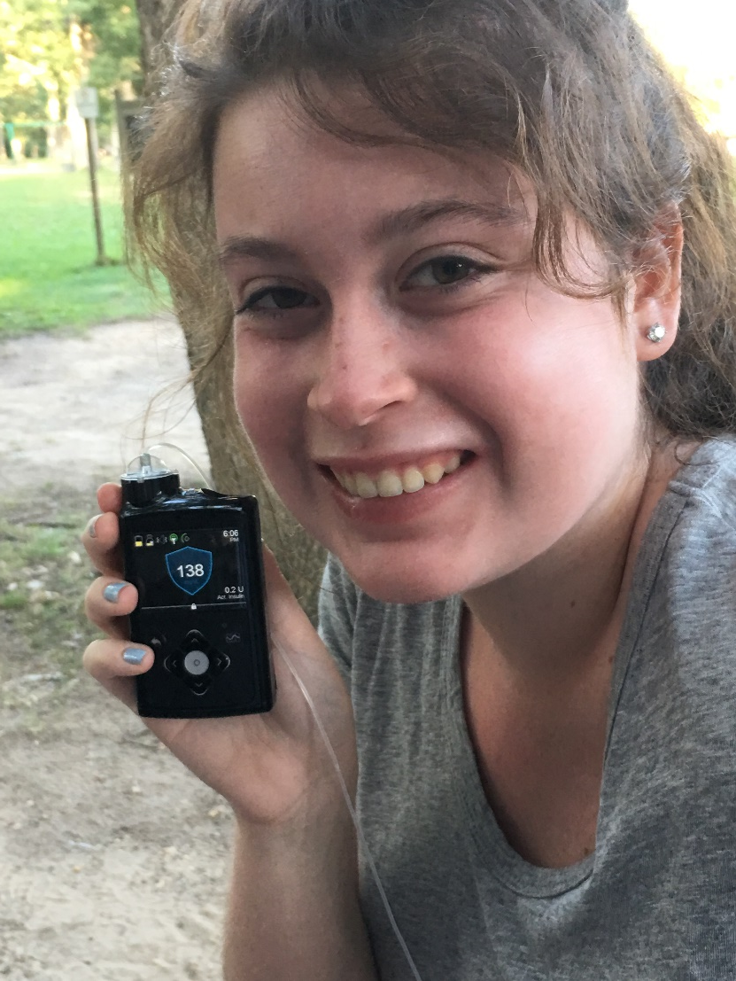
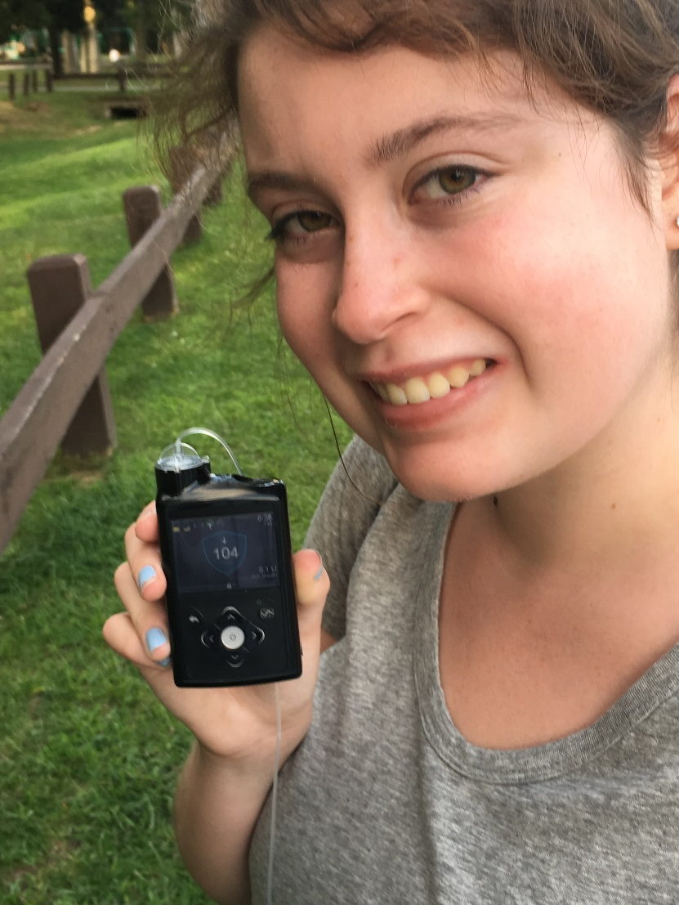
Narratives Tell Compelling Stories
Notes:
One of our younger walkers, who is a type 1 diabetic, shows the before and after blood glucose readings from her insulin pump that is connected to her continuous glucose monitor. After just a half hour of moderate-paced walking, her blood glucose level dipped 34 points and landed well within target range. Lends credence to the power of walking and vividly illustrates that fact better than any words could convey. Makes you a believer. Lots of research looks at narrative persuasion. Health communicators are looking to impart often complex and complicated health messages to get people to change their unhealthy behaviors. Always lots of resistance. There is growing body of evidence that suggests that purely evidence-based or data-based approach to health communication is insufficient. But narrative persuasion (telling the story in a humanistic, feature-like way) is a powerful tool to achieving behavior change. The receiver of the message becomes more wedded to the image and/or story and therefore has less resistance. Stories elicit a greater emotional response. Narratives can also resonate with the social values of a particular group, promoting a deeper understanding and a dissemination of a message through the community, Especially useful with hard-to-reach populations. Cognitive and behavioral sciences help communicators better understand human thought and motivation and help us better tell the story. Can measure effective using the Perception of Narrative Performance Scales.

Slide 15
Steps Ahead
Wag and Walk for Health – Canine Companion Walk – Walk Your Dog Week™ October 2018
School partnership mailing - December 2017
Pedestrian Safety Day in partnership with local county health department - Spring 2018
#ReadyFeet Rally – team-based competition between 23 hospitals (pilot this December)
Embed ‘Rx’ slip in 3 more hospital EMRs - 2018
Fitbit sync on website

Slide 16
Thank You
Janine Logan, jlogan@nshc.org
Director, Long Island Health Collaborative
Senior Director, Communications and Population Health, Nassau-Suffolk Hospital Council
www.lihealthcollab.org

