Slide 1
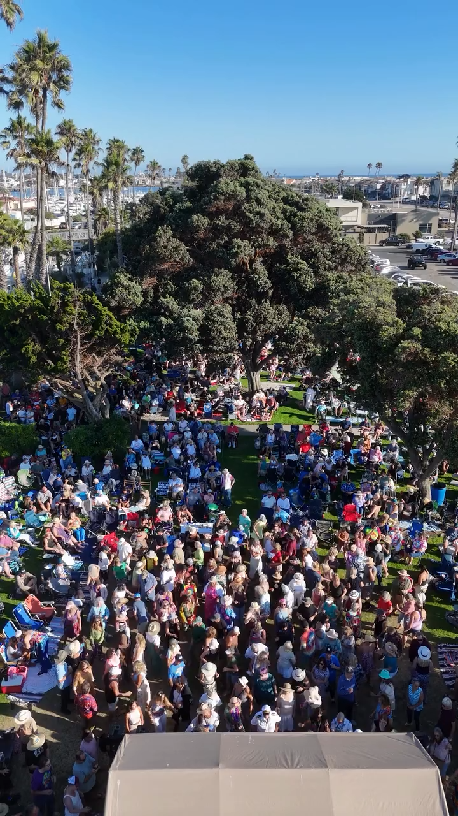

We wanna help you party
like it’s 1969 !!!

Slide 2
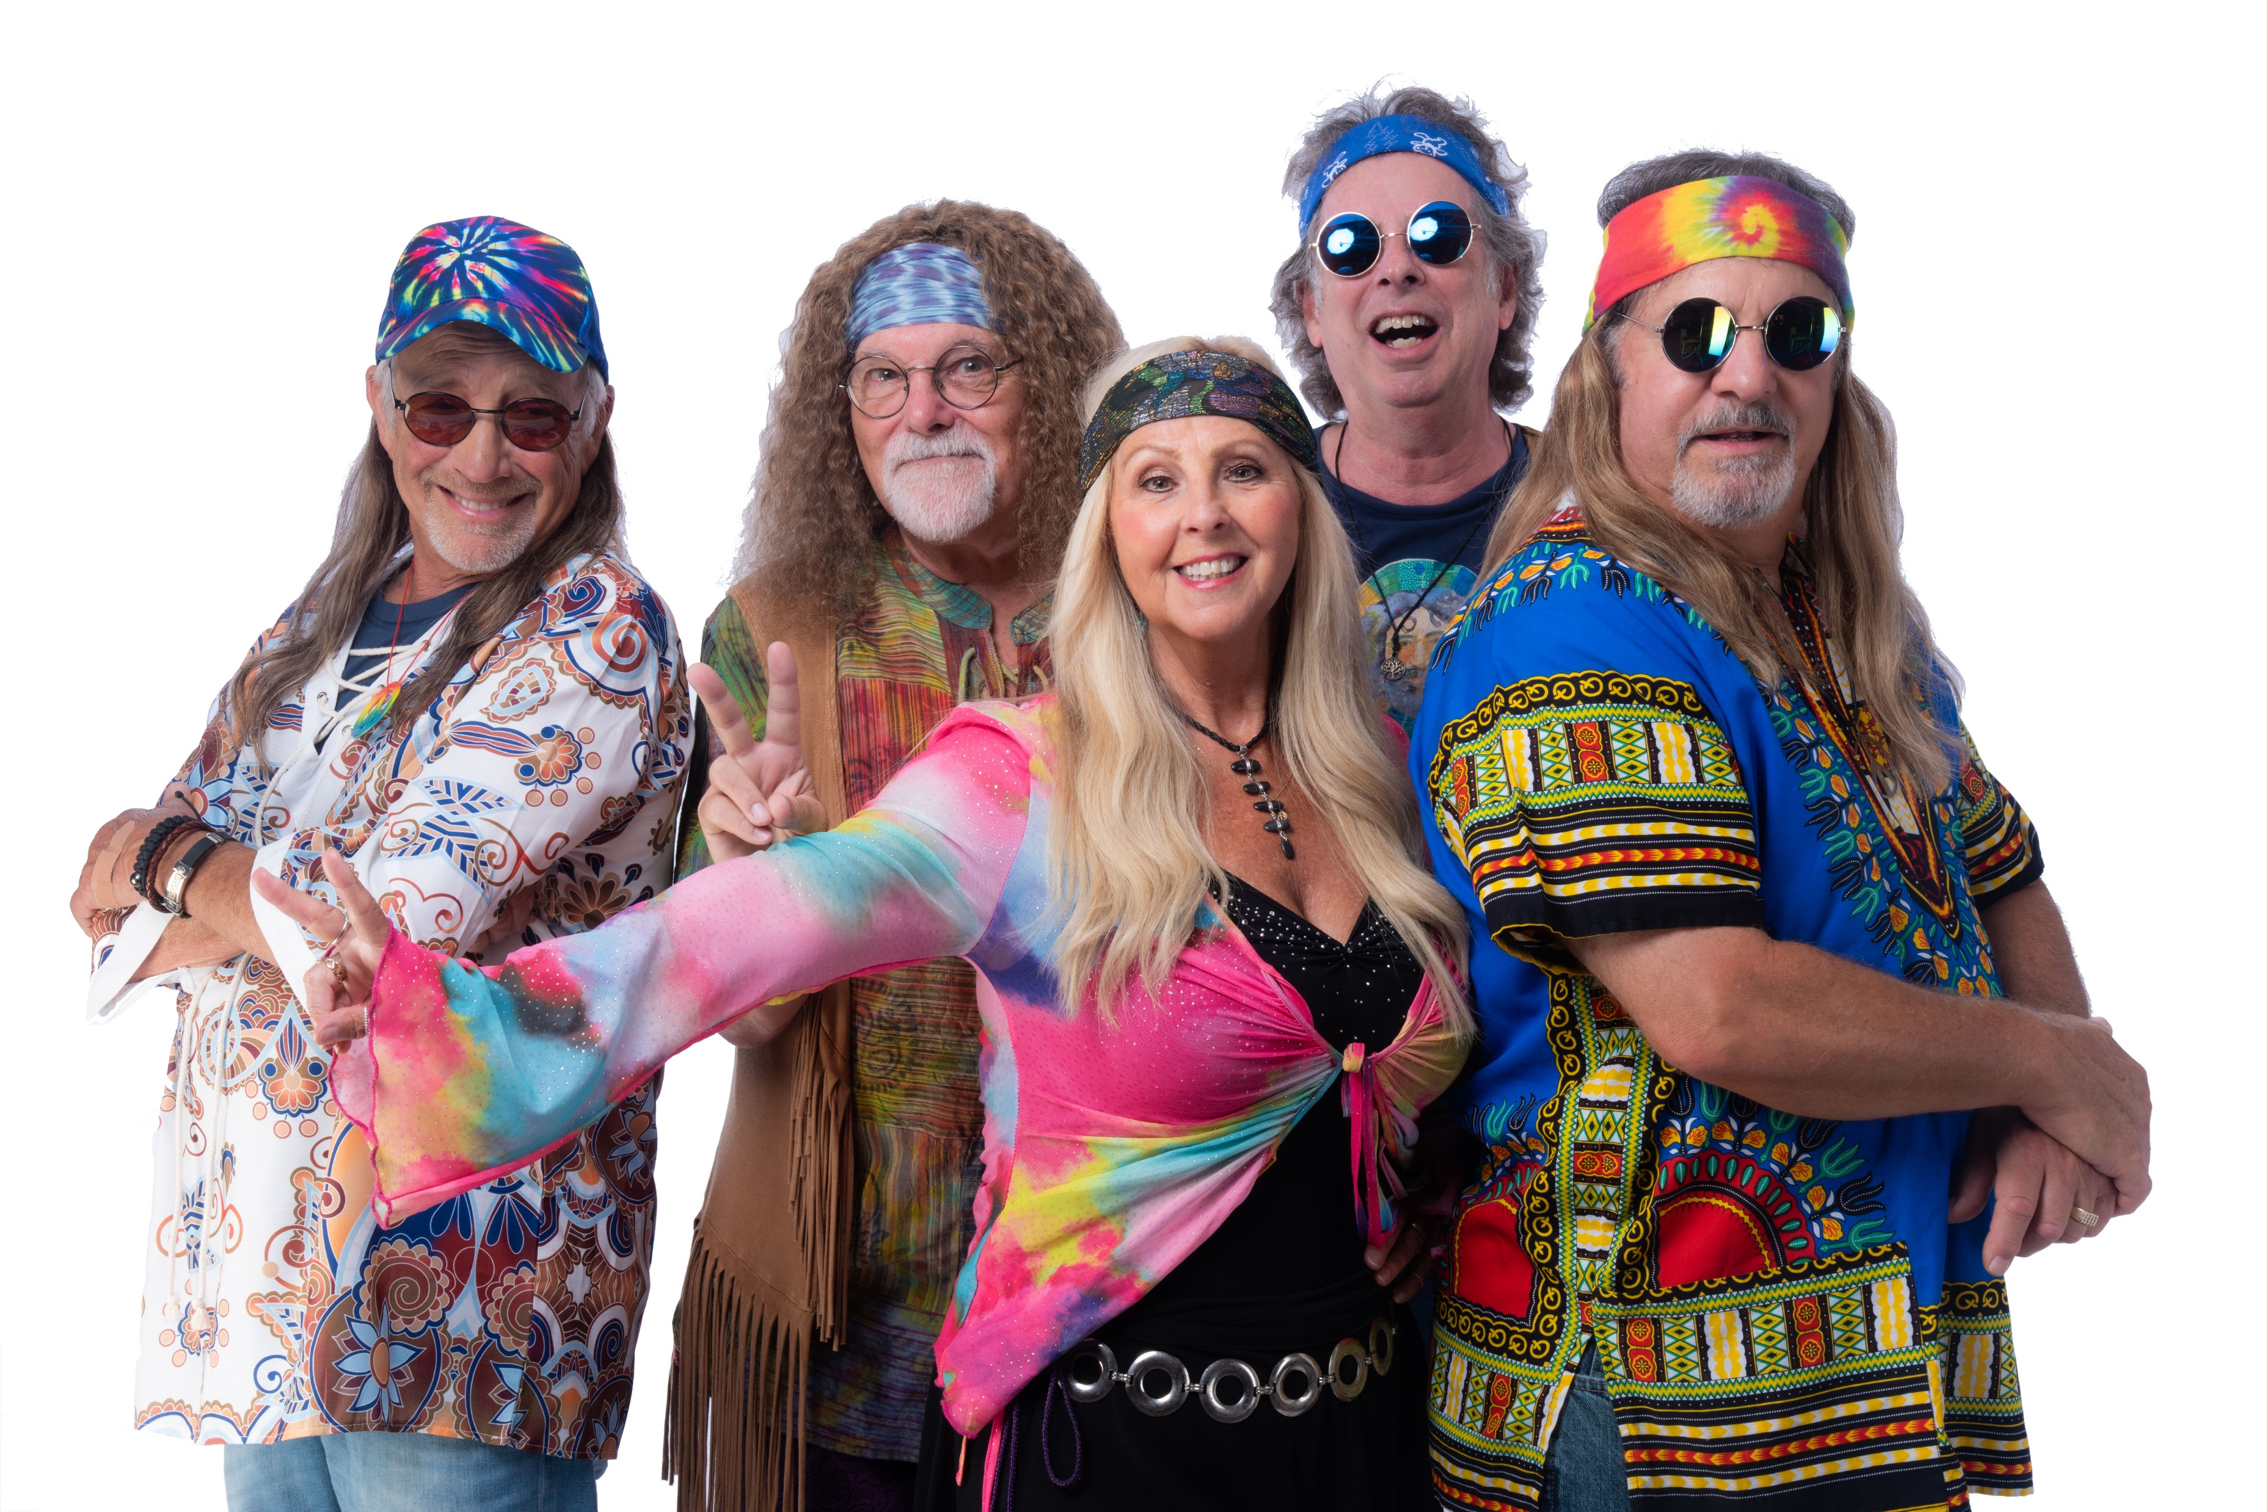

Slide 3

The cosmic tribal gathering
We recreate the vibe and music that epitomized the late 1960s - mid 1970s music scene, from Janis Joplin, Jefferson Airplane, Sly and the Family Stone and Buffalo Springfield to Beatles, Doors, CSNY, Creedence and Steppenwolf we leave NO stone unturned - we even DO STONES, TOO!
Fully professional attitude, delivery, appearance and instrumentation at each and every performance. Sparkling vocals, tasteful musicianship, always danceable grooves - and never-ending family-friendly fun!
Experience all that is PSYCHEDELIC SUMMER at YOUR next special event, corporate engagement or casino.
For more info, please email us here or call 805.794.7323

Slide 4
CURRENT SONGLIST (always evolving)
All Right Now
Love Her Madly
Born on the Bayou/Suzy Q/Fortunate Son
Venus
Story in Your Eyes
Ride My Seesaw
Somebody to Love
Magic Carpet Ride
Thank U For Lettin Me Be Mice Elf Agin
Woodstock
Piece of My Heart
Born to Be Wild
Radar Love
Pushing Too Hard/Got A Line On You
For What Its Worth
She’s Not There / Day Tripper
Mama Told Me Not To Come
In A Gadda Da Vida
Break On Through
I Just Wanna Celebrate
Bobby McGee
Aquarius - Let the Sunshine In
Good Lovin
These Boots are Made for Walkin
Everybody Get Together
Sunshine of Your Love/Hello I Love You
White Rabbit
I Just Wanna Make Love to You
Hold On Im Coming
Gimme Shelter
Love Me Two Times
I Wanna Take You Higher
I’m A Man
California Dreamin’
Eight Miles High
For more info, please email us here or call 805.794.7323

Slide 5
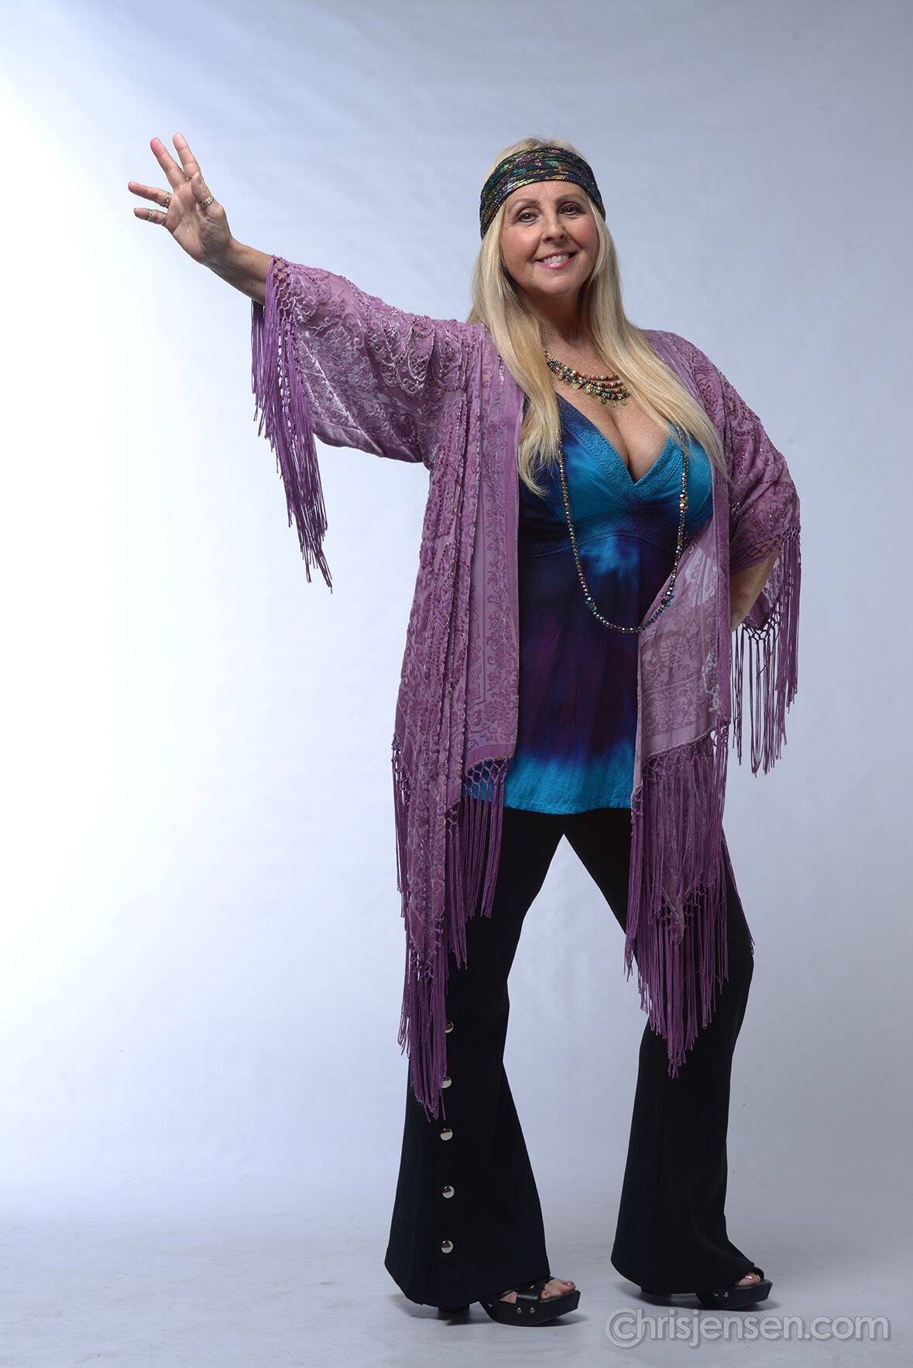
Colette Lovejoy (lead vocals) delivers a song breathing in her own feel, using her pure power-house vocals to wow the crowd. Her list of credits include gigging as a backup singer with many legendary singers, and she has performed at House of Blues locations across the US over a dozen times. She’s shared the stage with Jay Leno, Hootie and The Blowfish, the Go-Gos, David Paich (Toto), Gary Richrath (REO Speedwagon) and many others.
For more info, please email us here or call 805.794.7323

Slide 6
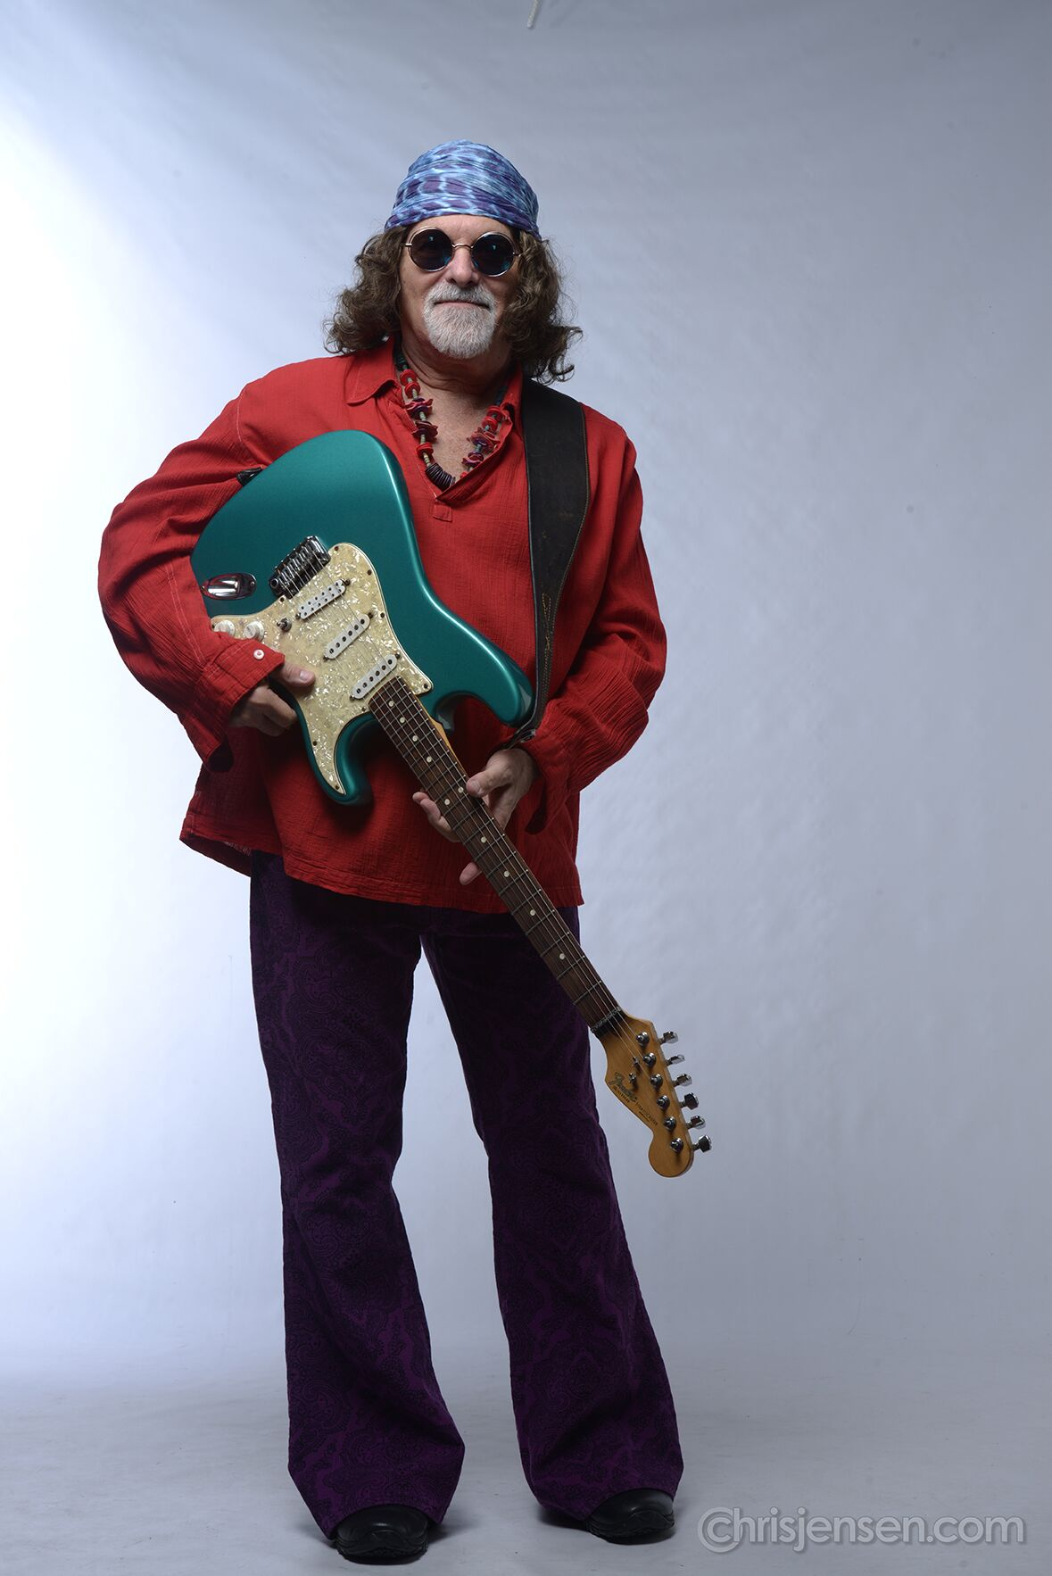
Jerry Breiner (guitar and vocals) is a Midwest native, though he has called California home since 1980 and has been a mainstay of the local Ventura, Los Angeles and Santa Barbara club and concert scenes since. Performing professionally since the age of 9, Jerry is a multi-instrumentalist and he has shared the stage with luminaries such as Al Stewart, Karla Bonoff, David Paich (Toto), Emmylou Harris, Chris Hillman, Jonathan Clark (Dwight Yoakam) and many more.
For more info, please email us here or call 805.794.7323

Slide 7
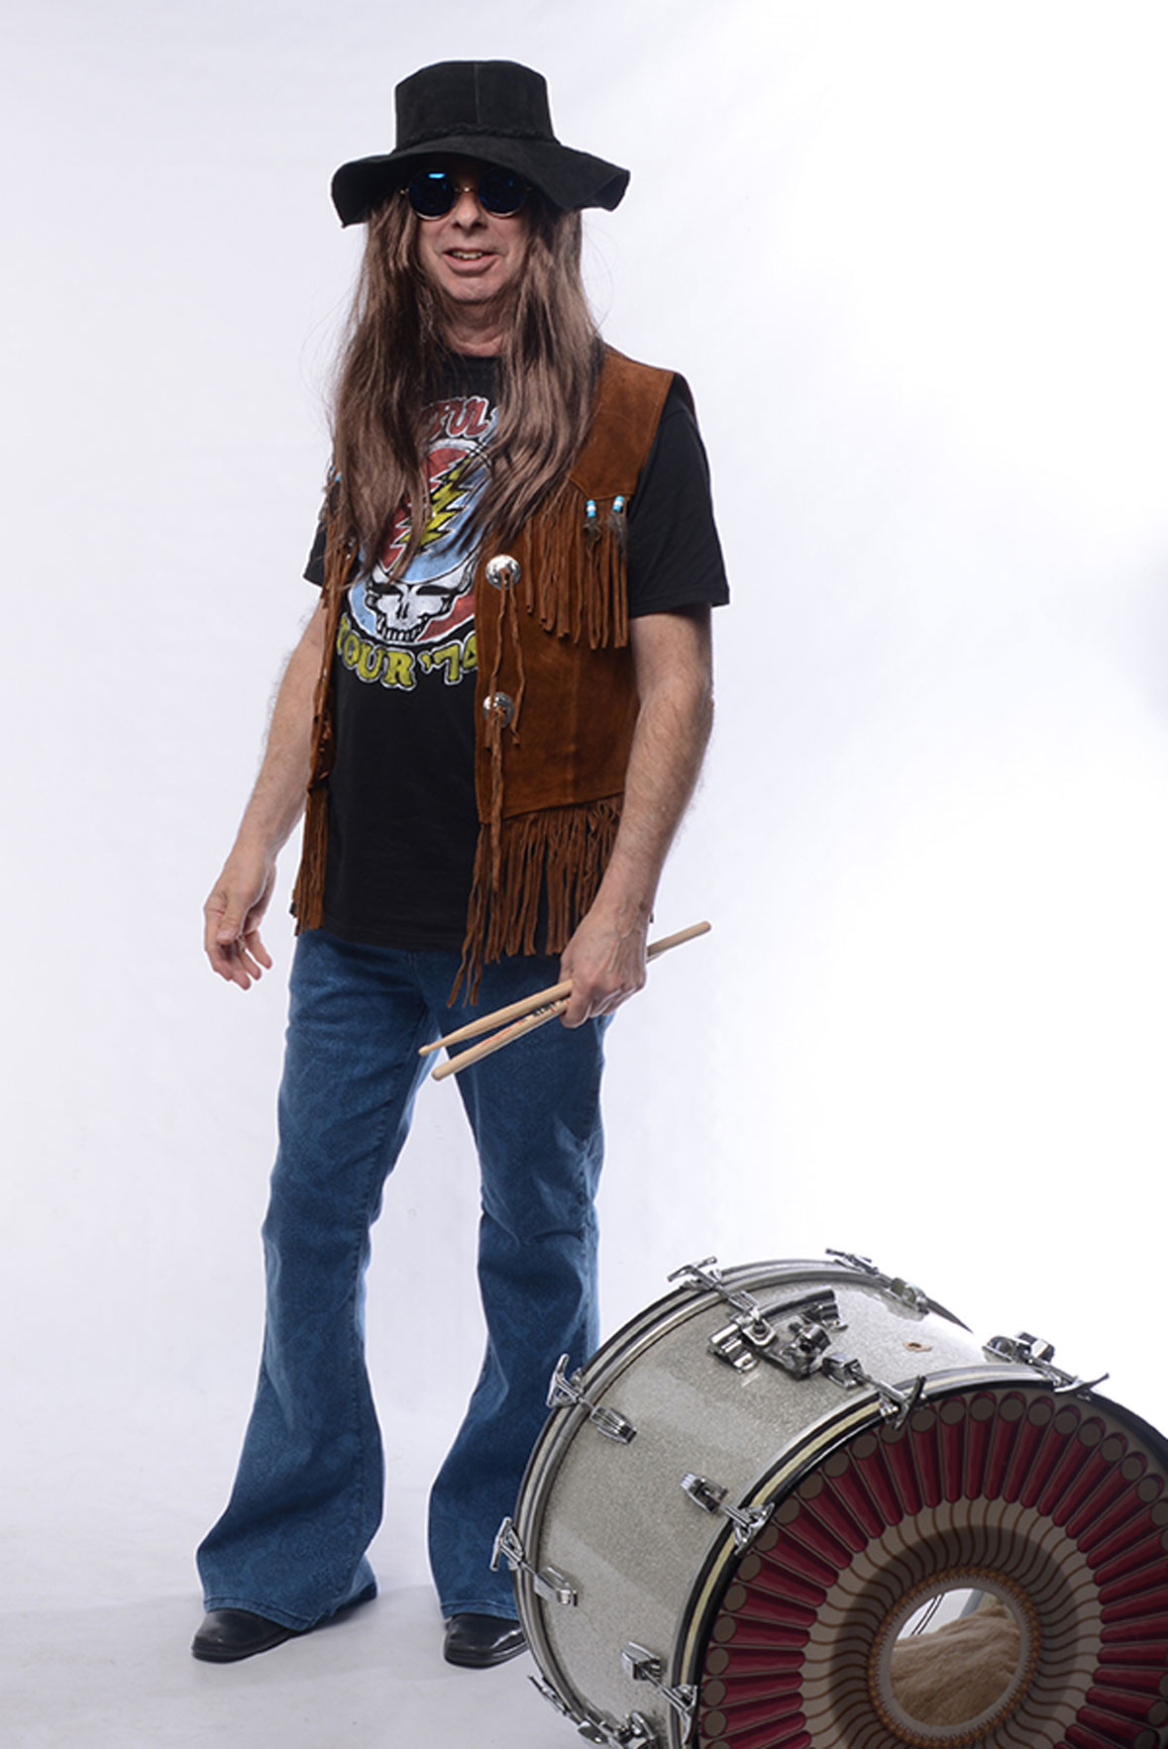
Brian Meegan (drums) is one of our two resident New Yorkers, having moved to California in the mid 80s. After seeing The Beatles on the Ed Sullivan show he got his first Ludwig Drum Set and began playing with local bands. By the age of 15 Brian was playing professionally in rock bands, show bands, teaching privately, and performing in the pit orchestra for musicals. After a short stint in New York City Brian moved to Los Angeles where he began recording demos for singer songwriters, bands, and solo artists.
For more info, please email us here or call 805.794.7323

Slide 8
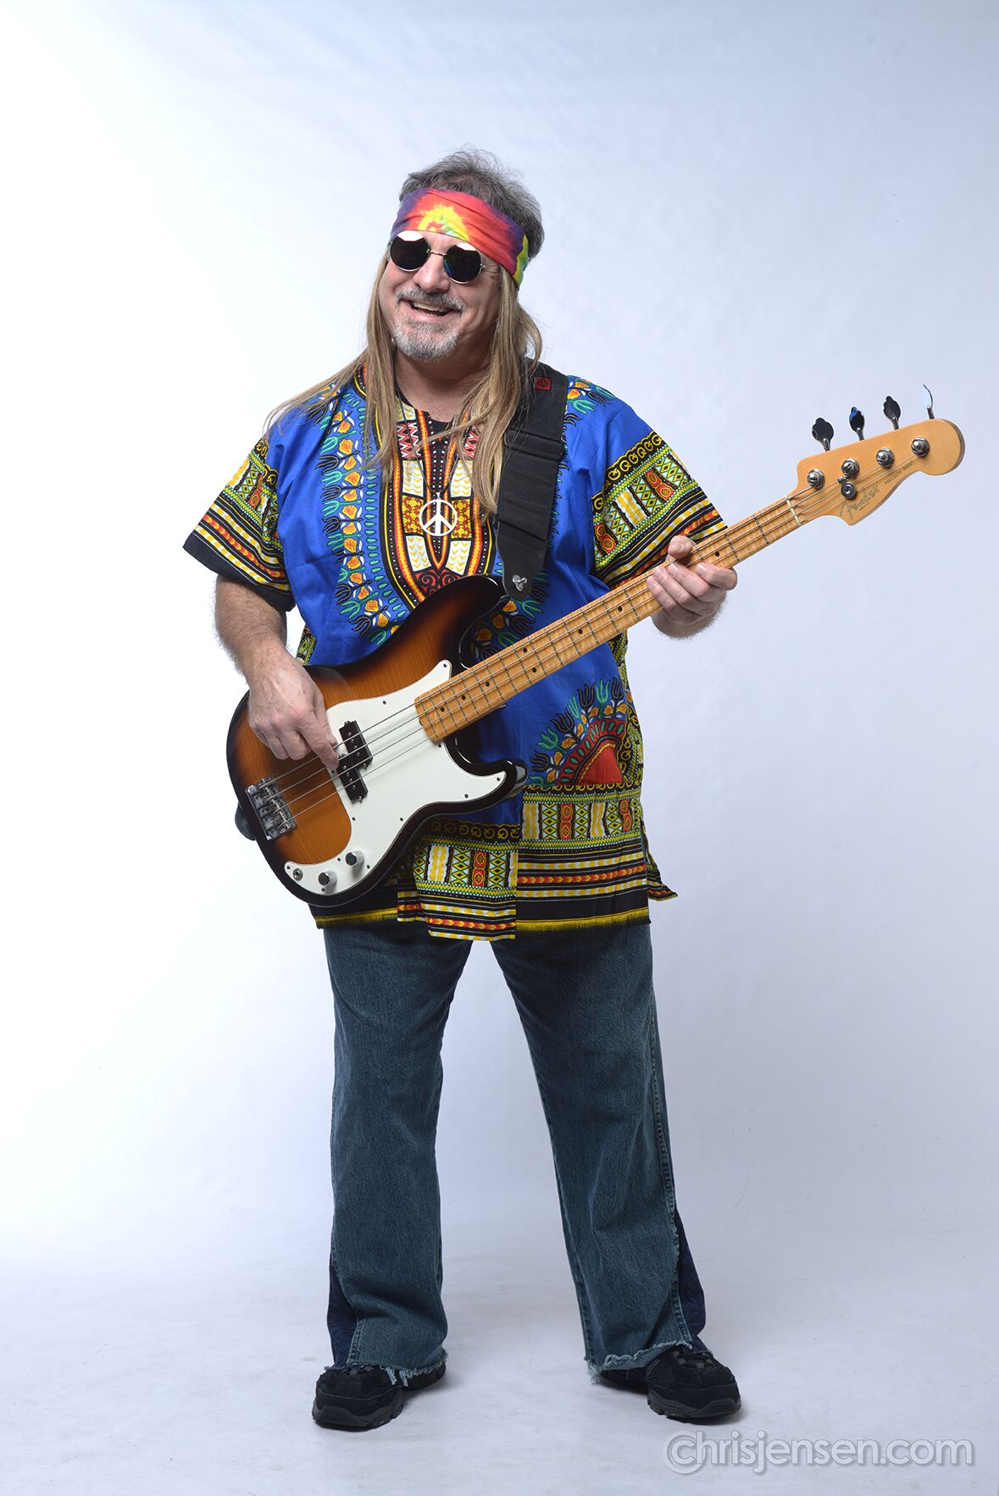
Chris Longo (bass, vocals) In 1976 he received a call to audition as the bass player for Bo Donaldson & The Heywoods, renowned for their 1974 #1 hit record “Billy Don’t Be A Hero” and their follow-up hit “Who Do You Think You Are.” He was selected from among 100 other bass players competing for the position. Chris toured the U.S. performing in concerts and TV shows such as Dick Clark’s New Year’s Rockin Eve with Bachman Turner Overdrive before deciding to return to L.A.
For more info, please email us here or call 805.794.7323

Slide 9
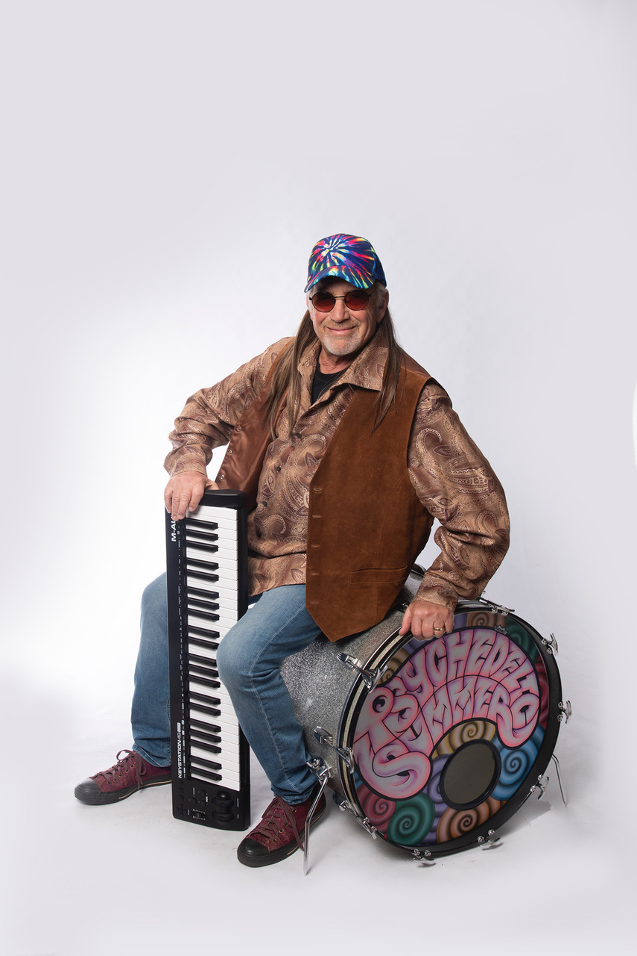
Bobby Orgel (keyboards) grew up around the Long Island, NY music scene. He was classically trained growing up but his heart is centered on improvising in rock ‘n’ roll, blues, and jazz. He graduated from the Berklee College of Music with a degree in arrangement and composition in between touring the world with Natalie Cole, Chubby Checker, Lana Cantrell and performing alongside Chuck Berry, Little Richard, Marvin Gay, Spinners, Tavares, and more.
For more info, please email us here or call 805.794.7323

Slide 10
For booking information, please email us at psychedelicsummerband@gmail.com
or call us at 805.794.7323
We are available nation-wide for your corporate event, big-deal celebration or casino/club purposes.
Professional PA and absolutely positive, professional attitude guaranteed. Rates available upon request.

Slide 11
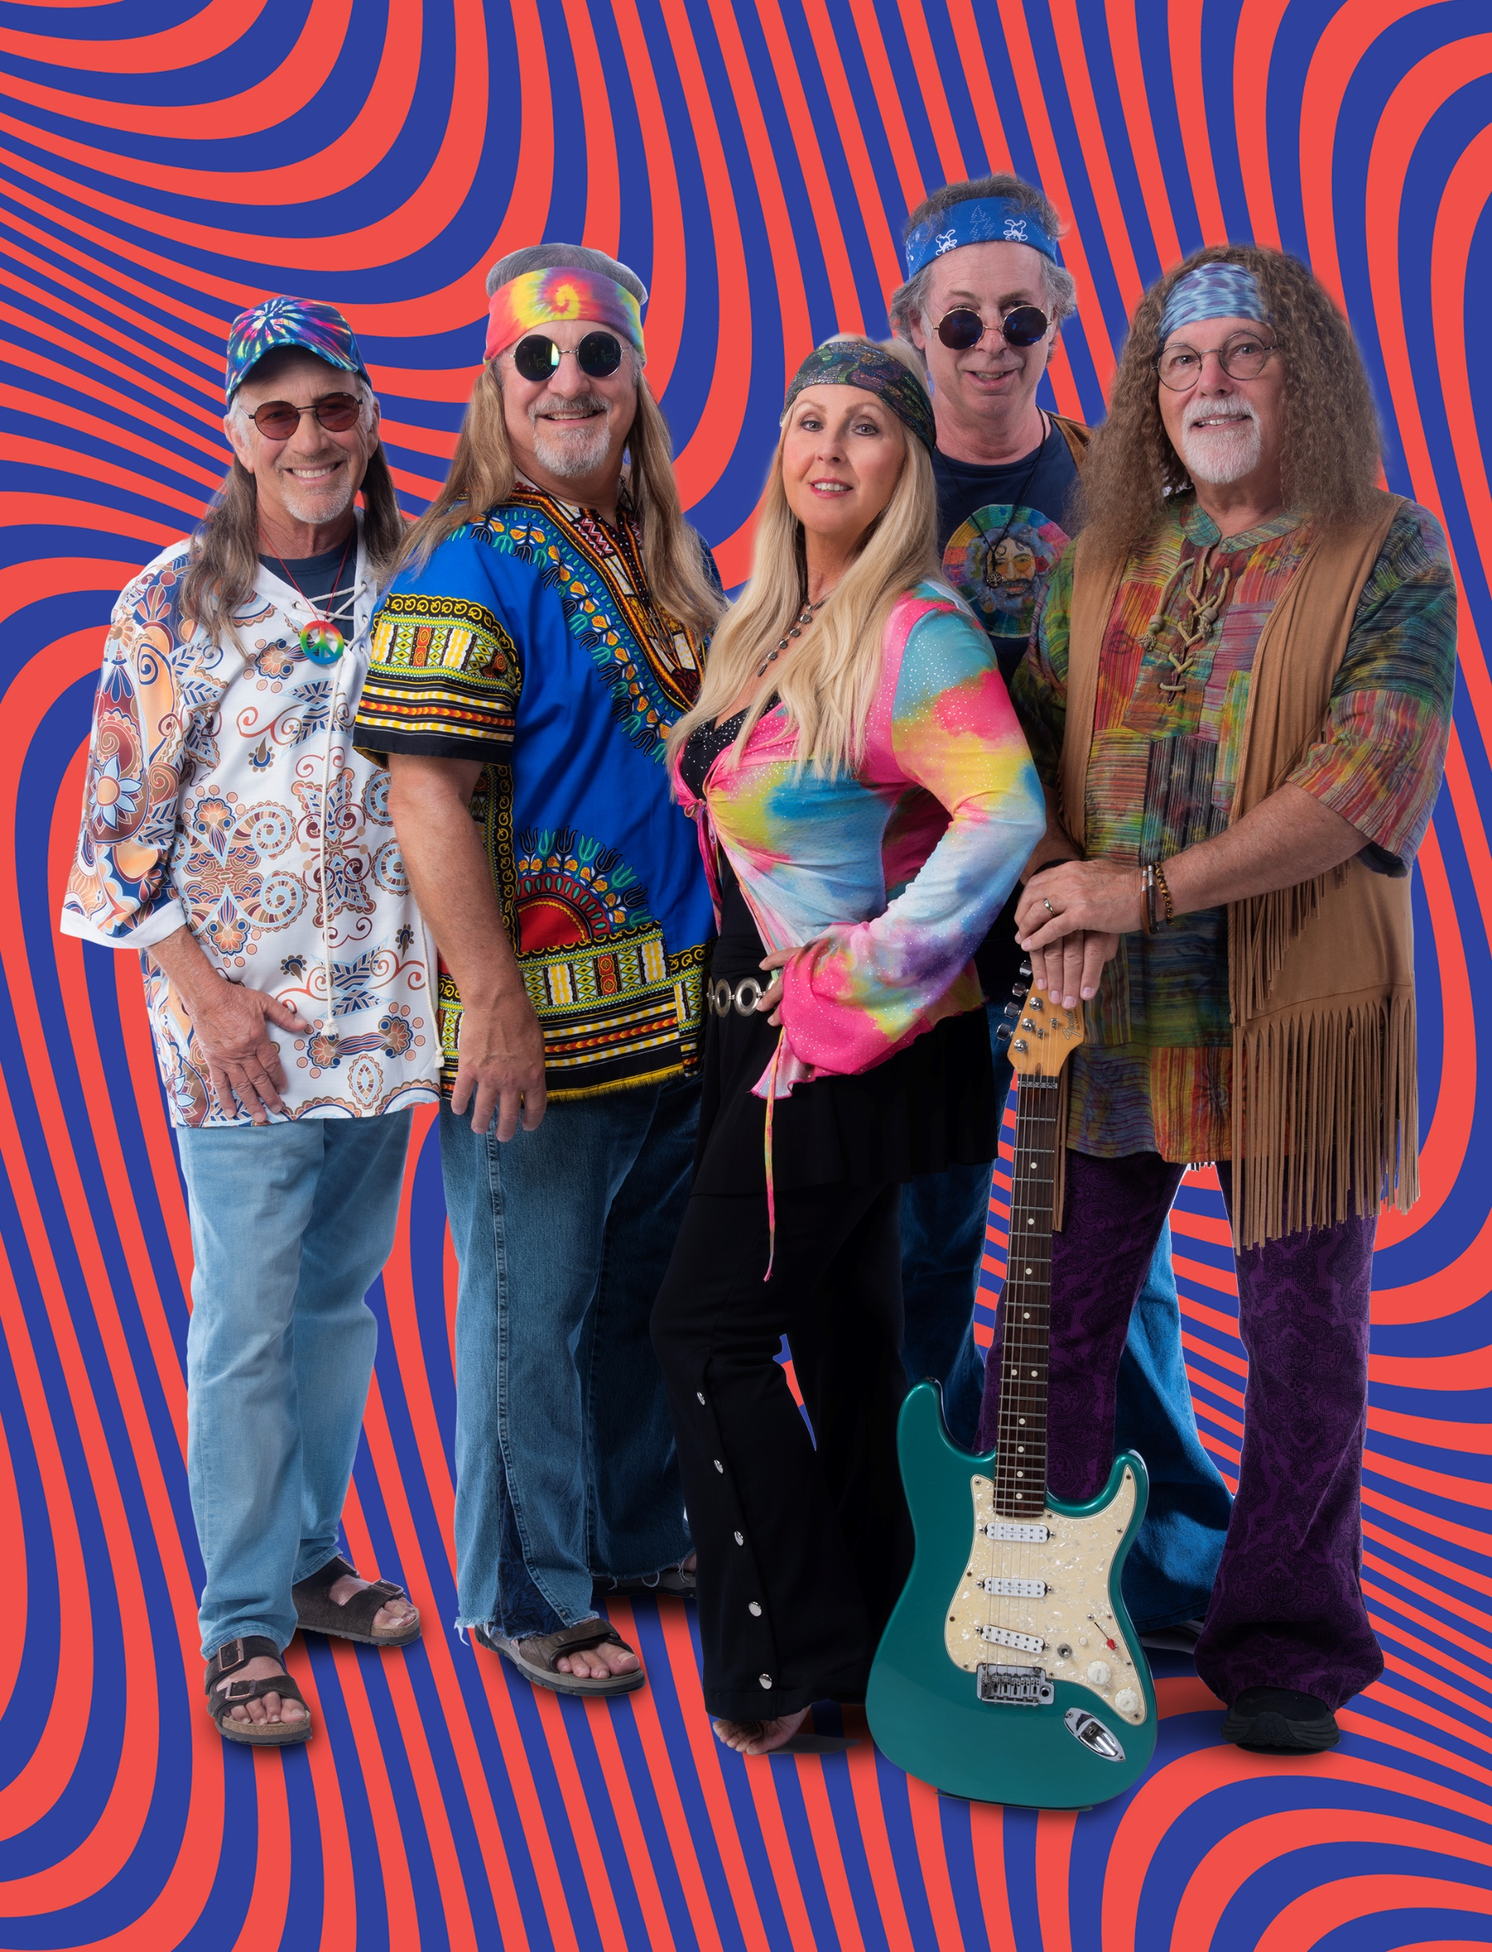

Slide 12
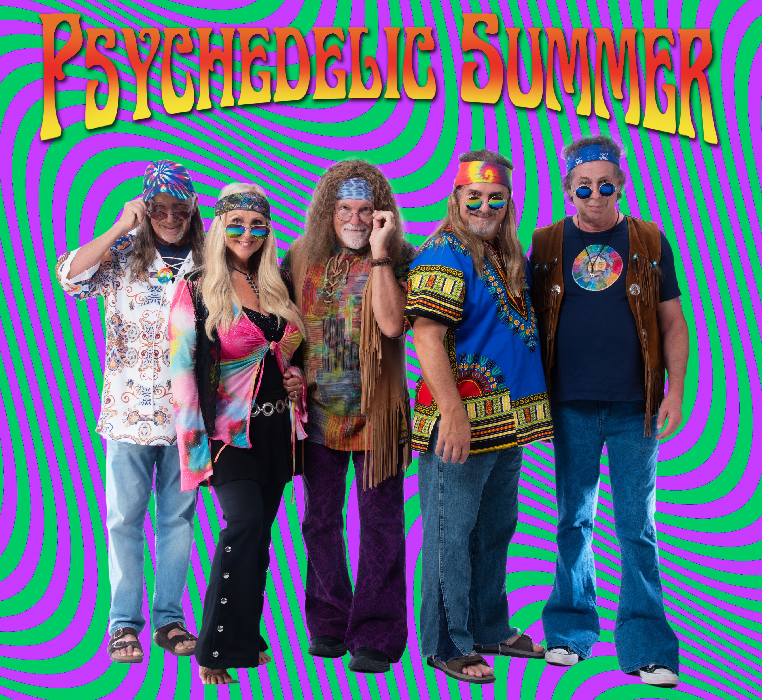
Click here to visit our
Website for more
awesomeness
Call and/ or text us at 805.794.7323 or email us at
psychedelicsummerband@gmail.com

