Slide 1


Reclaim-Defender Technology
Overview
The Science of Sludge Reduction, Odor Control, and Water Purification

Slide 2
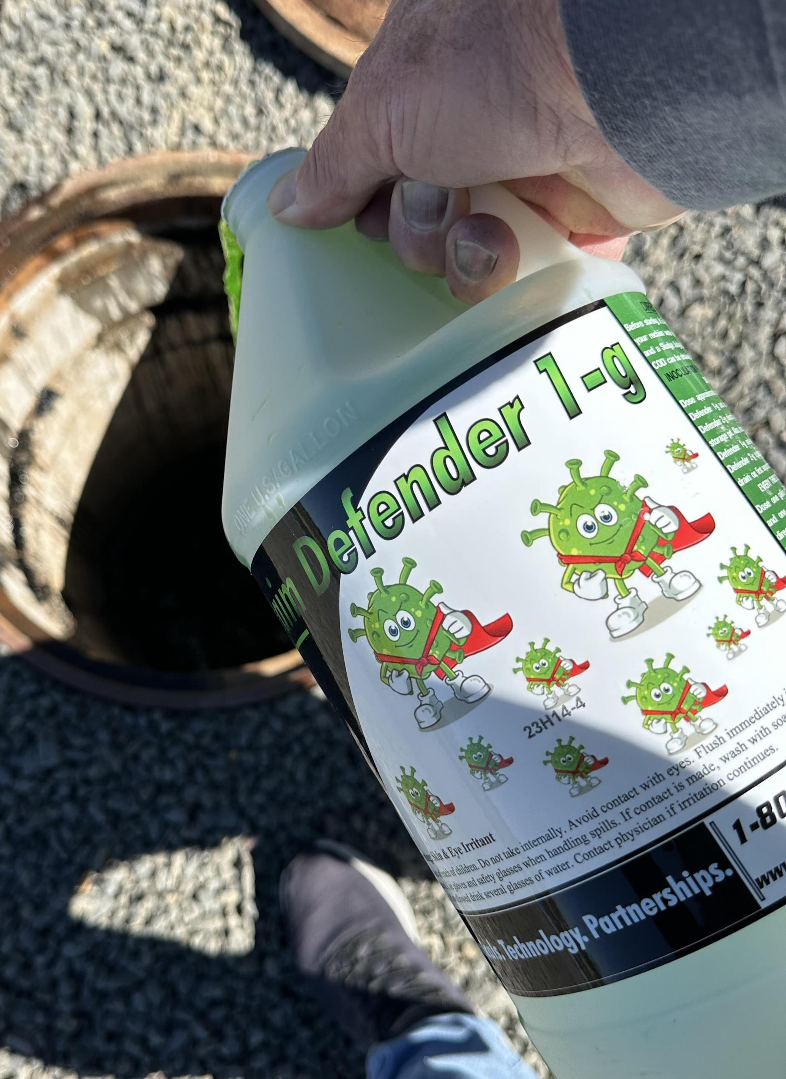
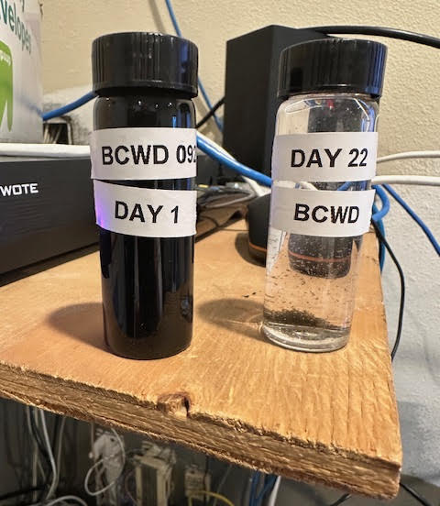

Reclaim Defender
Provides breakthrough, as a environmentally friendly solution for the treatment of recovered wash water stored in separator tanks adding value to this critical water treatment process.
By treating the recovered wash water prior to the reclamation process, recovered wash water is cleaner with significantly reduced pollutants, oils, pollens and car wash chemistry. All of which are not treatable by standard reclaim water treatment plants.
Our products are 100% Natural with No Genetic Engineering of the microbial bacterial blends. Which are used to rapidly break down these and other organic compounds found in recovered wash water.
Representing a cost-effective breakthrough in management of your reclaim water.
Separator Water Not Treated with Reclaim Defender
Separator Water Treated With Reclaim Defender

Slide 3

Reclaim Defender Water Purification Technology
Into
this
Reclaim Water Separator Tank Water treated by Anaerobic and Aerobic Bacteria for Improved Turbidity
Turn This
Quality of Reclaim Water from Standard Reclaim Water Processor
Benefits:
Removes all Malodor Naturally
Does Not Require Capital Investment
Restore Septic Water to “Living Water”
Lower Operating Costs
Lower Labor Costs from
  Fewer Equipment Breakdowns
  Cleaner Car Wash Bay Operations

Slide 4
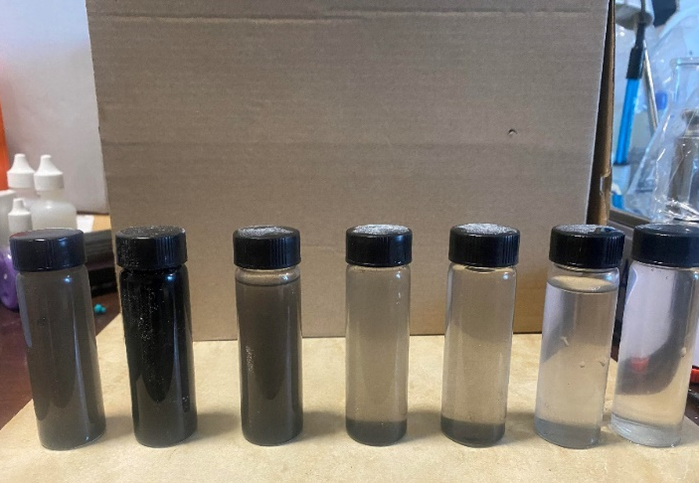
Top Benefits Behind Reclaim Defender
Unique Bacteria Blend - Arcadian's Reclaim-Defender Series is composed of unique bacterial blend’s designed to modify the metabolic traits of anaerobic bacteria that thrive in oxygen-depleted car wash water.
Sludge Accumulation - Over time, a buildup of oils, debris, and dead microbes results in nutrient-rich, black sludge—perfect for fostering bacterial colonies.
H2S Gas Production - In this zero-oxygen environment, bacteria expire anaerobically, creating Hydrogen Sulfide (H2S) gas which gives off an unpleasant odor and poses potential risks to humans and equipment.
Optimized Solution - Reclaim-Defender Series is an industry-specific product, Designed to remove sludge buildup, inhibiting H2S-producing bacteria, and significantly improving reclaimed water clarity by reducing organic compounds.
Day 1
Day 12
Day 16
Day 60

Slide 5
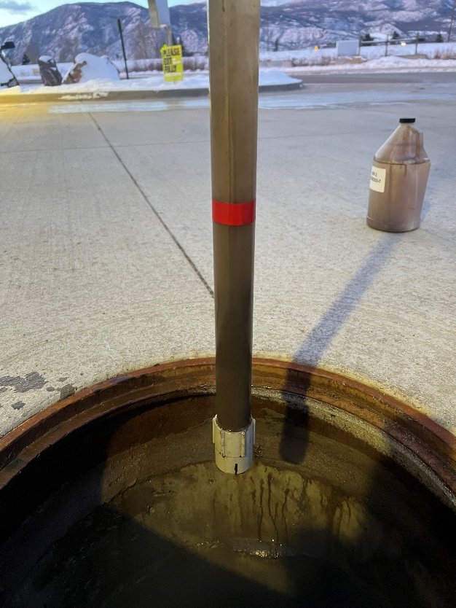
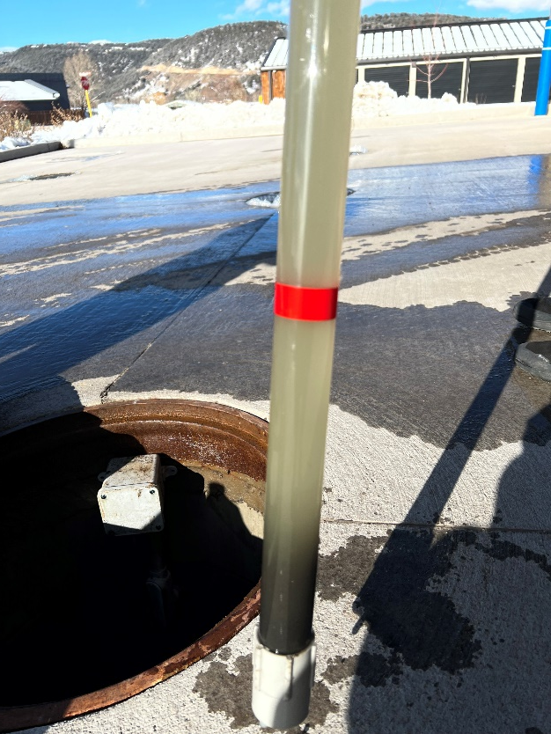

Overview
Arcadian Services Reclaim-Defender Series Technology Use of both Gram-Positive & Gram-Negative Bacteria to clean and purify recovered wash water. Eliminates the need for sterilization or deodorizers.
Controls Odors and Eliminates H2S Gas Effectively removes the sludge that anaerobic bacteria need to live in. Removing both the cost of sludge removal and the ability for bacteria to exacerbate Hydrogen Sulfide Gas (H2S).
Purifies Water and Removes Pollutants Effectively reduces both TDS and TSS, resulting in greatly improved Turbidity (Water Clarity), reduces Chemistry Oxygen Demand and Lower Nitrite Levels.
Day 1
Day 16
Less Smell, Cleaner and Reduced Costs

Slide 6
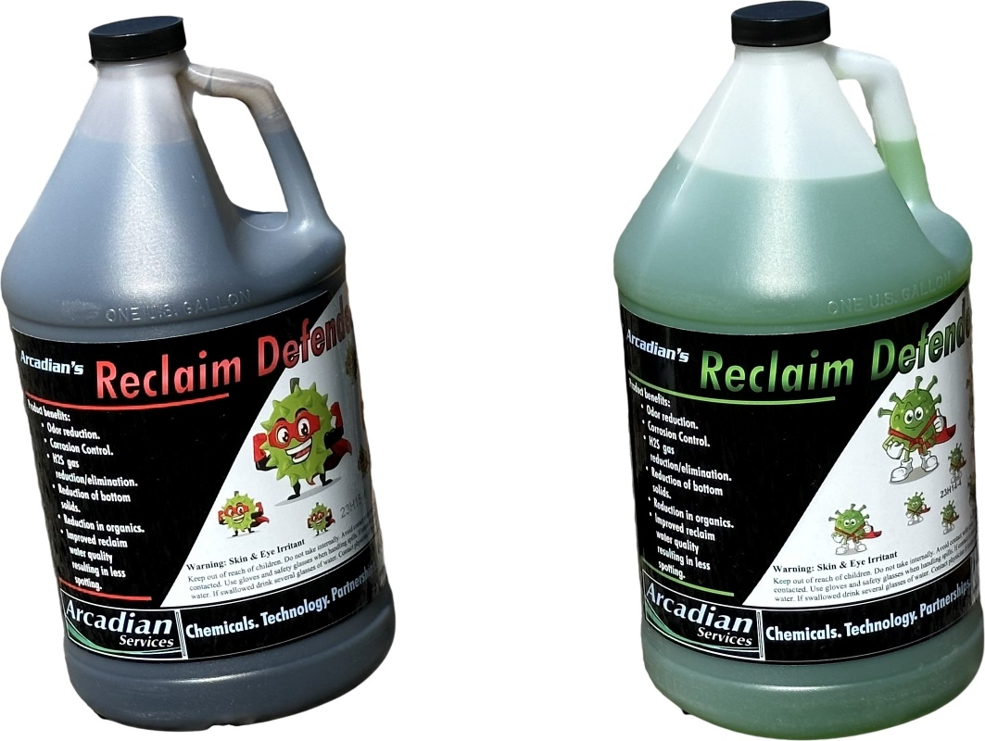


Two - Step Process Overview
Step One : Inoculation
1
Reclaim Defender 1G – Aerobic Bacteria Remediation and Odor Control Bacteria is introduced into separating tanks. Initiating sludge density reduction and blocking of H2S gas emissions.
Reclaim Defender 2G – Anerobic Bacteria consumes organic compounds and Car Wash Chemistry. Provides reduced TDS, Reduced Organic Aerobic Materials, Improved Chemical Oxygen Demand (COD) and Greatly Improved Water Turbidity, setting the environment for Step Two.
Step Two: Sustainability
2
Reclaim Defender 1F - Biological catalyst work to sustain Improved Water Turbidity & Odor Control.
Reclaim Defender 2F – Sludge catalyst Controls Sludge Production, Supports Water Turbidity. Consumes all Organic Pollen and Breakdown’s Car Wash Chemistry.
Expanded Use -Combined with RO Reject Water, Municipality water and sewer usage is Reduced Dramatically.
A Simple Two Step Process for Amazing Results
How it Works

Slide 7




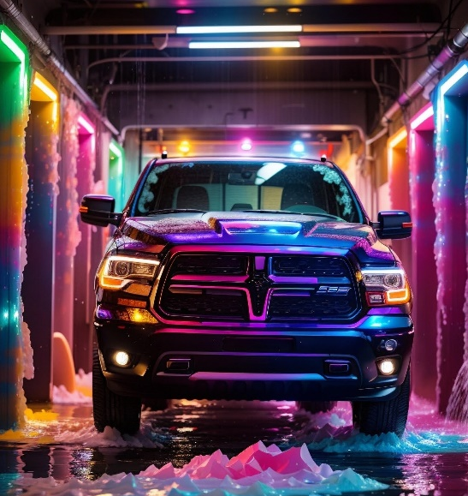
Reclaim Defender Video

Slide 8
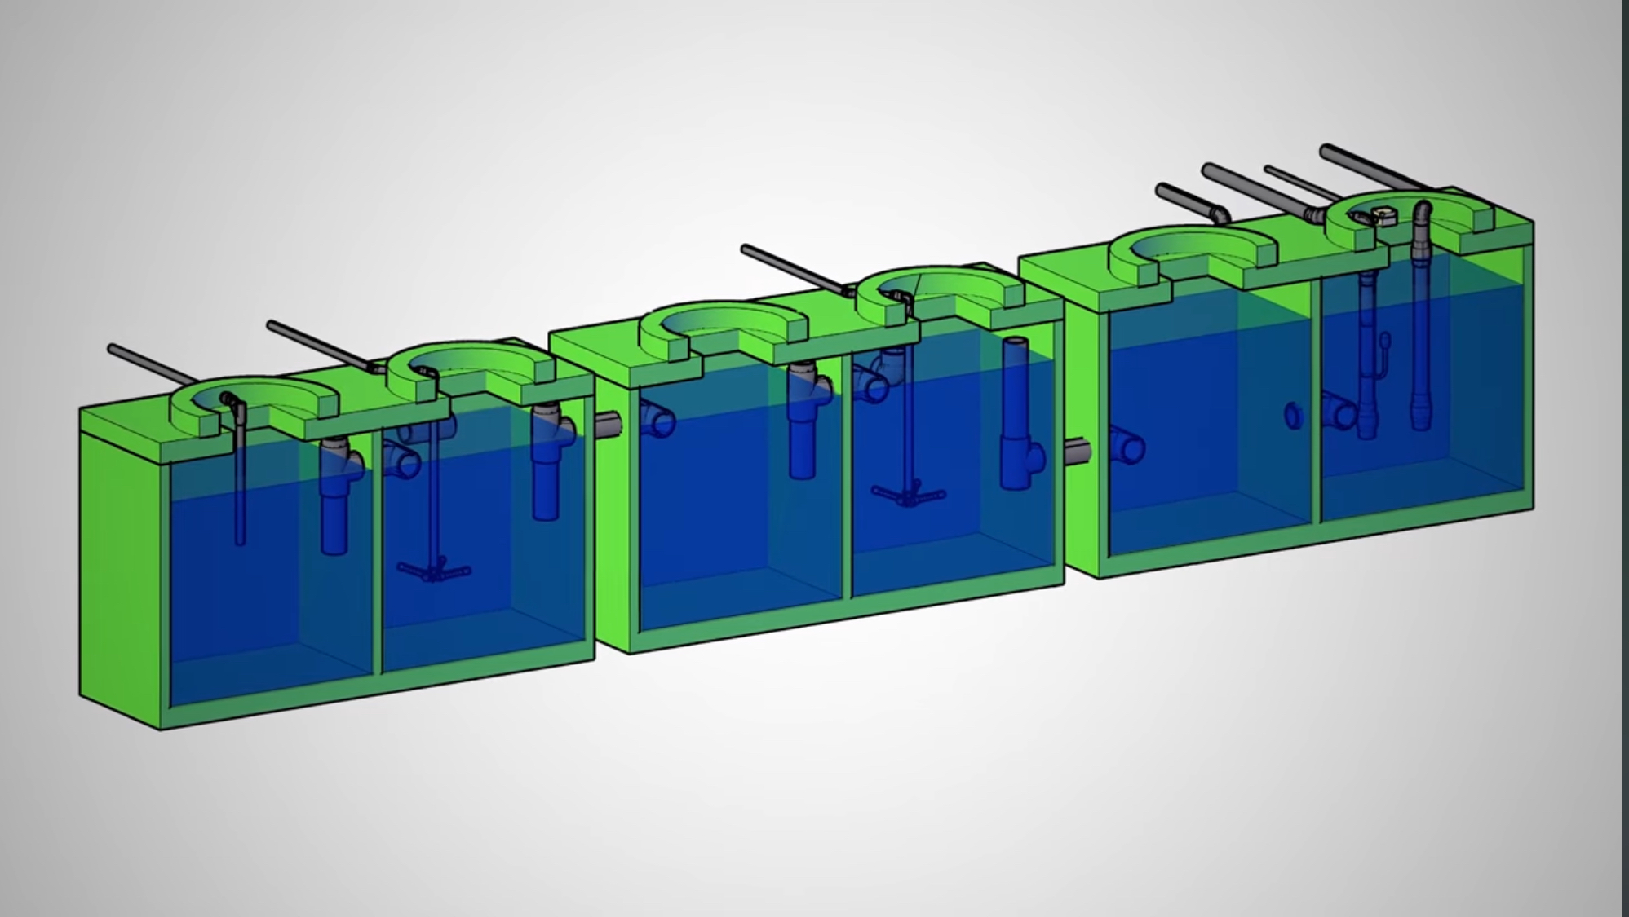
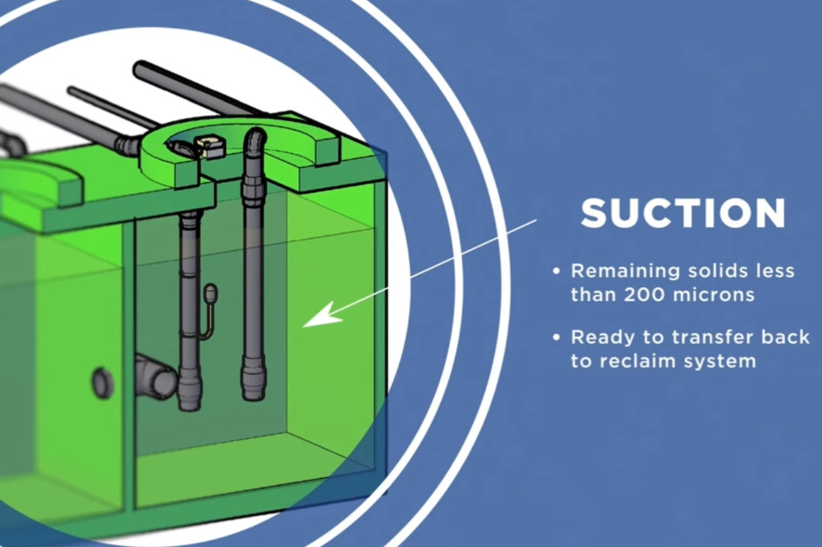
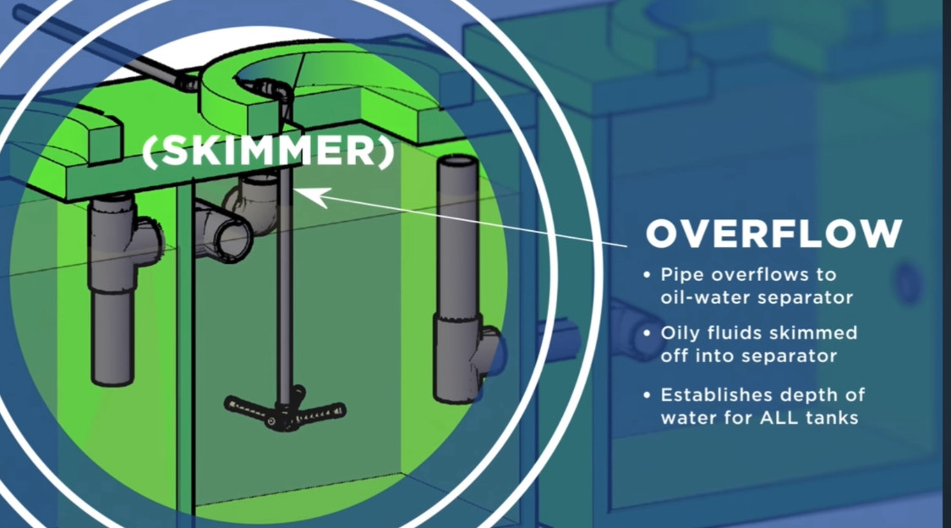
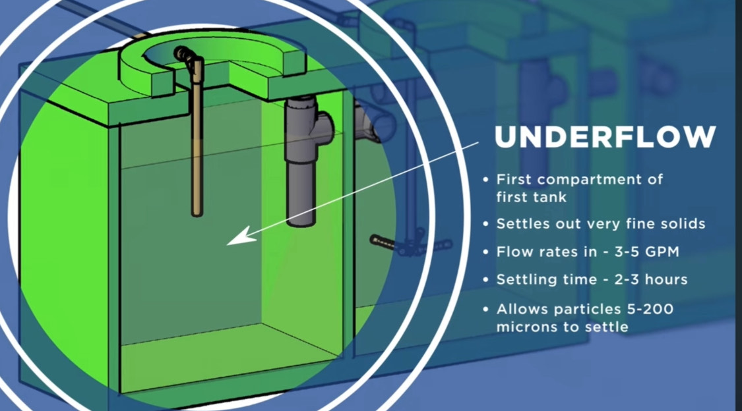
How Car Wash Separator Tanks work And Why Arcadians Microbiology aids in water separation / water clarity.
Uplift or Return Line Tank
Final Settling Tank Biological Colony Tank for Inoculation Phase
2nd Aeriation Tank
First Bio Tank – aeration feeds biologicals to help with growth
Use Old Ozone Line for Sustainability process
Underflow Tank
OVERFLOW TANK
Aeriation Tank
1ST Settling Tank
2nd Settling Tank
Primary Biological injection Tank
Tank 3a
Tank 3b
Tank 1b
Tank 2a
Tank 2b
MUD, Trash, Organic material
MUD, Trash, Organic material
MUD, Trash, Organic material

Slide 9
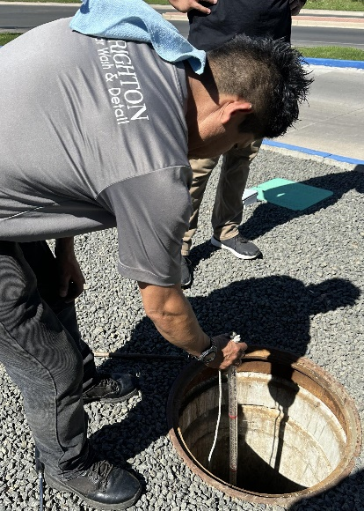
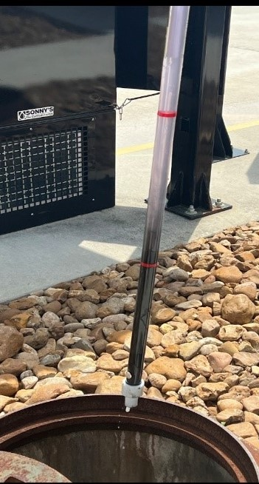
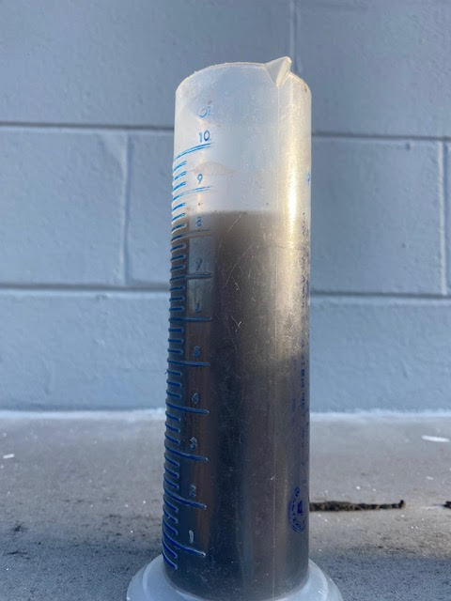

How we Do
IT
Inoculation
ChemSpider
Insert Probe into manhole, until it will not easily slide thru the sludge and mud. Do Not Force!
Step 1: Determine Sludge Levels of each separator tank and water clarity
  1a -Using a Sludge Judge - remove a sample of each of the separator tanks water and sludge. Take photos of each tank and label them for reference.
  1b -Ensure Sludge Judge Probe: is inserted to the bottom of the tank, if possible, Do Not Force it into the sludge and dirt. Take a small water sample as close to the top of the black sludge as possible.
  1c Place water sample in plastic or glass container: This sample will be tested for pH level, Turbidity and Nitrite.
Step 2: Determine Best Separator Tank to add Reclaim Defender Biologicals to the tank that has between 10 to 36” of sludge.
  2a – Examine the Sludge Judge Probe photos, select a separator tank that has between 10 to 36 inches of sludge in the probe. Its important to allow the bacteria blends time to build colonies in the sludge.
Water Sample Here-->>
Step 1- Inoculation

Slide 10
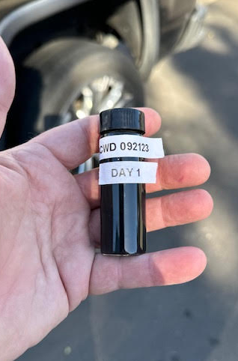
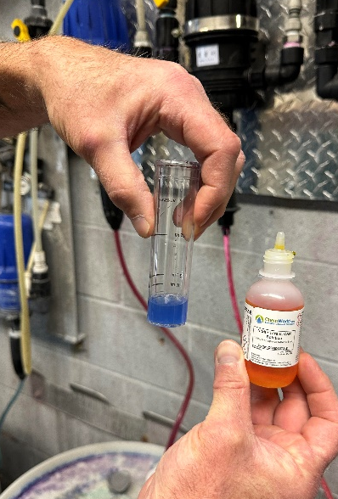
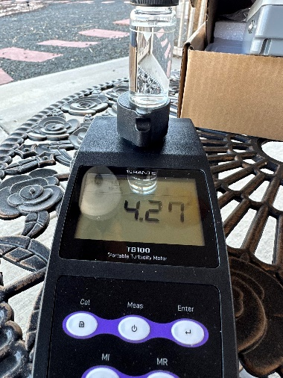
Phase One Inoculation
Step 3: Using your pH meter test the water to determine the pH of the reclaim water. BEFORE INOCULATION CAN BEGIN WATER MUST BE IN THE RANGE OF 6.8 and 8.5 pH, USE of high levels of Ozone or Chlorine must be suspended prior to the start of Inoculation.
Step 4 - Open two of the provided 3-ounce sample bottles and dip them into the collected sludge and water sample from Step 2, fill vials . Using a label maker or permanent ink marker place the date, pH value, Nitrite Level and NTU value on each test vial. Retain Vials for reference or shipping to AS lab for further analysis.
4a – pH Meter – Ensure meter is calibrated and rinsed in clean water before use. Insert prob into water sample and record reading. The ideal reading is between 6.8 pH and 8.5 pH. Please contact AS Technical Services for assistance if pH is under 6.8 or over 8.5.
4b – Perform Nitrite test on water sample - Nitrite levels will range greatly. Its important to record the level at the beginning of the process and several times during the inoculation process. Reading will Range from 110 to 600 NaNo2. Please follow instructions on Nitrite Test Kit. Goal is to obtain readings below 100 NO2
4c – Tubridy Test – This is a test on the clarity of the reclaim water and absorbed dissolved solids. If water is black and murky this test will not be accurate. Water celerity will continue to improve. The goal is to obtain a Turbidity between 20 to 110 NTU.
Step 5 – Using a TDS Meter record Total Dissolved Solids.
Step 1- Inoculation

Slide 11
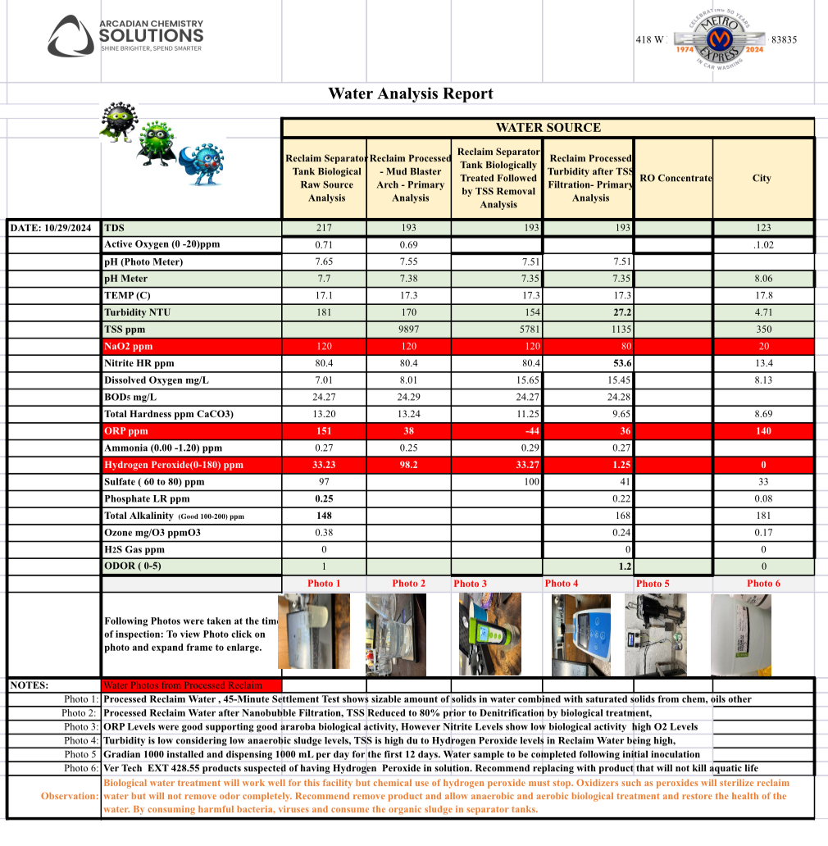
The Importance of Measurements
Throughout the process its important to take regular water chemistry measurements.
Water chemistry may shift from time to time
Balanced Wash chemistry supports healthy Recovered Wash Water

Slide 12
Start Inoculation
Step 6: Open 2-Gallons Each: Reclaim Defender 1G & 2G and pour all 4-gallons into the chosen separation tank. Dispose of empty containers and close manhole cover.
Step 7: Starting on the 4th day following the initial inoculation pour 1-gallon each of the Reclaim Defender 1G &2G. Repeat every 4 days until all 1-Gallon containers have been used.
Step 8: On Day 16 Repeat Steps 1 thru 4 – Water will be significantly clearer and sludge at the bottom of the tank will be reduced.
While water clarity will be showing significantly improved signs of clarity. If Odor or water clarity is still murky, Contact Technical Services for support.
NOTE: In some systems where, bacterial growth is above average an additional 16-Day inoculation Phase may be necessary before water COD and BOD content has been completely treated.

Slide 13
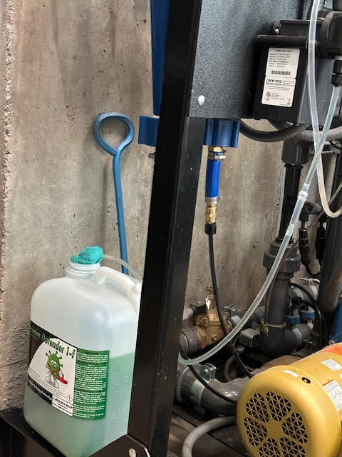
Start Sustainment
Step 1: Open a five Gallon Container of Reclaim Defender 1F and connect to an Injection Pump. Set Injection to start at 70 ml (2.5 ounces) per day.
Perform Nitrite Test , reading should be the same as day 16 or lower. If reading is higher, Increase dose of 1F to 100 mls per day and retest after 48 hours.
NOTE: Its important to monitor the system for Odor build Up or Nitrite build Up. If these issues are detected or measured it is possible additional inoculation products may be necessary.
In the event of a bio-plume following a heavy rain, excessive heat or other conditions that stimulate growth of bacteria. Add 2 pounds of Reclaim Defender 2-pounds of ALLn1 to your conveyor or reclaim return line to block the metabolic unwanted bacteria to prevent the release of sulfur H2S Gas.
Contact Technical Services for additional information.

Slide 14
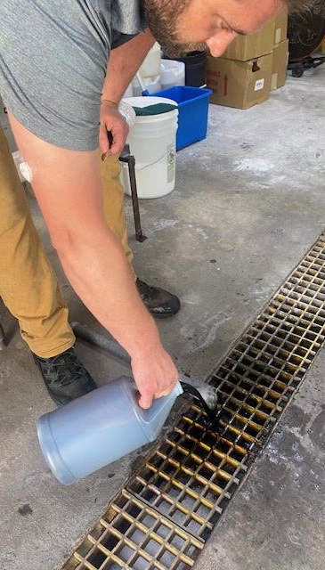

Boosting Catalyst
Use Reclaim Defender 1G and 2G to Boost the Biologics after the mud pits have been cleaned or during peak usage.
In the event of seasonal changes (Snow, Rain, Hot Weather) it is advisable that you add 1-gallon of Reclaim Defender ALLn1 to introduce a metabolic inhibitor to prevent sulfate reduction (stop rotten egg smell).

Slide 15


Reclaim Defender
For Further Information On Reclaim Defender Please Contact
  David Buzzard – Technical Services Manager:
    Cell – 938-832-2299
    Office 256-766-7734 ext 226
    Email – David@arcadianservices.com
  Michael Gordon – Director of National Accounts:
    Cell – 720-234-2462
    Office – 256-766-7734 ext. 237
    Email – mike@arcadianservicesco.com
Day 1
Day 60

Slide 16
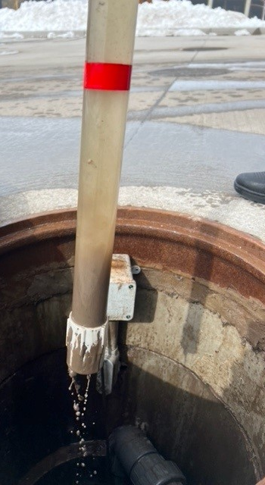
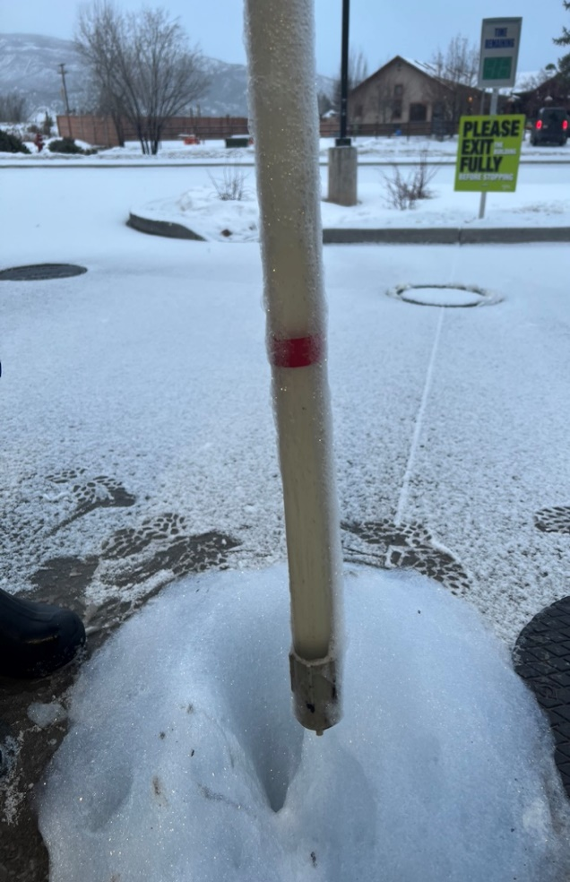
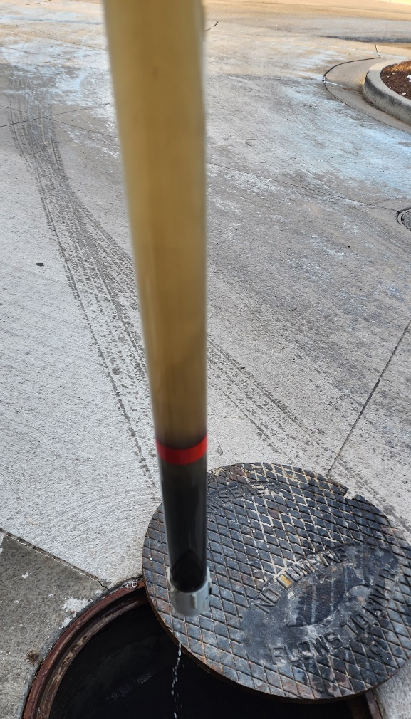
Measured Results:
Day 1 Photo:
13 inches of Sludge measured, COD level HIGH water is murky Brown, H2S gasses heavy throughout car wash.
Day 25 Photo:
5 inches of Sludge measured, COD levels Moderate, H2S Gases light to non existing
Day 36 Photo:
No Measurable Sludge Observed, Water is cloudy but NO visible particulates, H2S Gases continue to be absent in Car Wash bay or equipment room
Color of separated water has gone from a dark black to grayish green indicating a reduction in organic material in water Collum.
SITE ONE - IBA Operator
Location: el Jebel, Colorado.
Car Count: 240 vpd
Equipment: Petit 360I (2-Bay Automatic)
Reclaim Water Processor: SoBrite
Day 1 Sample
Day 25 Sample
Day 36 Sample

Slide 17
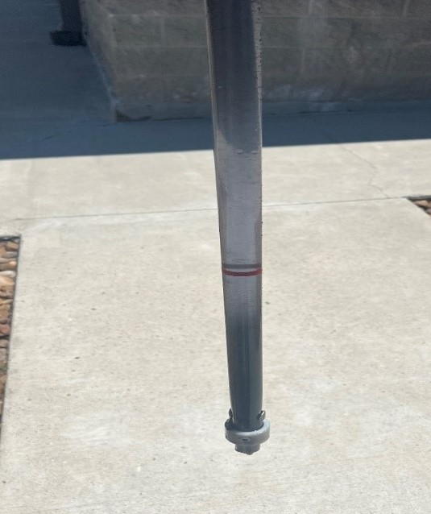
Site TWO - Tunnel Operator
Location: Houston, Texas
Car Count: 600 vpd
Equipment: Sony’s 125’ Tunnel
Reclaim System: Velocity
Measured Results:
Day 1 Photo:
15 inches of Sludge measured, COD level 550 VERY HIGH, water is murky Brown, H2S Gasses very heavy throughout car wash.
Day 36 Photo:
No Measurable Sludge Observed, Water is cloudy but NO visible particulates, H2S Gases continue to be absent in Car Wash bay. H2S Gasses are present in equipment room During Startup. Cause was found to be deadhead Reclaim Plumbing. Trapped Reclaim Water not treated.
Color of separated water has gone from a dark black to Light grayish green indicating excellent reduction organic material in water column.
Day 1 Sample
Day 36 Sample

Slide 18
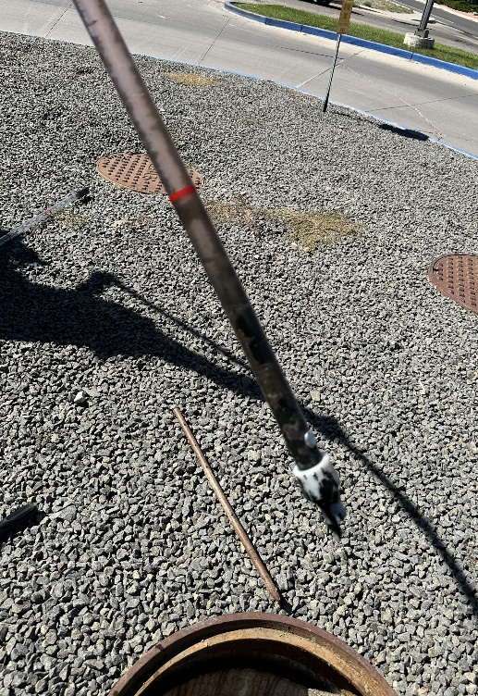

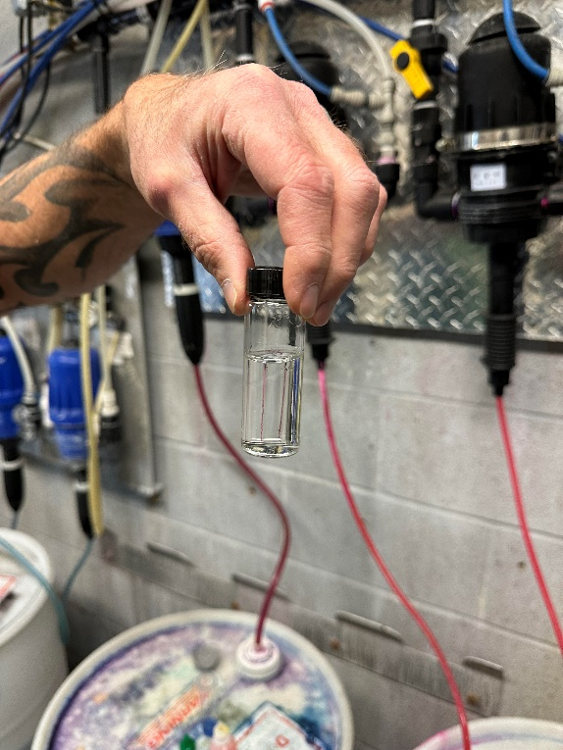
SITE THREE - Tunnel Operator
Location: Brighton, Colorado
Car Count: 500 vpd
Equipment: AVW/Peco 100’ Tunnel
Reclaim System: Con-Serv Reclaim System
Measured Results:
Day 1 Photo:
14 inches of sludge measured, COD level 435 VERY HIGH, water is black to murky Brown, light H2S gasses present throughout car wash.
Day 22 Photo:
3 inches of sludge measured, Water is clear into high pressure holding tank, H2S gases absent in wash bay. H2S gasses are present in equipment room during startup but dissipate after high pressure tank is cycled.
Day 71 Photo:
Turbidity Meter and Nitrite Test confirm low chemistry oxygen demand. Reclaim Water is now ready for expanded use.
Day 71 Sample
As new wash owners we are excited to work with Arcadian Chemistry Solutions.
Chris Dawkins – Owner
Brighton Car Wash and Detail

