Slide 1
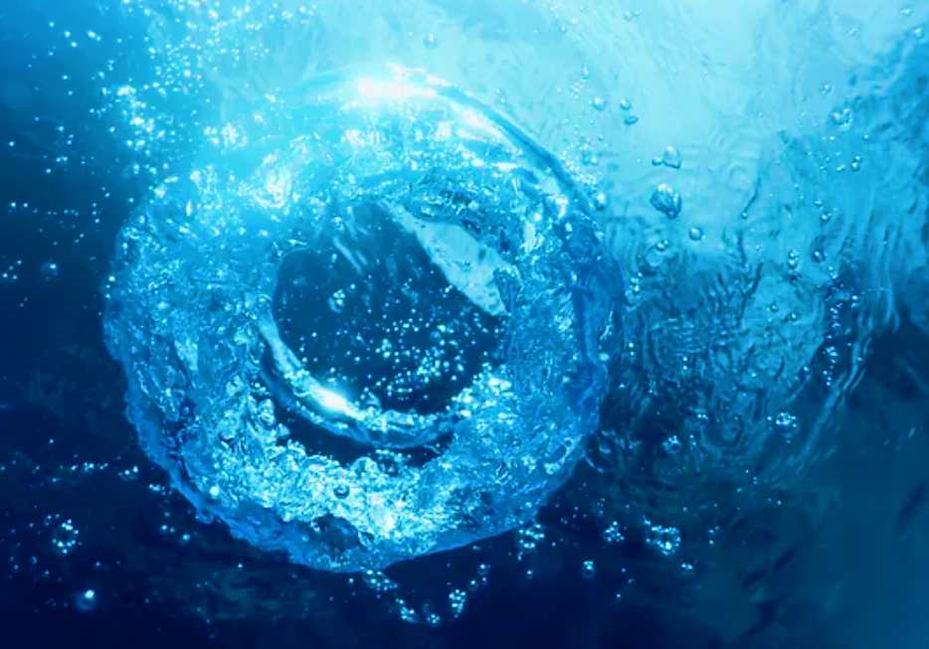
Eco-Wash Solutions
Restore Cleanliness, Refresh Your Wash

Slide 2

Transforming Reclamation Systems
Harnessing Microbiology and Gas Transfer

Slide 3
  Microorganisms plays a crucial role in the biochemical processes in all ecosystems.
  Used in wastewater treatment they cause organic pollutants to degrade.
  Microbes restore and maintain ecological balance, fostering healthier environments and promoting biodiversity.
  Nanobubbles improve gas transfer in physics and fluid dynamics.
  They optimize liquid-gas interactions, revolutionizing efficiency in water treatment processes.
  Nanobubbles deliver oxygen and create dispersion used to remove and clean water with no mechanical filtration.

Slide 4

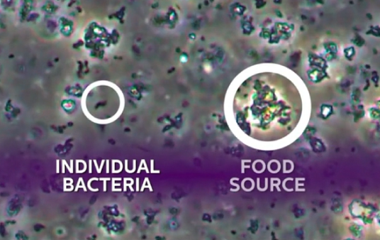
Microbial Action Mechanisms
Microorganisms - decompose organic matter, recycling nutrients back into ecosystems.
Aerobic Microbes - thrive in oxygen-rich environments, producing CO₂ and water.
Anaerobic Microbes - work in low-oxygen settings, generating noxious gases and by-products.
Enzymes - help microorganisms digest complex molecules for energy and nutrients.

Slide 5
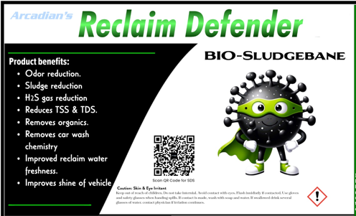
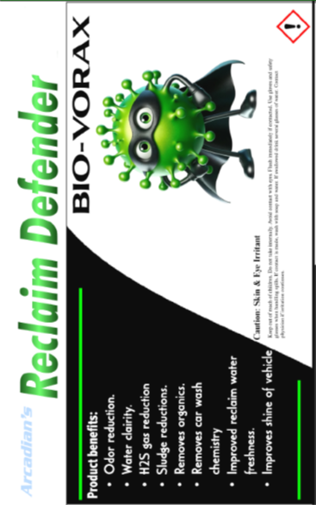

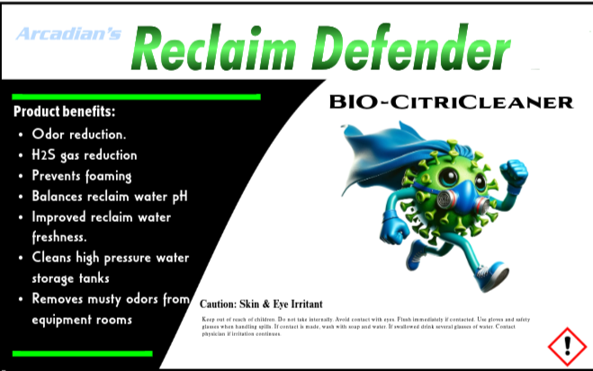
Microbiology and Car Wash Reclaim Water
Key Benefits
Improve Water Turbidity by 86%
  Consumes surfactants, oils and greases, resulting in noticeably cleaner water.
Reduce Dissolved Solids by 16%
  Reduces surface tension in water, allows heavier particles to settle out of water
Reduce Saturated Solids by 48%
  Microbes consume organic particles that inhibit settling, allowing solids to separate more efficiently
Reduce Organic Sludge by 87%
  Removes Volatile Organic Compounds (VOCs) emitted from detergents, cleaning agents, and other chemicals
Reduces Chemical Odors by 92%
  Methane (CH₄), Hydrogen Sulfide (H₂S), Carbon Dioxide (CO₂) & Ammonia (NH₃)
Reduces Biofouling in Equipment by 75%
  Reduces biofilm and scale buildup in pipes, pumps, and nozzles

Slide 7
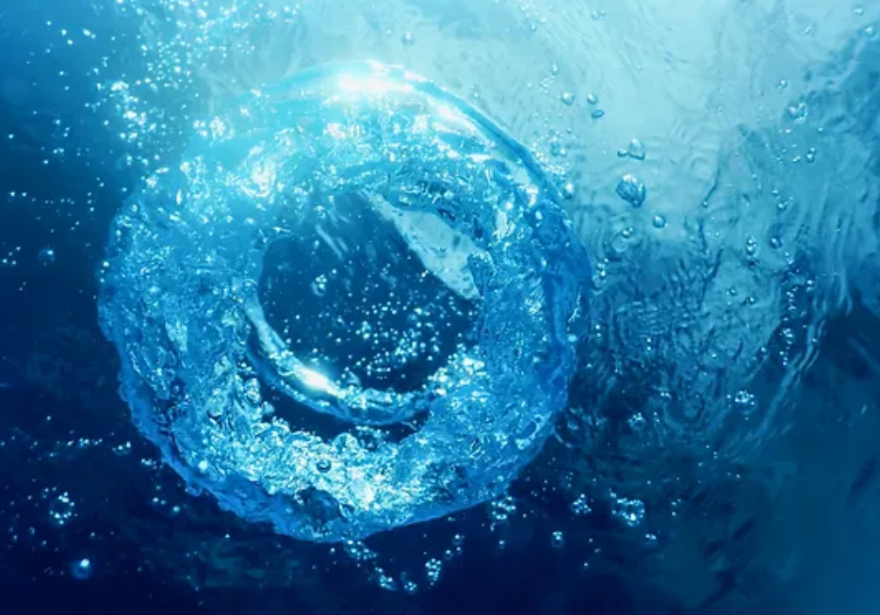
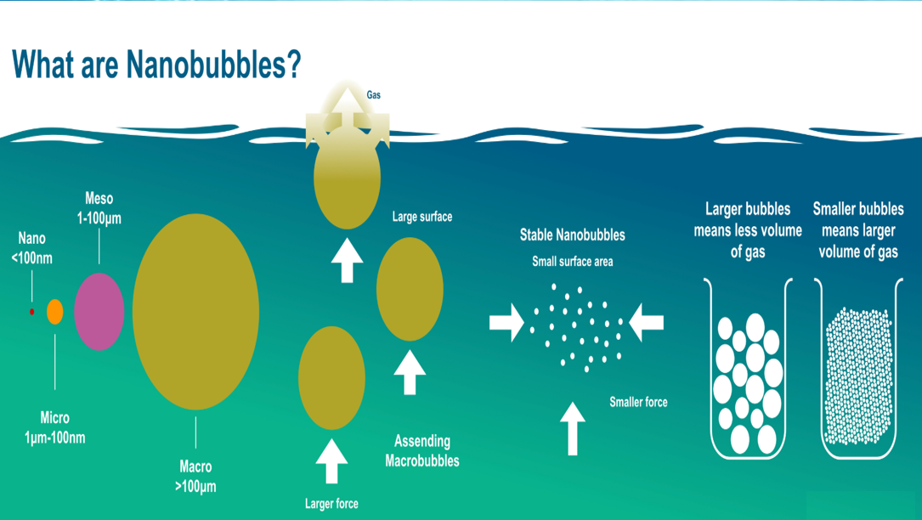

Slide 8
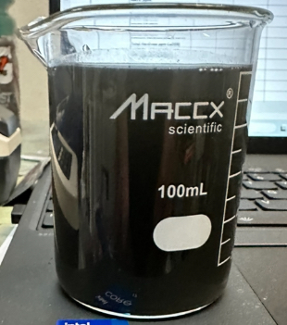
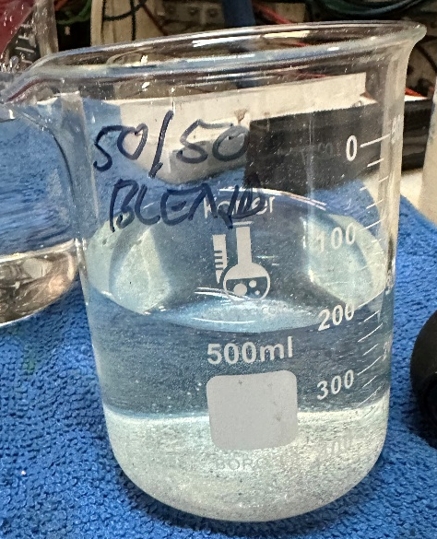
Innovative Water Solutions for a Sustainable Future

Slide 9
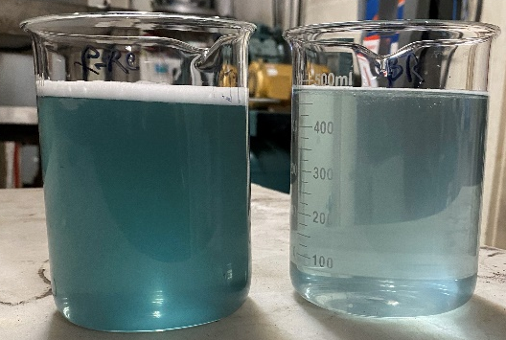
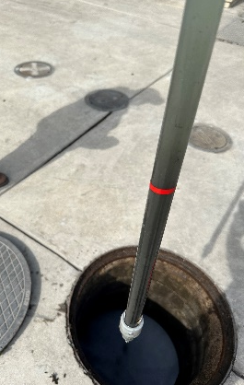
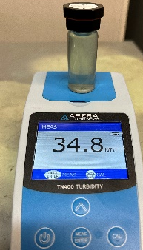
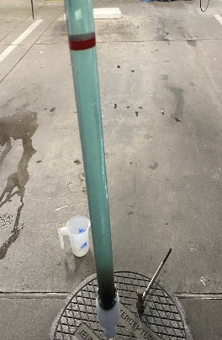

Integrating Technologies
Deionized Water
DO=9.1 mg/L
Deionized Water
DO=28.3 mg/L
Merging technologies optimizes remediation. Nanobubbles enhance oxygen for microbial activity, boosting pollutant breakdown.
DO = Dissolved Oxygen
Microbiology and nanobubbles synergize in car wash systems, improving efficiency, odor control, and water clarity.

Slide 10
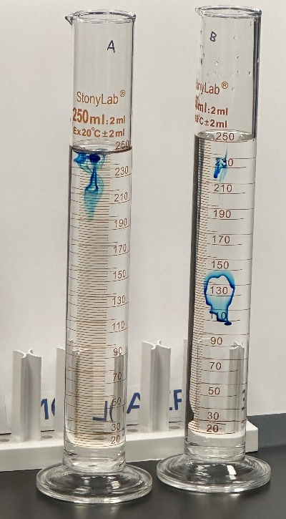
Microbiology & Zeta Particle Infusion
Water treatment enhances quality by reducing anaerobic conditions and improving oxygen dispersion.
Deionized Water
DO=9.1 mg/L
Deionized Water
DO=28.3 mg/L
DO=Dissolved Oxygen
Hyper-saturated oxygen improves car wash performance, reducing costs and enhancing shine.

