Slide 1
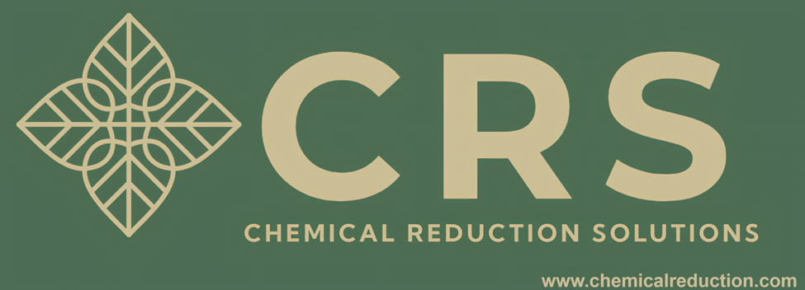
How does THE SHAFT work?
THE SHAFT works on a simple premise that has been proven by the world’s leading universities. Ionization + Cavitation = Bulk Formation of Nanobubbles and Charged Particles. By taking the air that is entrained in water and ionizing it while hydrodynamically cavitating the water, bulk quantities of nanobubbles and charged particles are formed. THE SHAFT’s patent pending system uses baffles in a tube that alternate polarity to achieve ionization/cavitation.
CRS is the car wash industry’s leading provider of nanobubble and charged particle technology. With over 25 car wash operators currently utilizing CRS technology, no other provider has more car washing experience than CRS. Arcadian Services is a leader in car wash chemistry and is leveraging nanobubbles and charged particles to change the car wash industry.
WWW.CHEMICALREDUCTION.COM
WWW.ARCADIANSERVICES.COM

Slide 2
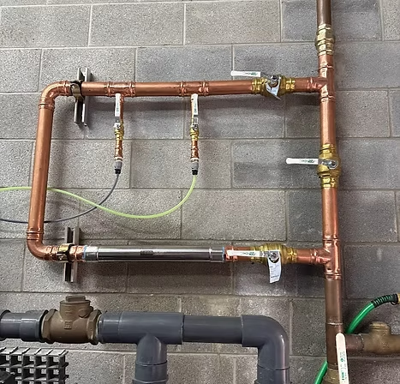
Use THE SHAFT to Turbo Charge Reclaim Systems
THE SHAFT can be used to generate nanobubbles and charged particles that can dramatically improve any reclaim process (both ozone and biological). From reducing odors and sludge to enhancing the clarity of the reclaim water, the use of nanobubbles and charged particles represents one of the biggest improvements in car was reclaim systems.
Top 5 car wash operator using THE SHAFT and biological reclaim system to achieve material water savings
WWW.CHEMICALREDUCTION.COM
WWW.ARCADIANSERVICES.COM

Slide 3
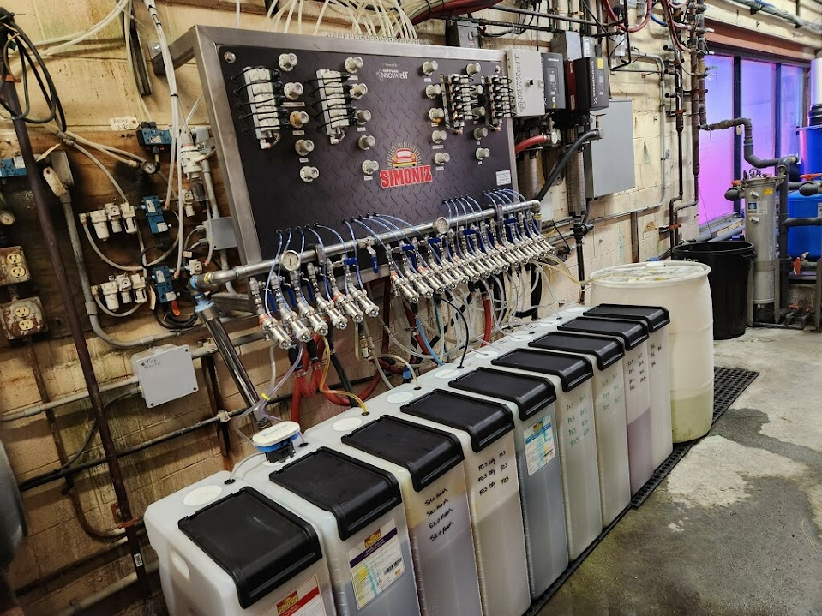
Use THE SHAFT to Enhance Your Chemistry and Finishing Products
Nanobubbles and charged particles generated by THE SHAFT increase the dispersion of chemicals in water, enhancing foaming action and cleaning power. Nanobubbles and charged particles also act as a drying agent. Things like pesky brows, hard to dry cars, and lackluster foaming action are all solved by the SHAFT.
THE SHAFT installed on a water feedline to a top-of-the-line chemical delivery panel
WWW.CHEMICALREDUCTION.COM
WWW.ARCADIANSERVICES.COM

Slide 4
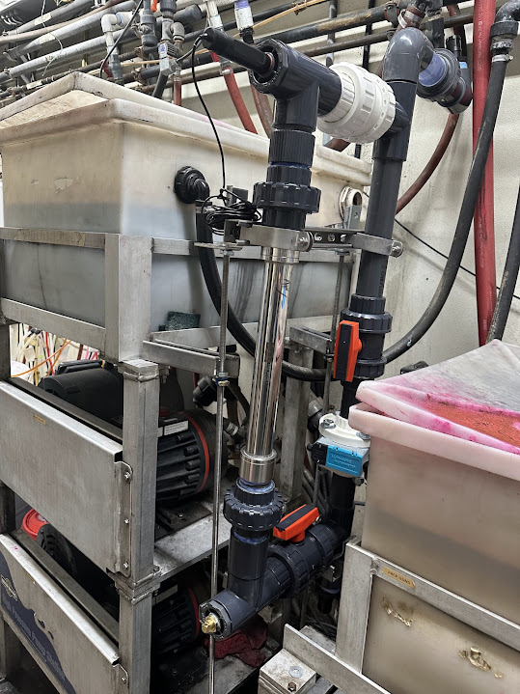
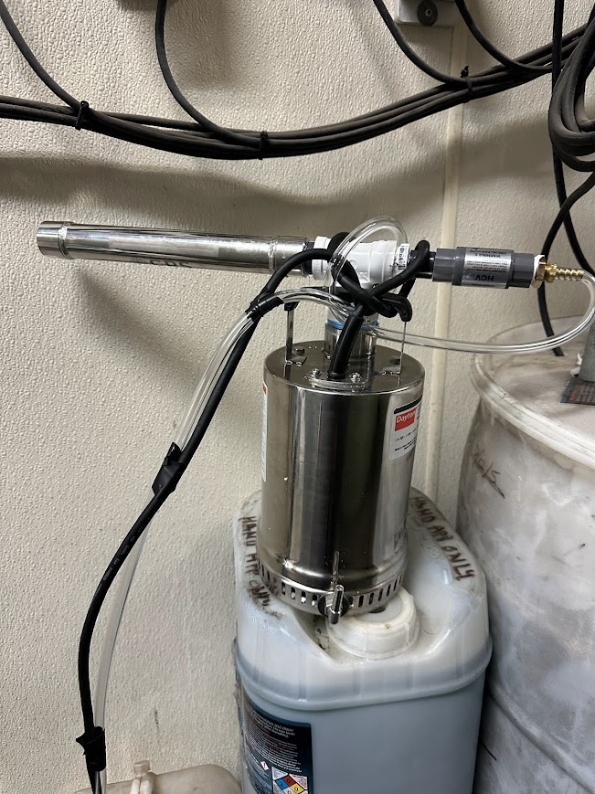
Use THE SHAFT to Clean RO Membranes and Enhance RO Water
Nanobubbles and charged particles generated by THE SHAFT remove biofilm and scale that can foul RO membranes, resulting in premature failure and expensive maintenance. By installing THE SHAFT on the feedline to an RO membrane, nanobubbles and charged particles keep the membrane clean and well functioning. THE SHAFT can also be installed on a submersible pump for deployment in an RO or softened water holding tank enhancing RO or softened water with nanobubbles and charged particles.
WWW.CHEMICALREDUCTION.COM
WWW.ARCADIANSERVICES.COM

