Slide 1

(FORMERLY Chiltern decorative & Fine Arts Society) young arts painting competition 2019
Title: rainforests

Slide 2
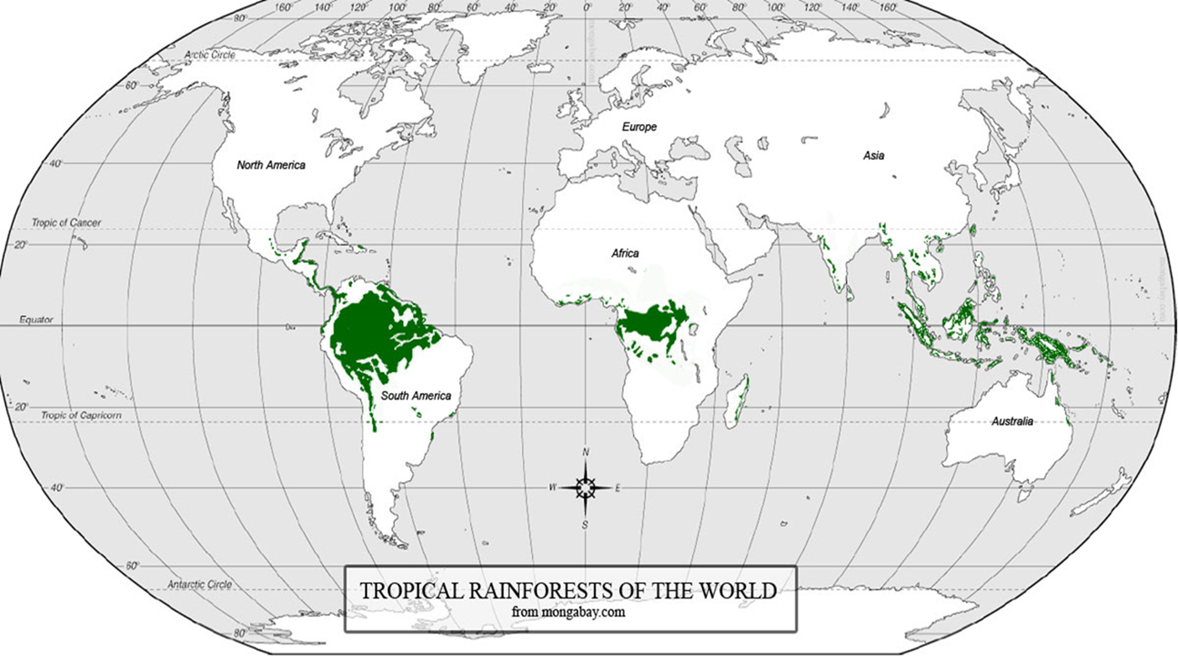
Where are rainforests?
Rainforests are mostly found around the equator. The largest rainforest is the Amazon.
The Amazon Rainforest

Slide 3
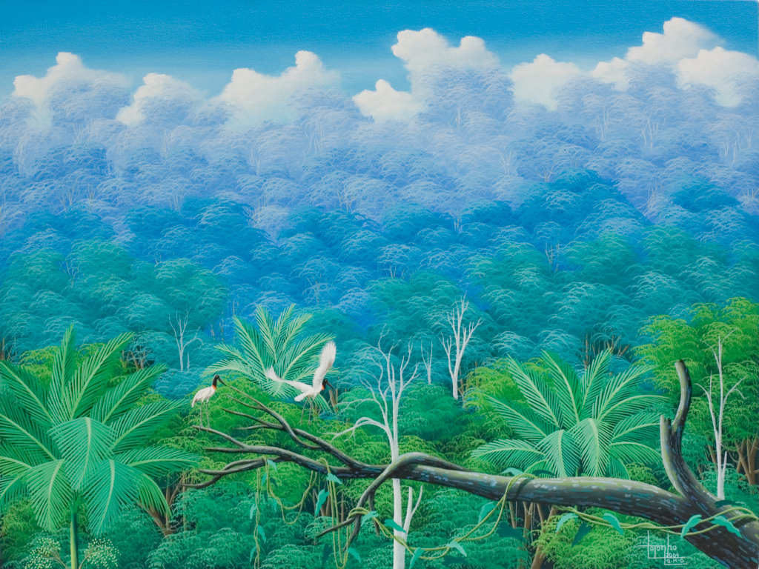
Rainforests are very important for the environment

Slide 4
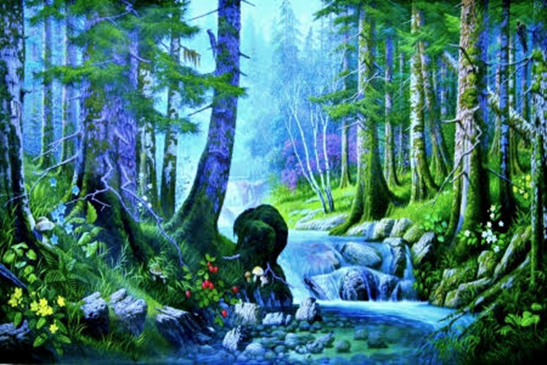
They are also very beautiful with lots of bright colours

Slide 5
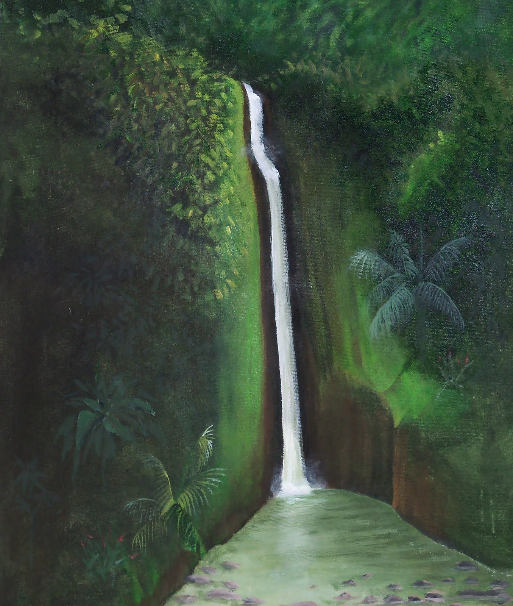
Rain-forests have inspired lots of artists
Because of the colours and amazing wildlife…

Slide 6
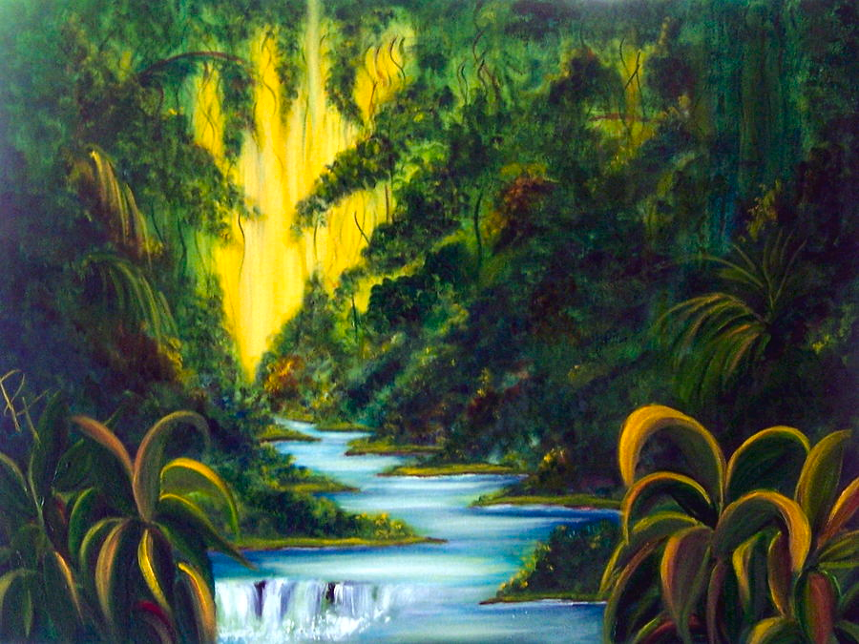

Slide 7
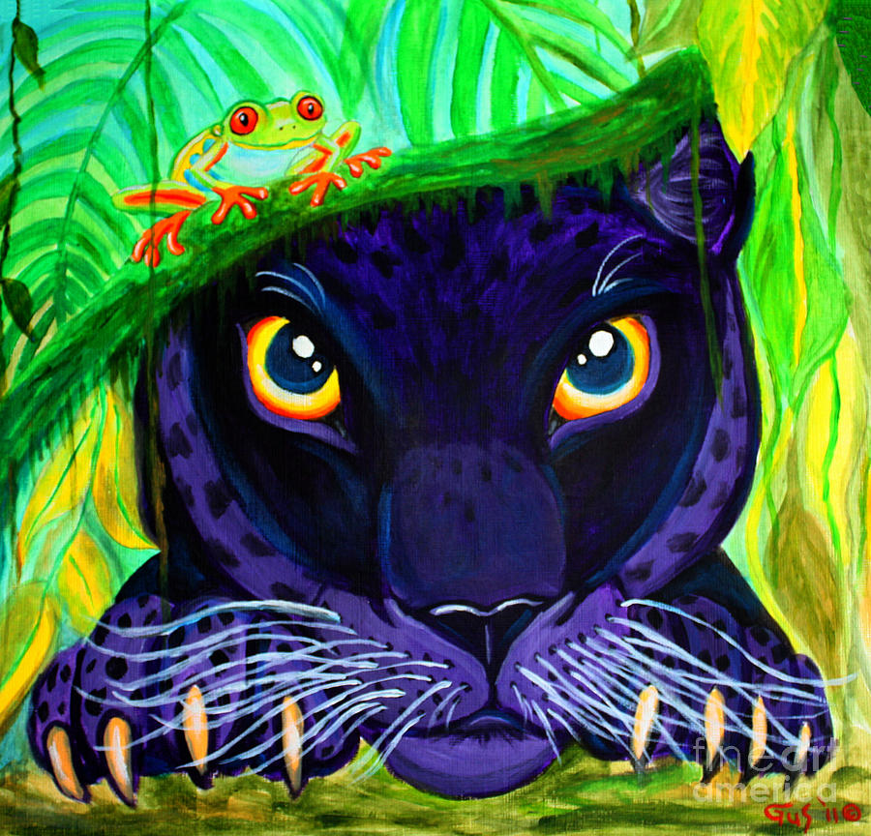
Painting by Nik Gustafson

Slide 8
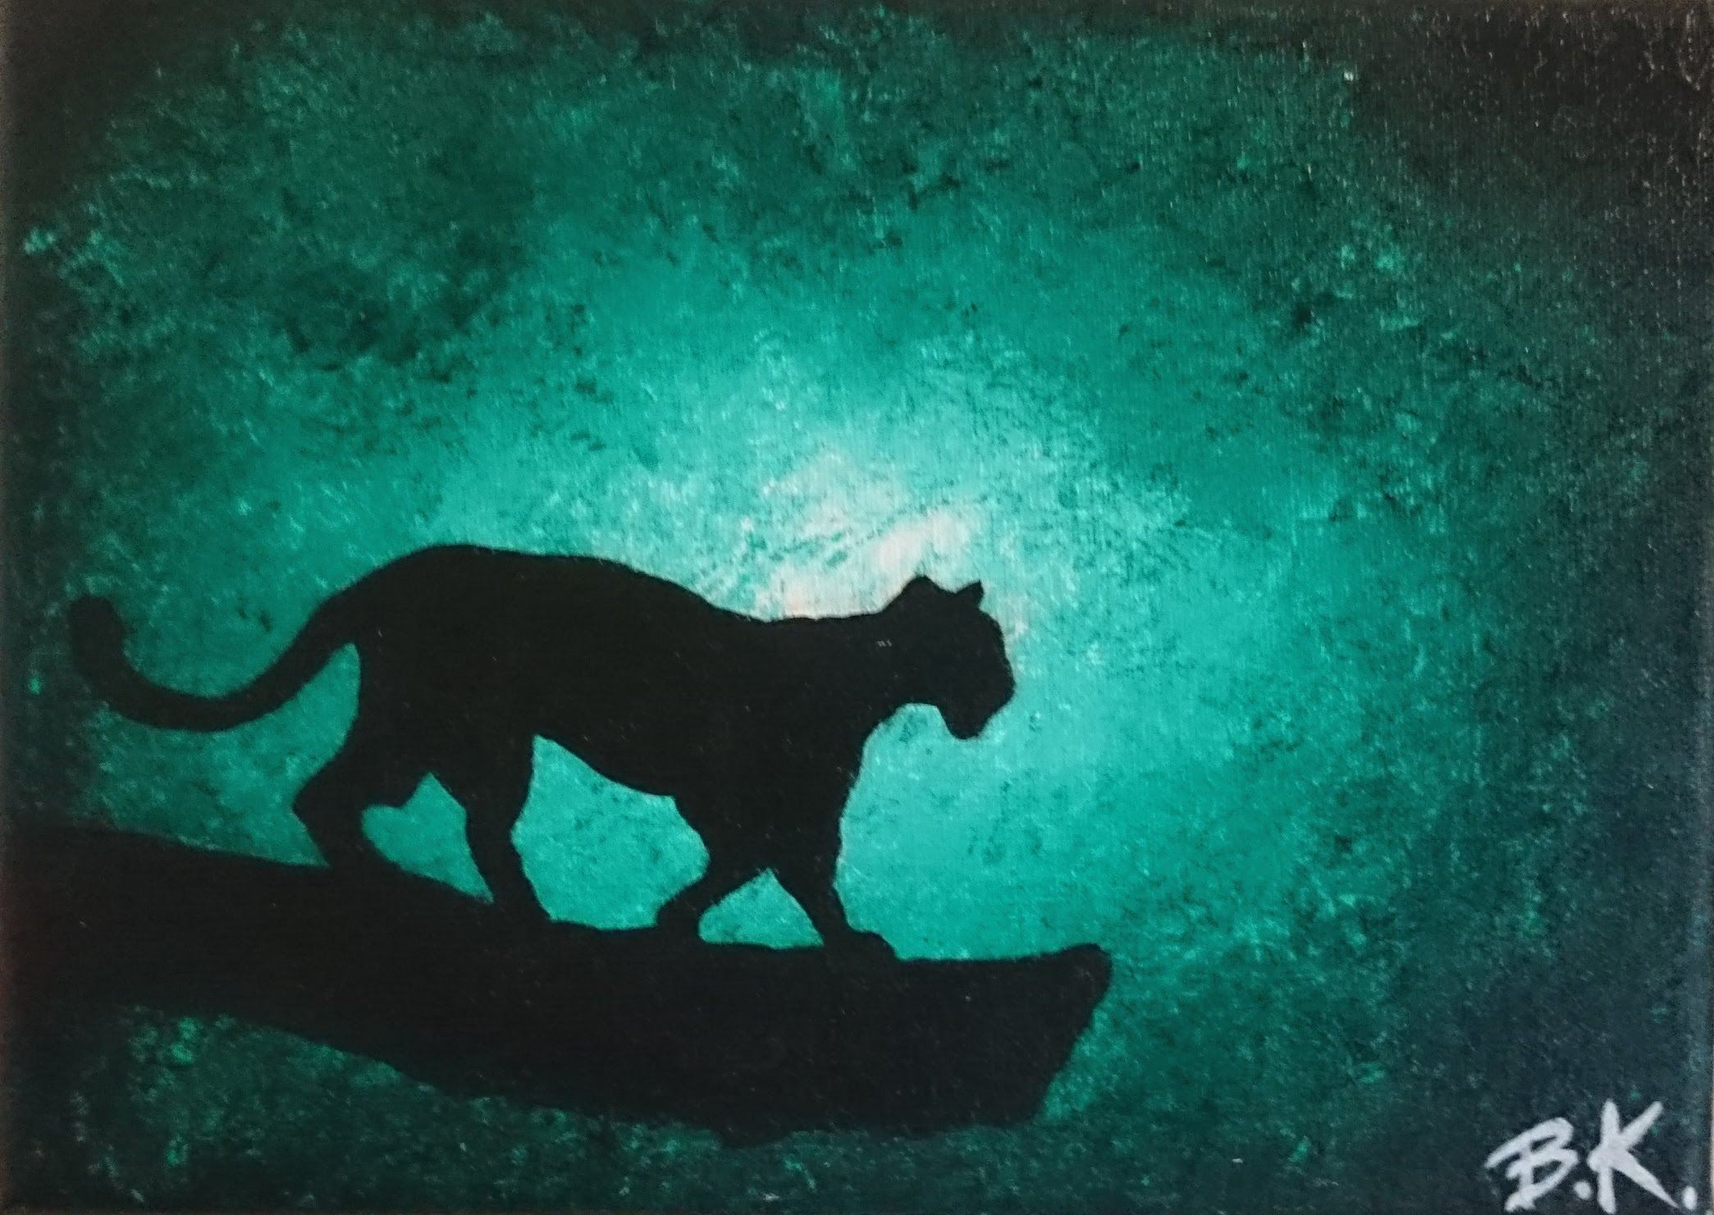
A painting of a jaguar in the rainforest (the only place where jaguars are found)

Slide 9
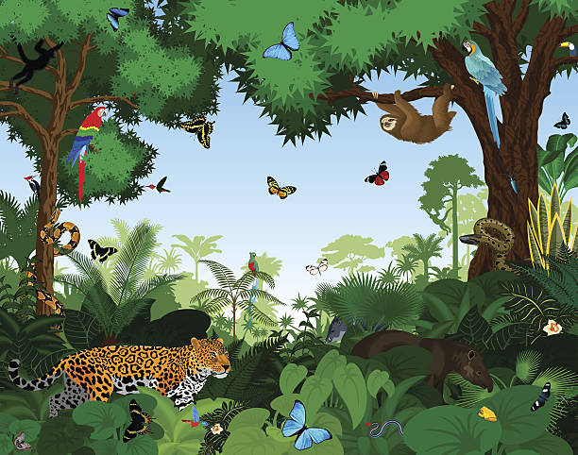
A painting showing some of the wildlife of the Amazon rainforest

Slide 10
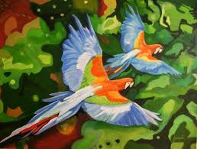
Parrots flying in the canopy

Slide 11
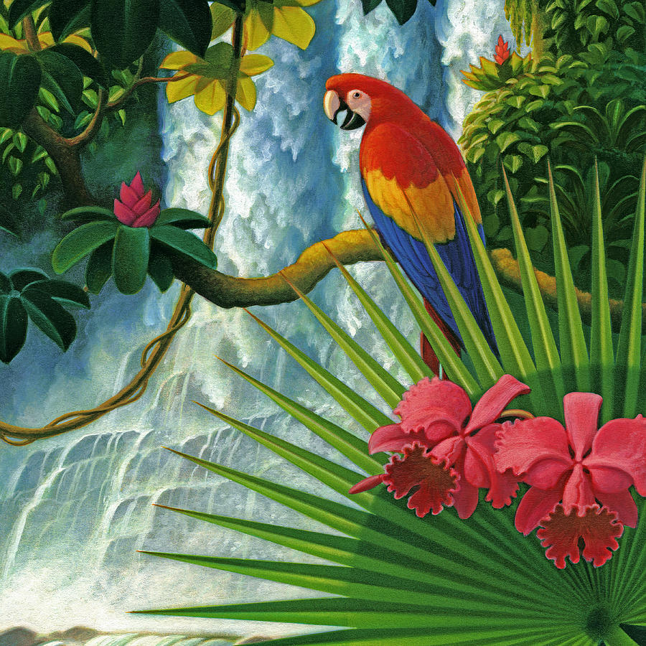
Painting by
Leland Klanderman

Slide 12
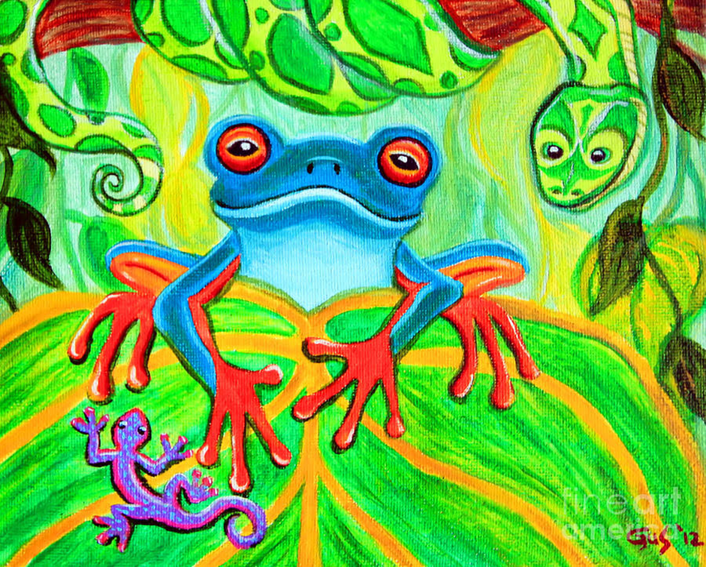
Frog, Snake and Gecko by Nik Gustafson

Slide 13
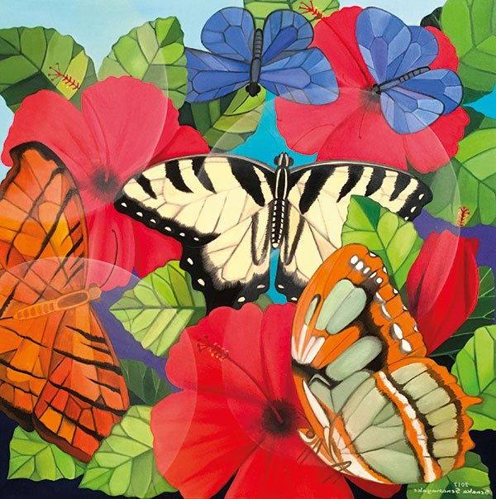
Butterflies by Senaka-Senanayake

Slide 14
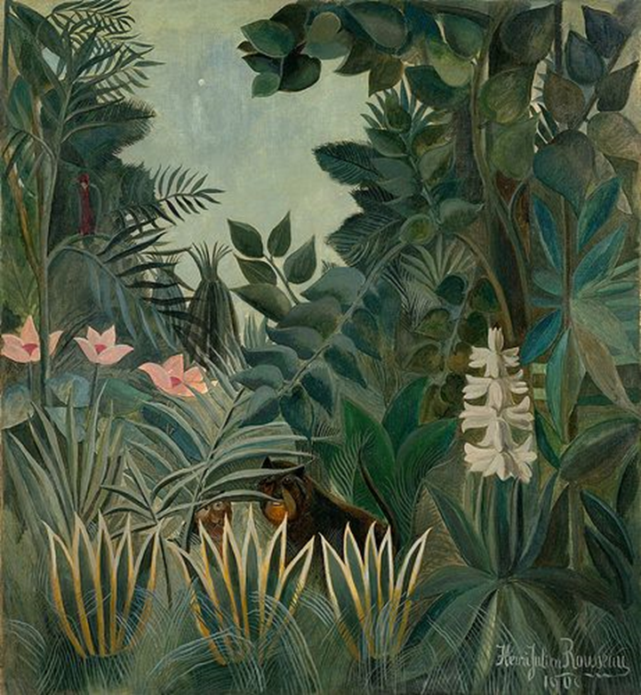
Painting by Henri Rousseau
(who probably did not really know what the rainforest looked like)

Slide 15
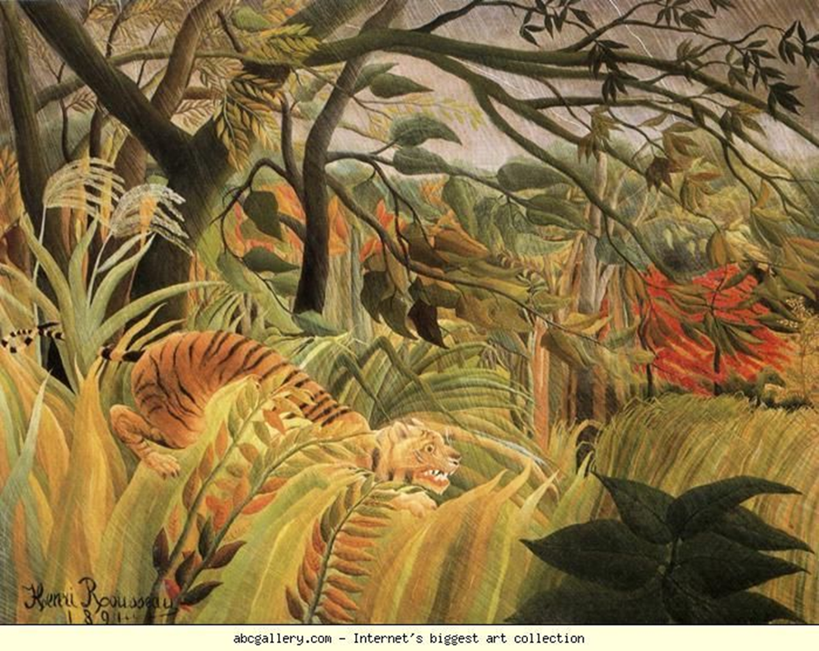
Another painting by Henri Rousseau

Slide 16
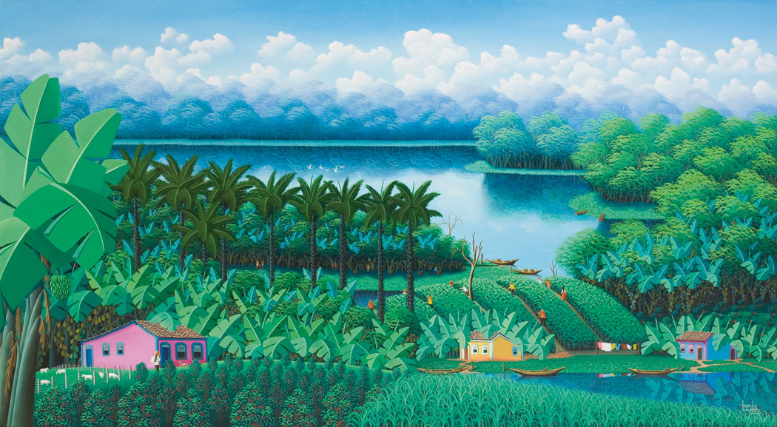
The Amazon River flows through the rainforest

Slide 17
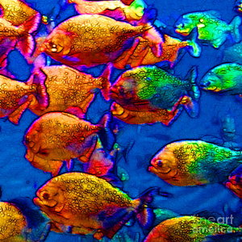
A school of piranha fish from the Amazon

Slide 18
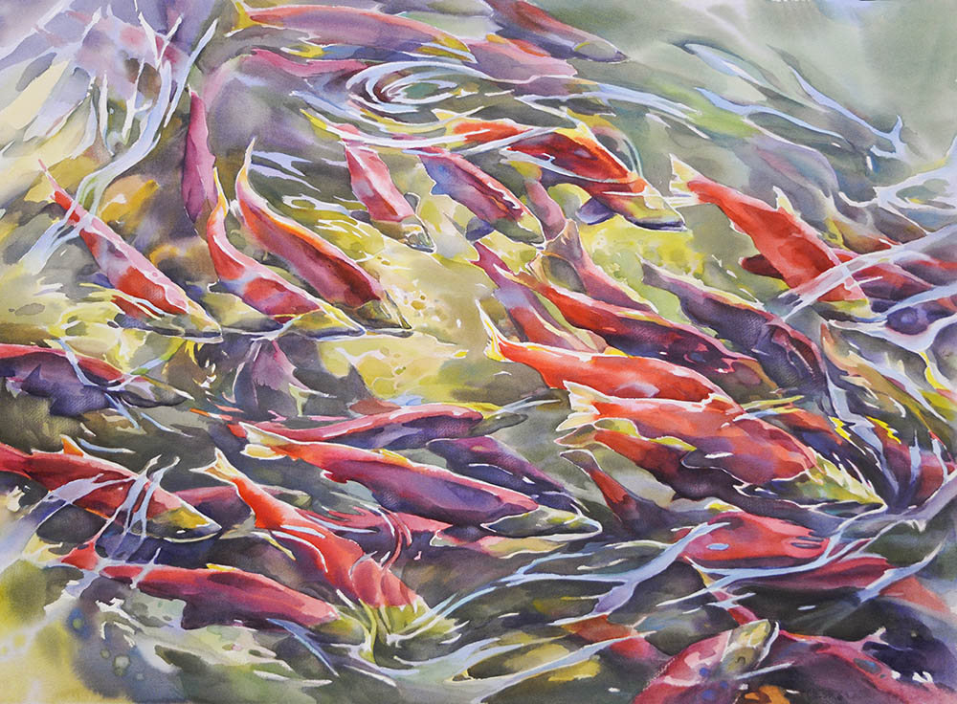
and more fish

Slide 19
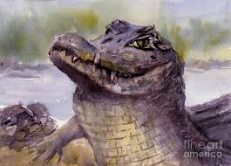
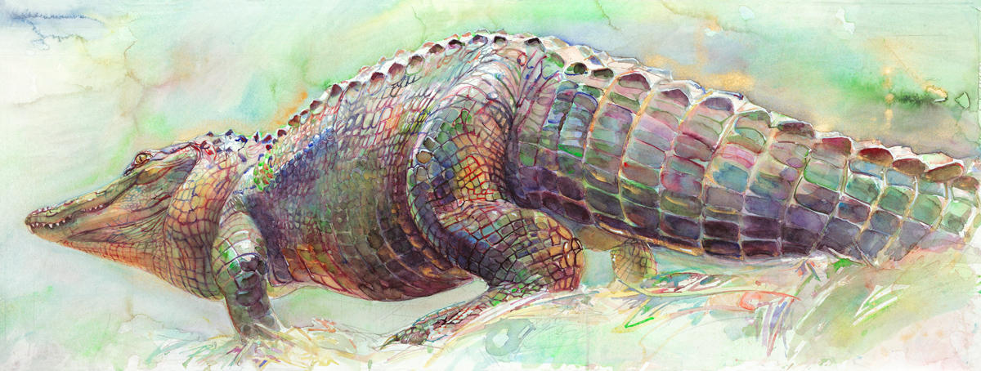
Caiman Crocodile by Virginia Potter
Swimming Caiman by Peggy Macnamara

Slide 20
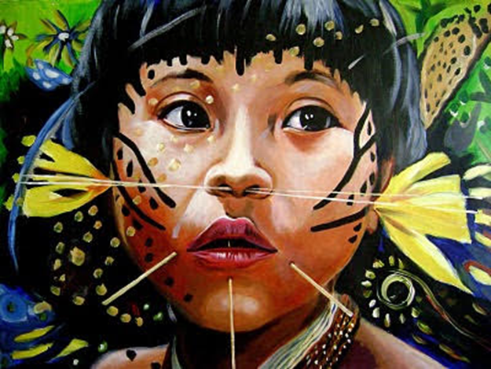
Some of the best art is done by the people who live in the Rainforests – the indigenous people

Slide 21
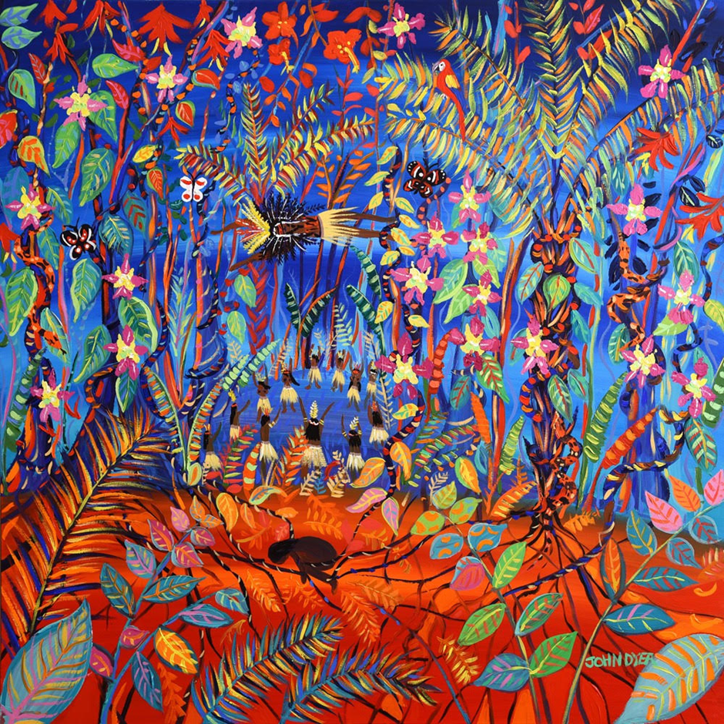
Some examples of indigenous art

Slide 22
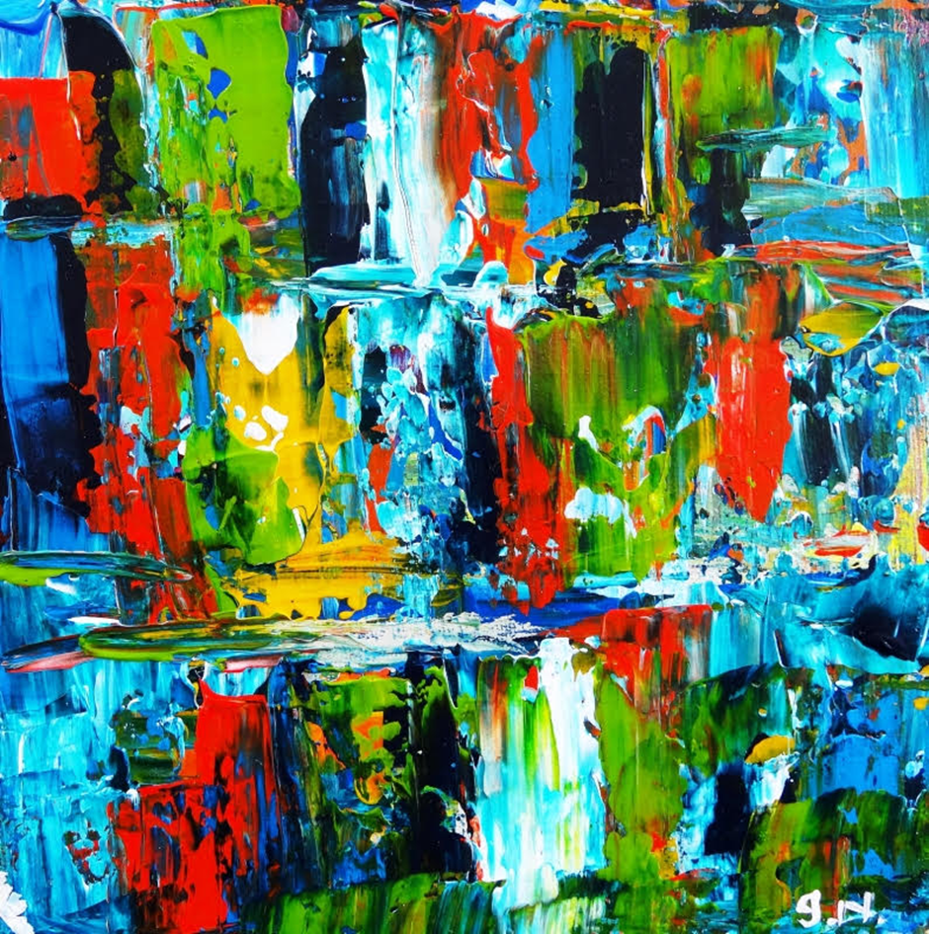

Slide 23
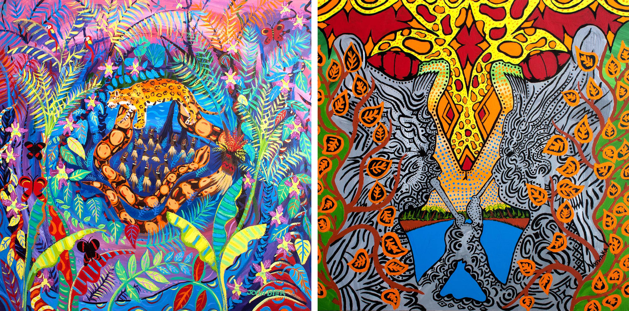

Slide 24
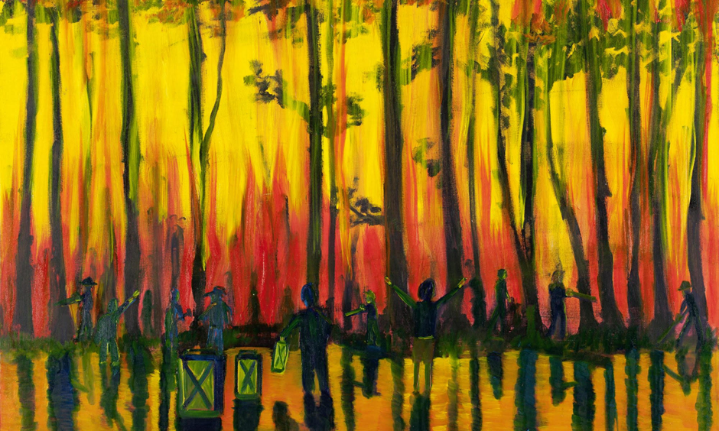
Many areas of the rainforest are being burnt down to create farmland. This is very serious for the environment and the plants and animals of the rainforest.

Slide 25
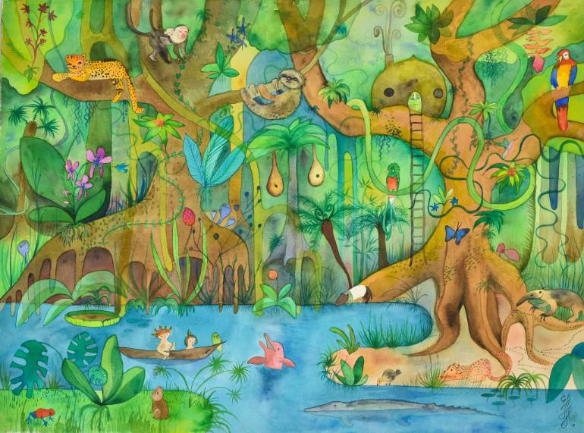
How many creatures of the rainforest can you see?
Up the Xingu Painting by Cynara Mori

Slide 26

We are sure you will all have your own ideas. But remember:
A3 paper
Landscape format only
Not mounted
PRINT your name in full, age, school year and school on the back
By 13th February 2019
Prize presentation at Chalfont St Peter library on 16th March 2019
Winners displayed in website gallery on: http://theartssocietychiltern.org.uk

