Slide 1
(Formerly Chiltern Decorative and fine Arts Society)
YOUNG ARTS PAINTING COMPETITION 2022
Title:
‘Water’

Slide 2
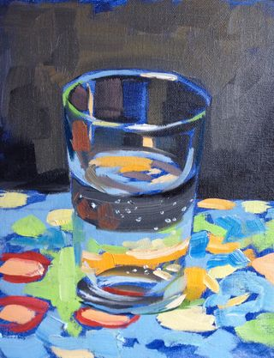
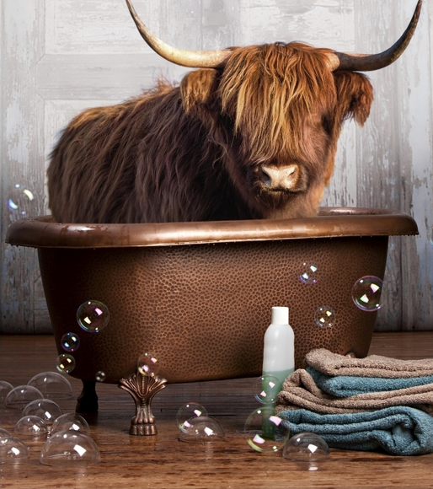
Water can be in a glass:
Or in a bath!

Slide 3
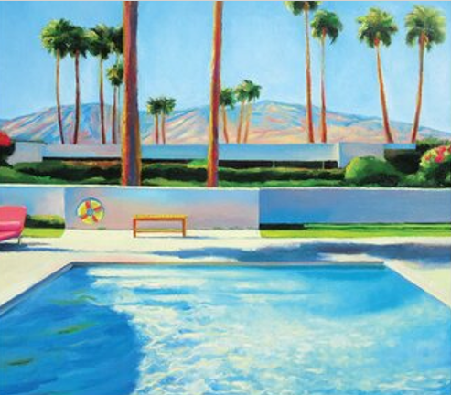
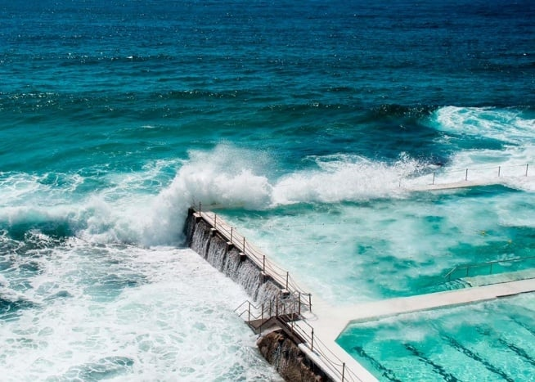
Or in a swimming pool:

Slide 4
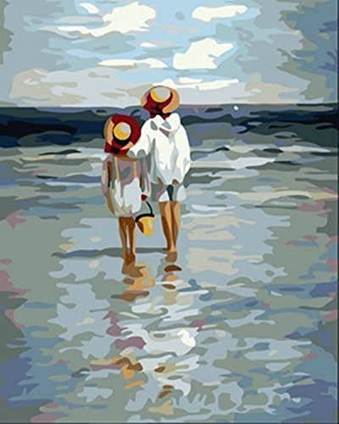
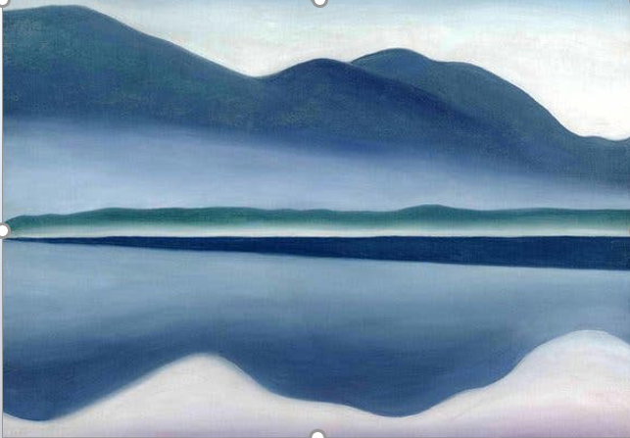
Or by a calm sea or lake:

Slide 5
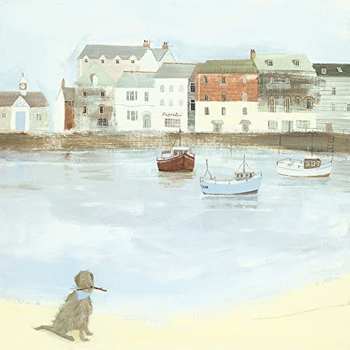
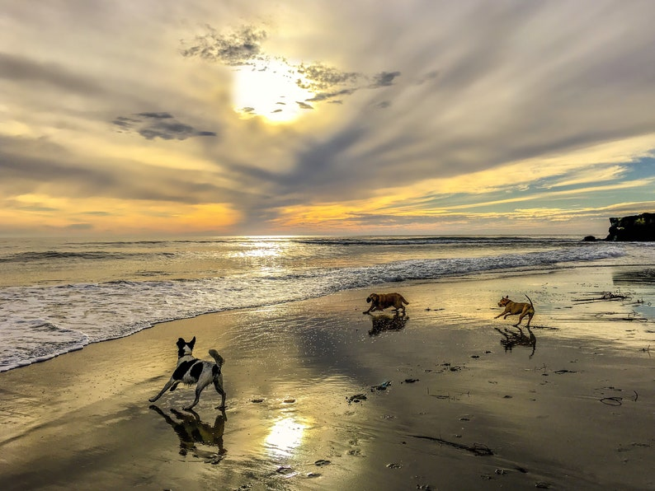
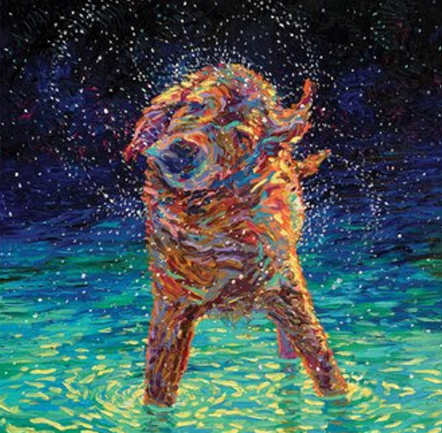
To enjoy with dogs:

Slide 6
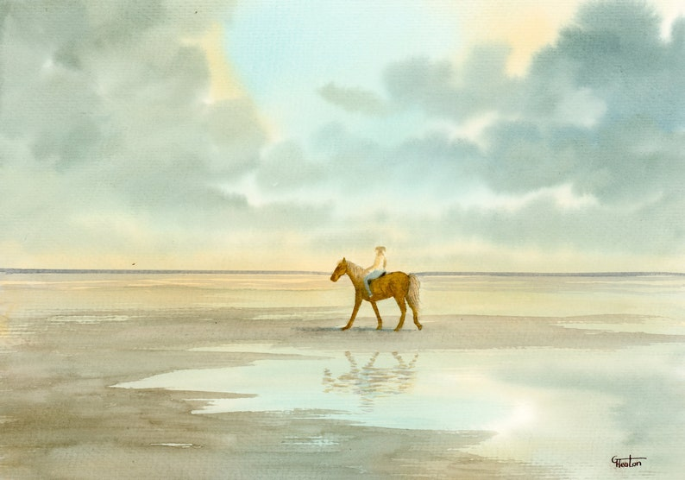
And horses!

Slide 7
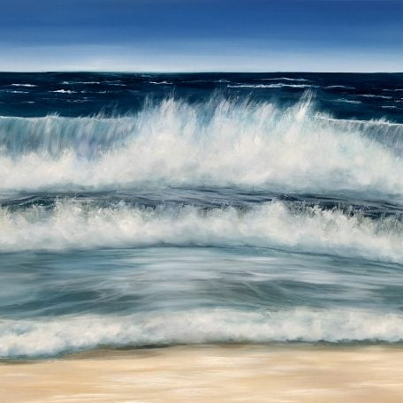
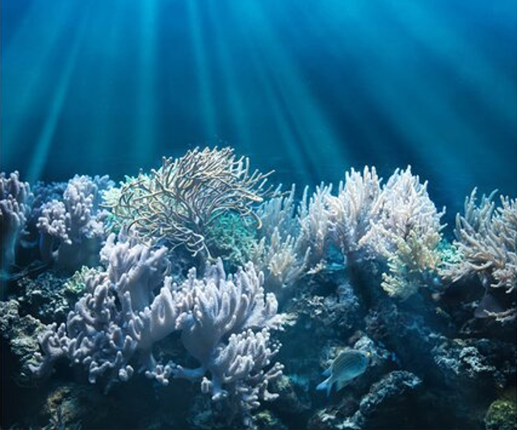
By the beach or under the sea:

Slide 8
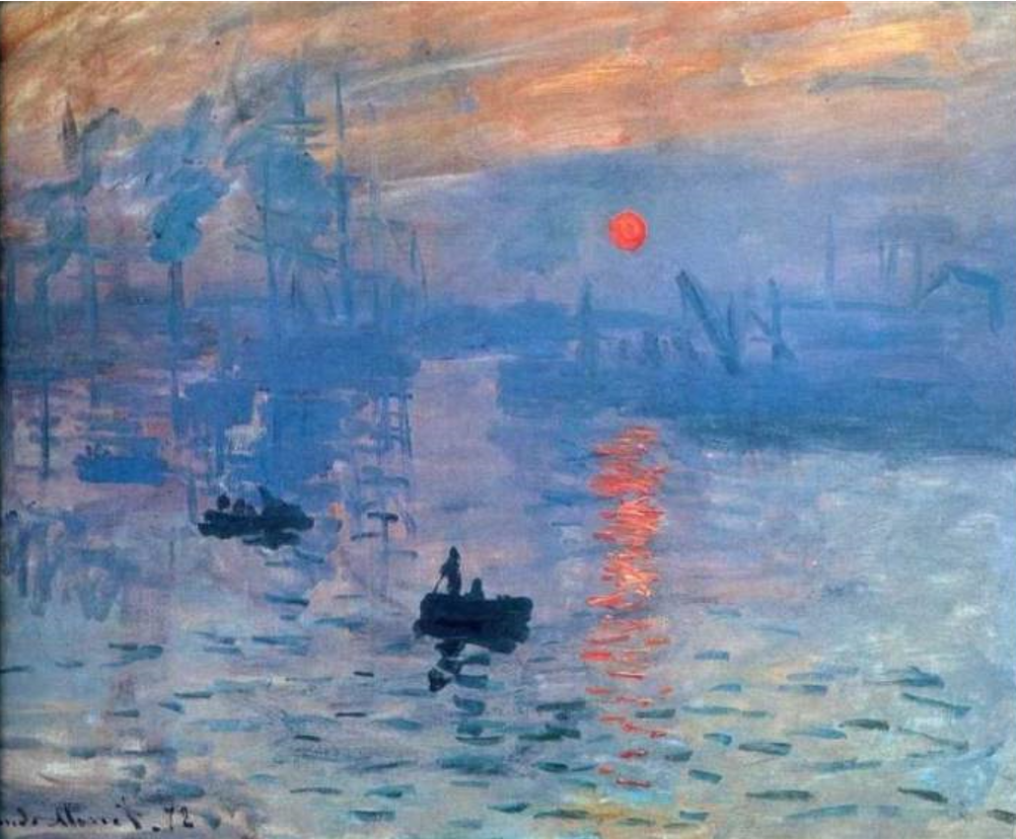
This is how some famous artists painted WATER
Claude Monet Vincent Van Gogh

Slide 9
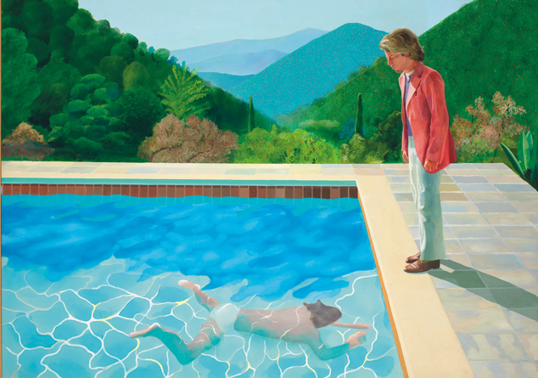
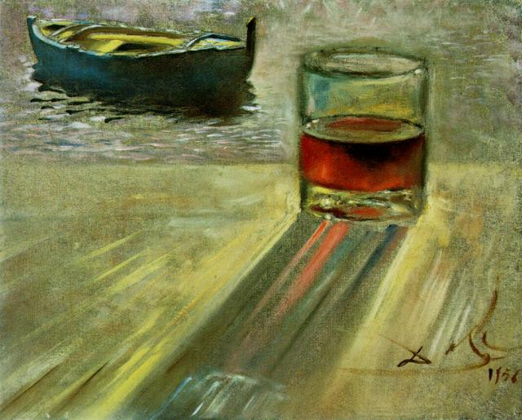
David Hockney Salvador Dali

Slide 10
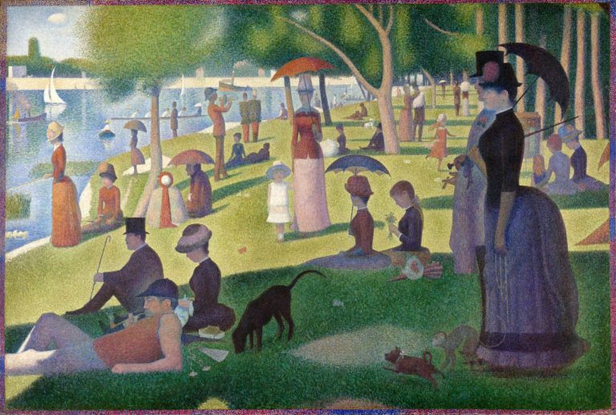
A Sunday afternoon on the Island of La Grand Jatte by Georges Seurat

Slide 11
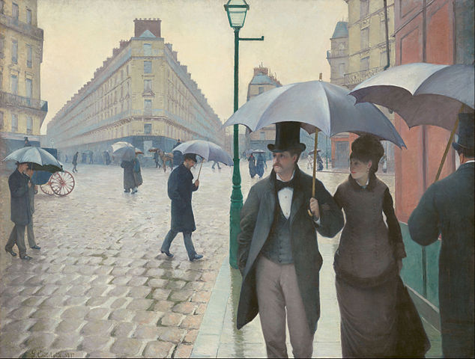
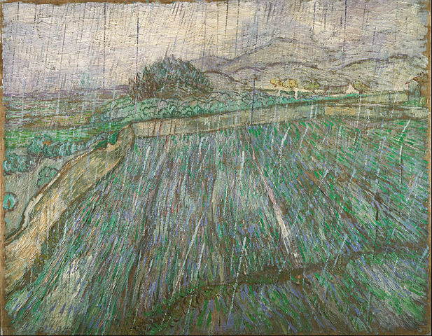
Rain is water!
Gustave Caillebotte Vincent Van Gogh

Slide 12
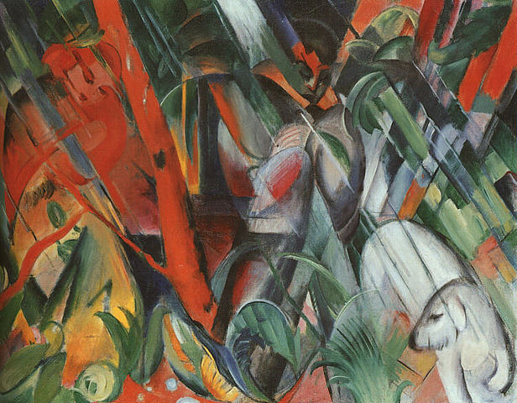
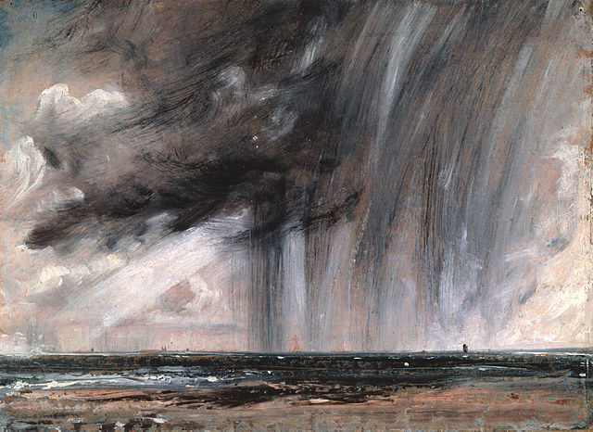
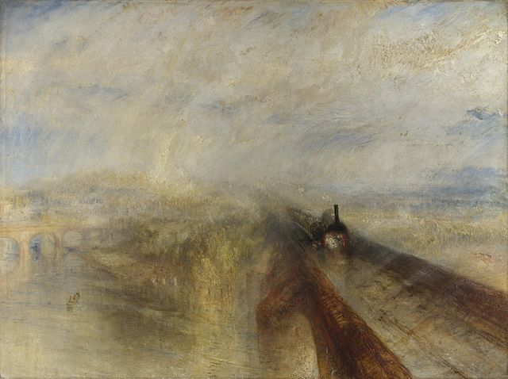
More famous paintings of Rain
Franz Marc
John Constable J.M.W.Turner

Slide 13
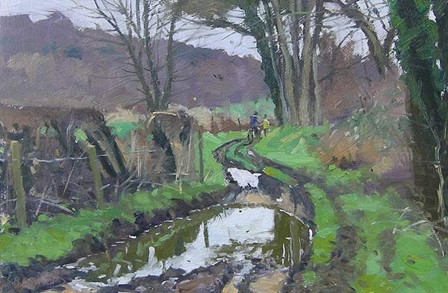
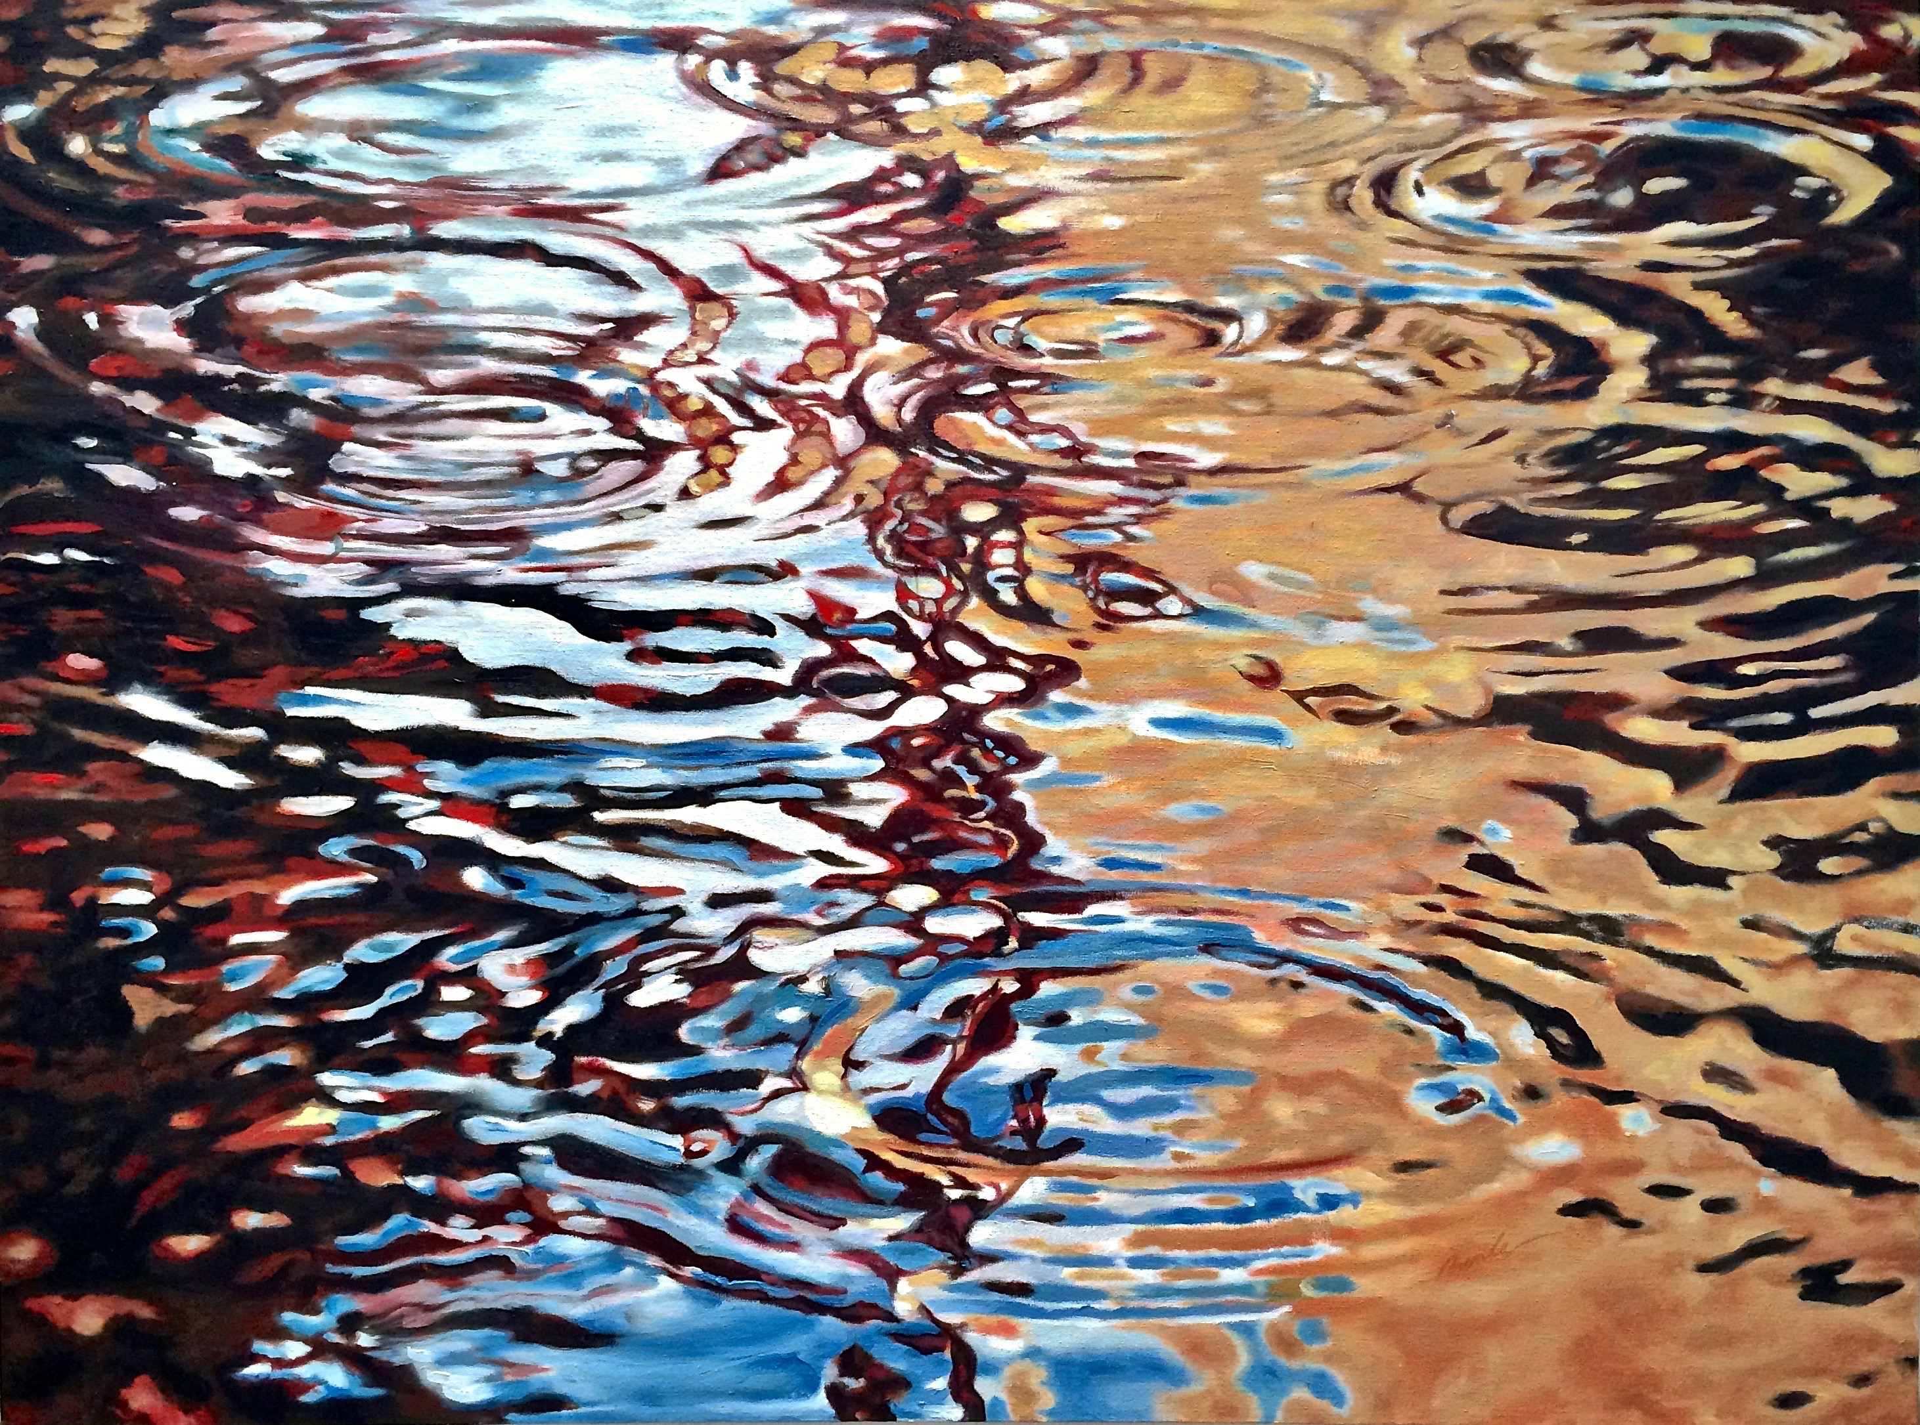
And then puddles

Slide 14
Paintings of Water at Work

Slide 15
Fishermen at ‘Calais Pier’
Above is a very famous paintings by J.M.W. Turner called The Fighting Temeraire

Slide 16
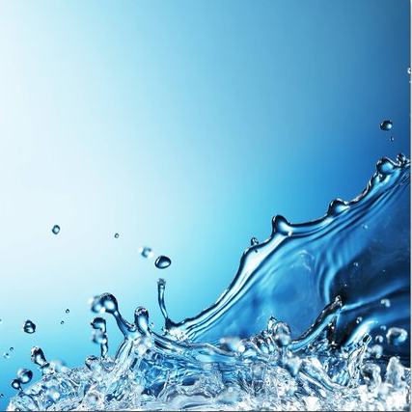
anda
And just
Water!

Slide 17
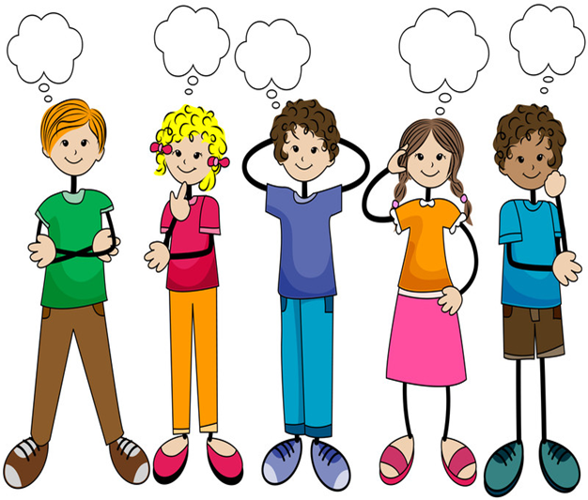
We are sure you will all have your own ideas but remember:
A3 paper
Landscape format only
Not mounted
PRINT your name in full, age, school year and school on the back
By 17th February 2022
If possible we will have a presentation at Chalfont St Peter Library
IF NOT:
All winners will be displayed in website gallery on:
http://theartssocietychiltern.org.uk

