Slide 1
Energy In Schools

Slide 2
Why do we want you to cut down energy use in schools ?

Slide 3
Energy in Schools addresses 3 big energy problems
Climate change
School it too cold/hot/light/dark/stuffy → harder to learn
High school fuel bills → less money for other stuff
Notes:
Introduce the project and self, a brief explanation of why we doing the project ?
For example- We are working to make fun and engaging technologies and learning, so that you can help reduce further climate change, make your school more comfortable and save money on energy, so your school can spend it on more fun learning resources.

Slide 4
This Photo by Unknown Author is licensed under CC BY

Slide 5
“Unless someone like you cares a whole awful lot, Nothing is going to get better. It's not.”
The Lorax by Dr. Seuss
This Photo by Unknown Author is licensed under CC BY-NC-ND
Notes:
Reference Greta, David Attenborough, depending on age and previous work on environment by school etc

Slide 6
How can we cut energy waste energy in school?
Notes:
Try to engage the pupils by asking them how they think they can cut energy waste energy in school.
Q and A- to be interactive as possible
How can we cut energy waste energy in school? How can we cut energy waste energy in school?

Slide 7
Energy In Schools Dashboard

Slide 8
Notes:
Introduce Omar and the penguin pals.
Highlight and encourage the pupils to regularly look at the dashboard screen to keep up to date with information.
Try to use Q and A around some of the terminology, for example does anyone know what Kwatts are? Explain the impact of higher use, more impact on environment, more money.
Highlight the competition and the leader board and explain ‘peaky points’, and prize for school who get the most.
Explain that by all pupils helping to reduce energy will increase peaky point and encourage them to keep a close on their school position on ‘peaky mountain’ and be proactive in reducing energy use.

Slide 9
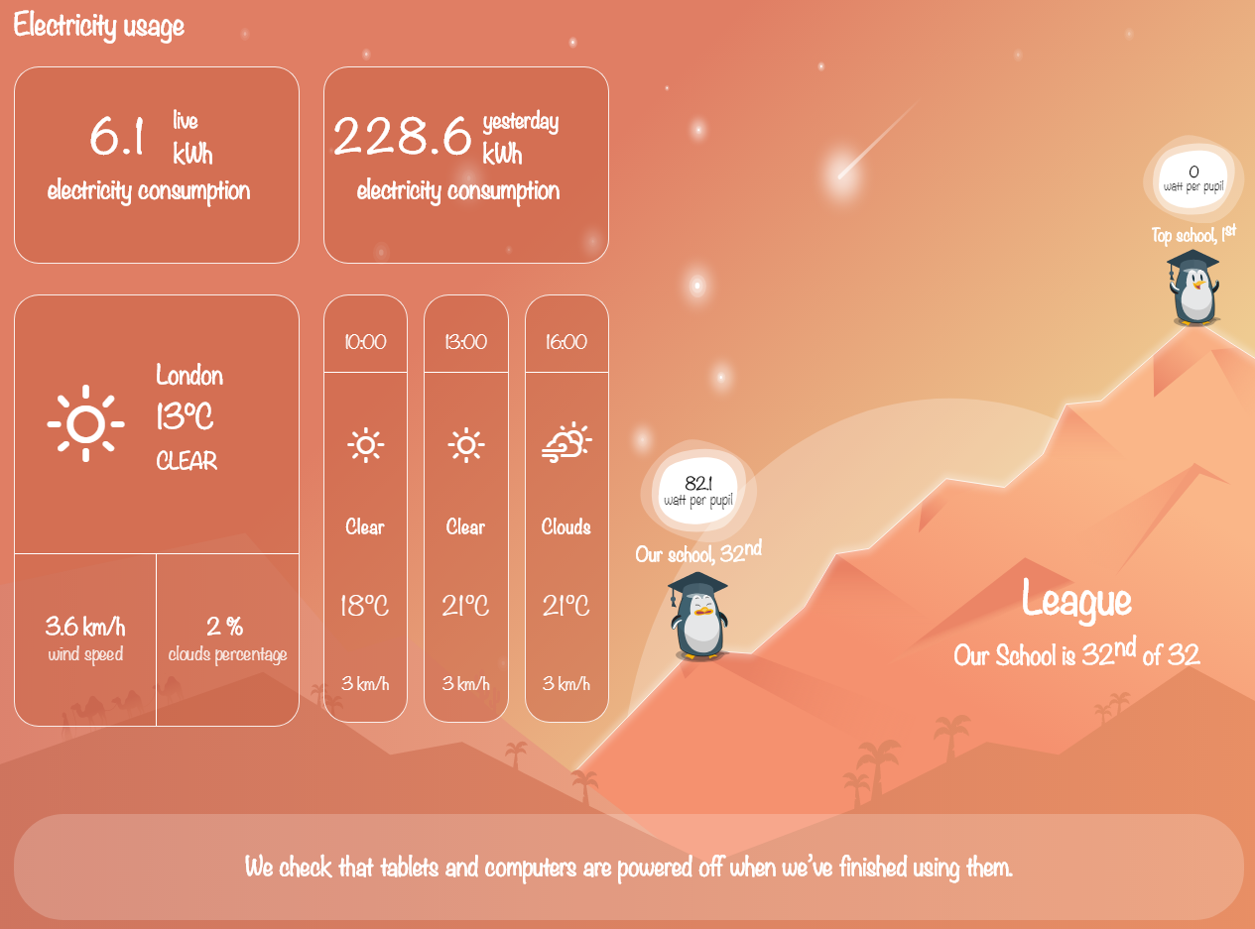

Slide 10
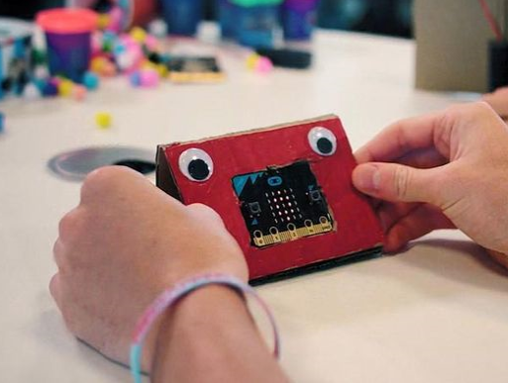
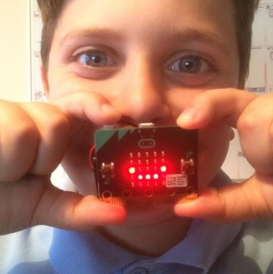
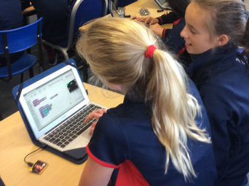
Meet the Energy Champions
Notes:
Introduce the ‘Energy Champions’ to the group. If pupils are comfortable explaining some of the activities, they will be doing encourage them to do so, if not explain some of the initiatives and highlight how pupils can get involved or support the project.

Slide 11
Any questions?

