Slide 1
Year 1
Parents information evening

Slide 2
Welcome
The Year 1 TeaM
Mrs Kratky & Mrs Rushworth = 1KR
Miss Corrigan = 1C
Wednesday afternoon – Mrs Kirchgaesser (1KR) and Mr Crayden (1c)
Supporting Adults
Mrs Tindall, Mrs Ross, Miss short, Mrs simpson, Mrs Plunkett

Slide 3
Welcome To Key Stage 1
Monday | Tuesday | Wednesday | Thursday | Friday
Maths Snack and story + intervention | Maths Snack and story + intervention | Maths Snack and story + intervention | Maths Snack and story + intervention | Maths Star of the week assembly
B | R | E | A | K
English Daily Mile | English Daily Mile | English Daily Mile Phonics | English Daily Mile | English Daily Mile
L | U | N | C | H
Phonics Topic Story | Phonics Science/ Topic Story | PPA COMPUTING P.E. Outside | Phonics Science/ Topic Story | Phonics P.E. inside Star Time
Timetable

Slide 4
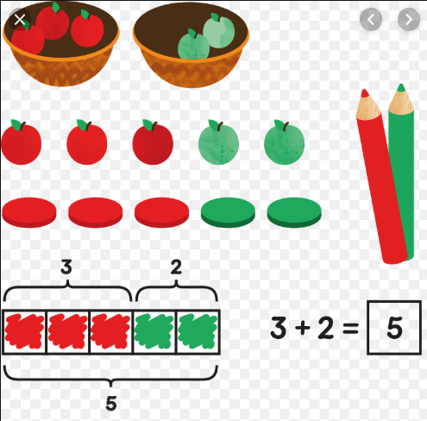
maths
Practical hands on resources pictorial learning abstract
Ten frames, part whole models, counters, dinosaurs
Fluency reasoning problem solving
Practise writing numerals

Slide 5
Phonics
Phase 4
Consolidates phase 2 and 3 sounds.
Teaches children to read and spell words with adjacent consonants (ccvc) e.g. ‘Stop’ (cvcc) e.g. ‘Tent’
They then begin to apply this to their own reading and writing

Slide 6
Phonics
Phase 5
Teaches children that the same sound can be spelt in different ways i.e. ‘Rain’ and ‘day’ and that the same spelling can represent different sounds i.e. ‘Meat’ and ‘bread’ or ‘cow’ and ‘low’
Children separate words into syllables and can read and spell decodable two/three syllable words. They recognise an increasing number of high frequency words automatically

Slide 7
Handwriting
Pre cursive = Getting ready to write- start every letter on the line

Slide 8
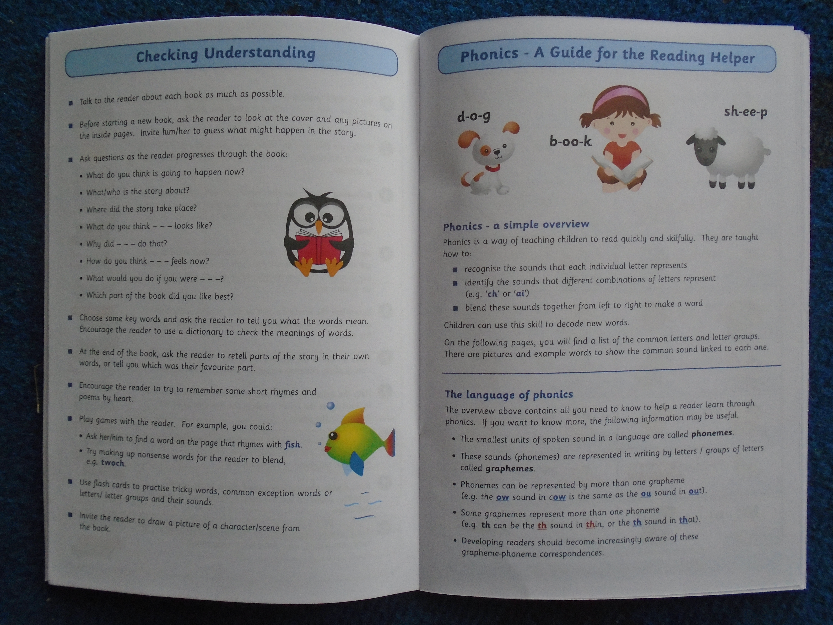
Reading
Identify which words appear again and again.
Relate reading to own experiences.
Re-read if reading does not make sense.
Re-tell with considerable accuracy.
Discuss significance of title & events.
Make predictions on basis of what has been read.
Make inferences on basis of what is being said & done.
Read with pace & expression, i.e. pause at full stop; raise voice for question
Know difference between fiction and non-fiction texts.

Slide 9
Spelling homework

Slide 10
Spelling Homework

Slide 11
Homework Reading records,books and homework due Monday New Homework given Tuesday New books given Tuesday
Daily reading – 5 times per week for a respect token
Spelling – please practise throughout the week. Matching our phonics in school –tested on Mondays.
1 piece of Homework -Maths or English in blue homework folder, given out weekly. Homework is designed to consolidate what the children have been learning in class.
Brainbuilder every 3 weeks – creative, engaging, child led, present/share with class. We will try to offer suggestions and ideas for the learning.

Slide 12
topics
We will be learning about:
Science - Seasons, materials, animals, plants
History - Changes within living memory – transport
Geography – local, Polar Regions, deserts
Dt - Free standing structures, mechanisms – levers and sliders Food Technology- Fruit salad
ART - Drawing, painting, collage, textiles, printing and 3d
R.E. – what it means to be me, special people, special about the world, festivals
PSHE – health and wellbeing, relationships, living in the wider world
Music – exploring sounds, pitch and beat
Computing – logging on, saving and retrieving files, reading eggs, internet safety, programming (beebots)

Slide 13
Star values, star time and minutes
Robertswood star values
Respect tokens are rewards
Star of the week assembly
All children entitled to reward time for following star values -Friday
can bring a toy for star time on Fridays –put in box

Slide 14
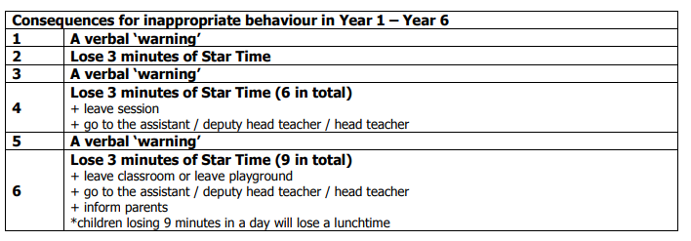
Star values, star time and minutes
Robertswood star values
Warnings/Minutes

Slide 15
Names
Thank you for ensuring that all your children’s uniform and belongings (coats, shoes, bags, lunchboxes, water bottles) are clearly named.
Water bottles –water only please –no juice or squash allowed

Slide 16
lunch
Thank you for pre-ordering – this saves so much time.
12.10 to 1.10pm –Year 1 go at 12.10 to eat
Water bottles can be brought to the lunch hall

Slide 17
End of the day
ThWe will only allow your child to go with these named individuals.
If there is any change-please send us a note or contact the school office last-minute.
Please be reminded that once your child has been dismissed , they are your responsibility -keep an eye on them when they are playing on the playground before you leave.

Slide 18
concerns
Please talk to us if you have any concerns or questions
Email the office, write a note, catch us at 3.15pm, phone to arrange a meeting.
Parent Consultations at the end of October

Slide 19
Thank you for your time ☺
Year 1 team

