Slide 1
Year 1
Parents information evening
Notes:
Welcome and thank you for taking the time to join us this evening. The aim of this longer ‘meet the teacher’ to introduce ourselves and our year 1 team and provide you with important and useful information to help us work together to make this a really successful year for your child. In Year 1, the children are transitioning from Early Years Foundation Stage into Key Stage 1 and there are many new aspects of their school life that we would like to explain to you. Lets get started with introductions…

Slide 2
Welcome
The Year 1 TeaM
Mrs Kratky & Mrs Rushworth = 1KR
Miss Corrigan = 1C
Monday afternoon –Mrs K. Bennett in 1c
Wednesday afternoon – Mrs Kirchgaesser (1KR) and Mrs Brown (1c)
Supporting Adults
Mrs Hardy, Mrs Tindall, Mrs James Mrs Roberts, Mrs Cooper, Mrs Tyson

Slide 3
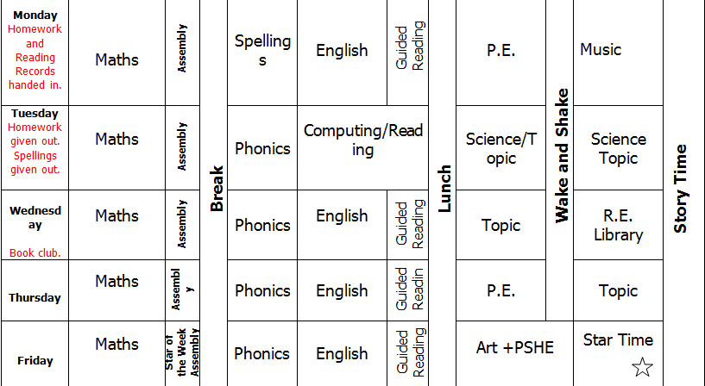
Welcome To Key Stage 1
Timetable
Notes:
Year 1 big change from foundation change –curriculum –topics – beginning of key stage 1
This timetable is where we are heading as we progress through Year1. At the moment the afternoons are split between one focussed activity or lesson followed by some ‘Choosing’ time . During choosing time children are free to move between the 2 year 1 classrooms where we have an adjoining door and select from different activities such as craft, drawing, construction, reading, dress-up . We are also very fortunate to have a lovely brand new outdoor area where water and sand play and other activities are available for the children to choose.

Slide 4
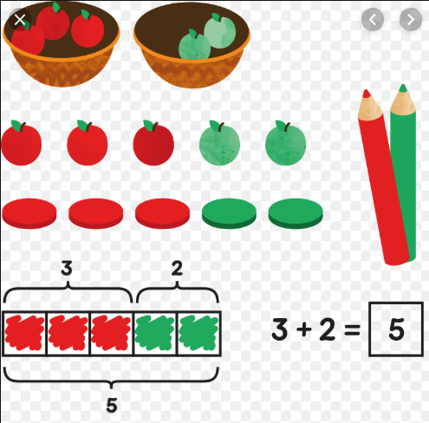
maths
Practical hands on resources pictorial learning abstract
Ten frames, part whole models, counters, dinosaurs
Fluency reasoning problem solving
Practise writing numerals

Slide 5
Phonics
Phase 4
Consolidates phase 2 and 3 sounds.
Teaches children to read and spell words with adjacent consonants (ccvc) e.g. ‘Stop’ (cvcc) e.g. ‘Tent’
They then begin to apply this to their own reading and writing
Notes:
Phonics underpins so much of the learning that takes place this year. It is a tool for both reading and writing The children have been learning phonics in the Early Year foundations Stage and are used to daily phonics sessions from last year in Reception class. In Year 1 we are starting by recapping Phase for for the first 4 weeks and then all children will be moving on to Phase 5 . If your child is not fully secure with Phase 3 or Phase 4 , they will receive some extra phonics booster sessions during the week from some of our supporting adults. All the phonic sounds are in the centre of your child’s reading record. In addition to learning daily phonics at school, reading daily at home is the most successful way to help your child apply their learning and make good progress with reading.

Slide 6
Phonics
Phase 5
Teaches children that the same sound can be spelt in different ways i.e. ‘Rain’ and ‘day’ and that the same spelling can represent different sounds i.e. ‘Meat’ and ‘bread’ or ‘cow’ and ‘low’
Children separate words into syllables and can read and spell decodable two/three syllable words. They recognise an increasing number of high frequency words automatically
Notes:
Tricky words
Children should Use phonics when reading
Brief mention of screening

Slide 7
Handwriting
Pre cursive = Getting ready to write- start every letter on the line
Notes:
A few years ago, as a whole school , introduced pre-cursive handwriting ‘getting ready to write’ –having experienced it –very successful. Start all letters on the line. Tricky at first BUT stick with it –don’t worry if you don’t do it all the time.
Getting used to it –by the end of Year 1 most children will fid joining easy and writing is more fluid. Last 2 years we’ve been amazed by how the pre-cursive handwriting has helped children.

Slide 8
Reading
Identify which words appear again and again.
Relate reading to own experiences.
Re-read if reading does not make sense.
Re-tell with considerable accuracy.
Discuss significance of title & events.
Make predictions on basis of what has been read.
Make inferences on basis of what is being said & done.
Read with pace & expression, i.e. pause at full stop; raise voice for question
Know difference between fiction and non-fiction texts.
Notes:
Children should be bringing home a colour-coded book from school each day or as needed-some longer books may take a few days to finish. Children are reminded to change their books themselves as we are encouraging their independence and sense of responsibility in Year 1. The school reading books are a mixture of phonic-specific readers and story books. If you feel child requires more than the book they have brought home, please feel free to read additional books from home –these can also be written in the reading record. Children should try to de-code the words by sounding out and blending using the phonics they have learnt If they come across some unknown sounds, they may need support – sounds are in the middle of the reading record.
Not all words can be sounded out – we call these words’ Tricky words’ and we will be learning a few of these each week. We say to the children ‘we just have to train our brain’ to spot the tricky words . …

Slide 9
Spelling Homework

Slide 10
Spelling homework

Slide 11
Homework Reading records and homework due Monday New Homework given Tuesday
Daily reading – 5 times per week for a respect token
Spelling (clear plastic wallet) – please practise throughout the week. Matching our phonics in school –tested on Mondays.
1 piece of Homework -Maths or English in pink homework folder, given out weekly. Homework is designed to consolidate what the children have been learning in class.
Brainbuilder every 3 weeks – creative, engaging, child led, present/share with class. We will try to offer suggestions and ideas for the learning.

Slide 12
topics
We will be learning about:
Science - Seasons, materials, animals, plants
History - Changes within living memory – transport
Geography – local, Polar Regions, deserts
Dt - Free standing structures, mechanisms – levers and sliders Food Technology- Fruit salad
ART - Drawing, painting, collage, textiles, printing and 3d
R.E. – what it means to be me, special people, special about the world, festivals
PSHE – health and wellbeing, relationships, living in the wider world
Music – exploring sounds, pitch and beat
Computing – logging on, saving and retrieving files, reading eggs, internet safety, programming (beebots)
Notes:
We are starting with transport in history and Saesons and materials for science. We have already started exploring the local geography of our school.
You can see there a lot of topics that we cover this term.
In computing this term we will be logging on to our Reading Eggs programme. This is familiar to the children and will reinforce phonics that we are learning. In addition, you can log on at home if you have your login. Please come and see us if you are unsure.

Slide 13
School trips
Transport – History – London Transport museum –Tuesday 5th November details to follow.
Animals – science – Whipsnade zoo (Spring Term)
plants - science – Kew gardens (Summer Term)
Notes:
3 fab trips!

Slide 14
Star values, star time and minutes
Robertswood star values
Respect tokens are rewards
Star of the week assembly – barnaby/Betty bear
All children entitled to reward time for following star values -Friday
can bring a toy for star time on Fridays –put in box
Notes:
Now that the children are in Key stage 1, they have been introduced to our star values, which are a set of simple rules for how to behave in school. Rewards are given for demonstrating these values -respect token are tickets which your child can collect throughout the week to be in with a chance of a prize at Mr Richings star of the week assembly on Fridays. One child per class is chosen as star of the week and they receive a certificate and a weekend with Barnaby/Betty bear. All children are entitled to Star Time on a Friday for following our Star Values
Everybody at Robertswood has the right to succeed at school and enjoy playtimes. This means that everybody has the responsibility of looking after the school rules and procedures. If individuals behave in an inappropriate way, then they will face a consequence for their actions.

Slide 15
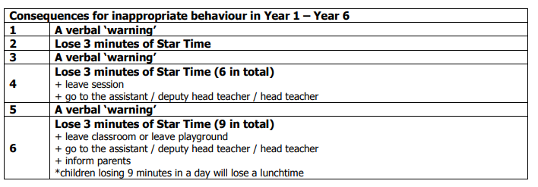
Star values, star time and minutes
Robertswood star values
Warnings/Minutes
Notes:
Everybody at Robertswood has the right to succeed at school and enjoy playtimes. This means that everybody has the responsibility of looking after the school rules and procedures. If individuals behave in an inappropriate way, then they will face a consequence for their actions.
We regularly use ‘verbal warnings’ to remind children of our expectations for behaviour. If a child continues to misbehave after a warning, then the consequence is to lose 3 mins of their star time that week. If the behaviour is still unacceptable a second warning is given and following that, another incidence of misbehaving would be losing another 3 minutues. If this happens in one session then a child would have to leave the session and speak with the head or deputy head.

Slide 16
P.E.
Mondays and Thursdays
Please ensure everything is named, even plimsolls/trainers
Tights –turning inside out/right way round
Turning inside out
Tracksuit bottoms
Notes:
Encourage independence
Send home half termly for washing

Slide 17
Names
Thank you for ensuring that all your children’s uniform and belongings (coats, shoes, bags, lunchboxes, water bottles) are clearly named.
Water bottles –water only please –no juice or squash allowed

Slide 18
End of the day
Thank you for returning your collection list –if you have not yet returned, please do so ASAP.
We will only allow your child to go with these named individuals.
If there is any change-please send us a note or contact the school office last-minute.
Please be reminded that once your child has been dismissed , they are your responsibility -keep an eye on them when they are playing on the playground before you leave.
Notes:
We ask that you list the names of the people you authorize to collect your children at the end of the day, For example, childminders, family members and friends. This can be adjusted at any point in the year. We will get to know your faces and regular pick up people, but this is not just for us, it ensures whoever is releasing the children to do so safely.
If your child has a playdate or for any reason someone not on your list is picking your child up, please email, drop a message or phone the school office, or let us know directly. If we have not had your consent we won’t be able to release your child. We hope you understand that these procedures are in to ensure your children are safe at all times when in our care.

Slide 19
lunch
Thank you for pre-ordering – this saves so much time.
12.10 to 1.10pm –Year 1 go at 12.10 to eat
Water bottles can be brought to the lunch hall

Slide 20
concerns
Please talk to us if you have any concerns or questions
Email the office, write a note, catch us at 3.15pm, phone to arrange a meeting.
Parent Consultations at the end of October

Slide 21
Thank you for your time ☺
Year 1 team

