Slide 1
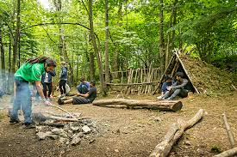
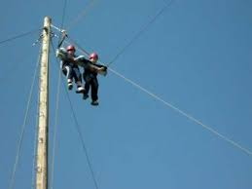
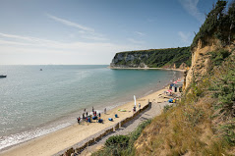
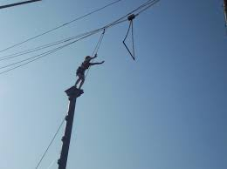
IOW 2019

Slide 2
IOW 2019
Staffing
Clothing – to and from IOW plus packed lunch
Clothing in general inc disco
Meeting up – on Monday and Friday
Activities - cameras
Dorms – extra pillow, books, cards.
Food – not required except for Monday’s packed lunch
Extra item - torch

Slide 3
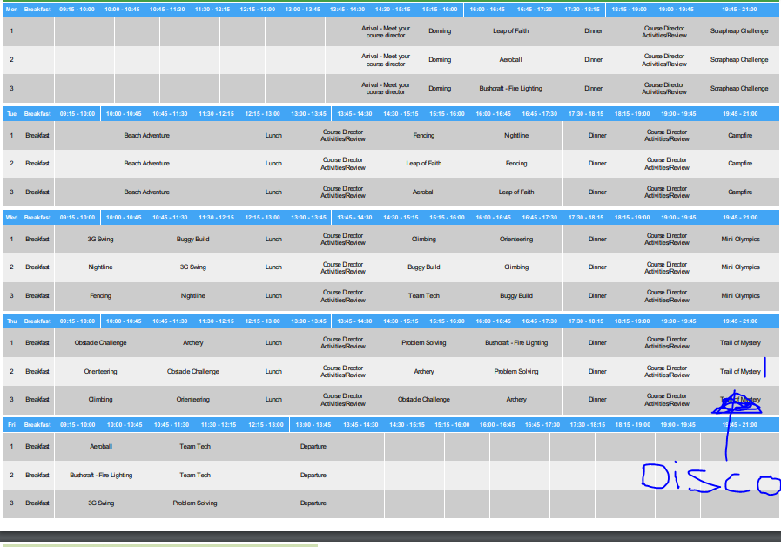

Slide 4
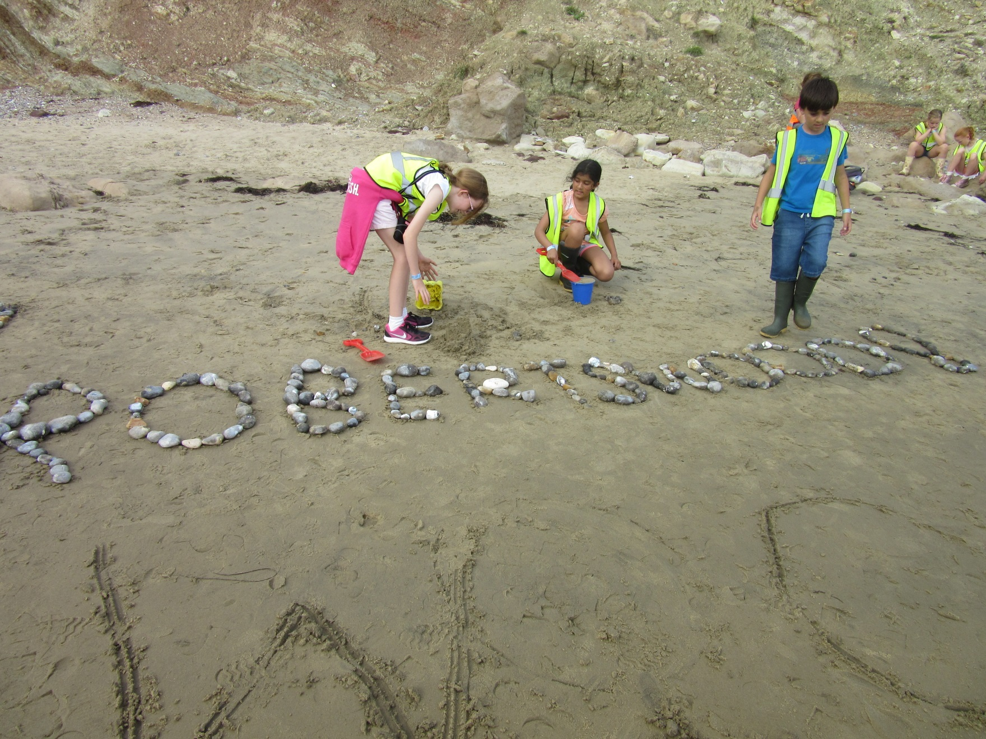

Slide 7
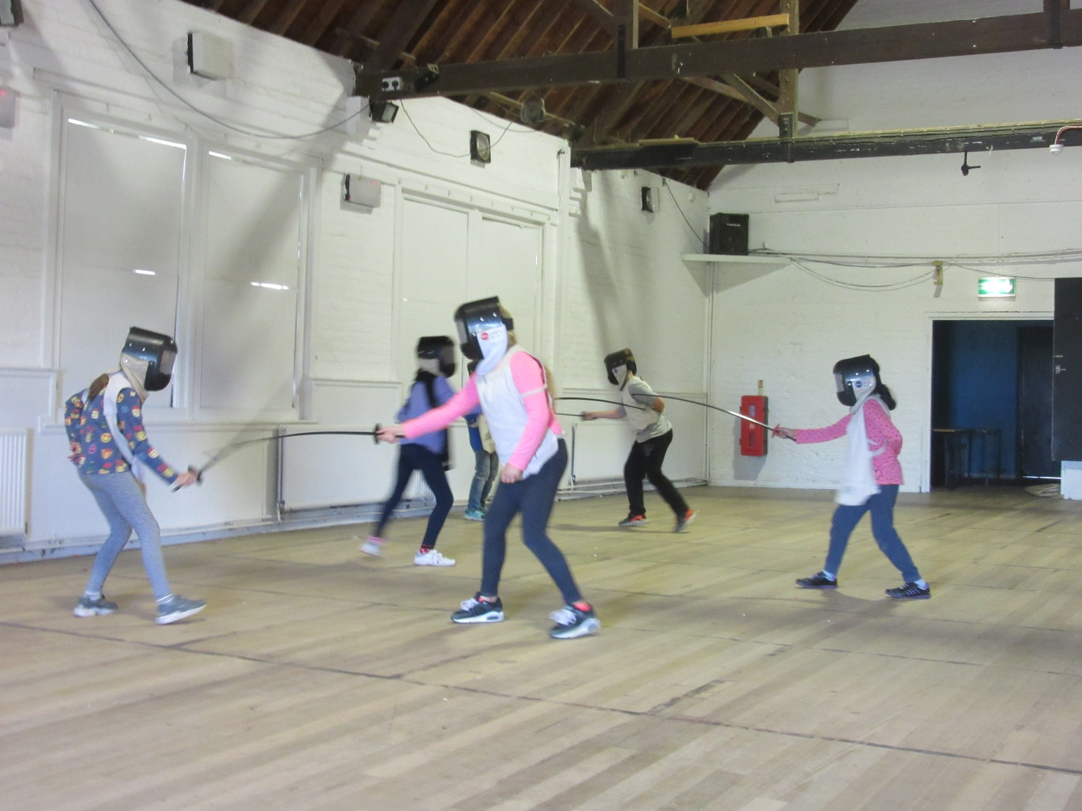

Slide 8
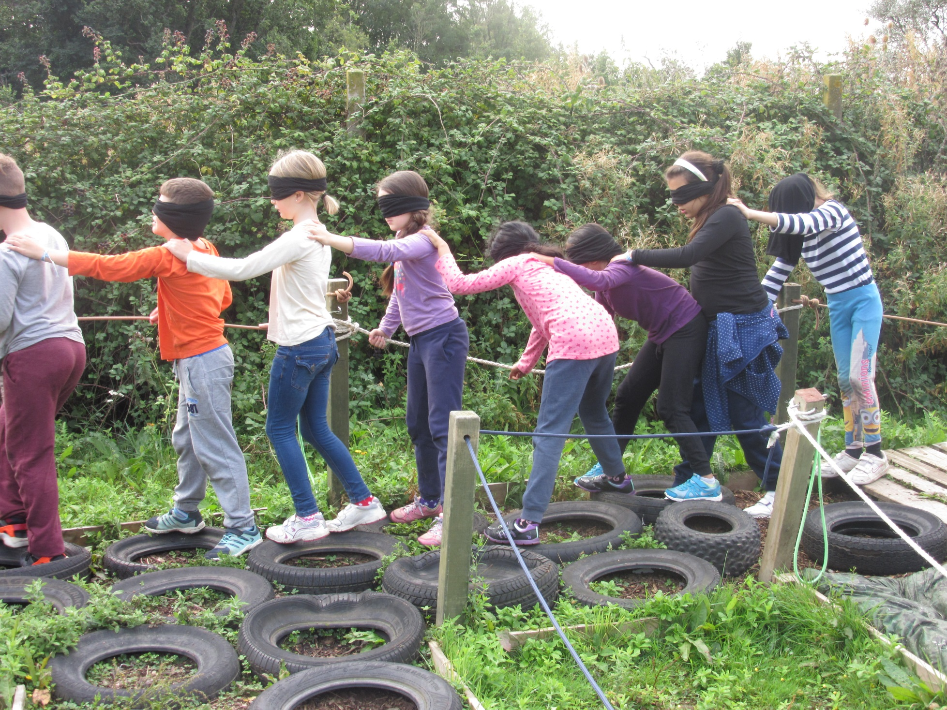

Slide 9
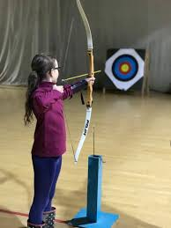

Slide 11
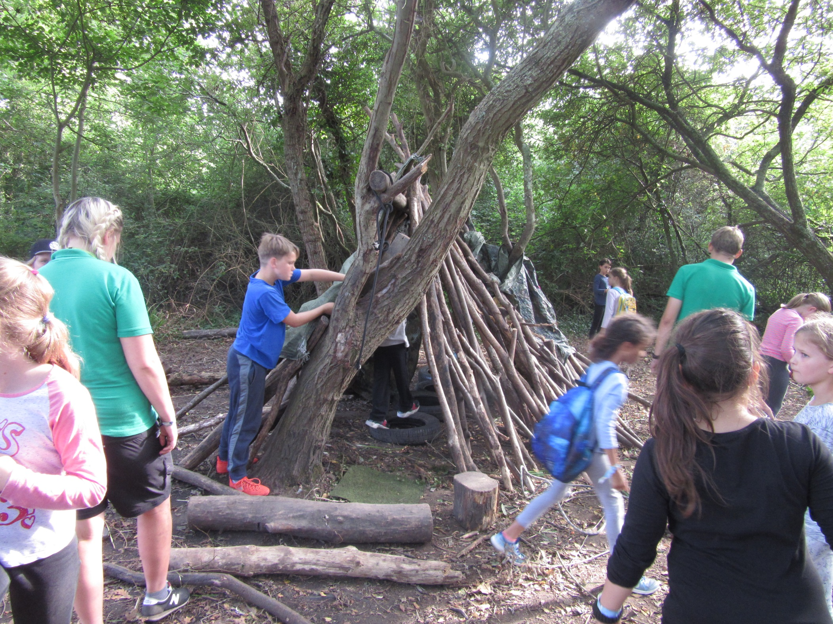

Slide 12
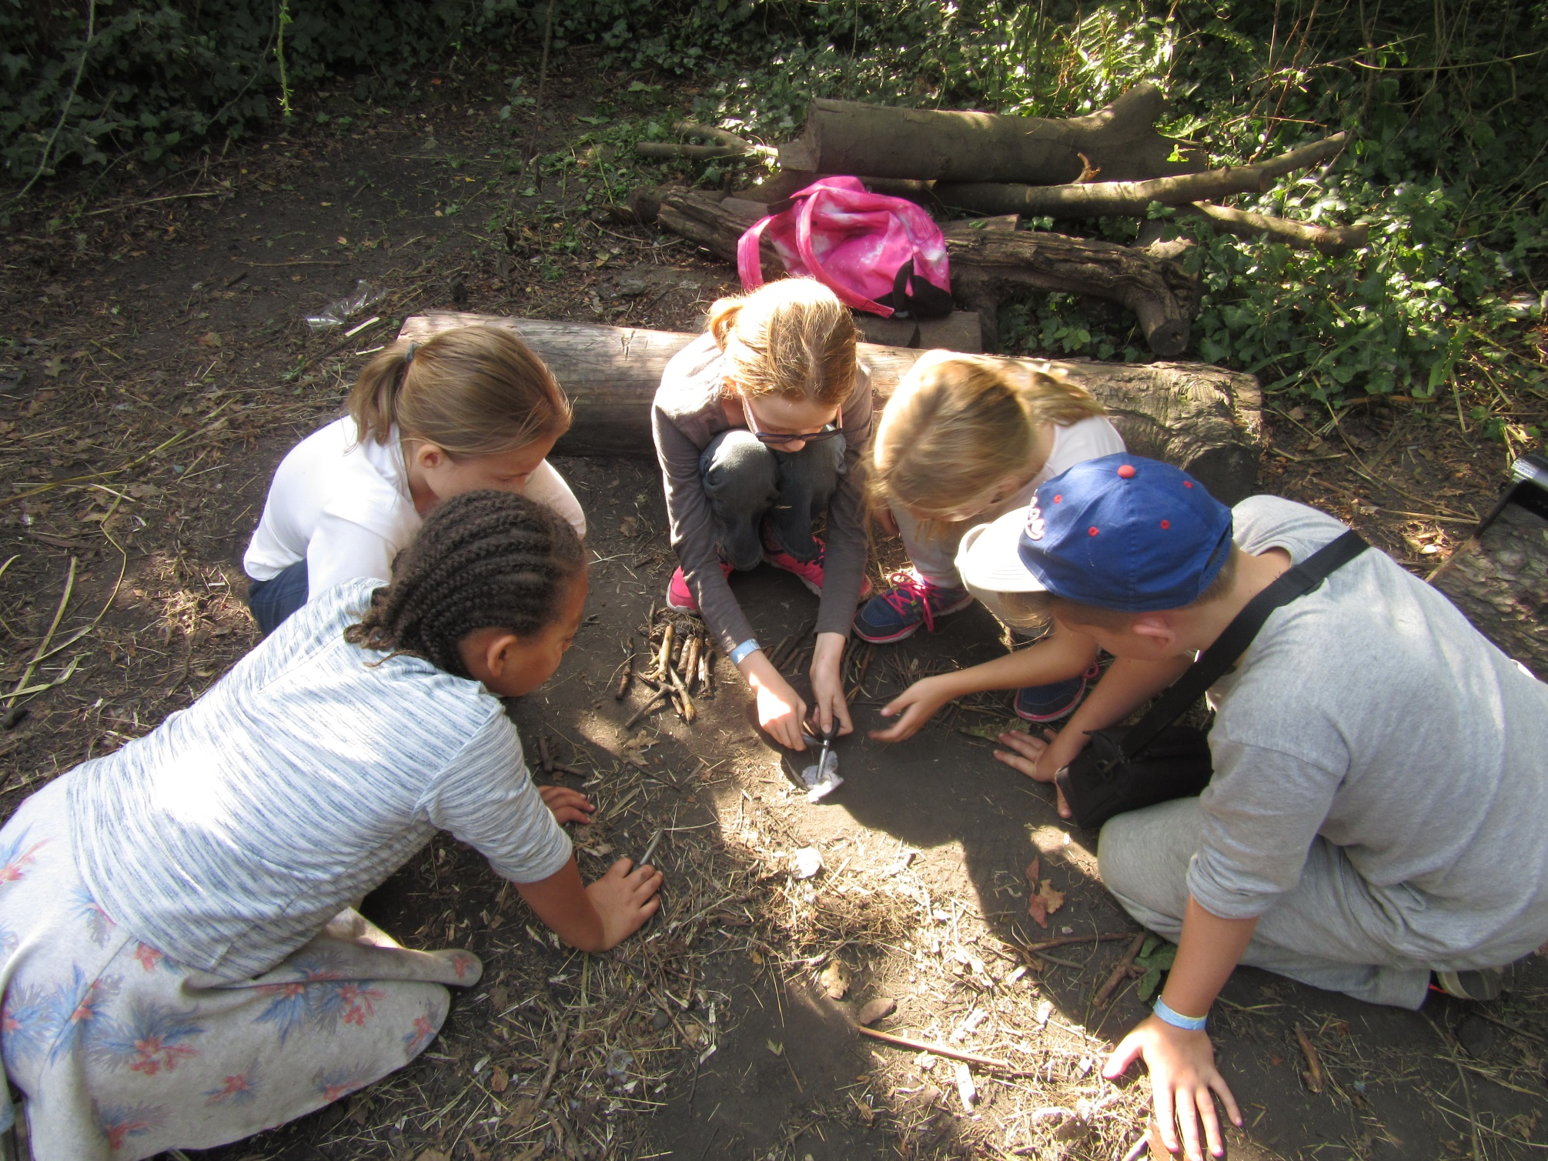

Slide 14
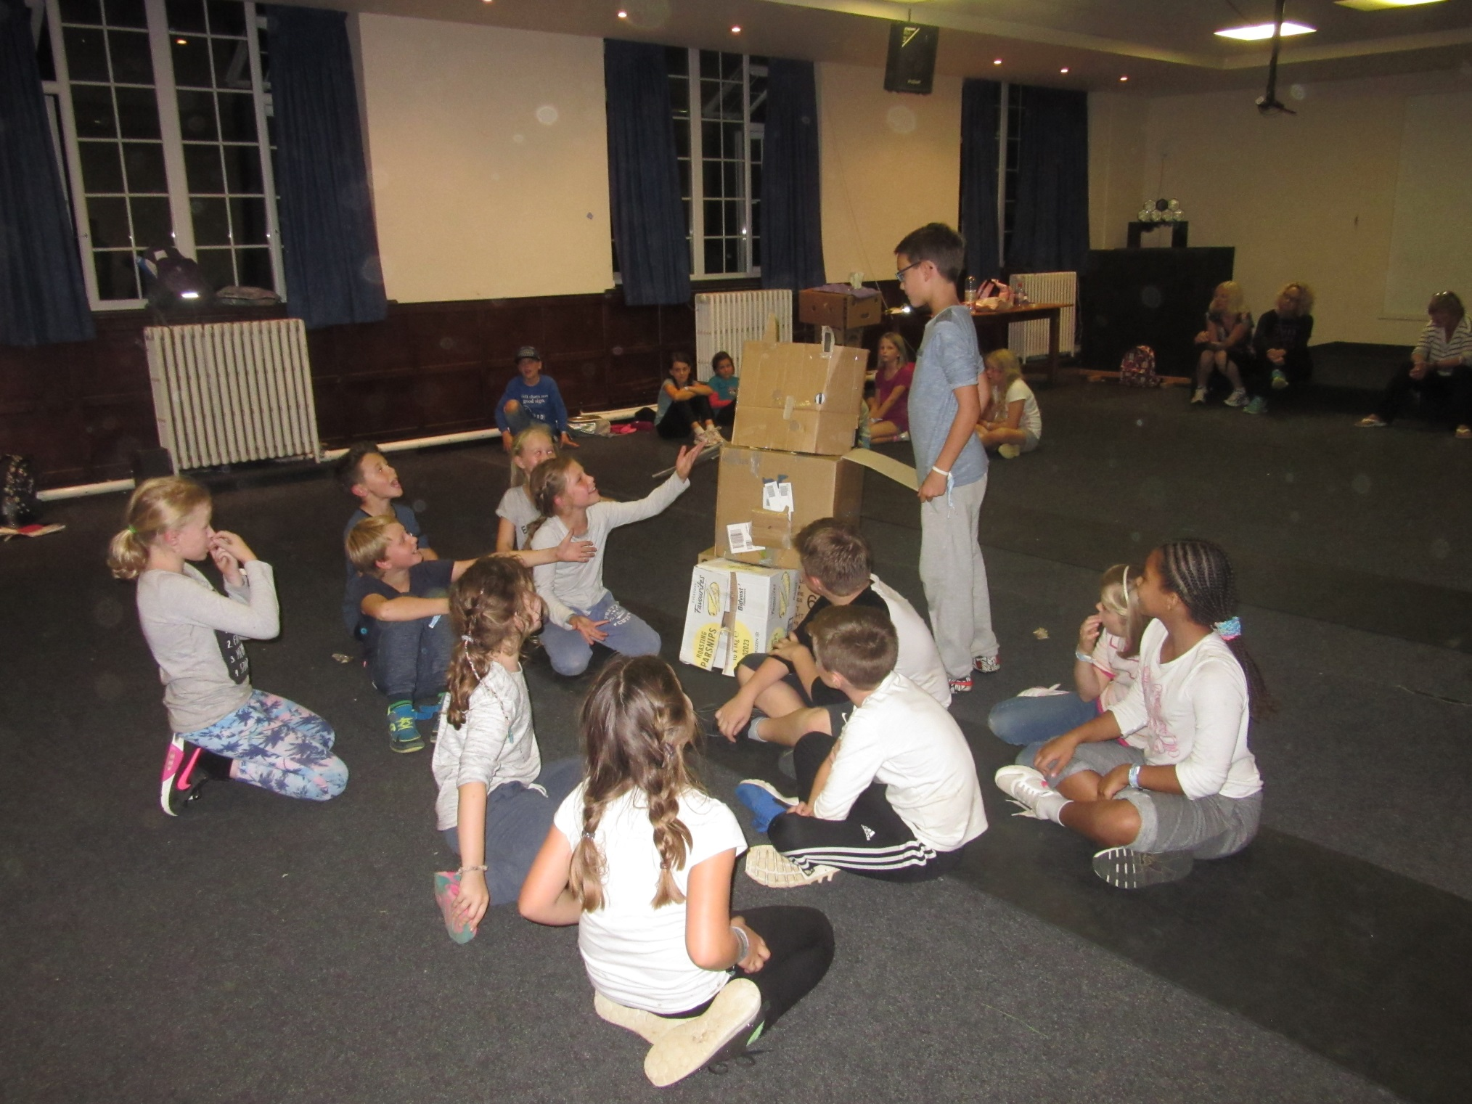

Slide 15
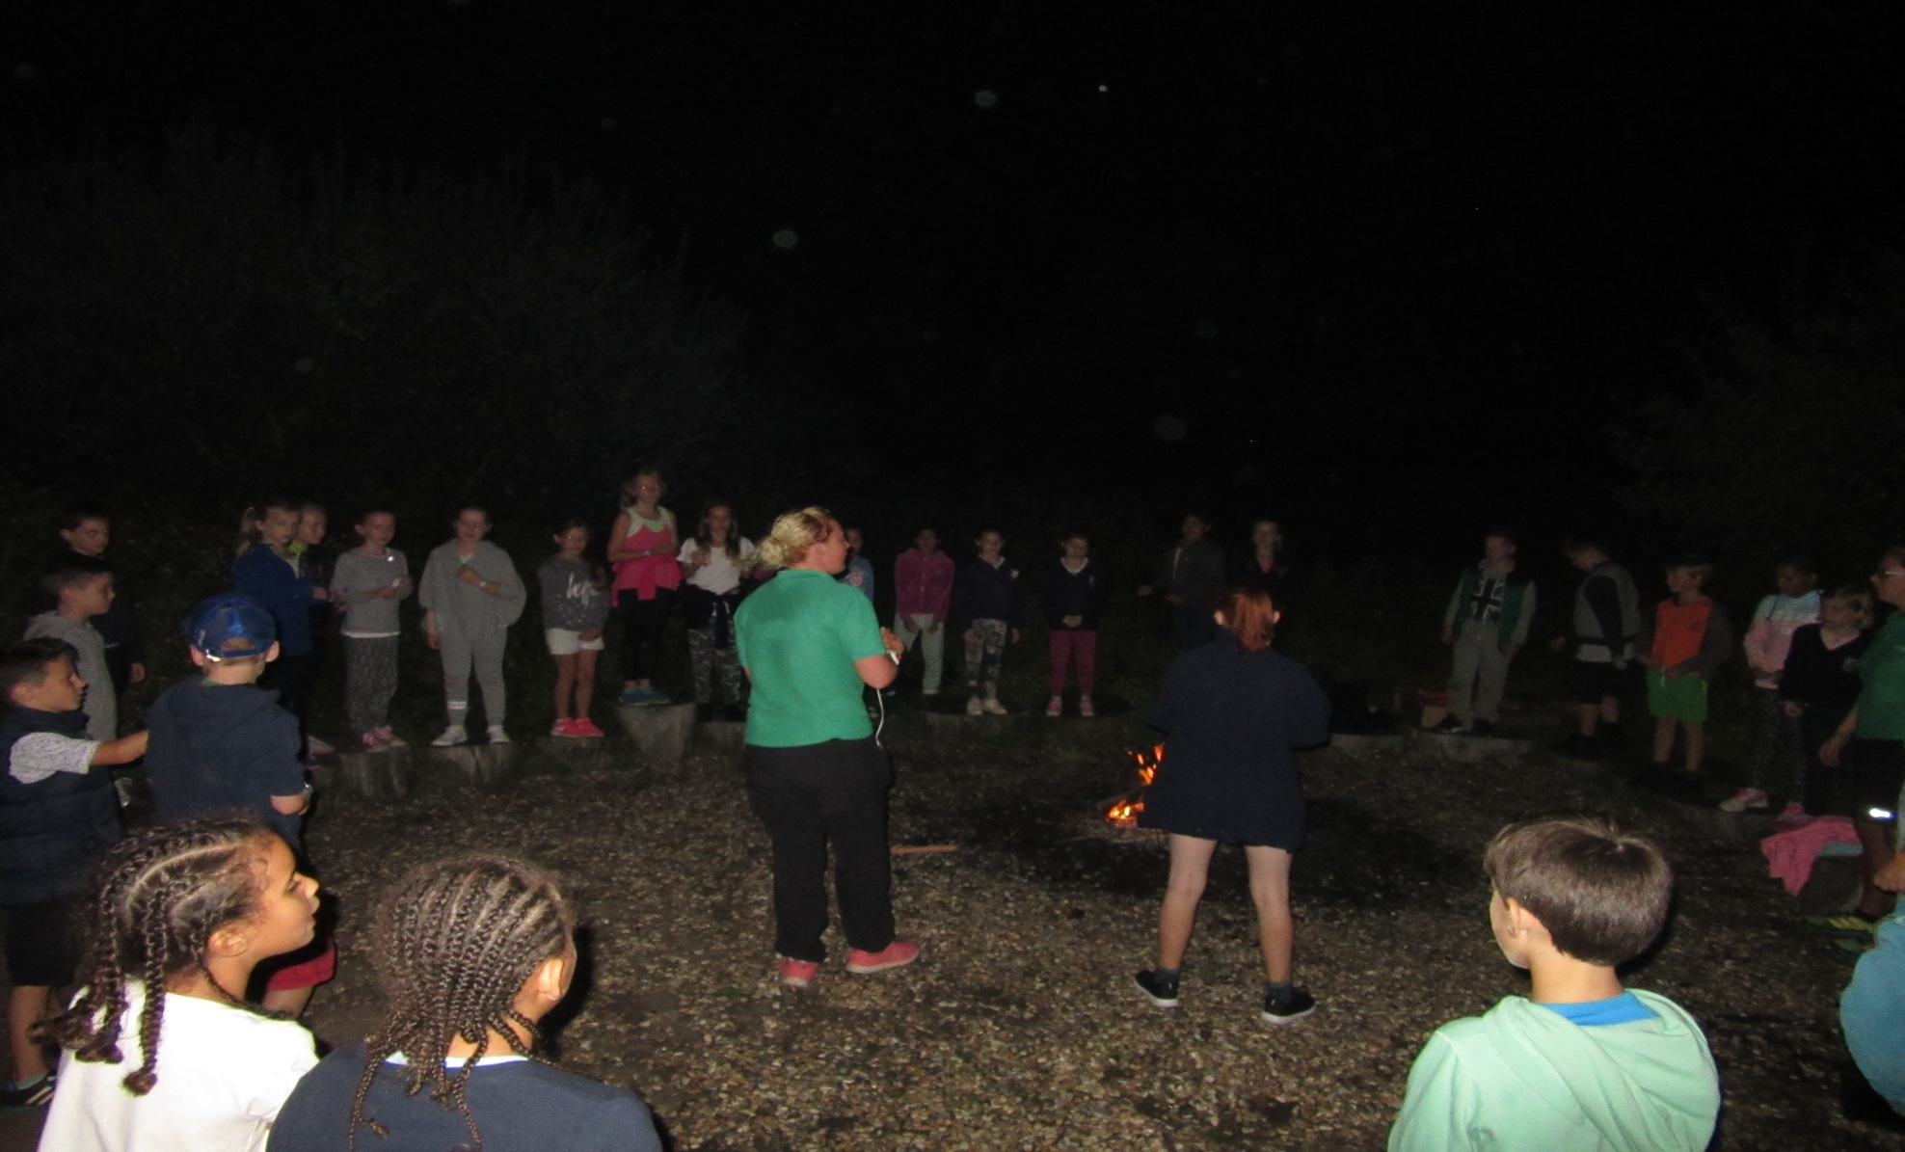

Slide 16
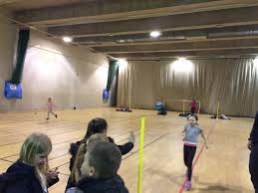

Slide 17
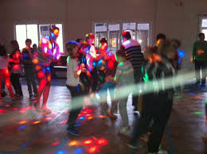

Slide 18
Food
Breakfast TBC
X2 activities
Lunch 12.15
X3 activities
Dinner 5.30
Activity
Evening activities

Slide 19
Rooms
6 – 8 sleeps – room groupings released on arrival
Boys downstairs
Girls upstairs
Room inspections before breakfast
Showers each night (not necessarily washing hair each night)

Slide 20
Updates
www.robertswoodschool.co.uk
Under ‘parents’ and ‘residential updates’

Slide 21
