Slide 1
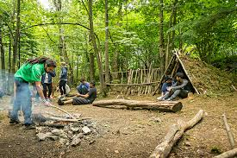
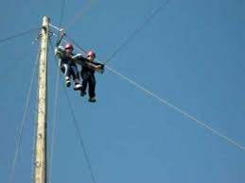
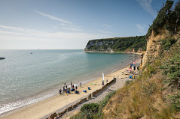
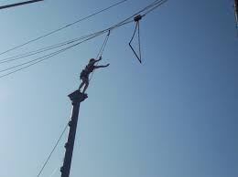
Isle of Wight – Year 5
8th – 12th March 2021

Slide 2
IOW 2021
Activities
– at least 2 friends (groups of 15) in day groups
– children have chance to lead group around site – Kingswood leaders lead sessions.
Dorms
– at least one friend (6-8 in a room)
Food

Slide 3
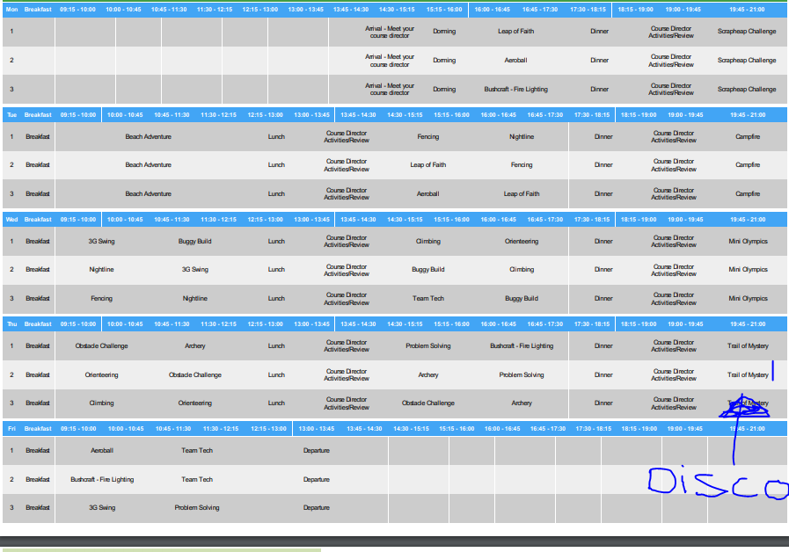

Slide 4
Timings of the day
07.00 Wake up 07.30 Room inspections 08.00 Breakfast | Session 1 9.15 | Session 2 10.00 | Session 3 11.15 | Lunch 12.00 | Session 4 13.00 | Session 5 13.45 | Session 6 14.30 | Dinner 17.30 | Evening session 19.45- 21.00 | 21.15 Showers and ready for bed 21.45 Quite time 22.00 Lights out
Free time 18.30

Slide 5
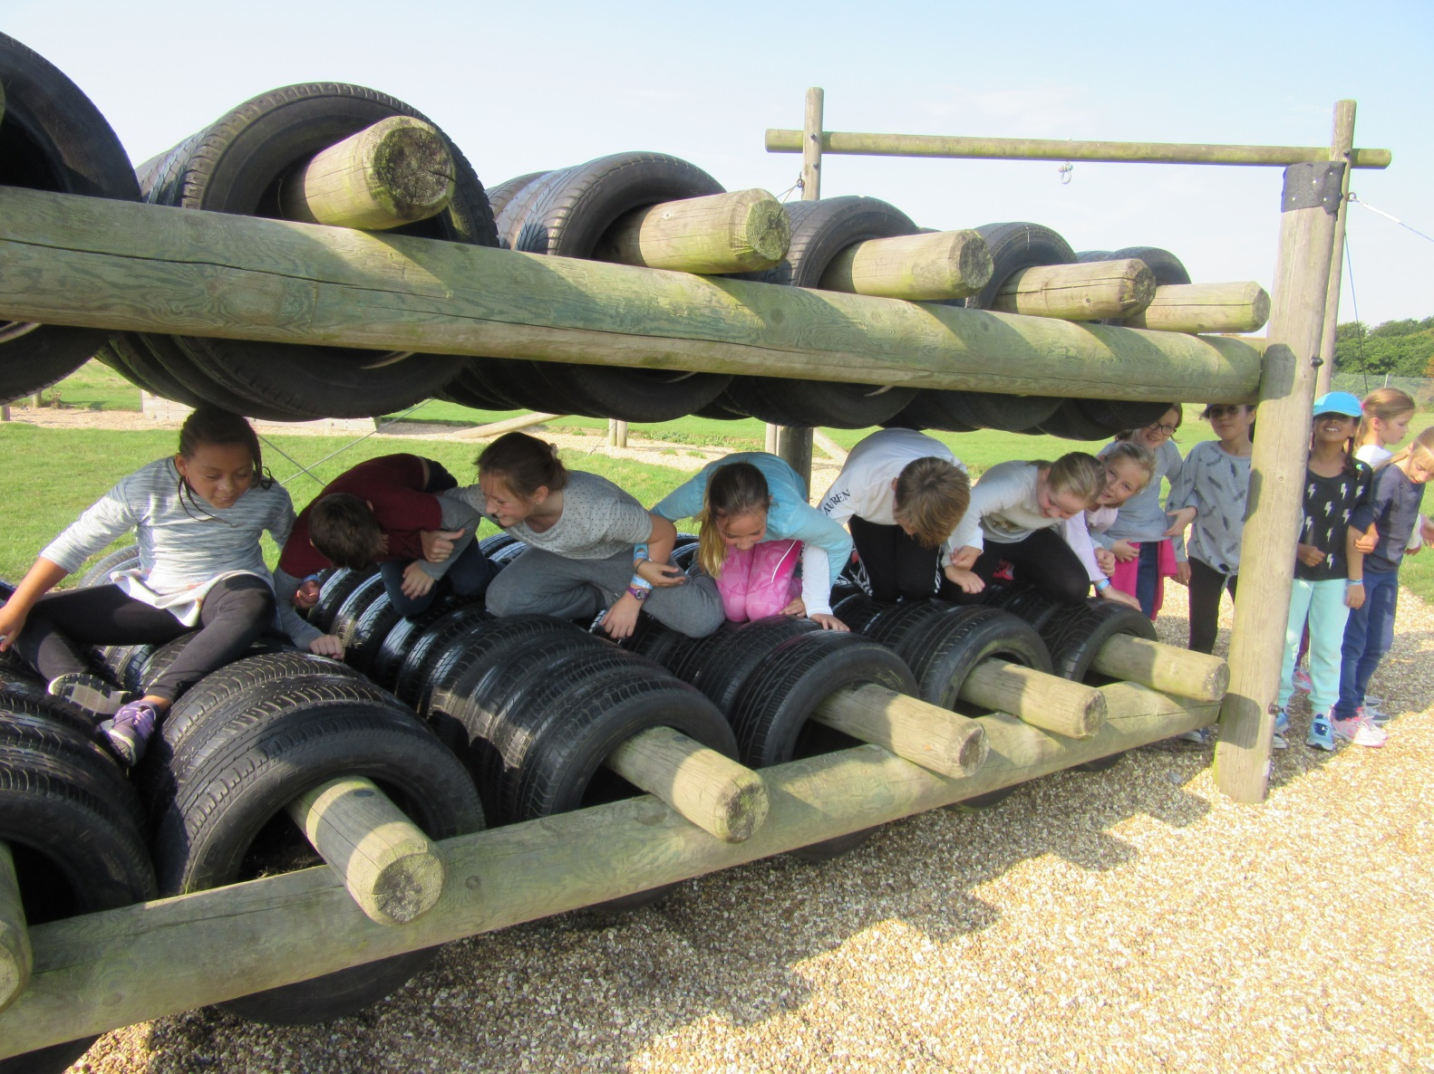

Slide 6
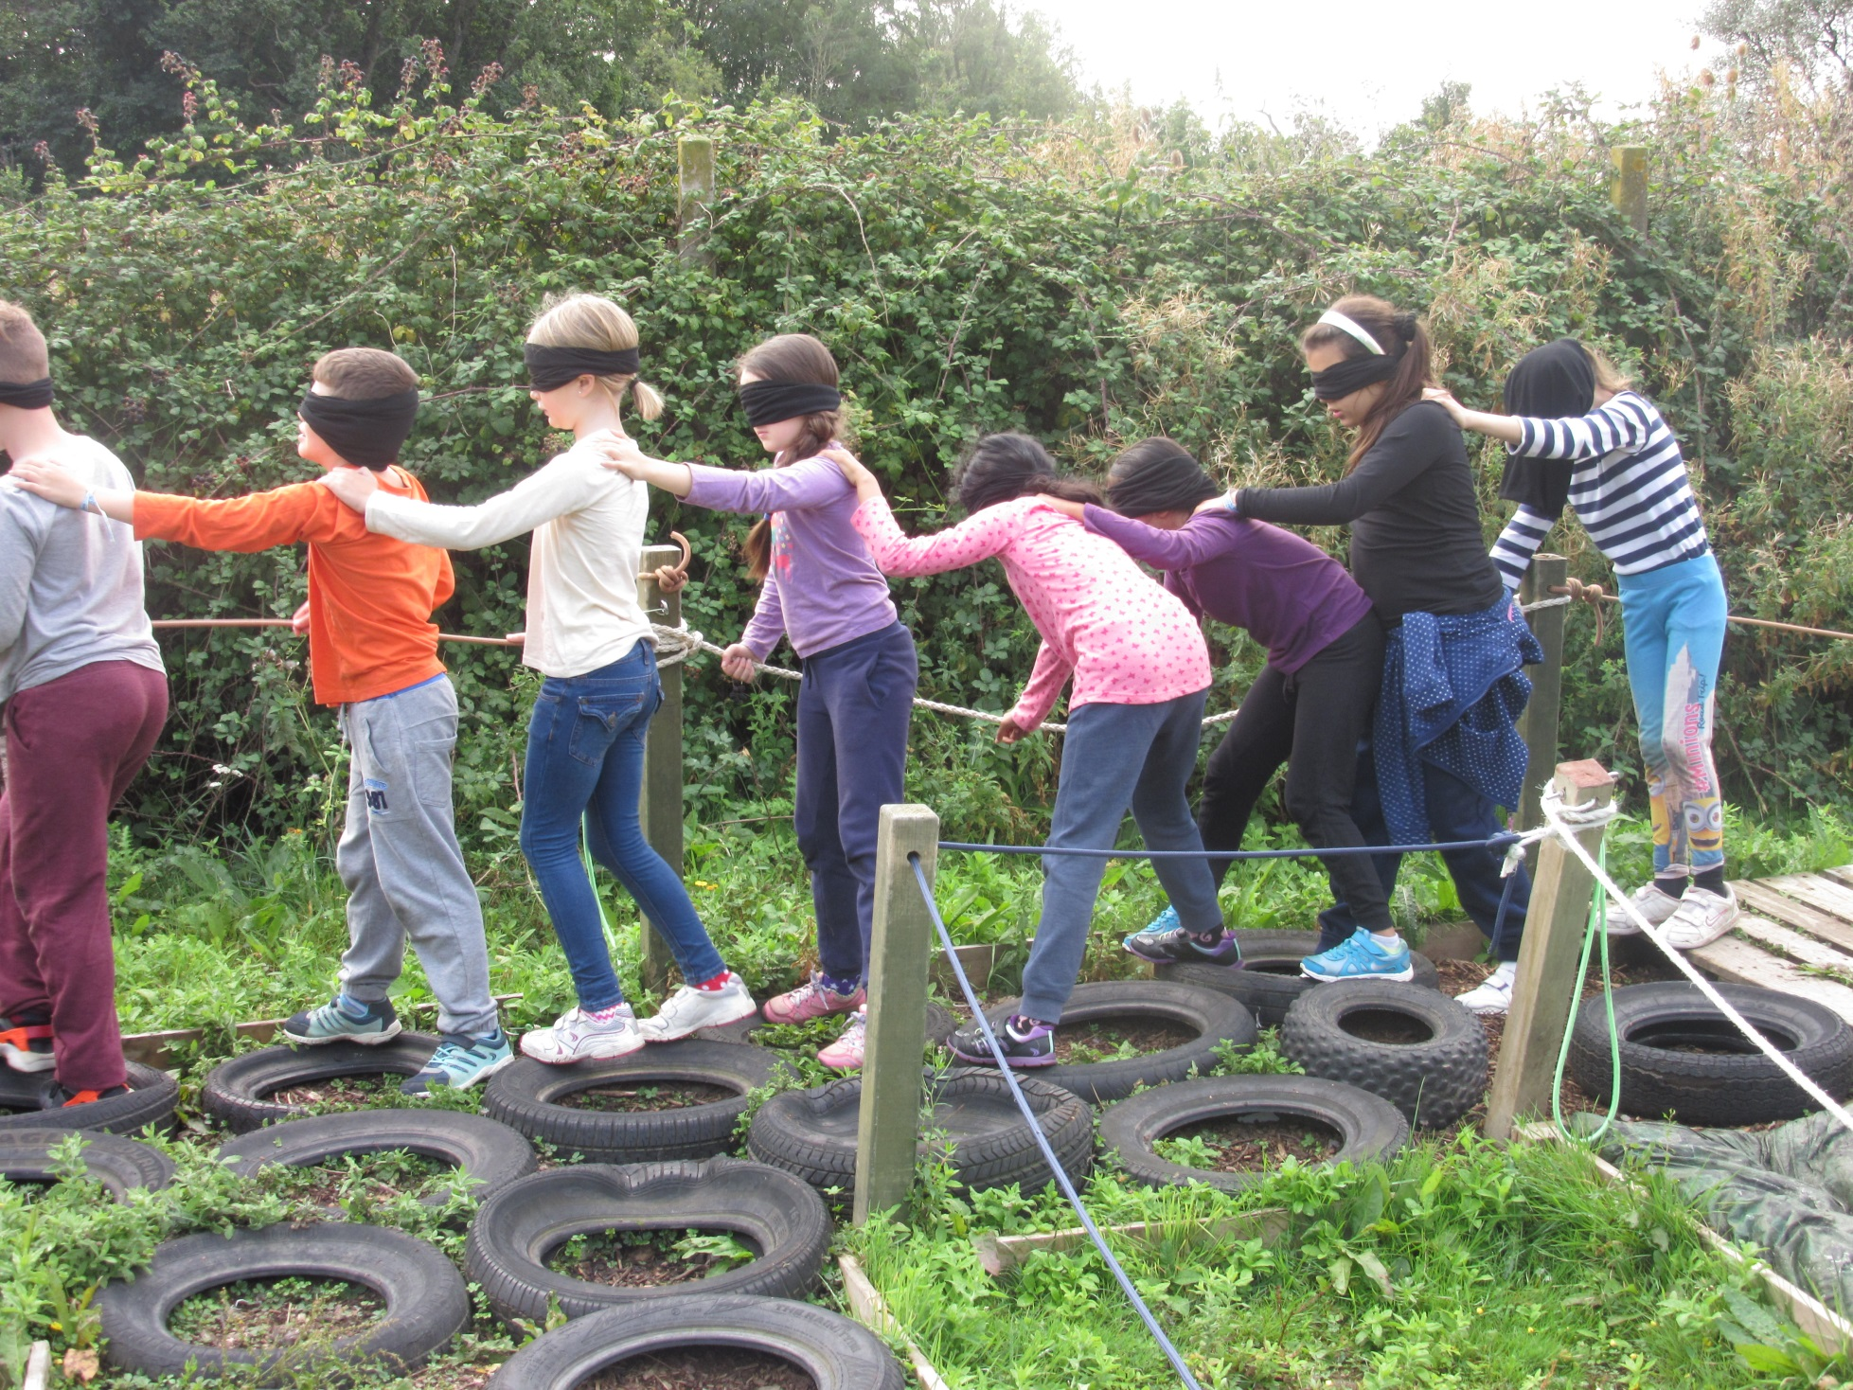

Slide 9
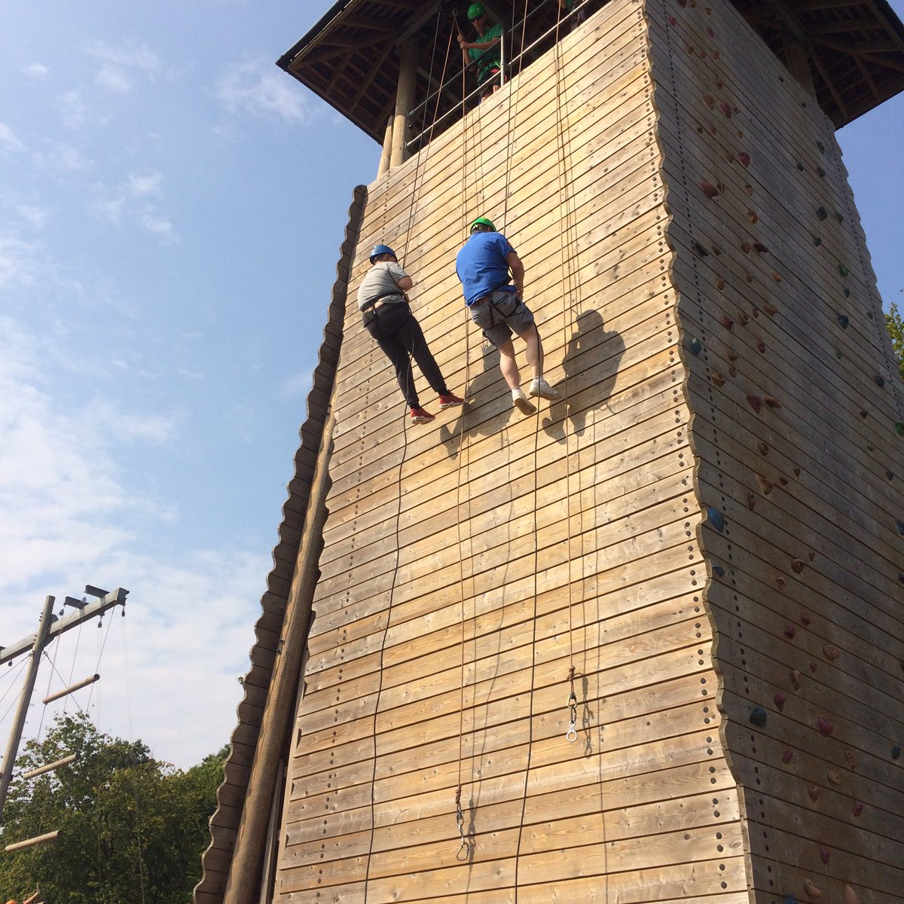

Slide 10
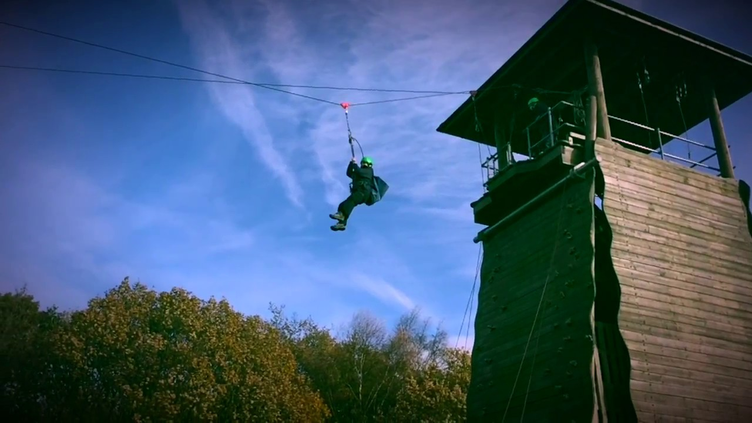

Slide 11
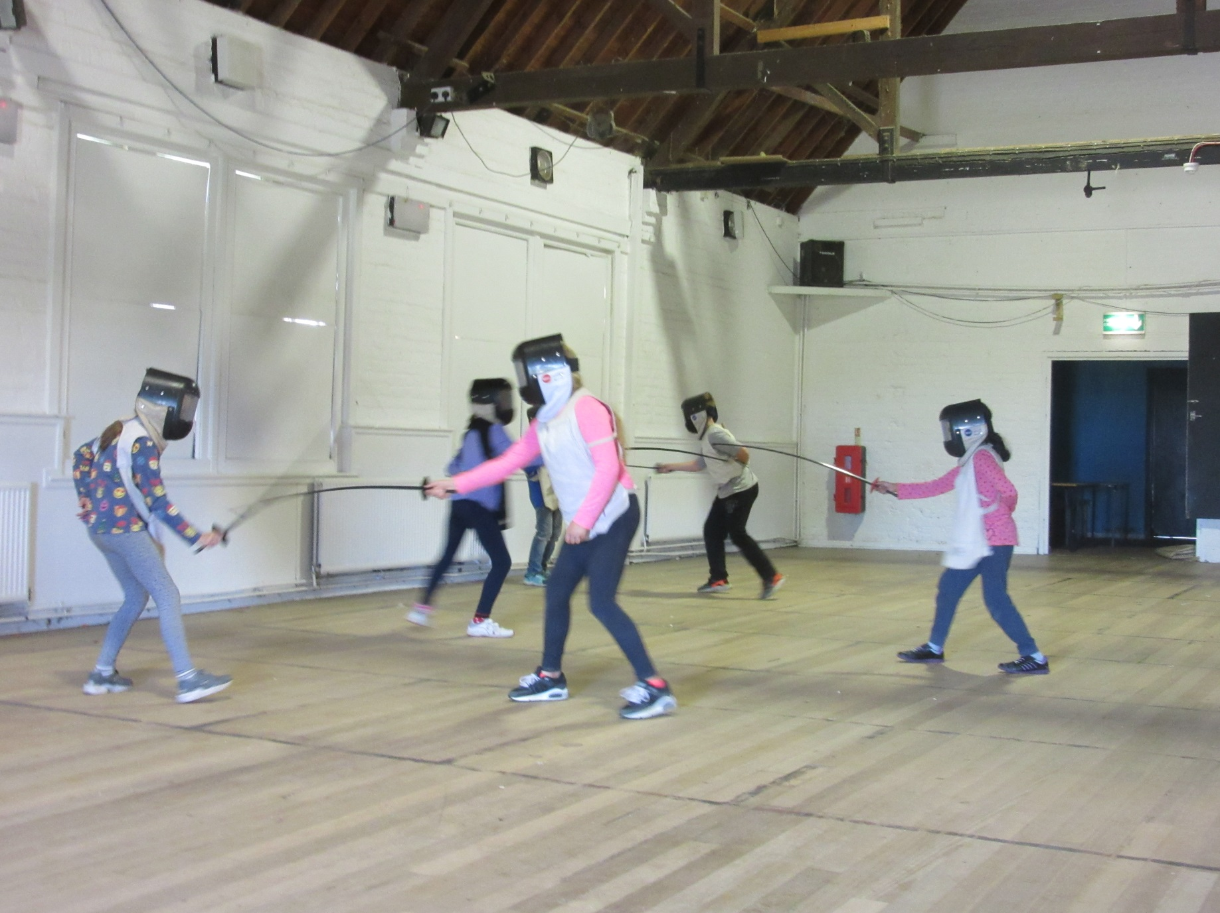

Slide 12
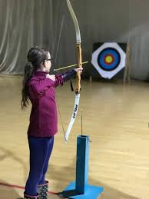

Slide 13
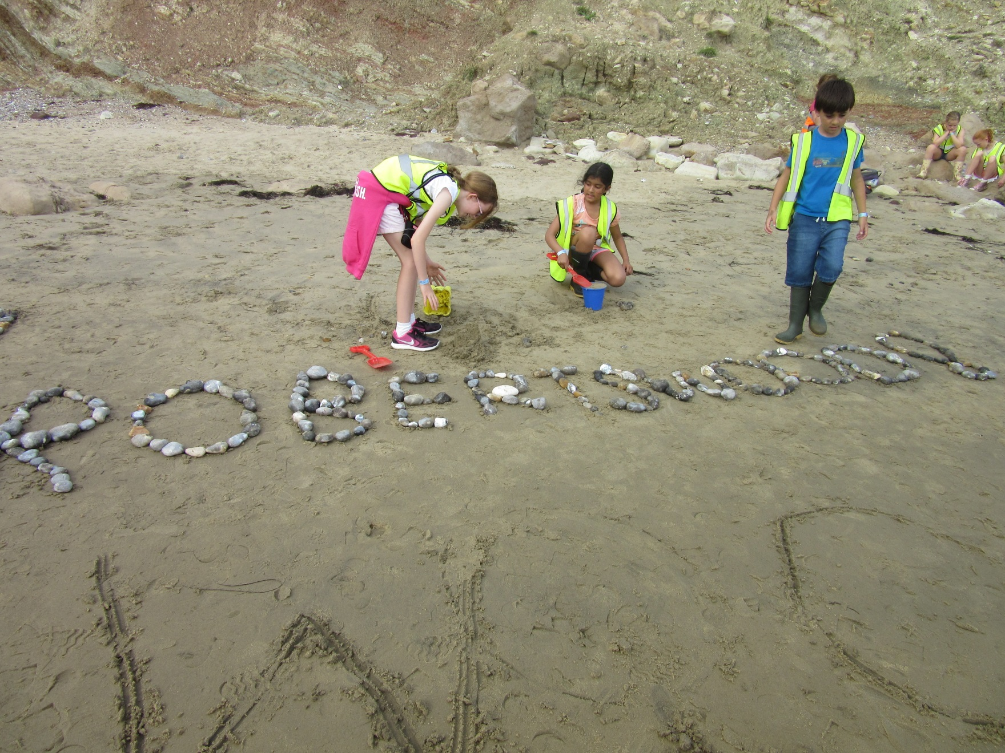

Slide 14
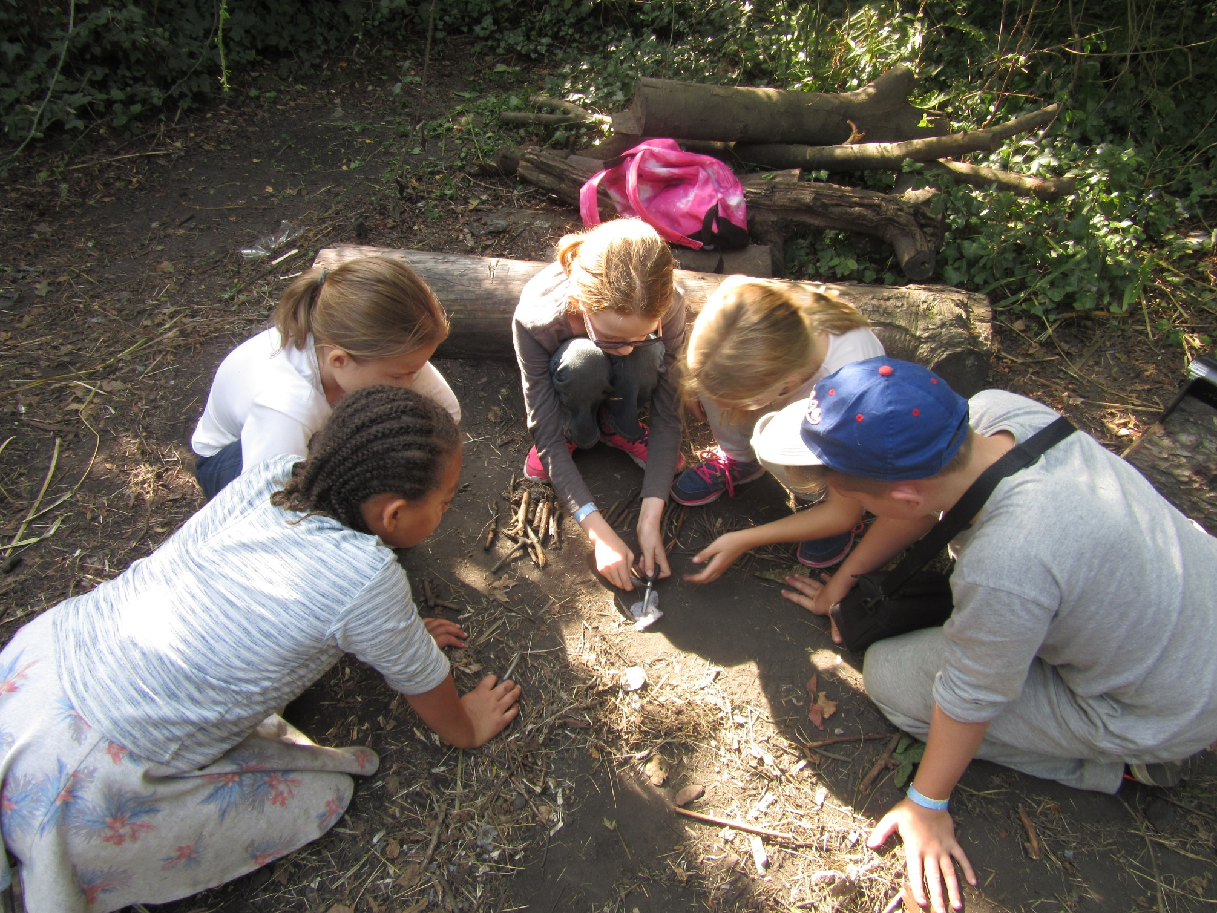

Slide 15
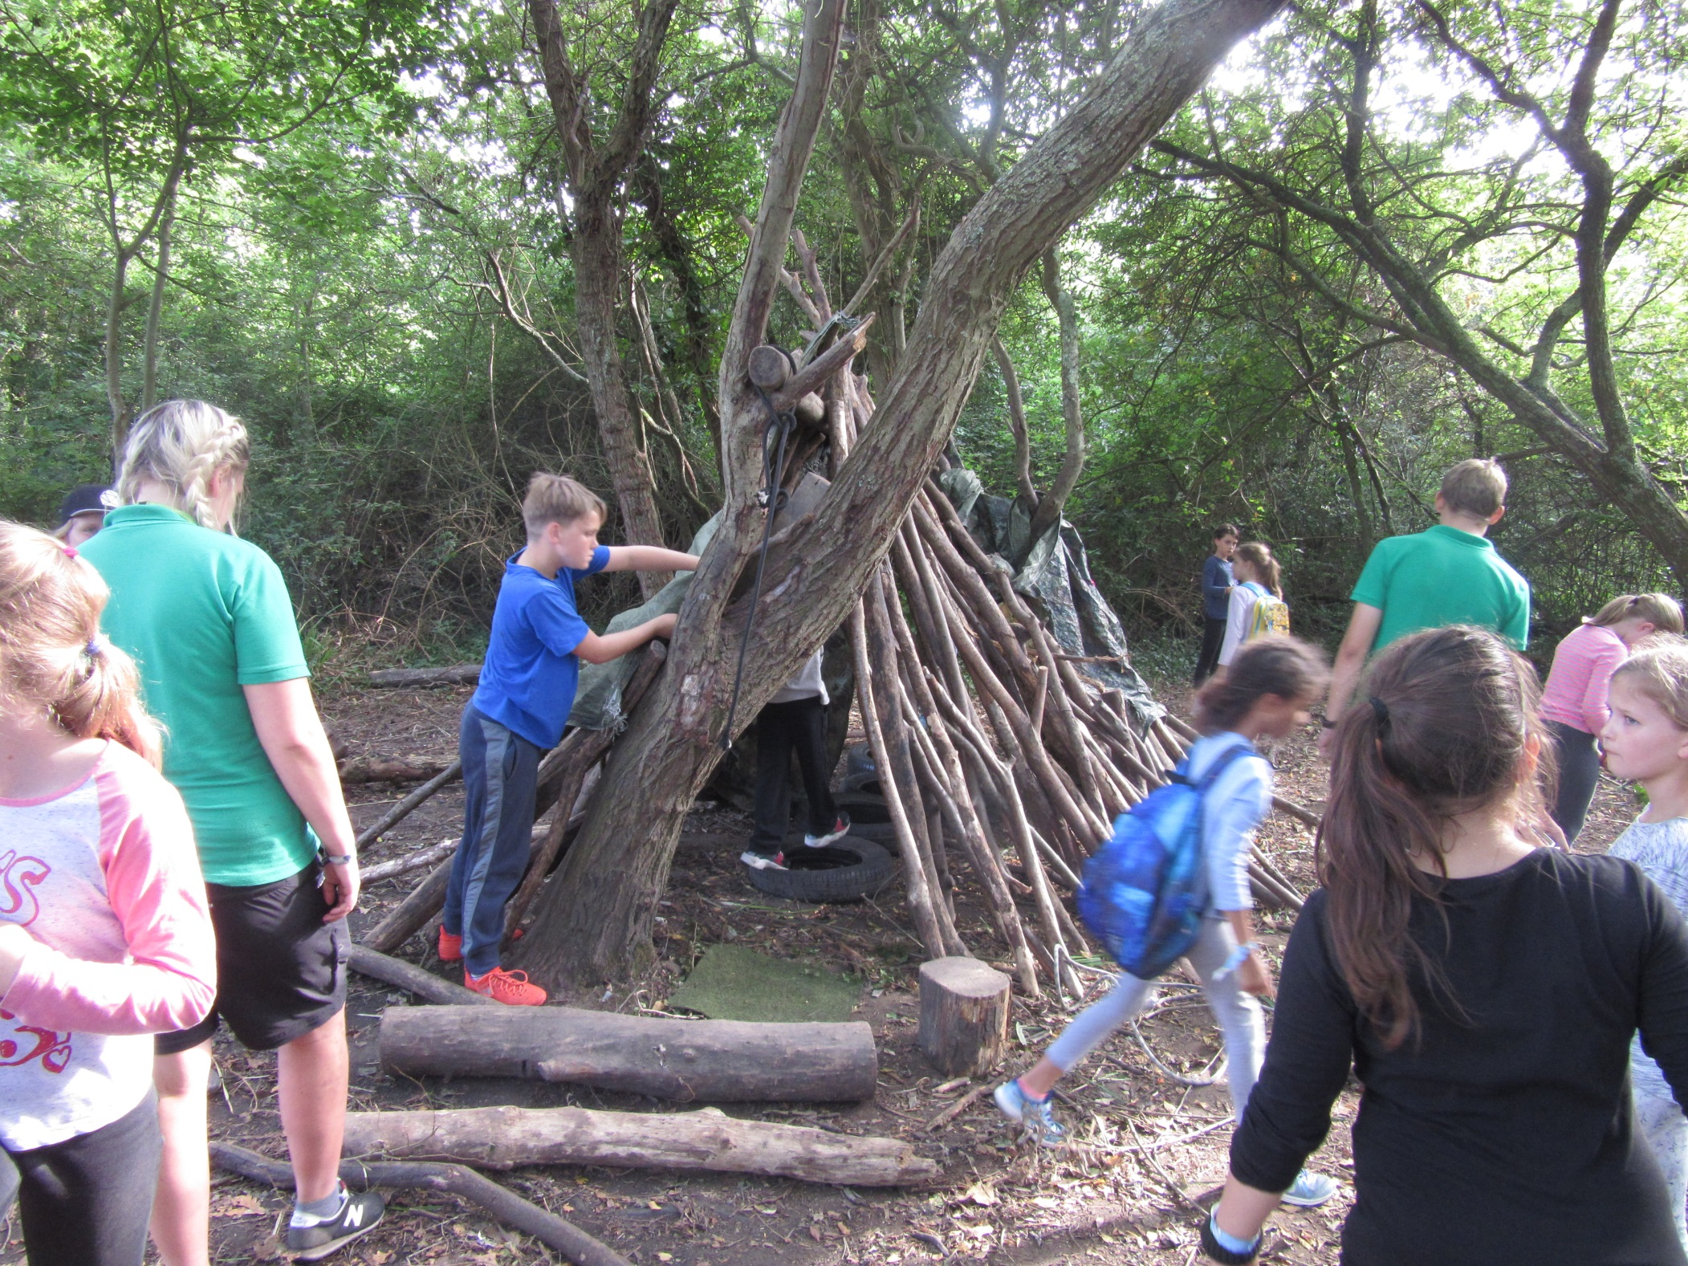

Slide 16
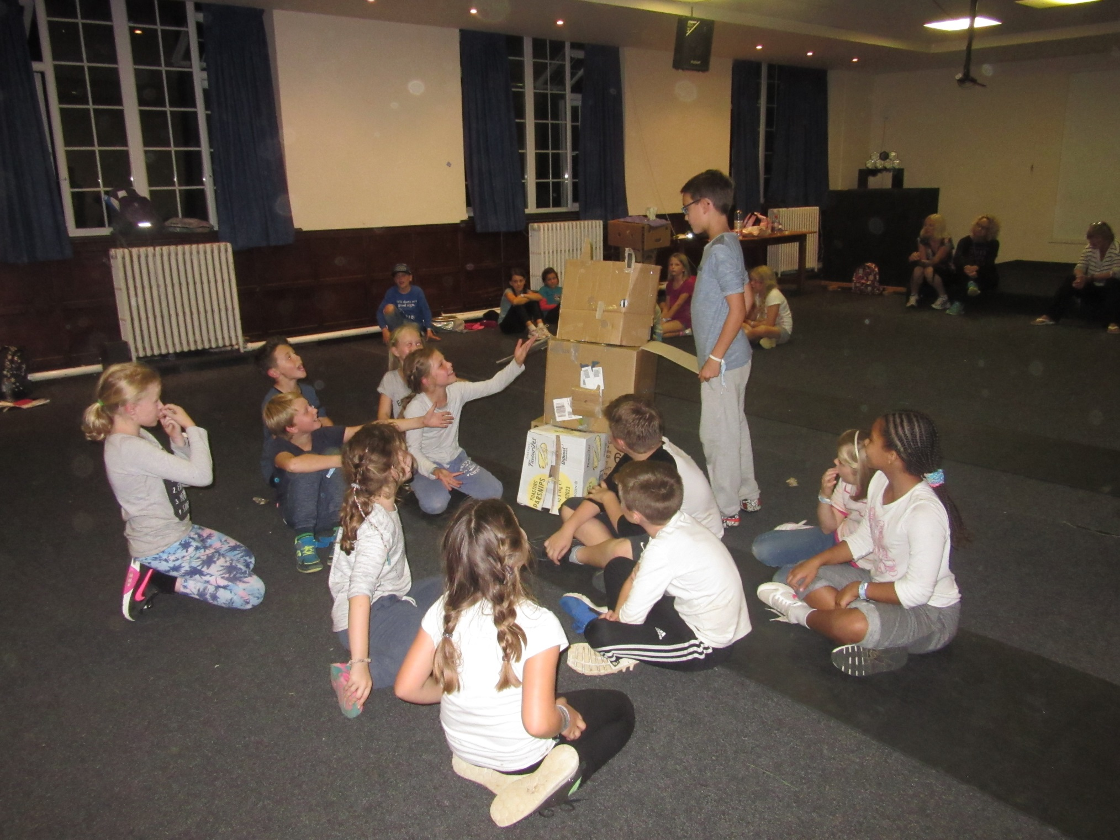

Slide 17
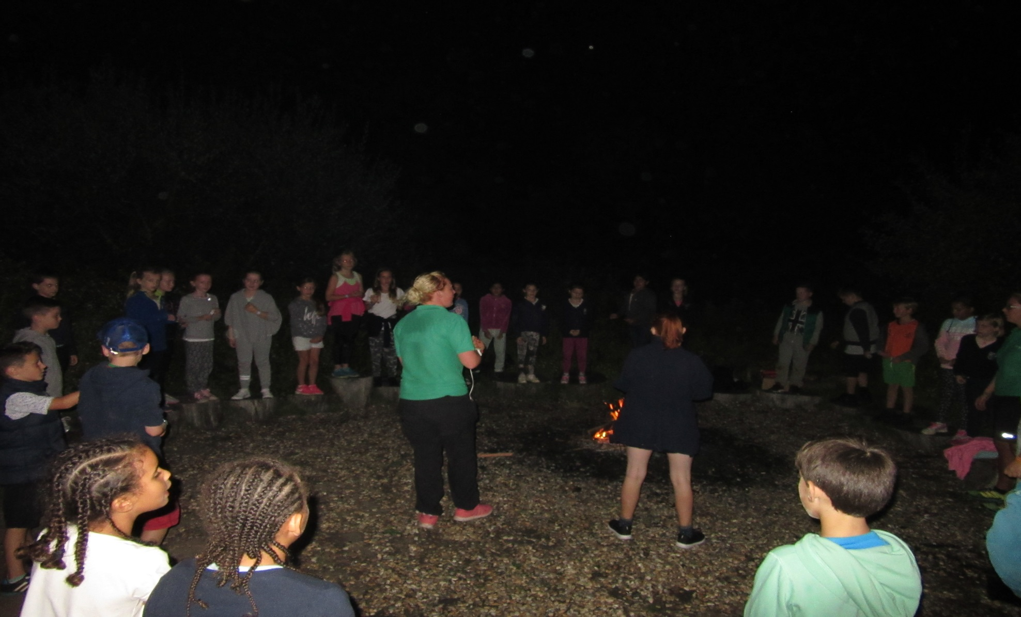

Slide 18
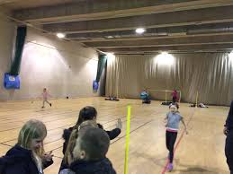

Slide 19
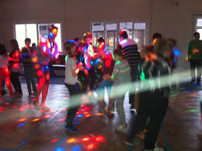

Slide 20
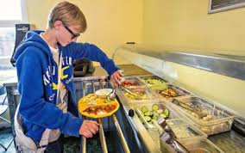
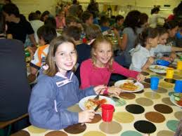
Food
Breakfast TBC
X3 activities
Lunch TBC
X3 activities
Dinner TBC
Evening activities

Slide 21
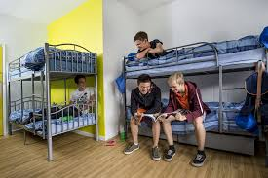
Rooms
6 – 8 sleeps – room groupings released on arrival – at least one friend nominated
Boys downstairs
Girls upstairs

Slide 22
Updates
www.robertswoodschool.co.uk
Under ‘parents’ and ‘residential updates’

Slide 23
