Slide 1

Simplified-Issue/Individually-Owned
Cash-Benefit Programs - California

Slide 2


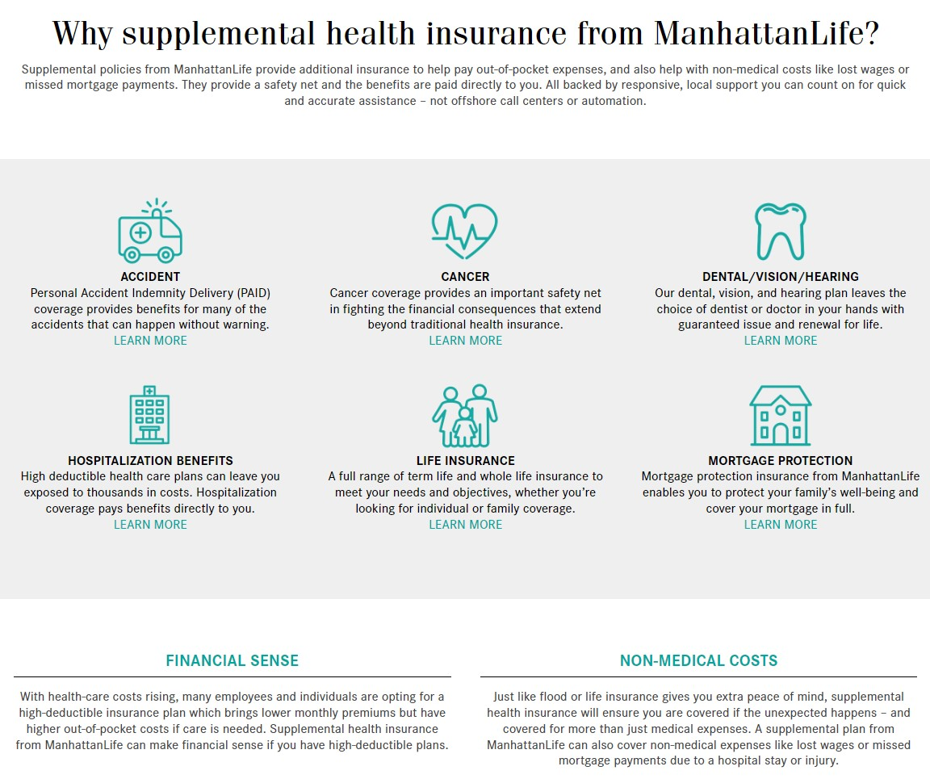
ManhattanLife Overview

Slide 3
Why do people sign up for Cash-Benefit programs?
We all own insurance for specific reasons:
  Car Insurance is purchased to pay the auto mechanic, so that we don’t have to pay for all the expenses.
  Home Owners/Renters Insurance is purchased to pay for repairs or replacements to our property & effected items.
  Traditional Health Insurance is purchased to pay the hospitals & medical providers, so that we don’t have to pay for all the expenses.
  Life Insurance is purchased to pay off debts & provide additional financial support for living loved ones.
Unfortunately, most families do NOT have insurance that will pay them cash to help pay their monthly bills, help replace lost income and/or help them pay for all the leftover medical bills. Making sure that we have money coming in to pay our bills & support our family SHOULD BE our highest priority, but most people don’t know (until now) that there are insurance programs that do just that!
Manhattan Life benefits PAY CASH DIRECTLY TO YOU, & the programs typically cost $2-$8/week for Individuals & just a few dollars more to cover the entire family!

Slide 4







Simplified-Issue/Individual Benefits - California (Sept ‘24)
Affordable Choice
(Fixed-Indemnity Health Plan)
Signup Ages 18-64
Dental, Vision & Hearing
(Standalone or In Addition)
Signup Ages 18-85
Accident/Injury Policy
(includes AD&D & Wellness)
Signup Ages 18-84
Out-of-Pocket Protection
(Medical Bills Gap Plan)
Signup Ages 18-64
Cancer, Heart & Stroke (CHAS)
(Lump-Sum Cash Payout)
Signup Ages 20-64
Cancer Care Plus
(Ongoing Payment Plan)
Signup Ages 20-64
Term Life Insurance
(Affordable Death Benefit)
Signup Ages 18-60
Whole Life Insurance
(Cash Value + Death Benefit)
Signup Ages 45-89

Slide 5
Which plans may be best for you?
Are you or your family looking to save money on health insurance and/or own something that pays YOU, not the doctors/hospitals?
  If so, we highly recommend looking into the Affordable Choice plan as a standalone policy OR in addition to what you have.
Are you or your family in need of Dental, Vision or Hearing coverage, OR on Medicare & in need of coverage?
  If so, take a look at our Dental, Vision & Hearing plan as a standalone policy OR in addition to what you have.
Are you or your family active, in sports, manual labor, traveling, and/or likely to experience even the smallest of injuries?
  If so, you’ll probably make money owning the PAID Enhanced Accident plan.
Are you or your spouse looking for an affordable way to cover copays & deductibles?
  If so, you may want to look into the Out-of-Pocket Protector plan (though we would probably recommend the Affordable Choice regardless).
Are you or your family concerned about the diagnosis of Cancer or experiencing a heart condition, based on lifestyle and/or family history?
  If so, the CHAS Lump-sum plan & Cancer Care Plus plans are definitely something to look into.
Are you or your family looking for an affordable life insurance program to pay off debt & provide financial security for the living with no physical/labs?
  If so, please ask for a quote for the Viva Life Insurance plans (Term & Whole Life).
If you don’t see a need for all of the plans, that’s perfectly fine. Most people feel comfortable initially participating in 1-3 plans, & adding on as needed. If your situation and needs change down the road changes, at least you know which policies are available. Our #1 priority is to educate you on the options available, and if 1 or more of the policies make sense for you & your family, we’re here to help enroll & support you after your coverages are in force. It’s a quick & easy enrollment process, & our only suggestion is that coverage must be in place before something happens. We can’t cover a situation that has already happened.

Slide 6

Affordable Choice Plan (AFC)
Affordable Choice Policy
This policy is unique to Manhattan Life & provides a strong yet affordable alternative to traditional health insurance plans. This plan is perfect for anyone who wants to own a health insurance plan that pays YOU (the policyholder), NOT the doctor or hospital (unless you assign payments to them). Ideal for self-employed, part-time and/or anyone wanting to supplement their current coverage.
Product Features
Four plan choices to choose from:
  Elite Plus (richest benefits & could be standalone coverage)
  Elite (standalone or partnered with high-deductible plan)
  Classic Plus (usually complements current coverage)
  Classic (most affordable compliment to current coverage)
Issue Ages: 18-64
Cancer benefit & 6 ancillary services included!
Notable Exclusion: Pregnancy is not covered

Slide 7

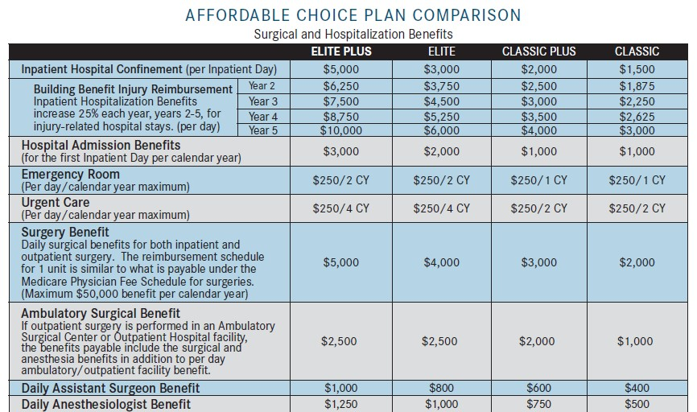
Policy Benefits
Elite Plus Example (highest tier)
Admission Benefit = $3,000
Hospital Confinement = $5,000/day
Emergency Room/Urgent Care = $250
4 benefits related to Surgeries
Classic Example (lowest tier)
Admission Benefit = $1,000
Hospital Confinement = $1,500/day
Emergency Room/Urgent Care = $250
4 benefits related to Surgeries
See policy for full details

Slide 8
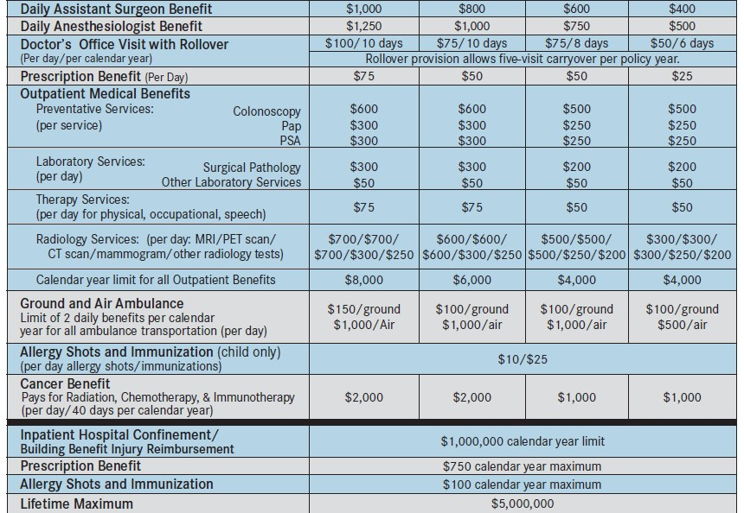
Policy Benefits (continued)
Elite Plus Example (highest tier)
Doctor’s Office Visits = $100 (x10)
  Unused benefits rollover
Prescription Benefit = $75/day
Preventive Services = Up to $600
Lab Services = Up to $300/day
Therapy Services = $75/day
Radiology Services = Up to $700/day
Ground/Air Ambulance = Up to $1,000
Allergy Shots & Immunizations Benefits
Cancer Benefit = $2,000/day
Policy Limits
Outpatient Benefits = $8,000/cal. year
Inpatient Hospital Confinement =
$1,000,000/calendar year
Prescription Benefit = $750/cal. year
Allergy Shots/Immunizations = $100/y
Lifetime Maximum = $5,000,000
See policy for full details

Slide 9
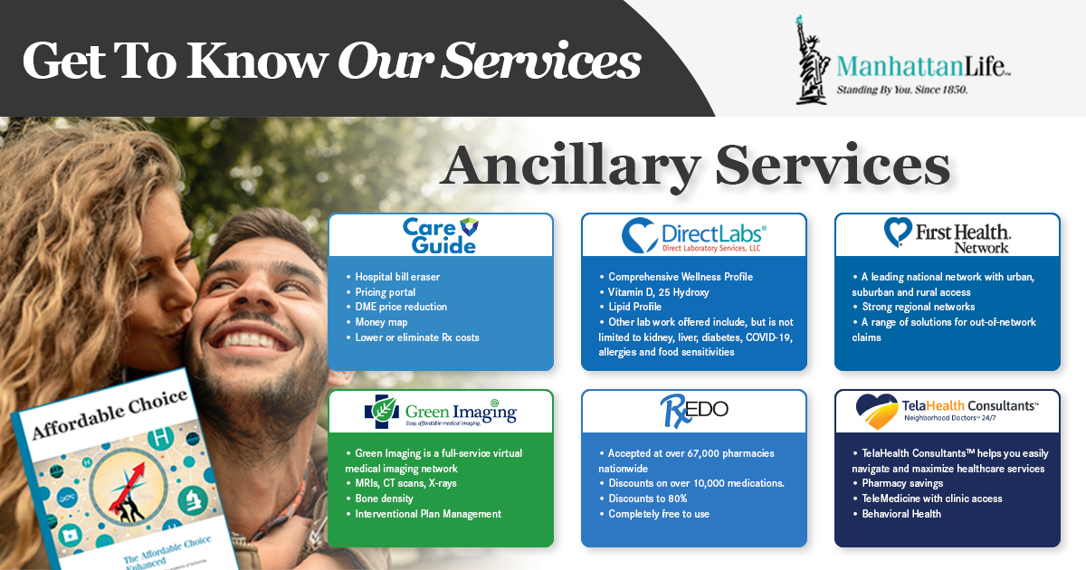
6 Ancillary Benefits (included with this policy)

Slide 10

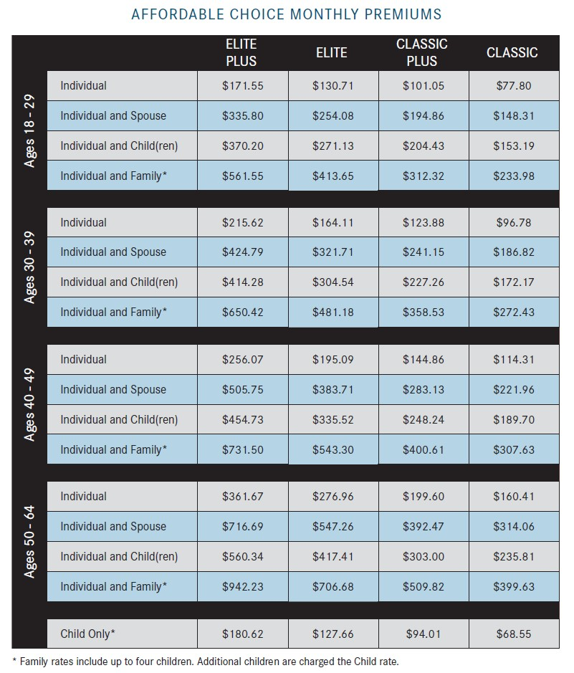
Affordable Choice Policy Rates – California

Slide 11
Dental, Vision & Hearing (DVH & DVH Select)
Dental, Vision & Hearing Policy
Everyone needs to access these services, regardless of age, and ManhattanLife now has a new policy that provides benefits for Dental, Vision & hearing needs. This policy can be a standalone policy or in addition to any other dental coverage in place, and this can be a great policy for people with Medicare, since it currently doesn’t cover dental, vision or hearing expenses.
Product Features
Issue Ages: 18-85 (DVH - Bundled) or 18-99 (DVH Select)
Family Rates (including up to 3 children)
$0 or $100 deductible (does not apply to preventative services)
Glasses, Contacts & Hearing Aid benefits
Guaranteed-issue & Guaranteed renewable for life
Choose your dentist
$1,000, $1,5000, $3,000 or $5,000 policy year maximum benefit
Orthodontia benefit

Slide 12

Overview

Slide 13
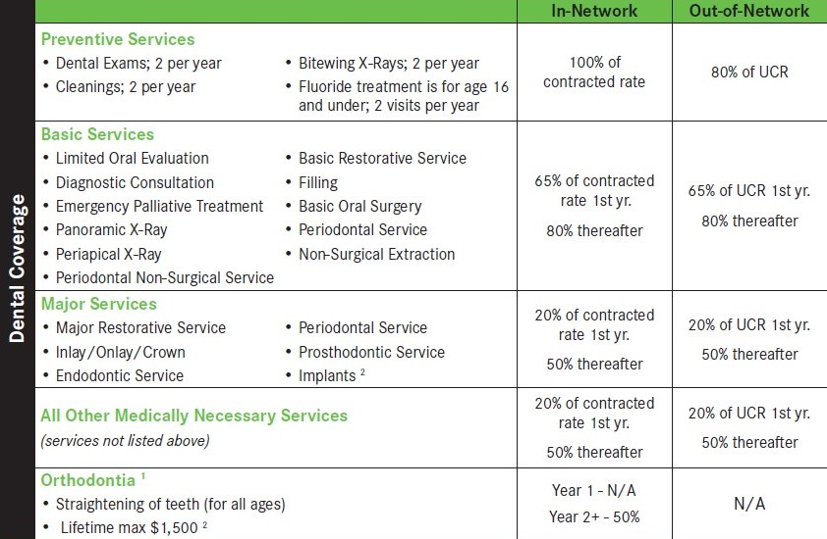
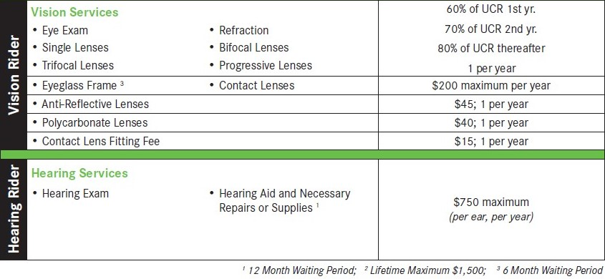
DVH Select Policy Benefits (Dental Plan + Optional Riders)

Slide 14
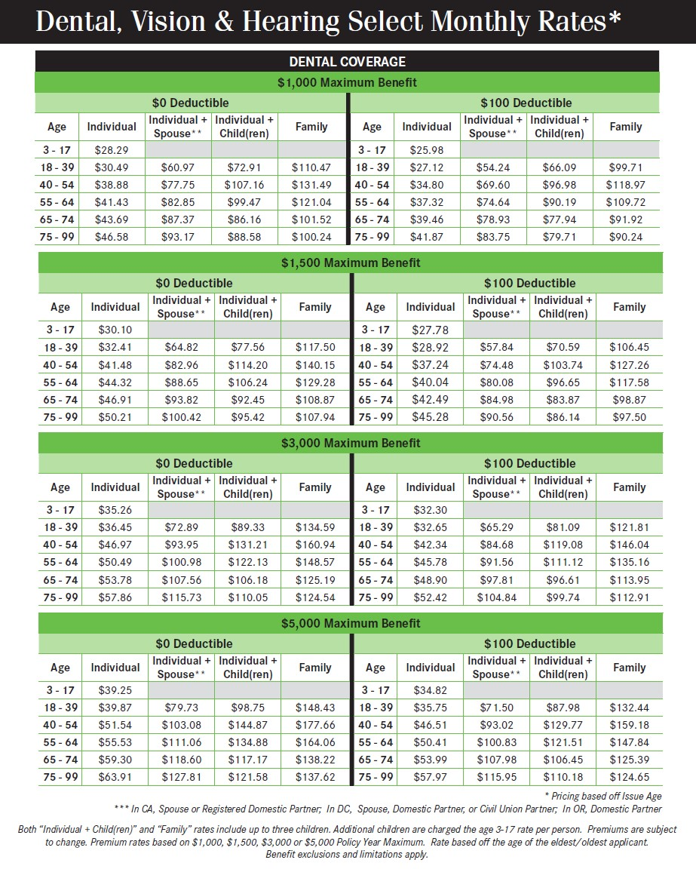
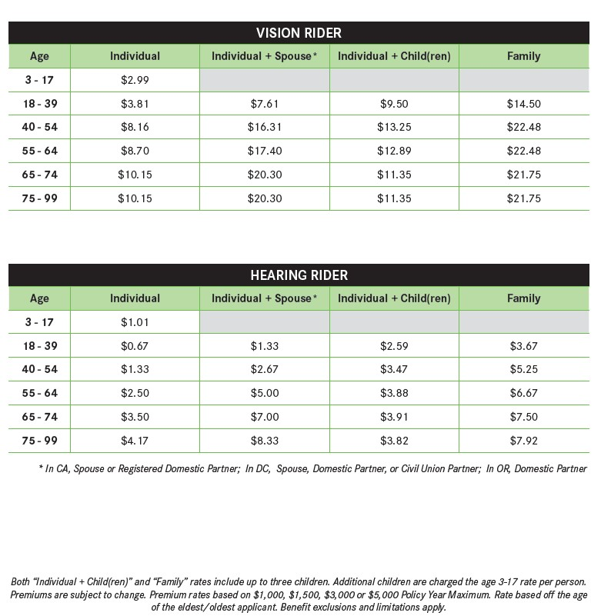
Dental Rates (with optional Vision & Hearing Riders – CA)

Slide 15

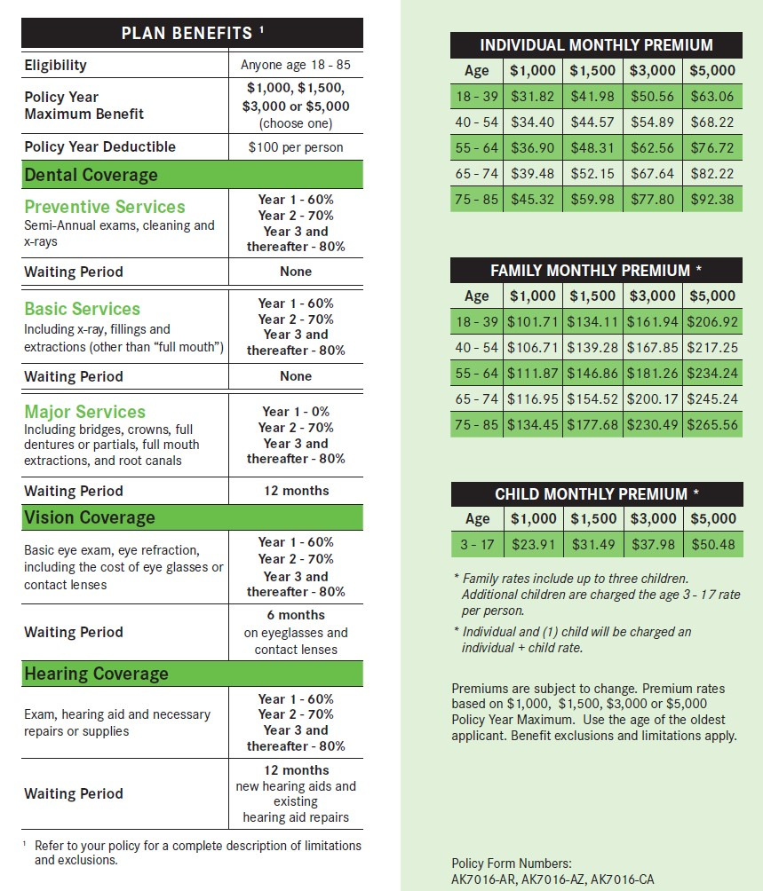
DVH Bundled Policy Benefits & Rates (All-in-one)

Slide 16
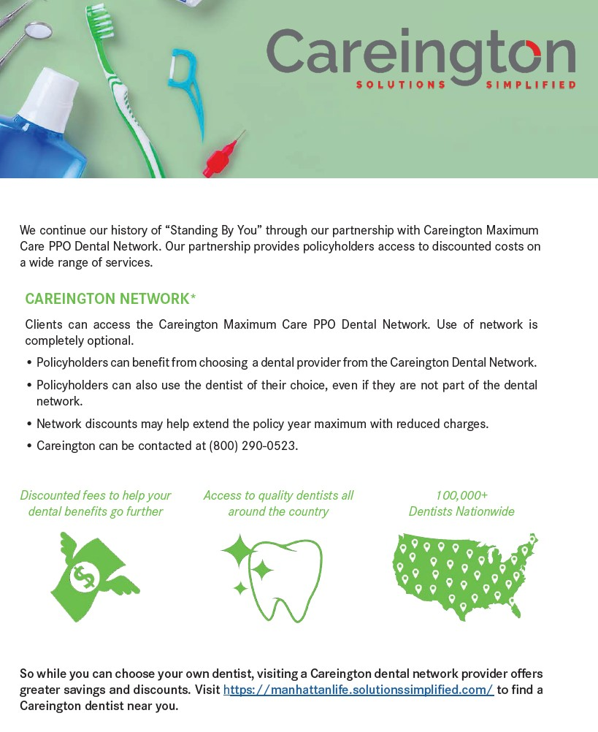
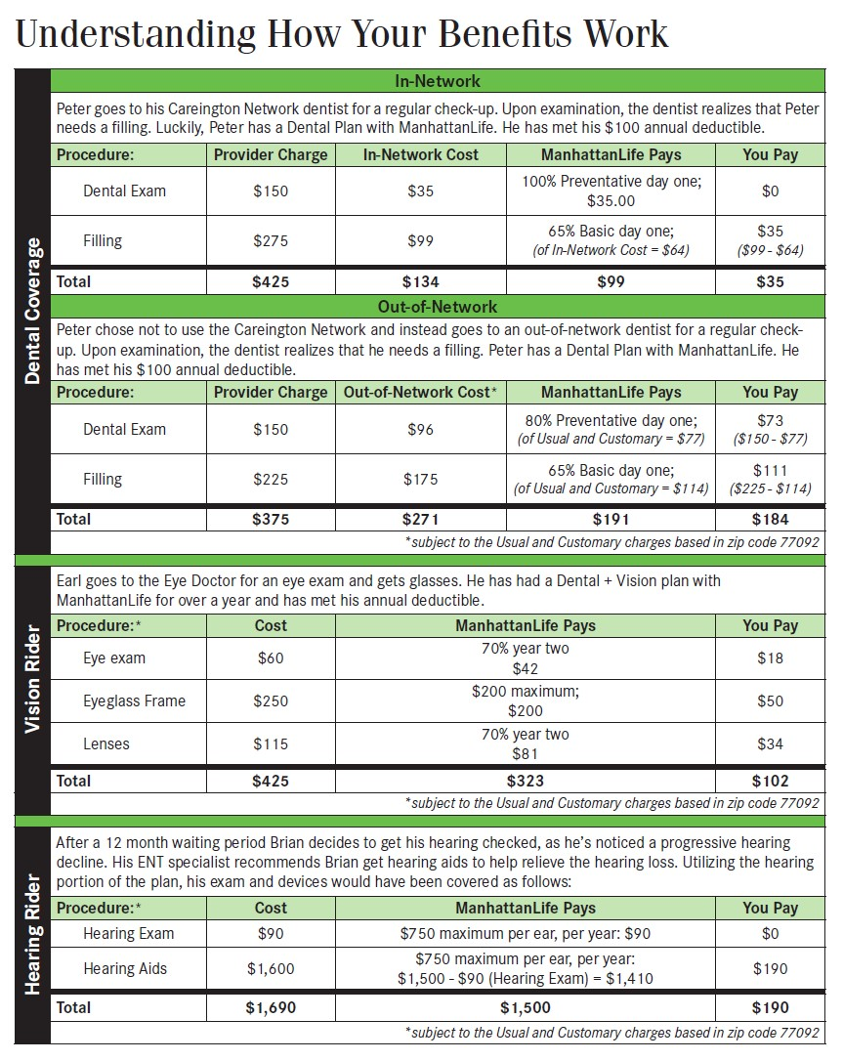
Additional Policy Information

Slide 17
PAID Enhanced Accident Plan (ACC)
PAID Enhanced Accident Policy
This is our most popular plan, because it pays you cash the next time someone gets injured & goes to seek medical treatment! Injuries are the main reason most of us go to the doctor, so wouldn’t it be nice to receive a few hundred dollars or a few thousand dollars the next time it happens?
Product Features
Helps you pay for out-of-pocket expenses
Pays for injuries, big or small
2 options: 24-hour or off-the-job only
Issue Ages: 18-84
Guaranteed renewable for life, subject to our right to change premium rates
Choose one or two units
AD&D Included

Slide 18
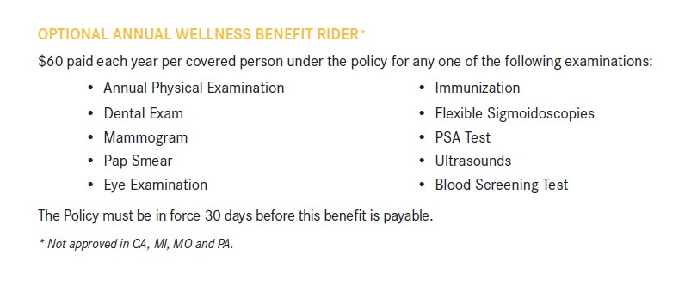
Optional Wellness Rider (recommended)

Slide 19
Policy Benefits (2-unit coverage shown)
Money for the 1st Treatment Visit
Physicians Office - $150
Emergency Room - $200
Urgent Care - $225
Emergency Dental - $100-$300
Money for Follow-up Visits
Physicians Office (x8) - $50
Physical Therapy (x10) - $70
Chiropractor (x5) - $70
Wellness Visits - $60*
Tests & Supplies
X-Rays - $100
Crutches/Braces - $150
MRIs, CT Scans, etc - $200
Blood/Plasma - Up to $300
Money for the Types of Injuries
Cuts/Lacerations - Up to $800
Tendon/Ligament/Rotator Cuff - $1,000
Dislocations - Up to $4,000
Fractures - Up to $5,000
Burns - Up to $20,000
Pays out for several types of Injuries
Accidental Death
Policyholder - $50,000
Spouse - $20,000
Child - $10,000
All amounts x2 for
Common-Carrier Incidents
Hospitalization, Surgeries & Services
Hospital Confinement - $300/day
ICU Confinement - $600/day
Surgeries - Up to $2,000
Ambulances - Up to $2,000
See policy for full details - *optional rider

Slide 20
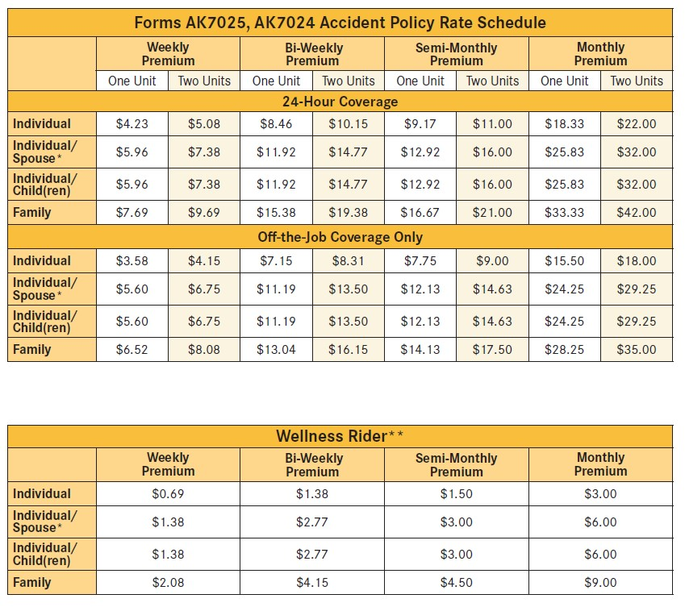
PAID Enhanced Accident Policy Rates – California

Slide 21
Out-of-Pocket Protector (OOP)
Out-of-Pocket Protector
With rising medical expenses and higher out-of-pocket costs associated with health insurance plans, many individuals face significant financial burdens during hospital stays or emergency treatments. This policy offers an affordable solution, providing cash benefits to help bridge the gap left by high deductibles and co-pays. This plan pays cash benefits directly to the policyholder, covering hospital admissions, inpatient stays, outpatient surgeries, and emergency treatments, easing the financial stress of unexpected medical events and allowing individuals to focus on recovery​.
Product Features
Issue Ages: 18-64
Guaranteed-renewable up to Age 69
No deductibles or networks

Slide 22
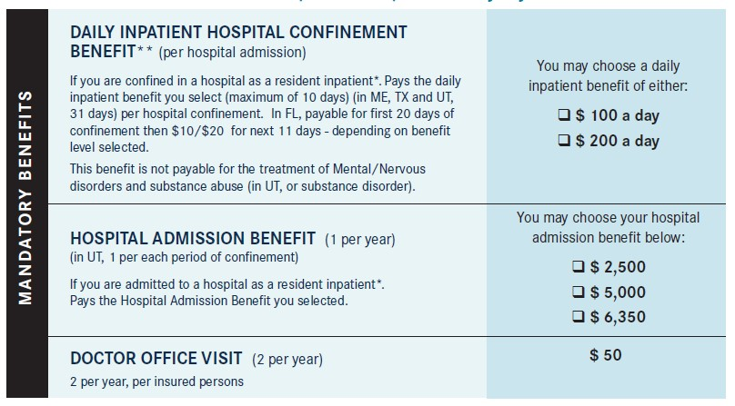
Policy Benefits
You Choose the Benefit Options
Daily Inpatient Hospital Benefit
Hospital Admission Benefit
Doctor Office Visits (x2)
See policy for full details

Slide 23
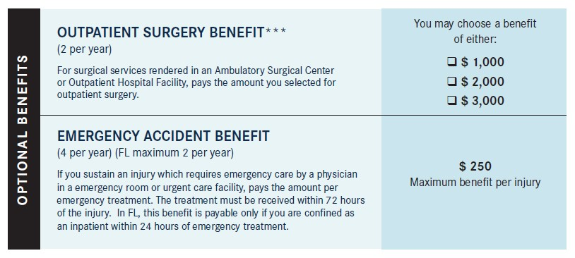
Optional Riders
Optional Benefits
Outpatient Surgery (x2)
Emergency Accident Benefit (x4)
See policy for full details

Slide 24
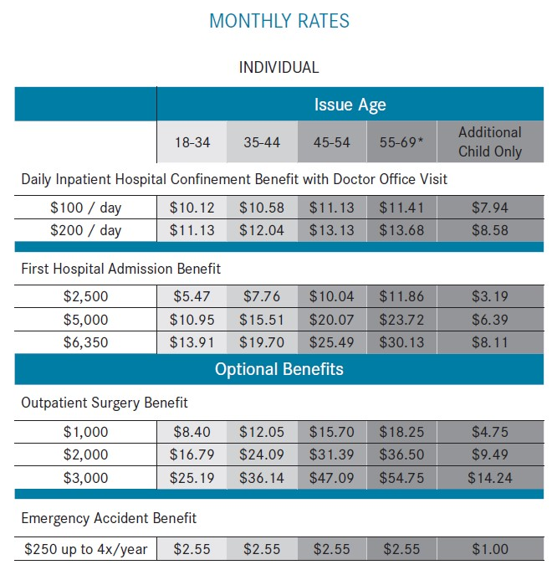
Out-of-Pocket Protector Rates (Individuals) – California

Slide 25
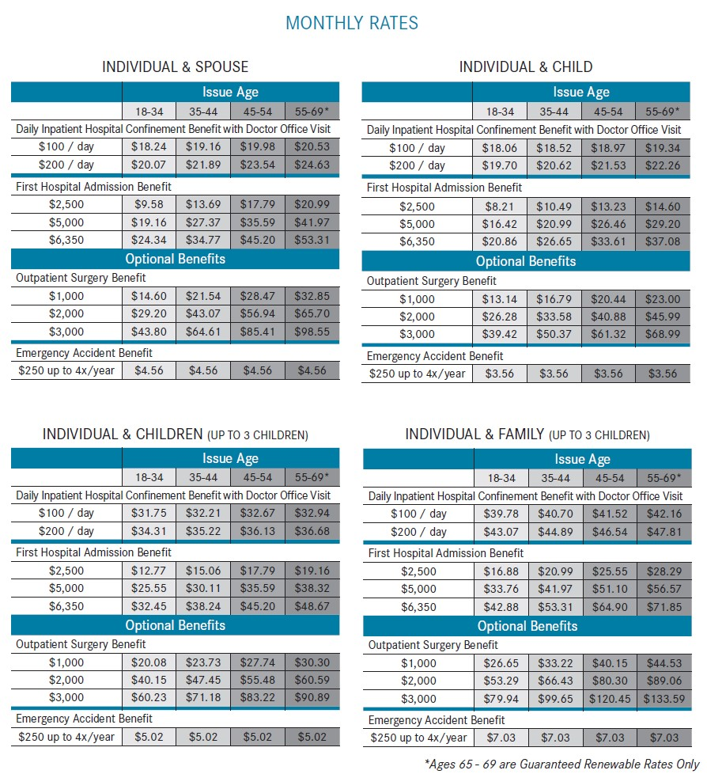
Out-of-Pocket Protector Rates (Family Options) – California

Slide 26
Cancer, Heart and Stroke Plan (CHAS)
Cancer, Heart and Stroke Policy
This may be the most important policy available through Manhattan Life, since more people are experiencing serious medical events at younger ages, regardless of family history. Cancer illnesses & heart-related medical events typically generate huge medical & non-medical costs, and usually effect the income of 1 or both providers in the home. This policy provides lump-sum benefits that help the family focus on recovery.
Product Features
Lump-sum benefit payouts from $10,000-$75,000
Coverage available for Cancer, Heart & Stroke or All
Issue Ages: 20-64
30-day waiting period before benefits become active
2 additional riders available

Slide 27
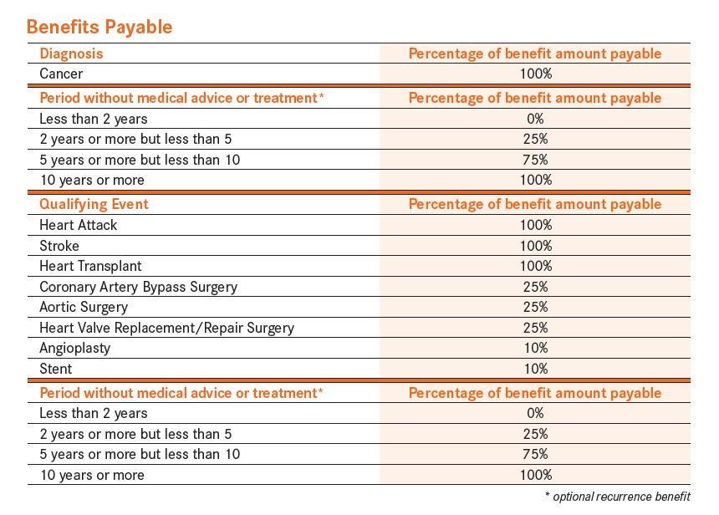
Policy Benefits
You Choose the Benefit Amount
Benefits range from $10,000 to $75,000, in $5,000 increments
Benefits are available for Cancer, Heart & Stroke OR Both Plans
Lump-sum benefits will pay out up to 100% of the selected benefit amount, based on the medical event
Cancer Recurrence Rider (optional)
Heart & Stroke Restoration Rider (optional)
See policy for full details

Slide 28
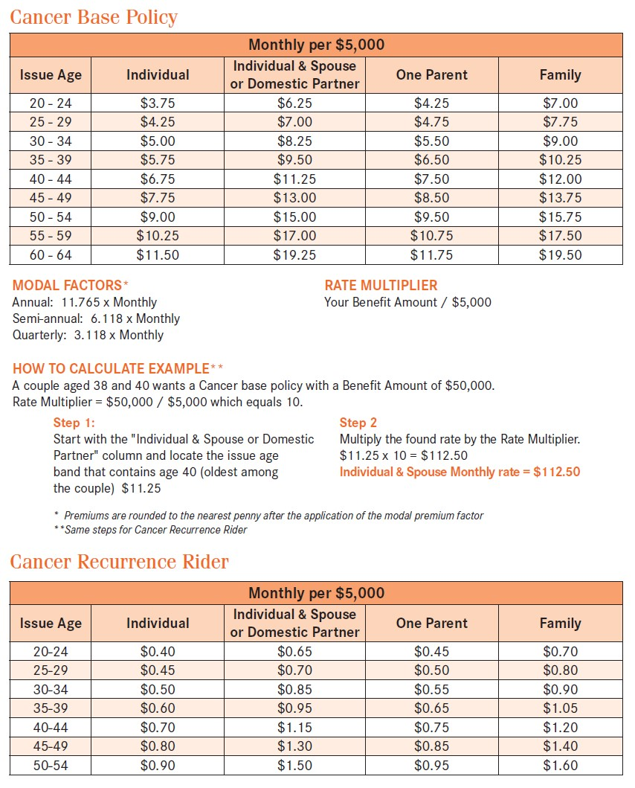
CHAS (Cancer only) Rates – California

Slide 29
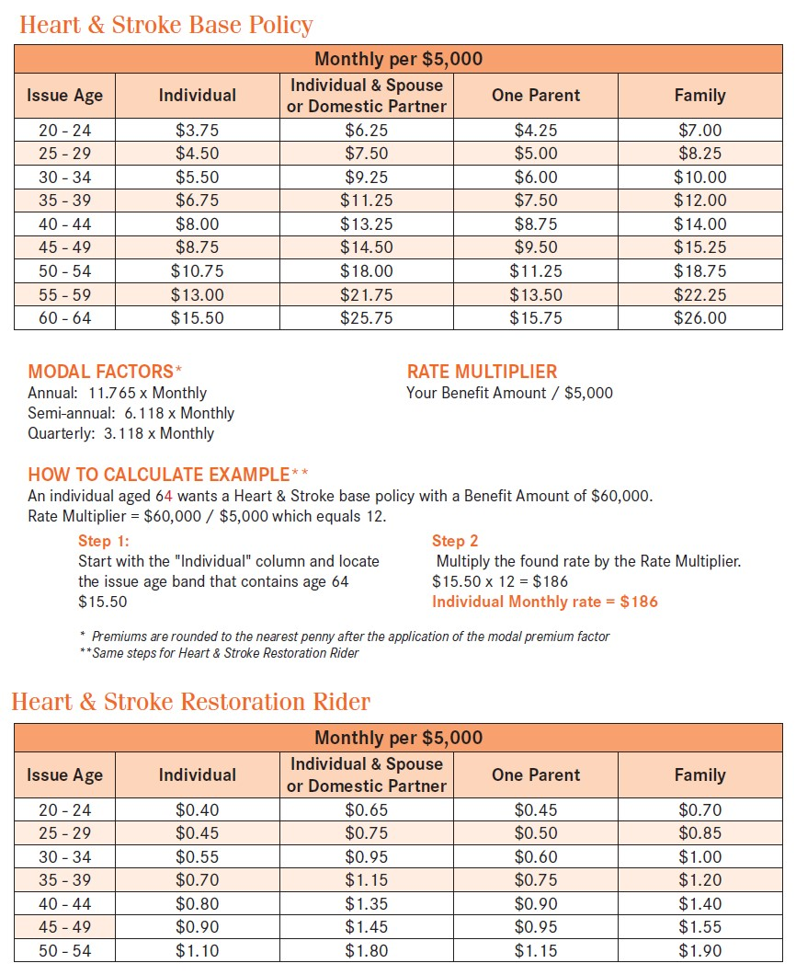
CHAS (Heart & Stroke only) Rates – California

Slide 30

Cancer Care Plus (CAN)
Cancer Care Plus Policy
Another important policy available through Manhattan Life, that is the strongest ongoing payment insurance policy related to Cancer on the market. Cancer illnesses typically generate huge medical & non-medical costs, and usually effect the income of 1 or both providers in the home. This policy provides ongoing support & benefits that help the family focus on recovery.
Product Features
4 Levels of Coverage to choose from
Provides ongoing benefits through the life of the illness
Issue Ages: 18-64
30-day waiting period before benefits become active
2 additional riders available

Slide 31
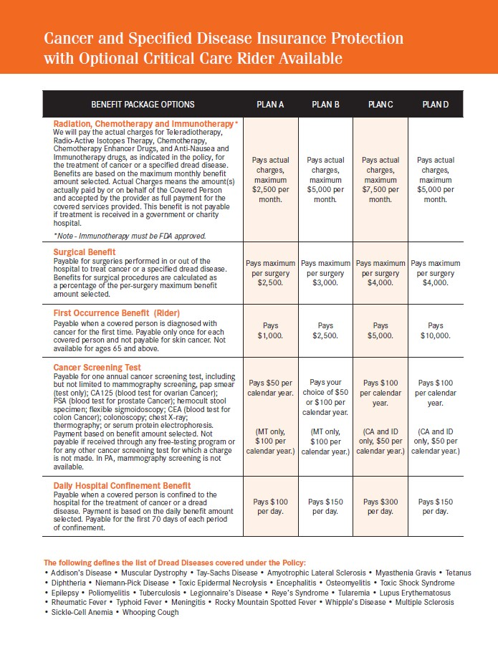
Policy Benefits (Core Benefits)
You Choose the Benefit Amount
4 benefit plan options to choose from
Base plan covers the diagnosis & treatment of Cancer
This plan pays for the life of the illness, where a lump-sum (CHAS) plan will give you all your benefits upfront
Intensive Care Rider (optional)
Critical Care Rider (optional)
See policy for full details

Slide 32

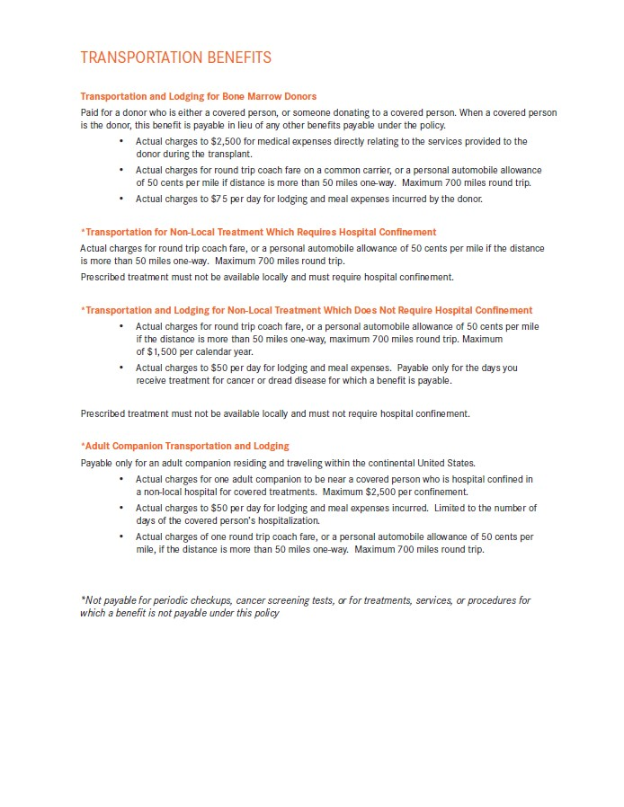
Policy Benefits (Hospital, Care Facility & Transportation)

Slide 33
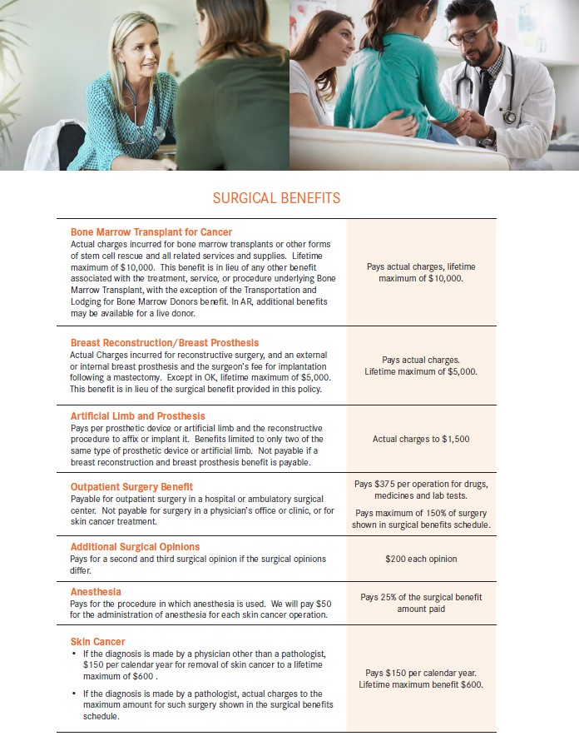
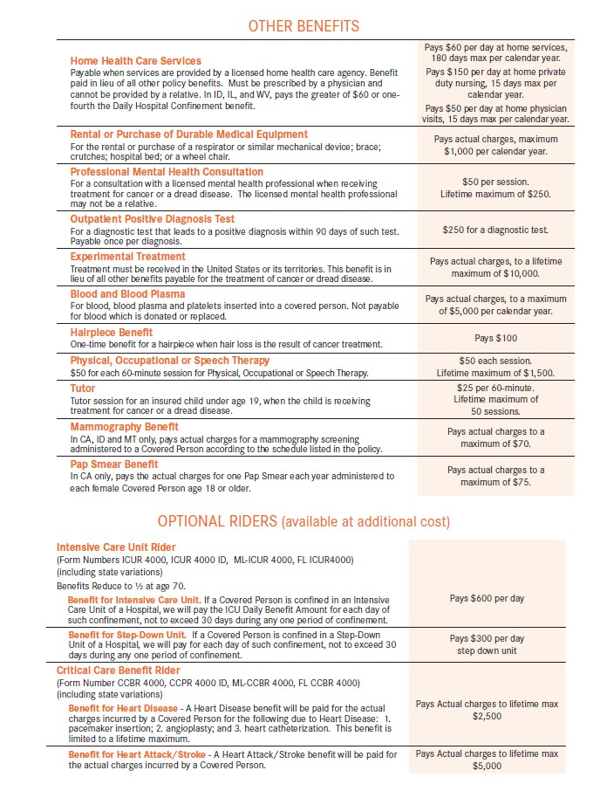
Policy Benefits (Surgical, Other Benefits & Optional Riders)

Slide 34
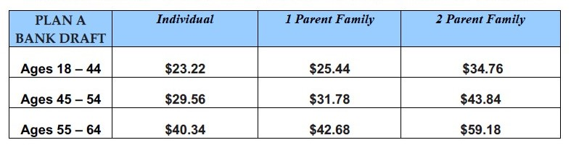
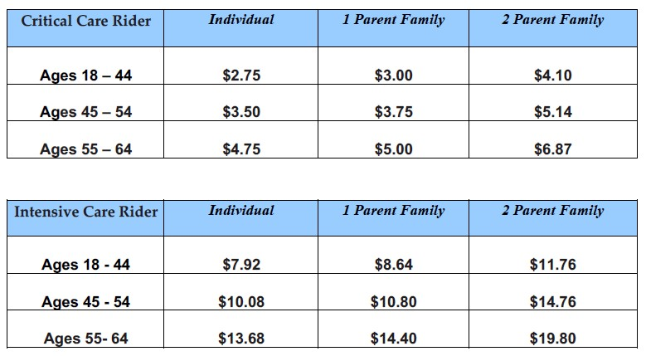
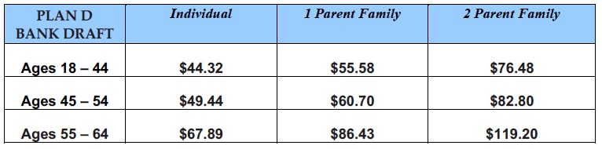
Cancer Care Plus Rates – California
Plan A – Most Affordable Option
Optional Riders
Plan D – Richest Benefits Option

Slide 35
Viva Life Term Life Insurance (VLT)
Viva Life Term Life Insurance
This policy is designed to provide affordable, flexible protection for families in the event of the premature death of a parent, spouse, or family member. Viva Life offers peace of mind by providing a financial safety net, allowing families to maintain their financial security during difficult times. The policy includes customizable coverage amounts, an optional accidental death benefit that doubles the payout, and the ability to convert to a permanent plan without additional evidence of insurability, ensuring that your family is cared for when they need it most​.
Product Features
Issue ages: 18-60
Benefit options: $25,000 - $250,000
20-year Term Benefit Period (15-year term for ages 56-60)
Accidental Death Benefit rider available
Simplified-Issue – No medical exam required
Conversion Option to a permanent plan of insurance without evidence of insurability

Slide 36
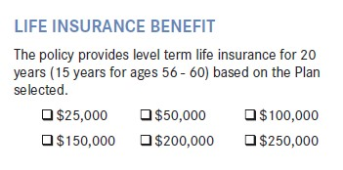
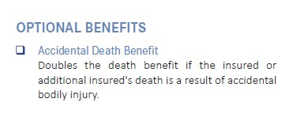
Policy Benefits (& Optional Benefits)
Benefit Options
Death Benefit: $25,000-$250,000
Term Options
  20-year Term (18-55)
  15-year Term (56-60)
Optional Benefit
Accidental Death Benefit (x2)
See policy for full details

Slide 37
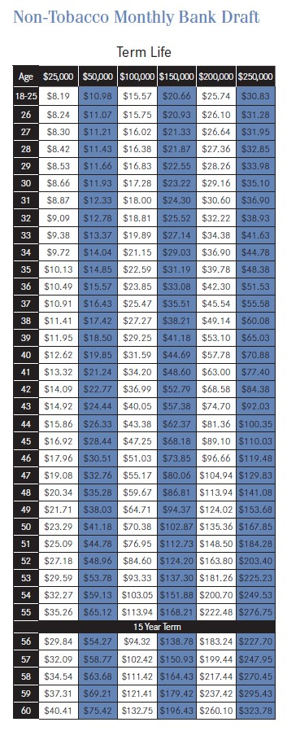
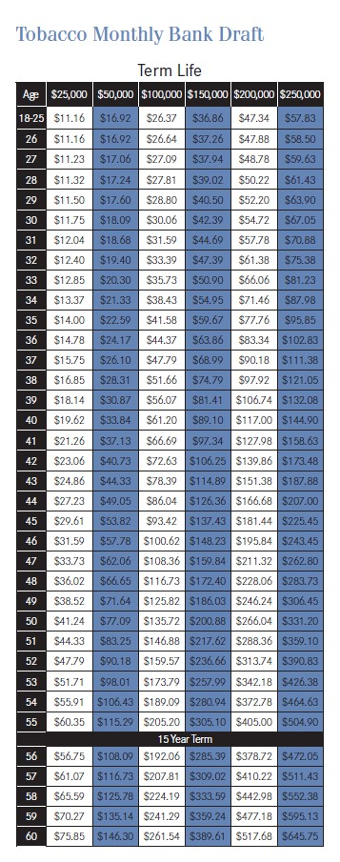
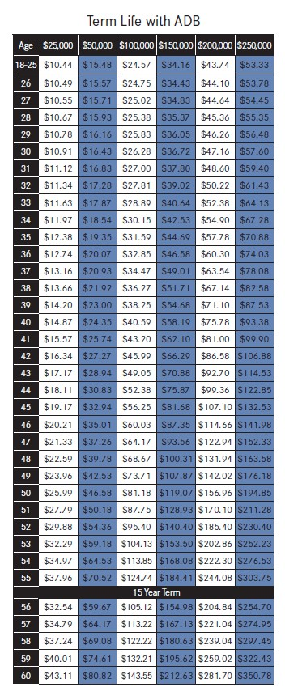
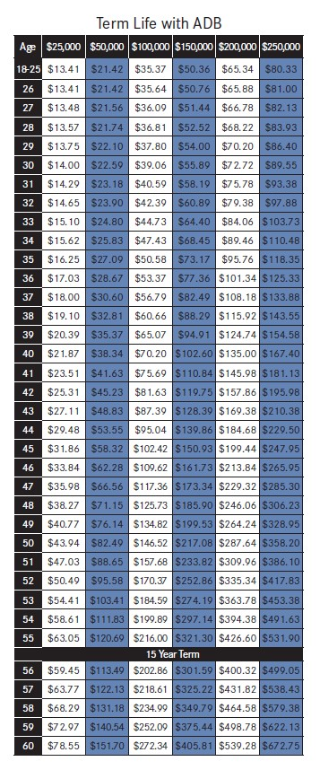
Viva Life Term Life Insurance Rates – California

Slide 38
Viva LifeTime Whole Life Insurance (VLTW)
Viva LifeTime Whole Life Insurance
This plan offers permanent life insurance protection with guaranteed premiums, coverage, and cash value accumulation. In today’s uncertain world, securing long-term financial protection for your family is more important than ever. This policy provides peace of mind by ensuring that your loved ones are financially protected in the event of your passing. With options for flexible payments, no medical exams, and guaranteed cash value that grows tax-deferred, Viva LifeTime ensures lifetime protection for both adults and children. It’s an essential part of planning for your family’s future security.​
Product Features
Issue ages: 18-65
Benefit options: $20,000 - $100,000
Simplified-Issue – No medical exam required
Premiums are guaranteed never to increase
Guaranteed cash values that accumulate on a tax deferred basis
Cash value available as a policy loan
Available to non-smokers only

Slide 39
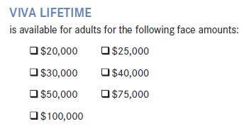
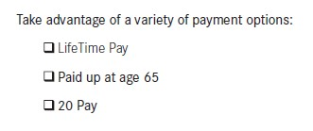
Policy Benefits (& Optional Benefits)
Benefit Options
Death Benefit: $20,000-$100,000
Payment Options
  LifeTime Pay
  Paid up to 65
  20 Pay
See policy for full details

Slide 40
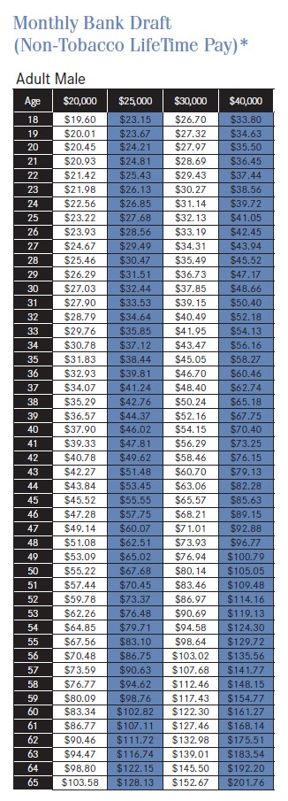
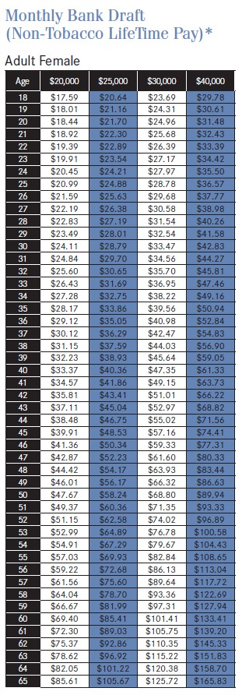
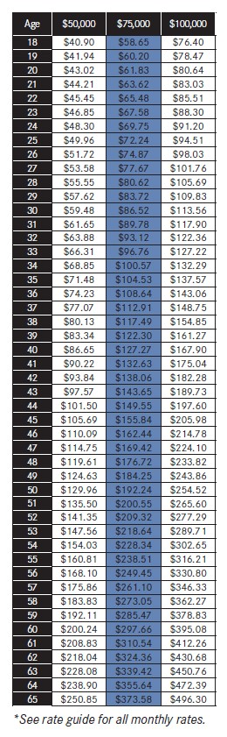
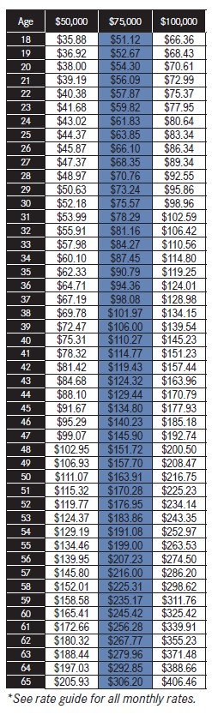
Viva LifeTime Whole Life Insurance Rates – California

Slide 41

What’s Next?
Quoting & Enrollment Process
Decide which plan(s) you’re interested in
Quote each plan with me (or through my self-enroll site)
Provide information for enrollment
Select beneficiaries
Select benefit effective date & bank draft date
(suggested date of 10 days after application date)
Input bank account information (from a check or bank login)
Signature process is completed with mother’s maiden name
(in-person or remote)
You will receive electronic & paper copies of your policies
If you know 1 or more people in your network that would benefit from these policies, I would love to help them out!
Claims/Servicing
If you have a claimable situation, please make sure to grab paperwork as your leaving the doctor (not a copay receipt – paperwork that includes your name, facility name & treatment)
Call me & I will help you file your 1st claim!

