Slide 1
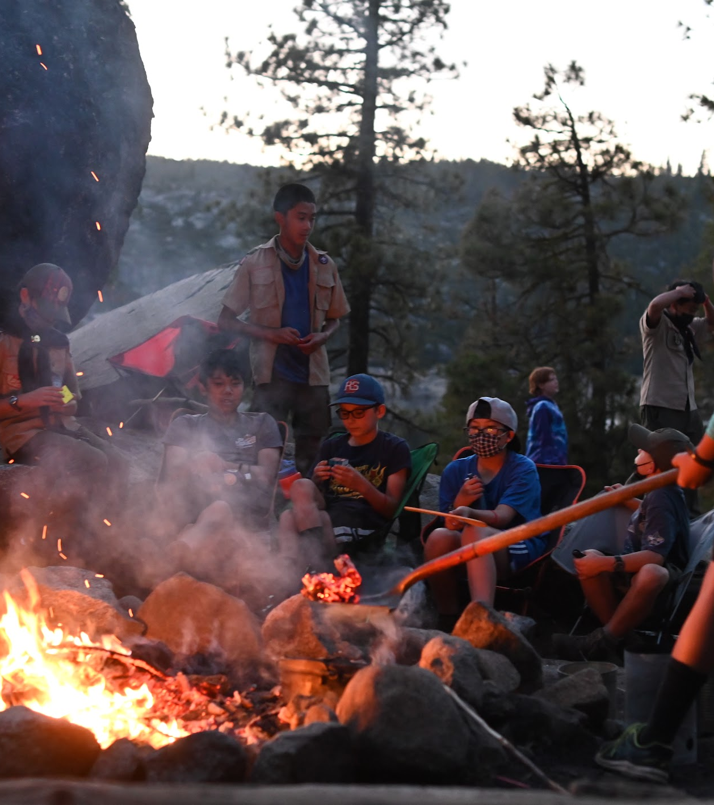
SCOUTING AMERICA LEADER TRAINING
Working with
Scouts with Autism
A curated training for leaders across all Scouting programs — Cub Scouts, Scouts BSA, and Venturing.
Andrew Mendonsa, Psy.D., MBA
Clinical / Forensic Psychologist
GEC – Council Chair | National Jamboree MH Lead

Slide 2




What Is Autism Spectrum Disorder (ASD)?
Social Communication
Sensory Processing
Executive Functioning
Hyper- or hypo-sensitivity to sound, light, texture, smell, and other input.
Interpreting cues, conversation, and language — including literal interpretation of idioms.
Planning, organization, transitions, and adapting to unexpected changes.
A neurological condition affecting communication, social interaction, sensory processing, and information organization.
The term 'spectrum' reflects the wide variation in how these traits present in each individual.
No two autistic Scouts are alike — understanding the individual is the foundation of great leadership.
Scouting America Leader Training
Working with Scouts with Autism

Slide 3



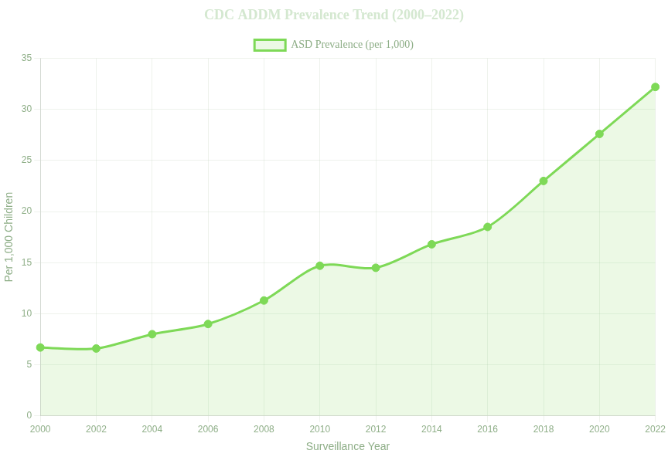


ASD Prevalence in the United States
1 in 31
3.2%
↑ Consistent Rise
of the U.S. population (2022 CDC)
Prevalence has increased every monitoring cycle since 2000
children identified with ASD
1.7×
Children born in 2018 identified with ASD by age 4 vs. children born in 2014
16 Sites
CDC ADDM Network monitors ASD across 16 U.S. sites — the most comprehensive surveillance system in the world
Scouting America Leader Training
Working with Scouts with Autism

Slide 4

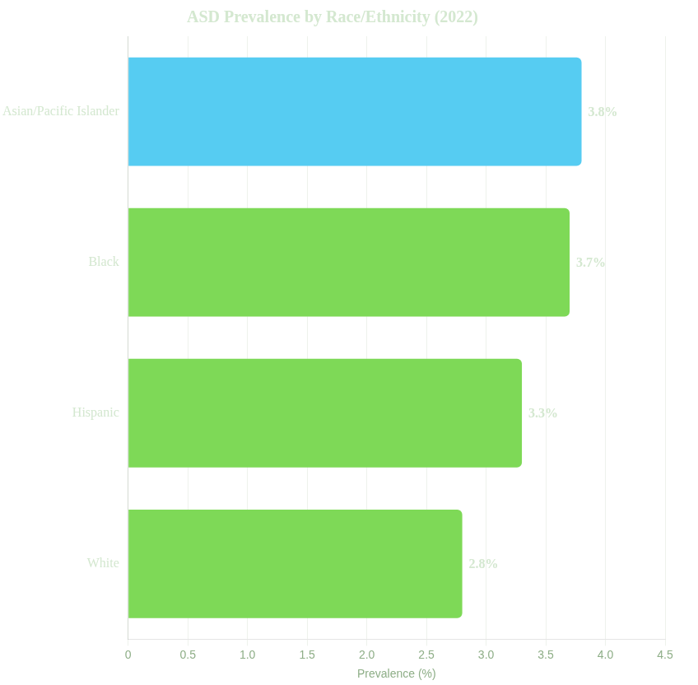


Who Is Affected? Demographic Variances
3.4×
more prevalent in boys than in girls
Gender differences in presentation may also lead to underdiagnosis in girls
What This Means for Your Unit
ASD crosses all racial, ethnic, and socioeconomic boundaries
Girls may be underdiagnosed — look beyond stereotypes
Improved screening means more Scouts may arrive with a recent diagnosis / request for accomodations
Scouting America Leader Training
Working with Scouts with Autism

Slide 5

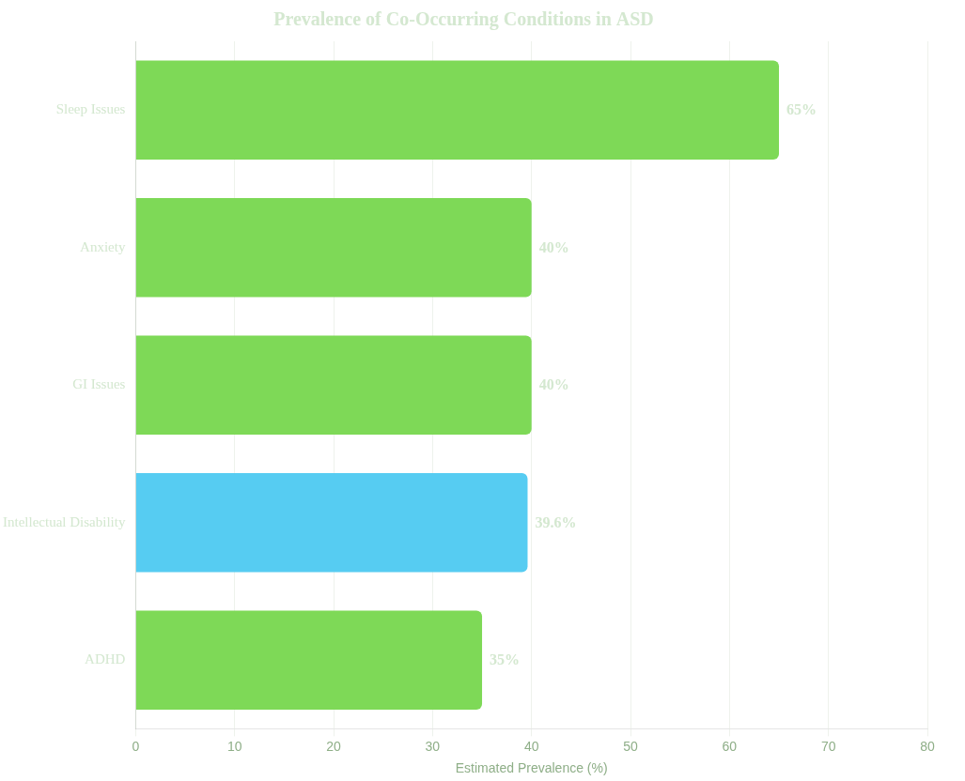



Co-Occurring Conditions
Most autistic Scouts have at least one additional condition. Leaders benefit from knowing these patterns.
Sleep Issues (50–80%)
Difficulty falling or staying asleep — particularly relevant for overnight camping trips.
Anxiety (≈40%)
New environments, unpredictable schedules, and social demands can heighten anxiety.
ADHD (≈30–40%)
Co-occurring ADHD adds challenges with sustained attention, impulsivity, and activity transitions.
Scouting America Leader Training
Working with Scouts with Autism

Slide 6




Social Communication in a Scouting Context
Reading the Room
Literal Interpretation
Conversation Patterns
Difficulty interpreting facial expressions, body language, and tone of voice.
Idioms, sarcasm, and metaphors are often taken literally.
Challenges in initiating or sustaining conversations; may focus heavily on one special interest.
Relationship Patterns
Challenges in initiating or sustaining relationships. May become isolated by choice or rejection.
What you might see:
What you might see:
What you might see:
A Scout who seems unaware that peers are frustrated or that a leader is being serious.
'Keep an eye on the fire' could cause genuine confusion about what action is required / or being asked.
Appearing blunt or 'rude' without any intent — a Scout who speaks without a social filter.
These are neurological differences — not deliberate behavior. Assume good intent and communicate clearly.
Scouting America Leader Training
Working with Scouts with Autism

Slide 7









Sensory Sensitivities
Hypersensitivity (Over-Sensitive)
Hyposensitivity (Under-Sensitive)
The environment feels amplified and overwhelming
The environment doesn't register — or intense input is sought
Crowded meeting hall noise is physically painful
Flickering fluorescent lights cause distress
May not notice they are cold, hot, or injured
Uniform texture is deeply uncomfortable
Seeks deep pressure, heavy blankets, or tight spaces
Campfire smoke smell is overwhelming
Pursues strong flavors or intense physical sensations
May appear clumsy or unaware of personal space (this can lead to strained relationships too)
Scouting America Leader Training
Working with Scouts with Autism

Slide 8







Executive Functioning in Scouting
Real Scenario: Preparing for a Campout
Use Checklists
Pack your own gear
A printed gear checklist transforms an overwhelming task into a step-by-step process any Scout can follow.
Overwhelming without a checklist — where do I even start?
Arrive on time
Difficulty estimating how long tasks take
Adapt to plan changes
Warn Before Transitions
Unexpected changes trigger significant distress
Give a 5-minute verbal warning before any activity change. Visual schedules make the day predictable.
Follow multi-step instructions
Holding several steps in working memory simultaneously is hard
Scouting America Leader Training
Working with Scouts with Autism

Slide 9



Special Interests & Stimming
Special Interests
Stimming
Intense, highly focused passions — knots, astronomy, wildlife, a specific game — that bring deep expertise and joy.
Repetitive movements or sounds — hand-flapping, rocking, humming — used for self-regulation.
Stimming manages sensory input, anxiety, or strong emotions. It is not a behavior to eliminate.
Use them as a bridge:
Connect merit badge topics to their interest
Leader guidance:
Assign roles that draw on their expertise
Allow stimming unless it poses a safety risk
Use interest as a reward for completing tasks
Do not draw attention to it or ask it to stop
Build confidence through demonstrated mastery
If safety is a concern, offer an alternative (e.g., fidget toy)
Scouting America Leader Training
Working with Scouts with Autism

Slide 10






Meltdowns, Outbursts & Shutdowns
How to Respond
Meltdown
Stay calm — your calm is contagious
Looks like: Crying, emotional flooding, or intense sadness
Reduce stimuli: dim lights, move to a quieter area
Cause: Overwhelm exceeds the Scout's ability to cope
Offer the pre-arranged quiet space
Use few words — avoid lengthy explanations
Wait. Recovery takes time. Don't rush the Scout.
Outburst
Looks like: Verbal or physical reaction — the Scout needs space
Cause: An involuntary attempt to remove an overwhelming trigger
Avoid These Responses
Calling it a 'tantrum' or treating it as defiance
Threatening consequences during the event
Shutdown
Looks like: Withdrawal, silence, non-communication
Touching without consent
Cause: The nervous system goes offline to protect itself
Scouting America Leader Training
Working with Scouts with Autism

Slide 11





Why Scouting Works for Autistic Youth
Social Skills
Building Confidence
Independence
Belonging
Self-Advocacy
Patrol activities provide structured social contexts — easier to navigate than unstructured peer settings.
Campout preparation teaches planning, organization, and self-reliance — critical life skills.
For youth who feel isolated, a troop offers real friendship and a team that accepts them.
Leadership roles encourage autistic Scouts to speak for themselves and grow in confidence.
Earning merit badges and ranks gives tangible, visible proof of achievement and boosts self-esteem.
Scouting America Leader Training
Working with Scouts with Autism

Slide 12





Scouting America's Inclusion Framework
Inclusion Toolbox
Guide to Advancement (Section 10)
Comprehensive online resource with an 'Understanding Autism' module for leaders and parents.
Official policies for accommodations, alternative merit badges, and age-of-eligibility extensions.
"Scouting belongs to every young person — regardless of ability."
A foundational principle backed by programs, policies, and resources.
Individual Scout Advancement Plan
Special Needs Prepared Camp
New 11-step camp accreditation program for inclusive, accessible Scouting camp experiences.
Form 512-936 — adapts requirements so Scouts meet the spirit of advancement.
Scouting America Leader Training
Working with Scouts with Autism

Slide 13







Individual Scout Advancement Plan (ISAP)
How the ISAP Works
ISAP (Form 512-936)
Like an IEP in schools — a personalized advancement roadmap for Scouts with disabilities.
Convene the Team
Parents, Scout leaders, and health professionals collaborate
Identify the Requirement
Determine which standard requirements need adaptation
Spirit of the Requirement
Alternatives must honor the intent of advancement — not simply bypass it.
Design the Alternative
Create an equivalent activity that meets the spirit of the requirement
Document & Implement
Record on Form 512-936 and follow through with the plan
Eagle Scout Is Possible
Section 10 allows alternative merit badges for Eagle — no Scout is excluded from the highest rank.
Review Regularly
Revisit as the Scout grows and their needs change
Scouting America Leader Training
Working with Scouts with Autism

Slide 14




Special Needs Prepared Camp Program
11-Step Camp Accreditation Process
NEW INITIATIVE
1.
Designate a Special Needs Coordinator
A New Standard for Accessible Camps
Scouting America's newest program creates a formal accreditation path for camps to become genuinely inclusive — not just welcoming in principle.
2.
Conduct staff training on invisible disabilities
3.
Provide adaptive equipment
4.
Ensure accessible facilities
Staff Training
5.
Develop pre-camp planning protocol with families
Invisible disabilities education for all camp personnel
6.
Create sensory-friendly spaces at camp
7.
Establish quiet zones
Pre-Camp Planning
Families collaborate with camp staff before arrival to set Scouts up for success
8.
Train medical staff on ASD-related needs
9.
Develop emergency procedures for dysregulation
10.
Create inclusive activity adaptations
Sensory Spaces
Designated quiet zones and sensory-friendly areas throughout the camp
11.
Annual review and re-accreditation
Scouting America Leader Training
Working with Scouts with Autism

Slide 15


Evidence-Based Practices for Supporting Autistic Scouts
Visual Supports
Task Analysis
Modeling
Reinforcement
Social Narratives
Social Skills Training
Peer-Based Instruction
Self-Management
Functional Communication Training
28
Naturalistic Intervention
Antecedent-Based Intervention
Prompting
Evidence-Based Practices Identified
National Clearinghouse on Autism Evidence and Practice (NCAEP)
We focus on the practices most applicable to the Scouting environment.
+ 16 additional practices documented in NCAEP research
Scouting America Leader Training
Working with Scouts with Autism

Slide 16


Visual Supports & Task Analysis
NCAEP Evidence-Based Practices #1 & #2
EBP #1
EBP #2
Visual Supports
Task Analysis
Using visual information — pictures, symbols, written words — to increase understanding and independence.
Breaking a complex skill into a sequence of small, teachable steps.
In Your Units:
Fire Building — Task Analyzed:
Picture schedule posted at every meeting (opening → skills → game → closing)
1.
Clear the area of debris
2.
Gather tinder (dry leaves, paper)
Visual gear checklist for campouts — check off each item as packed
3.
Gather kindling (small sticks)
4.
Build the tinder bundle
Step-by-step visual knot-tying guide on a laminated card
5.
Add kindling in a teepee shape
6.
Light the fire safely
Makes the invisible (schedule, expectations) visible and predictable.
Each step is achievable — success builds on success.
Scouting America Leader Training
Working with Scouts with Autism

Slide 17
Modeling, Reinforcement & Social Narratives
NCAEP Evidence-Based Practices #3, #4 & #5
EBP #3
EBP #4
EBP #5
Modeling
Reinforcement
Social Narratives
Demonstrating a desired skill so the Scout can observe and replicate it.
Providing a positive consequence after a desired behavior to encourage recurrence.
Short stories describing a social situation and appropriate responses.
In Your Units:
In Your Units:
A senior Scout demonstrates proper knife handling step-by-step
In Your Units:
A story about what happens at a Court of Honor
Specific praise: 'Great job leading cleanup, Alex!'
Share a short video of tent setup before the campout. Provide link to parent/guardian
A narrative describing flag ceremony participation step by step
Recognize achievements at Courts of Honor
Peer modeling is especially effective — Scouts watching Scouts.
Be specific — 'Good job' is far less effective than naming what was done well.
Write it with the Scout. They know their own experience best.
Scouting America Leader Training
Working with Scouts with Autism

Slide 18

Prompting, Self-Management & Peer-Based Instruction
NCAEP Evidence-Based Practices #6, #7 & #8
EBP #6
EBP #7
EBP #8
Prompting
Self-Management
Peer-Based Instruction
Providing cues that help a Scout initiate or complete a task independently.
Teaching Scouts to monitor, evaluate, and reinforce their own behavior.
Training peers to facilitate skill development for autistic Scouts.
In Your Units:
In Your Units:
Hierarchy: Natural cue → Gestural → Verbal → Physical
Scout uses a personal checklist to track behavior goals during a meeting
Pair a supportive older Scout as a patrol buddy during new activities
In Your Units:
Scout earns a self-selected reward when a goal is met
Brief Scouts on inclusion — being a good patrol/den member
Point to the gear checklist before reminding verbally
Fade prompts over time as the Scout gains independence
Always use the least intrusive prompt needed first.
Self-management builds the self-advocacy skills Scouting develops.
The patrol/den method is a natural peer-instruction system — use it intentionally.
Scouting America Leader Training
Working with Scouts with Autism

Slide 19


Partnering with Parents & Families
The Joining Conference
Ask the Family:
A one-on-one meeting with parents before the Scout's first meeting
What are your Scout's greatest strengths and interests?
What are known triggers or sources of anxiety?
Schedule before the first Scout meeting
What coping strategies work at home and at school?
Invite both parents/guardians if possible
Are there sensory sensitivities we should know about?
Listen more than you talk — parents are the experts
What does a good day look like for your Scout?
Take notes and share them confidentially with co-leaders
Is there an IEP or ISAP we can reference?
Schedule a follow-up after the first two meetings
Never share a Scout's diagnosis with other troop/pack members without express family consent.
Parents are your most valuable partners.
Scouting America Leader Training
Working with Scouts with Autism

Slide 20




Communicating Clearly with Autistic Scouts
Be Direct & Literal
Transition Warnings
One Instruction at a Time
Use clear, unambiguous language. Avoid idioms, sarcasm, and indirect requests.
'In 5 minutes we move to closing ceremony.' Give verbal and visual advance notice.
Break multi-step directions into individual steps. Confirm understanding before adding the next.
Language in Practice
Instead of saying...
Say this:
"Don't you think it's getting messy here?"
"Scouts, please take five minutes to clean up your area now."
"Keep an eye on the fire."
"Watch the fire and call me if it gets too large or if something catches fire outside of the fire ring…"
"Let's wrap this up soon."
"We will end this activity in exactly 5 minutes at 7:30."
Scouting America Leader Training
Working with Scouts with Autism

Slide 21

Building an Inclusive Troop/Pack/Crew/Post (Unit)
Establishing a Quiet Space
Inclusive Troop Practices
Designate a specific, consistent low-sensory location at every meeting venue
Manage meeting environment — control lights, noise, and crowding
Dim lighting, minimal noise, comfortable seating — fidget tools available
Post a visual schedule at every meeting
Use consistent meeting structure — same format every time
Agree on a non-verbal signal the Scout can use to request a break
Brief co-leaders on the Scout's needs (confidentially)
Going to the quiet space is not a punishment — normalize its use
Leverage special interests to assign meaningful roles
Celebrate every achievement — not just major milestones
An adult should be visible/nearby but not intrusive
For many autistic youth, a troop/pack is the first place they feel genuinely included.
Scouting America Leader Training
Working with Scouts with Autism

Slide 22



Leveraging Special Interests
A Scout's special interest is not a distraction — it's a doorway to engagement, confidence, and mastery.
Knots & Rope
Astronomy
Wildlife / Nature
Technology / Coding
Assign as the patrol's knot-tying instructor for rank requirements
Lead the Astronomy merit badge or plan a night sky observation campout
Serve as patrol naturalist on hikes and nature-based activities
Lead the Digital Technology or Programming merit badge for the troop
Builds confidence and leadership
Expertise earns peer respect
Genuine contribution to the patrol/den
Positions Scout as an expert
Start with what they love — then build outward. Interest is the bridge to everything else.
Scouting America Leader Training
Working with Scouts with Autism

Slide 23


Sensory Accommodations
At Meetings
At Campouts
Dim or replace harsh fluorescent lighting
Practice tent setup in the backyard first — no surprises at camp
Reduce unnecessary background noise; avoid simultaneous loud activities
Choose a quieter, more secluded campsite when possible
Allow personal space — avoid crowding or unexpected touch
Pack noise-canceling headphones, fidget toys, weighted blanket
Ensure good ventilation; minimize strong smells
Plan menus with texture/taste sensitivities in mind; allow preferred foods
Permit fidget tools and movement breaks
Maintain a consistent meeting structure every time
Prepare for sleep disruption — have a plan for nighttime anxiety
Build in downtime and a quiet alternative activity option
Scouting America Leader Training
Working with Scouts with Autism

Slide 24


Your Action Plan
Before Joining
At Meetings
On Campouts
Hold a Joining Conference with the family
Post a visual schedule at every meeting
Share the schedule/agenda in advance (visual format)
Review any existing IEP documentation
Use clear, direct language — no idioms
Pack sensory tools (headphones, fidgets, blanket)
Begin ISAP process if needed (Form 512-936)
Give 5-minute transition warnings
Choose quieter campsites when possible
Use specific praise and reinforcement
Brief co-leaders confidentially on Scout's needs
Plan menu for sensory food needs
Permit stimming; allow quiet space breaks
Build downtime into every day
Designate a quiet space at your meeting location
Scouting America Leader Training
Working with Scouts with Autism

Slide 25
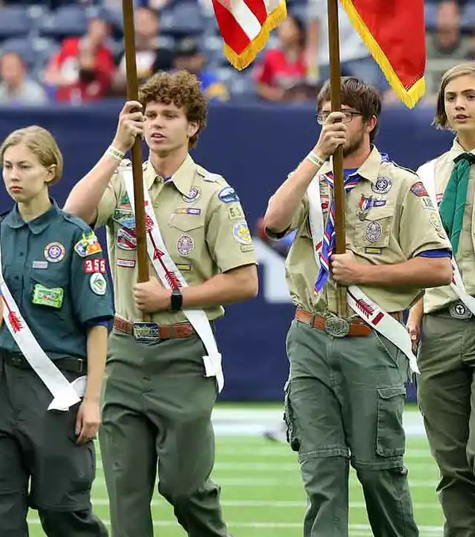



Resources & Next Steps
Inclusion Toolbox
scouting.org/resources/disabilities-awareness
ISAP Form 512-936
Available through your council's advancement team
Special Needs Prepared Camp Program
blog.scoutingmagazine.org
NCAEP Evidence-Based Practices
ncaep.fpg.unc.edu
Guide to Advancement (Section 10)
Available at scouting.org
Be the leader that makes every Scout feel like they belong.

Slide 26
Questions?
Thank you for your commitment to supporting the mental health and well-being of our scouts.
Andrew Mendonsa, Psy.D., MBA
Andrew@AndrewMendonsa.com | (916) 224-0212
mentalhealth@scouting.org
scouting.org/health-and-safety

