Slide 1

A Training for Scouting America Leaders
Supporting Youth Mental Health
Recognizing and Responding to Anxiety & Depression
Andrew Mendonsa, Psy.D., MBA
Clinical/Forensic Psychologist
GEC Council Chair
2023/2026 National Jambo Mental Health Lead

Slide 2



The Reality Facing Our Youth
1 in 5
40%
16.1%
Adolescents have a diagnosed mental or behavioral condition
of high schoolers report persistent sadness or hopelessness
of adolescents have a diagnosed anxiety disorder
20.3% in 2023 — up 35% since 2016
Up 61% since 2016
53% of girls; 65% of LGBTQ+ youth
54% of youth report difficulty accessing mental health care — your role as a leader has never been more important.
Scouting America | Youth Mental Health

Slide 3
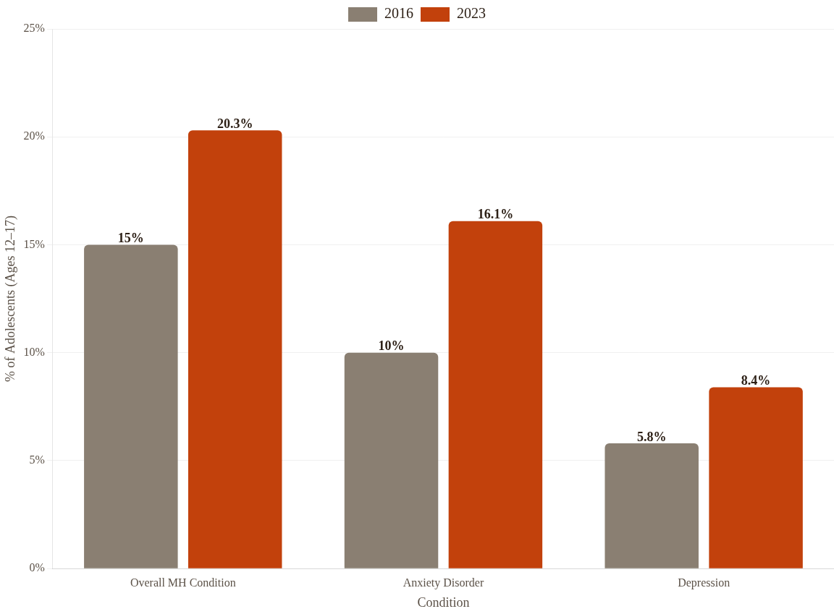
A Steep and Steady Rise
+61%
Increase in anxiety diagnoses since 2016
+45%
Increase in depression diagnoses since 2016
Scouting America | Youth Mental Health | Source: HRSA MCHB, 2023

Slide 4



What Is Anxiety?
Anxiety is a persistent, excessive worry or fear that interferes with daily activities. It goes beyond normal nervousness — it can be paralyzing.
Mental
Excessive worry, racing thoughts, difficulty concentrating
Physical
Racing heart, headaches, stomach-aches, shortness of breath
"My heart is racing and I don't know why. I just can't stop thinking about everything that could go wrong."
— What an anxious Scout might be experiencing
Behavioral
Avoidance of situations, social withdrawal, 'stuckness'
Scouting America | Youth Mental Health

Slide 5



What Is Depression?
Depression is more than sadness. It's a persistent low mood, loss of interest, and a sense of hopelessness that affects how a young person thinks, feels, and functions.
Emotional
Persistent sadness, hopelessness, irritability, loss of interest (anhedonia)
Physical
Changes in sleep or appetite, fatigue, low energy, physical health complaints
"In children and teens, depression often looks like irritability or anger — not just sadness. It can be easy to miss or misattribute."
— Important distinction for Scout leaders
Behavioral
Withdrawal, neglecting responsibilities, expressing worthlessness, detaching from things that once brought enjoyment
Scouting America | Youth Mental Health

Slide 6


Recognizing Signs — Children (Ages 8–12)
Anxiety
Depression
Specific phobias or intense separation anxiety
Frequent stomach-aches or headaches (physical complaints)
Irritability and anger — often mistaken for 'bad behavior'
Significant changes in eating or sleeping habits
Social anxiety — clingy or reluctant to join group
Persistent fatigue and low energy
Worries that seem 'internalized' — not always obvious
Difficulty concentrating in activities or at school
Avoidance of activities they can’t control
Loss of interest in things they once enjoyed
Dreams/nightmares with themes of death, fear, loss of control, harm to others/self
Scouting America | Youth Mental Health | Sources: CDC, PMC

Slide 7

Recognizing Signs — Adolescents (Ages 13–17)
Anxiety
Depression
Intense social anxiety — fear of judgment from peers
Persistent sadness, hopelessness, 'nothing matters'
Avoidance of group activities, presentations, or leadership roles. Withdrawing from sources of enjoyment/friend group.
Loss of interest in activities they previously loved
Panic attacks: racing heart, shortness of breath, nausea
Withdrawal from social group, enjoyed activities
Sharp rise in suicidal ideation — must be taken seriously
Excessive worry about performance and fitting in
1 in 5 high schoolers seriously considered suicide in the past year. Take any mention of self-harm seriously — always.
Scouting America | Youth Mental Health | Source: Annie E. Casey Foundation

Slide 8


Recognizing Signs — Young Adults (Ages 18–25)
Key Triggers
Signs to Watch
By 24
Most lifetime mental illnesses have their onset
Leaving home / starting college or a career
Similar to adolescent symptoms but intensified
Financial independence pressures
#2
Sudden drop in engagement or reliability
Identity and relationship navigation
Suicide is a leading cause of death for ages 18–25
Expressing feeling 'stuck' or purposeless
Reduced access to prior support systems
This age group is often overlooked — they seem 'grown up.'
Isolating from peers, community
Scouting America | Youth Mental Health | Source: Compass Health Center

Slide 9

Scouting Scenario: Camping Trips & Outdoor Activities
Anxiety
Depression
A Scout refuses to try the climbing wall despite repeated encouragement. They appear frozen, pale, and are breathing rapidly.
A Scout who used to love hikes now stays in their tent alone. They skip meals, don’t respond to jokes, and seem distant from their patrol.
Extreme fear that persists despite reassurance
Withdrawing from the group voluntarily
Racing heart, shortness of breath, nausea (panic attack)
Lack of energy or enthusiasm for activities they once enjoyed
'Stuckness' — unable to move forward even when willing
Skipping meals or showing little interest in food
Intense focus on what could go wrong
Flat affect — not connecting with peers. ”Present but checked out.
Scouting America | Youth Mental Health | Source: Able Scouts

Slide 10
Scouting Scenarios: Merit Badges & Group Dynamics
Merit Badge Session
Anxiety
Merit Badge Session
Depression
Scout struggles to focus, asks to be excused, or avoids anything evaluated. Excessive worry: 'What if I fail?'
Visible lack of motivation. Difficulty completing tasks. May say 'I'm not good at anything' or give up quickly. Already talk about ending Scouting.
Troop / Patrol / Unit Interaction
Anxiety
Troop / Patrol / Unit Interaction
Depression
Avoids speaking in group settings. Constant worry about what others think. Trouble making eye contact or contributing.
Irritability with patrol members. Withdraws from friendships. Stops participating in troop traditions they used to love.
Scouting America | Youth Mental Health | Source: Able Scouts

Slide 11

Scouting Scenario: When a Youth Leader Starts to Struggle
Watch For
Sudden loss of self-confidence
Alex is a 16-year-old Senior Patrol Leader (SPL) who has always been reliable, enthusiastic, and a role model for younger Scouts.
Feeling like a 'burden' to the group
Over the past month, Alex has stopped running patrol meetings, snapped at younger Scouts, and told you privately: "I don’t think I should be SPL anymore. I just mess everything up."
Abdicating responsibilities without explanation
Is this just burnout — or something more?
… Inquire and explore. Don’t assume.
Expressing hopelessness about abilities
Increased irritability or withdrawal
Scouting America | Youth Mental Health | Source: Able Scouts

Slide 12




Scouting Is Already Part of the Solution
Nature & Outdoor Time
Belonging & Social Connection
Resilience & Confidence
Proven to reduce stress, anxiety, and depression. Hiking and camping disconnect youth from digital pressures and restore emotional well-being.
Patrols/Dens bonds combat loneliness and isolation — major risk factors for depression. Scouting fosters lasting friendships and a sense of community.
Earning merit badges, conquering difficult hikes, and leading projects builds a mindset for handling adversity. Coping skills are practiced, not just taught.
Adults who participated in Scouting as youth have significantly better mental health and are less likely to suffer from mood or anxiety disorders later in life.
Scouting America | Youth Mental Health | Source: Scouting Magazine, PMC

Slide 13







Your Role: First Responder, Not Therapist
What you ARE here to do:
You are part of a Circle of Care
The Scout
Observe
Support
Refer
Scout Leaders
Notice changes in behavior, mood, or participation
Create a safe, non-judgmental space for youth to feel heard
Connect youth and families to the right professional support
Parents & Family
Mental Health Professionals
Scouting America | Youth Mental Health

Slide 14
Two Approaches That Actually Work
01
02
Therapeutic Mentoring
CBT-Informed Conversation
A structured, one-on-one relationship focused on building social skills, problem-solving, and communication. Strengths-based — you focus on what the Scout can do, not what they can’t.
Help a Scout identify unhelpful thought patterns and gently explore alternative, balanced perspectives. You don’t need to be a therapist — just a thoughtful, curious listener.
Try This:
Try This:
Scout: 'I'm going to fail this merit badge.' You: 'What makes you think that? Have you prepared? What’s one thing you do know?' Guide them toward evidence-based thinking.
Meet one-on-one with the Scout regularly. Ask about their goals, celebrate small wins, and help them identify and build on their strengths.
Scouting America | Youth Mental Health | Sources: Frontiers, PMC

Slide 15






Youth Mental Health First Aid — 5 Steps
A concrete action plan for any leader
1
2
3
4
5
Assess
Listen
Reassure
Refer
Encourage
Assess for risk of suicide or harm. Ask direct questions if needed. This is the most critical step.
Listen nonjudgmentally. Create a safe space with no fear of criticism or judgment.
Give reassurance and information. Let them know help is available and they are not alone.
Encourage appropriate professional help. Connect the youth and family to mental health professionals.
Encourage self-help and other support strategies — mindfulness, exercise, talking with trusted friends.
Scouting America | Youth Mental Health | Source: GSU Center for Leadership in Disability

Slide 16



Scouting America’s MESH Initiative
Prevention
Self-care promotion, positive peer interactions, displaying 988 Lifeline
MESH
Mental, Emotional, and Social Health
Scouting America has formally launched MESH — a national framework to support youth mental health through prevention, training, and crisis response.
Capacity Building
YMHFA and QPR training for leaders, staff, and youth leaders
NCAP Standard RP-551 requires camps to have written mental health procedures and a network of local resources.
Crisis Response
Written emergency plans, assessment protocols, and referral to professional support
Scouting America | Youth Mental Health | Source: Scouting America / Simplified Newsletter

Slide 17


Responding Well: Do’s and Don’ts
Do
Don’t
Educate yourself — learn common signs of mental health challenges
Don’t diagnose — observe, inquire, support, and refer
Create a safe, stigma-free environment in your troop
Don’t use dismissive language: ‘just get over it’ or ‘pray it away’ or “it’ll be fine just ignore it’
Listen actively — give the youth your full attention
Don’t ignore warning signs — take any mention of self-harm seriously
Build trusting, steady, authentic relationships
Don’t act alone — involve parents and professionals
Have a plan — know who to call and keep resources handy
Don’t promise confidentiality you can’t keep
Scouting America | Youth Mental Health | Source: Fuller Youth Institute

Slide 18
How to Talk to Parents
Say This, Not That
1
Find a private time and place
Never discuss this publicly or in front of the Scout.
✔ Say This:
“I’ve noticed that Jamie has seemed withdrawn on our last two campouts and isn’t eating much. I wanted to check in — have you noticed anything at home?”
2
Share observations, not diagnoses
Describe behaviors: ‘I’ve noticed John seems withdrawn on our last two campouts.’
3
Express your concern
‘I care about John and wanted to share what I’ve seen.’
✘ Not This:
“I think Jamie is depressed and needs professional help.”
4
Ask how you can help
Inquire about known triggers, coping methods, or things that work for their child.
5
Offer resources
Observations open doors. Diagnoses close them.
Provide local counselors or national hotlines. Respect the family’s decision to seek care.
Scouting America | Youth Mental Health | Source: Able Scouts / Mental Health First Aid

Slide 19




Crisis Response & Referral Resources
Resource
Contact
Notes
SAMHSA Helpline
1-800-662-4357
Free, 24/7
If a Scout Is in Immediate Danger
Suicide & Crisis Lifeline
988
Free, 24/7
Crisis Text Line
Text 741741
Text-based, 24/7
Call 911
For emergency services
FindTreatment.gov
findtreatment.gov
Locate local care
Call or Text 988
Suicide & Crisis Lifeline
Pediatrician / Counselor
First referral point
Text HOME to 741741
Local
Crisis Text Line
Do not leave them alone
Stay with the Scout until help arrives
Scouting America | Youth Mental Health | Source: SAMHSA, 988 Lifeline

Slide 20




“You don’t have to be a therapist to make a difference. You just have to show up, pay attention, and care.”
The Leader’s Promise
Recognize
Support
Refer
Know the signs for each age group
Listen, reassure, and connect
Use YMHFA steps and available resources
Start with one thing: Learn the 5 YMHFA steps before your next meeting.
Scouting America | Youth Mental Health | Thank You

Slide 21
Questions?
Andrew Mendonsa, Psy.D., MBA
Clinical/Forensic Psychologist
GEC Council Chair
2023/2026 National Jambo Mental Health Lead
Email: Andrew@AndrewMendonsa.com
Phone: (916) 224-0212

