Slide 1

Supporting Our Scouts
A Leader's Guide to Mental Health Awareness
Andrew Mendonsa, Psy.D., MBA
Clinical/Forensic Psychologist
GEC Council Chair | National Jamboree MH Lead
Scouting America

Slide 2
Mental Health Awareness
1
The State of Youth Mental Health
2
Recognizing the Warning Signs
Today's Agenda
3
How to Talk to Youth & Parents
4
Available Support Resources
5
Integrating Wellness into Scouting
Scouting America

Slide 3

Why This Matters
1 in 5
High school students in the U.S. seriously considered suicide in the past year.
2023 CDC Youth Risk Behavior Survey
Scouting America

Slide 4



The State of Youth Mental Health
A Statistical Overview
21%
61% & 45%
Of youth (3-17) have a diagnosed mental, emotional, or behavioral health condition.
Increase in diagnosed anxiety and depression among adolescents (2016-2023).
CDC, 2021
AECF, 2023
40%
54%
Of high school students felt persistently sad or hopeless in the past year.
Of youth had difficulty getting needed mental health care in 2022-2023.
CDC, 2023
NSCH Data Brief
Scouting America

Slide 5
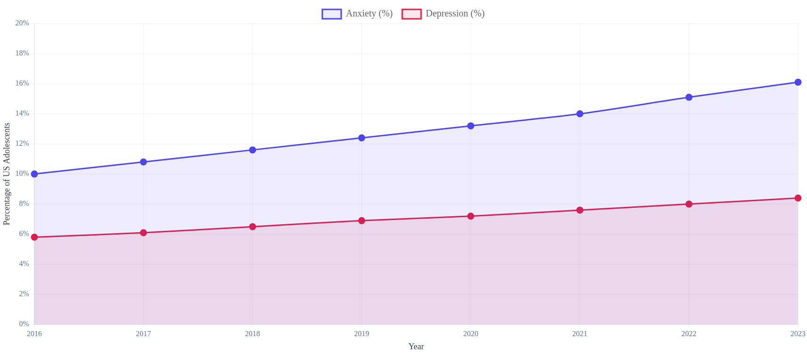
A Growing Concern
Prevalence of Diagnosed Anxiety & Depression, Ages 12-17 (2016-2023)
Scouting America

Slide 6



The Impact on a Scout's Life
3x
10x
2x
More likely to be disengaged from school.
More likely to have difficulty making or keeping friends.
More likely to be victims of bullying.
Scouting America

Slide 7
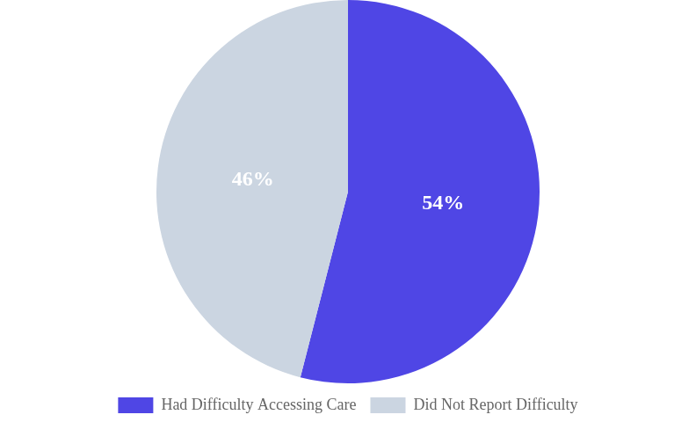
Barriers to Care
Difficulty Accessing Care
40%
Of adolescents who experienced a major depressive episode did not receive any mental health care.
NSCH Data Brief
Scouting America

Slide 8

Section 2: Warning Signs
Your Role: To Observe, Not Diagnose
Warning signs are persistent changes from a youth's typical behavior. As a leader, you are in a unique position to notice these shifts over time. The goal is not to diagnose, but to recognize the need for support.
Recognizing the Signs
Look for patterns, not isolated incidents.
Scouting America

Slide 9




Warning Signs: Emotional & Mood Changes
Persistent sadness, hopelessness, or irritability lasting more than two weeks.
Loss of interest or pleasure in activities the youth once enjoyed (anhedonia).
Intense mood swings or frequent, dramatic shifts in energy levels.
Excessive worry, fear, or anxiety that seems out of proportion to the situation.
Scouting America

Slide 10





Warning Signs: Behavioral Changes
Social Withdrawal
Risky Behavior
Self-Harm
Pulling away from friends, family, and unit activities.
Engaging in dangerous or self-destructive actions.
Any talk of or engagement in self-harm. May hide marks.
Substance Use
Aggression
Increased use of alcohol or drugs.
Frequent outbursts of anger, defiance, or out-of-control behavior.
Scouting America

Slide 11


Warning Signs: Cognitive & Physical
Cognitive & Academic
Physical Symptoms
Sudden drop in grades or performance
Significant changes in sleep (more or less)
Difficulty concentrating or deciding
Major changes in appetite or weight
Lack of interest in future plans
Unexplained headaches or stomachaches
Scouting America

Slide 12


Immediate Action Required
If a scout talks about suicide, death, or hurting themselves or others, gives away prized possessions, or seems to be hallucinating or detached from reality, you must act immediately.
Your responsibility is to get them professional help.

Slide 13
How to Talk to Youth: Best Practices
1
2
3
Create a Supportive Opening
Listen to Understand
Offer Support & Resources
Practice active listening. Validate their feelings with phrases like, "That sounds really difficult." Ask open-ended questions.
Ask what they need. Reassure them that seeking help is a sign of strength. Know your boundaries and when to escalate.
Choose a low-pressure time. Start with a non-judgmental observation like, "I've noticed you seem quieter lately. How are you doing?"
Scouting America

Slide 14
Communication Skills
Active Listening Skills
Give your full attention (no distractions).
"Listen to understand, not to reply."
Validate their feelings without judgment.
Ask open-ended questions to learn more.
— Stephen Covey
Embrace silence; give them space to think.
Scouting America

Slide 15
Approaching Parents & Guardians
Prepare Your Observations
1
Gather specific, objective, behavioral examples. Use "I've noticed..." not "I think they are depressed..."
Initiate with Care
2
Request a private conversation. Start by expressing care for their child and frame it as a partnership.
Share and Listen
3
Present your observations calmly. Then, ask "Have you noticed anything similar at home?"
Offer Support, Not Solutions
4
Your role is to share information. Offer general resources but defer to the parent's judgment on next steps.
Scouting America

Slide 16



Immediate Crisis Support (24/7)
Free, Confidential, and Always Available
988 Suicide & Crisis Lifeline
Crisis Text Line
The Trevor Project
Call or Text 988
Text HOME to 741741
Call 1-866-488-7386
For immediate connection to a trained counselor.
Connect with a crisis counselor via text.
Crisis intervention specifically for LGBTQ+ youth.
Scouting America

Slide 17


Support Resources & Initiatives
National Organizations
Scouting America Initiatives
NAMI: National Alliance on Mental Illness — support groups and education.
Psychological First Aid (PFA): Training for leaders to provide immediate, compassionate support.
The Jed Foundation (JED): Focuses on suicide prevention for teens.
MESH Resources: Mental, Emotional, and Social Health training materials.
SAMHSA: National helpline for treatment referral and info.
Focus on Outdoor Activity: Proven strategy for reducing stress and anxiety.
Scouting America

Slide 18



Integrating Wellness into Scouting
Leverage Core Principles
Introduce New Practices
Model & Recognize
Frame hikes as stress-reducers and challenges as resilience-builders. The patrol method is a built-in peer support system.
Start meetings with "Mindful Minutes" or use "Rose, Thorn, Bud" check-ins to normalize sharing highs and lows.
Leaders can model healthy coping. Consider unit-level recognition for scouts who complete wellness activities.
Scouting America

Slide 19

"Your actions as a leader create the culture. By modeling healthy coping and prioritizing well-being, you give scouts permission to do the same."
Be the Example

Slide 20
Questions?
Thank you for your commitment to supporting the mental health and well-being of our scouts.
Andrew Mendonsa, Psy.D., MBA
Andrew@AndrewMendonsa.com | (916) 224-0212
mentalhealth@scouting.org
scouting.org/health-and-safety

