Slide 1

Child Behavior 101
A Leader's Guide to Behavior Management in Scouting America
For Adult Leaders
Andrew Mendonsa, Psy.D., MBA
Clinical/Forensic Psychologist
GEC Council Chair | National Jamboree MH Lead
Scouting America

Slide 2

Our Goal: A Positive Environment
This presentation provides a framework for understanding and managing scout behavior (ages 8-12). Effective management is rooted in understanding development, applying proven strategies, and upholding Scout values.
"To prepare them to make ethical and moral choices over their lifetime."
— The Mission of Scouting America
Child Behavior 101 — Scouting America

Slide 3
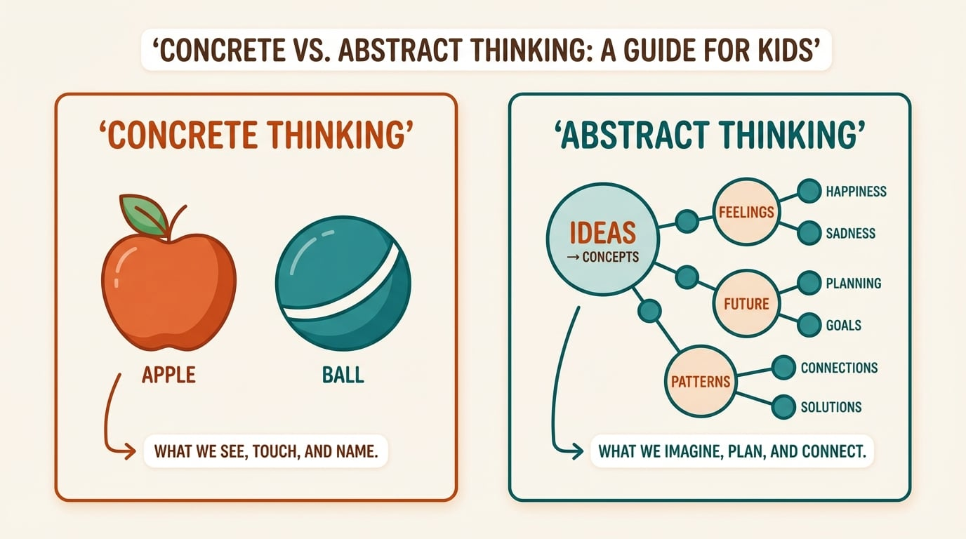





Cognitive Development: The Thinking Scout
Logical & Abstract Thought: Moves from concrete to abstract thinking; enjoys strategy.
Problem-Solving: Improved ability to process information and solve complex problems.
Time & Money: Solidifies understanding of schedules and money; becomes 'future-minded'.
Reality vs. Fantasy: Stronger distinction between what is real and what is not. Think Santa.
Behavior is a form of communication. Understanding their cognitive stage provides context for their actions.
Child Behavior 101 — Scouting America

Slide 4
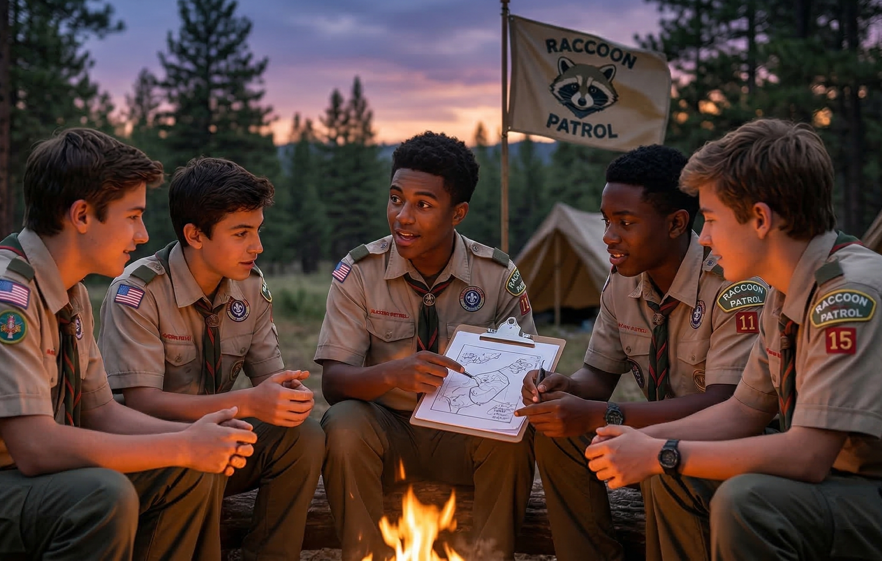



Social Development: The Peer-Focused Scout
Peers are Central: Friendships can take precedence over family; influenced by peer pressure.
Group Dynamics: Enjoys group activities; learns cooperation, negotiation, and compromise.
Rules & Fairness: Develops a strong sense of justice; can be bossy about rules.
Social Awareness: Becomes self-conscious and sensitive to others' opinions.
Child Behavior 101 — Scouting America

Slide 5





Emotional Development: The Independent Scout
Growing Independence: Shows a desire for more responsibility, which builds confidence.
Emotional Regulation: Still learning to control a wide range of emotions; moods can be dramatic.
Empathy & Conscience: Growing ability to show sympathy and understand right from wrong.
Self-Esteem: In the 'industry vs. inferiority' stage; self-worth is tied to accomplishment.
Child Behavior 101 — Scouting America

Slide 6




Common (and Normal) Behavior Challenges
Preferring Peers
Talking Back
Actively avoiding adults to spend time with friends.
Using defiant language to assert independence.
Focus on Fairness
Stretching the Truth
Becoming upset over perceived unfairness or cheating.
Lying to avoid consequences or navigate social situations.
Child Behavior 101 — Scouting America

Slide 7
Developmental Norms from 5 to 18
Age Range | Developmental Phase | Primary Social Focus | Key Behavior Characteristics
5 to 7 | Early Childhood | Caregivers and Parents | High physical energy: brief attention spans: need for constant movement: difficulty with abstract rules.
8 to 10 | Middle Childhood | Same Gender Peers | Strong sense of "fairness": desire for logic: collecting and organizing; mastery of physical skills.
11 to 13 | Early Adolescence | Peer Acceptance | Sensitivity to criticism: questioning authority: rapid mood shifts: social comparison.
14 to 18 | Late Adolescence | Identity and Autonomy | Abstract thinking: risk evaluation: seeking adult like responsibility: values clarification.
Child Behavior 101 — Scouting America

Slide 8
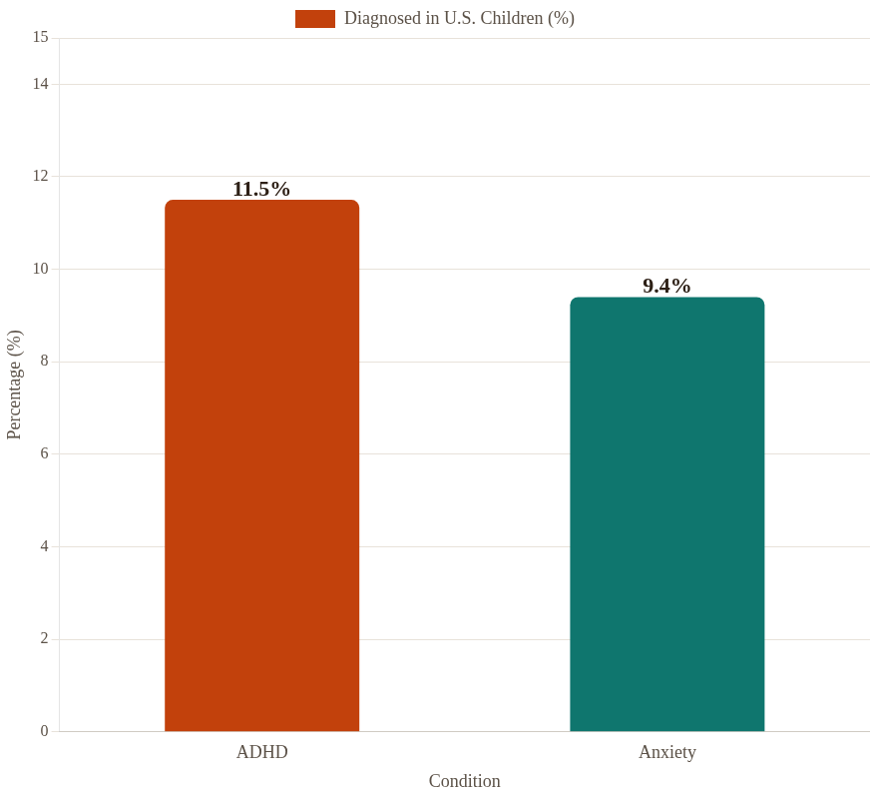
Beyond the Norm: Behavioral Health Stats
~40%
of children with ADHD also have anxiety.
Boys > Girls
>44%
with ADHD
have conduct problems
Key Insight: Children with diagnosed behavioral health conditions are more likely to be disengaged, bullied, and have difficulty making friends.
Child Behavior 101 — Scouting America

Slide 9


Foundational Management Strategies
Set Clear Expectations
Use Positive Reinforcement
Establish a few clear, simple, and positively worded rules. The Scout Oath and Law are the perfect foundation. Review them regularly.
Notice and praise positive behaviors. Be specific rather than generic to reinforce exactly what you want to see repeated.
Example: "I was impressed with how you helped your patrol clean up without being asked."
Example: "We are Trustworthy — we keep our promises and tell the truth."
Child Behavior 101 — Scouting America

Slide 10


Foundational Strategies (Continued)
Offer Choices
Redirect Behavior
Provide acceptable choices to give Scouts a sense of control. This empowers them and reduces power struggles.
Instead of just saying "stop," guide the Scout toward an appropriate activity. Give them a specific, helpful task.
Example: "Would you like to work on knot-tying or start the fire-building activity?"
Example: ”A Scout is helpful; can you be our supply manager and hand out the rope?"
Child Behavior 101 — Scouting America

Slide 11

Intervention: De-escalation
1
Speak Calmly
Use a calm, respectful voice.
Scouting Scenario
The Frustrated Builder
2
Get at Eye-Level
Situation: A Scout becomes angry and throws down their woodcarving project after making a mistake.
Attempt to be at their eye level.
3
Acknowledge Feelings
Leader Action: Approaches calmly, kneels down, and says, "That looks frustrating. Let's take a five-minute break and look at it again with fresh eyes.” This models healthy coping.
"I can see you're frustrated."
4
Offer a Break
Suggest a pause or an alternative.
Child Behavior 101 — Scouting America

Slide 12


Challenge: Attention & Focus
Strategies for Leaders
Scouts have varying attention spans. They may be easily distracted, seem restless, or have trouble completing multi-step tasks. This is often linked to cognitive development and high energy levels.
Break Down Instructions: Give one or two steps at a time.
Use Visual Aids: Demonstrate tasks instead of just explaining them.
Incorporate Movement: Plan for active games or stretches between quiet activities.
Remember: An 11-year-old's sustained attention is roughly 16-24 minutes. Plan activities accordingly! Re-focus/ grounding breaks are key.
Set Time Limits: Use a timer for tasks to create a focused work period.
Child Behavior 101 — Scouting America

Slide 13

Challenge: Emotional Regulation
Moods can change quickly. Scouts may be overly dramatic, sensitive to criticism, or have trouble managing frustration and disappointment. This is a normal part of learning to handle complex feelings.
Scouting Scenario
The Unfair Game
Situation: A Scout accuses others of cheating during a game and storms off, close to tears.
Key Fact: The prefrontal cortex (responsible for impulse control) doesn't fully mature until the mid-20s. Patience is essential.
Leader Action: Follow, acknowledge the feeling ("Losing can feel unfair"), and offer a coping strategy: "Let's try the Turtle Technique* to cool down before we talk about it."
* See next slide for Info
Child Behavior 101 — Scouting America

Slide 14
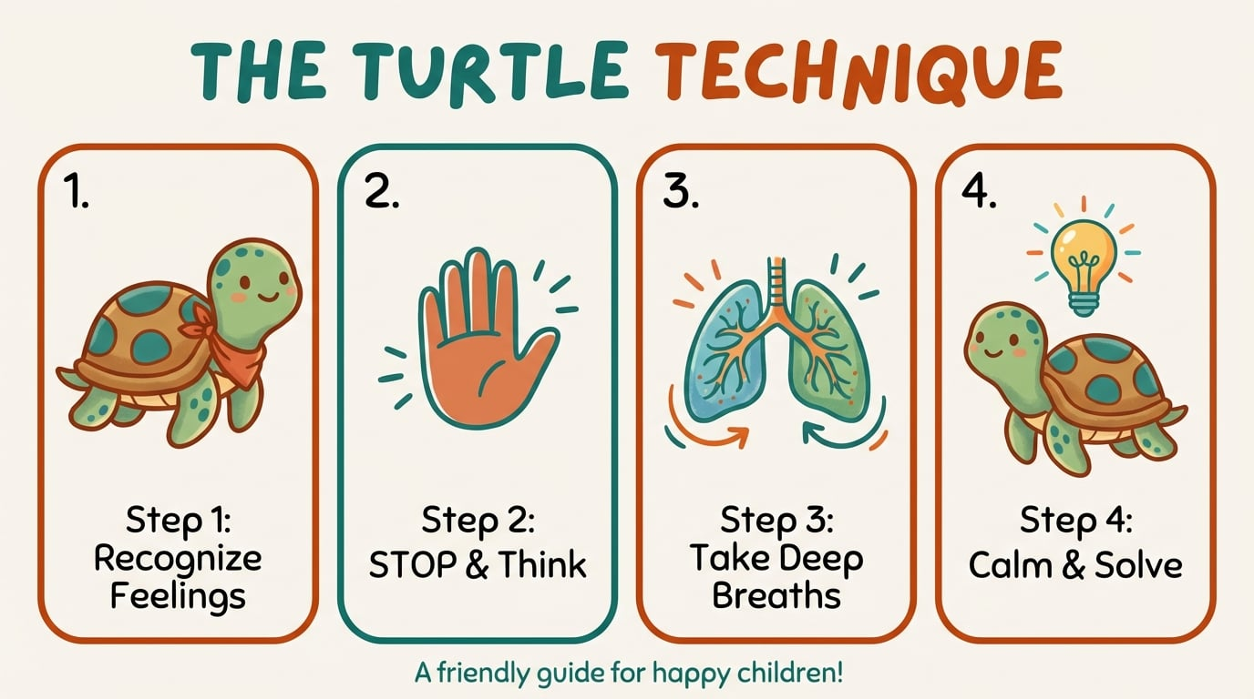
Intervention: The Turtle Technique
How to Teach It
1
Stop
Recognize you have a strong feeling and stop.
2
Go In Your Shell
Tuck your body in and be quiet.
3
Take 3 Deep Breaths
Breathe slowly to calm your body and mind.
4
Think of a Solution
Once calm, think of a positive way to solve it.
Child Behavior 101 — Scouting America

Slide 15


Challenge: Group Dynamics
With the focus on peers, conflicts can arise over rules, fairness, and leadership. Cliques may form, and peer pressure can influence negative behavior. Tattling and bossiness are common.
The Good Behavior Game
Goal: Use positive peer influence to encourage teamwork.
How it Works: Patrols earn points or rewards for meeting specific behavioral goals as a team.
Did You Know? Research shows that group-based behavioral interventions are more effective than individual discipline for this age group.
Benefit: Shifts focus from individual negative behavior to collective positive achievement.
Child Behavior 101 — Scouting America

Slide 16

Challenge: Managing Transitions
Strategies for Smooth Transitions
Switching from a fun, high-energy activity to a quiet, focused one can be difficult. Scouts may resist, become disruptive, or lose focus during the changeover. This is a common executive functioning challenge.
Give a 5-Minute Warning: Announce the upcoming change ahead of time.
Use a Consistent Signal: A specific call, song, or hand signal to mark the end of an activity.
Make Cleanup a Game: Turn tidying up into a timed race between patrols.
Pro Tip: The most chaotic moments in a meeting are usually transitions, not the activities themselves. Plan for them!
Plan 'Buffer' Activities: Have a short, calming activity between high and low energy tasks.
Child Behavior 101 — Scouting America

Slide 17

Challenge: Following Instructions
Scouting Scenario
Scouts may not follow instructions for many reasons: they didn't hear, didn't understand, were distracted, or are testing boundaries. It's rarely about simple defiance.
The Lashing Lesson
Situation: During a knot-tying lesson, a Scout is poking their neighbor with a rope instead of practicing.
Reframe It: Before assuming defiance, ask yourself: "Did they hear me? Did they understand? Are they able to do this right now? Are they able to do what I am asking"
Leader Action: Makes eye contact, walks over, and gives a choice: "You can either practice the square lashing with us, or you can take a break and be our rope inspector. Which do you choose?” This let’s the Scout decide and more likely to stick with it.
Child Behavior 101 — Scouting America

Slide 18




Our Framework: The Scout Code of Conduct
Live the Scout Law
Youth Protection First
Model the Scout Oath and Law and hold others accountable.
Make the safety and protection of youth your personal priority.
No Bullying or Hazing
No Humiliation
Refrain from bullying, hazing, harassment, or discrimination.
Never use corporal punishment, isolation, humiliation, or ridicule as discipline.
Child Behavior 101 — Scouting America

Slide 19
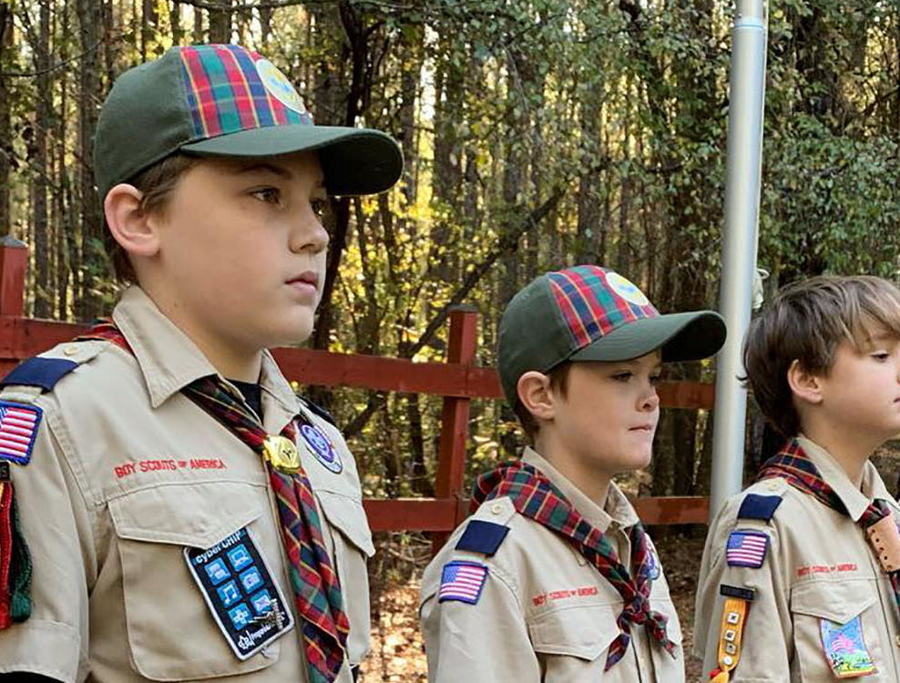


Youth Protection: Our Shield
Two-Deep Leadership
Two registered adult leaders are required at all Scouting activities. A registered female leader (21+) must be present for any activity with female youth.
No One-on-One Contact
All interactions between adults and youth must be in view of other adults and/or youth. This includes online communications. Group texts only with parent/guardian as a member of the chat.
Child Behavior 101 — Scouting America

Slide 20

Empowering Scouts for Safety
The SAFE Activity Checklist
S
Supervision
The Buddy System
Qualified adults present?
Every Scout is paired with a buddy to monitor each other. This simple but effective system promotes accountability and ensures no one gets left behind.
A
Assessment
Have we assessed risks?
In Practice: Buddies check in at transitions, hikes, and water activities.
F
Fitness & Skill
Are youth prepared?
E
Equipment & Environment
Is gear safe?
Child Behavior 101 — Scouting America

Slide 21
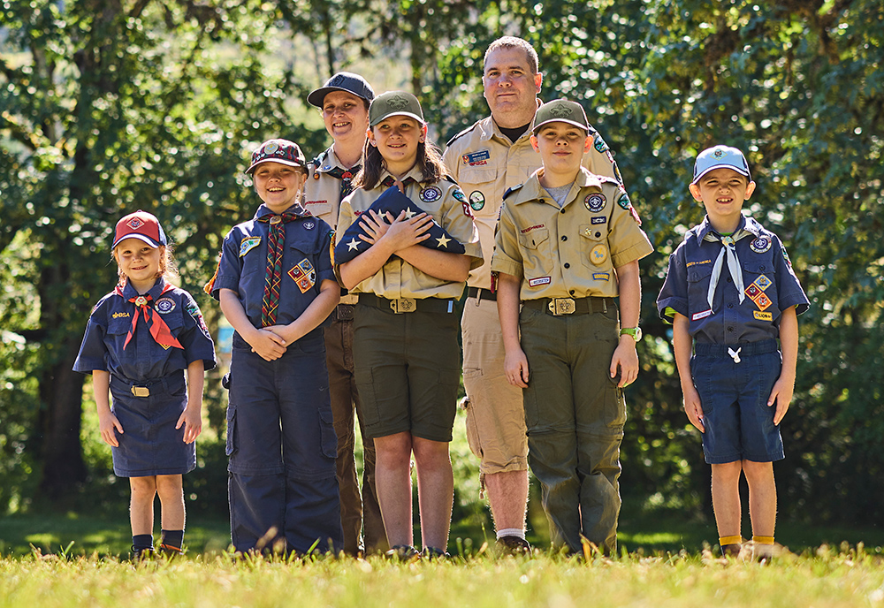



The Leader's Role: Guide & Mentor
Model the Way: Consistently demonstrate the Scout Law in your actions.
Be Proactive: Plan engaging, age-appropriate activities to minimize boredom.
Build Relationships: Get to know your Scouts as individuals.
Use the Patrol Method: Empower youth leaders to manage their own patrols.
Child Behavior 101 — Scouting America

Slide 22


Escalation: When to Involve Parents
Your Most Important Partners
Persistent Behaviors: When issues don't respond to standard guidance after multiple attempts.
Situation: A scout who is usually engaged has been quiet and withdrawn for three consecutive meetings and is not participating.
Consistent Disruption: When one scout's behavior regularly disrupts the program for others.
Leader Action: Call the parent privately, not to complain, but to partner: "I've noticed [Scout's Name] seems a bit down lately, and I wanted to check in and see if everything is okay."
Suspected Deeper Issues: If you suspect struggles beyond typical development (e.g., significant anxiety, withdrawal).
Child Behavior 101 — Scouting America

Slide 23
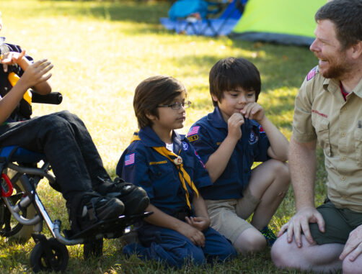

Building the Parent Partnership
"Maintain open communication with parents and guardians. They are your most important partners."
— A Leader's Core Responsibility
Remember: Frame conversations around partnership, not problems. You're on the same team. Don’t diagnosis.
Child Behavior 101 — Scouting America

Slide 24


When to Involve Professionals
Youth Protection Violations
MANDATORY REPORTING OF ABUSE
Any serious violation of Youth Protection policies or behavior that puts a youth's safety at risk MUST be reported to the Scout executive.
Any suspicion MUST be reported immediately to law enforcement AND child protective services.
Also report to the Scout Executive or the Scouts First Helpline.
Examples: Inappropriate adult-youth contact, bullying that causes harm, unsafe activity conditions.
Scouts First Helpline
1-844-726-8871
Child Behavior 101 — Scouting America

Slide 25
Developmental Quick Reference
Ages 5 to 7 (Lions and Tigers)
  Traits: High physical energy, brief attention spans, concrete thinking.
  Leadership Strategy: Use frequent "wiggle breaks”, provide 10-minute activities, use visual cues.
Ages 8 to 10 (Wolves and Bears)
  Traits: Strong sense of fairness: logic driven, peer focused.
  Leadership Strategy: Involve them in rule making, explain the "why”, use cooperative games.
Ages 11 to 13 (Middle School)
  Traits: Peer acceptance focus, questioning authority, emotional shifts.
  Leadership Strategy: Always correct privately, provide logical reasons, foster a safe social space.
Ages 14 to 18 (High School)
  Traits: Seeking autonomy, abstract reasoning, identity building.
  Leadership Strategy: Act as a coach, provide real responsibility, allow for "voice and choice."
Child Behavior 101 — Scouting America

Slide 26
Key Takeaways for Leaders
Understand the "Why"
Behavior is driven by development. Understanding this allows for empathy and effective responses.
Be Proactive
A well-planned program with clear expectations prevents most behavioral issues.
Use Scouting's Tools
The Scout Oath, Law, and Youth Protection policies are your best guides.
Build Positive Relationships
Trust and respect are the cornerstones of effective leadership.
Know When to Get Help
Involve parents or professionals when a situation is beyond your scope.
Child Behavior 101 — Scouting America

Slide 27
Questions?
Thank you for your commitment to supporting the mental health and well-being of our scouts.
Andrew Mendonsa, Psy.D., MBA
Andrew@AndrewMendonsa.com | (916) 224-0212
mentalhealth@scouting.org
scouting.org/health-and-safety
"Your leadership builds the character of the next generation. Be prepared.
Be positive. Be a guide."

