Slide 1
Asian American Contributions
Compiled and Presented by Asian Community Cultural Association of San Leandro
Notes:
Welcome to this presentation; Thank you for coming.
Presentation bought to you by Asian Community Cultural Association of San Leandro
Reason for making this presentation:
Lots of conversations about the discrimination and massacres that Asians face in the late 1800’s, Exclusion Act, Internment Camps, and now we have the Anti-Asian hate crimes
We want to celebrate Asian Heritage Month by talking about the positive contributions that Asians have made in America
While racism can’t be cured overnight, understanding contributions will go a long way in curing the disease
This Information is not currently shared in American History classes; we think it should be shared
We’re sharing this information so that you are aware of how Asians helped contribute to the American infrastructure, culture, medicine, science and technology and be proud of these accomplishments
Compilation of information found on the internet, not making this up.

Slide 2
Asian Immigration to the U.S.
1587: Luzonians Visited Morro Bay in California
1763: Tagalas Settled in Saint Malo, Louisiana
1830: Chinese, Japanese, Korean, Indian & Filipino contract workers in Hawaiian plantations
1848: California Gold Rush
1875: Page Act
1882: Chinese Exclusion Act
Notes:
First, let’s talk about how Asians come to America:
First Asians to enter the U.S. were the Filipinos from Manila called Luzonians who were on board the galleon “Nuestra Senor de Buena Esperanza”, which was on a trade mission between Mexico and the Spanish East Indies
First group of Asians to actually settle in the U.S. were a group of Tagalas from Manila who build a fishing village in Saint Malo, Louisiana
In the 1830’s the sugar cane growers in Hawaii needed low cost workers, so they hired Chinese workers to keep the labor cost down in the plantations
When the native laborers protested against the cheap Chinese laborers, the Hawaiian plantation owners developed the first Formal Contract for contract workers and imported more foreign laborers from Japan, Korea, India and the Philippines.
While there is evidence that there were a small group of Chinese immigrants in the US before the CA Gold Rush, the first major wave of Chinese came to the U.S. from the Guangdong Province in Southern China to work the gold mines so they could send their fortune home
After the Gold Rush, the Chinese migrated to other parts of the U.S. to fill the need for cheap labor, working on the Transcontinental Railroad, factories, and plantations in the south in place of the slaves
Of course, that didn’t sit very well with the Americans because they viewed that as competition for the limited jobs, which lead to what was known as the Yellow Peril, where the Chinese were victims of violence and discrimination
In 1875, the Page Act was enacted which viewed laborers and women (who they saw as prostitutes) as “undesirables” and barred from entering the U.S.
In 1882, the Chinese Exclusion Act was enacted, which made the Page Act very specific to Chinese laborers and women. Exceptions were made for Chinese merchants, diplomats and students

Slide 3
Asian Immigration to the U. S.
1898: End of Spanish American War, Treaty of Paris
1907: Gentlemen Agreement between U. S. & Japan
1907: First East Indian Immigrants
1924: Exclusion Act of 1924
1965: Immigration & Nationality Act
1953: End of Korean War
1975: End of the Viet Nam, Laotian Civil War & Cambodian Civil War
Notes:
However, there was still a demand for inexpensive labor
1898, with the End of the Spanish American War and the Treaty of Paris, the Philippines became U.S. territory, so many Filipinos immigrated to the U.S. to replace the Chinese and Japanese workers
1907, the Japanese and U.S. governments entered a Gentlemen’s Agreement where the Japanese would prohibit new emigration to the U.S. and the U.S. Government would allow Japanese immigration for family reunification purposes
Since the Koreans were colonial subjects of Japan at that time, Koreans were allowed to immigrate to the U.S. to unify with their family or come over as picture brides
In 1907, the first wave of East Indian immigrants arrive to ease the labor market, only to find that immigration restrictions applied to them as well
In 1924, the Exclusion Act was passed to limit the number of Immigration into this country by setting a quota of how many can immigrate from each country per year, (e.g., 100 each year from China, Japan, India). This didn’t apply to the Philippines because they were part of the U.S. Territories.
While there were some relaxation of immigration after WWII for unification of family members of veterans, the biggest change happened when the Immigration & Nationality Act was approved in 1965, where immigration was allowed from Asian countries again
1953, After the Korean War, professionals, students and war brides immigrated to the U.S. The Korean War also resulted in many children displaced. With Korea allowing for International adoptions, many of the displaced children ended up being adopted by U.S. families
1975, After the end of the Viet Nam War and the Laotian and Cambodian Civil Wars, many Vietnamese, Laotian, Hmong, Cambodian and Thai immigrated to the U.S. as refugees seeking asylum. Included in these immigrants were highly skilled and educated families seeking a better life in the U.S.

Slide 4
Asian Contributions to Cultural Diversity
Food and Cooking Style
Music and Art
Values & Practices
Medicine
Self Defense
Religion
Notes:
The emergence of Asians into America has contributed a lot to the cultural diversity of this country.
For instance, instead of having just steak and potatoes or hamburgers and hot dogs, you can now have Chinese, Japanese, Korean, Vietnamese, Thai food. Americans can now enjoy dim sum, peking or roast duck, hot bowl of udon, ramen or pho noodles. Rather than going to a Sizzlers or a MacDonalds, you have choices—Panda Express for Chinese, L&L for Hawaiian, Jolibee for Filipino, Yoshinoya for Japanese or Pho Hoa for Vietnamese food. Instead of throwing meat on a BBQ, or broiling a steak, Americans are learning how easy it is to wok fry their meals.
Talking about food, did you know that the waffle cones they use for ice cream was actually first invented by a Syrian named Ernest Hamwi at the 1904 St. Louis Worlds Fair? He was a concessionaire selling a waffle-like pastry called zalabis. He was next to an Ice cream vendor and noticed that the vendor ran out of dishes for his ice cream. So Mr. Hamwi quickly took his pastry and rolled it into a cone an gave it to the ice cream vendor to put ice cream inside, which was a hit. Mr. Hamwi later founded the Missouri Cone Company.
In Music and Art, Asians have introduced a variety of traditional Asian instruments, such as the Chinese guzheng or the Japanese Taiko drums and brush paintings or carved jade and furniture inlaid with shells. And now, with K-POP, which includes a mixture of Korean music with pop, hip hop, rock, and disco dance music, we have the toddlers mimicking the musicians.
Asian philosophies such as family-first, importance of education, hard work, food sharing, and gift giving are positive attributes in the American life-styles today. Some Americans have made it a point to learned the practice of feng shui or arranging the furniture to harness energy forces and harmony in their environment.
Ancient healing methods such as acupuncture, acupressure and herbal medicine is now sought as alternatives to modern medicine
In addition to boxing, people are now taking kung fu, tae kwon do, karate, judo, aikido, or Muay Thai boxing classes as other forms of self defense
In addition to the Catholic, Baptist, Protestant Churches, Asians have constructed many beautiful Buddhist temples throughout the Nation.

Slide 5
Asian American Accomplishments
Building American Infrastructure
Technological Contributions
Medical Contributions
Scientific Contributions
Social and Public Advocacy Contributions
Arts & Entertainment Contributions
Notes:
For the rest of the presentation, we will provide an overview of just some contributions and accomplishments Asians, either as a group, or as individuals, have made to advance life in America.
They include all aspects of life, including helping to build the infrastructure we all use to technological, medical, and scientific advancements, to social and political contributions, and arts and entertainment we all relish.

Slide 6
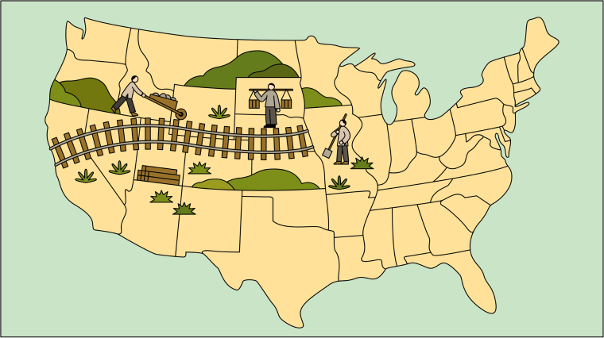
Transcontinental Railroad
Notes:
One of the major accomplishments is the Chinese’s role in the building of the Transcontinental Railroad.
Before we talk about the railroad, let’s lay the groundwork of how the Chinese even got the opportunity to work on the railroad.
The first major wave of Chinese to immigrate to America was attracted by the opportunity of the Gold Rush. They thought it would be easy to earn money to send home to their families or bring their families over. However, they soon found that Gold Mountain was all an illusion. There was simply not enough work, mining was uncertain, there were many disappointed prospectors leading to a hostile environment for them. They soon found that they were stranded in a foreign country with no family and money to survive.
Meanwhile, the Central Pacific Railroad was getting pressure to complete and connect the railroad from Promontory, Utah to Sacramento, CA so they can connect to the Union Pacific line in Utah and was having problems finding enough workers because the work was brutally difficult, pay was low, and the fatality rate was so high.
Here’s where the Chinese immigrants found an opportunity to survive. More than 20,000 Chinese workers blasted tunnels, built roadbeds, laid hundreds miles of track, often in freezing cold or searing hot environment. The final spike was driven in the rails in 1869, after the deaths of hundreds of Chinese workers, but the Chinese was never recognized for their contributions in making it possible to travel from the east coast to the west coast in 4 days as opposed to a 6 months time in a covered wagon or 25 days by stagecoach.
It took 145 years for the U.S. to recognize the Chinese for their contribution to the Transcontinental Railroad when the U.S. Department of Labor inducted the Chinese into their Hall of Honor

Slide 7
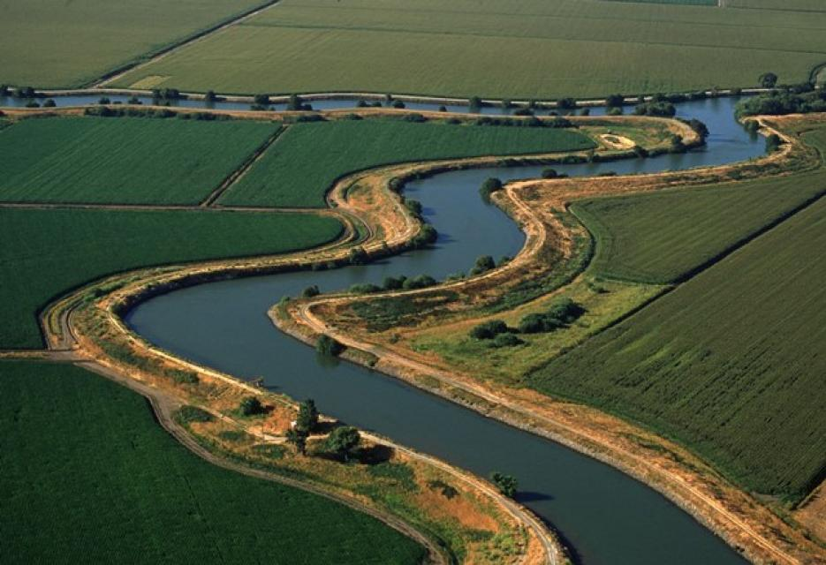
CA Deltas and Levees
Notes:
After the construction of the Transcontinental Railroad, the Chinese immigrants had to find other work to survive.
Some found work in factories making shoes, sewing clothes, rolling cigars, but since there is a language barrier and racial discrimination barred the from many trades, many of them created opportunities for themselves by launching businesses, such as restaurants, retail markets, and laundries in mining towns
To this day, you’ll still find immigrants who are language dependent in the same fields because it’s much easier to have all the products labelled with price tags or on paper where you show the customers the paper and ring up the cost on the cash register
However, because many of the Asian immigrants were farmers in their homeland, they gravitated to farming. In Hawaii, a lot of the plantations were built by the Japanese, Chinese, Filipinos who were hired on contract
The Sacramento Delta levees were built in large part by the Chinese. In 1861, the CA Legislature passed the Swamp and Overflow Act to reclaim farmland from marsh land by building levees. As a result, thousands of Chinese helped built hundreds of miles of levees and reclaimed 88,000 acres of farmland
The added farmland provided farming opportunities for the Chinese and many settled in the towns of Walnut Gove, Isleton, Rio Vista, and Courtland and became farmers and sharecroppers
Today, the Delta provides drinking water for millions of people and one of the most fertile agricultural regions in the U.S.

Slide 8
Other Asian Constructions
Lake Chabot
China Camp
Locke
Asian Communities, Districts and Buildings
Plantations in Hawaii
Notes:
If you’ve ever walked the trail around Lake Chabot, you’ll notice about 8 markers making reference to the Chinese laborers’ contribution to the building of Lake Chabot. In 1874, about 800 Chinese laborers, called “shovel men” moved over 600,000 cubic yards of dirt to make way for what is now called Lake Chabot.
In a Regional Park along the San Pablo Bay in San Rafael, you’ll find the remnants of a shrimp and fishing village called China Camp. This town was developed by some Chinese from Canton, Chinatown in the 1880’s. It had several general stores, a marine supply store and a barber shop and 500 Chinese people living there. Over 90% of the shrimp they harvested was dried and sent back to China.
When Walnut Grove burnt down, several Chinese businessman, who wanted to stay in the area, approached George Locke, who owned the neighboring town, and secured a lease on the land and built several buildings on the land, now known as the historic town of Locke
Throughout the U.S., you’ll find Asian communities built with unique architectural designs reflecting their home countries, such as Chinatowns in San Francisco, New York, Sacramento, Honolulu, Los Angeles and Oakland, Japan Town in San Francisco, Korea Town in Los Angeles, Little Saigon in San Jose and Tustin .
In Hawaii, Japanese, Chinese, Korean, and Filipinos immigrants were hired on a 3-5 year contract to chop and weed the sugar cane fields. Since the majority of the immigrants were from Japan, they did not have to face the sense of isolation and fear of racial attacks that many Asian immigrants faced in the west coast. They were able to transplant their traditions to their new home, building buddhist temples on the plantations, and celebrating traditional festivals, such as obon festivals and the emperor’s birthday.

Slide 9
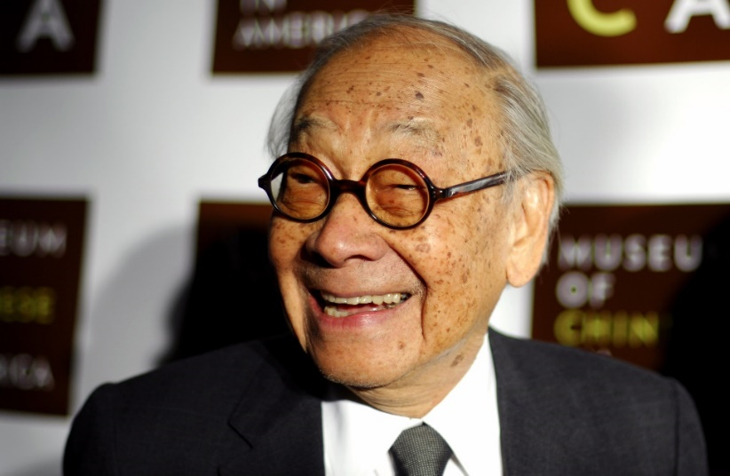
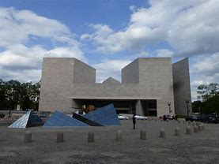
Noted Asian Architects
Ieoh Ming Pei (IM Pei)
60 years as an architect with projects world-wide
Eugene Choy, Gilbert Leong, Helen Liu Fong, and Gin Wong
Los Angeles cityscape
Ninoru Yamasaki
World Trade Center
Maya Lin
Vietnam War Memorial
Notes:
List of some noted Asian American Architects and their projects
Yoh Ming Pei (goes by IM Pei), born in Shanghai, educated in University of Pennsylvania and MIT
Spent 60 years as an architect; known for his modernist style combining the natural environment and open space
Had over 60 projects internationally under his direction
To give you an idea of the breadth of his projects in the U.S., he was responsible for office buildings and research centers, museums, symphony halls, and libraries, university buildings and plazas, City Centers, hotels, hospitals, air traffic control towers and airport terminals
Some noted projects includes the East Building of the National Gallery of Art in D.C., pictured here, Dallas City Hall and the Fountain Place, Rock and Roll Hall of Fame in Cleveland, and locally, the Buck Center for the Research on Aging In Novato
Some of lesser known architects include Eugene Choy, Gilbert Leong, Gin Wong, and Helen Liu Fong, who were instrumental in shaping the cityscape of Los Angeles
Eugene Choy, known for his design of the Cathay Bank Building in LA Chinatown
Gilbert Leong: had a strong role in the design of LA Chinatown, such as the Bank of America and Kong Chow Family Association buildings
Helen Liu-Fong: was known for structures with cantilevered roofs, boomerang angles, elaborate colors, lighting typography and signage
Gin Wong: designed LA Airport’s satellite system that moves arrival, departure and baggage efficiently, blending technological & innovation with practical design. This system provided a blueprint for all airports today.
Ninouru Yamasaki: Designed the original World Trade Center before it got demolished by terrorist attack
Maya Lin, daughter of a Chinese immigrant, designed the Viet Nam War Memorial, a simple black granite wall inscribed with 57,939 names of Americans killed in the conflict. Her designed was voted unanimously over 1,400 other entries.

Slide 10
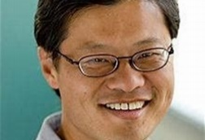
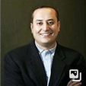
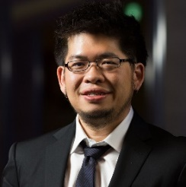
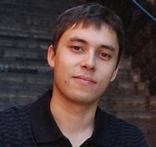
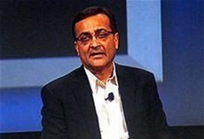
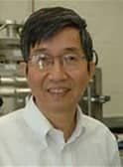
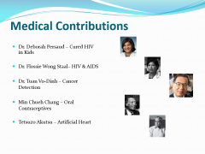
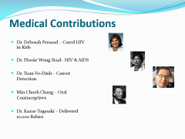
Technological Contributions
Jerry Yang – Yahoo
Sabeer Bhatia – Hot Mail/Outlook
Steven Chen & Jawed Karim– You Tube
Ajay Bhatt – USB Ports
Ching Wan Tang – OLED Technology
Notes:
Here’s a few names you might recognize in the area of technological advancements:
Jerry Yang, , a Taiwanese American, co-founded the web portal, Yahoo with David Filo in 1994. While the two was studying at Stanford, they developed an internet website called Jerry and David’s Guide to the World Wide Web, which consisted of a list of other websites. As the website grew in popularity, they renamed it Yahoo Inc.
Sabeer Bhatia, an Indian American, co-founded Hotmail with his colleague, Jack Smith, on 7/4/96, symbolizing freedom from ISP-based email and the ability to access the mailbox from anywhere in the world. In 1998, Microsoft purchased Hotmail for $400M and renamed Hot Mail to Microsoft Outlook
Steven Chen, a Taiwanese American, and Jawed Karim, a Bandeleshi German, founded You Tube in 2005. While working at PayPal, Steven, Jawed, and Chad Hurley was looking for a way to share videos, so they developed You Tube, a website designed to simplify the sharing of videos online.
Ajay Bhatt, an Indian American, invented the USB port initially to help his wife print letters for his daughter’s school. Because all computers and peripheral equipment were not compatible and could not communicate with each other, he had to look for a way for his wife to transport the information from the equipment at school to the equipment at home. As a result, he developed the USB port to help his wife with the project. Ajay was such an innovator at Intel, he holds 132 patents in the U.S. and internationally.
Ching Wan Tang, escaped Communist China by immigrating through Hong Kong, Canada , then into the U.S. He worked at Eastman Kodak where together with Steven Van Slyke invented the OLED technology. Today, the OLED technology is used by Apple, Samsung, Sony and LG on smart phones, TV, tablets, and smart watches. He was inducted into the National Inventors Hall of Fame in 2018 for his OLED invention.

Slide 11
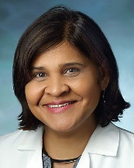
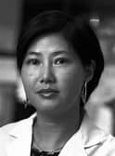
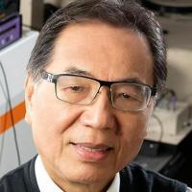
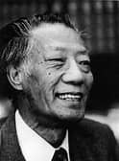
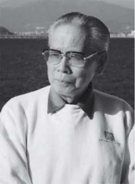
Medical Contributions
Dr. Deborah Persaud – Cured HIV in Kids
Dr. Flossie Wong Staal– HIV & AIDS
Dr. Tuan Vo-Dinh – Cancer Detection
Min Chueh Chang – Oral Contraceptives
Tetsuzo Akutsu – Artificial Heart
Notes:
Here are a few examples of Asians who made contributions in the medical field:
Dr. Deborah Persaud, a Filipina born in Guyana, is a Pediatrics Professor at Johns Hopkins University. Her claim to fame is finding a cure for HIV in infants and received the Elizabeth Glaser Scientist Award and featured in the Times Magazine as one of the 100 most influential people in 2013.
Dr. Flossie Wong Staal, born Wong Yee Ching from Guangdong China, is a virologist and a molecular biologist who cloned HIV, which lead to the discovery that HIV causes AIDS. Her father named her after a hurricane when her teachers encouraged her to continue her science education in the U.S. and change her name to a more English name.
Dr. Tuan Do-Vinh, immigrated from Viet Nam in 1975. He is a biomedical engineering professor at Duke University Pratt School of Engineering. He holds more than 20 U.S. patents. One of the patents is the development of new gene probes that can detect cancer at an early stage. He also developed a new method of treating metastatic bladder and breast cancer and a way to target cell proliferation disorders.
Min Cheuh Chang, who immigrated from Shanxi China, is a reproductive biologist.. He came up with the oral conceptive pills in the 1950’s and received FDA approval in 1960. In 1972, the People’s Republic of China consulted with him on how to reduce the country’s population. In front of the Beijing University faculty, he came up with the “One Child Policy”, which still exists today. He also conducted research on artificial insemination of farm animals, which lead to human vitro fertilization technology, which made parenthood possible around the world.
Dr. Tetsuzo Akutsu, a surgeon, designed models of prosthetic hearts that used an air-driven system. He was the chief collaborator of the team lead by Dr. Willem Kolff that implanted an artificial heart into a pig that lived for 90 minutes in 1957. His work led to the implant of an artificial heart in a human in 1981.

Slide 12
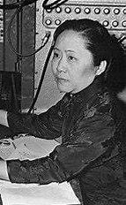
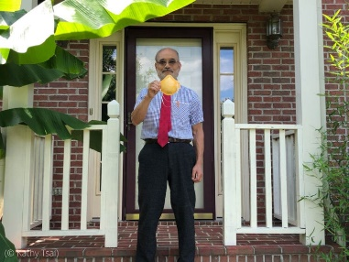
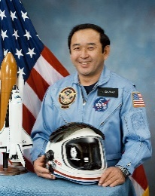

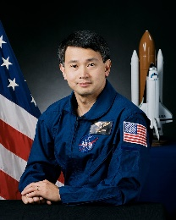
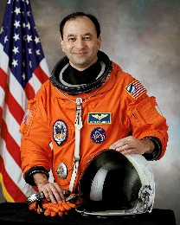
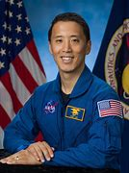
Scientific Contributions
Chien Shiung Wu – Manhattan Project
Peter Tsai – N95 Respirator
Ellison Onizuka – First Asian Astronaut
Taylor Wang
Eugene Trinh
Mark Polansky
Jonathan Kim
Notes:
Asian American scientists we should mention:
Chien Shiung Wu, nicknamed the First Lady of Physics, the Chinese Madame Curie, and The Queen of Nuclear Research developed a way to detect radiation and enrich uranium. Under the Manhattan Project, she used her findings in radioactive uranium separation to build the standard model for producing enriched uranium to fuel the atomic bomb as well as build an innovative Geiger counter. Like many of the people who worked on the Manhattan Project, she later distanced herself from the project because of the mass destruction it can cause.
Peter Tsai, a Taiwanese American materials scientist developed a material with electrostatically charged fibers that pulled particles in making it more effective than the standard masks used in construction, mining, automotive repair industries that cause black lung disease in the 1990’s. Today, the mask is recommended by the medical field to help stem the spread of air-borned particles such as COVID and Sars.
Ellison Onizuka, was the first Asian American astronaut who represented the U.S. in space in 1985. Unfortunately, he didn’t make it on his second flight when he was on the Space Shuttle Challenger that exploded in 1986.
Taylor Wang followed Ellison as the second Asian American in space in April of 1985.
Eugene Trinh went up in space in 1992,
followed by Mark Polansky, who is Korean, went up on 3 different space shuttles in 2001, 2006, and 2009.
Jonathan Kim, who is a Navy Seal and a medical doctor just completed his space training and is working at NASA awaiting his flight assignment for a moon landing scheduled for 2024.

Slide 13
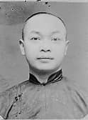
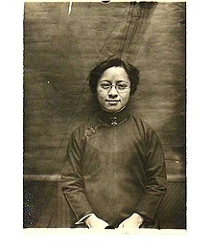
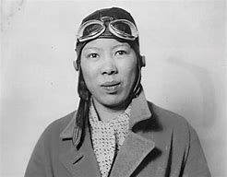
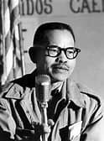
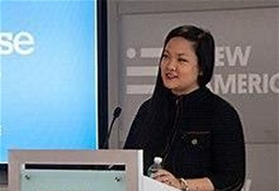
Social Change Contributors
Wong Kim Ark – Birthright Citizenship
Tye Leung Schulze –1912 Voter
Leah Hing – Pilot
Larry Itliong – Filipino Farm Workers Union
Amanda Nguyen – Sexual Assault Survivor’s Right Act
Notes:
There were a number of Asians who fought for social change. Here’s a few highlights:
Wong Kim Ark, was born in the U.S. to Chinese immigrants. Because of the Exclusion Act, his parents could not become U.S. citizens. Wong, himself could not re-enter the U.S. even though he was born here. As a result, he file a writ of habeas corpus and the Supreme Court ruled in his favor by a 6-2 vote that he was considered an American citizen.
Tye Leung Schulze, was arranged to marry an elder man to fulfil her family’s obligation when her older sister, who was supposed to marry the man, ran off with her boyfriend. Donaldina Cameron (of the infamous Cameron House in San Francisco) took her in and saved her from that marriage. Donaldina taught her English and Tye became an interpreter for anyone who needed the services. She was the first Chinese American to pass the civil service examine took on a job at Angel Island as the interpreter where she met her husband, Charles Schulze. Because interracial marriages were illegal, both she and her husband lost their government jobs. Tye had to take jobs in Chinatown and her husband had to take jobs in the private sector to support their family. In 1912, Tye became the first Chinese woman to vote in a Presidential Primary election.
Leah Hing, met John Gilbert Rankin at her dad’s restaurant. He encouraged her to take up flying and gave her lessons at his school. She became the first Chinese American woman to earn her pilot license in 1934. She repaired airplanes during WWII. Even though she had her pilot’s license, she couldn’t join any of the social clubs because she was Chinese, so she would volunteer to work their switchboards or take pictures just to be around them.
Larry Itliong formed the Filipino Farm Workers Union in 1956. In 1965, he organized the Delano Grape Strike with 1500 Filipino Grape Pickers. The strike was ultimately joined by Caesar Chavez and Delores Huerta and became the United Farm Workers Union. To this day, we celebrate Caesar Chavez Day, but we very seldom hear of Larry Itliong.
Amanda Nguyen was raped in 2013 while studying at Harvard. At the time, she had to pay money every 6 months for them to store the rape kit. She wrote the Sexual Assault Survivors’ Right Act to provide survivors access to a forensic medical examine at no cost and to preserve the rape kit without having to pay and make multiple requests. She was nominated for a Nobel Peace Prize in 2018 for her efforts

Slide 14
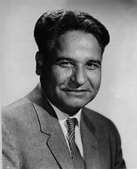
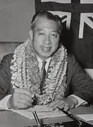
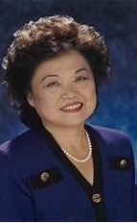


Political Trailblazers
Dalip Saund – 1st Asian American in Congress
Hiram Fong – 1st Asian American Senator
Patsy Mink – 1st Asian American Woman in Congress
Norm Mineta – U.S. Secretary of Commerce and Transportation
Kamala Harris – Vice President
Notes:
Asians are underrepresented in leadership of large corporations and Corporate Boards. This is also true in politics. However, we do have some trailblazers to provide models for future generations.
Dalip Saund was sworn in on 1/3/57 to the U.S. House of Representative representing northern San Fernando valley. He immigrated from India, became a citizen in 1949, earning a PHD from UC Berkeley in Food Preservation and became a farmer in the Imperial Valley. He was elected as a judge in Westmoreland in 1952. When he ran for Congress in 1956, there was a legal challenge filed against him for not being a citizen long enough to run for office, but was dismissed by the Supreme Court. He became the first Asian American to win a seat in the House of Representatives and served until 1963.
Hiram Fong was a son of poor Chinese immigrants who worked in sugar plantations. He was a businessman and a lawyer before being elected as the first Asian American U.S. Senator in 8/24/59 when Hawaii became a state. He retired as the only Republican ever representing Hawaii in 1976.
Patsy Mink earned her law degree from the University of Chicago Law School where she met and married her husband, John Francis Mink and had a daughter. She faced discrimination because no employer, even those headed by Japanese, would hire a woman with a child, so her father set her up in her own private law practice. She ran and won for Congress in 1965 and became the first Asian American woman and first woman of color in Congress, serving until 1977.
Norm Mineta was interned in a Wyoming Internment Camp with his family. He was elected to the San Jose City Council in 1967. When he became Mayor of San Jose in 1971-1975, he was the first Japanese American to become a Mayor of a major city. He became a Congressman representing CA from 1975-1995. In 1992, President Clinton wanted Congressman Mineta to serve as Secretary of Transportation, but he wanted to remain in Congress, so President Clinton appointed him to Secretary of Commerce in 2000, making him the first Asian American to hold a Presidential Cabinet post. In 2001, President Bush appointed him to Secretary of Transportation, making him the only Republican to serve on a Democratic Cabinet.
Kamala Harris, whose parents is Jamaican and Asian Indian became Vice President, the first Asian American to be elected as Vice President

Slide 15
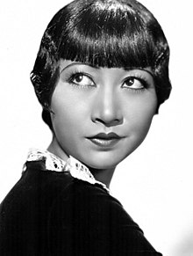
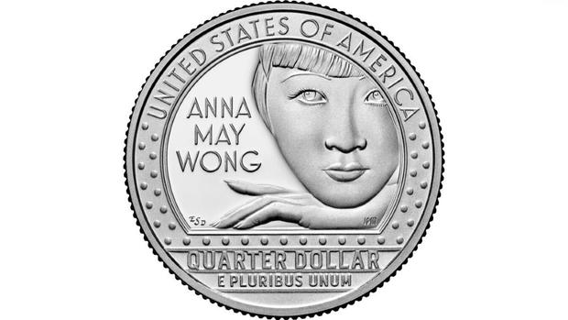
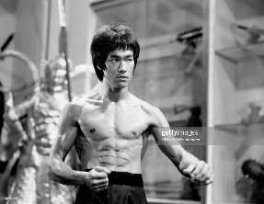
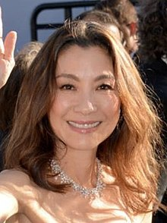
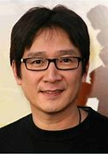
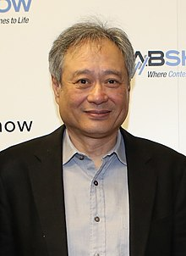
Arts & Entertainment Contributions
Film
Anna May Wong
Bruce Lee
Michelle Yeoh & Ke Huy Kwan
Ang Le
Notes:
We’re seeing more and more Asian American actors and actresses. We’re just naming a few:
Anna May Wong is the first Asian American actress to appear in film. Born in 1905 in Los Angeles. She starred in silent films, sound films, stage, television and radio. Some of her movies include Piccadilly, Daughter of the Dragon, Shanghai Express, and Daughter of Shanghai. She is featured in a quarter as part of the U.S. Mint’s American Women's Quarter Program. I have X uncirculated Anna May Wong Quarters for the raffles, that I will be raffling off at the end of the seminar.
Bruce Lee was born in San Francisco when his parents came here for an International Opera tour. Despite his multi-racial ancestry (mother was Eurasian), he trained under Ip Man in Hong Kong which was considered a no no, and later developed Jee Kune Do, a form of martial arts that combines kung fu, fencing, boxing and his own techniques. He trained several celebrities, including Steve McQueen, Kareem Abdul –Jabbar and Chuck Norris, who later used his new skills in movies. Bruce Lee’s first appearance in movies was as a baby and continued in various movies. He appeared in a television series as Kato in the Green hornet and Batman. He was a screen writer, director, and producer of such movies as Fist of Fury, Enter the Dragon and Return of the Dragon.
Michelle Yeoh was born in Malaysia and started her acting career in Hong Kong doing her own martial arts stunts. After she moved to the U.S., she starred in the James Bond movie Tomorrow Never Dies and Ang Lee’s Crouching Tiger, Hidden Dragon. Early this year, she won the Academy Award for Best Actress for her role as an overwhelmed mother navigating multiverse in Everything Everywhere All at Once. This makes her the first Asian American to ever win this award.
Ke Huy Kwan, also known as Jonathan Kwan, was born in Viet Nam and came over as a Refugee with his family. As a child, he played Short Round in the Indian Jones and the Temple of Doom. Earlier this year, he wan Academy Award Best Support Actor in his role as Waymond in Everything Everywhere All at Once, making him the first Vietnamese to win an Academy Award.
Ang Lee, born in Taiwan and moved to the U.S. to complete his college education. He is a writer, director and producer, earning 12 Academy Awards, 14 BAFTA Awards, and 9 Golden Globes Awards.

Slide 16

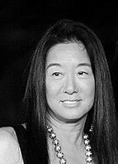



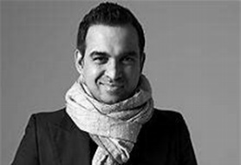

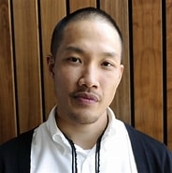
Fashion Designers
Vera Wang
Kimora Lee Simmons
Bihu Mohapatra
Dao-Yi Chow
Notes:
Here’s a few Asian fashion designer who’s made a name for themselves:
Vera Wang was a figure skater when she was young, but when she didn’t make the Olympics, she started her career as a designer. She was hired as the youngest editor of Vogue. She worked for Ralph Lauren before opening up her own line of clothing. Known for her wedding gowns, her dresses are worn by celebrities walking on the red carpet events, as well as figure skaters in the Winter Olympics. Her designs include accessories, fragrance, and products for the home.
Kimora Lee Simmons, whose mother is Japanese Korean, is an astute business woman who created designs that she thought women would wear. Because her designs were pigeonholed as Urban wear, she purposely worked with hip hop artists to market her fashions to the hip-hop fans, expanding sales from $30M in Year 2 to $345M by year 4.
Bibhu Mohapatra learned to sew on his mother’s sewing machine at a very young age. He graduated from the Fashion Institute of Technology in NY. After graduation, he worked for J. Mendel furrier for 9 years before he launched his own business designing evening gowns, cocktail dresses and furs sold only in high end boutiques and stores like Nieman Marcus and for private clients such as Michelle Obama, Glenn Close and Jennifer Lopez.
Dao Yi Chow co founded the fashion line Public School New York with Maxwell Osborne in 2008. Their line of street clothes have caught the attention of the fashion industry. In addition to Public School, they have been hired by DKNY and Tom Brady as creative designers to help design clothes for their respective companies/clients. They also have collaboration projects going with Mont Blanc, Eileen Fisher, Gordon Parker and Russell Athletics.

Slide 17
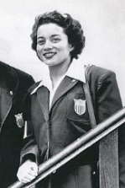
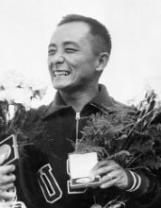
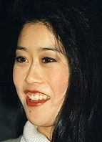
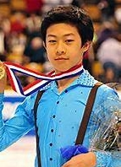
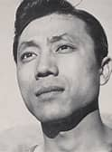
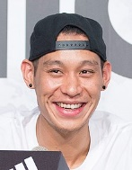
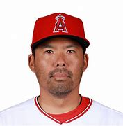
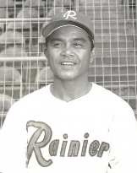
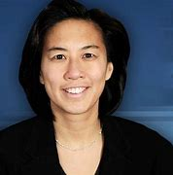
Sports Achievements
Olympians
Victoria Manalo Draves & Sammy Lee
Kristi Yamaguchi & Nathan Chen
Professional Athletes
Wataru Misaka & Jeremy Lin
Bobby Balenca & Kurt Suzuki
Kimberly Ng
Notes:
Here are a few notables under the Sports category:
Victoria Manalo Draves, a Filipino American won gold medals for Platform and Spring Board diving in 1948. That makes her the first woman to win 2 gold medals in diving and the first Asian American to win gold medals in the Olympics.
Two days later, Sammy Lee, a Korean American, won a gold medal for diving and won a second gold medal 4 years later, making him the first Asian American man to win a gold medal and first Asian American man to win gold medals back to back in two separate Olympics. He is also a medical doctor.
In 1992, Kristi Yamaguchi won a gold medal in the Olympics, making her the first Asian American to win a gold medal in figure skating and the second Asian American woman to win a gold medal in the Olympics in any sport. She serves as a role model for Asians in figure skating.
Nathan Chen won first place in 6 consecutive U.S. Championships, 3 consecutive world champions, and 3 consecutive Grand Prix ice skating events, but it took him 2 tries at the Olympics to come home with a gold medal in 2022 where he broke all records in the men’s single skating competition. He was the first Asian American man to earn a medal in figure skating in the Olympics.
Wataru Misaka played point guard for the NY Knicks Basketball team in 1947. At 5’7”, he was the first man of color to break the color barrier in basketball, even before Jackie Robinson broke the color line in baseball in 1950. In fact, he was the first Asian American to play basketball professionally.
Fast forward, we have Jeremy Lin. He actually started with the Golden State Warriors in 2010 and moved to the NY Knicks the following year where he earned his moniker Linsanity by helping to win a seven game winning streak for the NY Knicks with 38 points against Kobe Bryant and a game winning 3 pointer against Toronto. In 2018, he was playing for the Toronto Raptors where they won the NBA Championship. He was the first Asian American and a Harvard graduate to win an NBA Championship.
Bobby Balenca was the first Asian American professional baseball player and the first Filipino to ever play in the Major Baseball League. He played for the Cincinnati Redlegs in 1956.
We have a number of Japanese baseball players today. All but one are born in Japan. Kurt Suzuki was born in Hawaii. He was a pitcher who joined the Major League Baseball with the Oakland A’s in 2007. He played with the Washington Nationals, Minnesota Twins, Atlanta Braves, and was playing for the LA Angels when he announced his retirement at the end of the 2022 season.
In 2020, Kimberly Ng became the first female General Manager in Major League Baseball for the Miami Marlins. She is not only a role model for other females in sports, but all Asians in sports.

Slide 18
Asian American Contributions
Compiled and Presented by Asian Community Cultural Association of San Leandro
Notes:
The people I mentioned today are just a few of the noted Asian Americans who have made some great contributions to advance the life styles of Americans. There are many more I’ve neglected to mention, and Asian Americans who will contribute more in the future. After all, Asian Americans strive to achieve, but we usually do so quietly and don’t usually brag about it.
That concludes my presentation.
Raffles

