Slide 1
Chinese Minority Groups
Arlene Lum
Asian Community Cultural Association of San Leandro

Slide 2
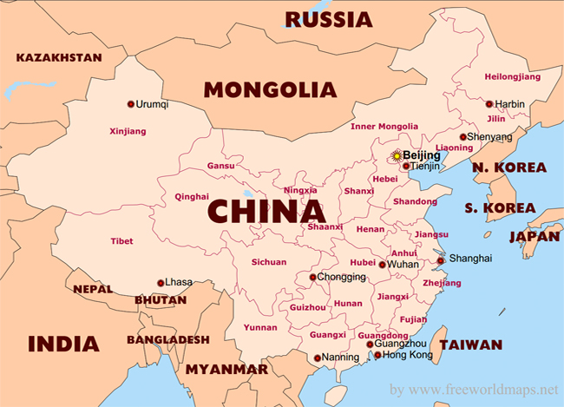
China Population
Almost 1.4 Billion people
56 ethnic groups
92% are Han Chinese
55 Minority Groups make up the other 8%
Notes:
1.386B people live in China, representing 18.47% of world’s population
The People’s Republic of China recognizes 56 Ethnic Groups
The Han Chinese make up 92% of China’s population or 1.2B people
The remaining population make up the other 55 Chinese Minority Groups
The Han population is concentrated in the eastern part of China, but they make up the majority of the population in all Chinese provinces except for Tibet and Xinjiang in the western border of China

Slide 3
Chinese Minority Group Origin
Manchu Emperors adopted official policy that people have the right to develop their own culture and language
In 1949, People’s Republic of China officially identified and confirmed the 56 ethnic minority groups
Notes:
In the Qing Dynasty (1644-1912), the Manchu Emperors, who were not Hans, adopted an official policy that all groups should have the right to develop and maintain its own culture and language
People’s Republic of China officially identified and recognized the 56 ethnic minority groups in 1949

Slide 4
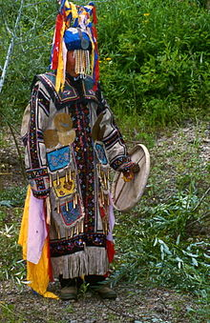
Oroqen
8,700 population
Live in Inner Mongolia & Heilongjiang Provinces
Worship bears and tigers and have many gods, such as God of the sun, moon, fire, wind, mountain
Had to give up hunting
Men make wares out of bone, wood and iron; women are good at sewing leather clothes and carving wares out of birch bark
Notes:
ORCUN
8,700 people
Live in Inner Mongolia & Heilongjiang Province in Northeastern China where there is an abundance in wild animals
Oroqen means people living in the mountains or people domesticating reindeers
At one time, followed in Shamanism, but in 1952, the Chinese Government coerced them to give up the practice. Pictured here is the last Shaman, who served his people from 1927-2000
Replaced with faith in power of nature, ancestors and totems and have a god of sun, moon, mountain, fire, wind
Also worship bears and tigers
For more than 1,000 years, they were hunters, but in the 1990’s the Chinese government made it illegal to hunt
Had to change their way of life and now make ware out of bone, wood and iron
Women make leather clothes and carve wares out of birch bark

Slide 5
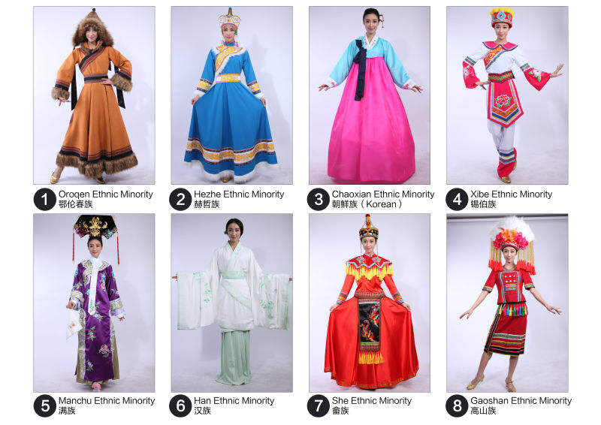
Oroqen
Take pride in boat building
Eat deer and boar and just recently started growing their own vegetables
Passed on historical events, hunting life and customs through their fairytales, ballads, riddles and dances
Celebrate the same festivals as the Hans, such as Spring, Dragon Boat and Mid-Autumn Festivals
Notes:
Also good at building boats
Eat deer and boar
Started growing and consuming their own vegetables
Like eating a fried flour roll, think it improves your intelligence
Creative in oral literature and musical performances
Pass on historical events and customs through their fairy tale stories, riddles, songs and dance performances
Celebrate the same holidays as the Chinese, such as Spring Festival, Dragon Boat Festival and Mid-Autumn Festival

Slide 6
Hezhe
5,400 population
Hezhe translates to people of the Orient
Live by the Amur, Songhua and Ussri Rivers in Heilongjiang Province in Northeast China
Believe in Shamanism; worship as many gods as there are varieties of animals and plants
Travel by sleds powered by snow dogs
Live on fish and other wild animals
Notes:
Hea shea zu
5,400 people, one of the smallest minority groups in China
Hezhen Live along the rivers in the Heilongjiang Province in Northeast China
Hezhe translates to “people of the Orient”
Believe in Shamanism and worship many gods
Travel by sleds pulled by snow dogs
Because they live by the river, they live on fish and other wild animals
They would fish throughout the summer, eat the fresh fish and freeze what fish they don’t eat for the winter

Slide 7
Hezhe
Wear clothes made of fish and deer skin
Drink wine, cold water or tea infused with roses
Practice a ritual of respect before drinking the wine
Celebrate Spring Festival
Also celebrate a unique Herzhe Festival called Wurigong Festival every other year
Notes:
Wear clothes made of fish and deer skin;
They like fish skin because it is light, soft, water-proof and non-abrasive
They hang the fish skin to dry, beat it with a mallet to soften the skin and sew it together; the fasteners are made of fish bone
They are also know as the fish skin tartars because of this practice
Unlike other Chinese minorities, they prefer to drink wine or cold water; the only exception is tea flavored with wild roses
One custom they have before drinking the wine, they would dip a chopstick in the wine and cast it to the sky and sprinkle it on the land to show respect for the Gods and their ancestors
As with other Chinese, they celebrate the Spring Festival
Also celebrate a festival unique to the Hezhe called Wurigong Festival; celebrate this every other year held in the 5th or 6th month of the lunar calendar; celebrate for several days by playing traditional sports, feasting on traditional food, and singing folklore that praises the history of their tribe

Slide 8
Chaoxian (Korean)
1.9 million people
Migrated from Korea
Majority live in Heilongjiang, Jilin and Liaoning Provinces
Mostly atheists, but some believe in Buddhism and Christianity
Main products include rice, timber, beef, herbs and tobacco
Notes:
Chow shun
1.9 million people who migrated from Korea
Majority of them live in Heilongjiang, Jilin and Liaoning Provinces in Northeast China bordering Korea, but also find some people in major cities such as Beijing, Xian and Inner Mongolian
Most of them are atheist, but some adopted Buddhism and Christianity
Main products include rice, timber, beef, herbs and tobacco

Slide 9
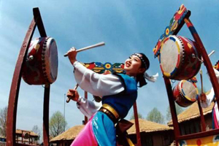
Chaoxian
Eat rice, millet, pickled spicy vegetables, sponge cakes and cold noodles
In addition to traditional Chinese holidays, also celebrate a baby’s 1st birthday, senior’s 60th birthday, 60th wedding anniversary, and Day of Older Person on August 15th
Eldest son is expected to care for his parents forever
Girls dance with long drums and fans, boys dance with knives
Notes:
Eat rice, millet, spicy vegetables, sponge cakes, and cold noodles
Dishes of food need to placed in certain order: chopsticks and spoons to the right, rice to the left of the soup and spices in the middle of the table
Celebrate the same holidays as the Hans, including Spring, Dragon Boat and Mid-Autumn Festivals. Pictured here are some Chaoxian girls on the taiko drums during a festival.
Other unique holidays include baby’s one-year birthday, a senior’s 60th birthday, a couple’s 60th anniversary and Day of the Older Persons on August 15th
One cultural nuance, eldest son is expected to support the parents forever or looked upon by society if obligation is not fulfilled
No marrying someone who share the same surname
During festivals, girls wear colorful dresses and dance with long drums and fans and boys dance with knives
For sports, they like to wrestle and play football while women prefer to swing

Slide 10
Xibe
190,000 people
Live in Liaoning, Jilin and Xinjiang Provinces
Believe in animists, Shamanist and power of ancestors; and recently observe Confucianism
Produce agriculture and livestock
Eat rice, wheat flour, mutton, pork, milk, milk tea and oil tea; boar, duck and hare in the winter
Notes:
Shee Be
190,000 people
Split between Liaoning and Jilin Provinces in Northeast China and Xinjiang Province in Northwest China; People living in the east speak Mandarin, but people living in the west speak a Xibe language
Believed animals are manifestation of human spirits, Shamanists and the power of ancestors; recently they have also adopted Confucianism
Produce agriculture and livestock
Eat rice, products made of wheat flour, mutton and pork and take their meals with milk, milk tea, and oil tea; during the winter they hunt and eat boar, duck and hare

Slide 11
Xibe
Girls wear one braid in their hair whereas married women wear two braids
Celebrate the same holidays as the Hans, but the holidays are celebrated with activities showcasing their strong equestrian heritage, water play, wrestling, singing and dancing
Will not wear clothes made of fox leather or fur
A piece of red cloth at the door indicates that a person is sick inside and guests are not welcomed
Notes:
Girls wear their hair in one braid, but when married, they wear their hair in two braids
While they celebrate the same holidays as the Hans, like Spring Festival, Dragon Boat Festival and Qingming Festival, the way they celebrate the holidays is totally different. During the spring festival, they eat dumplings on New Years ever, and noodles for longevity. They have horse riding competitions, water sports, wrestling, singing and dancing
As a custom, they will not wear any clothing made of fox leather or fur
When a guest leaves a home, the entire household sees them to the door
If a person is sick, they place a red cloth at the door to indicate guests are not welcome because someone inside is sick

Slide 12
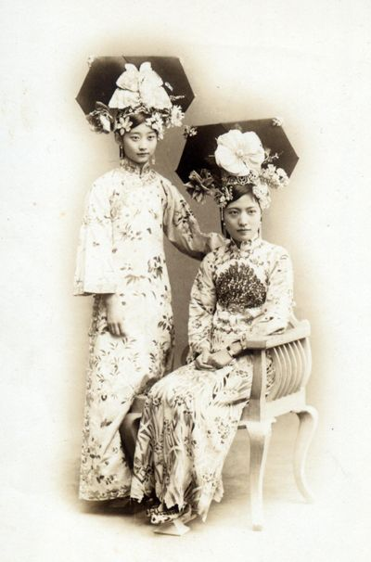
Manchu
10.7 million people
Live in Heilongjiang, Jilin and Liaoning Provinces
Believe in Buddhism, Taoism, & Confucianism
1,400 years of history with major contributions in Chinese culture, literature, music and arts
Accomplished at agricultural, fishery and raising livestock
Notes:
Mon Zhu
10.7 million people
Majority live in Heilongjiang, Jilin and Liaoning Provinces in Northeast China, but will also find them spread throughout China
At one time, believe in Shamanism, but have now adopted Buddhism, Taoism and Confucianism
Have a 1,400 year history dating back to the Sui and Tang Dynasties in 580 AD
Manchus have contributed a lot to Chinese culture, literature, music and arts
In fact, they encouraged education and many tried for the imperial examinations and served the emperors in high scholarly positions
Picture shows a couple of Manchu ladies of nobility
Good at agricultural, fishery and raising livestock

Slide 13
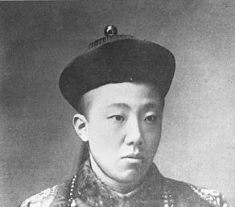
Manchu
Women wear Cheongsum or Qipao
Men wear a queue and Mandarin Hat
Also known as red-tasseled Manchus
Celebrate same holidays as the Hans
Excel at riding and shooting
Notes:
Women wear cheongsam
Men shave the top of their heads and wear a single braid or queue down their back with a Mandarin hat as shown in the right
They’ve earned a nickname “red-tussled Manchus because of the red tassels you’d see in their headpieces and Manchu hats, as shown in the lower picture
They celebrate the same holidays as the Hans, such as Spring Festival, but they throw in distinct sports such as ice skating in the festivities
Both men and women are good at riding and shooting

Slide 14
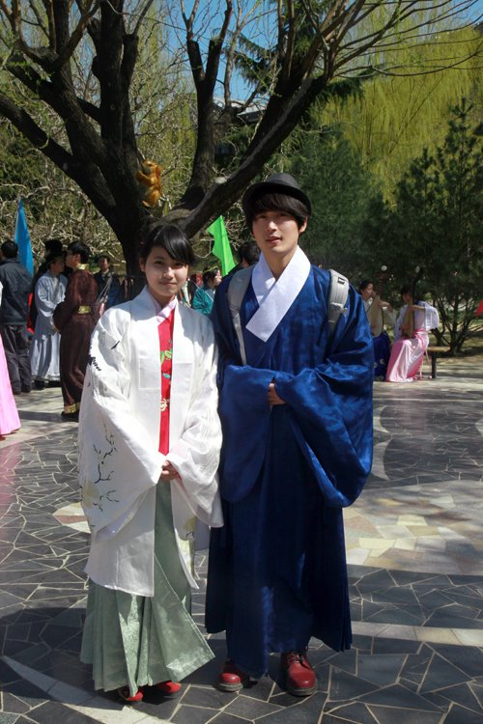
Han
1.2 Billion people, 19% of world population
99% live in China, 92% of China’s population
7 dialects: Mandarin, Wu, Xiang, Gan, Min, Cantonese & Hakka
Main religion include Confucianism, Taoism and Buddhism
Eight unique styles of cooking: Anhui, Cantonese, Fujian, Hunan, Jiangsu, Shandong, Sichuan, and Zhejiang cuisines
Notes:
Han hu
1.6 billion people world-wide, 19% of the world’s population
99% of the Hans live in China; 92% of China’s population are Hans, living in the eastern China show on the map in olive green
While the official language of China is Mandarin, the Hans speak six other language, Wu, Xiang, Gan, Min, Cantonese, and Hakka, some of which you may recognize
Main religion is Confucianism, Taoism, and Buddhism
Staples include rice and wheat with tea and alcohol as traditional drinks, but there are 8 different styles of cooking, the more common ones being Cantonese, Hunan, Sichuan, and Shandong
Pictured is a couple in the traditional Han garment with the wide sleeves

Slide 15
Han
Major contributions include printing, paper-making, compass, gunpowder and porcelain china
Hanfu-style dress is influential to the Japanese kimono and Korean Hanbok
Housing styles and material varies by locale; thick bricks with a courtyard in the north, use of timber in the south where houses face south
Notes:
Hans are proud to have invented printing, paper, the compass, gunpowder and porcelain china
While most Hans wear western clothing today, the Hanfu style of clothing that you see on the slide is still worn during festivities and has been a great influence on the Japanese kimono and the Korean Hanbok
The house styles varies depending on the region they live
In northern China, homes are made with thick brick with a central courtyard to keep them warm
In southern China, homes are made of timber, positioned north and facing south so they can catch the maximum sunlight

Slide 16
She
710,000 people
Live in the Fujian and Zhejiang Provinces
Believe in the power of their ancestors and totems
Produce rice, corn, beans, potatoes, tea, mushrooms, and medicinal herbs
Women are good at embroidering and weaving waistbands and handkerchief
Notes:
Shee
Population of 710,000 people
Most live in Fujian and Zhejiang Provinces in the Eastern Coast, but will also find some in Guangdong and Jiangxi Provinces
Believe in the power of their ancestors
Worship their ancestors in a memorial temple where pictures of their ancestors, also know as totems, are hung
Survive on agriculture, producing rice, beans, corn, potatoes, tea, mushrooms and herbs
Women also good at embroidering waistbands and handkerchiefs, which they now export

Slide 17
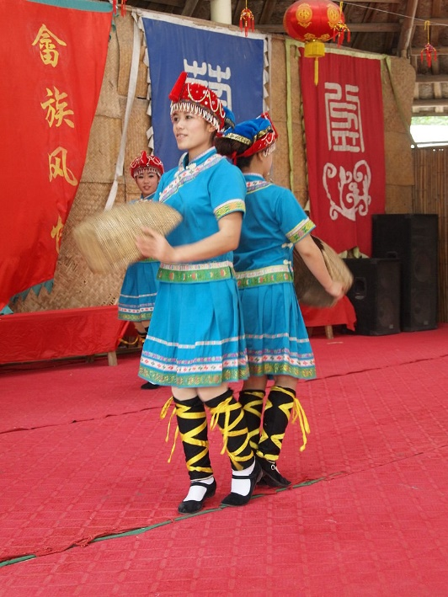
She
Men have practiced martial arts for centuries
Love to sing impromptu
In addition to celebrating the typical Han festivals, they also have 3 special days for worshipping their ancestors and spirits
Notes:
Men have practiced martial arts for centuries
Like to sing impromptu
During wedding ceremonies, the bridegroom must sing a song about an object or dish he wants; for instance, if he needs a cup of their famous yellow wine brewed from rice and wheat, he must sing about the wine
In addition to celebrating the same holidays as the Hans, they also have three additional special days set aside for worshipping their ancestors and spirits on the 15th day of the 2nd, 7th & 8th months
Picture showing them performing a traditional She dance with baskets depicting tasks they do in their everyday lives

Slide 18
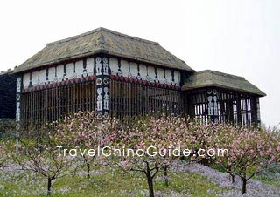
Gaoshan
535,000 people
Most live in Taiwan
Believe in spirits of ancestors and totem and practice wizardry
Today, 70% identify themselves as Christians
Very creative at bamboo weaving, woodcarving, pottery and embroidery
Notes:
Gao Shan
535,600 people, mostly living on Taiwan Island, but can also find some in Fujian and Zhejiang Provinces in Eastern China
Also known as Taiwanese Aborigines or the indigenous people of Taiwan
Believe that the spirits of their ancestors stay to protect their descendants
With heavy influence from the missionaries, 70% of the Gaoshan people considered themselves to be Christians
Very creative in bamboo weaving, woodcarving, pottery and embroidery and use their skills to decorate pots, pipes, barrels, eaves, fishing boats, and clothing
Picture shows what the homes look like for the Gaoshan people

Slide 19
Gaoshan
Favor colorful clothing adorned with flowers crowns, earrings, bracelets, and turbans
Eat rice, millet and taro; drink cold water with ginger or pepper and a yellow wine
Harvest Festival is their biggest holiday
Strong taboos: no communications with outsiders during harvest season or step in other’s fields; do not touch things of hemp before hunting; women do not use guns or other weapons, and men do not use women’s looms
Notes:
Like to wear very bright and colorful clothing as shown here
Will accent their clothing with flower crowns, earrings, bracelets, turbans, and if they are rich, add strands of pearl beads to show their wealth
Eat rice, millet and taro
Unlike other Chinese, they do not drink hot water or tea, but like to drink cold water flavored with ginger or pepper
Biggest celebration is the Harvest Festival where they eat a big meal and get together to sing and dance They have some strong taboos; for instance, before a man goes hunting, he has to avoid touching anything made of hemp or he might get lost or get hurt; during harvest season, they are not to talk to outsiders or step on anyone else’s fields; women are not to touch the men’s weapons and conversely, the men are not to touch the women’s looms

Slide 20
Li
1.5 million people
Live in the South and central portions of Hainan Island
Believe all things have spirits and that their ancestors will protect them; some also adopted Christianity
Thrive on agriculture, breeding livestock and fish, and harvesting salt
Notes:
1.5 million people
Live on Hainan Island off the south western coast Guangdong Province
Believe all things have spirits, especially their ancestors
Pray to their ancestors to protect them
Also influenced by the Christian missionaries
Live on agriculture, breeding livestock and fish, and have established a thriving salt industry

Slide 21
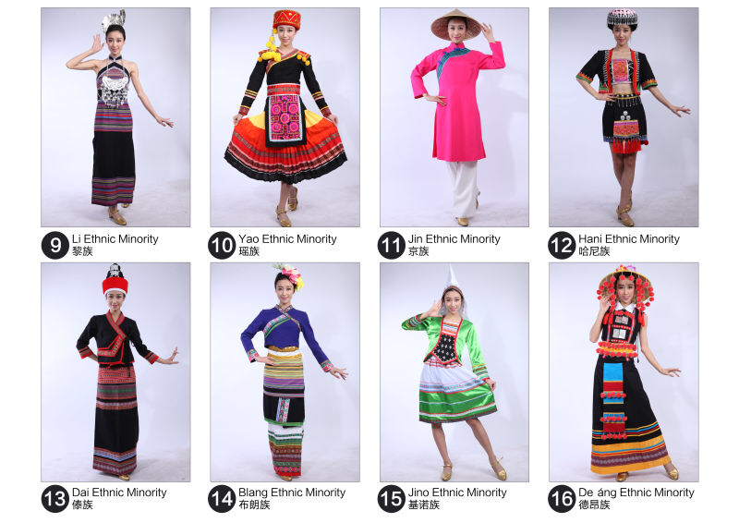
Li
Staple food include rice, corn, sweet potatoes and game from hunting
Women like to chew on betel nuts
Take pride in embroidering delicate wood-craft and bamboo vine weaving
Celebrate the same holidays as the Hans
Women wear their hair in a bun with metal or bone hairpins; during festivals, they wear bracelets, necklaces, earrings, and foot rings
Notes:
Eat rice, corn sweet potatoes and meat from animal hunting
One popular dish is the bamboo pole rice, a dish so fragrant that people passing by can smell the distinct
The Li people love to chew on betel nuts, especially women because they consider the nuts to be a tonic that can cure disease and beautify
They take pride in embroidering, delicate wood craft and bamboo vine weaving; in fact the bamboo weaving is an indispensable adornment in their homes
Celebrate the same holidays as the Hans, such as Spring Festival and Sanyueesan, a day where the elders and ancestors are honored
Women wear their hair in a bun with a metal or bone hairpin and during festivals, they wear necklaces, bracelets, earrings, and foot rings.

Slide 22
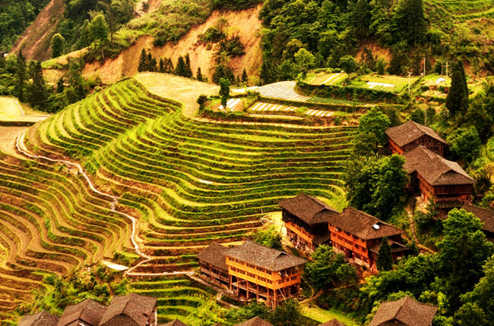
Yao
2.6 million people
Live in Hunan, Yunnan, Guangdong, Guizhou, Jiangxi and Guangxi Provinces
Beliefs vary by regions, ranging from worship of nature, ancestors, totem, and Taoism
Food includes rice, corn, potatoes and meat from livestock they raise or game they hunt
Notes:
2.6 million people
Live in Hunan, Yunnan, Guangdong, Guizhou, Jiangxi and Guangxi Provinces, all in southeast China
Their beliefs vary by regions, with some worshipping nature, some idolizing their ancestors, and some adoring the totem
Taoism also plays an important role in some lives
They eat rice, corn, potatoes, meat from livestock their raise or game they hunt
Drink tea and homemade wines
You see a picture of their houses, which are made of bamboo and wood on stilts overlooking their terraced fields

Slide 23
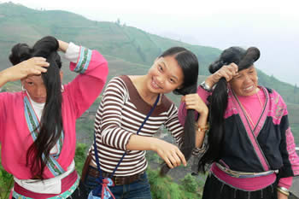
Yao
Noted for their batik, sculpture, printing and dying
Women wear pleated skirts decorated with unique embroidery and their hair long
Hold monthly festivals, including Panwang and Danu festivals
Notes:
They’re masters at handicrafts, including batik, sculpture, printing and dying
Women usually wear pleat skirts decorated with colorful embroidery and exceptionally long hair and whip their hair around as part of their dance
In fact, they have been recorded in the Guinness Book of Records as having the longest hair
They have at least one festival a month
Two notable festivals include Panwang and Danu; the Panwang festival is held every year to express reverence for their earliest ancestor, Panwang. They dress in their finest and sing and dance.
The Danu Festival is held to commemorate their grandmothers

Slide 24
Gin (Jing)
28,000 people
Immigrated to the Guangxi Province from Viet Nam in the 16th Century
Believe in Taoism, Buddhism and wizardry
Experts in fishing, but also farm
Food staples include rice and seafood
Known for Nianzhi, a seasoning made from fish
Men like to smoke and women like to chew on betel nuts
Notes:
28,000 people
Immigrated to the Guangxi Province in southeast China from Viet Nam in the 16th Century
Believe in Taoism, Buddhism and wizardry; also believe there are many gods
After centuries of practice, they’ve become experts in all ways of fishing; Very superstitious people because whenever they launch their fishing boats, the women and children would say a prayer for them
They also grow rice, sweet potatoes, corn, taro, peanuts, bananas, longan and pineapple
They eat rice and seafood, but especially like glutinous rice and surgery foods
They are known for a season made from fish derivative called Nianzhi
Men have a habit of smoking and the women like to chew betel nuts

Slide 25
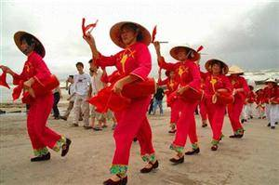
Gin (Jing)
Simple style-clothing with a tall spire hat
Besides Spring Festival, also celebrate Changha Festival
Gin taboos include not walking over fish nets, not dropping rice while out chopping wood, not asking to borrow money after supper when a lamp is lit, and never say meat is burnt (jiao) because the word sounds like reef in their language
Notes:
Their clothing have simple lines, but you’ll often find them under a tall spire hat to keep them shaded from the sun and rain
Besides celebrating the Spring Festival, they also celebrate a festival called Changha Festival, which means singing
Picture shows a group singing and performing during the Changha Festival
Other holidays include worshipping their ancestors and gods on the 15th day of the 7th month, and sharing cooked new rice with family members on the 10th day of the 10th month after the harvest
Gin minorities are very superstitious and follow some strict customs, including no walking over the fishing nets when they are put on shore, when they go out and cut wood and bring rice for lunch, they have to avoid dropping the rice, after supper, they light a lamp to tell people to not come and borrow money; and if they burnt the meat by accident, they are not to say they burnt the mean because they fear that their relatives would shipwreck on a rock because the word jiao or burnt meat sounds the same as reef

Slide 26
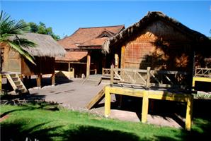
Hani
1.7 million people
Immigrated from the Tibetan Plateau into the Yunnan Province
Worship many gods and ancestors
Doctors cure patients with witchcraft and herbal medicine
Known for their production of Dian Lu and Pu’er Teas from their terraced fields
Notes:
1.7 million people
Immigrated from the Tibetan Plateau into the Yunnan Province in Southwestern China
Worship many gods
Use witchcraft and herbal medicine to cure patients
Hani people have developed a reputation of living in the land of milk and honey where they are known for producing Dian Lu and Pu’er tea
Picture of a Hani house

Slide 27
Hani
Celebrate the same holidays as the Han
Most important holiday is the first day of the 10th month
Ku-Zha-Zha is celebrated for 3 days in the 6th month
Interesting marriage custom
Notes:
Celebrate the same holidays at the Han people, like Spring Festival, Dragon Boat Festival and Mid-Autumn Festival
In addition, they celebrate the first day of the 10th month where they sing and dance overnight and make sacrifices to their ancestors
Ku-Zha-Zha is celebrated for 3 days straight in the 6th month; Day 1, the men kill an ox and share it with people in the village, Day 2, the women clean the house and prepare a dinner for worshipping their ancestors, and on Day3, they wear their flowery clothes and entertain
When a boy & girl want to get marry, the parents take a long walk and if on the walk, they do not encounter any wild animals, like a rabbit or a wolf, that would mean a successful engagement

Slide 28
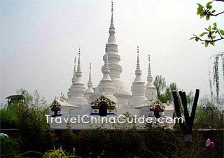
Dai
1.3 million people
Live near the Mekong River in south Yunnan Province
Buddhism influence their culture, arts, politics and economy
Distinct architecture combines styles of South Asian and Chinese culture
Favorable climate is great for agriculture
Abundant minerals and rare animals
Notes:
1.3 million people
Live along the Mekong River in southwest China in Yunnan Province
Strong Buddhism belief that spillover to their culture, arts, politics and economy
Many boys from 8-10 years old are sent to temples to learn sutras for 1-5 years and spend their lives as monks
Architecture incorporates styles of South Asian and Chinese, as depicted by the picture of one of their temples where they include pavilions, thrones and bells
Homes are made of bamboo with 2 stories, the 1st floor for livestock and the upstairs, well ventilated for people
Great farmers producing rice, Pu’er tea, bamboo, sugar cane, rubber, wild apples, bananas, and gooseberries
Plenty of minerals like gold, silver, iron and crystals
Rare animals like gibbons and peacocks

Slide 29
Dai
Love glutinous rice and hot & sour dishes
Peacock Dance is most popular folk dance
Traditional musical instruments include an elephant-foot drum, used by the men for a dance
Important festivals include Water-Splashing, Door Opening and Door Closing, and Huajie Festivals
Notes:
Love glutinous rice and hot & sour dishes
Bamboo rice is one of their favorite dishes; put cleaned rice in a bamboo tube, soak the tube in water for 7-8 hours, wrap the tube with banana leaf and roast for 12 minutes
Because they have so many peacocks, they consider the peacocks a symbol of good fortune, happiness, beauty and kindness
The Peacock Dance is the most popular folk dance, where they wear clothing with patterns of peacocks and imitate peacocks
Another well know dance among the men is the Elephant Foot Drum dance where they use a drum that looks like an elephant foot
Most important festival is the Water-splashing Festival, which is considered the New Year of the Dai community; they engage in water splashing and dragon boating on Day 24-26 of the 6th month
Door Opening is celebrated in mid-September and Door Closing is celebrated in mid-June; worship Buddha by sacrificing food, flowers, clothes and other items
Huajie Festival of Flower Street Festival is celebrated on Day 7 of the 1st month to bid farewell to the past year and welcome the new year; people wear new flowery clothes and sing to each other; this is the day the unmarried people try to find their mate

Slide 30
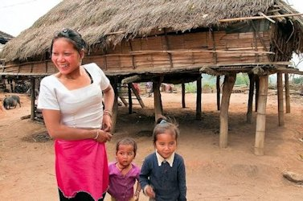
Blang
120,000 people
One of the oldest minority groups in the Yunnan Province dating back to the Han Dynasty
Worship their ancestors and Hinayana Buddha
Totems contain small animals like a bamboo rat and toads
Produces cotton, sugar cane, Pu’er Tea, medicinal herbs
Abundance of oral literature in the form of legends, tales, aphorism and puzzles
Notes:
120,000 people
One of the oldest minority groups who live in the mountains area of Yunnan Province in Southwestern China
They show history dating back to the Han Dynasty from 206-220 BC)
Worship their ancestors and Buddha
Instead of having fierce animals like tigers or lions on their totem poles, they carve small animals like a bamboo rat and toad. They believe they must stay away from small animals or their relatives will pass away
Live in very fertile land, producing cotton, sugar cane, Pu’er Tea, herbs such as pseudo ginseng and lemongrass
Also rich in minerals such as copper, iron, silver and crystal
They have created an abundance of oral literature, including stories on how they work and the solar system was created
Picture of their village

Slide 31
Blang
Skillful at weaving bamboo and vine into baskets, sieves, mats, and furniture
Staple foods include rice, corn, soybean, peas, buckwheat, acid fish, raw meat, and cured vegetables
Torch Festival to burn away pests on fruit trees
Chengding Festival to transform kids to adulthood
Notes:
Very good at weaving with bamboo and vine into all kinds of baskets, sieves, mats, and furniture
The homes they make out of bamboo can last 20 plus years
Eat rice, corn, soybean, peas, buckwheat, acid fish, raw meat, and cured vegetables
Torch Festival is celebrated on June 23rd; offer a sacrifice to the gods and pray for a good harvest; light the torches to indicate the pests are burnt away
Chengding Festival is celebrated on the boys & girls’ 14 birthday; Girls would light special branches to make black smoke and help the boys dye their teeth, after which they have the right to marriage; in the evening, the boys would wear their new clothes and serenades the girls at their homes and the girls would sing back, present them with tea, and the black smoke to blacken their teeth

Slide 32
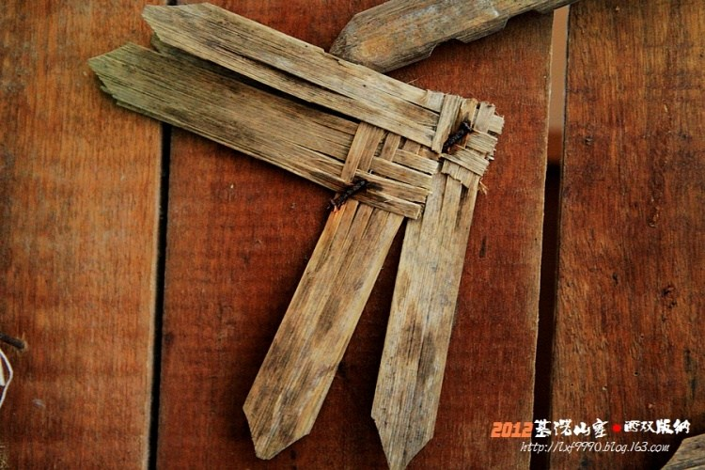
Jino
21,000 people
Live in the Yunnan Province
Believe everything has a soul, and worship Zhuge Kongming and Amo Yaobai
Women learn to embroider at childhood and men carve handles of sickles and musical instruments and weave thin bamboo strips into boxes, cigarette cases, workboxes and desks
Notes:
21,000 people, the last group to be recognized an a minority group by the Chinese Government in 1979
Live in Yunnan Province
Believe everything has a soul
Worship Zhuge Kongming because their ancestors were part of the troops of Zhuge Kongming during the Three Kingdoms Period between 220-280 A.D.
Also worship Amo Yaobai because they believe he created the sky and land for the Gin people
Women learn how to embroider at a very early age
Men learn to carve pictures on the handles of sickles and musical instruments and weave thin bamboo strips into boxes, cases and desks
Picture shows what they used for currency or for trading before 1976

Slide 33
Jino
Eat rice and corn; chew on betel nuts; brew and drink wine
Celebrate Iron Forging Festival and New Rice Festivals
Adult Ceremony
Respect for seniors and mother’s brother
Daily life taboos
Notes:
Eat rice and corn
Like to chew betel nuts; in fact they think their black teeth from chewing betel nuts is beautiful and protects them from moths
Drink wine to help cure them from rheumatism and arthritis
Most important festival is the Iron Forging Festival, which is celebrated on the 12th lunar month as a blessing for their good fortune and to bring a good harvest the following year
The New Rice Festival is celebrated on the 7th or 8th month to share their happiness for their success in a good harvest
In the Adult Ceremony, the 15 year olds receive clothes, decorations and tools to use as an adult; the girls change their hair to an adult style; the seniors talk about the hardships of labor; after the ceremony, the kids undertake the obligations of an adult
Show high respect for the seniors, especially women and the mother’s brother, who’s opinion is highly regarded
Taboos: Women can only eat an egg after it’s been cut or her children would become sick; can’t hurt a monkey when hunting or the children will not be pretty; the first meal after giving birth must be a chicken or a bird so the baby can grow to be lovely

Slide 34
De’ang
21,000 people
“Ang” means rock or rock cave
Yunnan Province
Worship Buddha and original gods such as Dragon King, Mountain and Land Gods
Skilled silversmiths
Known as ancient tea farmers
Notes:
21,000 people
“Ang” means rock or rock cave, to commemorate that their ancestors lived in caves at one time
Today, they exclusively live in Yunnan Province in Southwestern China
They worship Buddha and some original gods such as Dragon King, the God of Mountains and God of Land
Boys under 10 are sent to temples to become monks and the learn sutras, but only the few who are educated and knowledgeable are promoted to Buddha
Skilled craftsmen and silversmiths who cast bracelets, fasteners, necklaces and tobacco pipes
They have tea trees that are hundreds of years old with leaves that’s a 13” wide, earning them the name of ancient tea farmers
They take pride in their unique tea culture and offer tea as gifts to gain respect or ask for forgiveness

Slide 35
De’ang
Eat rice, supplemented with corn, wheat and legume
Drink a dense tea or chew on a wet tea to help them keep cool in the scorching heat
Celebrate Water-splashing, Door-Opening and Door-closing Festivals
Practice Wushu
Notes:
Mainly eat rice, but supplemented with corn, wheat and beans
It’s no surprise they drink tea for their beverage, but when they brew their tea, it’s as strong and dark as coffee
They also chew on wet tea leaves on a hot day to help them keep cool
As with the Dai minority group, they celebrate Water-splashing, door-opening and door closing festivals
For Water-splashing ceremony, which is celebrated mid-way of the 4th month, everyone goes to the temple to listen to sutras and clean the Buddha statue
During the Door closing on the 15th day of the 9th month to Door Opening on the 15th day of the last month, the Buddha stays in the temple and the disciples supply them with food, flowers and money; After the Door Opening ceremony, Buddha is allowed to return to their regular life
Practice Wushu as a form of entertainment

Slide 36
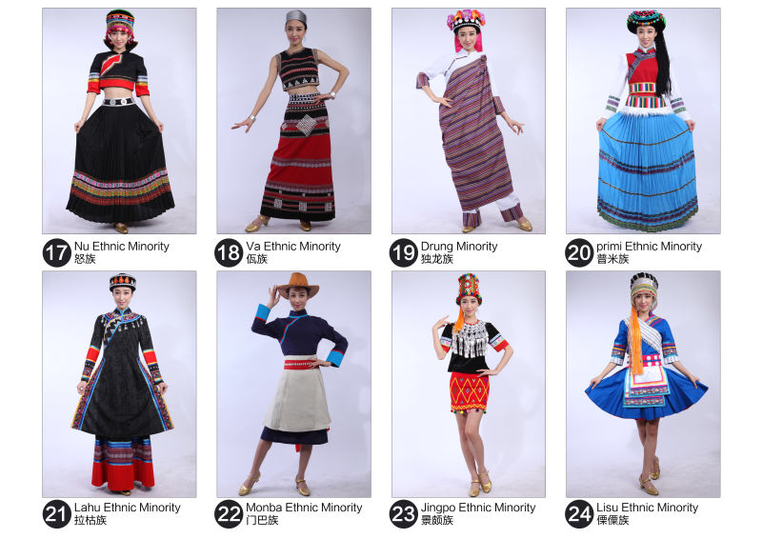
Nu
29,000 people
Southwest Yunnan Province
Religious belief remain primitive and animistic with some Christianity
Agricultural, producing corn and barley
Only eat two meals a day
Eat corn, supplemented with livestock and wild prey like fish, mossback, boar and deer
Notes:
29,000 people
Live in the southwestern part of Yunnan Province
Believe everything has spirits and admire the power of nature
Grow corn and highland barley
Only have 2 meals a day, eating corn, supplemented with livestock and wild animals like boar and deer
Enjoy drinking wine for a beverage

Slide 37
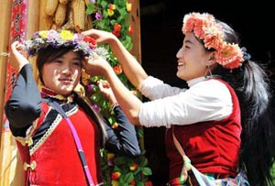
Nu
Share Tongxin wine with special guests
Women wear skirts, men hang knives from their waists and arrow bags on their backs
Women learn to weave woolen socks at childhood to give to their lovers as gifts
Celebrate New Year’s Day and Flower Festival
Notes:
When you have special guests, they offer a Tongxin wine, meaning with one heart
Women wear skirts
Men like to hang knives from their waists and arrow bags on their backs
Women learn to weave woolen socks in their childhood and when they grow up, they give them to their lovers as gifts; if he accepts the gift, that means he lover her, and his refusal shows his rejection
Celebrate New Year’s Day by preparing a meal and feeding their oxen first to show their gratitude for their hard work
During the Flower Festival, which is 15th day of the 3rd month, they take corn, flowers and objects of sacrifice to stalactite caves and worship their ancestors. They pick water falling from stalactites (which they call fairy milk) and pour the water onto the fields for a good harvest or into wine for good health
Nu weddings are very special; They would pick days during the year of the dragon or snake to marry because those two years are symbols of good fortune. Their weddings take 3 days, with preparation, dancing, singing, banquets. During the 3 days, the bride and groom sleep in separate bed an accompanied by their maids. On the 4th day, the groom brings his father-in a pig and wine to show respect and only after that can he bring his wife home and sleep together.
Picture shows people getting ready for the wedding

Slide 38
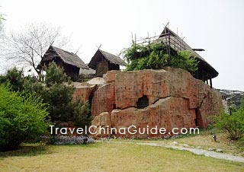
Wa
Over 400,000 people
Yunnan Province
Believed in the power of natural things and thought all things have spirits, but recently converted to Buddhism and Christianity
Produce rice, beans, peas, poppies and walnuts
Eat rice and other foods with spicy flavors
Chew on betel nuts and drink wine
Notes:
Over 400,000 people
Live in the Yunnan Province in southwest China
Believe that all things have spirits, such as water, mountain, and wood but in recent years, some have converted to Christianity and Buddhism
They live mainly on agriculture producing rice, beans, poppies and walnuts
Their main diet is rice and the food they prepare is spicy
They chew on betel nuts and consider wine a necessity when hosting guests and elders
Picture shows a Wa house

Slide 39
Wa
Favor red and black clothes and wear necklaces and bracelets of silver or bamboo
Women wear their hair very long and incorporate their hair in their dances to highlight their charm
Hold the Plaoniu ceremony at every festival
Taboos include not riding into the Wa village on horseback, not touching the head or ear, and not giving a girl an adornment
Notes:
They like red and black clothes adorned with necklaces, bracelets, and earrings made of silver, bamboo, bird bones and shells
Ladies wear their hair very long and use it in their moves when they dance to highlight their charm
Whenever they have a ceremony, they always perform the Piaoniu ceremony to wish for peace and a great harvest; In the Piaoniu ceremony, they kill an ox, divide the meat amongst the families for sacrifice to their ancestors and present the ox bone to the host to symbolize wealth
Other taboos for the Wa minority group include not riding into their village on horseback, not touching the head or the ear of a person and not giving adornment to a girl as a gift

Slide 40
Drung (Dulong)
7,000 people
Live in the mountains of Yunnan Province
Believe spirits control their every day lives
Live in area with many rare herbs and animals
Eat 2 meals a day, with rice as a main staple
Notes:
Only 7,000 people
Quite isolated living in the mountains of Yunnan Province in Southwestern China
They believe the spirits control their everyday lives and fortune so they worship and charm away the spirits
They live in an area rich in rare herbs and animals
They eat 2 meals a day, a stirred barley noodles or roasted yam as breakfast and rice with various potherbs, bird’s eggs and fungus for supper. During the winter, when it’s best for hunting, they add meat like mossback and fish to their diet

Slide 41
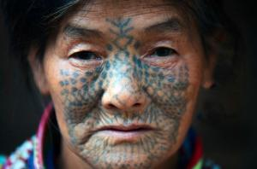
Drung (Dulong)
Take cotton and weave the colorful threads into a colorful carpet, which they wear as part of their clothes and decoration
Women used to wear tattoos on their face to show that she’s an adult
Climb hills and crossing rivers on suspended bridges as a form of entertainment
Only celebrate the Kaquewa Festival on the last lunar month
Notes:
Their most distinctive handicraft is a colorful carpet, which you see in this picture;
They take colorful cotton thread and weave it into a carpet, which they wear and use for decorations or gifts.
Women used to have their face tattooed to show that they are an adult when they turn 13, but they’ve stopped this painful experience after the founding of Communist China in 1949
Picture shows the tattooed face
For entertainment, they like to climb the mountains and cross fast moving rivers over a suspension bridge
They only celebrate one festival a year and that’s Kaquewa, which is celebrated in the last month of the year where they spend days enjoying food and wine with guests

Slide 42
Pumi (Primi)
34,000 people
Live in Yunnan Province
Some Taoism, but many still believe that many gods and ancestors influence their lives
Primary diet is rice, supplemented with flour, oats, cabbage, beans, eggplant, melon, beef & pork
Very hospitable people
Notes:
34,000 people
Live in Yunnan Province, but heavily influenced by Tibetans
Some have converted to Taoism, but many still believe there are many gods and that their ancestors influence their lives
Their ceremonies are led by wizards to promote peace, happiness and a good harvest
Their primary diet is rice, but they also eat items made of flour, oat, cabbage, beans, eggplant, melons, beef and pork
The also like to drink tea, wine and smoke tobacco; tea is usually held in ox horns and drunk with bamboo straws
They have an interesting way of preserving pork. They would cut off the feet, take out the internal organs, use the lean meat for sausages, and then pack salt inside the pig and sew it back up. After the pig is dried, it looks like a pipa instrument and is called pipa meat
When they host guests, they toast they continuously and when they leave, they would always give them 4 things: a drumstick, a piece of pork, a bag of tea and a bottle of wine

Slide 43
Pumi
Homes are made of timber with a central room for family activities where there is a fire ring and an ox or sheep mounted on the wall
Celebrate Spring, New-Grain Tasting, Pure Brightness and Dragon Boat Festivals
Children become adults at 13
Notes:
Their homes are made with timber
They usually build a larger burner in the center of the room where the family gathers and an ox or a sheep head on the wall
The head on the wall to is to show their wealth
There is a big significance for the burner. Outside guests are not to touch the burner
Behind the fire ring, they usually have Guazeis, which are small stone towers
During the meal, the eldest in the household would place a spoonful of food and place it onto of the Guazei and throw one spoonful into the fire, a gesture symbolizing the feeding of the ancestors
They celebrate some of the same festivals as other minority groups
During the New-Grain Tasting Festival, they would feed the oxen first to show their gratitude for their diligence and faithfulness
When a child turns 13, they attend a ceremony signifying they are adults and can attend the social activities.
Girls are given a cow in advance for her dowry, which she would care for and bring to her future husband’s home

Slide 44
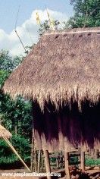
Lahu
490,000 people
Yunnan Province
Believe everything has its spirit and Mahayana Buddhism
Forced by the Chinese Government to take on surnames
Farmers who cook with bamboo containers
Notes:
Lad Hul
Their name translates to tiger hunter; no sure how they got the name, but they do eat what they hunt, and sometimes that includes tiger meat
720,000 people in southwest China living in Yunnan Province
Some Lahu were recruited by the CIA along with the Hmong, Loatian, and Mien to fight against the Communist in the Loatian Civil War; after the war, they were afraid of retribution so they fled to Thailand seeking asylum; some got relocated to the United States; in fact Visalia, CA has the largest concentration of Lahu people outside of Asia.
Originally, they believe everything has a spirit, but have since converted to Mahayana school of Buddhism
The Lahu used to go by their given names only, but the Chinese Government assigned them surnames. 90% of the Lahu either have Lee or Zhang as their surname. Their given name is usually 2 syllables, the first indicating gender, and the 2nd describing the zodiac sign in which they were born. E.g., a boy born on the day of the ox is Zanu and a girl is Nanu
Cook with bamboo containers giving their food and beverages a distinctive flavor
Picture of the house exterior

Slide 45
Lahu
Women’s clothing resemble a Chinese cheongsam
Spring Festival, called Kuota, is the biggest festival
Great Year, Days 1-4, for women
Lesser Year, Days 9-11, for men
Full Year, Days 12-15, for all people
Notes:
They favor black
As you can see from the picture, the women’s clothing resemble a cheongsam with the high color, buttons to the right, and slits along each side
The most important holiday is the Spring Festival, which they call Kuota
They break the Spring festival into different days
Days 1-4 is called the Great Year and celebrated by the women because traditionally, the men went hunting and usually don’t make it back in time when they come back, the women celebrate again with the men
Days 9-11 is celebrated by the men-carry first barrel of new water to show token of happiness, worship ancestors, feed oxen with tender grass, and visit others with gifts of food, singing and dancing.
Days 12-15 celebrate by swinging and playing

Slide 46
Monba
25,000 people
Live in southern Tibet
Believe in Lamaism, a form of Mahayana Buddhism
Farmers of rare herbal medicines, hunters, and raise stock
Eat rice, buckwheat and corn accompanied by ghee tea and chili
Notes:
Men Ba
25,000 people living in southern part of Tibet
Believe in Lamaism, a form of Mahayana Buddhism
Live in an area that is home to many rare herbal medicines so they collect and process the herbs, hunt and raise stock
Eat rice, buckwheat and corn.
Drink ghee tea and apply chili to their food

Slide 47
Monba
Very hospitable people
Good at weaving with bamboo and vines
Celebrate Spring Festival and other Tibetan holidays
Bride’s maternal uncle has the privilege of creating difficulties for the bridegroom to test his sincerity for the bride
Buildings face east to be auspicious
Notes:
Very hospitable people. When they host, they like to get their guests drunk because it would mean that their sincerity and warmness was accepted by their guests
They would walk their guests out of the village
They are good at weaving with bamboo and vines, making wooden bowls for holding food and for giving as gifts
They celebrate the Spring Festival and other Tibetan holidays by singing love songs and dancing
When a Monba couple gets married, the bridge’s maternal uncle has the tasks of making it difficult for the bridegroom to test is sincerity for the bride. He would make trifle complaints like the wine is too hot, the tea is too cold or the dish is too salty, and until the uncle is satisfied, the wedding cannot go on. The couple would be asked to drink and who finishes first would be the one who would manages the household
Another custom is that the front door to their house needs to face east to capture the sunshine in order for the household to be auspicious
After a hunting, hunters will give part of their catch to anyone they meet to bring them good luck next time

Slide 48
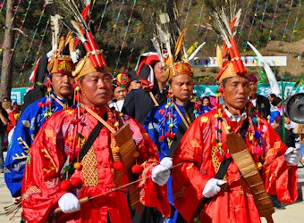
Jingpo
148,000 people
Live in the mountainous regions in Yunnan Province bordering Burma
Believe everything has a soul that will never die and will worship the spirits
Abundant resources such as crops, wood, fruits, medicinal herbs, wildlife and minerals
Skilled at painting, carving, weaving and embroidering
Notes:
148,000 people
Live in the mountains above 5,000 feet in Yunnan Province in southwestern China bordering Burma
Believe everything has a soul that will not die so if they have a misfortune, they’d worship the spirits
Some have converted to Christianity because of the influence from the missionaries
The area in which they live have an abundance in crops such as rice and corn, wood like rosewood and bamboo, fruits such as pineapple and mangoes, wildlife such as bear and tigers, and minerals like iron and precious stones
They also live in an area with lots of medicinal herbs that are used by doctors and acupuncturists
They are natural artisans, skilled at painting, carving, weaving, and embroidery
Their paintings depict their traditional religious belief
Their embroidery usually consists of over 300 patterns of flowers
Girls learn to embroider at a young age and give them as gifts to their lovers
Picture shows Jingpo musicians getting ready for a performance

Slide 49
Jingpo
Women adorn their clothing with sheets of silver while men will carry a knife, a gun and a bag with betel nuts or tobacco
Celebrate Zongge, New Rice Festival, Pumpkin, and Nangxian Festivals
Follow unique gift giving customs
Taboos include women not moving men’s knives or guns or it will bring bad luck to the family
Notes:
As show in the picture, women like to wear sheets of silver
The men will wear a gun or knife and a small bag to carry betel nuts or tobacco
They celebrate different festivals than the Hans
In their festivals, they sing, dance, and hold shooting competitions and a knife dance
They follow a unique gift giving customs
When they want to express their feeling of absence, they will send a root to their friends or family, and if they really miss them, they will include some sesame with the root
If a boy want to marry a girl, he’ll give her two chestnut leaves facing each other; if the girl wants to refuse marriage, she’ll return the leaves, but turn them back to back
They also have taboos; an example is women cannot touch a man’s knife or gun or the family will have bad luck

Slide 50
Lisu
730,000 people
Live in Yunnan Province
Believed in the existence of gods and totem, but some converted to Christianity in the 19th century
Staple food is corn and buckwheat and an herb called Gail
Very kind and hospitable to guests
Notes:
730,000 people
Live in Yunnan Province in southwest China
Believe in the existence of god and totem, but some converted to Christianity in the 19th century because of the Missionaries
Eat corn and buckwheat
Use an herb called Gail as a seasoning and put it in their wine because they think it helps clean the diver and digestive tract
A Lisu family will treat guest very well, regardless of whether they know they well or not.
Before eating, the host will hold the wine with a delicate bamboo pole, pour some onto the flour as an offering to esteemed ancestors, then drink some themselves to show it’s palatable before serving offering it to their guest with both hands.
Seniors are served first to shows their respect

Slide 51
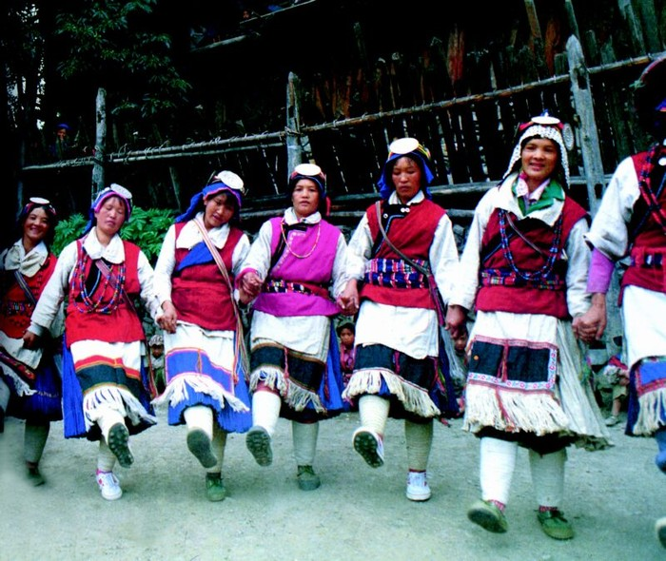
Lisu
Very honest people
Created a unique calendar with 10 months, matching the changes of nature
Biggest festival is Kuoshi Festival, followed by Zoatang Festival and the Knife Pole Festival
Taboos include no loud noises inside the house, closing the door after dark, no watching sacrifices
Notes:
They are very honest people
When on a long journey, they will divide food into parcels and hang the parcels on tree branches and caves on their outbound trip so that they will have food for the return trip
Others who pass by will not touch the food, even if they are very hungry
They created their own calendar with 10 months, varying with the changes of the season, which starts with blooming, tweedling, firing, collecting, harvest, wine boiling, hunting, year spending and house building months
The biggest festival is Kuoshi Festival, usually held on December 12th , followed by the Zaotang Festival and the Knife Pole Festival.
The Kuoshi Festival is equivalent to the Han’s Spring Festival; they would clean their homes with oak branches to sweep out the disease and end the suffering, poor and hungry days and line the front of their homes with pine tree and needles to bring longevity and end the suffering to the family
On the 8th day of the 2nd lunar month, they celebrate the Knife Pole Festival by watching the brave Lisu men climb the Knife Mountain and dive into the fire sea.
Taboos that they follow include not making loud noises inside the house because it’s considered inauspicious, closing the door after dark, and no watching sacrifices without permission

Slide 52
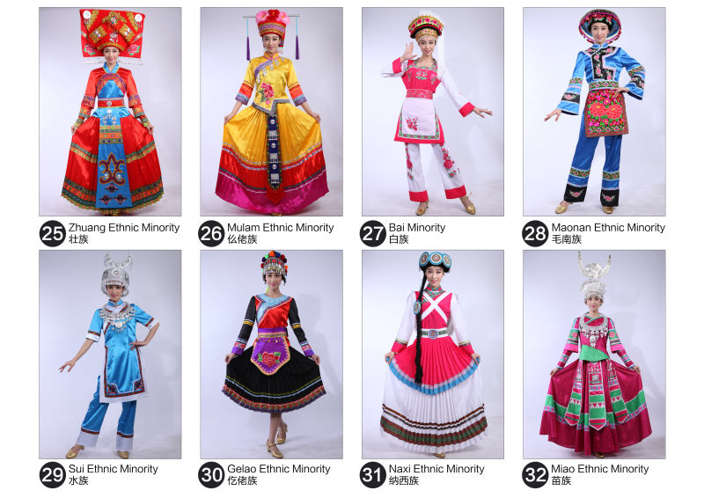
Zhuang
18 million people
Mostly live in Guangxi Province
Believe in totem, ancestors and the power of many inanimate things in nature
Produce and consume rice and corn
Eat a variety of meats
Wine is a must when hosting guests
Notes:
18 million people, largest Chinese minority group
90% of the Zhuang live in Guangxi Province in southwest China, the rest spread out between Yunnan, Guangdong, Guizhou, and Hunan Provinces
Believe in the power of the totem, ancestors, and inanimate things such as giant trees, high mountains, cavity, the earth, sun and water
They conduct sacrificial activities because they believe they are being blessed by the divinity who can prevent disasters
They have tropical and subtropical weather allowing them to grow rice and corn
They eat all kinds of meat, including beef, mutton, pork and chicken
Their vegetables are usually poached or pickled
Wine is a must when hosting guests
They exchange each other’s wine by drinking from a spoon by crossing each other’s arms

Slide 53
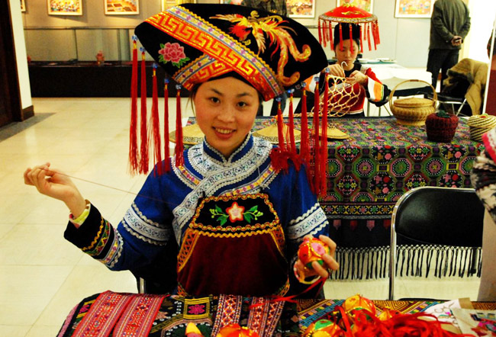
Zhuang
Like other minority groups, Zhuang women are good at weaving and embroidering
Have a reputation for distinctive designs of cotton woven yarn brocade and dying with wax
Besides celebrating the traditional Han festivals, they also celebrate the Devil, Ox Soul, and the Singing Festivals
Notes:
Zhuang women are good at weaving and embroidering
They are famous for their brocades with distinct designs, colors, luster, durability and versatility
Shown in the picture are 2 women at work on weaving silk brocade
They also dye their brocades with wax.
Today, you can see their handicrafts in carpets, aprons, bed covers, waistbands tablecloths and curtains’
Besides celebrating the Han holidays, they also celebrate the Devil, Ox Soul and Singing Festivals
The Devil Festival is held on 7/14 of the lunar month where duck, pork, good wines, candies and fruits are offered to their ancestors to show respect
The Ox Soul Festival is held on 4/8 of the lunar month to celebrate the king of oxen and to shoe their love and respect to the ox. They remove the yoke from the ox, bathe it and feed the ox with five-colored glutinous rice in hopes of a good harvest
In lieu of visiting their ancestor’s gravesite, they use the Singing Festival to express their sentiments
Lyrics in the songs are usually improvisational and humorous
The Singing Festival has also become the Valentine’s Day for the Zhuang because the young men use the songs to express their love to the girls

Slide 54
Mulam
207,000 people
Live in Guangxi Province since 265 A.D.
Believe in natural spirits and influenced by Buddhism and Taoism
Primary crop is rice
Excavate coal and iron forging and pottery making
Notes:
Mulao
207,000 people
Live in Guangxi Province in southern China since the Jin Dynasty in 265 A.D.
Believe in natural spirits & influenced by Buddhism and Taoism
Live in an area that is excellent for growing rice
Many Mulam people also work in the coal mines so much so that the town they lim in is called the Town of Coal
Have forged iron and made knives for centuries
Also good at making pottery, which people give as gifts

Slide 55
Mulam
Eat porridge for breakfast and have a more lavish dinner
Eat their food cold along with acidic and spicy dishes
Celebrate festivals every few month
Wives do not live with their husband until after they’ve had their first son
Notes:
Eat porridge for breakfast with a more substantial meal for dinner
Like to each their food cold with acidic and spicy dishes, such as bean soy sauce and pickled vegetables
They seem to celebrate every other month
Starting with Lunar New Year, the family eat a big meal on the first day of the New Year, on the second day, the married women return to their parents home and they invite friends and family over to the house, and on the third day, they celebrate as a village
On the 8th day of the 4th month, they worship their god and let their oxen rest and feed them glutinous rice
On the 5th day of the fix month, they celebrate Dragon Boat Festival to ensure a good harvest
The middle of the 8th month is reserved for the youth to choose their lovers
They also celebrate the Yifan Festival by improving ballads and dances, hoping that their ancestors bless them with peace.
An interesting tradition, Marriages are usually arranged and the Mulam wife does not live with the husband until she’s given birth to their first son

Slide 56
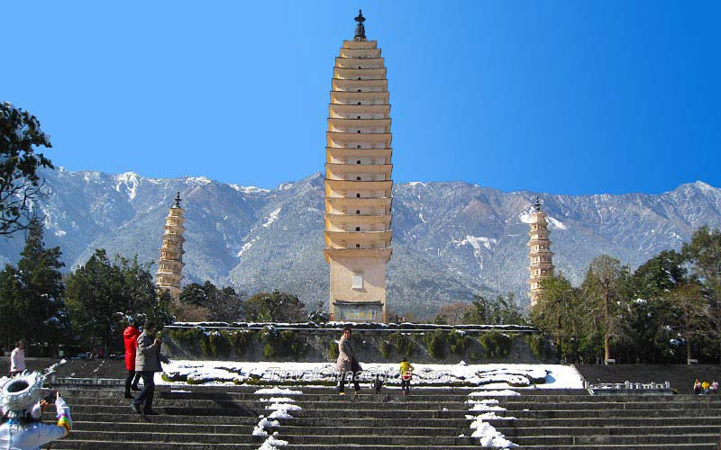
Bai
1.9 million people
Live in Yunnan Province
Believe in Buddhism, but also worship their specific village god, someone like a local hero
Creative architects, sculptress, wax painters, and lacquer work
Dance and music has been incorporated into the Han culture after they were accepted as part of the court entertainment
Notes:
1.9 million people
80% live in Yunnan Province in Southwest China with the rest spread between Guizhou and Hunan Provinces
Believe in Buddhism, but they also have local gods that they worship; these local gods could be a local hero or someone of significant importance to the village
The Bai’s a very creative people, especially in architecture, sculptures, wax painting and lacquer work
The Three Pagodas in Dali, pictured here, was one of their creations and was erected in 618 during the Tang Dynasty
Today, their dance and music has spread widely and accepted by the Han people, especially after being accepted as part of the court entertainment
One elegant dance example is their Three Course Tea Ceremony, which is performed at festivals and weddings.

Slide 57
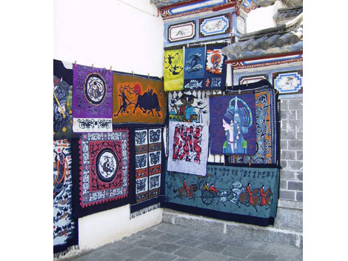
Bai
Prefer sharp, cold and spicy food
Favor white clothes adorned with embroidered color belts
Most important festivals include the March Fair and the Torch Festival
Notes:
The Bai prefer sharp, cold and spicy flavored food
They often cure their ham and fish and eat them with rice and flour
The favor white clothes, as their name might indicate, trimmed with colorful embroidery belts
Picture shows some of their intricate embroidery on display
The most important holidays include the March Fair and the Torch Festival
The March Fair is held annually at the foot of Mt. Cangshan in Dali between the 15th and 20th day of the 3rd month.
Originally it was a religious holiday to pay homage to their ancestors, but has turn into a fair where there are performances of traditional dance and sports as well as merchandise trading from neighboring villages
The Torch Festival is celebrated on the 25th day of the 6th month to wish for a good health and a good harvest. They would hang banners with auspicious words and light torches in front of their gates and around the fields to catch pests

Slide 58
Maonan
177,000 people
Live in Guangxi Province
Believe in Taoism and animism with many gods who control their lives
Very efficient in agriculture
Their cattle sell well in southern China
Very creative in building houses, tables, utensils with stones and sculptures
Notes:
177,000 people
Live in Guangxi Province in Southern China
80% of the population carry the surname Tan
Believe Taoism and that there are many gods who can control their lives so they need to sacrifice during festive days
Utilize every inch of farming land to increase their crop yield
The Maonans have 3 treasures, which include their beef, sweet potatoes and bamboo caps
They like to build houses, tables, and utensils out of stone
In fact, they are famous for amazing sculptures of flowers, birds, fish, insects and people and they do all this free-hand

Slide 59
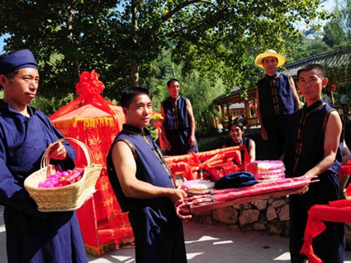
Maonan
Eat corn, rice, sweet potatoes, pumpkins and beef in a hot pot
Celebrate Feninong Festival after the Summer Solstice and the Dragon Boat Festival
Arranged marriages; brother of a widow will take the late husband’s wife as his wife
Taboos include no vulgar language on New Years Day, guests are not welcomed at homes with a sick patient,
Notes:
Eat corn, rice, sweet potatoes, pumpkins and beef in a hot pot
Food is usually pickled
Biggest festival is the Feniong Festival, which is celebrated after the Summer Solstice
For this festival, they make a pot of glutinous rice, find a willow twig and bring it home and paste rice grains on it to symbolize fruitfulness and a good harvest
They also celebrate Dragon Boat Festival, but on this they, instead of worshiping, they pick and boil medicinal herbs to get rid of disease
On both days, they would worship their ancestors and sing to each other
Maonans marriages are arranged at a very young age
Picture shows wedding proceedings
If a husband should pass away, the brother of the widow would take the wife in as his wife
Some taboos to remember when dealing with the Maonans is to not use vulgar language on New Year’s Day and not visit them if they have someone sick at home

Slide 60
Shui
407,000 people
Live in Guizhou Province
Believe all natural things have spirits that influence their lives
Crafts include paper cutouts, stone-carving, silver jewelry-making and batik
Enjoy rice, supplemented by pickled fish, vegetables and yellow wine
Notes:
Shew
407,000 people
Live in Guizhou Province in south central China
Believe all natural things have spirits that can influence their lives so when disaster hits, they turn to wizards and worship their powers
They are good at paper-cutouts, stone-carving, silver jewelry making and batik techniques
Their Shuijia Bu, cloth made by the Shui are very delicate, yet durable and is considered their pride and joy
They enjoy eating rice, with pickled fish, vegetables, and yellow wine

Slide 61
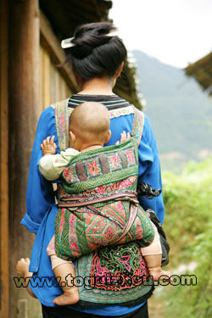
Shui
Houses usually have odd rooms
Have their own calendar, treating the first day of the ninth month as their New Year’s Day
Also celebrate Pure Brightness and the Dragon Boat Festivals
Unique Shui customs, include saving the head of the pig for worshipping the ancestors, giving the chicken’s head to the guest, presenting an elder with a long gown of white cloth to wish him longevity
Notes:
They houses are usually with fir with pine wood, covered by fir bark or tiles
As with many of the Chinese minorities, the bottom floor of the houses are for the livestock and fowl live on the first floor and the humans live upstairs
Their homes usually have odd number of room because they believe even number of rooms is inauspicious
They have their own calendar, making the night month the beginning of their New Year
In addition to celebrating their New Year, which they call Duan, they also celebrate the Pure Brightness and the Dragon Boat Festivals
They consider the head of a pig and chicken are symbols of dignity so they use the pig head for offerings to their ancestors, but the chicken head is given to the guest
Women and children in a Shiu family eat after the head of household and guest finish eating
When celebrating an elder’s birthday, his descendants usually presents him with a long gown of white cloth for longevity
Picture shows Shui lady carrying her baby

Slide 62
Gelao
580,000 people
Spread throughout Ghizhou, Yunnan, and Guangxi Provinces
Believe in many gods as well as their ancestors
Grow corn in the hilly areas and rice in the plain fields
Proud of their forging, blacksmith and stonecutting
Notes:
580,000 people
Spread out in southern China, including western Guizhou Province, western Guangxi Province, and southeastern Yunnan Province
One of the oldest ethnic minorities with 2,100 years of recorded history
Believe in the blessings of many gods and their ancestors
Live in a very wet are so they depend on agriculture for their livelihood
Grow corn in the hills and rice in the plain fields
Also good at forging, blacksmith, and stonecutting

Slide 63
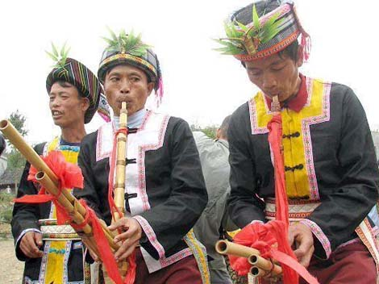
Gelao
Eat corn and rice, with glutinous rice cakes as one of their favorites
Known for their Papo Jiu, a wine brewed with corn, jowar and rice
In addition to celebrating the same festivals as the Hans, they also celebrate Gelao Nian and Ox God Festival
Notes:
Eat rice and corn
Glutinous rice cakes is one of their favorites
Like to flavor their foods with honey, sesame, brown and white sugar
Make their food acidic and spicy
Brew a wine with rice, corn and jowar called Climbing Wine or Papo Jiu
Celebrate the same holidays as the Han people
For the Spring festival, they make a large glutinous rice cake to worship their ancestors and leave it untouched for 3 days
They cannot sweep floors, carry water, use unripe food, pour water by the door or labor in the fields during Spring Festival
They also celebrate Gelao Nian, their New Year, on the 3rd day of the 3rd month
For the Gelao Nian, the men would sacrifice a chicken and sheep under a divine tree and pray for a good harvest for the following year
The Ox God Festival is celebrated in the 10th month
They prepare a feast for the Ox God and ask him to bless their cattle and keep them healthy, give the cattle a day of rest and feed them the best food.
Picture shows Gelao men playing their flutes at a wedding

Slide 64
Naxi
309,000 people
Na means senior and honored and Xi means people
Live in Yunnan Province
Believe everything have spirits that live on forever
Survive on agriculture, stockbreeding and handicrafts
Notes:
Na she
Na means senior and honored and Xi means people
309,000 people with 1,000 year history living in Yunnan Province
Believe everything have spirits that live forever
When they have festivals or significant events such as a wedding, death, or disasters, they would invite a wizard to chant
They live on agriculture, stockbreeding, and handicrafts
They live in an area with lots of botanical resources such as trees and medicinal herbs
Their horses enjoy a reputation as “Three treasures of Lijiang” and presented as gifts to court officials because of their ability to transport goods across mountainous areas

Slide 65
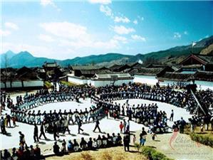
Naxi
Breakfast consisted of a steamed bread, but lunch and dinners are more substantial
Famous for their Pipa pork that can last for years
Celebrate Spring, Pure Brightness, Dragon Boat, Mid-Autumn, Torch and Sandou Festivals
Warm and kind to everyone
Notes:
Eat a steamed bread for breakfast, but lunch and dinner is more substantial
Like to pickle their pork
Pickled pipa pork can last for several years
Celebrate same festivals as the Hans
Usually celebrate their festivals by worshipping and sacrificial activities
Picture shows the Naxi people celebrating the Sandou Festival, which is their biggest festival.
Sandou is an ancestor and god who protects them from the devil. They built a temple on top of Jade Dragon Mountain to honor him and each year on Sandou Festival, they go to the temple to offer sacrifice to honor the god
Warm and kind to everyone.
When they hunt, they’d share their kill with someone just passing by
When they have guest, they would prepare a 6-8 course meal

Slide 66
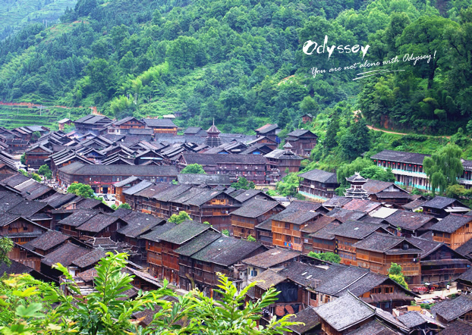
Miao
9.5 million people
Spread out in Guizhou, Yunnan, Hunan, Hubei, and Hainan Provinces
Also known as Black, White, and Stripped Hmong
Believe everything in nature has a spirit that can control their lives
Eat rice with meat, acidic soups, pickled vegetables, hot seasonings, and home-made wine
Notes:
9.5 million people
Also known as the Black, White, and Stripped Hmong
Spread out in southern China in Guizhou, Yunnan, Hunan, Hubei and Hainan Provinces
Shown in picture is one of their villages on the hillside
They believe everything in nature has a spirit that can control their lives so whenever they have a disaster, they invite wizards to perform ceremonies to drive away the devil ghost
When they worship their ancestors, their sacrifices are very elaborate
They eat rice as a stable, accompanied with mean and acidic soups, pickled vegetables, hot seasonings, and home made wine

Slide 67
Miao
Skilled at embroidering, weaving, batik, paper-cutting and jewelry casting
Women decorate themselves with dainty and dazzling skirts and jewels
Celebrate their festivals at different times, but common festivals include Spring, Dragon Boat, Huashan, Pure Brightness and New Rice Tasting Festivals
Notes:
They learn how to embroider at a very young age from their mother and sisters so when they are teens, they are good at making colorful hats, collars, cuffs, skirts, and baby carriers
They are also good at weaving, paper-cutting, batik and jewelry casting
As shown on the picture, the women like to wear dainty and dazzling skirls and jewelry
While they celebrate their festivals at different times, they tend to celebrate the same festivals like Spring Festival, which is celebrated between the 9th-11th months
They also celebrate Dragon Boat, Huashan, Pure Brightness and New Rice Tasting Festivals
As the name denotes, during the New Rice Festival, they steam newly picked rice, brew wine with the new rice, and cook dishes with the newly picked vegetables and fresh fish to express their gratitude for a good harvest

Slide 68
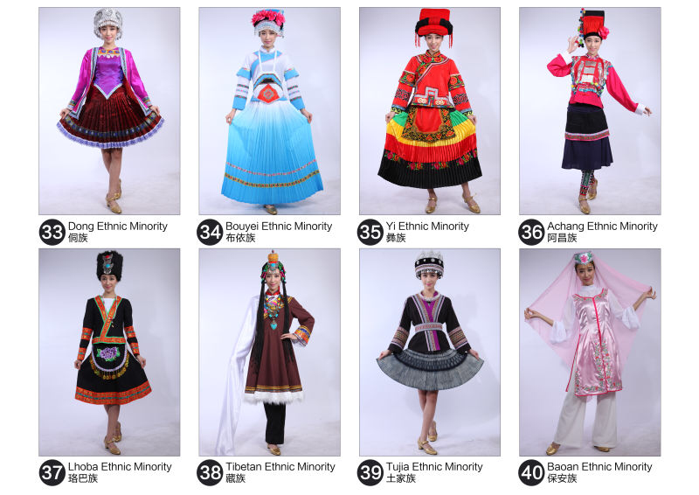
Dong
About 3 million people
Live in the borders of Guizhou, Hunan and Hubei Provinces
Believe that all things have spirits and gods, including land, water, ox and ancestors
Grow glutinous rice and cotton for textiles
Eat rice, millet, corn, wheat, and a beverage called oil tea
Notes:
Approximately 3 million people
Concentrated around the borders of Guizhou, Hunan, and Hubei Provinces in southern China
Believe that all things, such as land, water, ox, and ancestors have spirits and gods
During times of disasters, they believe the devils are responsible and ask a wizard to ward them off
Dong people grow glutinous rice while the Han grow non-glutinous rice
They also grown cotton for textile use
They also grown millet, vegetables, plums, peaches, pears, mushrooms, mandarin oranges, pomelos and watermelons for consumption
Eat rice, millet, corn, and wheat
They like pickled and acidic foods
Drink a beverage called oil tea made of peanuts, sesame, soybean, and tea leaves
One custom they have around oil tea is when they have a guest, they would give the guest a bowl of oil tea with a single chopstick, if the guest does not return the chopstick to the host, the host would assume that it was not enough and replenish the oil tea

Slide 69
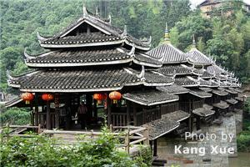
Dong
Known for their polyphonic choirs, operas and architectural capabilities
Besides the New Year, Mid-Autumn and Dragon Boat Festivals, the Dongs also celebrate Dongnian, New Rice Tasting and Sisters Festivals
Have many taboos and superstitions
Notes:
Known for their polyphonic (multi-melody) choirs, operas and architectural capabilities
Picture shows the Wind and Rain Bridge, a sample of their architecture
Besides celebrating the normal Han festivals, they also celebrate unique Dong festivals
They celebrate the Dongnian Festival on the first day of the 11th month for a good harvest by making Ziba, (cooked glutinous rice pounded into paste), chicken and pickled carps
They celebrate the New Rice Tasting Festival when the early rice is ripe by cooking the rice, worshipping their ancestors, and have bullfighting activities
They celebrate Sisters Festivals on the 8th day of the 4th month where married women go home to their parents house, make Ziba and bring some back home to their husband’s family
The Dong people have many taboos and superstitions; a few interesting ones include:
Not getting married in Year of the Tiger because they need to wait 9 years before giving birth to a child
Pregnant women cannot participate in wedding ceremonies, visit sick people, make sacrifice to gods or watch houses being built
Main entrances of two houses cannot face each other or neighbors will quarrel all the time
Corpses cannot be placed in coffins in wet weather and no metal objects, such as copper be placed inside the coffins because the departed souls fear metal objects
Meat of dead animals with unknown causes of death should not be consumed because it’ll cause bad luck; catching a fish swimming upstream is also bad luck as the fish is protected by god

Slide 70
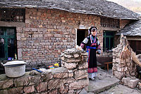
Bouyei
2.9 million people
Live in Guizhou, Yunnan and Sichuan Provinces
Believe in many gods and worship their ancestors
Fertile land and mild climate enables them to grow rice and unique teas such as honeysuckle and a very precious tea name Girls Tea or Guaniang Cha made by unmarried girls
Notes:
Boo Yi
2.9 million people
Live in Guizhou, Yunnan, and Sichuan Provinces in Southern China with a 2,000 year history
Picture shows what they house looks like
Believe there is a god for each mountain, river, lake, pond, unusual tree, caves, paddy field and when it rains or thunders
They also worship their ancestors
They live in the hills with mild climate and fertile land enabling them to grown rice and special teas such as honeysuckle and a very precious tea called Girl’s Tea or Guniang Cha made by unmarried girls

Slide 71
Bouyei
Eat rice with pickled sour vegetables, sausages and blood curd
Known for Bouyei batik, brocade, embroidery and vivid masks
Versatile musicians, singers and dancers
Besides the Spring Festival, they also pay homage to the gods, their cattle, gods of the field, land, and mountains, and their ancestors
Notes:
Eat rice with pickled sour vegetables, sausage and blood curd
When entertaining people, they serve wines and meat
Pork is served to symbolize that the guests will have a good harvest
When serving chicken, the head is auspicious, the wings means success and the drumsticks mean free of anxiety
They’ve made their batik for over 1,000 years where they paint patterns on white cloth with molten wax, dye the cloth with indigo liquor and herbal medicines, and dewax the cloth. Patters include pear flowers, waves, eddies, and chains
They are also good at embroidering and carving wood, especially masks with vivid colors
They are also very accomplished musicians, singers and dancers
As with the Hans, the Bouyei spend the last month preparing for the lunar new year, brewing wine, cooking glutinous rice cakes, blood curd and sewing new clothes, presenting a sumptuous meal to their ancestors on News Years Eve.
On the 3rd day of the 3rd month, they offer sacrifice to the gods of land and mountain
On the 8th day of the 4th month, also knowns as Ox God Festival, they allow their cattle to relax and feed they cake
On the 6th day of the 6th month, they worship the gods of the field, land and mountains
14th day of the 7th month, they honor the dead

Slide 72
Yi
7.7 million people
Live in Yunnan, Sichuan, Guizhou, and Guangxi Provinces
Believe in Christianity and Buddhism, but cherish the belief of the spirit most
Eat buckwheat, corn, potatoes, pork, mutton, and beef, and drink wine
Sandao Tea is a popular tea drinking ritual
Notes:
7.7 million people
Live in the mountainous areas in Yunnan, Sichuan, Gizhou and Guangxi Provinces
Some had adopted Christianity and Buddhism, but still worship their ancestors
One belief is heirlooms left to the Yi people by their ancestors are endowed with magic that can bring good will to their owners so they highly value those possessions and pass them down through the generations
Since they live in the mountainous areas where the land is suitable for buckwheat, corn and potatoes, those have become their staple diet
Pork, mutton and beef are their main meats they consume
They drink tea and wine
A daily tea ritual they follow is called Sandao Tea, where tea is divided into Yingbin Tea, the tea for welcoming guests, Xuku Tea, the tea for confiding hopeless things, and Sanmen Tea, tea for dispelling boring moods

Slide 73
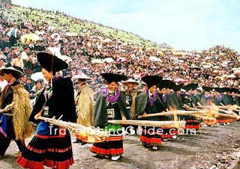
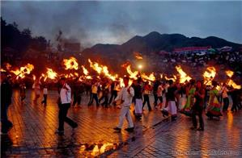
Yi
When drinking wine, they prefer to drink on an empty stomach
Skilled at painting, sculpture, embroidery, and drawing with lacquer
Celebrate Torch and Chahua Festivals as well as Shiyue Nian
Notes:
When they drink wine, they sit around in a circle and drink it on an empty stomach, without food
Goblets they use vary from wood, sheep or ox horns and even eagle’s claws
They are skilled at painting, sculpture, embroidery, and drawing with lacquer
In fact, the women’s reputations are based on how well they embroider
The Torch Festival is the most important festival, held on the 24th day of June to celebrate the victory of a rebellion against a tyrannical landlord. They wear their traditional costumes and enjoy themselves with wrestling, horse racing, bull fighting, tug of wars, singing and dancing.
Pictures show the Yi people celebrating the Torch Festival during the day and night
The Chahua Festival is held to commemorate the hero, Mi Yinu who helped them overcome the tyrannical ruler
Shiyue Nian is the traditional spring festival for the Yi people, but it’s help in October

Slide 74
Achang
34,000 people
Live in Yunnan Province since the 2nd century
Follow Buddhism and Taoism with temples in every village
Good at forging iron weapons and cutting tools
Enjoy eating rice, fried fish, which come from the waters of their rice paddies and drinking yellow wine
Notes:
34,000 people
Live in the Yunnan Province and have been there since the 2nd Century
Believe in Buddhism and Taoism and almost all villages have a temple with various architectural styles
They are good at making iron weapons and cutting tools
They grow a high quality rice, which they are proud of and eat that with fried fish that live in the waters of their rice paddies
They also drink a mellow tasting wine

Slide 75
Achang
Unmarried young men wear a white or black cap over short hair; married men wear blue caps
Girls wear long braided hair, but when married, they wear a chignon .5 meter high
Celebrate Water Splashing, Torch and Wolou Festivals
Have many taboos
Notes:
Unmarried men usually wear their hair short under a white or black cap; once married, they wear blue caps
Girls wear their hair in braids, but once, married, they wear their hair in a bun, piled has high as 20”
As the Dai people, the Achang use the Water Splashing Festival to choose a mate
They celebrate the Torch Festival on the 24th day of the 6th June by enjoying rice noodles with pork and walk around the neighborhoods carrying bright torches
They celebrate the Wolou Festival on April 4th by paying homage to their ancestors, Zhepama and Zhemina, who made great contributions to their nationality
Taboos for the Achangs include:
Not killing or harming domestic animals on January 1st
Males of other families cannot visit a family who has given birth for the first 7 days
Standing and sitting on the threshold or cutting the threshold with a sword is forbidden because the threshold stands for the prosperity of the family and the abundant generation of the family
Males and females of the same family name cannot marry
No burning of hair because if burnt, the person will become ill or mad

Slide 76
Lhoba
Only 3,000 people
Live in southeast Tibet, where they’ve been suppressed by the Tibetan Government until 1950
Believe the world is filled with spirits and use shamans and pray to the spirits to seek blessings
Food and culture resembles those of the Tibetans like the use of a local grain called Jizhuagu or chicken claw grain or a buckwheat pie dusted with chili powder
Notes:
Lo Ba
Smallest minority group with only 3,000 people
Live in the southeast region of Tibet; in fact, the name Lhoba is derived from the Tibetan word for southerners
The Lhobas were kept in virtual slavery by the Tibetan government until the 1950’s when the Chinese Government help improve their livelihood by expanding their development of the wide variety of resources ranging from mineral to plants to animals
They believe the world is filled with spirits that control their everyday lives and pray and use shamans to seek blessing and control the spirits
Because they live so close to Tibetans, the food and culture resembles that of the Tibetans
They eat rice, corn and a local grain called Jizhuegu or chicken claw grain
They use the grain to brew a popular yellow wine
One of their favorite dishes is the buckwheat pies dusted with chili powder

Slide 77
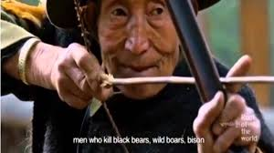
Lhoba
Very hospitable to their guests
Hunt with poisoned arrows so meat must be treated after the animal is prepared
Some follow Tibetan holidays while others follow their own calendars, but all celebrate the arrival of the New Year
Notes:
Lohba people are very hospitals to their guest, giving them to best seats and the prized part of each dish
Since they hunt using poison arrows, they meat has to be treated after it’s cut up
Picture shows a Lhoba hunter aiming for black bear, wild boar or a bison
To show that the meat is safe to eat, the host would eat and drink a little to show that the food is safe before offering the food to the guests
The guests in turn must eat all the food on the table or the host would be offended
Some Lhobas follow Tibetan holidays according to their holidays, while others live according to their own calendar, but all celebrate the arrival of the New Year on the same day by slaughtering a pig, oxen or sheet and sharing the meat with others, drink, sing, and dance

Slide 78
Tibetan
6.3 million people
Live in Qinghai, Sichuan, Yunnan and Gangsu Provinces
Devout Buddhist
Farmers grow barley; nomads herd yaks and sheep
Some migrating into cities to start businesses or become craftsmen
Notes:
7.5 million people in China
Live in Yunnan Province in Southwest China and Qinghai, Sichuan and Gansu Provinces in Central China
Most are devoted Buddhists
Tibetan farmers grow barley
Those who live the nomadic life style herd yaks and sheep
Tibetans who have migrated to cities have started their own businesses or work as craftsmen

Slide 79
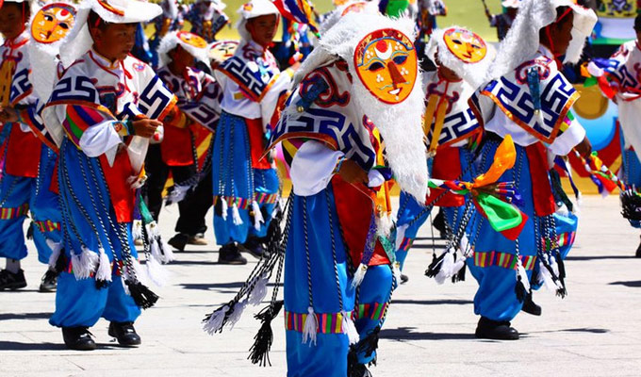
Tibetan
Eat beef, mutton and dairy products, but no vegetables
Drink buttered tea, sweet tea and barley wine
Because of the cold weather, they wear heavy thick garments
Celebrate Losar, Shoton and Bathing Festivals
Notes:
They eat noodles or dumplings made from barley dough, beef, yak or mutton, and dairy products with no vegetables
They would dry hang their meat in their tent or home to dry and eat it raw
Since their cultivate mustard seeds, they might also cook the meat in a spicy stew with potatoes
They drink buttered tea, sweet tea and barley wine for beverages
Their clothing tend to be thick and heavy because of the cold weather
The festivals they celebrate include Losar, which is their Lunar New Year and usually celebrated in February/March timeframe, slightly different than the Han schedule
They also celebrate the Sho Dan Festival on June 30th of the Tibetan calendar after the monks return home from the Monastery where they stay to avoid stepping on summer insects
Picture shows the Tibetan Chinese celebrating the Sho Dan Festival
The Bathing Festival is celebrated 3 times during a person’s life, at birth, marriage and at death

Slide 80
Tujia
8 million people
Live in the Wuling Mountains bordering Hunan, Hubei, Sichuan and Guizhou Provinces
Believe in their ancestors and gods and revered white tigers for preventing evil
Main crops include tung oil, tea, and fish
Mt. Wuling and Mt. Wudang have attracted many tourists
Notes:
8 million people
Live in the Wuling Mountains bordering Hunnan, Hubei, Sichuan and Guizhou Provinces
Believe in their ancestors and gods and respects white tigers because they believe white tigers help prevent evil
They live mainly on agriculture, with main crops being tung oil and tea and fishing
Lately, tourism has been great for them because people have started going their to see the scenic views of Mr. Wuling and Wudong

Slide 81
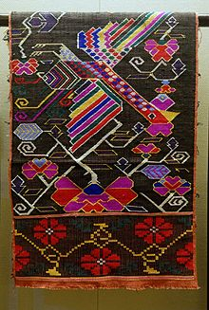
Tujia
Eat rice, corn, pickled vegetables and drink wine brewed with glutinous rice
Known for their brocade cloth called Xilandgkapu used for bedspreads
Baishou Dance includes 70 hand gestures depicting war, farming, hunting, courtship and other aspects of life
Biggest festival includes the Tujia Year, or Gannian, celebrated on New Year’s Eve
Notes:
Eat rice, corn and pickled vegetables
Drink a wine brewed with glutinous rice
Know for their woven brocade cloth called Xilandgkapu, which are often used for bedspreads (shown on the slide). They usually show over 100 patterns
Tujia people are also know for their Baishou Dance, which include 70 hand gestures depicting war, farming, hunting, courtship and other aspects of life
The grandest festival is the Tujia Year, also called Gannian, which is celebrated on Lunar New Year’s Eve; they usually prepare a large meal an dance together
They also celebrate the Dragon Boat Festival

Slide 82
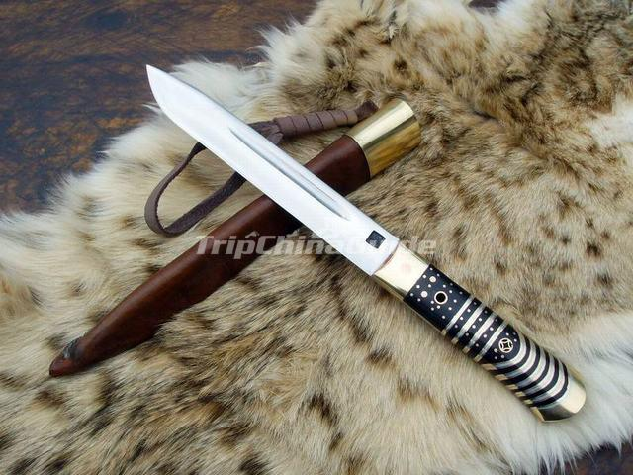
Bonan
16,000 people
Live in the southwest Gansu Province
Descendants of the Muslim Mongol soldiers stationed in Qinghai during the Ming Dynasty
Maintained Moslem and Islam traditions
Agriculturists growing barley, wheat and corn
Expert knife forgers using brass, copper or ox bones
Notes:
Bao An
Only a little over 16,000 people
Live in the southwest region in Gansu Province
They are believed to be descendants of Muslim Mongol soldiers who were stationed in Qinghai during the Ming Dynasty
Therefore, they’ve maintained their Moslem and Islamic traditions
They are agriculturalist by trade, growing barley, wheat and corn
They are also good at forging knives using brass, copper or ox bones
Picture shows a sample of their workmanship on forging knives

Slide 83
Bonan
Women are skilled at paper cutting and engraving unique flower patterns on furniture, utensils and knives
Only eat beef and mutton
With the exception of Spring Festival, they tend to follow Islam festivals that are of a religious nature, such as Lesser Bairam and Corban Festivals
Notes:
Women are good at paper cutting and engraving unique flower patterns on furniture, utensils and knives
They only eat beef and mutton and will not eat the remnants or by-products
They celebrate the Spring Festival, but tend to celebrate traditional Islamic festivals that are of religious in nature, such as Lesser Bairam or Corban Festivals

Slide 84
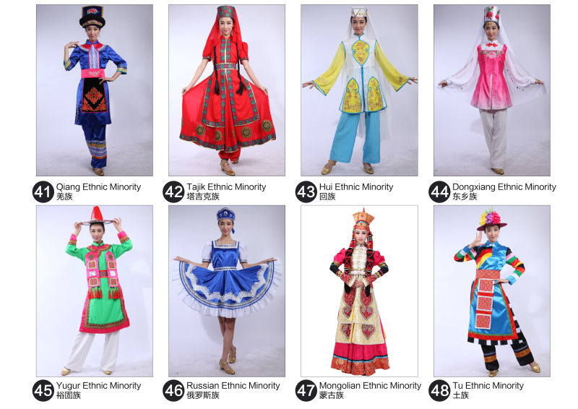
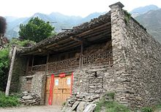
Qiang
Over 300,000 people
Live in northwest part of Sichuan Province
Qiang civilization have existed for over 3,000 years
Believe everything in nature has a spirit; white quartz is the symbol of rightness, black is evil
Adept at constructing buildings, rope bridges, plank roads and dams
Notes:
Over 300,000 people
Live in the northwest part of the Sichuan Province
Based on inscriptions found on oracle bones, the Qiang civilization has been around for over 3,000 years
They believe that everything in nature has a spirit
They consider white quartz stone as a symbol of rightness with the power of gods while black quartz is evil
On the third day of their new year, they would go to white stones on their rooftops and worship gods of mountain, stone king, or ox king, etc.
They are know for their construction capabilities
One structure that they are know for is the Diaolou, which is a building up to 98’ high made of stones and clay used to store food, firewood or used as forts
Picture shows a typical Qiang house, usually made of stone and mud

Slide 85
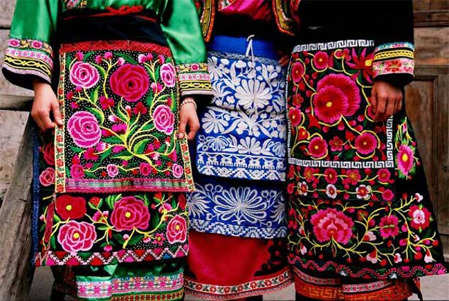
Qiang
Eat corn, wheat, potatoes, beef, mutton, pork, chicken and fish
All Qiang people drink wine
Embroidery and carpet weaving were known since the Ming and Qing Dynasties
Qiang New Year Day is the first day in the 10th month
Their folk stories are expressed through their music and dances
Taboos include not visiting a household with a red ribbon on the door, not walking over a burner or sitting on the threshold or stairs and not placing a chopstick across the bowl
Notes:
They eat corn, wheat, potatoes, beef, mutton, chicken, and fish
All Qiang people drink wine, including women and children (who prefer to drink wine with honey), so by the time they become adults, they have a great capacity for drinking liquor
Their embroidery and carpet weaving capability have been known since the Ming Dynasty
Picture shows some of their embroidering on their clothing
Unlike the Hans, they celebrate their new year in the 10th lunar month and they celebrate by offering flour and sacrificing meat to ancestors and gods
They preserve their culture by developing folk stories and expressing them through music and dances
One of the dances called the Armor Dance is performed with armor, copper, bells and long weapons, which reflect the character of the Qiang people, which are brave, simple and unconstrained
Some taboos to remember when meeting with Qiang people, is if you see a red ribbon on their door, that means they have some sick at home and do not welcome guests, Do not work over their burner, sit on their threshold or steps and do not put your chopsticks across your bowl when you eat

Slide 86
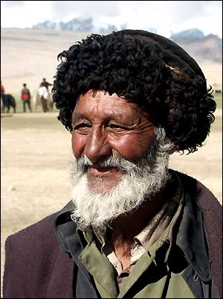
Tajik
41,000 people
Live in the Pamir Mountains in Xianjiang Province
Follow the Islam faith, but only visit the mosque during major festivals
Farmers grow highland barley, wheat, corn and peas; also breed sheep, goats, yaks, horses and camel
Notes:
41,000 people
Live in the Pamir Mountains in Xianjiang Province in northwestern China
Follow the Islamic faith, but only visit the mosque during major holidays
They grow highland barley, wheat, corn and peas
They also breed sheep, goats, yaks, horses, and camels

Slide 87
Tajik
Eat meat and cook rice or pies with milk; will not eat pork, dog, donkey, horse meat or animals that die naturally
Celebrate Spring, Corban, Almsgiving and Baluoti Festivals
Follow etiquette unique to the Tajiks
Notes:
They will eat meat and cook rice and pies with milk, but because of their religion, they will not eat pork, dog, donkey, horse meat or any animals that die of natural causes
They celebrate the Spring Festival on the 3rd month when they do their Spring cleaning, feed their ox and visit with others
They celebrate the Baluoti Festival in the 8th month by lighting candles and praying for peace for their family members
The Tajiks have certain traditions and etiquettes
During New Years, the women would sift flour on guests’ shoulders to wish them good luck
When greeting each other, they do not hug as that’s reserved for those whom they have the warmest feelings; instead, men will shake and kiss the back of each others’ hands; women will kiss the face and lips; and men and women will shake hands and kiss the palm of the hands
Mothers teach their daughters to respect the husband and in-laws and not to flirt with other men, to be diligent and economical
When hosting guests, they will respect the guests and never ask the guests when they will be leaving

Slide 88
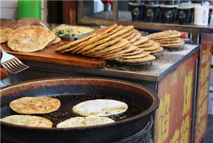
Hui
650,000 people
Descendants from the Arabic and Persian merchants who came to China in the 7th Century
Live in Ningxia Province
Follow the Islamic religion
Prefer food made with flour and will not eat pork, dogs, horses, donkeys, mules or blood of animals
Gaiwan Tea is made with other nutritious ingredients such as longan, jujube, sesame, sugar candy and medlar
Notes:
650,000 people
Descendants from Arabic and Persian merchants who travelled to China for trade in the 7th Century
Settled in the Ningxia Province in Central China
Follow the Muslim religion with a Imam and a Mosque in each community
Prefer food made from flour
Because they are Muslims, they will not eat pork, dogs, horses, donkeys, mules or blood from any animals
If a pot or pan is tainted by cooking ones of these meats, they will not touch the dish
When they drink tea, their Gaiwan Tea is made with other nutritious ingredients such as longan, jujube, sesame, or sugar candy medlar
Picture shows Naan, made of flour and typical of what Muslims eat

Slide 89
Hui
Live a puritanical life
Living customs differ from other Chinese minority groups
Primary festivals include Lesser Bairam (end of Ramadan, Corban, and Shengji Festivals
Notes:
They live a very puritanical life
They don’t joke or describe things with food
No smoking, drinking, gambling
Young people do not sit with elders
Do not use fortune tellers to predict the future
No sitting or stepping on the threshold because Muhammad uses the threshold as the pillow
To marry into a Hui family, the person must respect the Hui culture and convert to Islamism; Marriage feasts must have an even number of dishes to symbolize that the new couple will be a pair permanently
No wailing at funerals because that will be regarded as a complaint or hatred for the dead
They celebrate Lesser Bairam on the 1st day of the 10th month for 3 days. For the entire 9th month, the men older than 12 and women older than 9 will fast and will not eat from sunrise to sunset
They celebrate the Corban Festival on the 10th day of the last month where they skip breakfast, attend mosque, then kill an oxen and share it with the poor families and relatives

Slide 90
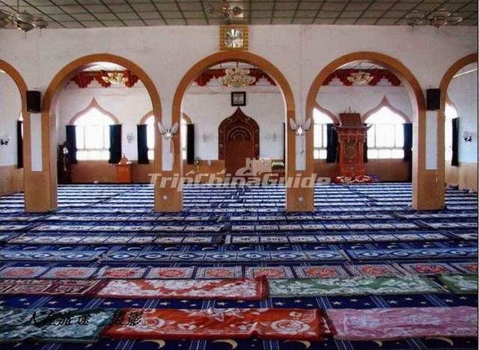
Dongxiang
Over 621,000 people
Descendants of Mongolian troops posted in the Hezhou area by Genghis Khan in the 12th century during his trip westward
Live in Gansu Province
Islamic faith
Grow yam, barley, potatoes and wheat and herd sheep
Notes:
Over 621,000 people
Believed to be descendants of Mongolian troops posted in the Hezhou area by Genghis Khan in the 12th Century during his trip westward
Live in Gansu Province in northern China
They are Moslems following the Islamic faith
Picture shows the interior of one of their mosques
Farmers grow yam, barley, potatoes, and wheat and herd sheep

Slide 91
Dongxiang
Eat yam, barley, chicken and mutton
Drink tea with sugar candy, longan and dates
Women wear head covers
Celebrate Islamic holidays such as Corban and Kaizhai Festivals
Notes:
Eat yam, barley, chicken, and mutton, but because they are Islamic, they will not touch pork, dog, horse, mule or donkey meat and will not each animal blood.
They drink tea with sugar candy, longan and Chinese dates
As with the Hui people, they do not joke about food, smoke or drink wine
Women will wear head covers because they think their hair should not be visible
They celebrate Islamic holidays like Corban and Kaizhai Festivals
When they celebrate, they spend their festivals in piety

Slide 92
Yugur
Only 15,000 people
Live in Gansu Province in northern China since 3 B.C.
Follow Tibetan Buddhism and practice Shamanism
Nomadic and live in tents
Raise stock
Adept at weaving and embroidering
Notes:
U gur
15,000 people
Records show that they’ve lived in Gansu Province in northern China since 3 B.C.
Practice Shamanism (a person who can transform himself in a trance to communicate with the spirits) and follow Tibetan Buddhism
They are nomads and move around based on the season
Their tents were tapered supported by 4-9 stakes, but since 1985, they’ve adopted the Tibetan-style tents using square-shaped rugs made from goat’s wood or white canvas
They raise stock for a living
They are good at weaving beautiful patterns on carpets and embroidering a variety of flower, insect, and grass patterns on their collars and sleeves

Slide 93
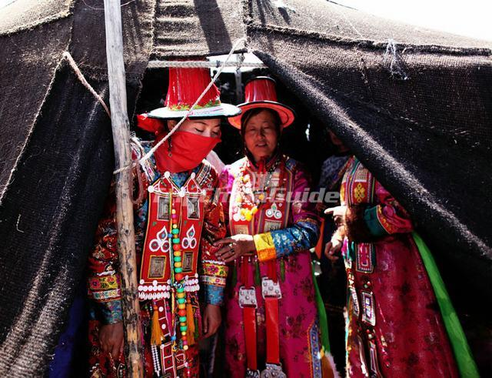
Yugur
Eat rice, wheat and mixed grain with beef, mutton, pork, chicken and camel meat
Milk tea, mixed with fried noodles, is consumed daily
Both men and women wear high-collared gowns with red waistbands; women wear trumpet-shaped red hats
Marriage customs last multiple days and unique
Notes:
They only eat one meal a day
They eat rice, wheat, mixed grain, beef, mutton, pork, chicken and camel meat seasoned with garlic, soy sauce and vinegar
Because of where they live, they eat very little vegetables and only use potherbs, shallots and leek when they can find it
In the fall, they get to eat mushrooms
They drink a milk tea mixed with fried noodles
Both men and women wear high-collared gowns with red waistbands
The women usually wear a red conical hat
Their wedding usually lasts two days for ordinary people and 3 days for the rich
During the wedding, the husband would shoot three arrows that are not sharp to the bride and then break the arrows and the bow during the ceremony to signify that they will love and live with each other forever
Picture shows ladies getting ready for a wedding

Slide 94
Russian
Over 15,000 people
Descendants of Russian immigrants to China in the 18th Century
Live in Xinjiang Province
Believe in Orthodox teaching with some Christianity, but not totally devoted
Work in schools and government as teachers, translators and interpreters
Notes:
Over 15,000 people
Descendants of Russian immigrants who came to China in the 18th Century
Live in Xianjiang Province in northwest China
Kind of follow Orthodox and Christianity faiths, but not real serious
Bilingual in Russian and Mandarin
Tend to have higher education that other ethnic minorities, so they work in schools and government as teachers, translators, and interpreters

Slide 95
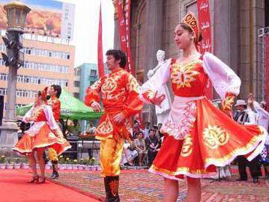
Russian
Wear traditional Russian clothing
Have a traditional Russian diet, eating flour-based bread, nang, pies, uncooked vegetables, alcohol and beer
Celebrate Christmas and Easter
Etiquette tips include not removing head cover before seniors and guests and not giving yellow-colored gifts because it signifies unfaithfulness
Notes:
Wear traditional Russian as shown in the pictures
Also retained Russian dance tradition; picture shows performers doing the Russian Tap Dance
Also have a traditional Russian diet, eating flour-based bread, nang and other pies, uncooked vegetables, and love to drink alcohol and beer
Instead of celebrating the traditional Chinese holidays, they celebrate Christmas and Easter as other Christians do
When they greet each other, they kiss and shake hands, but they’ll also bow like the Chinese
It would be considered impolite for a woman to remove her head cover in front of a senior or guests
When giving gifts, they avoid giving gifts that are yellow because it would imply that the person is unfaithful, but it’s ok to give gifts in blue because blue signifies friendship

Slide 96
Mongolian
Almost 6 million people, twice that of people living in Mongolia
Live in Inner Mongolia Province
Name means everlasting fire, but also referred to as ethnic minority on horseback
Believe in Lamaism, a form of Buddhism
Live in vast grassland favorable to agriculture and stock breeding
Notes:
Almost 6 million people, 2x more than Mongolians living in the country Mongolia
Live in Inner Mongolia Province in northern China
Mongol means everlasting fire, but most people refer to they as the ethnic minority on horseback
Believe in Lamaism, a form of Buddhism from India
They live in grassland that is favorable to agriculture and breed stock

Slide 97

Mongolian
Live in yurts, where they can pack and transport the yurts by yaks to new regions
Eat mutton, beef, goat, and dairy products
Biggest festival is the Nadam Fair in late August
Unconstrained, yet very warm-hearted people
Expect guests to follow their customs
Notes:
Because they are nomads, they live in round yurts that are made with a wood lattice framed formed in a circle and secured by rope to form a cylinder and covered with canvas; to add some stability, a heavy weight is suspended from the middle of the roof support
During the winter, they would simple roll it up and pack the yurts on their yaks and move to warmer regions
They eat mutton, beef, goat and dairy products. On special occasions, they might eat horsemeat, but horsemeat is consider sacred and only consumed at religious ceremonies. Meat is usually roasted on an open fire
They also drink milk from horse, sheep, deer and camels
They make wine from fermented horse milk because it helps keep them warm and strengthens the stomach. They also make milk tofu and milk tea from this process.
Their biggest festival is called Nadam Fair where they celebrate for 5-7 days in August with friends, wear new clothes, and participate in shooting, wrestling and horse-riding competition
They are very warm-hearted people, even to people they don’t know.
When visiting a Mongol’s home, they will be treated to wine. In return, the guests must respect their hosts by not stepping on the threshold, not sit beside the niche of Buddha, touch the kids’ head, not dry their boots on the stove or wash or bathe in the river as they consider the water holy. During a funeral, they do not wear red or white, and during festivals, they do not wear black and yellow.

Slide 98

Tu
242,000 people
Live in Qinghai Province
Believe in Animism, Taoism, Lamaism & Buddhism
Sheep breeders
Eat Qingke, a highland barley as well as wheat with sour vegetables and meat, like mutton
Drink milk tea and wine brewed with Qingke and herb to keep them warm and cure rheumatism
Notes:
242,000 people
Live in Qinghai Province in western China
Believe in Animism, Taoism, Lamaism and Buddhism
Picture shows some of the masks they use for their religion
Because of the geographic conditions of the land, they resort to breeding sheep for their livelihood
They eat Qingke, a high barley, wheat, sour vegetables and meat like mutton
They drink milk tea and wine brewed from Qingke with medicinal herb additives to help keep them warm and cure rheumatism

Slide 99

Tu
Both men & women wear high-collared shirts and long waist bands, which are embroidered with flowers
Celebrate the Spring, Dragon Boat and Nadun Festivals
Hosting guests brings them happiness
Notes:
Both men & women wear shirts with high-collars and long waist bands that are embroidered with flowers
Like the Hans, they celebrate the Spring and Dragon Boat Festivals
They also celebrate Nadun Festival, also known as the July Meeting.
Nadan is a carnival after harvest where they worship, gather to eat dinner and participate in sports like wrestling, martial arts, and horse-racing
They have a saying that the visiting of guests is the coming of happiness. When the guests sit, they offer them a strong cup of tea. Tea is never offers with a bowl or a cup that has a crack or broken.
They will also toast three cups of wine with their guests to reflect their forthrightness. If their guest cannot drink the wine, they will dip and flip three drops of wine to express their gratitude.
When there are visitors, the kids must be on their best behavior to not drive the guests away
Picture shows a typical Tu house

Slide 100

Salar
150,000 people
Live in the Xinjiang, Qinghai, and Gansu Provinces
Predominately Muslims
Made their living by hunting, forestry and livestock breeding for over 700 years
Women skilled at embroidery and paper-cutting
Men are proficient at building and horticulture, growing fruits like apricot, pears, apples and grapes
Notes:
105,000 people
Live in Xinjiang, Qinghai & Gansu Provinces in northwestern China
Predominately Muslims and follow Islamic beliefs
Make their living hunting, forestry and breeding livestock for over 700 years, but recently turned to agriculture, horticulture, and handicrafts
Women are good at embroidery and paper-cutting
Men are good at building and tend to fruit trees like apricot, pears, apples, and grapes
Picture shows a Salar woman tending to her food being dried

Slide 101

Salar
Diet includes flour, wheat, potatoes, vegetables, beef, lamb and chicken
Forbidden to drink alcohol, but drink white tea and wheat teas that taste like coffee
Celebrate the same holidays has the Huis, like Corban, Aimsgiving and Kalzhai Festivals
Must follow Salar etiquette
Notes:
Their diet includes flour, wheat, potatoes, vegetables, beef, lamb and chicken
They will not touch donkey and horsemeat, or meat from animals that have died of natural causes
Being Muslim, they do not drink alcohol, so they drink a white and wheat tea that when toasted and brewed, it taste like coffee
The celebrate the same festivals as the Hui people, like Corban, Aimsgiving, and Kalzhai Festivals
When visiting with a Salar Family, the first thing they will do is to offer a cup of tea, then they will offer you a piece of steamed bread, which you should break off and eat slowly.
The mother’s brother is held with the highest esteem
When a Salar is conducting a ceremony, it is impolite to walk in front of the ceremony
It’s customary for the village imam to conduct the wedding ceremony.
Before leaving the parent’s house, the bride must cry and sing to show her reluctance; The bride is escorted to the grooms house and pretend to force open the door while the grooms family pretend to resist; after the bride steps through the groom’s threshold, she presents samples of her embroidery to show here dexterity.

Slide 102
Uygur
8.4 million people
Live in Xinjiang Province, south of Mt. Tianshan
Believed in Shamanism & Buddhism, but converted to Islam in the 11th Century
For the past 2,000 years, they’ve had strong trade ties with a variety of middle Asian countries
Renowned for their abilities in processing gold, gems, silk and leather goods
Prefer to wear colorful one-piece dresses
Notes:
Wi gerz
8.4 million people
Live in Xinjiang Province, south of Mr. Tianshan
They used to believe in Shamanism and Buddhism, but converted to Islam in the 11th century
They have documented history showing that for the past 2,000 years, they’ve had a robust trade relationship with many middle Asian countries and other ethnic minorities in China
They are known for their abilities in processing gold, gems, silk and leather goods
Hetian jade, which they process, is regarded as one of the rarest jades
They also make one of the best knives
As show, in the picture, they prefer to wear colorful one-piece dresses with caps

Slide 103

Uygur
Staple food includes Nang, noodles, Zhuafan, beef, mutton, camel, chicken, goose, carrots, tomatoes, onions, peppers, eggplants, celery, dairy products & fruits
Drink tea, milk tea, and oil tea
Prefer to wear colorful one-piece dresses
Enjoy traditional folk dancing, singing and reciting poems and oral legends
Notes:
Their staple food includes Nang, a crisp baked pie that is usually eaten with tea
They also eat noodles, Zhuafan, beef, mutton, camel, chicken, goose, and various vegetables and fruits
Picture shows some Uygur men eating Zhuafan with their hands
They drink tea, milk tea, and oil tea
They enjoy traditional folk dancing, singing and reciting poems and oral legends, which includes stories about their culture and reflects their wisdom
When visiting a Uygur household, it’s important to remember that the eldest usually sit in the most distinguished seat, they would not appreciate you looking around their house, and leaving any small speck of food in the bowl is impolite to your host

Slide 104

Kirgiz or Kyrgyz
160,000 people
Migrated to southwest Xinjiang because Russian settlers to Kyrgyzstan drove the Kirgiz into China
Some follow Islamic belief, other follow Buddhism
Agricultural and raise livestock
Women like to embroider and weave on pillows, bedcovers, clothes, carpets, and pictures
Notes:
160,000 people
The name Kirgiz takes after a word meaning 40 girls
In the 19th century, the Russians who settled in Kyrgystan drove the Muslim Kirgiz people into China, who were more hospitable to them
Some remain Muslim and follow the Islamic beliefs, but others migrated to Buddhism
They farm and raise livestock for a living
Women are good at embroidering and weaving, decorating pillows, bedcovers, clothes, carpets and wall hangings with flower and bird patterns

Slide 105
Kirgiz
Eat 3 meals per day with nang and milk tea for breakfast, and for lunch and dinner, eat flour-based food with horsemeat, beef and mutton
Celebrate the Norooz Festival, similar to the Han’s Spring Festival
Weddings take place at the bride’s house
Notes:
They eat 3 meal a day, starting with nang and milk tea for breakfast and a more substantial meal for lunch and dinner, including flour-based products with horsemeat, beef and mutton.
They believe the best pieces of the mutton is the fat from the sheep’s tail and near the vertebrae and head
Before enjoying a meal, the guests would cut and share the food with the women and children of the host, which is different, because other groups would feed the seniors or their guests first
Leaving leftovers is impolite
They celebrate the Norooz Festival, much like the other Chinese people celebrate Spring Festival
Weddings are usually held at the girl’s house; the groom and his relatives will usually arrive at the girl’s house with a freshly slaughtered sheep; the girl’s family will also slaughter livestock and prepare it for their guests

Slide 106

Uzbek
15,000 people
Living in the Xinjiang Province
Adhere to the Islamic beliefs and customs
Live along the famous Silk Road where they were involved in trade and commerce
Became stock breeders since the foundation of modern China in 1949
Notes:
Ooz Bek
15,000 people
Name Uzbek came from a king in the 14th century and means leader of self
Live in the Xinjiang Province
Adhere to Islamic customs
Live along the Silk Road, so they were mainly involved in commerce and trade, but since the foundation of Communist China, they started to raise stock

Slide 107
Uzbek
Food staple include nang, milk tea, horsemeat, sheep and oxen
Shouzhuafan, a hand-grasping rice, is a popular meal with rice, mutton, carrots, & raisins
Women wear one piece dresses
Most important festivals include Kaizhai, Corban, and the Aimsgiving Festivals
Notes:
They eat nang with milk tea, horsemeat, sheep and oxen
A favorite dish includes the Shouzhuafa, literally translated to hand-grasping rice, which makes it easy for them to travel in the desert
Women usually wear one piece dresses with jewelry such as rings, earrings, and necklaces
Being Muslim, the most important festivals include Kaizhai, Corban and the Aimsgiving Festivals

Slide 108

Kazak
1.5 million people
Soviet persecution of Kazaks in Kazakhstan in 1916 and the 1932-1933 famine forced the Kazaks to move to Xinjiang Province
Multiple clashes between the Kazaks and the Tibetans forced some Kazaks to settle in the Qinhai and Gansu Provinces
Believe in Muslim and Islam customs
Breed livestock like sheep, goats and cattle
Notes:
Kesake
1.5 million people
Because they believe in the Muslim faith, they experienced persecution from the Soviet Russians in 1916, forcing them to move from Kazakhstan into China
During the 1932-1933 famine in Kazakhstan, more Kazaks migrated into China looking for better opportunities
They originally settled in Xinjiang Province, but the Kazaks living in Northern Xinjiang Province constantly clashed with the Tibetans, forcing some of them to migrate to Qinhai and Gansu Provinces

Slide 109
Kazak
Live a Nomadic lifestyle
Eat rice and products from wheat flour, meat and dairy products from their livestock
Women like to wear dresses and men wear loose clothing suitable for horseback riding
Celebrate Lesser Bairam, Corban and Nawruz Festivals
Notes:
Breed livestock for a living
Live a nomadic lifestyle, living in a collapsible round yurts during the spring, summer and autumn, but move their livestock stock build flat-roofed earthen huts in the pasture during the winter
All their family possessions, like riding gear, cooking utensils, provisions, etc., are kept in their yurts
Their yurts usually are divided so they have sleeping quarters on each side of the yurt, the center back is for their provisions and the front center has mats for their guests
Eat rice, and dairy products from their livestock
They especially like mutton stew
Meat is usually eaten with their hands
They usually cure their meat by smoking it for the winter
Women wear full dresses and men wear clothing that are loose, long-sleeve made or fur and suitable for horseback riding
They celebrate Lesser Bairam, Corban and Nawruz Festivals and follow Islamic traditions like Ramandan where they fast for 29-30 days and El Fitr where they break the fast.

Slide 110
Tartar
Only 5,100 people
Live in Xinjiang Province
Muslims, follow Islamic customs
Tartar Clerics helped reformed their traditional religious educational system to include math and science
Many well educated Tartars became merchants
Notes:
Da Da
Only 5,100 people
Live in Xinjiang Province with a history as far back as the Tang Dynasty in 600 AD
Most of the Tartar are Muslims and follow Islamic customs
Tartar clerics helped reform their educational system to include math and science
As a result of the educational system, many of the Tartars today live in the cities engaged as merchants in commerce, industry and, in education
Some Tartars are farmers, ranchers and make crafts

Slide 111
Tartar
City dwellers live in flat-roof mud houses; pastoral Tartars live a nomadic life in tents
Eat food made of flour, meat, milk and served with rice; drink a beer made of honey
Dinner is served to the eldest first and in succession by age; prayers are said at the end
Celebrate Islamic holidays like Kaishai, Corban and Aimsgiving Festivals
Notes:
Those that live in the city live in flat-roofed mud houses with a flue for heating and courtyards that they plant with flowers and trees to form a garden
Hang tapestries against their walls
Those who live in the country live like nomads in tents
They eat food made of flour, meat, milk and served with rice
They bake a cake made of flour, rice, cheese, butter, eggs, and raisins
They drink a beer made of fermented honey and a wine made of wild grapes
Dinner is served to the eldest first, and then in succession by page
Prayers are said at the end of each meal
Follow Islamic culture and celebrate Kaishai, Corban and Aimsgiving Festivals;
During their festivals, there is dancing, wrestling, horse-racing and pole climbing at festivals
One of their favorites contest is the jumping walk contest where the first to hold an egg on a spoon to cross the finish line wins

Slide 112

Daur
132,000 people
Descendants of the Khitan Tribe dating back in the Liao Dynasty and helped guard the frontier in the Tang Dynasty
Live in Heilongjiang Province and Inner Mongolia
Believe in Shamanism
Transitioned from eating mostly meat in the Qing Dynasty to other food groups including grain and dairy products
Notes:
132,000 people
Daur adopted a Mongolian dialect; Daur means cultivate in their language
They are descendants of the Khitan Tribe with history as early as the Liao Dynasty in 916 A.D.
They help guard the frontier in the Tang Dynasty from 1644-1911
Most of the Daur people live in the Heilongjiang Province in Northeast China with some in Inner Mongolian
They live in an area where there are a variety of fruits, vegetables grain, fish and meat, but during the Qing Dynasty, they ate mostly meat, such as deer, pheasant, and duck
Since then, they’ve added grain and dairy products to their diet
They eat buckwheat noodles and pies, soy bean, rice mixed with yogurt, milk tea, milk porridge and milk bean curd
Daurs live in round huts as seen on the slide, usually facing south

Slide 113
Daur
Engage in stock breeding and agriculture
Known for manufacturing handcarts and needlework
Today, they have factories that produce electric motors, transformers, and fertilizers
Celebrate Spring and Anie Festivals
Arranged marriages
Notes:
Hunt, and raise horses and oxen
Harvest edible plants from the forests and grow soybean, rice, sorghum, and maize
Women are known for their intricate needlework
Also known for their handcarts, which makes it easy to haul things on the grassland
Today, they have many factories producing electrical motors, transforms, and chemical fertilizers
The main holiday is the Spring Festival, where they celebrate by coming together to share hand-grasping meat, dance, and participate in games such as wrestling, horse-racing, archery and football with a ball made of hair
They end Spring Festival with a Black Ash Festival where they place black ask on each other’s face to wish them luck and happiness for the year
They also celebrate Anie Festival where they light cow dung or horse manure in front of their house to pray for good luck for the year and dance
Daurs usually live with fellow clan members of the same last name
Marriages are arranged by the parents and when a man marries a women he moves in with the woman’s family, but had no claim to their family belongings

Slide 114

Ewenki
31,000 people
Live in Inner Mongolia and Heilongjiang Province
Practice Shamanism, but also believe that there are Gods controlling their lives
Some live a nomadic life-style herding livestock like reindeer, horse and cattle, while others are farmers
Notes:
E Wen Ki, meaning people living in the mountains
31,000 people
Live in Inner Mongolia and Heilongjiang Provide where they enjoy green forest, green pastures for farming and minerals like iron, gold, bronze and crystals
Believe in Shamanism, but they also believe that there are Gods that control their lives
The most prominent is the God of Mountain; When hunters pass a mountain or cave, they would think the mountain is a domicile of God and would stop to offer some of their prey
Half of them are nomads, hunting and breeding animals like reindeer, horses and cattle, while the other half are more stable and farmers
They are know for domesticating reindeer and use them to help transport things
The nomads live in conical tents made of birch bark with reindeer skin tied to the bark
They produce and export a lot of wool for knitting, wool tops and casings, as well as milk, and reed for making paper

Slide 115
Ewenki
Eat meat, noodles and milk products
Best part of the meat gets fed to the eldest to show respect
Clothes are usually made of deer and sheep skin
Celebrate Spring, Lantern, and Mikuole Festivals and Pure Brightness and Fire Worship Days
Unique Ewenki customs
Notes:
They eat meat, like boiled mutton and beef, noodles and yogurt and drink milk wine
Those that live near hunting areas might offer their guests reindeer, venison, elk sausages
Food like bone marrow, which they considered to be the best part, is fed to the seniors first to show their respect
Because where they live is very cold, their clothing is usually made of deer and sheep skin
They celebrate Spring, Lantern, and Mikuole Festivals and Pure Brightness and Fire Worship Days
When they celebrate, they get together to sing, dance, worship, wrestle and show off their horse-riding skills
When they go away and hunt, they store their provisions like food, clothing and tools, in store along the way; those that pass by it and need it can borrow the provisions and return it the next time they see the person
Some customs: When they kill and animal, they need to clean the blood and filth because it’s considered immoral
Should they kill a bear, they would consider the bear “asleep” because a bear is considered auspicious
Children are not allowed to play with fire because they think the cattle will run away and not return
Milk is considered a precious food and should not be spilled or wasted

Slide 116
Questions?
This slide show was prepared by
Asian Community Cultural Association of San Leandro (ACCA)
Traditional costumes and head gear
were generously donated by
Yu Chen Wu Yue Clothing and Accessories Ltd.,
in Beijing, China
To ACCA and Dasen American Academy
Notes:
Hope you enjoyed what I’ve shared
Summary: The Chinese Government recognized 56 minority groups in China
Even though there are 56 minority group, each group has tried to maintain the language and customs handed down by their ancestors, some as old as over 2,000 years old
Yet some of the groups do co-exists and have adopted customs, holidays and festivals of other minority groups
Those groups that reside in the north and western part of China actually migrated from their neighboring countries in search for a better life or freedom from persecution
They brought along with them their physical features, cultures, clothing styles, and religious beliefs
All this makes China a very interesting country to visit and absorb

