Slide 1
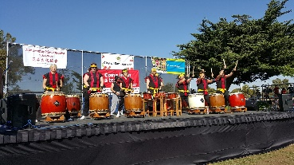
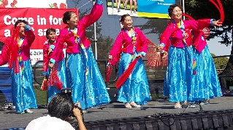
Asian
Community
Cultural
Association
of
San Leandro
JOIN
ACCA
ACCA is an non-profit organization formed in 2008 for educational and charitable purposes.
Our mission is to share, promote and educate our community about the Asian culture, customs, and language in order to assist bridging cultural gaps in the community.
ACCA helps to improve the quality of life in San Leandro by helping Asians integrate and assimilate in the community by providing networking opportunities and access to community resources and
multicultural and multilingual assistance.
Our non-profit EIN is 26-0542628.
Asian Community Cultural Association
of San Leandro
15127 Inverness Street
San Leandro, CA 94579

Slide 2
Asian Community Cultural Association of San Leandro
Membership Application
Member Name ________________________________________________________________________________
Address ______________________________________________________________________________________
City _____________________________________ State _________________________ Zip Code ______________
Phone _________________________________ Email Address __________________________________________
Reason for joining ACCA _________________________________________________________________________
_____________________________________________________________________________________________
ACCA Membership Dues: $25 Annual _________________ $250 Lifetime _________________________________
Please contact me so I can take advantage of the following activities:
_____Cultural Activities _____Networking & Social Activities _____Bilingual Assistance
_____Educational Seminars _____Community Resources _____Community Involvement
Send application and payment to ACCA, 15127 Inverness Street, San Leandro, CA 94579
For questions, please call 1-510-895-5200 or email us at asiancomcultural@gmail.com

