Slide 1

Session Notes
Casey Majewski, MS, BCBA

Slide 2
Session Notes
The gray boxes have the information automatically populated so you don’t have to worry about them. The red boxes are required information that you can to either type information in or choose an option from a menu.
Session notes are due by midnight on date of service, no exceptions.
It is required to pull in the session data. Do not forget.
Your signature must be able to be readable.
You must not end your session early to complete notes.

Slide 3
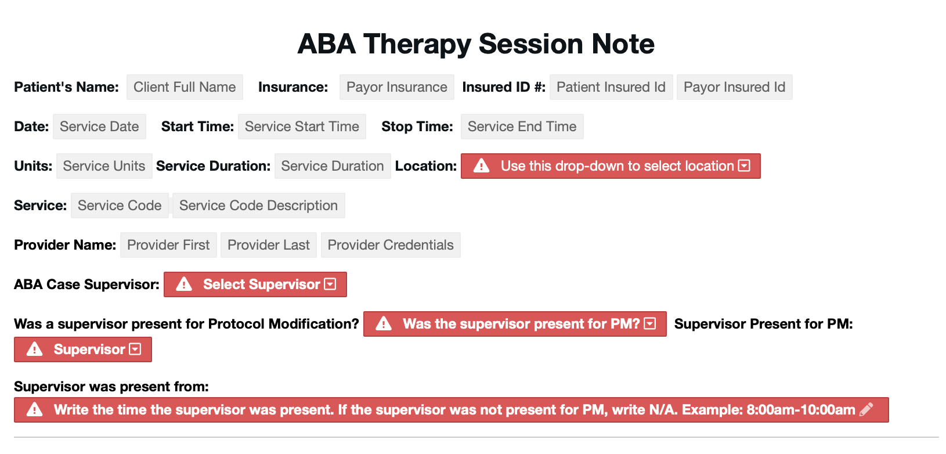
Here you choose what location (Home or Clinic)
←Put in the BCBA Supervisor
In these three boxes you put whether the supervisor was present, who the supervisor is (again) and what time they were present. (Sometimes the base supervisor BCBA can be different than the supervisor present at your session (maybe they are a BCaBA or a different BCBA)

Slide 4
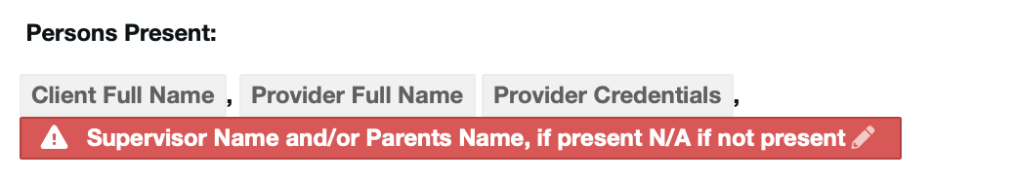
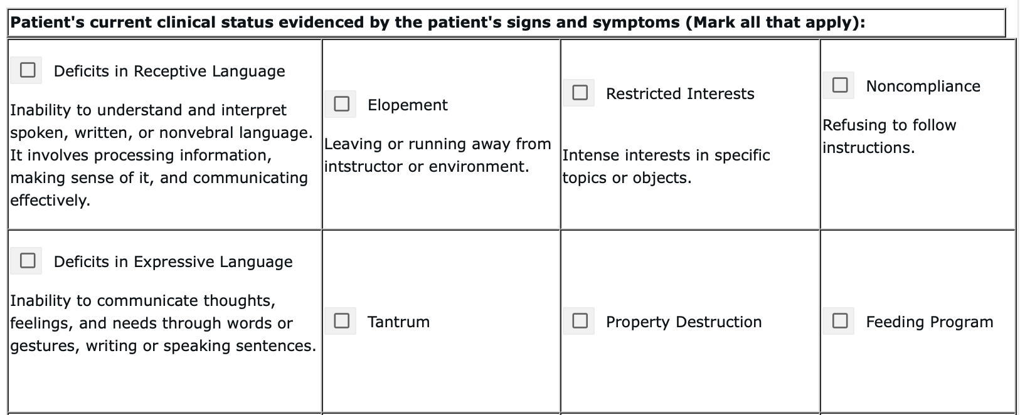
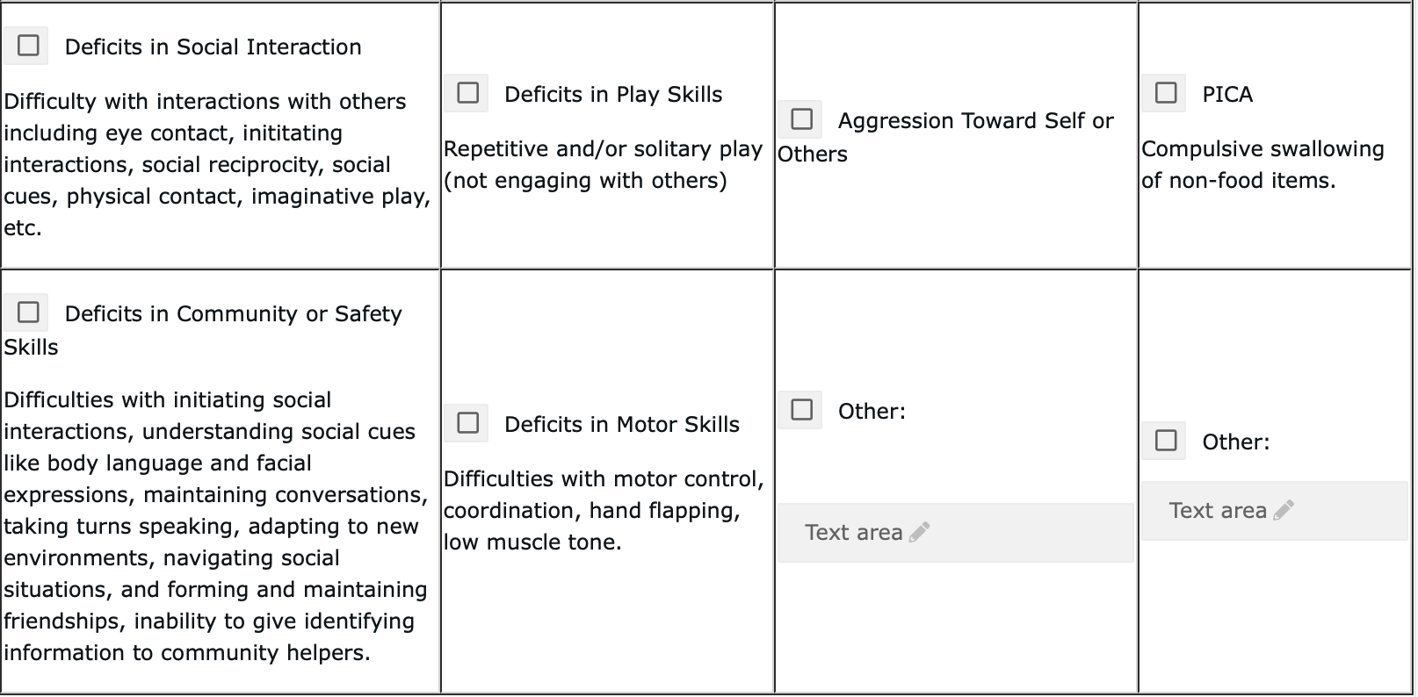
Put down parents name if present and/or supervisor name if present
For the current clinical status part they want you to explain their current behaviors/deficits for that day. If you have a new client and aren’t sure, read the BSP, look at the goals and/or contact the BCBA and she will let you know what to choose.
For non-verbal clients you would choose deficits in expressive language. For difficulty with receptive skills, you choose that box. For challenging behaviors, you’d choose the appropriate box, etc.

Slide 5
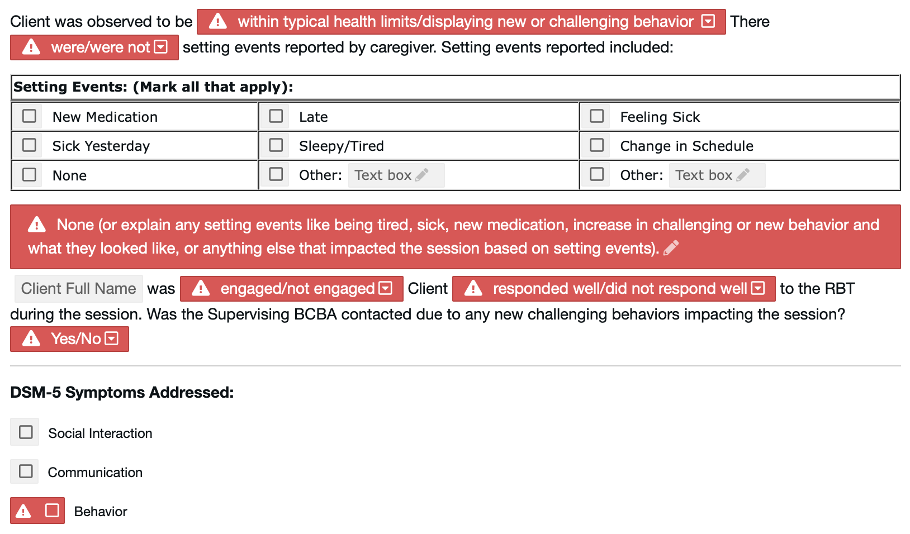
Choose the correct drop down for their current status. If they are abnormally tired or not responding normally, you’d choose that they are displaying new or challenging behavior. If everything is normal, you’d choose that they're within typical health limits.
For setting events, choose any appropriate ones. If there are none, check none and write none in the box. If there are setting events, then explain what they are.
Above, choose whether they were engaged, how they responded and whether the BCBA was contacted due to the behavior/response to treatment.
Here, if they have social or communication goals, check those boxes.

Slide 6
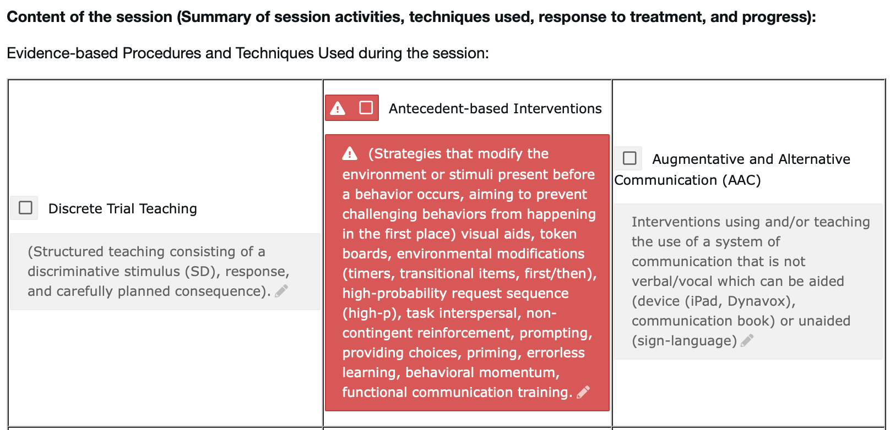
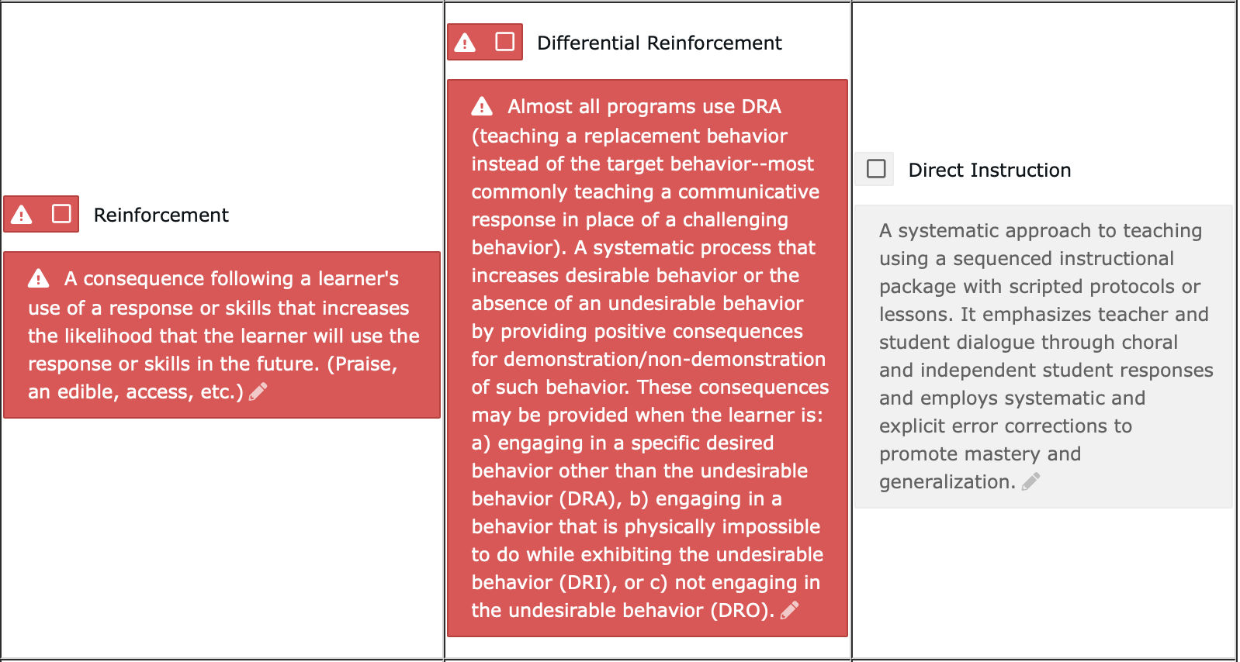
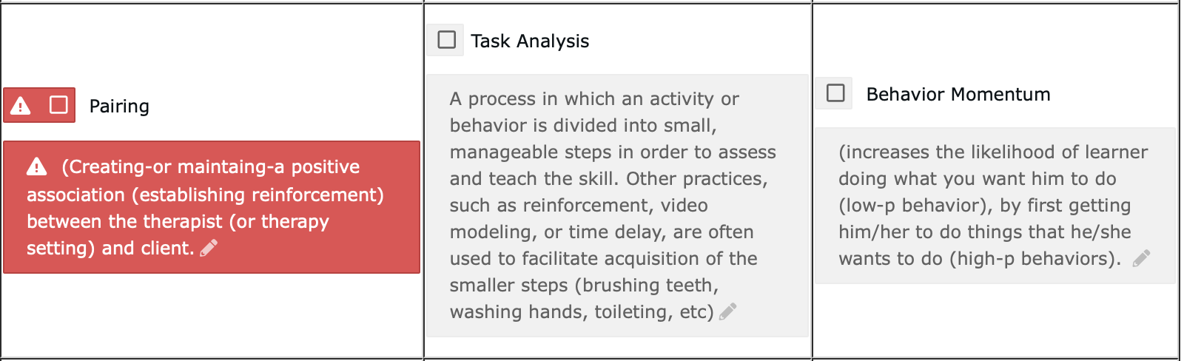
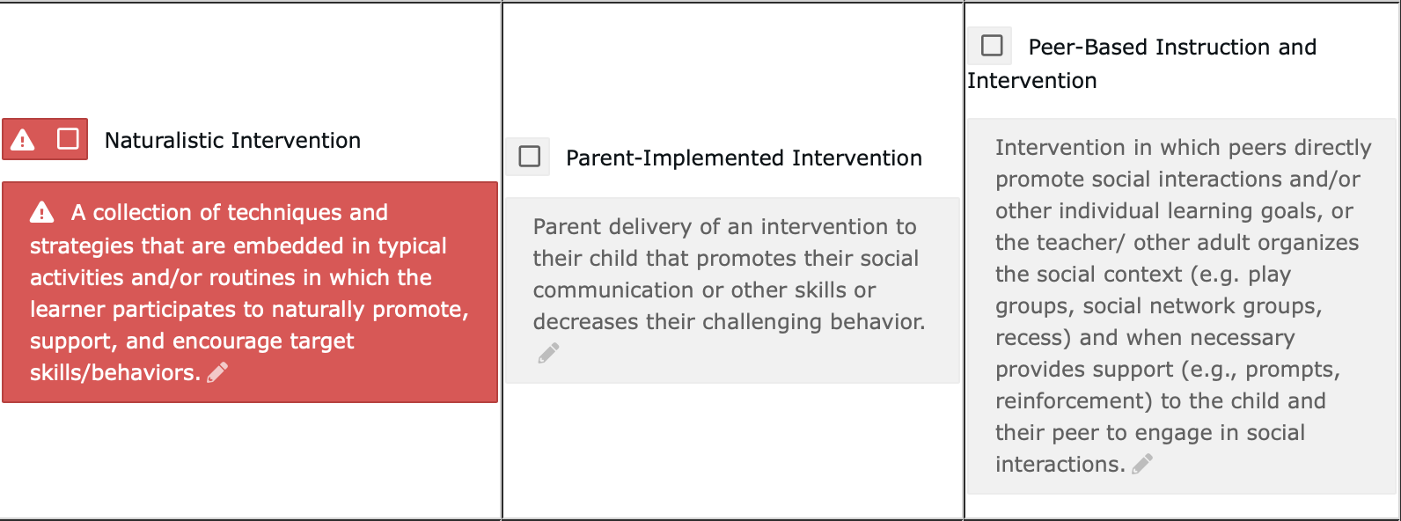
Here, you’re to talk about what evidence-based procedures you used. These would be mentioned in the behavior plan and in the procedures used in the session structure part of the plan. For antecedent-based interventions you might write: A visual aid was used to facilitate transitions without the display of challenging behaviors, a token economy was used to decrease tantrums and reinforcement replacement behaviors, First/then was used to facilitate transitions to less preferred activities, functional communication training was used to teach mands. If you need more examples of what procedures are used, be sure to ask.

Slide 7
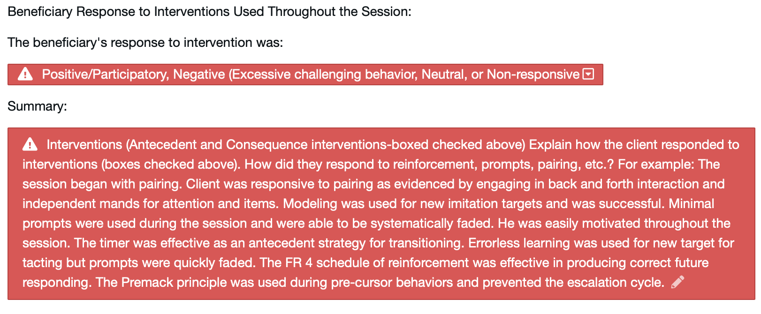
For the first dropdown, you’ll choose response to the interventions you used.
For the summary, you’ll explain the interventions you mentioned and just summarize how they were used during the session as mentioned in the template/prompt.

Slide 8
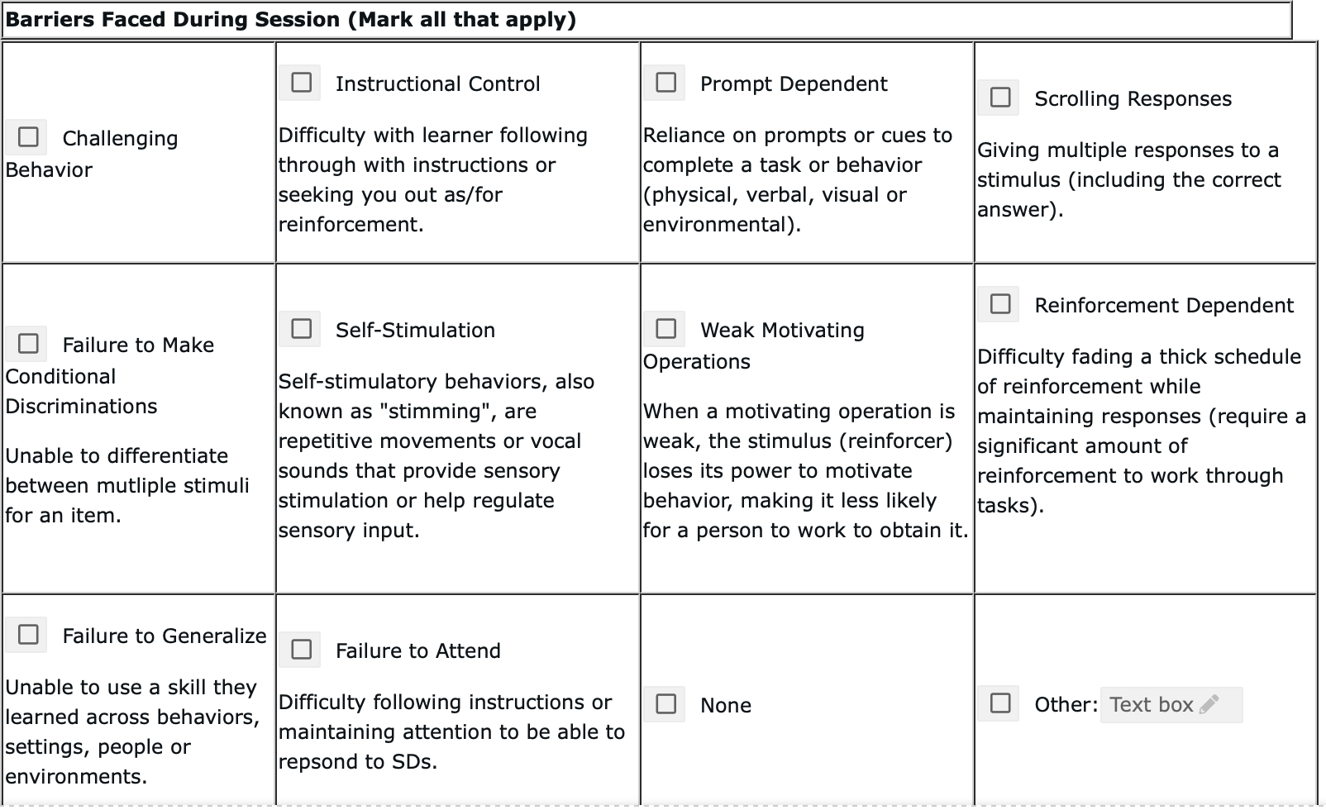
For barriers, these are things that might have impacted your session. You’ll choose which ones you encountered during the session.

Slide 9
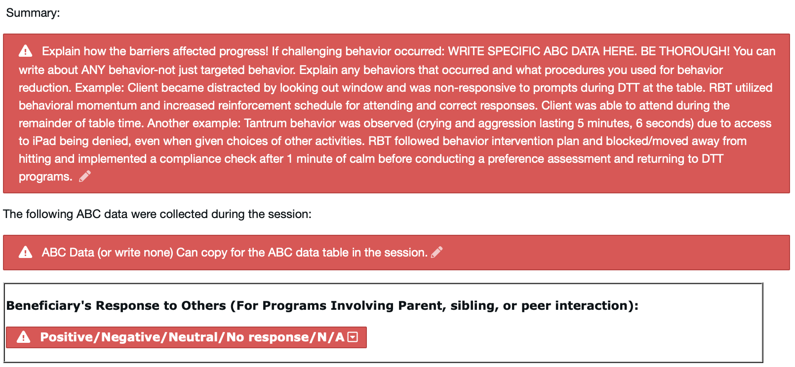
For the summary you will just summarize how the barriers you chose affected progress. For instance, if the client engaged in scrolling you could say “Client engaged in scrolling when working on intraverbals. RBT contacted the supervising BCBA for guidance. Client was prompt dependent which resulted in difficulty fading prompts. Client engaged in frequent self-stimulatory behaviors that impacted the session because it was difficult to redirect.”
In the next box you will write ABC data for challenging behaviors during the session. You can copy it from the session and paste it in the box. You can summarize if there’s a lot of data.
And in the last box if the client engaged in programming with a parent, sibling, or peer then you’ll put in their response to that person.

Slide 10
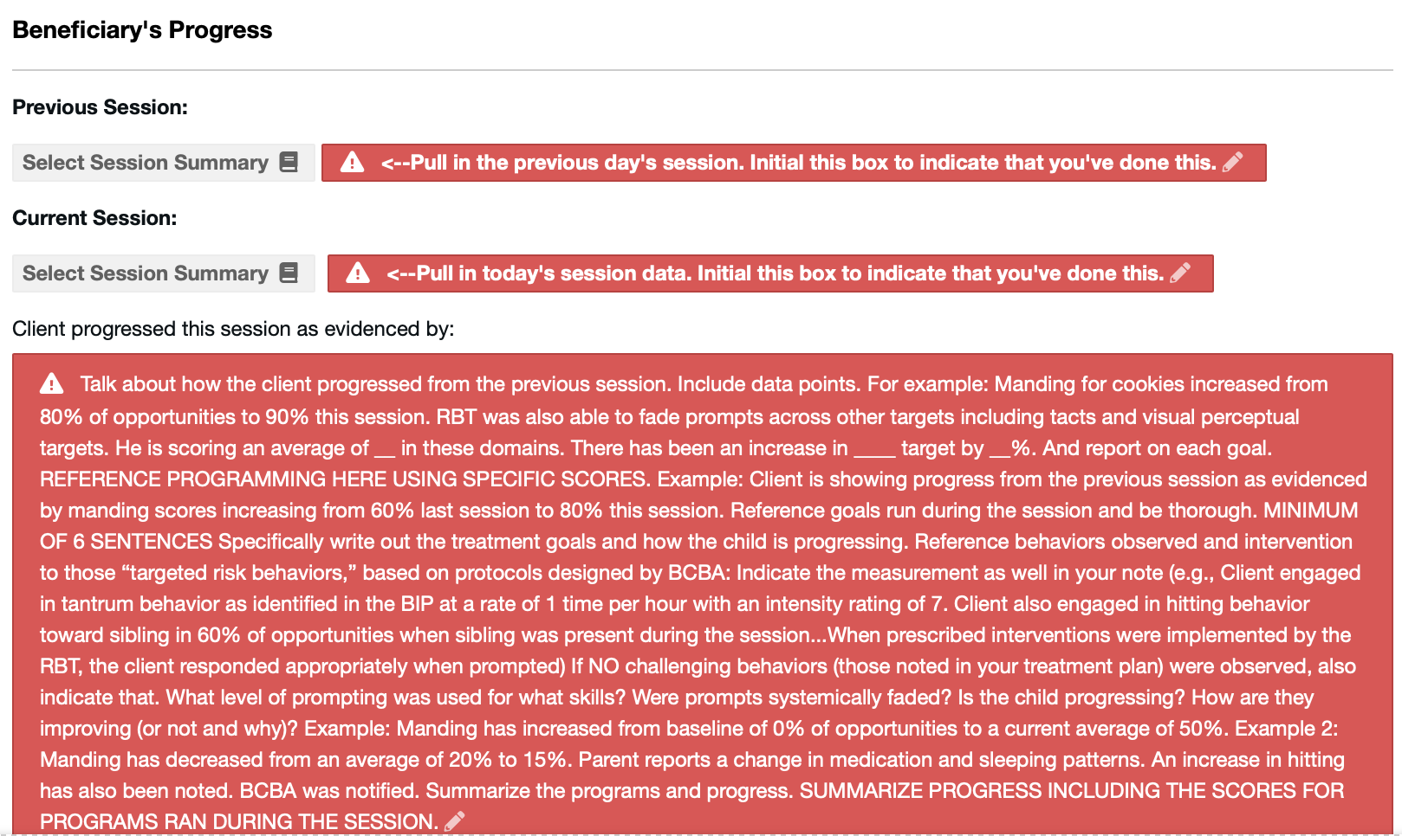
This section focuses on the client’s progress from the previous session to this session. It is required that you choose a previous session and then your current session. Initial each box to indicate that you have pulled the data. Then you will summarize their progress and include information as stated in the prompt/template.

Slide 11
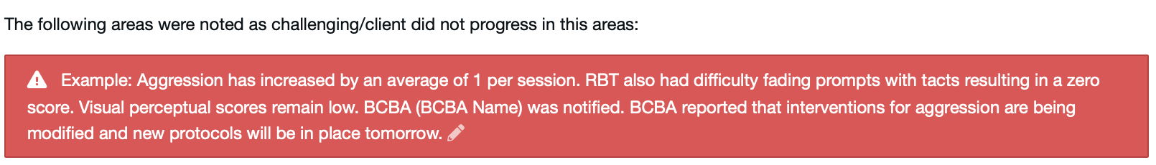
In this box you will summarize any programs that were difficult or in which progress was the same (or regression was noted) and you’ll explain why. Maybe there were setting events that impacted the session or a significant change for the client?

Slide 12
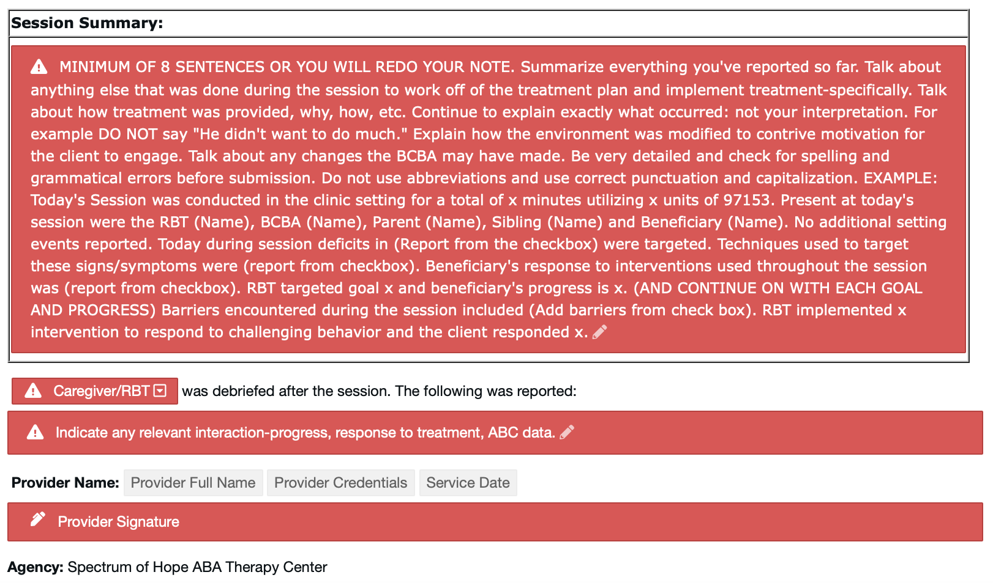
For the session summary, you will start from the beginning (The session began by….) and go through the entire session mentioning each piece that you mentioned above summarizing the session. Mention the location, persons present, strategies and interventions used, setting events, response to treatment, barriers, etc.
Then you’ll note any important things you reviewed when debriefing parent/caregiver (usually summarizing progress and concerns).
Lastly, you will sign the note making sure your signature is legible (it can be easily read by anyone).

