Slide 1

Leveraging the completed Cannabis genome for gene discovery and strain development
CJ Schwartz PhD
Sunrise Genetics
Marigene & Hempgene
Notes:
Alicia
Organizors
Audiance
I’m CJ…working with plants for decades
Parent company….5 years ago….hempgene….marigene
Things have changed

Slide 2
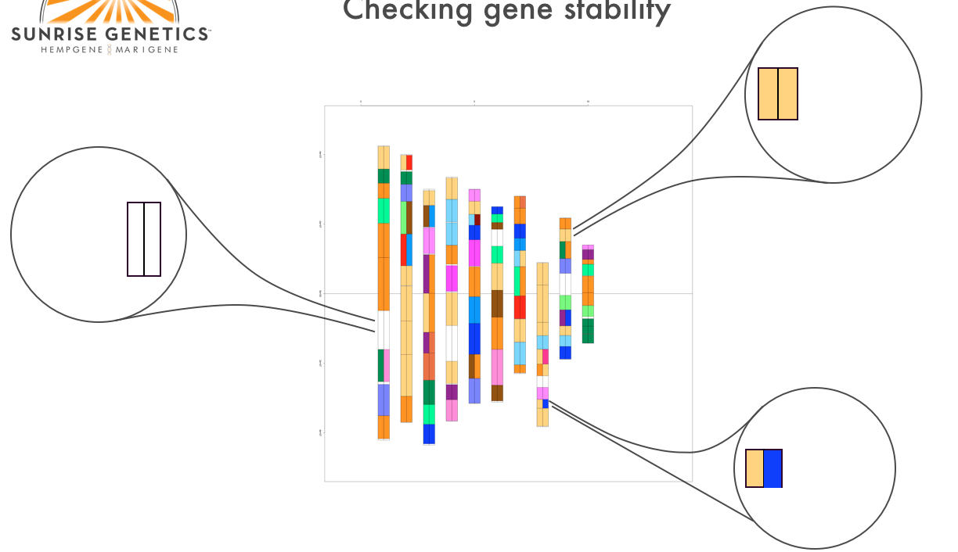
Marker Screen for Gene Stability
Stable for inactive THC
Stable for active CBD
Instable for flowering time

Slide 3
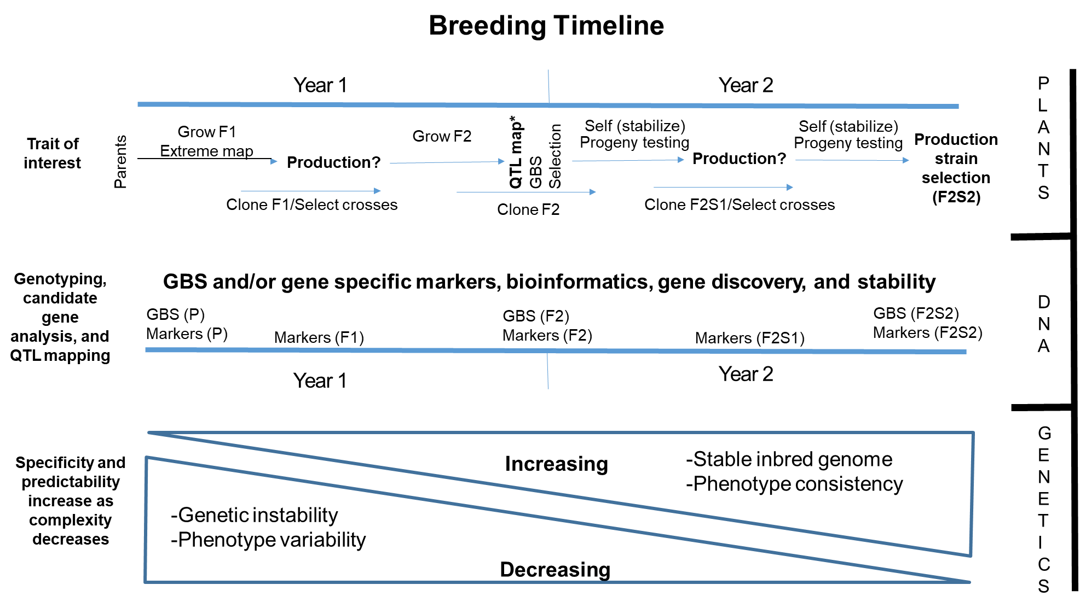
Partners and Collaborators
Seed and plant multiplication
Plant population trials
Laboratory – Plant and Wet

Slide 4
Collaborators
CJ Schwartz – Sunrise Genetics
Chris Grassa – Sunrise Genetics; Harvard University
George Weiblen – University of Minnesota
JP Wenger - University of Minnesota
Clemon Dabney - University of Minnesota
Todd Michael – J. Craig Venter Institute
Tim Gordon – CBDRx/Functional Remedies
Notes:
Team collaboration to complete the Cannabis genome…..People
It was a struggle, employing 5 different sequencing technique, with some falling below expectations

Slide 5
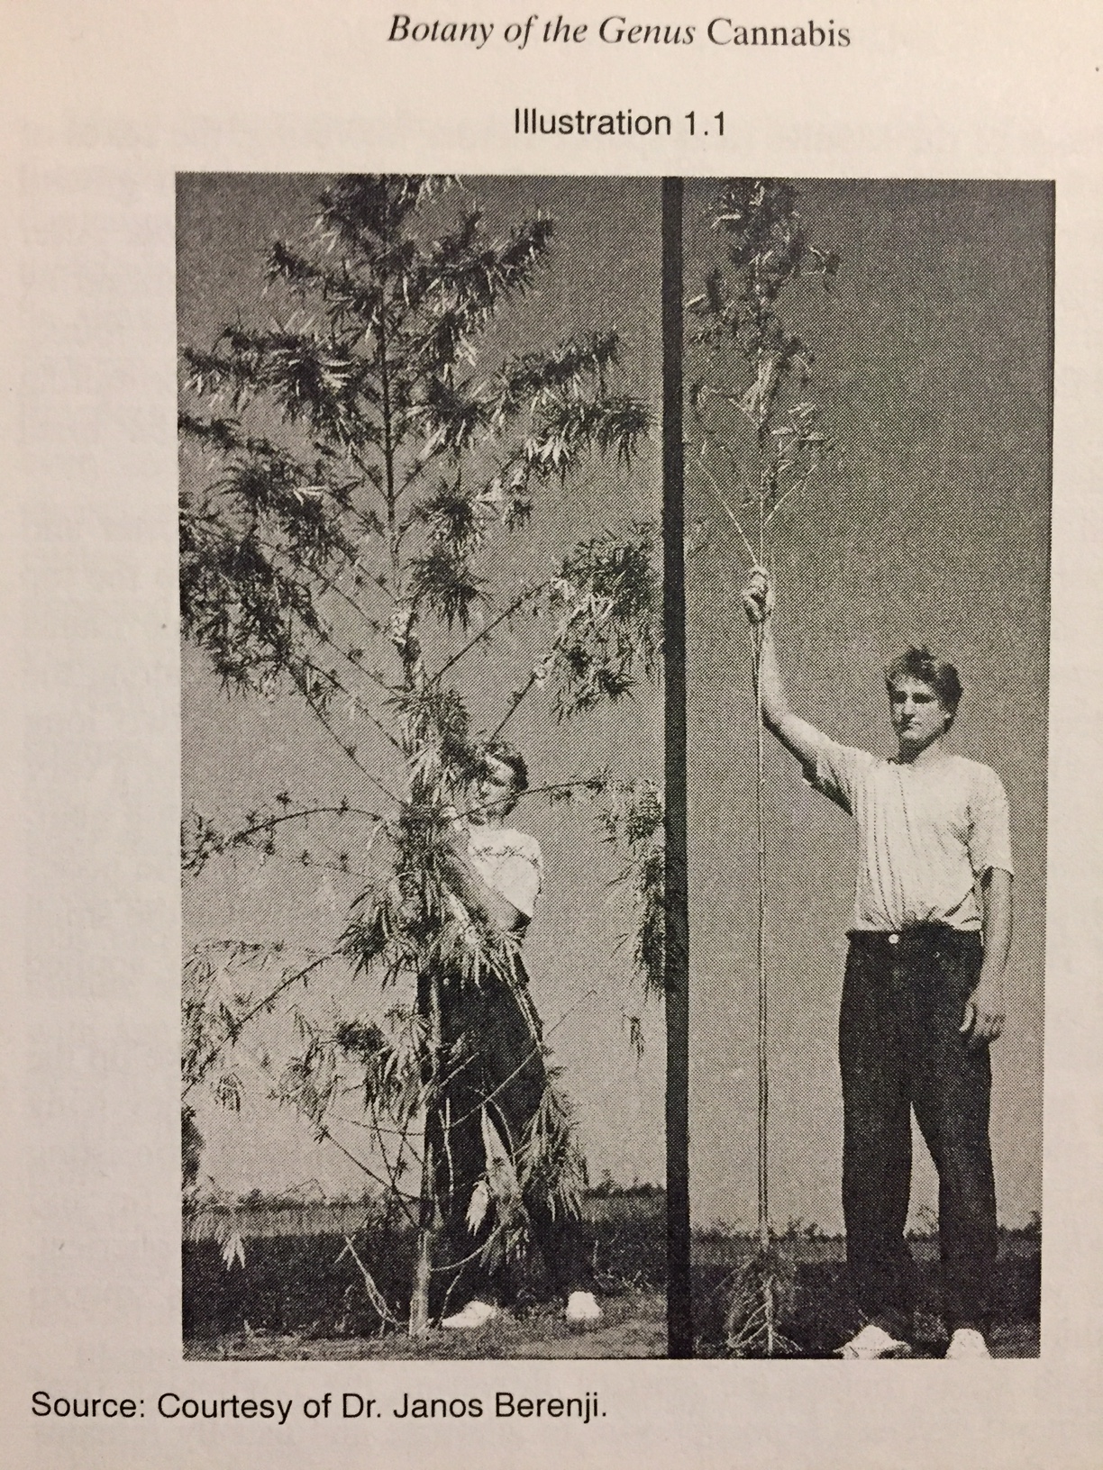
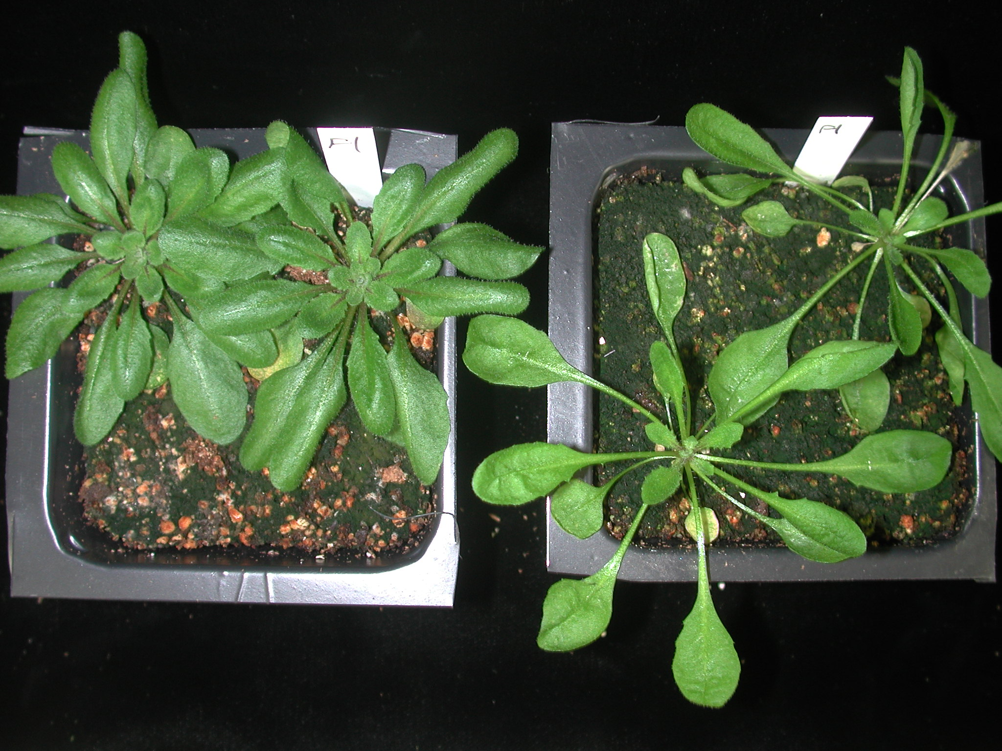

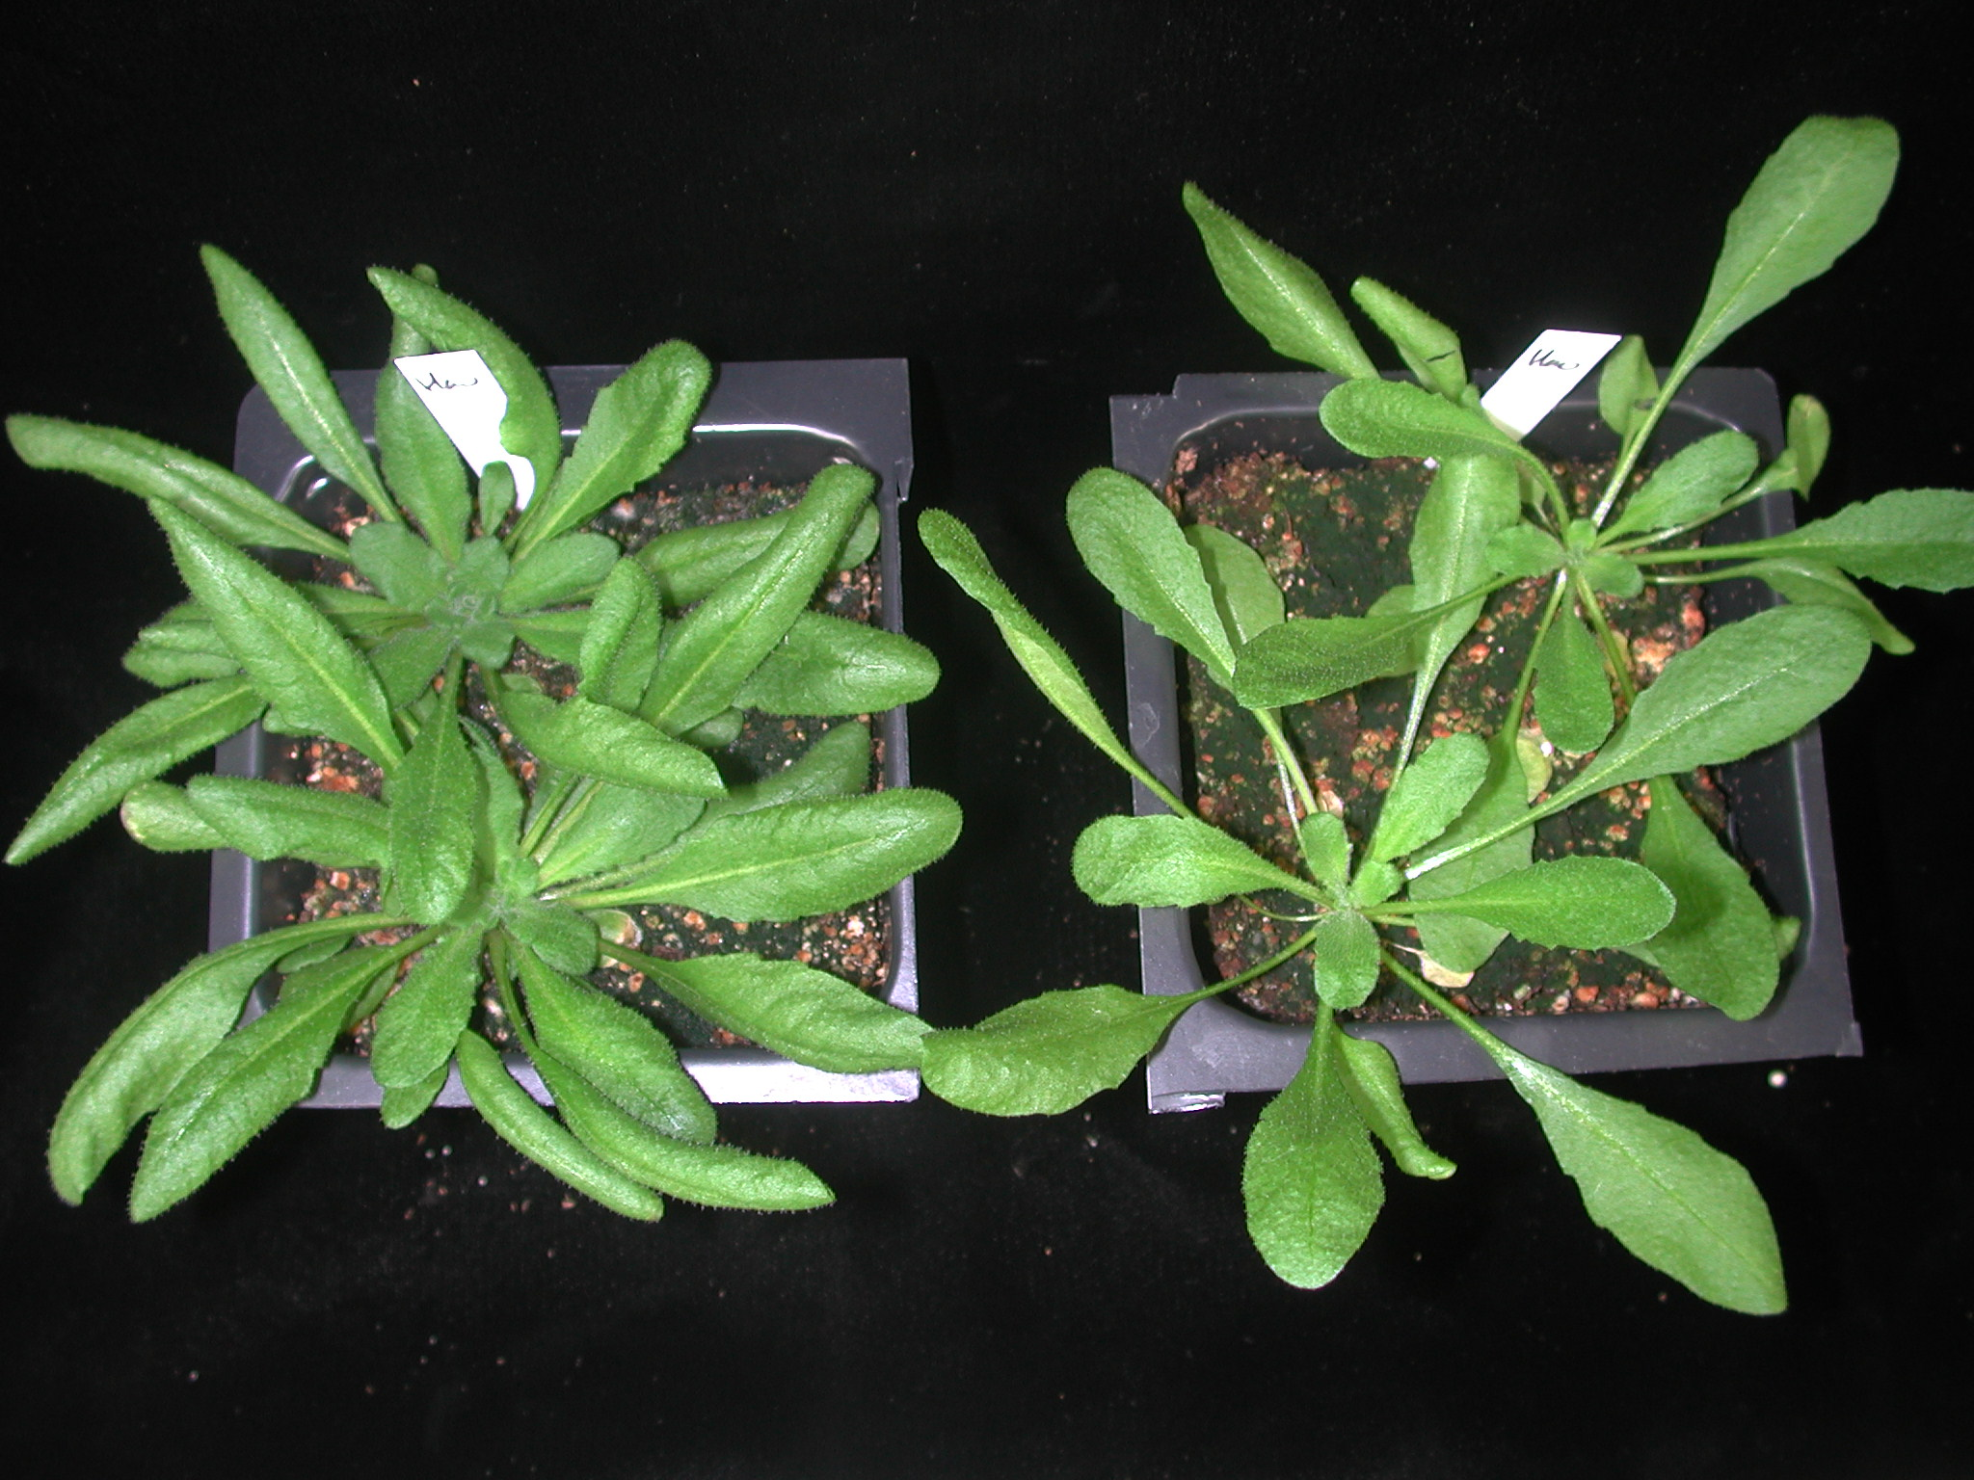
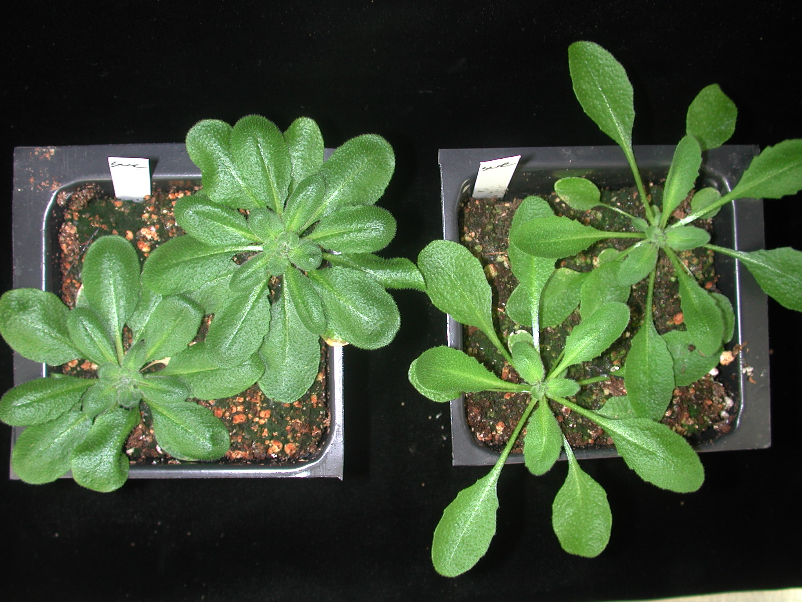
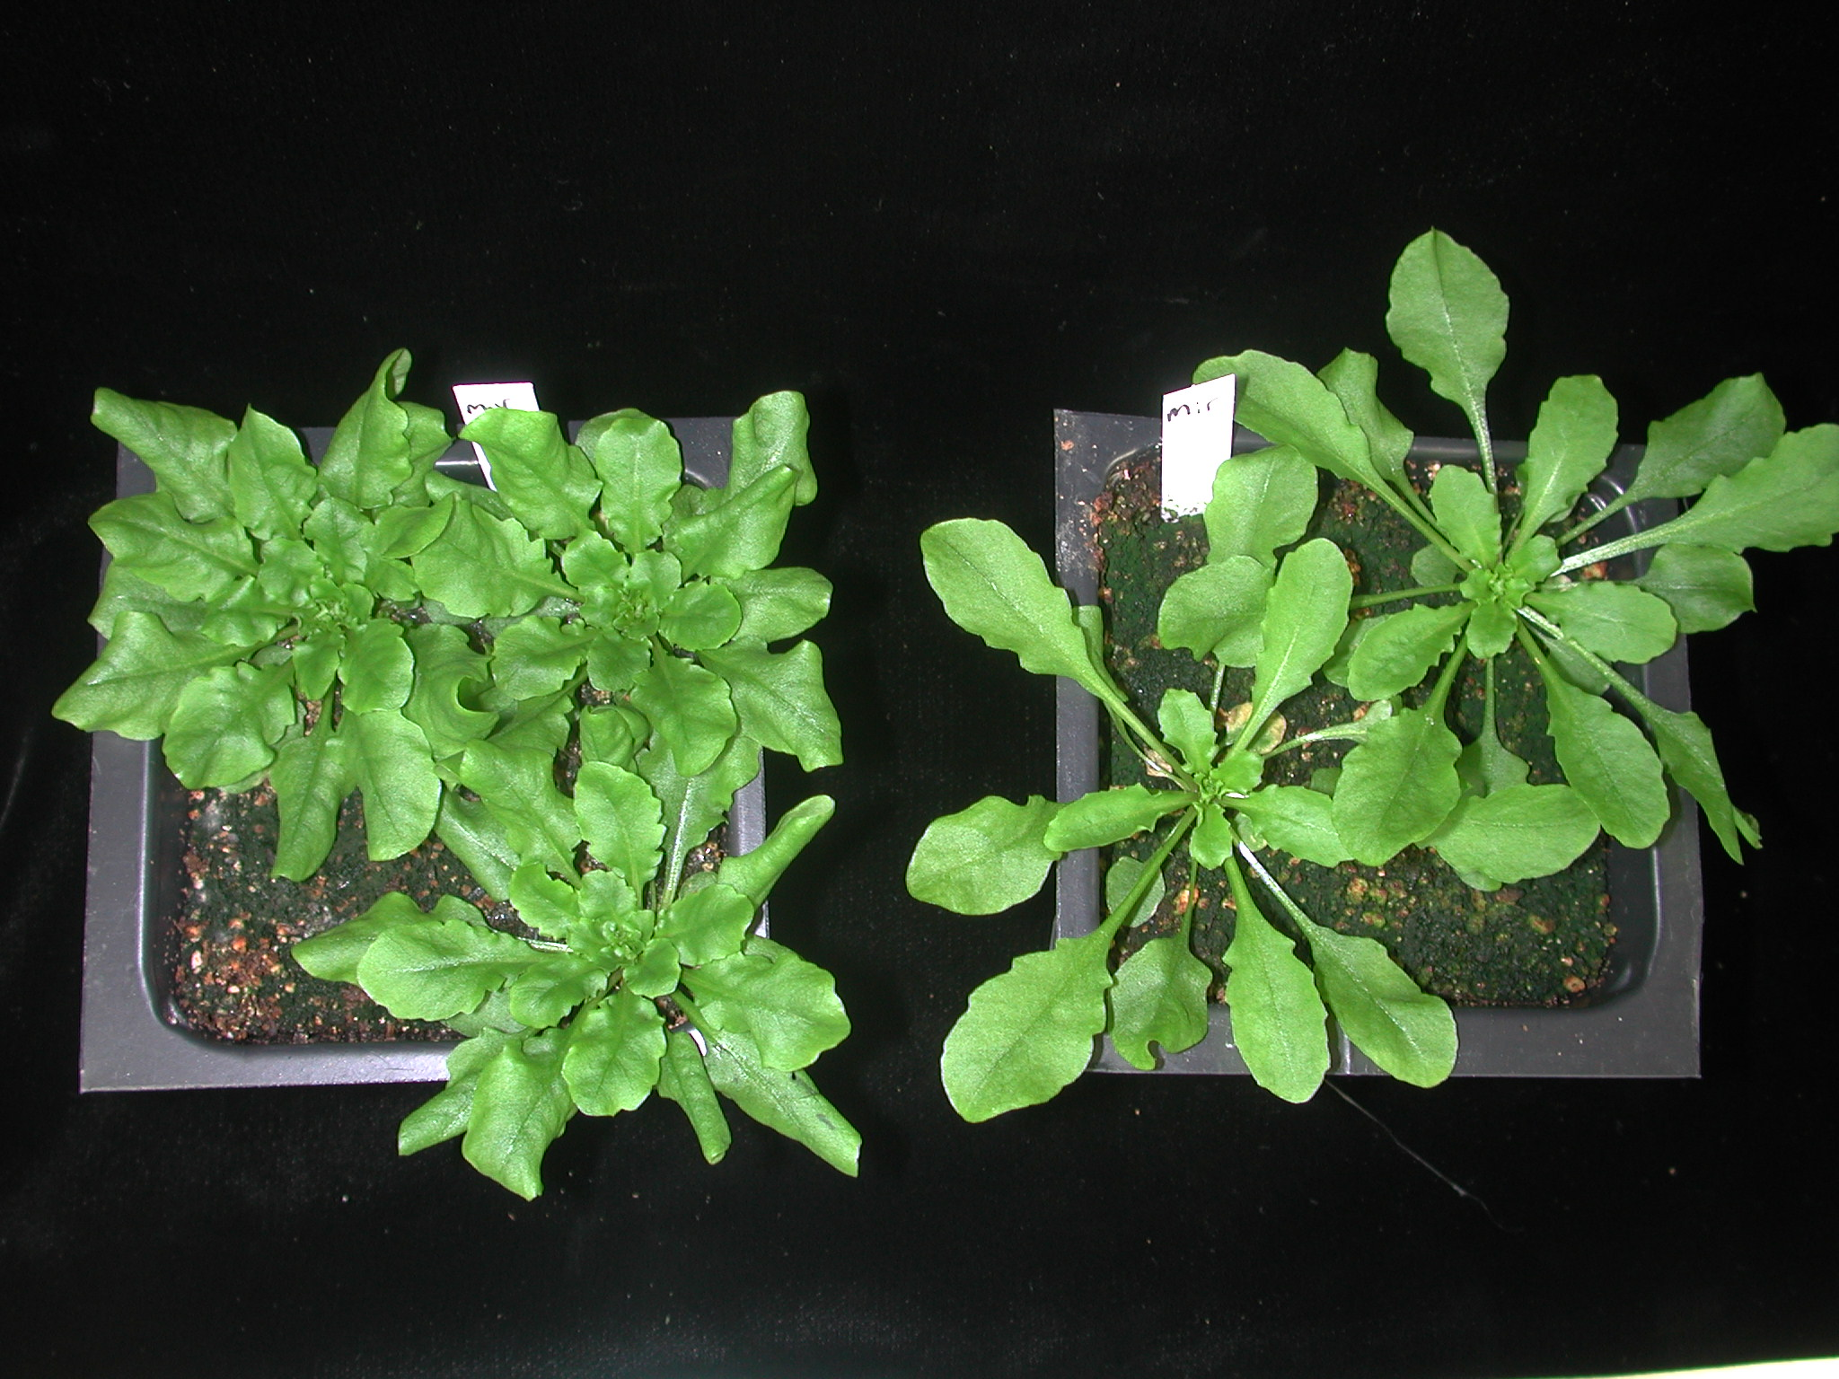
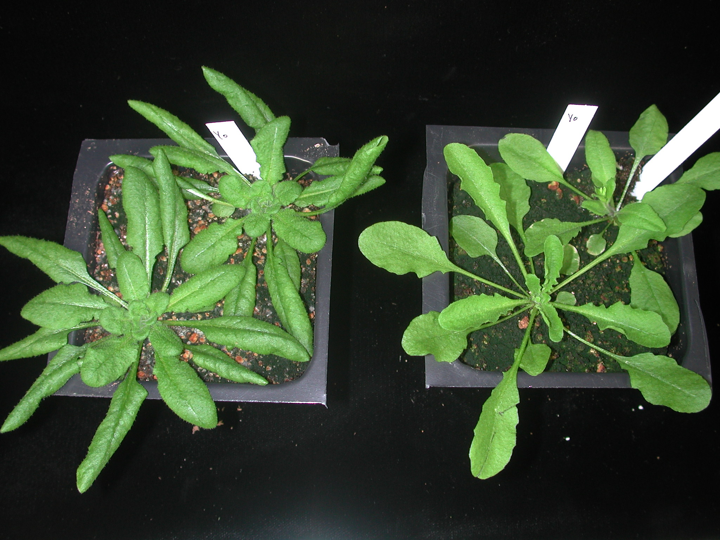
Arabidopsis
Shade Avoidance Syndrome
Fl-1
Hau-0
Sue-0
Mir-0
Yo-0
FR - +
Notes:
As an example of gene discovery and trait improvement – shade avoidance
On the right Arabidopsis
FR light transmission and reflection…petile elongation to reach for light
Early flowering - sensitive and insensitive. Some plants 10X difference in flowering time
I want to discuss how we use genomic information to facilitate trait improvement in crops.
As an example, I will use the shade avoidance syndrome. When plants are shaded, or crowded, they grow tall and skinny and often flower earlier.
Taken from Ranalli’s book, two hemp genotypes were grown in open or crowded conditions, resulting in vastly different phenotypes. Or as many people say the “expression” of the trait.
On the right is an experiment I did using Arabidopsis, a plant model organism. These plants were exposed to FR light, which mimics shade. In the environment, leaves reflect and transmit far-red light, leading to an incr as is seen in shaded conditions. The plants have elongated petioles, different shaped leaves, and flower earlier then the plants on the left

Slide 6
Assemblies to date
A huge effort by the Cannabis scientific community, with minimal funding
Notes:
Having a complete genome assembly allows us to QTL map.
These are the assemblies that I am aware of.
Kuddos to Jon Page and his group. It took half a decade to get something better.
But now Cannabis is in the big leagues. This number N50, describes the quality of the assemlbly. You can think about it as a road, and the number indicates how far you can go without encountering a stop sign.
500K is the hallmark of a platinum genome, established by the human genome mapping project.

Slide 7
Where are the cities (genes) in relation to each other and what is the distance between them
San Diego
Denver
Chicago
Detroit
Atlanta
Seattle
Notes:
Imagine planning a trip from San Diego to Seattle. If we did not know the distance or directions amongst the cities it would be pretty hard! Same with genes.
The Cannabis genome has been stuck in this state for years. We have not known where the genes are located in relation to one another.

Slide 8
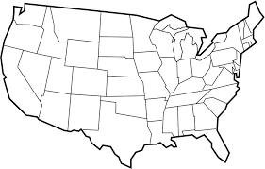
Where are the cities (genes) in relation to each other and what is the distance between them
Seattle
Detroit
Chicago
Denver
Atlanta
San Diego
COMBINATIONS!
Notes:
Now that we have high quality assemblies, including ours which delineates the 10 chromosomes, we now have an address for every gene.
Precise combinations of the cities for maximum efficiency.
And as I mentioned b4, it is the COMBINATION of genes that is important to achieve a maximum and stable phenotype. So we need to know there addresses.

Slide 9
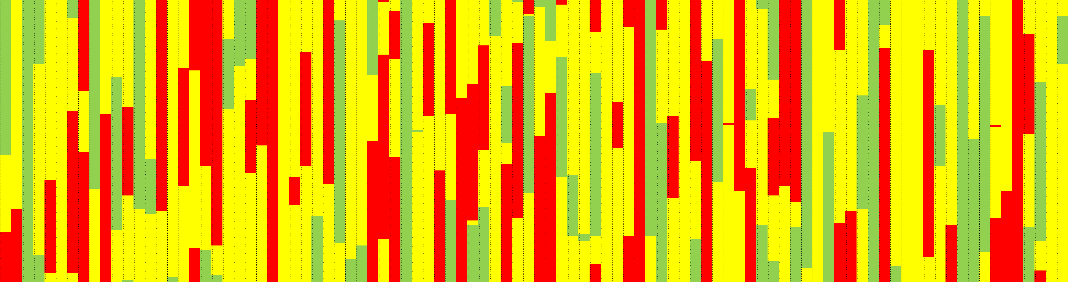
University of Minnesota F2 mapping population (Genetic Map)
One chromosome. Red=Skunk (MJ), Yellow=Het, Green=Carmen (Hemp)
50% HETS
Notes:
This is a single chromosome from 96 F2 plants. From a cross between highly inbred hemp and highly inbred marijuana.
This gives you some idea as to the recombination, in other words new combinations, in the F1.
Imagine this jumbled one more time….F3
…..this is what we need to QTL map.

Slide 10
University of Minnesota F2 mapping population (Genetic Map)
Green – High Myrcene
Yellow = average Myrcene
Red – low myrcene
Notes:
Imagine we have seen a correlation with this region of the chromosome and myrcene.
We now have a region and likely, a gene that we can track. GENE DISCOVERY.

Slide 11
Composite Linkage Map
Group | cM | No. | Interval
Ch1 | 102 | 151 | 0.68
Ch2 | 97.7 | 158 | 0.62
Ch3 | 96.4 | 143 | 0.67
Ch4 | 91.6 | 134 | 0.68
Ch5 | 82.4 | 130 | 0.63
Ch6 | 77.9 | 126 | 0.62
Ch7 | 75.2 | 100 | 0.75
Ch8 | 75.1 | 102 | 0.74
Ch9 | 66.3 | 104 | 0.64
Ch10 | 54 | 87 | 0.62
Total | 818.6 | 1235 | 0.66
Ongoing work: QTL mapping of cannabinoid, terpene, and biomass traits (Clemon Dabney - UMN).
Notes:
Using the genetic map, illumine, pacbio and nanopore sequencing, we were finally able to get to 10 chromosomes or pseudomolecules.
You can see cM and number of markers per chromosome.

Slide 12
Genetic segregation and gene discovery for Flowering Time in shade
Early (Dominant)
Parents
F3
(F2S1)
Progeny
test
F1
EARLY
ColFRI/ColFRI
1 2 3 4 5
ColFRI/Hau-0
Hau-0/Hau-0
LATE
F2
1 2 3 4 5
QTL mapping
Late
24Mb
22Mb
20MB
Notes:
Identify gene conferring difference….start with inbred sensitive and insensitive
Ability to inbreed = HUGE
F1 shows dominance (one copy), perhaps a bit of dose dependency
F2 shows 3:1 segregation
Low coverage genotyping and QTL mapping suggested a region on chromosome I
Progeny tested and genotyped at higher density. - “chromosome walking”
24MB highly correlated, was fine mapped to 700Kb, with FT in the interval
FT = florigen (1937) a transmissible substance from leaf to apical meristem (flower). Elusive for 70 years.
2007 breaktrought. First mRNA was proposed, article redacted. A close friend Phil Wigge who was part of Detlef Weigels group a mentor of mine, showed the protein moved.
These sets of experiments were designed to identify the gene or genes that confer the far red response for flowering time.
The red chromosomes are from a accession that is sensitive to the the shade avoidance syndrome and flower early. Others appear to not “see” the increase in FR light and are thus insensitive for the shade avoidance syndrome.
Arabidopsis has 5 chromosomes, Cannabis has 10. Arabidopsis is a natural selfer, leading to highly inbred or homozygous, accessions. As you all know, Cannabis can be forced to self, which is a HUGE genetic tool
The first experiment shows the parents and an F1. The F1 shows the sensitive phenotype is dominant. Thus only one “good” copy of the gene is required for the plant to sense shade, or FR light.
The F2 segregates in a 3:1 manner. I genotyped the F2 genome wide and found a region of the genome with the extremes being predominantly different in one region. This type of experiment is referred to Quantitative trait loci mapping. I’ll explain a bit more about this in the next slide
That region of the chromosome containing a gene called FT which has been shown to be the elusive chemical called florigen that was first described in 1937 which moves from the leaves to the shoot apical meristem to initiate flowering. Proving that FT was florigen occurred in 2007, after articles claiming the mRNA were proven false and retracted.
To verify results from the F2, we do a progeny test, which is testing a number of progeny from the F2 plants to determine if they breed true. Is the phenotype stable, and still associated with the same regon.
These F3 (F2S1) were phenotyped and genotyped. The FT gene is at 24 megabases. The correlation between phenotype and genotype increases, and is maximum at the FT gene.
------------

Slide 13
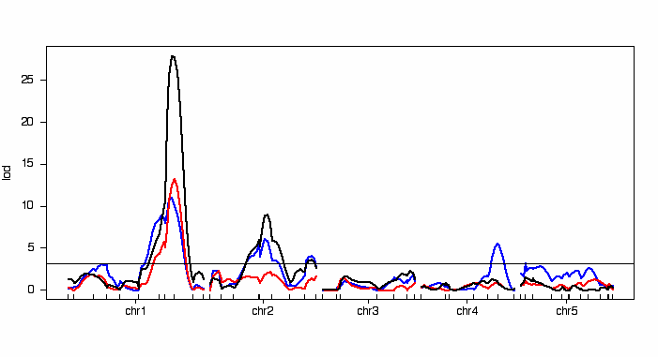
Shaded Flowering Time Quantitative Trait Loci (QTL)
FT
black=Growthroom(16°C), blue=Growthroom(23°C), red=Greenhouse (23°)
Notes:
This is a standard QTL map. What is a QTL you may ask
QTL – multiple genes!!
X-axis chrmosomes lines up from the beginning to the end of the genome – continuous
Y-axis statistical score for association with phenotype on a logarithmic scale
Permutation = significance
This is for shade avoidance, and once again this experiment shows FT is responsible for sensitivity to shade. I also grew these plants outside to verify the results.
TAKE HOME
The insensitive strains tend towards northern Europe, where twilight is exteneded and rich in FR. Thus these plants have evolved to NOT recogizde the FR flowering time que….FT expression
----
QTL mapping
-once genotyped, immortal population. Addityional condisitions. Branching, pest resistance
This is another population. Here I am showing a standard QTL map.
The figure represents the association between genotype and phenotype. On the bottom access are markers from the chromosomes organized from beginning to end. The y-axis is a statistical score on a logrithic scale testing association. The line is considered the point as insignificance as determined by permutations of the data. It is what you would expect if there was no correlation.
This is for shade avoidance, and once again this experiment shows FT is responsible for sensitivity to shade. I also grew these plants outside to verify the results.
TAKE HOME
The insensitive strains tend towards northern Europe, where twilight is exteneded and rich in FR. Thus these plants have evolved to NOT recogizde this flowering time que.
While we are looking at a QTL map, I want to make a few comments.
-once these plants have been genotyped, they can also be evaluated for other traits. In Cannabis we would keep clones and generate an “immortal” population. Thus you could grow the plants in different conditions and identify genes important to your specific growth conditions. Or map other traits, such as branching or pest resistance.
-Thus you can any number of traits with the same lines. In this figure you see we had 3 conditions and the QTL as this peak is called, the genes effect had less support, but was still highly significant , was effected by the different conditions.
Finally, the x-axis is only possible if we have a complete genome assembly. The ability to tell chromosomes apart
-------

Slide 14
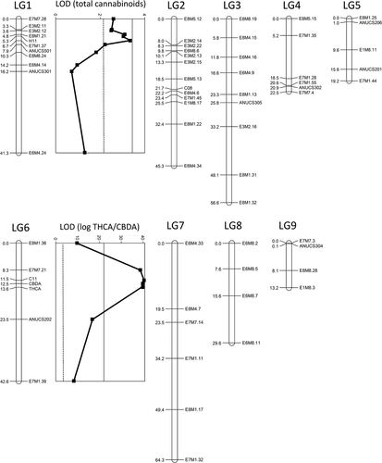
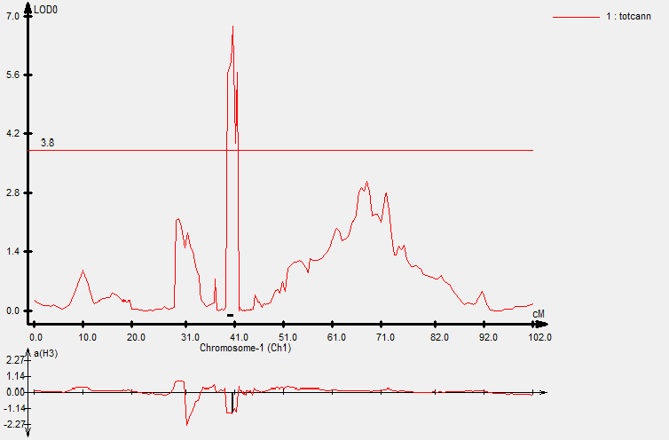
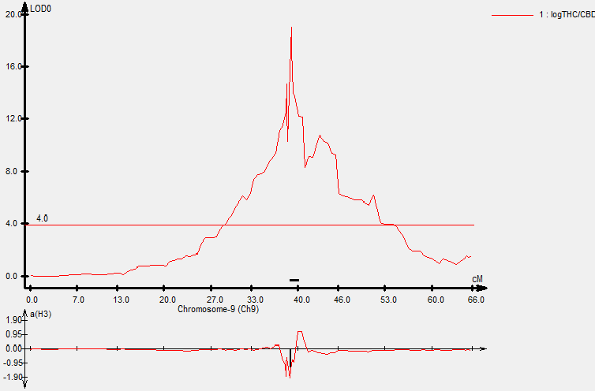
Cannabinoid QTL recapitulated (hemp X MJ)
2018
CIM, 10 markers, 1 cM window
CIM, 10 markers, 1 cM window
total cannabinoids
Max LOD: 6.79
Threshold: P = 0.05
TR2: 0.76
log(THC/CBD)
Max LOD: 19.09
Threshold: P = 0.01
TR2: 0.95
2015
Notes:
Weiblen groups initial results verified in 2015 paper
A QTL
POTENCY DUE TO OTHER QTLfor total cannabinoid content and of course, the CBDAS/THCAS locus

Slide 15
CBDAS/THCAS ORGNIZATION

Slide 16
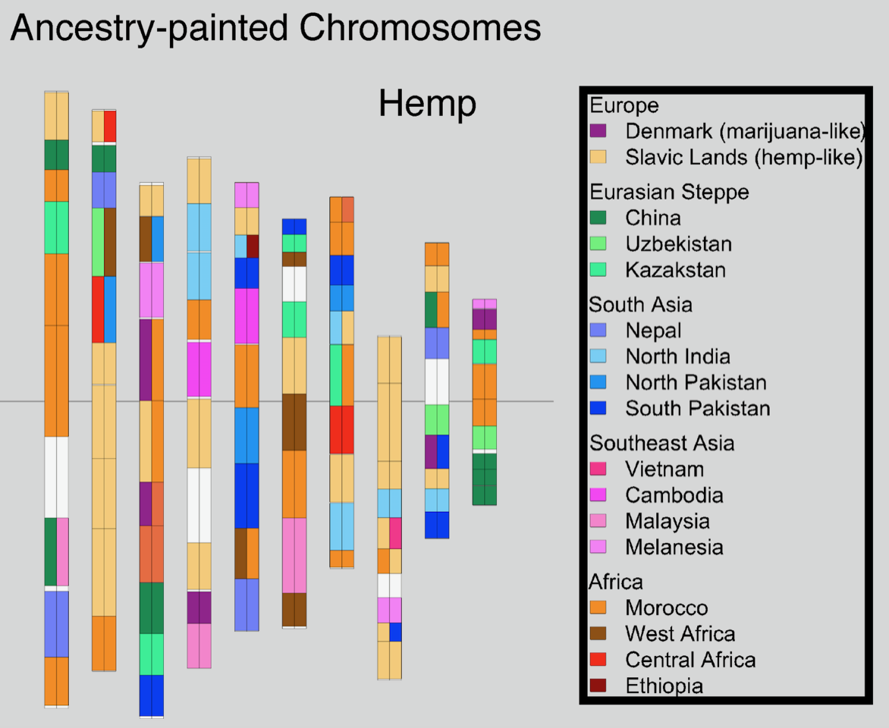
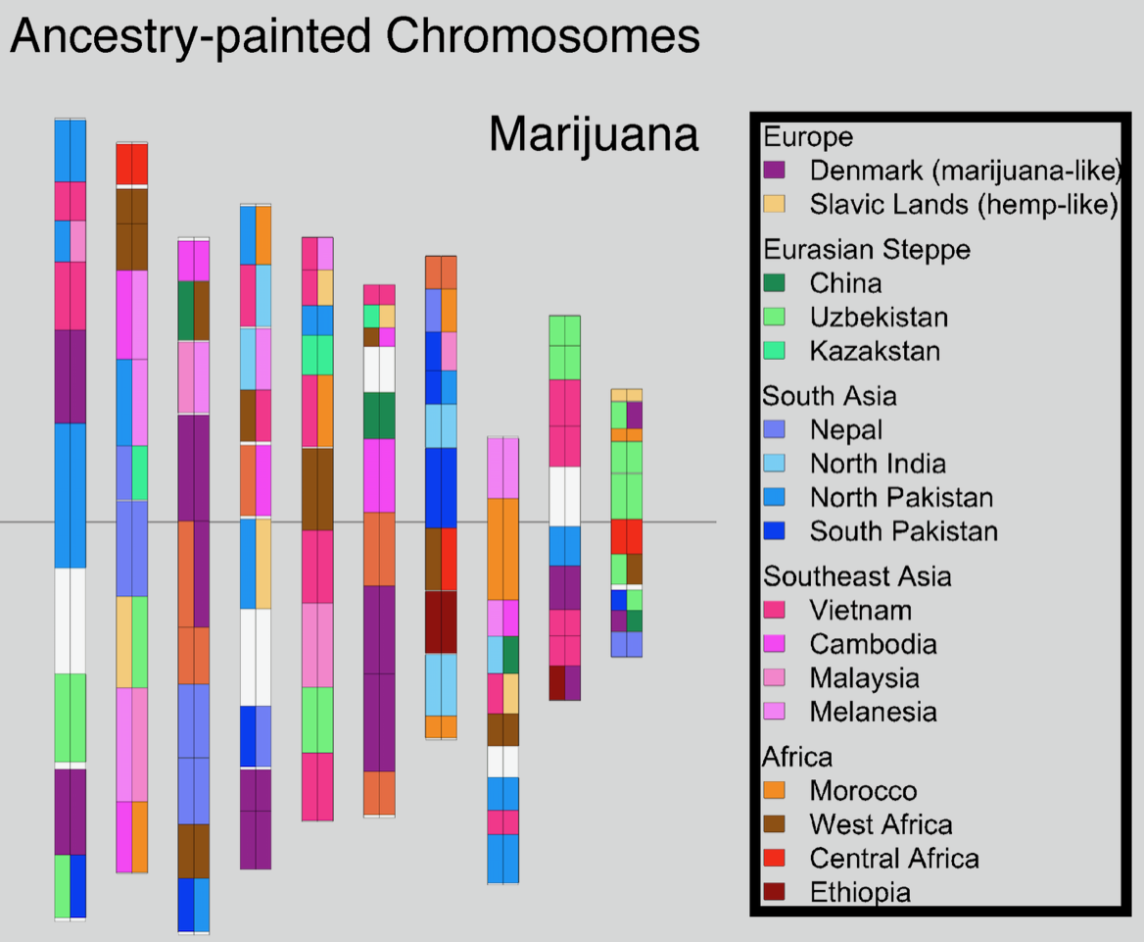
Painted chromosomes (23andMe of Cannabis)
Do these different origins have phenotypic consequences? Can it be predictive?
Notes:
With the map, we were able to identify ancestorial regions, and we compared these between hemp and marijuana.
Using data from all groups via NCBI and OCP

Slide 17
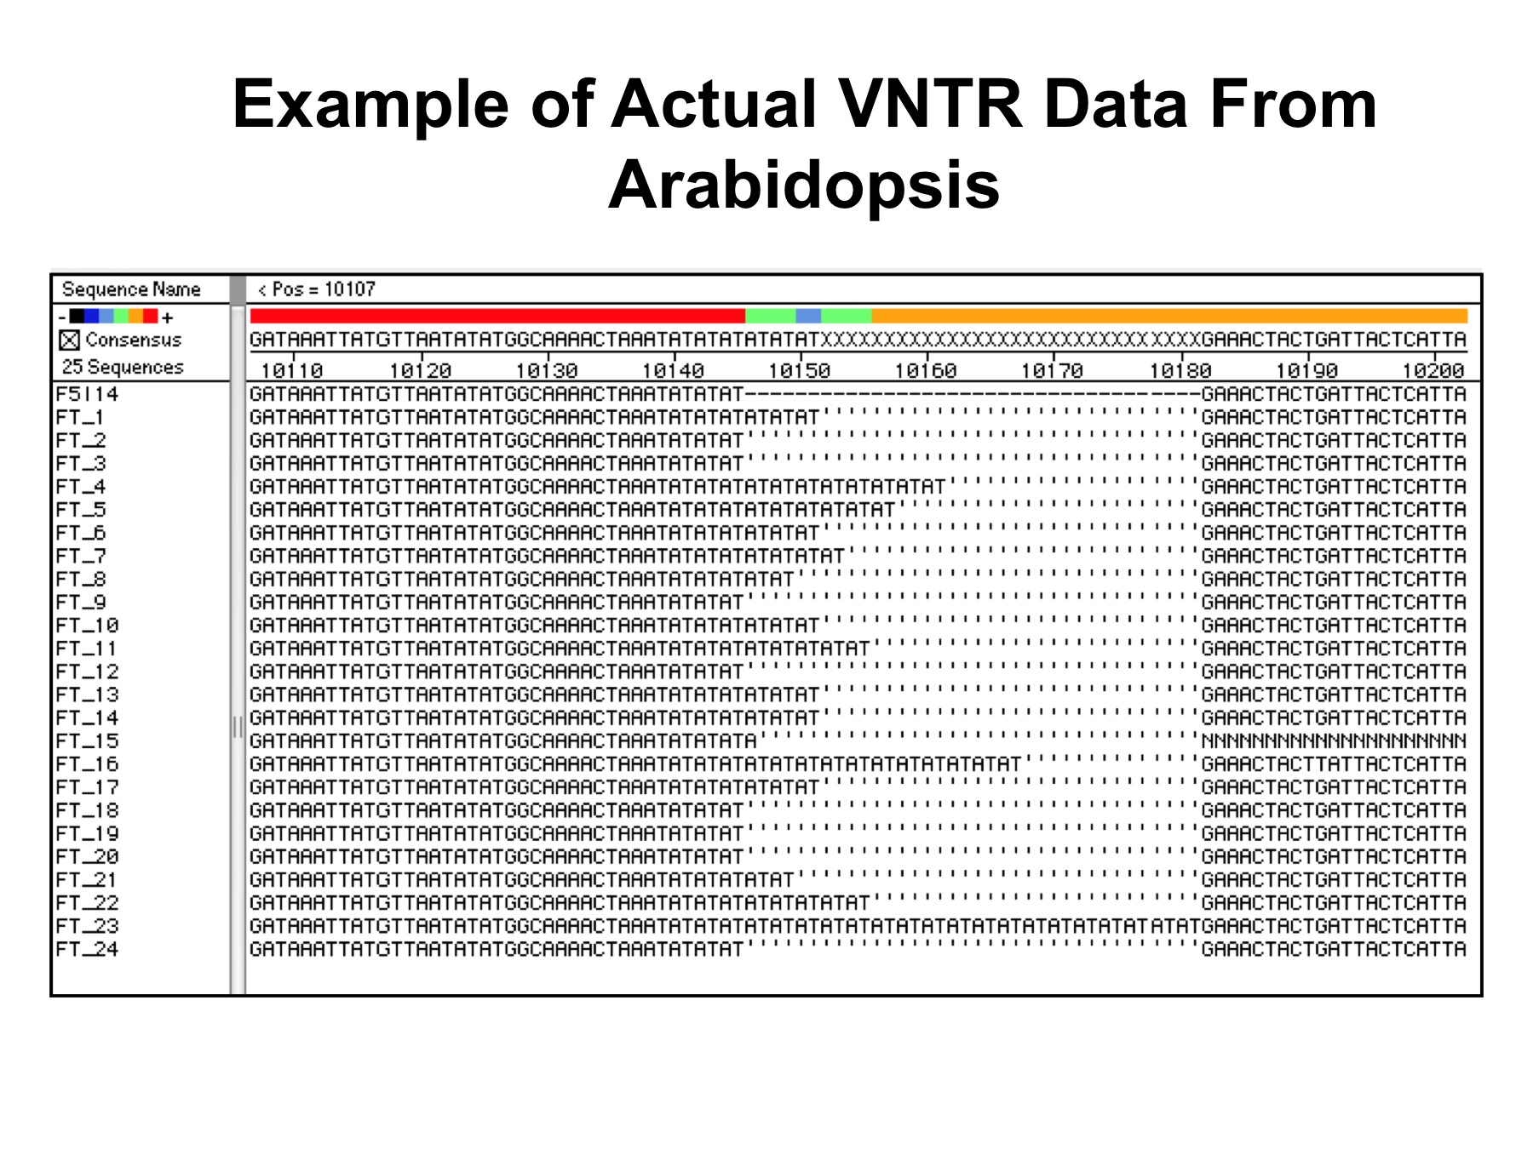
Gene Markers
SSR (simple sequence repeats) markers
Notes:
Markers = Use differences to “tag” genes, or a DNA difference
Primers same, sizes different

Slide 18
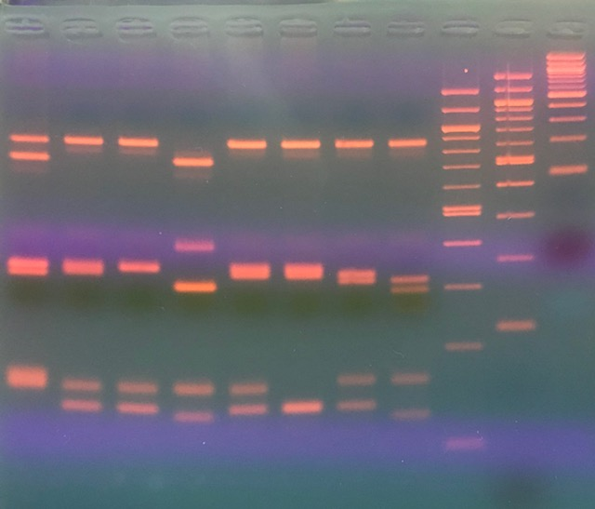
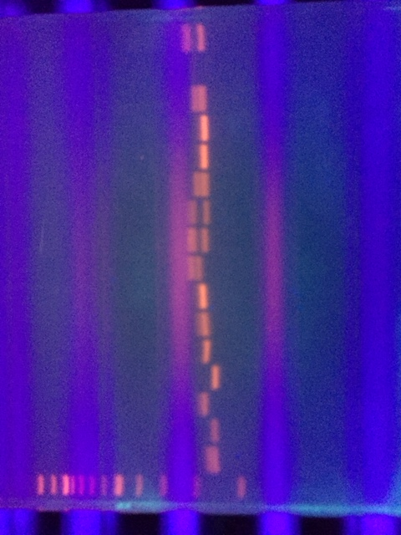

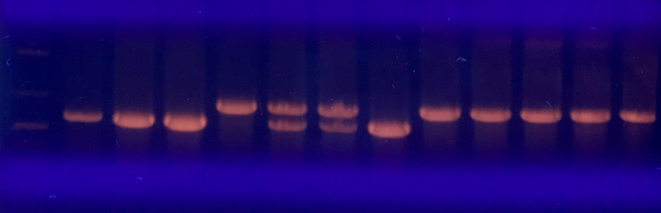
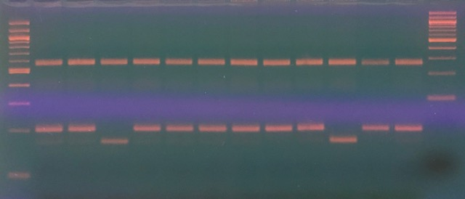
Contaminant
C
C
C
One marker, 16 strains
Clones – Two Mothers
CBDAS/THCAS
Small = CBDAS
Notes:
These are just differences in sizes. Small pieces if DNA reproduced a billion times so we can actually see it. BUT – they are in the same genomic region.
1) The available polymorphisms of a given marker for comparasion.
…these would be a good marker for breeding the two. If it were myrcene, could male a correlation to its size and myrcene production
2) THC/CBD
3) Internal audit
4) Identifying hermy cause

Slide 19
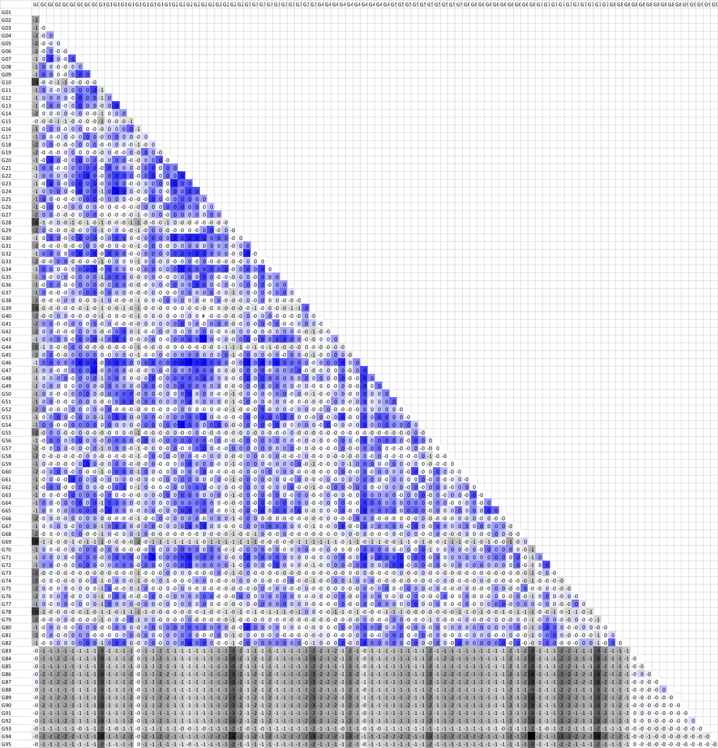
Relatedness
Matrix
Notes:
Population relatedness
Pairwise comparision between 83 plants in a population
darker the blue, more related are the plants strain.
Pick out the most alike strains to make crosses, purify population
Whole genome. NOW we can do it for each chromosome , or gene

Slide 20
FOR THE INDUSTRY
Documentation
Verification
Genetic (DNA) data is reproducible, which means irrefutable
Notes:
DNA fingerprint of the parents, F1, F2 -> selfed plants -> plants for production
Also phenotype data showing stability. – related to genes
Documentation can be used to verify germplasm unambigiously.
REPRUCIBLE -> IRREFUTABLE

Slide 21
Chemical Limonene
3:1
Gene discovery
Marker dev.
?
Genotype
CBDAS (0.1%) THCA (20%)
CBDAS (8.5%) THCA (5.5%)
CBDAS (18%) THCAS (0.7%)
CBDAS (0.1%) THCA (20%)
1. MYR
2. myr
CBDAS (8.5%) THCA (5.5%)
3. MYR
4. myr
CBDAS (18%) THCAS (0.7%)
5. MYR
6. myr
Self – CBDAS/THCAS het
CBDAS (0.1%) THCA (20%)
1. MYR
1a. LIMON
CBDAS (0.1%) THCA (20%)
1. MYR
1b. limon
CBDAS (0.1%) THCA (20%)
2. myr
2a LIMON
CBDAS (0.1%) THCA (20%)
2. myr
2b. limon
Self – CBDAS/THCAS het
GROW & PHENOTYPE
1000 plants
Broad continuous range of Myrcene (multigenic)
-pick extremes (fixed)
Gene discover
Marker Dev.
Feminized
population
3 lines
6 lines
….12 lines
Notes:
Look identical
Different chemical profiles
Perfect for clinical trials
MARKERS

Slide 22
CBDAS (18%) THCA (0.7%)
1. MYR
1a. LIMON
CBDAS (18%) THCA (0.7%)
1. MYR
1b. limon
CBDAS (18%) THCA (0.7%)
2. myr
2a LIMON
CBDAS (18%) THCA (0.7%)
2. myr
2b. limon
Self - genotype
Grow & Selection (Beta)
Self - genotype
PROGENY TEST (proof)
Seed Production
QTL or Trait stacking
Monsanto
-Plants look identical and have identical input requirements.
-Identical stature, pest resistance, etc.
-BUT 12 different chemical phenotypes
-Keep development germplasm for variation
GOAL CBDthcMYRlimon
CBDthc 1/4 1000->250
MYR 1/16 250->16
limon 1/4 16->4
Notes:
Progeny testing = PROOF

Slide 23





Thank you!
Harvard
University

Slide 24

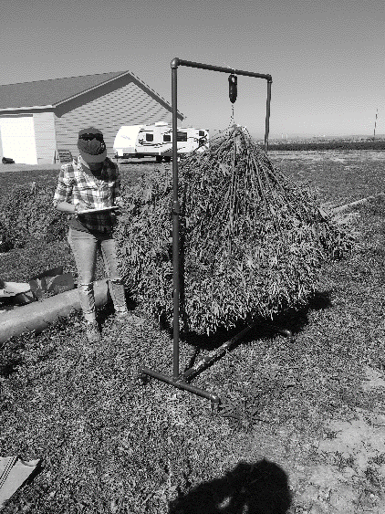


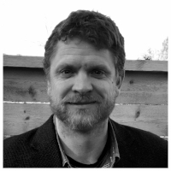
SGI Team
CJ Schwartz, PhD
Chris Grassa
Marie Turner
Jason Schwartz
Matt Gibbs
Notes:
BS degree in Genetics and Cell Biology from the University of Minnesota, and a PhD in Biochemistry from the University of Wisconsin. For the last decade, Dr. Schwartz's research has focused on the genetic differences that control flowering time. During that time he discovered that expression of a gene called Flowering Locus T leads to differential flowering time of plants and is dependent on their native locations. These results have been published in multiple peer-reviewed journals, and presented at conferences throughout the US.
Chris has a MSc in Botany from the University of British Columbia and BS in Zoology from the University of Florida. He is an expert bioinformatician, leveraging high performance computers to assemble genomes, study gene expression, and understand the genetics of populations. His focus has been providing genomic resources and analyses to answer ap
Marie Turner received a BS in Horticulture before working in cryobiology and tissue culture with the USDA ARS National Center for Genetic Resources Preservation for several years. She then obtained a PhD in Plant Breeding and Genetics with a focus on population genetics and the evolution of fitness in hybrids. Her first postdoc was focused on the breeding of multi-market and abiotic stress tolerance traits in sorghum. She then went on to do additional postdoctoral work integrating genetic and metabolomic data sets to map malting quality traits in barley and disease resistance traits in dry bean. She has strong interests in the intersection of agronomic practices, environment, and genetics and how they influence the ability to establish useful genotype to phenotype correlations.
plied and theoretical questions in genome biology, evolution, and domestication across a diverse range

Slide 25
