Slide 1

Genetic techniques for discovering genes involved in controlling traits, and deploying that information in Marker-Assisted Breeding projects.
CJ Schwartz PhD
Marigene and Hempgene
cj.schwartz@marigene.com
© 2017 Emerald Conference All rights reserved #EmeraldConference
Notes:
Thanks for coming and thanks to the organizers for offering me the opportunity to help educate the Cannabis community on genetics.
I am CJ Schwartz and I am the CEO and CSO of a two companies, Marigene and Hempgene specializing in Cannabis genetics.
I have a PhD in Biochemistry and over 15 years of Plant Molecular Genetics experience. The majority of my work was in an academic setting and during that time I published multiple peer-reviewed papers on plant genetic.
My interests in Cannabis lies in using DNA evidence for identifying a strain really is, and using DNA information to develop superior strains for medicine, agriculture, and recreation communities.
How can DNA information help us make better plants?

Slide 2
Outline
DNA
Variation
Genetics
One gene
Two genes
Phenotype profile
Gene Discovery
QTL mapping
Marker-Assisted Breeding
Cannabis phylogeny
Promising parental strains
Markers
Painted chromosomes
© 2017 Emerald Conference All rights reserved #EmeraldConference
Notes:
I have separated the talk into three broad categories, and I will try to summarize the conclusions of one section before moving on to the next.

Slide 3
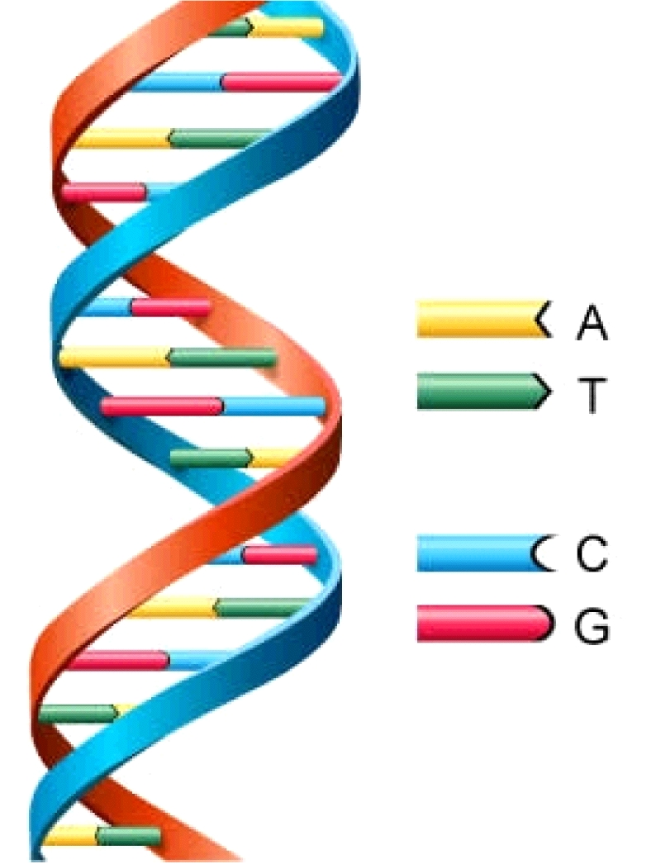
DNA – The Blueprint of Life
One cell has 6 feet of DNA
If you put all the DNA molecules in your body end to end, the DNA would be long enough to go the Mars and back.
Cannabis has 820 million basepairs
Humans have 3.2 billion basepairs
Incredible amount of information
Four digits versus binomial (0 and 1)
Bioinformatics -> Computers
DNA differences
-0.1% different among humans
-1.0% human versus chimps.
-Cannabis is 1.0%
Humans and plants share 50% of their genes.
http://www.astrochem.org/sci_img/dna.jpg
© 2017 Emerald Conference All rights reserved #EmeraldConference
Notes:
One cell smaller than a pencil head has 6 ft of DNA
All of your DNA, laid end-to-end, would go to Mars and Back
BASEPAIR = UNIT of information
Four digits vastly increases the amount of information that can be stored.
Due to next-generation DNA sequencing techniques, we now have access to this information, but the amount of data can be so large that it can only be evaluated using powerful computer and programs.
Humans/Plants - Evolution is real.

Slide 4
Definitions
-Genotype – the combination of DNA and genes specific to a single organism or a group of organisms
-Phenotype- the appearance of an organism resulting from the interaction of the genotype and the environment.
-Markers – DNA changes between strains
P = G X E
-Synergy, broad range, stable
-G minimize G by inbreeding
-E consistent -> common garden
© 2017 Emerald Conference All rights reserved #EmeraldConference
Notes:
Need to keep E constant for genetic discovery.

Slide 5
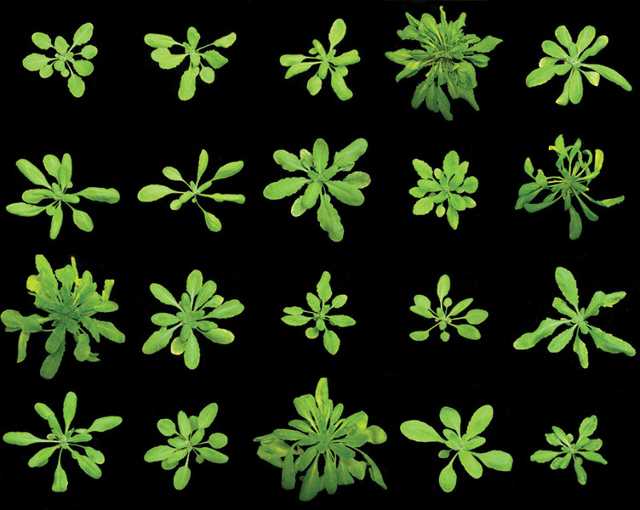
Phenotypic variation in shape and structure
Janne Lempe and Detlef Weigel, Max Planck Instiute for Developmental Biology
Consistent E
© 2017 Emerald Conference All rights reserved #EmeraldConference
Notes:
Massive variability in these morphologies collected from throughout the Northern hemisphere.
Natural variation due to DNA changes, not environment.
We need this natural variation for breeding

Slide 6
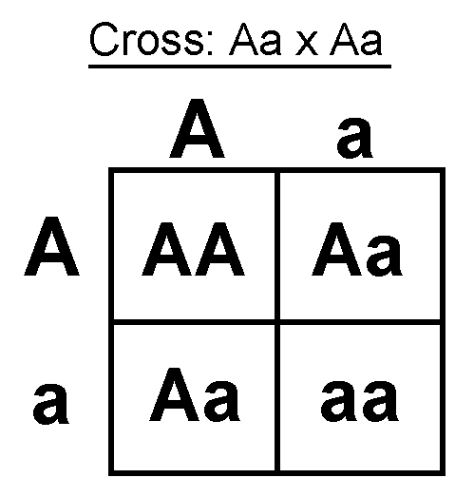
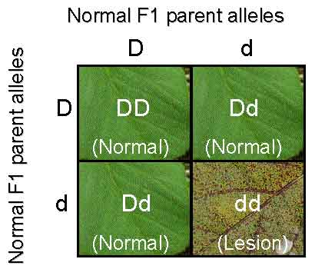
Genetics
noun
1. the branch of biology concerned with the study of heredity and variation in organisms
2. the genetic features and constitution of a single organism, species, or group
dictionary.com
aa=25%
http://passel.unl.edu
© 2017 Emerald Conference All rights reserved #EmeraldConference
Notes:
Genetics definition
I WILL USE STRAIN, NOT GENETICS FOR GENOTYPE
Parents are diploid
A and D are good copies while a d are bad copies or versionsof the genes
SEGREGATION. 1:2:1 or 25%, 50% and 25%
some cases heterzygote has an intermediate phenotype, or just one good copy is needed.
In this case the heterzygotes are carriers, a term familiar in discussions of human genetics and disease.
using DNA information, we can identify aa or dd without phenotyping them, and eliminate that 25% if that fits within the project goals

Slide 7
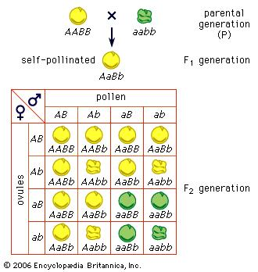
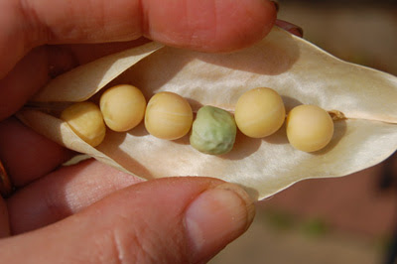
Polygeneic
http://daughterofthesoil.blogspot.com/2008/10/joy-of-mendelian-segregation.html
1/16th = 0.25 X 0.25 = 0.0625 = 6.25%
© 2017 Emerald Conference All rights reserved #EmeraldConference
Notes:
You have all likely heard of Gregor Mendel who used peas to discover how genes segregate.
In this example two genes are being evaluated simultaneously.
This greatly complicates the situation.
The desired phenotype and genotype is more difficult to find.
0.25 X 0.25
Out of 100 plants, 6 should will have this phenotype.

Slide 8
Traits tied to genes
Strain A
Strain B
F2-01
F2-02
Flowering time
THCAS
Height
Low THC
Late flower
Tall
High THC
Early flower
Short
High THC
Late flower
Tall
Low THC
Early flower
Tall
© 2017 Emerald Conference All rights reserved #EmeraldConference
Notes:
Preview of what is to come
A chromosome from each strain with different phenotypes
cross
progeny a mosaic
If you know the genes for certain traits, such as...
You can select the progeny you want
For height homozygous, both tall like parent
for flow time, heterozygous, so two progeny are different
Many breeding programs are concerned with multiple traits, a term called stacked traits in the agriculture, such as Monsanto corn with weed and pest resistences.
Mendel only has phenotypes, but we have both phenotypes and genotypes as input for developing a breeding program. Molecular Genetics.

Slide 9
Outline
DNA
Variation
Genetics
One gene
Two genes
Phenotype profile
Gene Discovery
QTL mapping
Marker-Assisted Breeding
Cannabis phylogeny
Promising parental strains
Markers
Painted chromosomes
© 2017 Emerald Conference All rights reserved #EmeraldConference
Notes:
I have separated the talk into three broad categories, and I will try to summarize the conclusions of one section before moving on to the next.

Slide 10
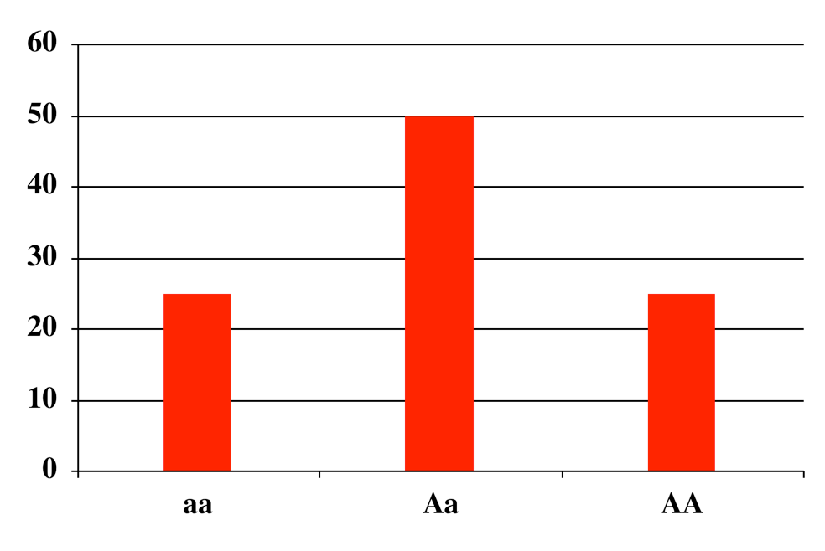
Qualitative Trait
Frequency
Height
© 2017 Emerald Conference All rights reserved #EmeraldConference
Notes:
This shows the phenotypic distribution for height being controlled by a single gene that has a large effect.
Phenotypes in discrete non-overlapping classes. Very easy to identify. A qualitative distribution, Yes or No, or On or OFF

Slide 11
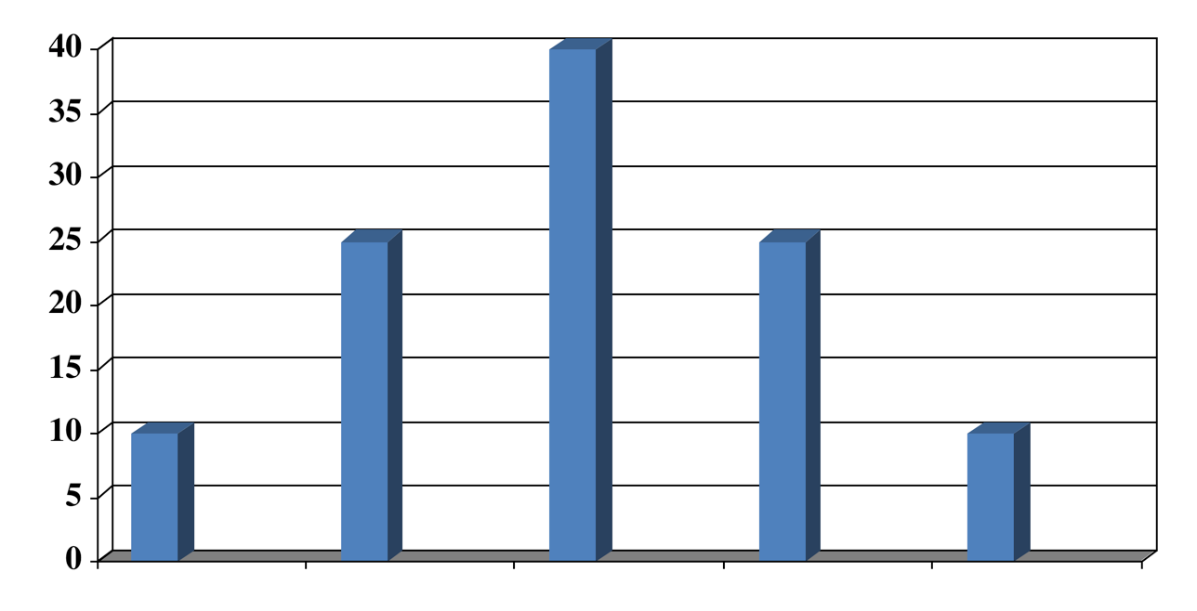
Quantitative Trait Loci (QTL)
Frequency
Height
AA
BB
CC
DD
--
--
--
--
++
--
--
--
++
++
--
--
++
++
++
--
++
++
++
++
© 2017 Emerald Conference All rights reserved #EmeraldConference
Notes:
But most trains are multi-genic, due to multiple genes, which complicates matters.
SYNERGY-Additivity-ENTOURAGE EFFECT
More to keep track of
Many more gene combinations and phenotypes
what are the contribution of each gene to the phenotype
Continous distribution---Quantitative
QTL mapping

Slide 12
Gene discovery
QTL mapping - Correlate phenotype with genotype
-Mutants - traditional
-GMO – over-expression
-Natural variation
© 2017 Emerald Conference All rights reserved #EmeraldConference
Notes:
other ways to discover genes
-classically a mutagenesis
-to many background mutations, often sick
-not considered GMO
-need to backcross to reduce the mutations
GMO
-overproduce a rate-limiting step enzyme -> more product
Natural variation-as good as mutants

Slide 13
QTL mapping
70 days
AA
27 day
aa
X
45 days
Aa
F1
recombination
Pollen
X
Egg
F2 plants
X
X
42 days 22 days 70 days 50 days
Aa aa AA Aa
© 2017 Emerald Conference All rights reserved #EmeraldConference

Slide 14
Long day flowering QTL
black=Growthroom(16°C), blue=Growthroom(23°C), red=Greenhouse (23°C)
© 2017 Emerald Conference All rights reserved #EmeraldConference
Notes:
QTL for flowering time. 3 independent experiment, different environmental conditions
X-axis, genome/chromosomes
Y-axis, statistical score of correlation with phenotype
Permutation
QTL accounts for 80-90% of variation
chances of this being wrong anr a billion to one

Slide 15
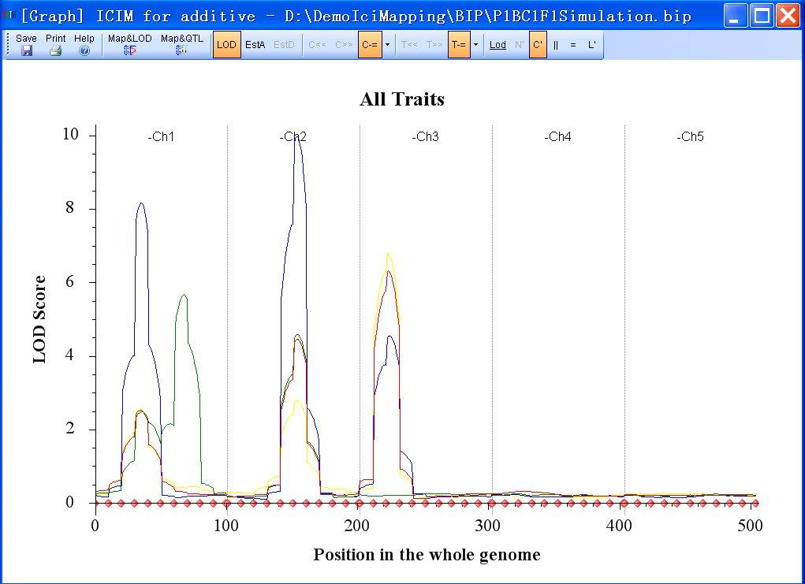
QTL Mapping - Quantitative Trait Loci
iplantcollaborative.org
© 2017 Emerald Conference All rights reserved #EmeraldConference
Notes:
Loci = multiple genes
Phenotype is divided among loci (genes)
REMEMBER HEAIGHT
Chromosome 2 - 32%
Last slide – 90%. = Easier due to bigger phenotype
PART OF BREEDING IS BREAKING APART THESE QTL IN A PLANNED precise MANOR

Slide 16
Strain ID, QTL mapping, Genetics
Strain A
-Pinene 0.2%
-Myrcene 4.2%
-Limonene 0.3%
-Linalool 2.1%
Strain B
-Pinene 6.2%
-Myrcene 0.6%
-Limonene 0.3%
-Linalool 2.1%
-Large phenotype differences
-Discover which genes are responsible for the phenotypes
-Make crosses to isolate a new high Myrcene and Pinene strain
© 2017 Emerald Conference All rights reserved #EmeraldConference
Notes:
Example

Slide 17
QTL mapping
A
X
B
F1
recombination
Pollen
X
Egg
F2 plants
X
X
Phenotype
© 2017 Emerald Conference All rights reserved #EmeraldConference

Slide 18
F2 plants
PPmm
ppMM
Chromosomes
Chromosomes
Discovered genes/regions!!!!!! -> -> -> MARKERS
© 2017 Emerald Conference All rights reserved #EmeraldConference

Slide 19
GOAL = PPMM
F1
-Heterzygous for each (PpMm), ½ as much product produced
-Clonal
F2
-Identify the 6% with correct genetic combination. Phenotypes?
-Phenotype progeny – confirmation and stability of phenotype
-develop markers to incorporate into breeding programs with other strains
© 2017 Emerald Conference All rights reserved #EmeraldConference
Notes:
Phenotype can change in different environmental conditions

Slide 20
Making better strains
Discover the genes, and their locations, responsible for the differences
Cross the strains to develop unique varieties
-Phenotype 100 (traditional) OR genotype and then phenotype 6 (MAB)
-Phenotypes can be variable (environment & genetic)!!!
-MAB-Focus on moving forward with the best variant(s) of the 6
-use saved space evaluating your marker in other populations
© 2017 Emerald Conference All rights reserved #EmeraldConference
Notes:
Relying on phenotype only can be problematic!!
MAB saves resources. Test more crosses -> better chance at discovery

Slide 21
Outline
DNA
Variation
Genetics
One gene
Two genes
Phenotype profile
Gene Discovery
QTL mapping
Marker-Assisted Breeding
Cannabis phylogeny
Promising parental strains
Markers
Painted chromosomes
© 2017 Emerald Conference All rights reserved #EmeraldConference
Notes:
I have separated the talk into three broad categories, and I will try to summarize the conclusions of one section before moving on to the next.

Slide 22
Picking your strains for breeding
A family tree is determined by statistically evaluating the number and location of DNA changes. Comparing DNA changes among strains to determine strain relatedness.
As strains accumulate, the ability to differentiate among families (geographical origin) increases.
© 2017 Emerald Conference All rights reserved #EmeraldConference

Slide 23
Narrow Leaf drug
22
13
5
Broad Leaf drug
Hemp
© 2017 Emerald Conference All rights reserved #EmeraldConference
Notes:
Using 40 handpicked strains, the Cannabis lineage can be divided into 3 groups. These are the most ancient splits in the family tree. The indica and sativa split occurred after hemp varieties became genetically distinct.

Slide 24
Haze
Kush
Durban
30
8
52
18
12
Northern Lights
Hemp
© 2017 Emerald Conference All rights reserved #EmeraldConference
Notes:
Adding additional strains allows for identification of splits within the indica (red) and sativa (blue) groups. The Northern Lights indica and Durban sativa have fewer representative samples in their group, while the Kush and Haze have a larger number of strains that are related. This data, suggests that those groups with a larger numbers of related strains may be able to be further split with even more strain data. For Hemp, there is insufficient evidence to split the Hemp family into smaller groups.

Slide 25
62
28
53
15
18
4
3
© 2017 Emerald Conference All rights reserved #EmeraldConference
Notes:
Adding even more strains for the analysis, leads to identification of an additional indica family, and a split in the Hemp family.

Slide 26
© 2017 Emerald Conference All rights reserved #EmeraldConference
Notes:
Cannabis Family tree (Lynch et al, 2016)

Slide 27
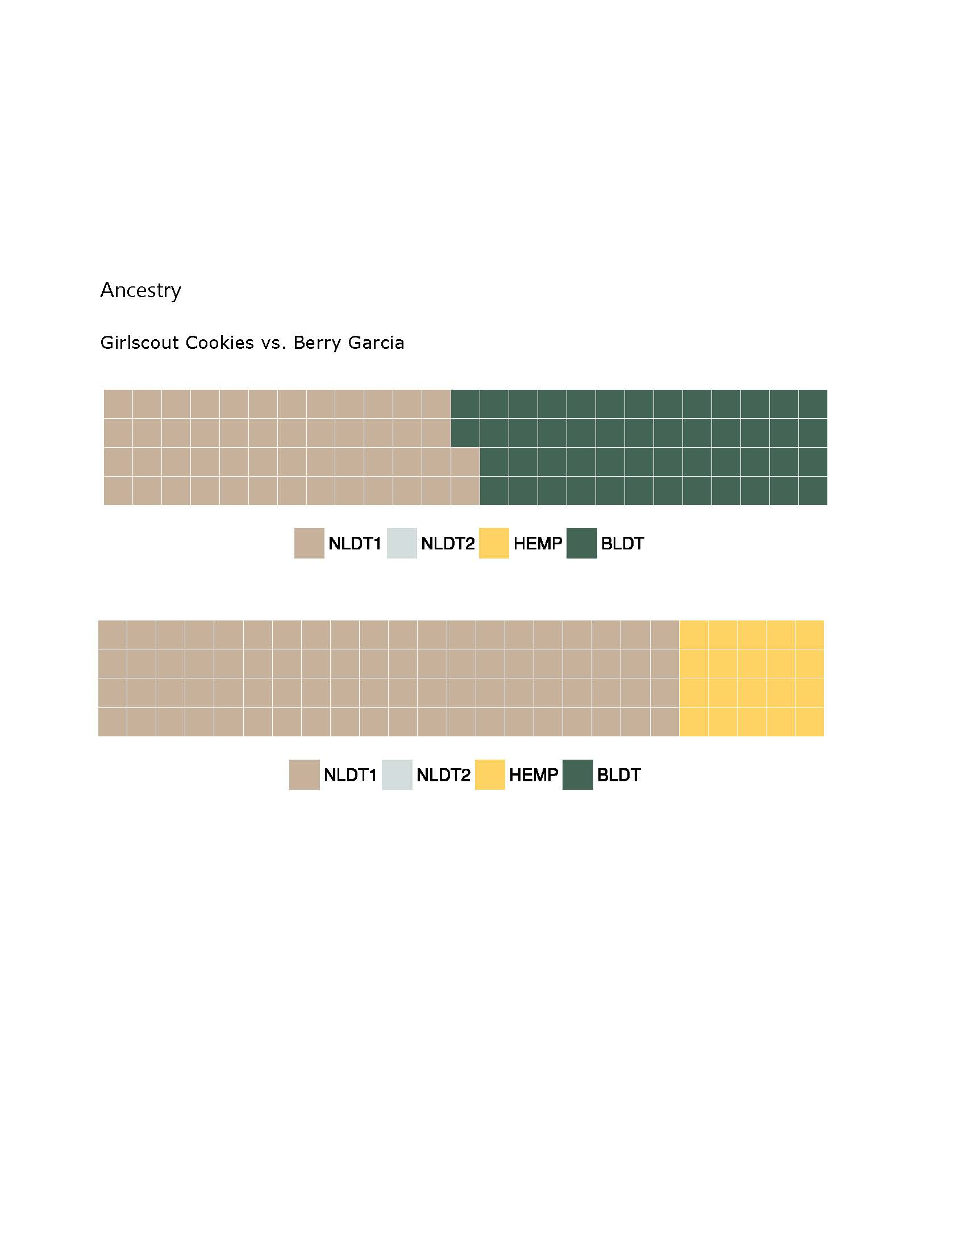
Recent hybrids
structure
Geographical origins
© 2017 Emerald Conference All rights reserved #EmeraldConference

Slide 28
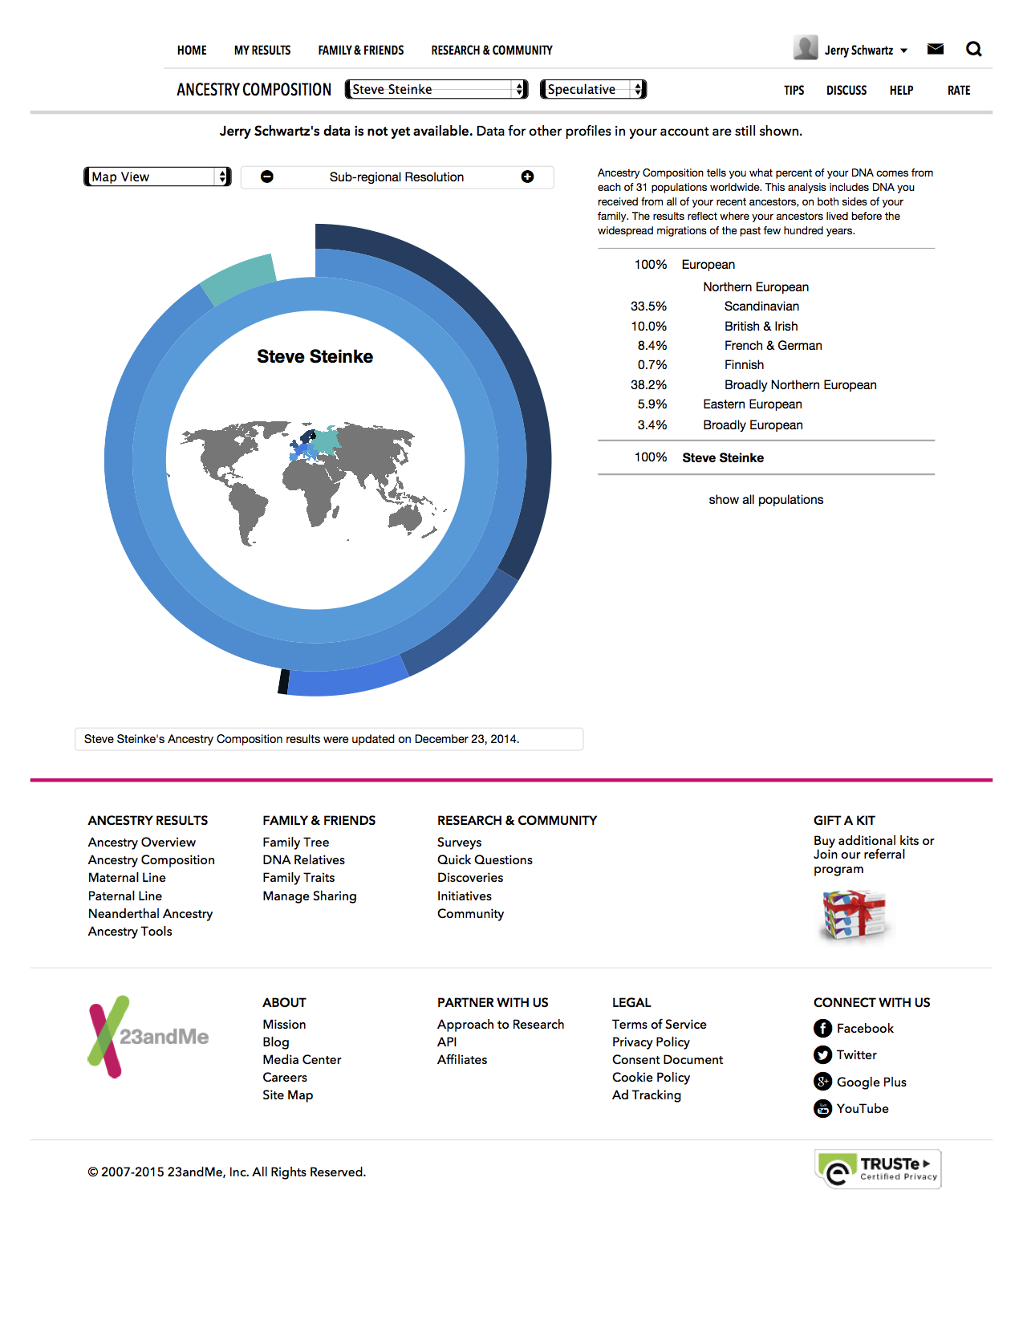
© 2017 Emerald Conference All rights reserved #EmeraldConference

Slide 29
Starting material for breeding program critical
-degree of genetic variation (stability).
-relatedness - Picking Parents
-one chemical
-two or more chemicals
© 2017 Emerald Conference All rights reserved #EmeraldConference
Notes:
Broad or narrow goals - > Complexity

Slide 30
Cross for QTL mapping
X
F1
recombination
Pollen
X
Egg
F2 plants
X
X
© 2017 Emerald Conference All rights reserved #EmeraldConference

Slide 31
-Recent hybrids are NOT ideal starting material,
-Inbred lines are ideal
Parents
F1
1 2
3 4 5 6
F2a
© 2017 Emerald Conference All rights reserved #EmeraldConference
Notes:
Problem with recent hybrids Missing genes from parents.
We can select best F1s to cross

Slide 32
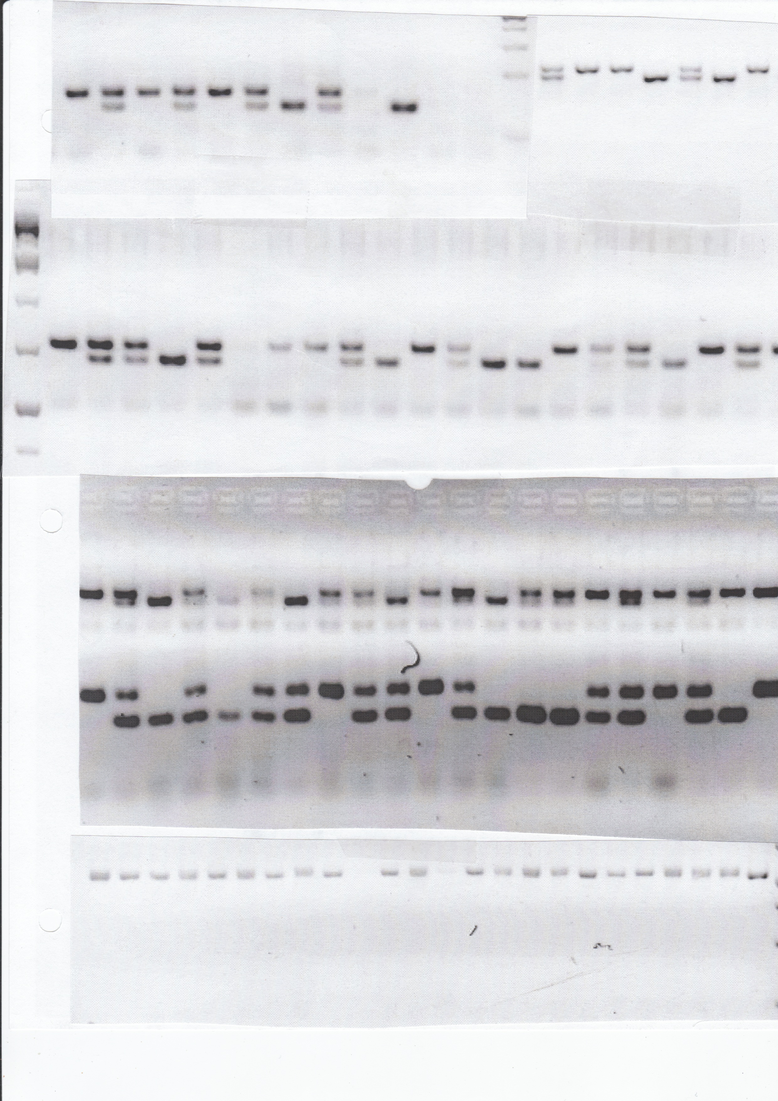
AA
BB
BB
CC
Molecular Markers
AB
1
BC
1 2 3 4 5 6 7 8 9 10
2
CBDA synthase
AA
Strain A
THCA synthase
aa
3
aa
bb
ab
CBDA synthase
BB
Strain B
AA
CC
4
THCA synthase
bb
AC
AC
AC
Linkage
CBDA synthase
CC
ac
cc
ac
Strain C
aa
cc
5
THCA synthase
cc
ac
aa
cc
6
© 2017 Emerald Conference All rights reserved #EmeraldConference
Notes:
We can now predict their chemical phenotype with this marker.

Slide 33
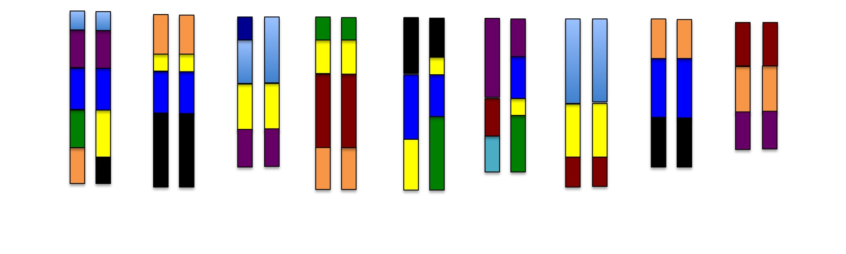
The holy grail - Painted Chromosomes
FT
Afghan Kush
N. Chinese Hemp
Haze
Northern Lights
Chemdawg
Durban Poison
Cookies
Thai
Russian
Height
THC syn
We need a reference genome!!!
© 2017 Emerald Conference All rights reserved #EmeraldConference
Notes:
Included with every strain sold

Slide 34
Recent hybrids
structure
Geographical origins
© 2017 Emerald Conference All rights reserved #EmeraldConference

Slide 35
We have partnerships with testing labs in 6 states
-Service
-Collect DNA
-can mail DNA
Chemical profiles -> Phenotypes
-Many
-Consistent
DNA analysis will document your breeding program
-Trademark
-Protection
© 2017 Emerald Conference All rights reserved #EmeraldConference

Slide 36
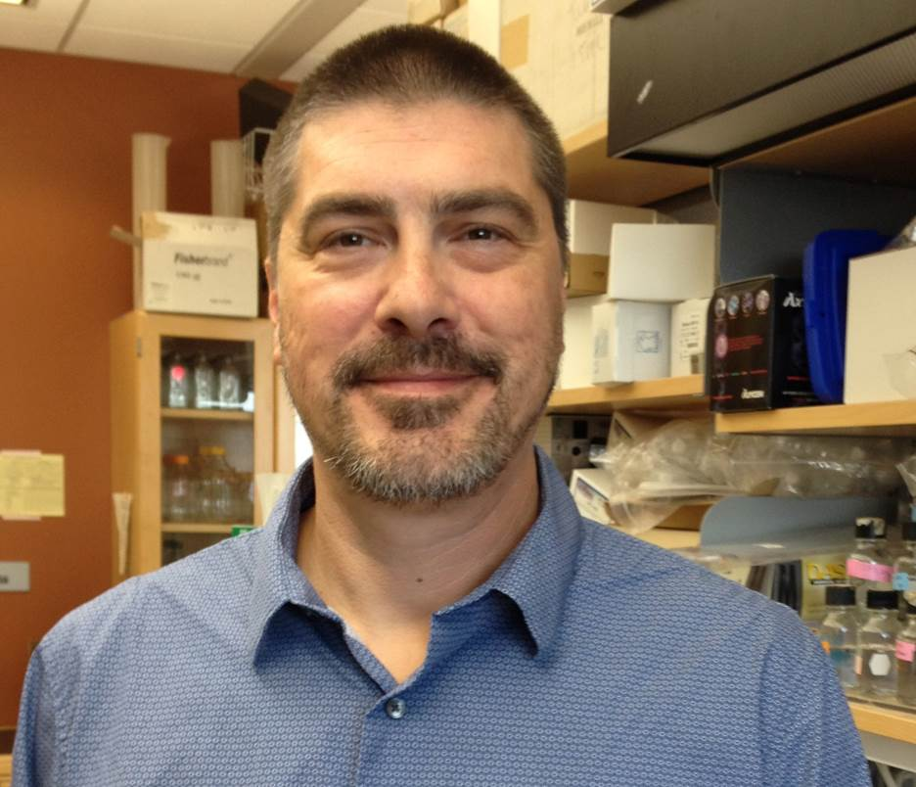
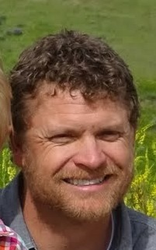
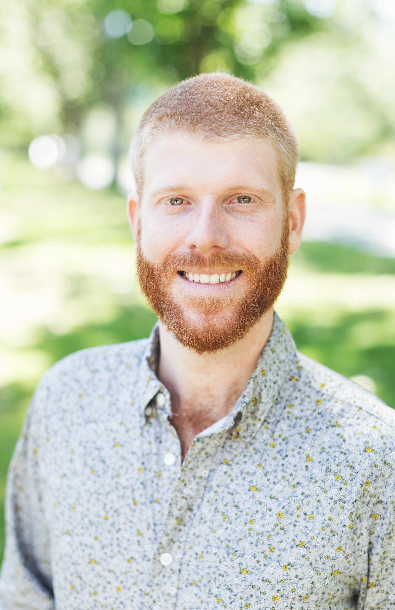
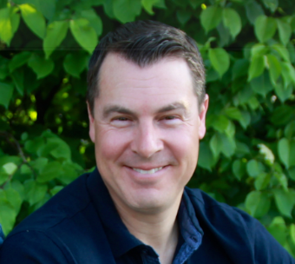
Marigene & Hempgene Team
info@marigene.com
CJ Schwartz-CEO/CSO
Matt Gibbs-COO/President
Chris Grassa-Chief Bioinformatist
Jason Schwartz-CFO
UC-Boulder/CGRI -Nolan Kane, Ryan Lynch, and Daniela Vergara
© 2017 Emerald Conference All rights reserved #EmeraldConference

