Slide 1
CJ3x4 F2 population segregates for multiple terpenes
CJ3 is unique for terpene producrtion
J7 was 40% heterozygous, while the CBD strain was 15% heterozygous
-will not segregate as a normal F2
2019 61 F2 plants at 3 field sites in Colorado and did chemical testing
2020 100 F2 plants
-Indoor
-In the field
CBD x J7(hemp)
CJ1, CJ2, CJ3, CJ4, CJ5, CJ6 - F1s
CJ3x4 F2

Slide 2
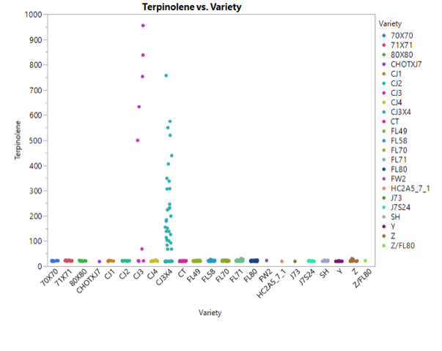
TERPENES
CJ3X4 has a unique terpene profile including a group of terpenes implicated as being chemical linked. Terpinolene is shown.
CJ3 produces terpinolene. Only 14% of Cannabis varieties produce terpinolene.
Terpinolene is segregating in the CJ3x4 F2.
CJ3
F2
CJ4
Allen, 2019

Slide 3
+/- a specific terpenes – CJ3 is different for many terpenes
Red box-Variety makes that terpene
Purple boxes are a distinct class of linked terpenes, including terpinoline. Blue boxes correspond to variation in the F2.

Slide 4
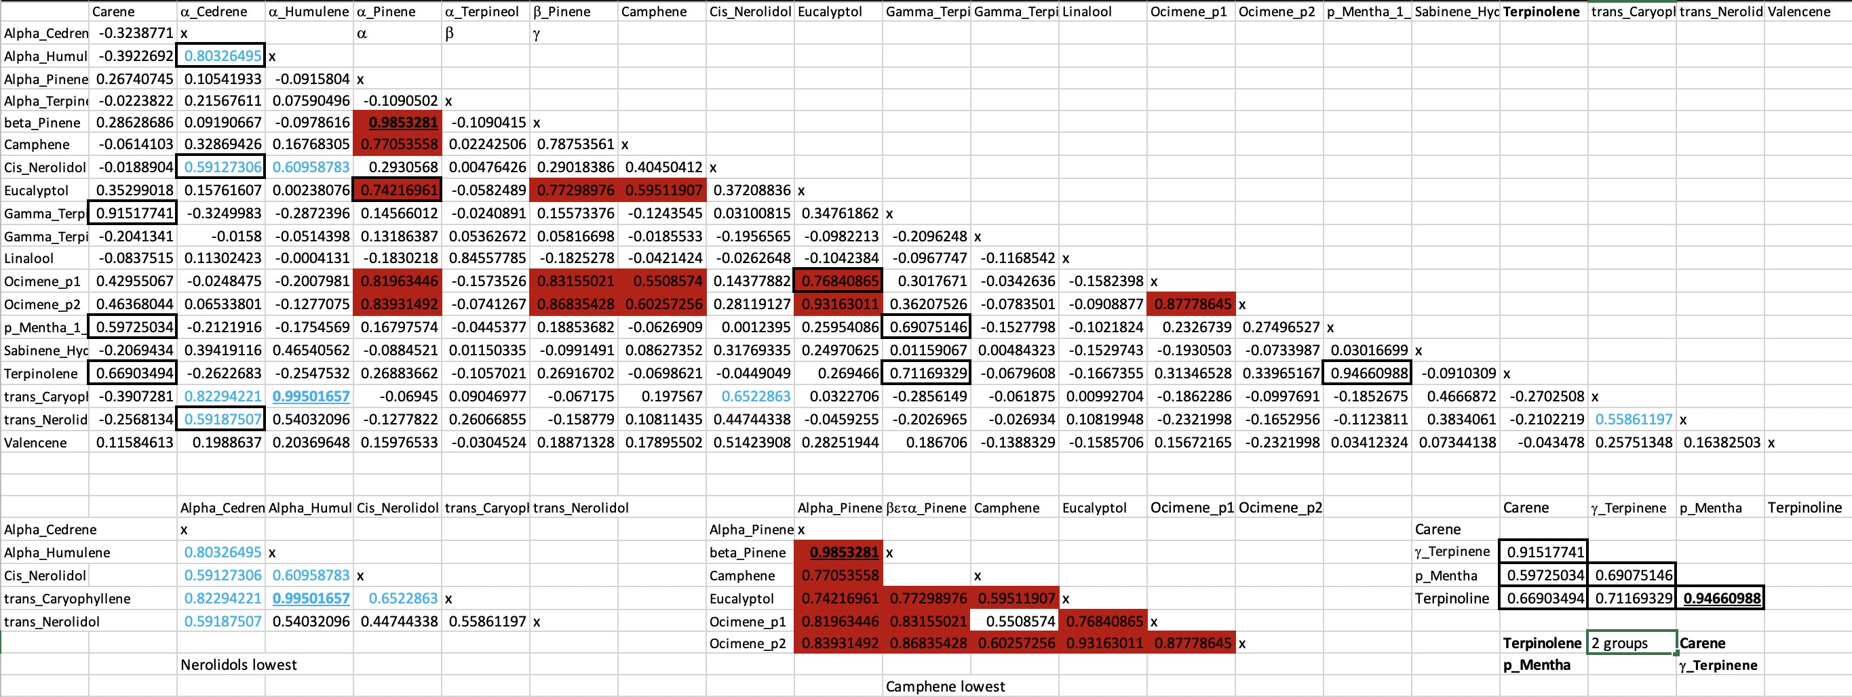
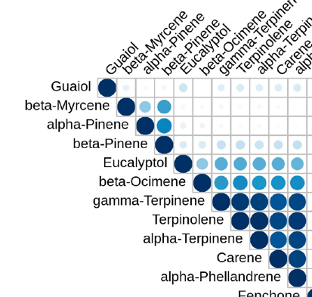
Chemical production correlation in 61 CJ3x4 F2
individuals – 3 distinct groups
Group 1
α_Humulene TPS9, TPS4 side rxn
β_Caryophelene TPS9
Trans-Cedrene
Tran Nerolidol TPS18, 19
Cis-Nerolidol TPS18, 19
Group 2
Alpha Pinene TPS2 Beta Pinene TPS5
Ocimene p1 TPS6,38 Ocimene p2 TPS13
Eucalyptol Camphene
Group 3
Terpinolene TPS37
Carene
Terpinene TPS33
Phellandrene
Allen, Zager

Slide 5
Group 1 - Sesquiterpenes
a_Humulene TPS9, TPS4 side rxn
β_Caryophelene TPS9
a-Cedrene
Tran-Nerolidol TPS18, 19
Cis-Nerolidol TPS18, 19
Highly correlated
Trans-Nerolidol has lowest correlations within group

Slide 6
Group 2 - Monoterpenes
Alpha Pinene TPS1,2,5 Beta Pinene TPS1,2,5
Ocimene p1 TPS6,38 Ocimene p2 TPS13 (bees)
Eucalyptol Camphene
Zeros – lowest correlation within group

Slide 7
Group 3 - Monoterpenes
Carene Terpinolene TPS37
Terpinene TPS33 Phellandrene (p_Mentha)
Terpinene - 38/61 = 0
Terpinolene - 33/61 = 0
Carene - 36/61 = 0
Phellandrene - 48/61 = 0
Low levels-detectability
carene
Notes:
A lot of zeros, more than half
Terpinolene and phellandrene distinct, mostly zero’s

Slide 8
Summary
-A variety of terpenes give plants their smell and taste
-TPS enzymes are promiscuous-multiple products
-TPS genes are grouped in clusters
-Many terpenes phenotypes are linked
-10+ chemovars
CJ3x4 F2 population
-segregating for multiple terpenes
-terpenes are linked forming 3-4 groups
-QTL mapping in progress (inside and outside)
-GOAL- specific terpene combinations
-medical efficacy
-challenge with biotic and abiotic stress
We need more biochemistry, transcriptome, and epigenetic data

Slide 9
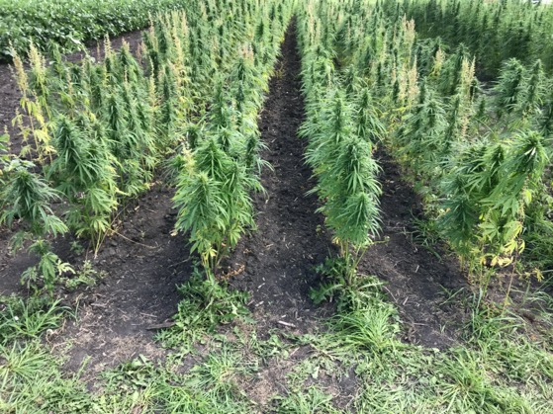
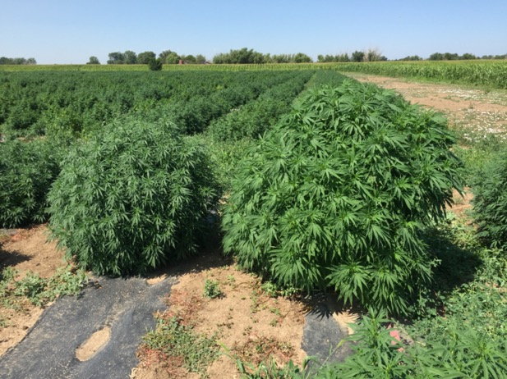
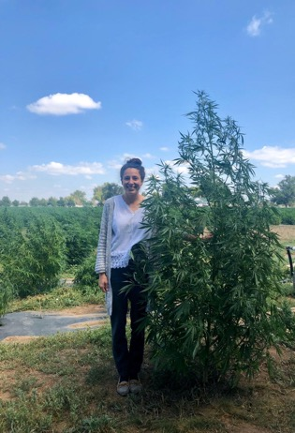
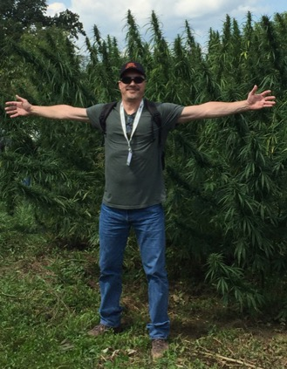
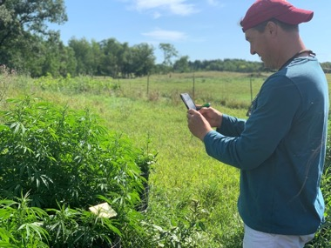
Acknowledgements
Sunrise Genetics
Matt Gibbs
Jason Schwartz
Scott Morton
Marie Turner
Lexi Valenti
Hunter Konchan
Chris Hayes
Row crop spacing
cj.schwartz@sunrisegenetics.com
Plant variation

