Slide 1
Cannabis Genomics – Advances and applications
Plant and Animal Genome Conference
January 17 2018
San Diego CA
Organizer
CJ Schwartz
Speakers
Christopher Grassa
John McKay
Graham King
Jonathon Page
George Weiblen

Slide 2
FIRST EVER!!
Cannabis Genomics – Advances and applications
Plant and Animal Genome Conference
January 17 2018
San Diego CA
Organizer
CJ Schwartz
Speakers
Christopher Grassa
John McKay
Graham King
Jason Sawler
George Weiblen
Notes:
Welcome to the inaugural PAG workshop devoted exclusively to the study of cannabis genomics. Thank you to the conference organizers for adding a Cannabis workshop.
I am honored to usher in a period where science and not voodoo guides policy and Cannabis crop development.
I am CJ Schwartz, I have nearly 20 years of plant molecular biology experience in academia and worked with Detlef Weigel, Joanne Chrory at the Salk institute in San Diego, and then Rick Amasino at UW Madison. Focusing largely upon natural variation for flowering time in Arabidopsis and Brachypodium. My interest in Cannabis was largely due to frustration with the naming convention and bogus medical claims. So I started a company focused on cataloging natural variation and developing MAB programs for Cannabis improvement.
My goals are to use modern genetic techniques to make drug types of Cannabis safe and well-defined for maximum efficacy and appropriate use. For hemp the goal is to produce an economically viable and environmentally sustainable agricultural crop.
We have a great group of speakers, many who are pioneers in the field, and they will be presenting actual results. I will mostly be giving an itroduction to te science of Cannabis, as well as coultural implications surrounding this plants.

Slide 3
One of the first and longest cultivated plants by humans
Russo 2007
Notes:
Cannabis is one of the first plants cultivated by humans.
Physical evidence suggests that Cannabis use dates back 5-10000 years ago, being found in Asia, Europe, and the middle east.
There is no denying that Cannabis has had a large influence on human society and culture, due to its versatility as a source for fibre, seed and chemical compounds.

Slide 4
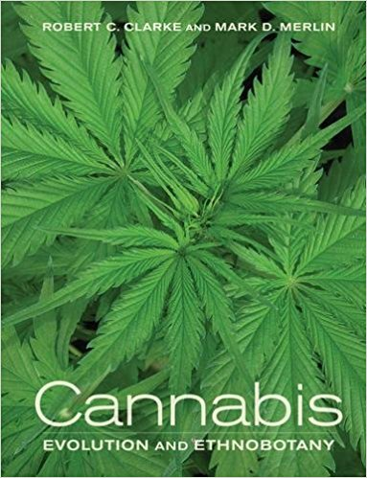
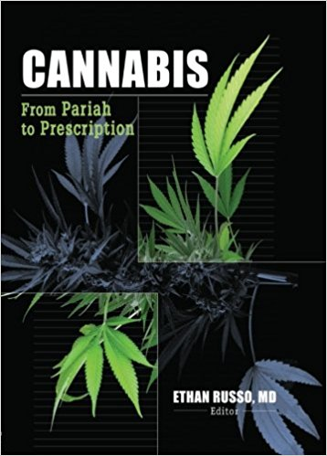
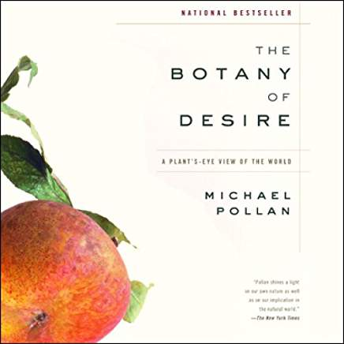
Literature on Ethnobotany and medicinal uses
Notes:
There are many sources of information on Cannabis and interactions with humans.
While I am not singling out these books specifically, much of the science is soft and claims as to the potential of Cannabis have been overstated. This is a disservice to science and society due to mis-information.
This is particlarily true with medical claims where misinformation can have true consequences on patients.
What the Cannabis industry needs is sound science.

Slide 5
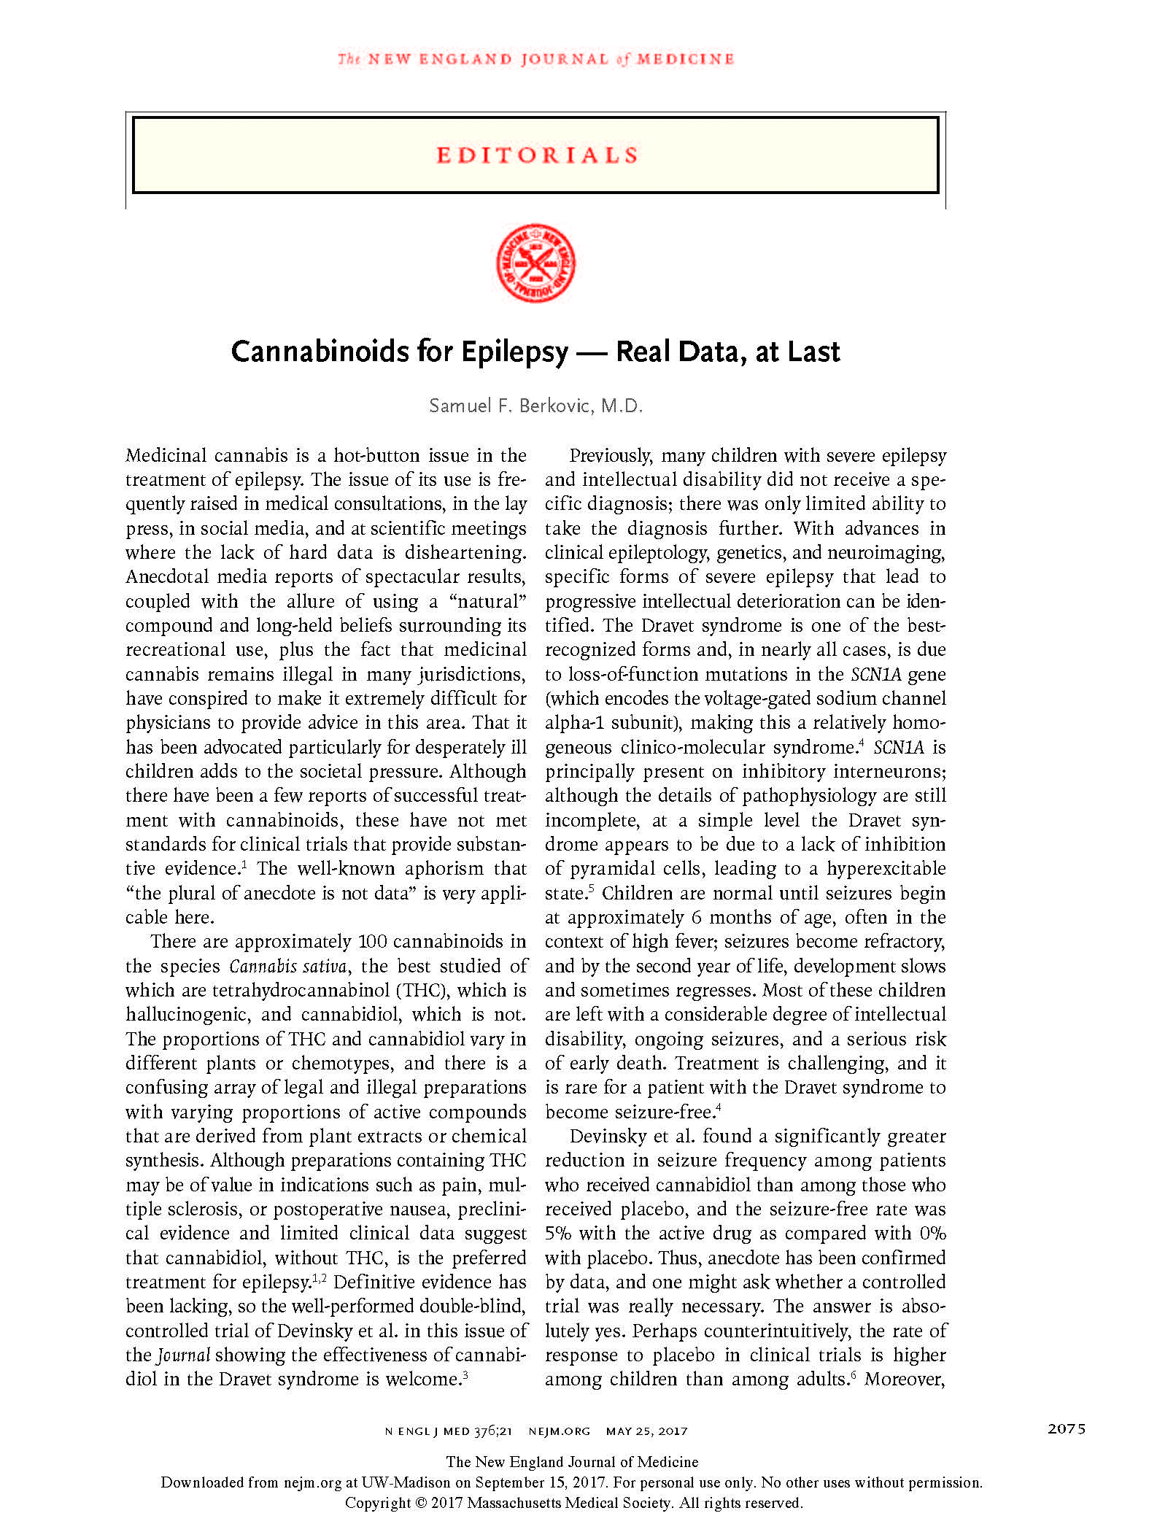
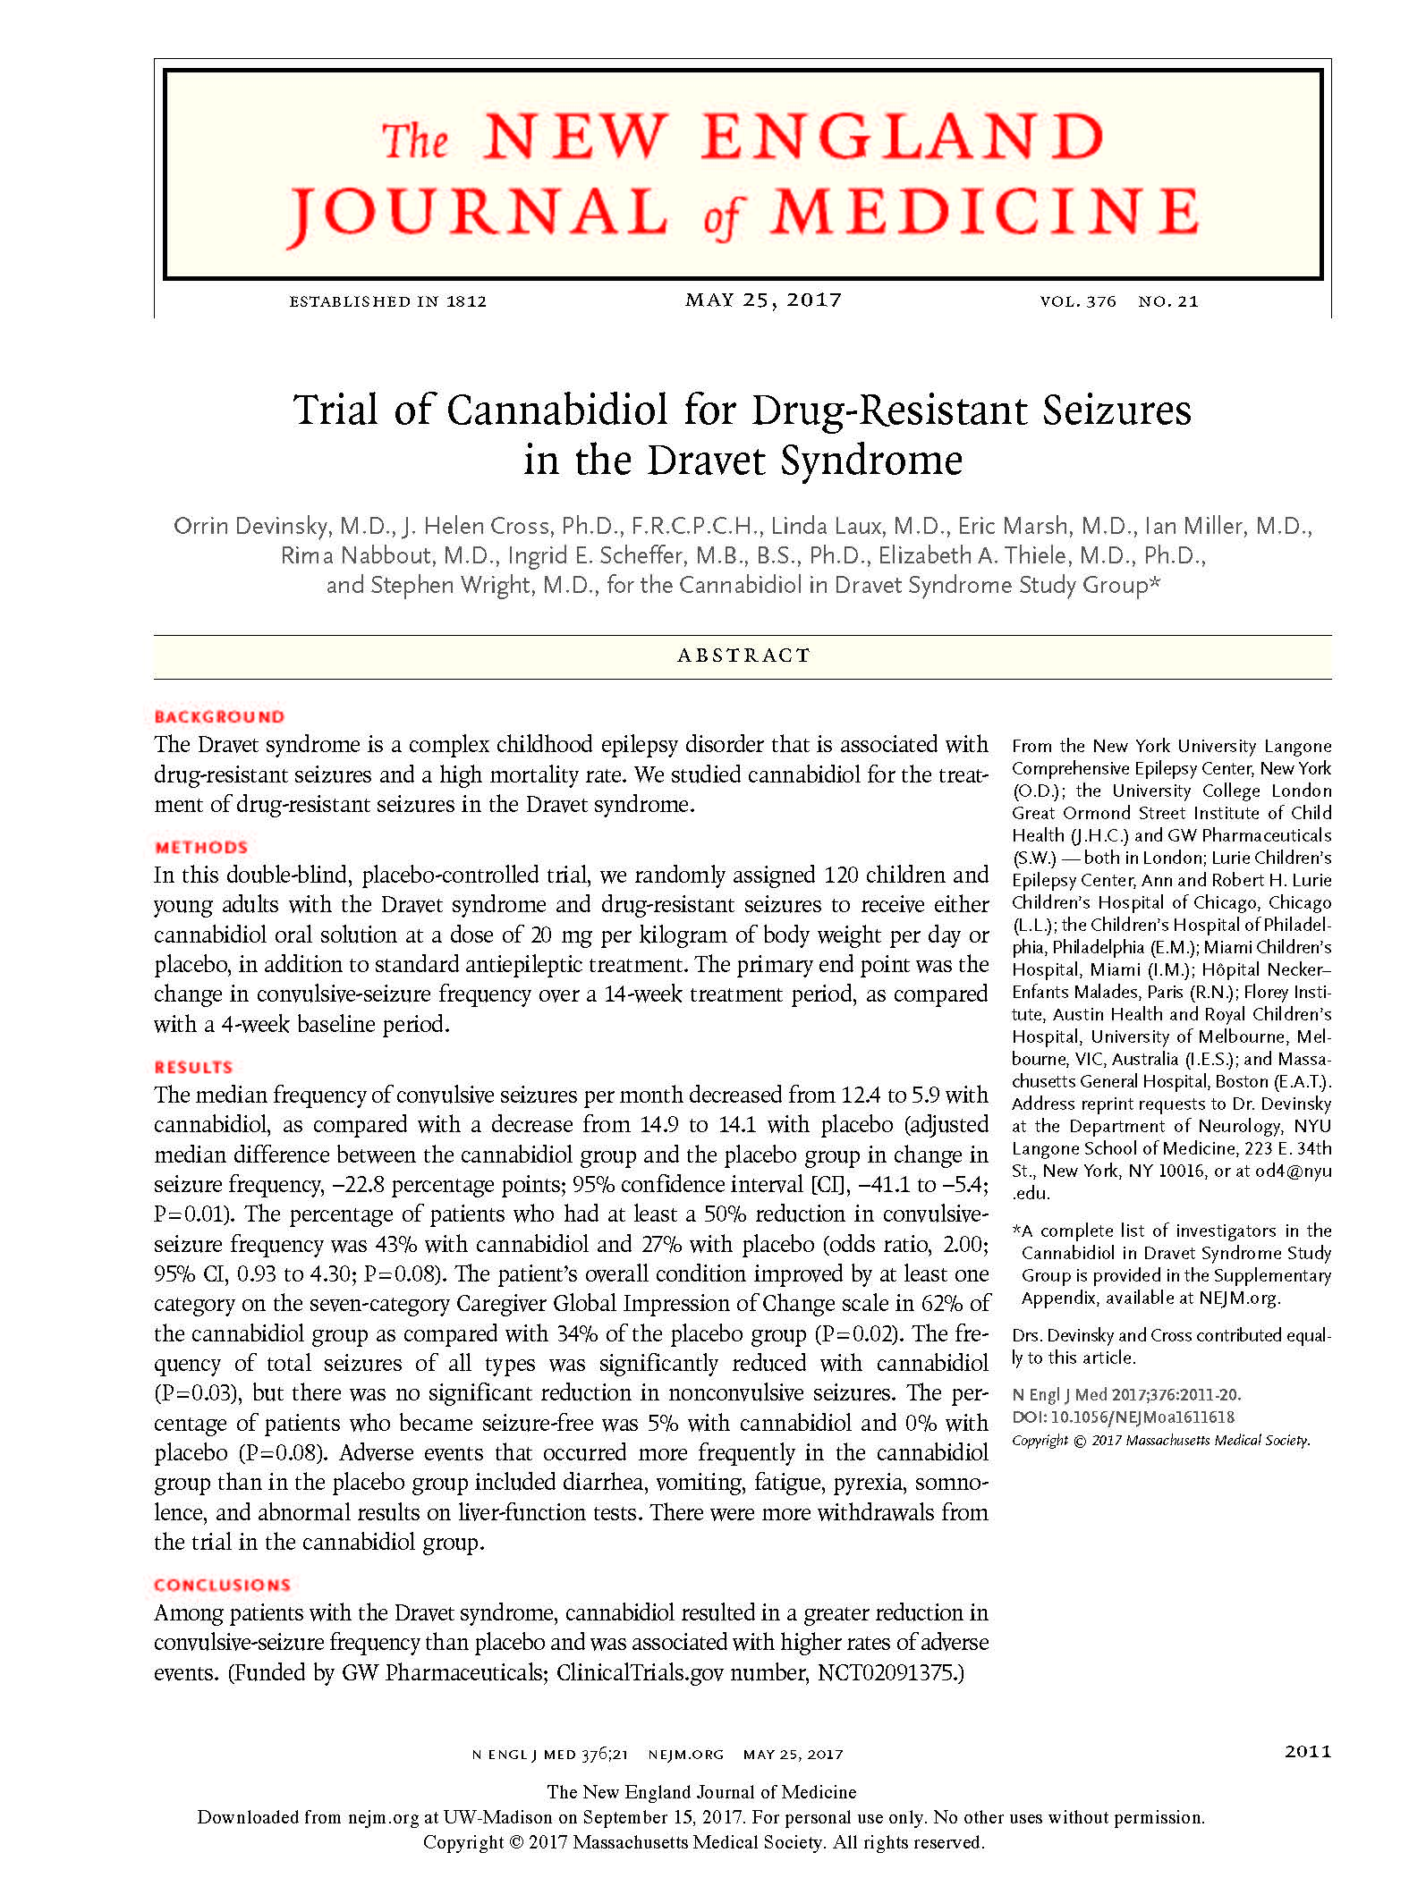
Notes:
I was overjoyed to see this article published last year, and the editorial in the same issue says it all.
REAL DATA, AT LAST
Dravet syndrome is a loss of function mutation that results in severe seizures in children, causing intellectual deterioration and early death.
CBD (Cannabidiol) a component of Cannabis that we will discuss shortly greatly relieves the symptons of this disease.
These are the type of studies which are required, and they are hindered by bad laws not based on science.
There are plenty of jokes about getting high, but there is nothing funny about a child having a seizure.
This work along with other studies makes it a fact that Cannabis is NOT a schedule I narcotic. Schedule 1 means it has no medical ues. The DEA just once again decided to list Cannabis as schedule 1 which is factually incorrect based upon science.
My favorite bumper sticker is ‘ “that’s the great thing about science, its true whether you like it or not.”

Slide 6



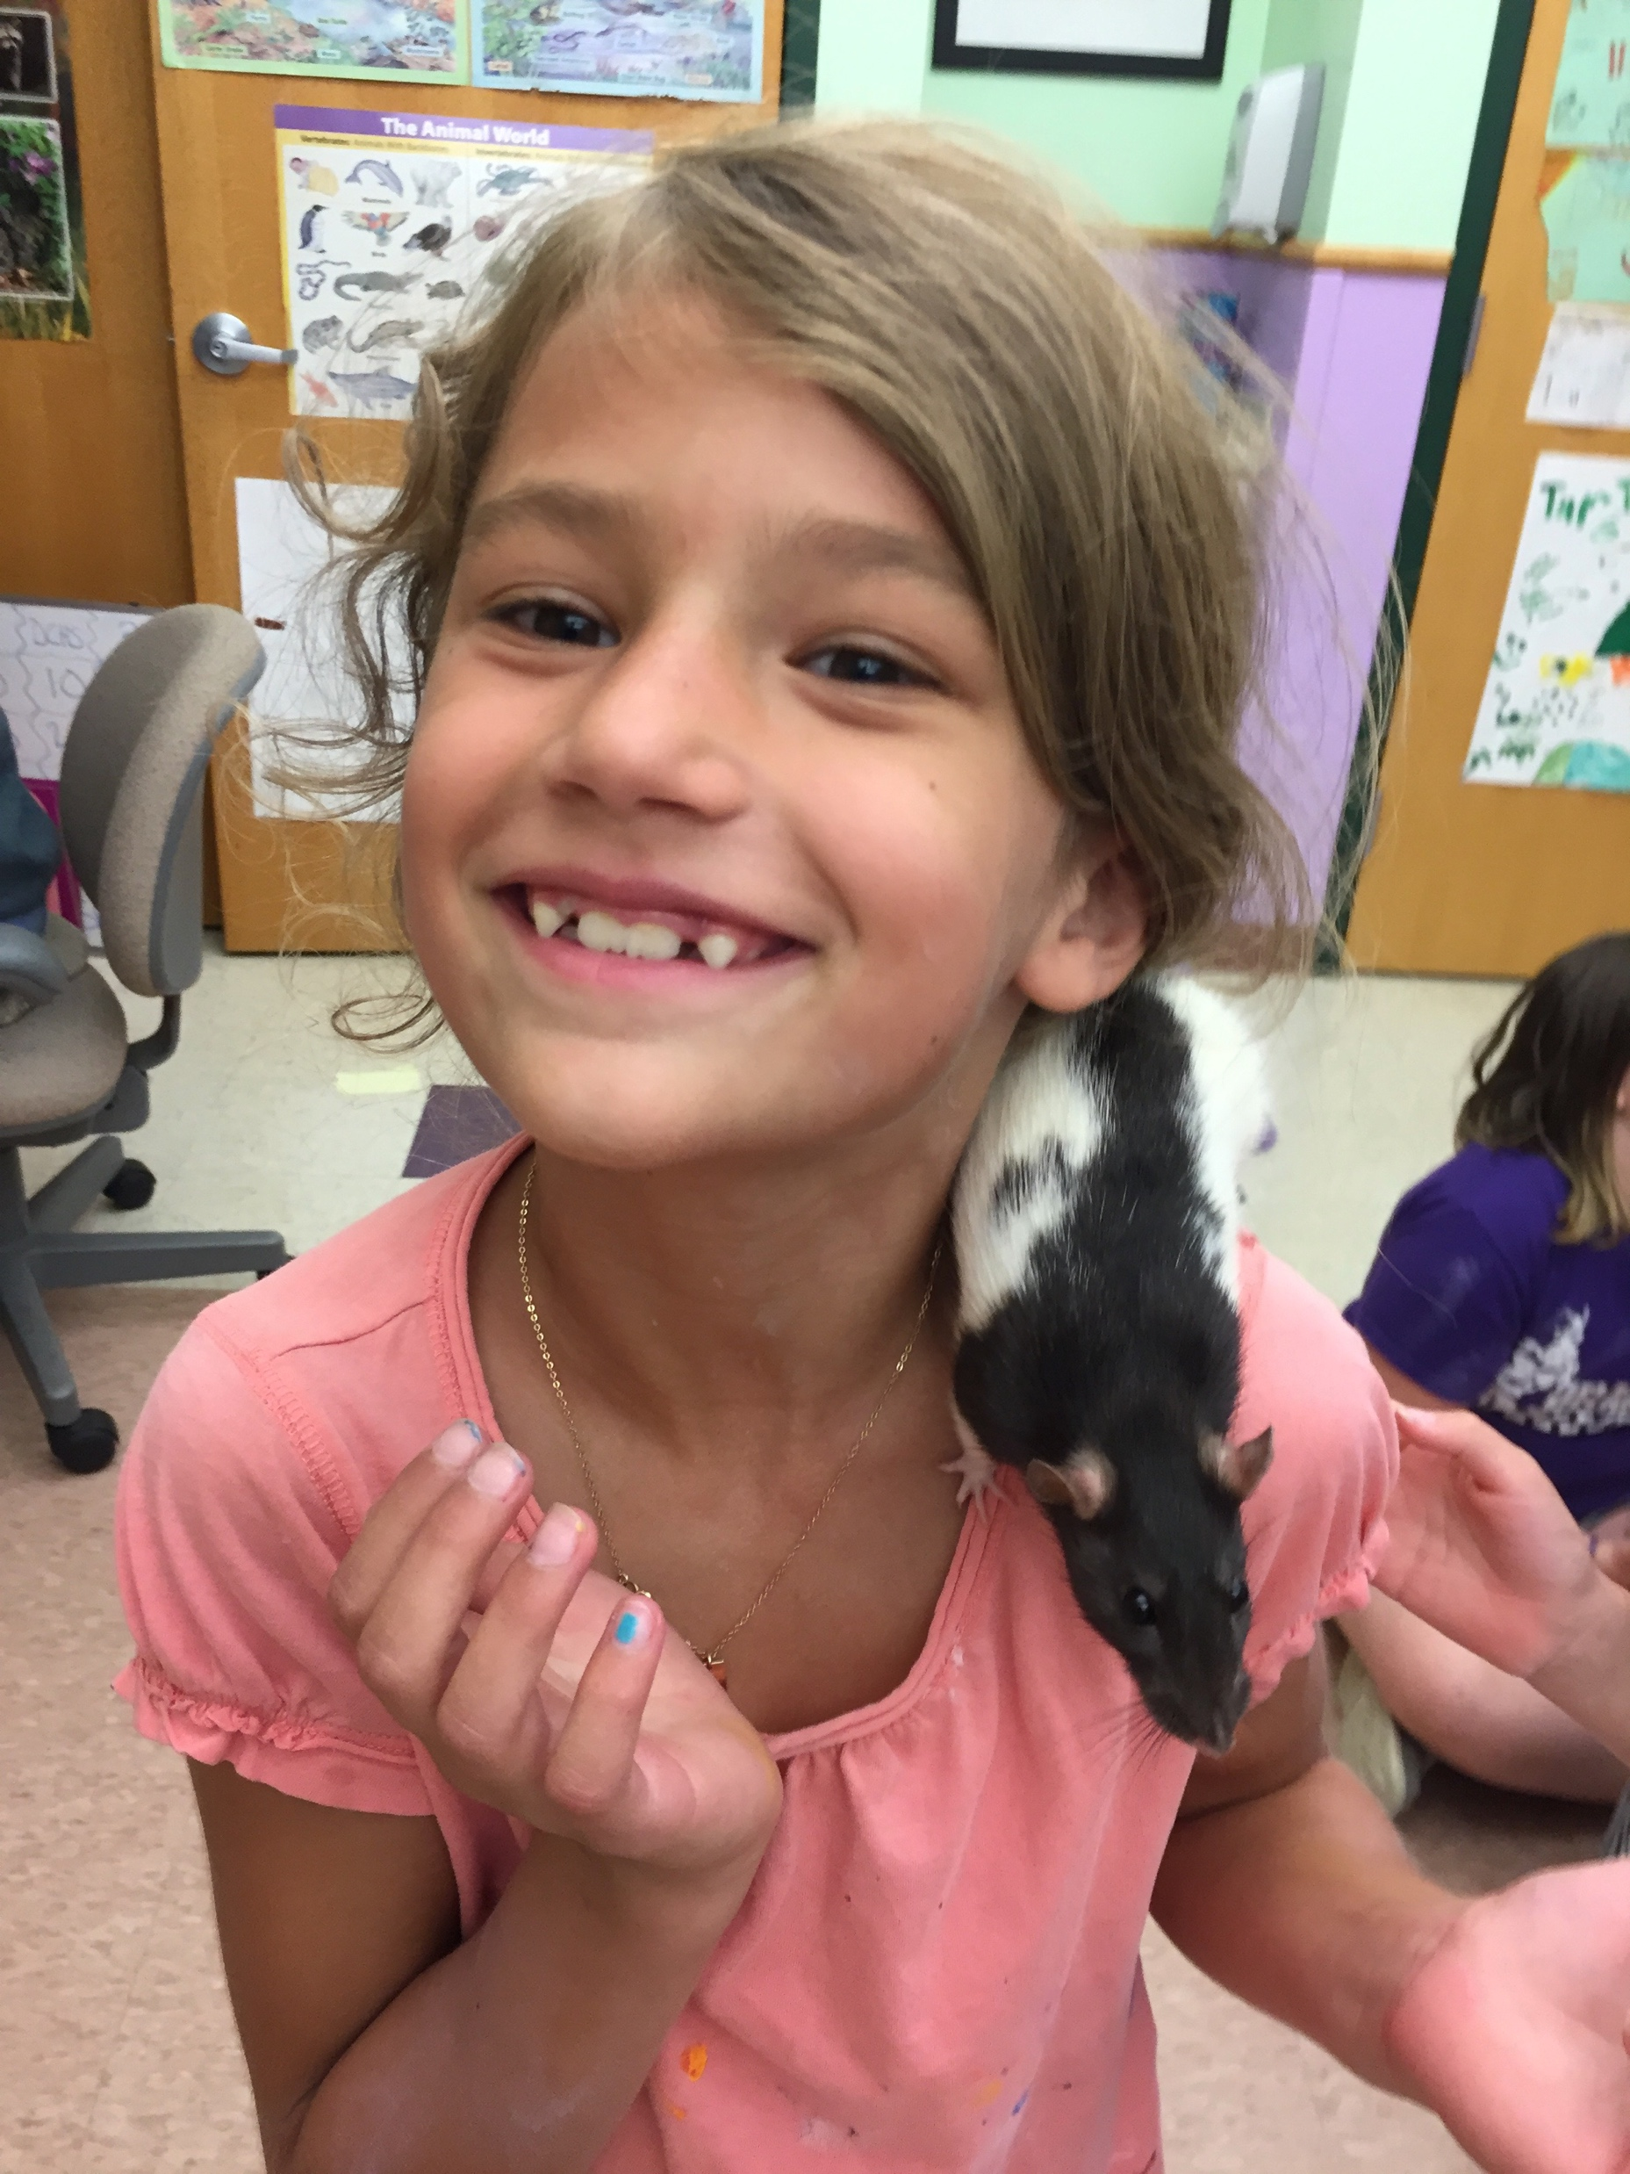


http://conscioushearts.foundation/wp-content/uploads/2014/08/06-juin.-Photo-37-Petite-bouille-redim.jpg, https://www.livehappy.com/sites/default/files/styles/article_featured/public/main/articles/TWO-Happy-Kids.jpg?itok=Sej0MxyK, http://volumeone.org/uploads/image/event/249/445/249445/header_custom/249445_49887_284_Kids.jpg, https://slodive.com/wp-content/uploads/2012/02/smiling-children-pics/baby-boy.jpg, https://i.pinimg.com/474x/c2/fd/b2/c2fdb20181d3a0027ab70c5b8340a3ad--syrian-kid-happy-smile.jpg
Notes:
Here are the true victims
Missing a parent
Financial hardship & emotional distress
Parental job exclusion
Life long reprecussions for a joint.
It isn’t scientific, its criminal.
Ask you all to please stand up for science..it is the only constant, the only truth.
As I saw on a bumper sticker, the nice thing about science is that it istrue wheater you agree with it or not

Slide 7
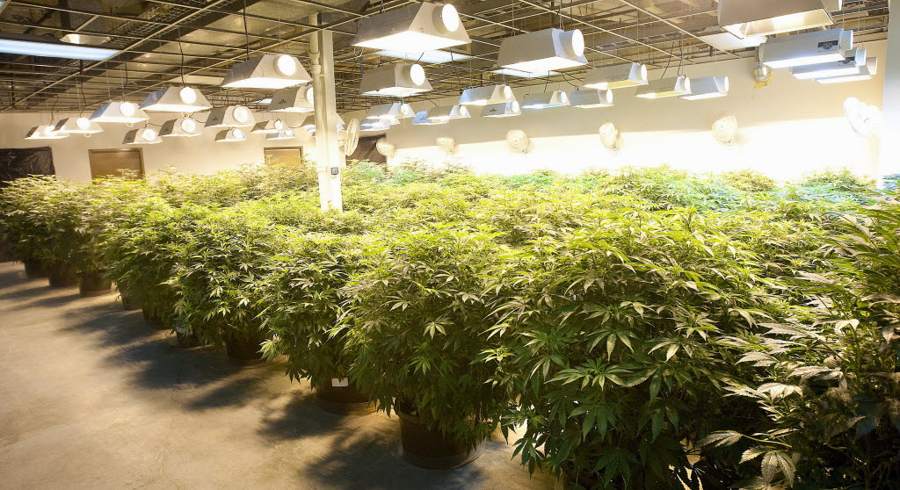
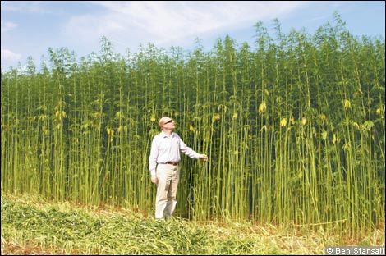
Genus: Cannabis
Marijuana
-Recreational (THC)
-Medical (CBD & THC)
Hemp (below 0.3% THC)
-fiber
-seed = food & oil
-CBD
THC- Tetrahydrocannabinol
CBD- Cannabidiol
Ganjababy & U of kentucky
Notes:
Allright, lets move on to some science!
Cannabis is generally split into two groups; Marijuana and hemp. Hemp is defined legally as containing less that 0.3% THC.
Top picture shows a standard marijuana grow operation, while the bottom image is of a hemp field.
For marijuana, chemical composition, predominantly THC has been the focus. This is produced primarily in the flower of Cannabis. CBD a close chemical relative to THC has also become a major focus. CBD does not have the psychoactive properties of THC, and actually counteracts THC, presumably by competing for the receptors in the brain
Traditionally, hemp is used for rope, paper, clothing, oil, and food
Oil can serve petroleum replacement. Henry Fords first car ran on hemp oil.
Hemp seed is quite nutritios and can be feed for humans or animals.
Hemp fibers are some of the longest found in nature making them ideal for such things as rope, paper, and clothes.
Finally, there is potential to use hemp as a biofuel. It grows robustly with a thick canopy eliminating the need for herbicides.
One way to make it more financially feasible is multi-cropping, which has been a focus in Europe. Collecting grain in the first cut and then harvesting the stalks.
One limiting factor world-wide is the necessary equipment and infrastructure.
Recently, hemp has taken on a new role, and that is as the source of CBD.
By most scientific definitions, CBD is considered a drug.
What is drug?
THC/CBD more like hormones versus a toxin such as alcohol.
But CBD production in hemp has clouded the issue because the definition of hemp based upon THC doesn’t reflect the science.

Slide 8
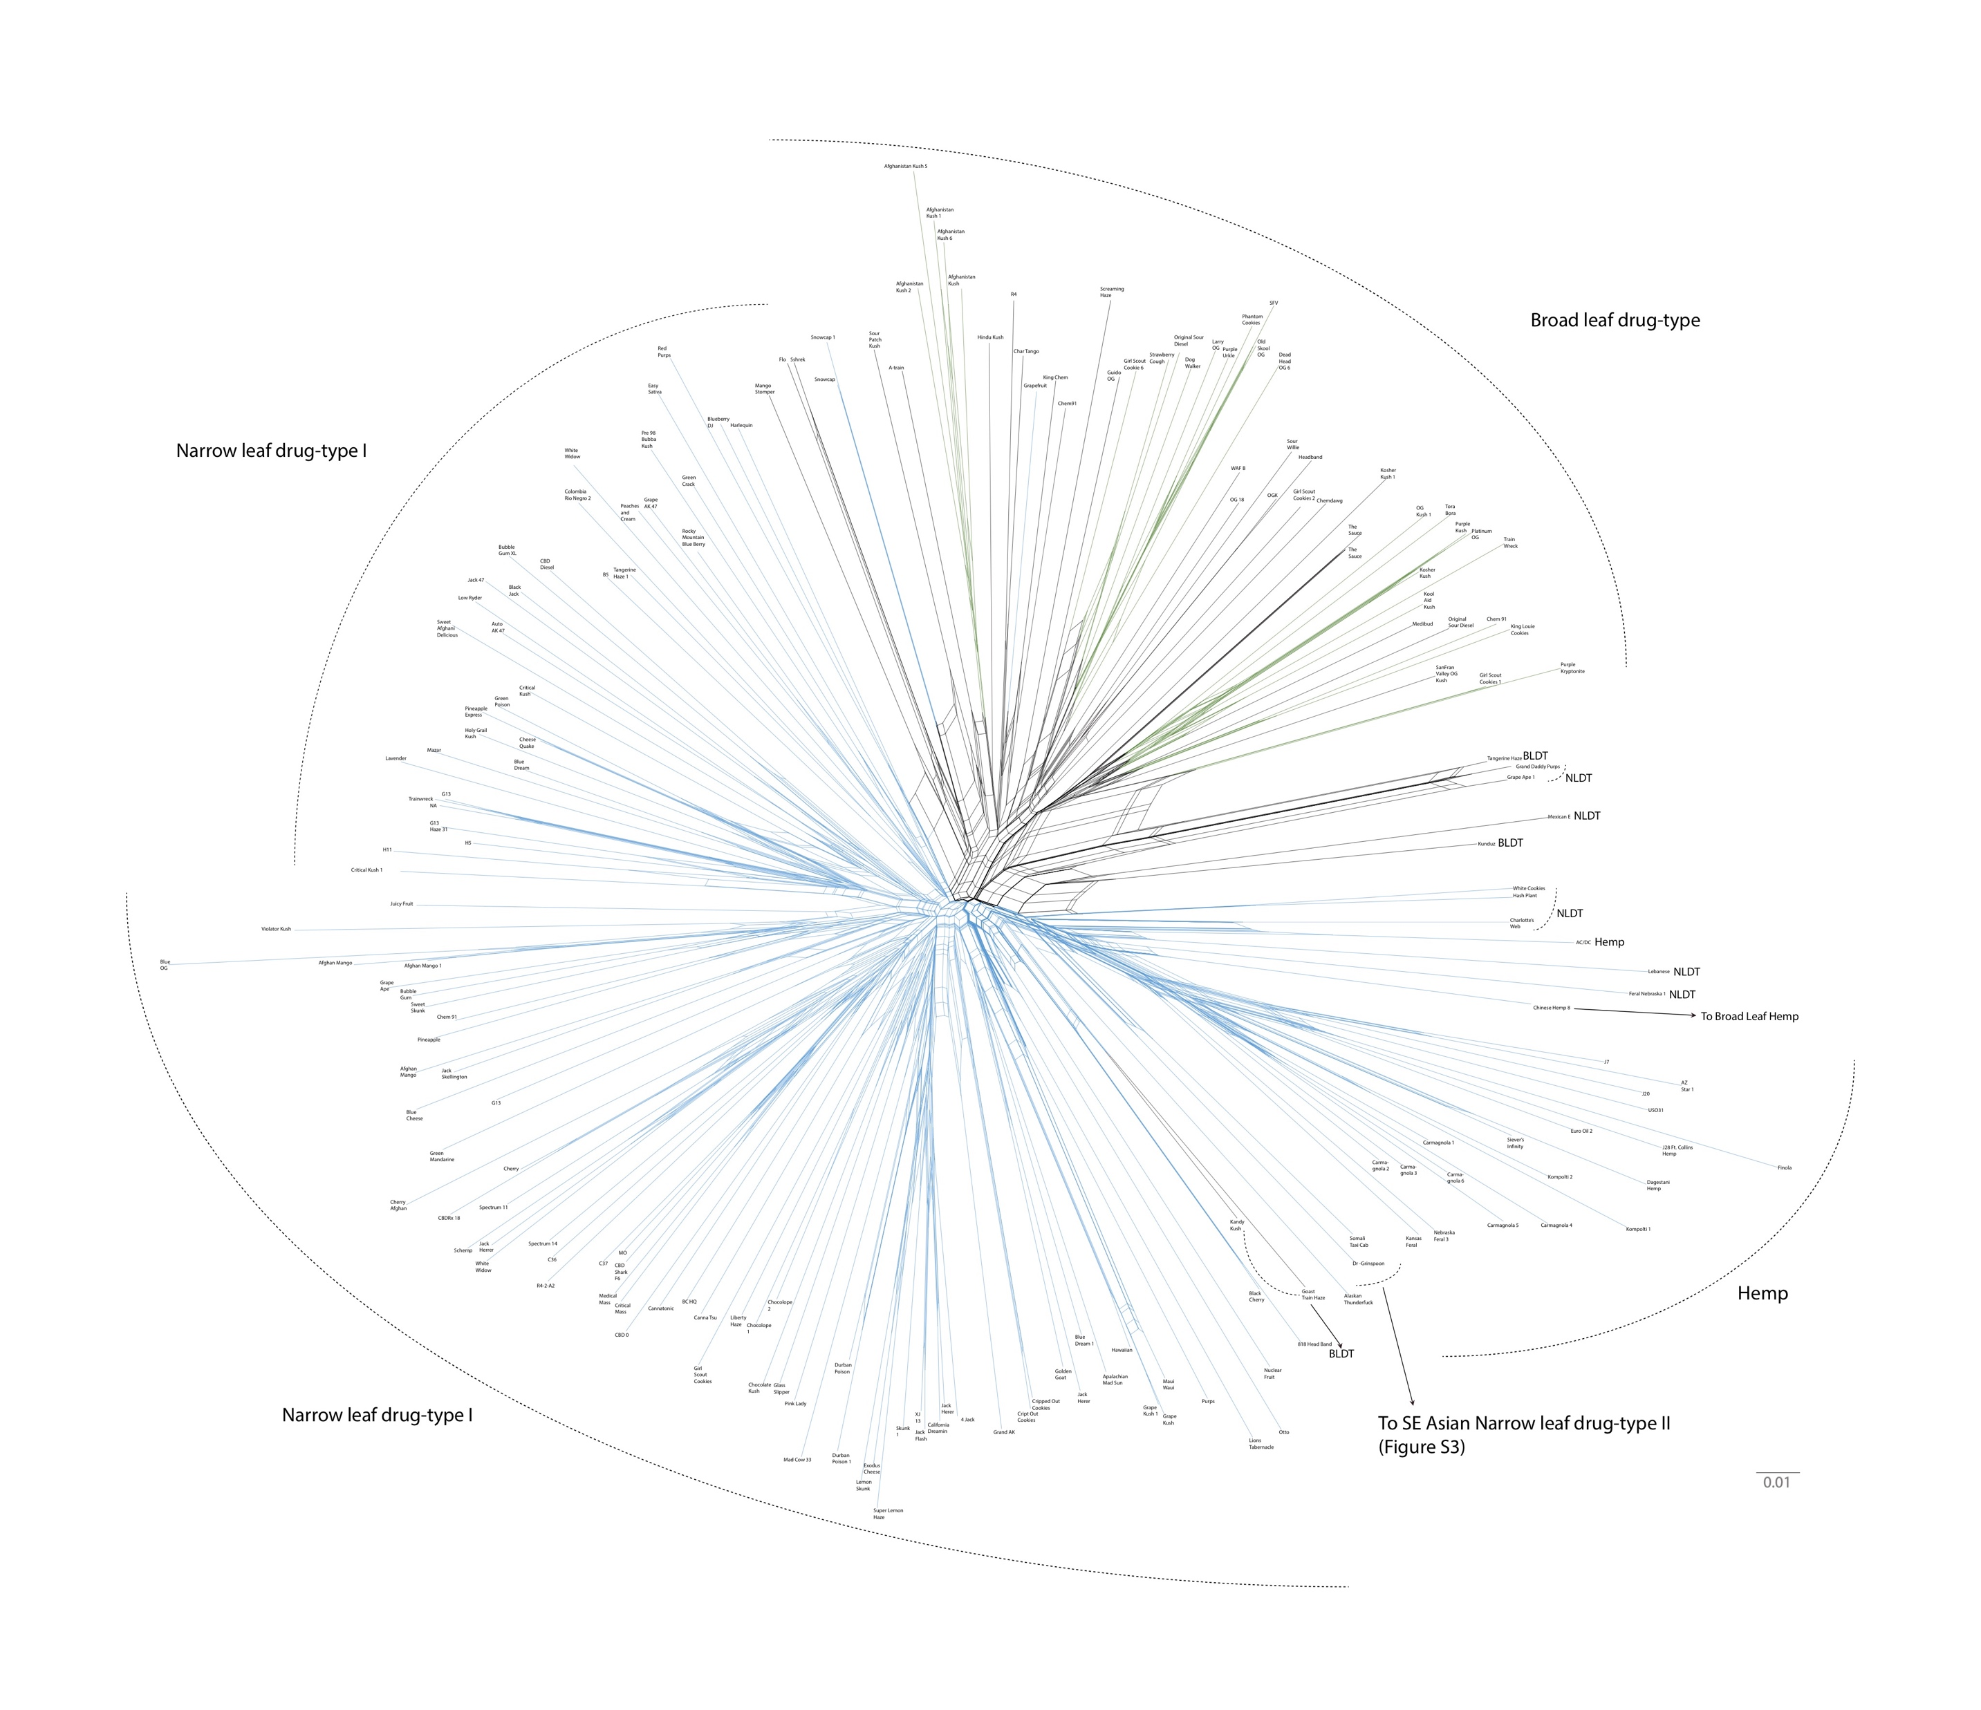
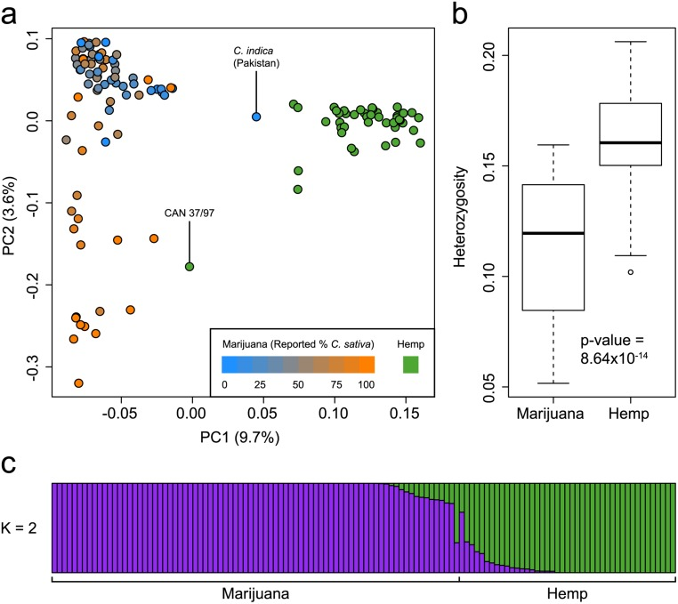
Star-Chart
HEMP
Narrow Leaf Drug Type I
Narrow Leaf Drug Type II
Broad Leaf Drug Type
Sawler, et al. 2015; Lynch, et al. 2016
Notes:
When we look at the population structure of Cannabis we see some distinct groups.
In work done by Jon Page’s group we can see that Cannabis samples fall into two groups, marijuana and hemp.
In the figure on the right from Nolan Kane’s group and hempgene we see that HEMP (arrow) form a distinct clade separate from the drug types.
And that is where we get some confusion. Oval = CBD.
Thus based upon the population structure of Cannabis, high CBD strains fall into the marijuana category.
Narrow leaf-broad leaf, which I will elaborate upon shortly. But notice hemp groups with narrowleaves as do many MJ strains
But I want you to note the Triangle within the broad leaf type – Afghanistan . Broad leaf type origin? Kushs. Indica. Hash

Slide 9
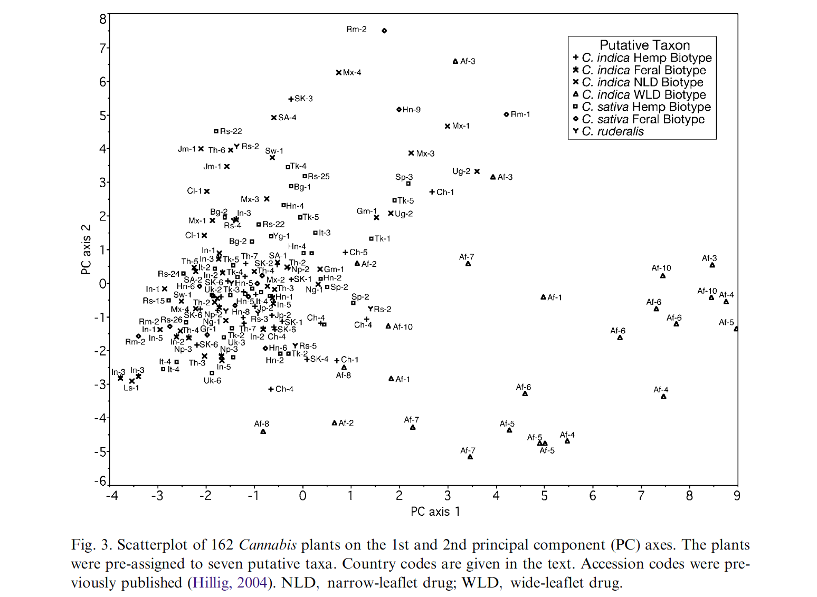
Hillig 2004
Notes:
Hillig 2004
Terpenes

Slide 10
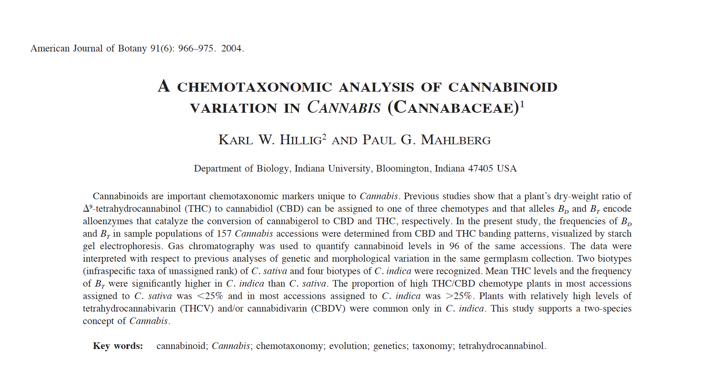
To Karl and Paul – THANKS!
Notes:
We owe them thanks for being the First to really do some population studies.
Story is they were raided by the DEA and everything was confiscated, including the DNA. Huge loss of germplasm.
I speak with Paul Mahlberg frequently, and hopefully we can get him here next year

Slide 11
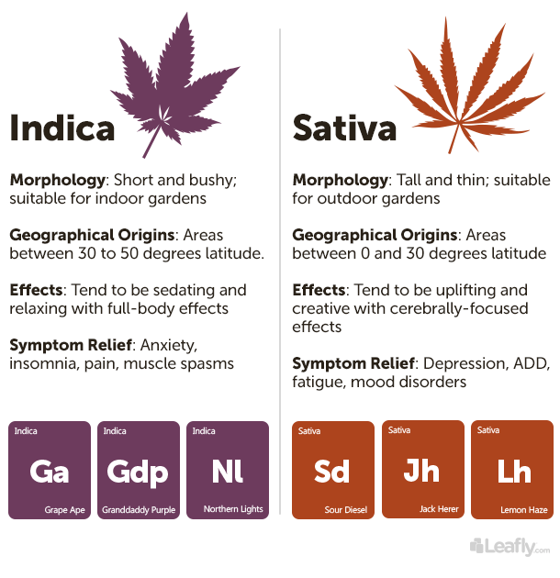
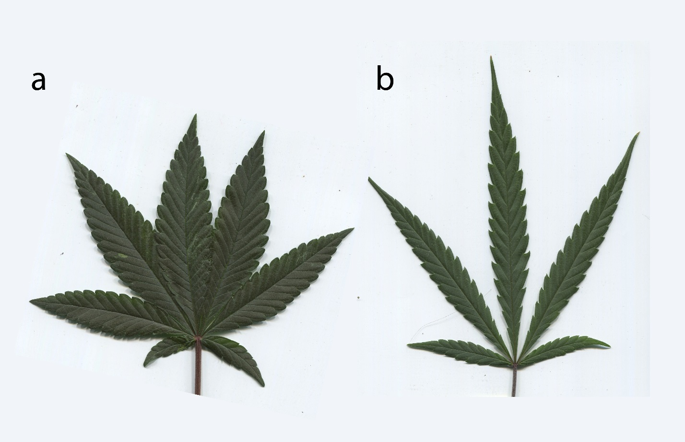
Broad leaf and narrow leaf drug types
Lynch, et al. 2016
Notes:
Wide leaf – short bushy, like the picture at the beginning with a bushy marijuana plant, while
Narrow leaf drug types are generally taller and this, similar to hemp.
Broad leaf orginate from high degrees of lattidtude while
narrow leaf strains are more equatorial.
Broad leaf general phenotype is sedating with whole body effects, while
Narrow leaf is more uplifting and cerebrally focused.
Thus broad leaf is used more for anxiety and insomnia, while narrow leaf is used for depression and fatigue
Sative = haze
Indica = kush

Slide 12
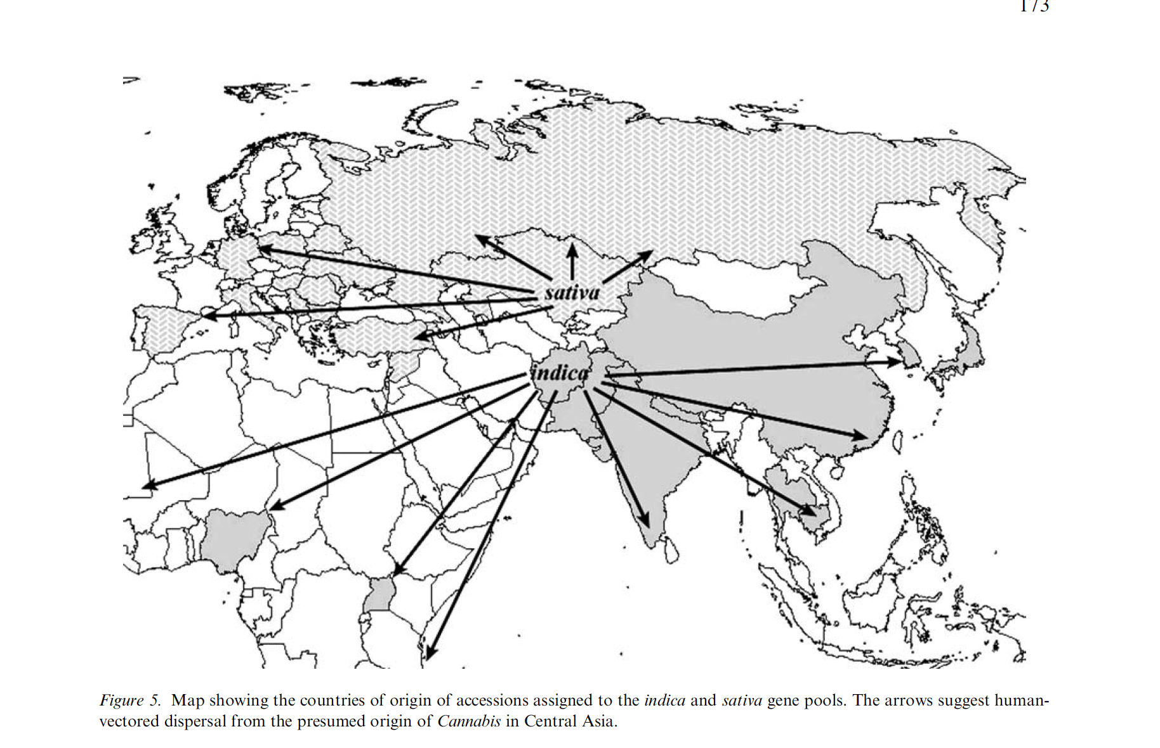
Narrow leaf (Sativa?) from Europe, broad leaf (Indica?) from Asia
Hillig 2005
Notes:
While the dissemination of Cannabis types is up for debate, and probly alwys will be Generally NLD Europe and BLD Asia.
Hillig 2005, First genetic study, 157 strains
Drug type sativa derived from hemp
Due to humans, there has been a lot of migration and admixture. Making it difficult to trace the origins of certain types or find true landraces.

Slide 13
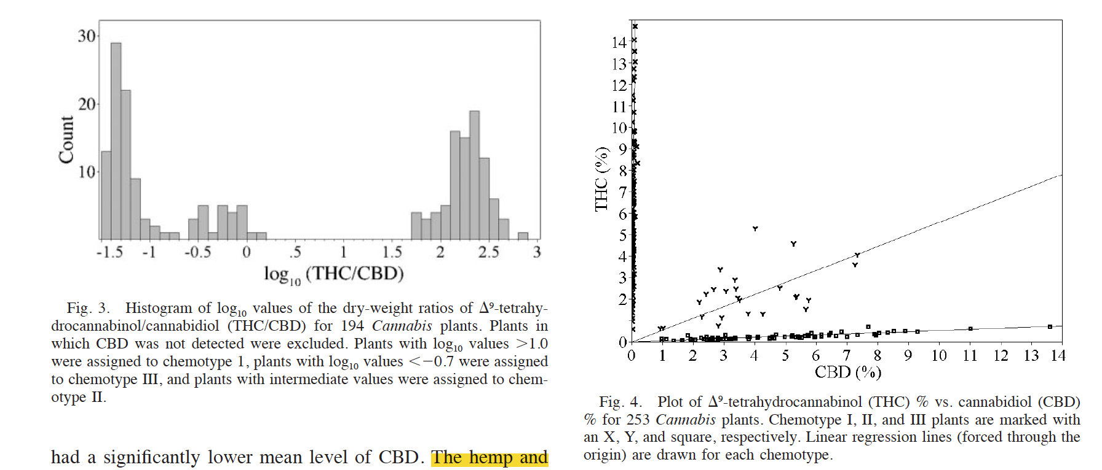
CBD and THC concentrations are negatively correlated
Hillig & Mahlberg 2004
Notes:
Hillig Mahlberg 2004
Intermediate variablility
THC/CBD variability
Raising questions as to the genomic organization of the genes

Slide 14
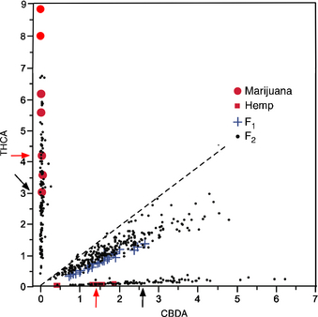
CBDAS and THCAS are tightly linked
Hemp X MJ
Weiblen 2015
Notes:
1:2:1 segregation
Tightly linked, segregates as one locus

Slide 15
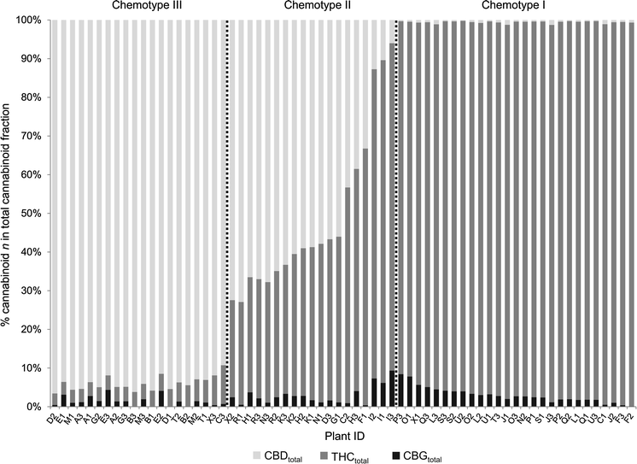
Three distinct classes of CBDAS and THCAS genotypes
Chemotype III
BdBd
CBDAS+ CBDAS+/-; THCAS- THCAS-
Chemotype II
BdBt
CBDAS+ CBDAS+/-; THCAS+ THCAS+/-
Chemotype I
BtBt
CBDAS- CBDAS-; THCAS+ THCAS+/-
De Meijer 2003
Beckstead (1973a, b)
Welling, 2016
Notes:
King 2015 - Good example
Certain terminology
CBDAS -> CBD with heat

Slide 16
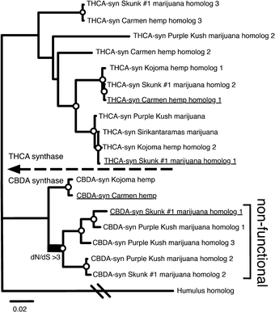
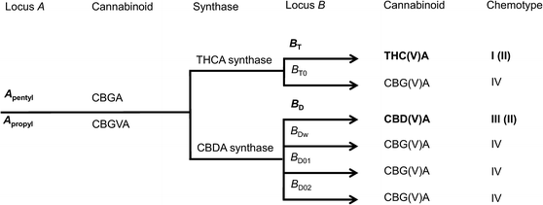
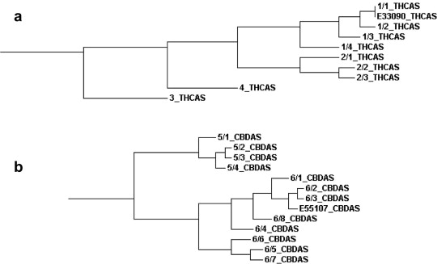
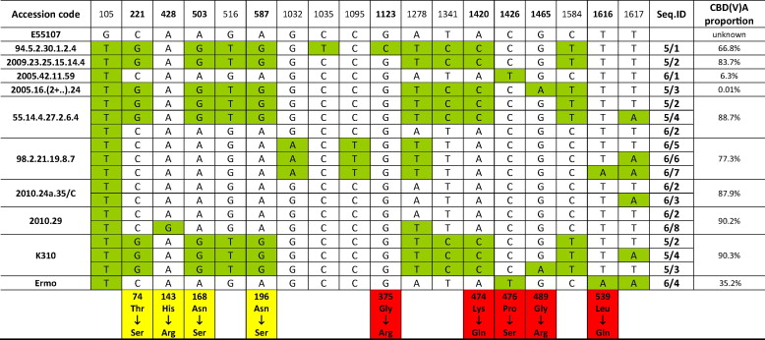
Weiblen 2015
Welling 2016
Onofrio 2015
Notes:
Paralouges??? - Tandem? Tandem versus trans, selection
George. Non-functional CBDAS in MJ strains indicating a higher affinity for CBDAS
Onofrio.
No introns
Bacterial
Promiscuos - hard to get zero THC plant
CBDAS is ancestoral

Slide 17
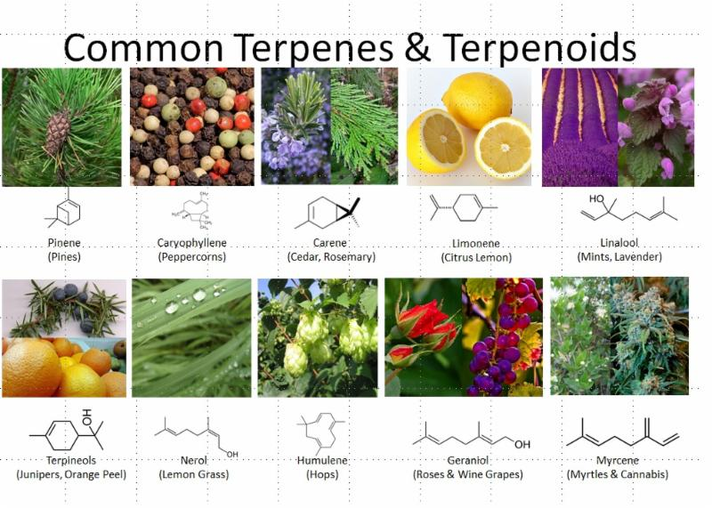
https://static1.squarespace.com/static/54a6e638e4b02cb3ce0c7c29/t/59d80f81f9a61eab9bae2c62/1507331981580/terpenes.jpg
Notes:
Other cannabinoids
Entourage effect - Synergistic responses
Effects?
Myrcene-indica like effects-some call couch-lock
Flavor
Hops is closest relative

Slide 18
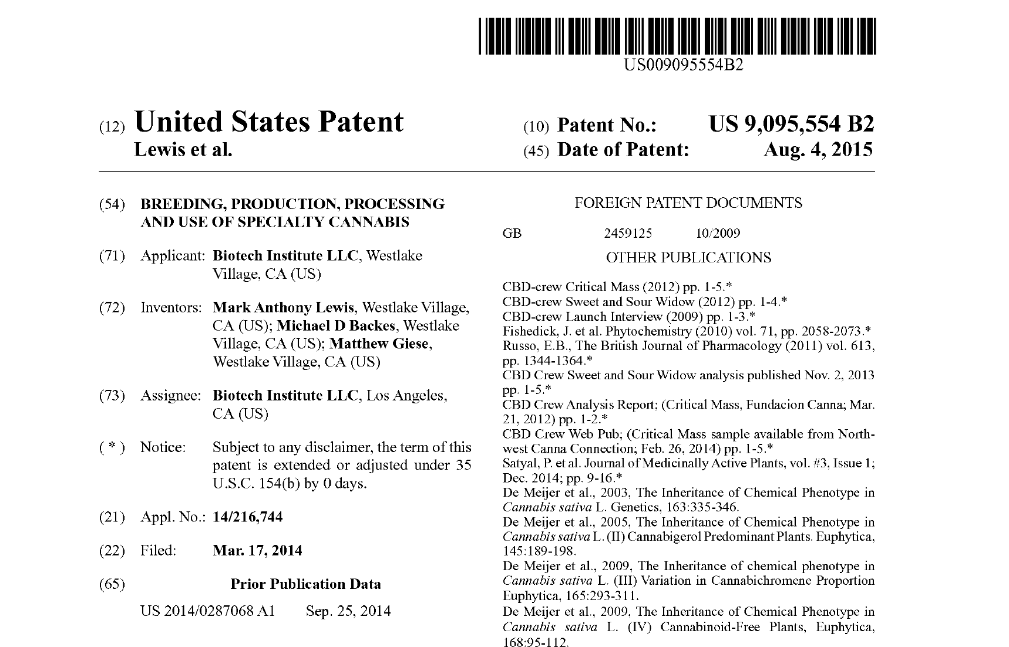
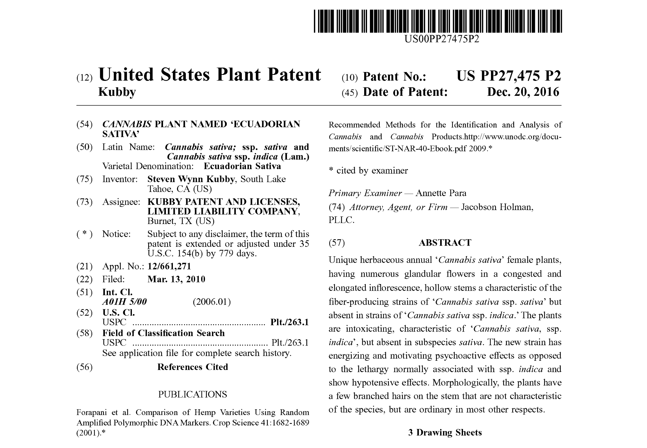
Questionable patents
“This invention provides compositions and methods for breeding, production, processing and use of specialty cannabis”
This patent protects a “unique” strain called Ecuadorian Sativa with a unique terpene profiles
Notes:
A major concern in the cannabis cummunity is restrictive over reaching patents
patentCannabis isn’t different than other plants. This is a general guide for phenotype driven breeding. All common techniques and common pipelines.
Who say its unique?
Major problem that needs to be addressed

Slide 19
Open source sequence data
2011
The draft genome and transcriptome of Cannabis sativa.
van Bakel, et. al., Genome Biology 2011. 12:R102
2018
Between 5-10 genomes have been sequenced, but the best assembly was around 700 contigs.
http://opencannabisproject.org
Phylos
Mowgli Holmes
Alicia Halloway
NCBI
Medicinal Genomics
Notes:
But the first published genome by Jon Page’s group was published in 2011 and had roughly 700,000 contigs.
Now, seven years later, there are a number of genome sequences available, but a platinum-level assembly is still missing. The best was at about 700 contigs.
I’ll just barely touch on the progress towards having a reference genome because it will likely be covered by our speakers.

Slide 20
Odds and ends
Sex determination – Has sex chromosomes
-Cannabis has both monecious and diecious types
-Stress or silver nitrate induces pollen on female
-true selfing!!
Clones and feminized seed
Epigenetics
-sex determination and/or organ formation
-clonal “inbreeding depression”
CRISPR
-THCAS/CBDAS gene editing
State laws
-Grow your own
-determining intoxication level
-an order of magnitude efficiacy

Slide 21
Acknowledgements
Sunrise Genetics - Hempgene & Marigene
Chris Grassa
Matt Gibbs
Jason Schwartz
Alex Menk
Marie Turner
Alexandra Valenti
U of Minnesota
George Weiblen
Jonathon Wenger
Clemon Dabney
CBDRx
Tim Gordon
CVRI
Todd Michael
Blue Circle Development
George Blankenbaker
UC Boulder
Nolan Kane & Ryan Lynch

Slide 22


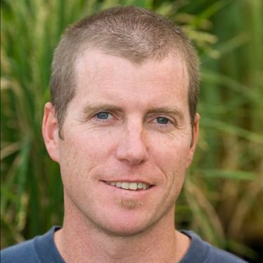
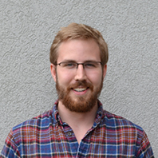
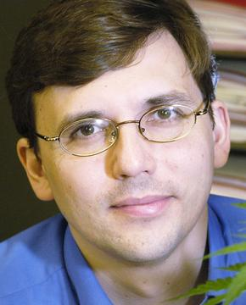
Christopher Grassa – Boston, USA
-Hempgene and Marigene
-Harvard U
Graham King – Lismore, Australia
-Southern Cross U
-Ecofibre
John McKay – Colorado, USA
-Colorado State U-FoCo
-New West genetics
Jason Sawler– Vancouver, Canada
-Anandia
George Weiblen – Minnesota, USA
-U of Minnesota

