Slide 1
”After” prohibition, Cannabis is rapidly catching up to other crops using modern science, but hurdles remain
UC-Davis Plant Science Symposium
May 6
Davis CA
CJ Schwarz
Sunrise Genetics
Chief Scientist
cj.schwartz@sunrisegenetics.com
Notes:
Thank you everyone for tuning in to hear my talk. I would like to especially thank the students for selecting me as a speaker. I was always very involved in recruiting students when I was a grad student and served on the admissions committee for 3 years. The training at that point of a students development is so important for the critical thought required to be a scientist. Grad school was one of the best times of my life and I made many life long friends. SO ENJOY IT! I actually interviewed at Davis for grad school and it came in a close second. So it is an honor to be chosen.
Even though I never imaged I would be giving a talk without wearing pant. I have shorts on.
But in all seriousness, these are scary times. I attended a talk in 1995 by Joshua Lederberg a Nobel Laureate and his whole talk focused on an upcoming pandemic. I have been concerned ever since and have become a part time prepper with a off-grid cabin in Northern Minnesota. While this outbreak is serious, it doesn’t appear to be the end of mankind, but we have been given a wake up call that we need to be prepared for these challenges.
OK, who am I and why am I speaking today. My name is CJ Schwartz and I have worked on plant molecular genetics for nearly 20 years mostly in academia.
6 years ago I took the plunge into the business world because I saw a need to bring real science to Cannabis. As it became clear that there were some medical benefits, especially for children with seizures, I was very troubled about the lack of knowledge and transparency for this plant. While research continues to be hindered by unwarranted prohibition and the associated stigma, we have the tools to advance the science of Cannabis to the level of other economically important crops such as corn. With that in mind, I founded Sunrise Genetics. Yes the name is very generic, but it allows us to get a bank account.
Our goals are to use modern genetic techniques to make drug types of Cannabis safe and well-defined for maximum efficacy and appropriate use. For hemp the goal is to produce an economically viable and environmentally sustainable agricultural crop.

Slide 2
One of the first and longest species cultivated by humans
Russo 2007
Notes:
Cannabis is one of the first plants cultivated by humans.
Physical evidence suggests that Cannabis use dates back 5000-10000 years ago, being found in Africa, Asia, Europe, and the middle east.
There is no denying that Cannabis has had a large influence on human society and culture, due to its versatility as a source for fiber, grain, and chemical compounds.

Slide 3
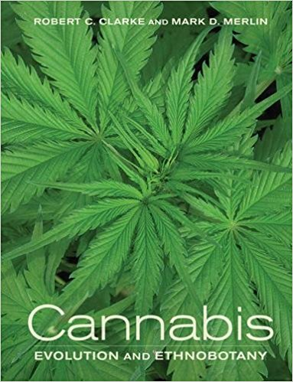
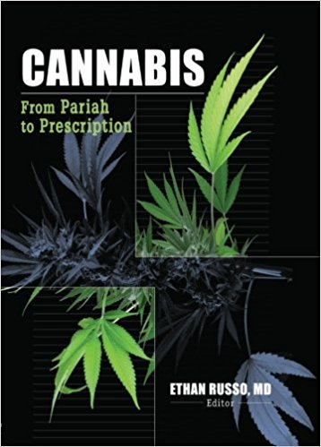
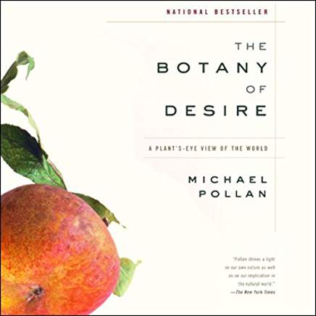
Literature on Ethnobotany and medicinal uses
Notes:
There are many sources of information on Cannabis and interactions with humans called Ethnobotany
While I am not singling out these books specifically, much of the science is soft, and claims as to the potential of Cannabis have been overstated. This is a disservice to science and society, due to unproven information and unrealistic expectations
This is particularly true with medical claims where misinformation can have serious consequences on patients.
What the Cannabis industry needs is sound science using modern techniques.

Slide 4
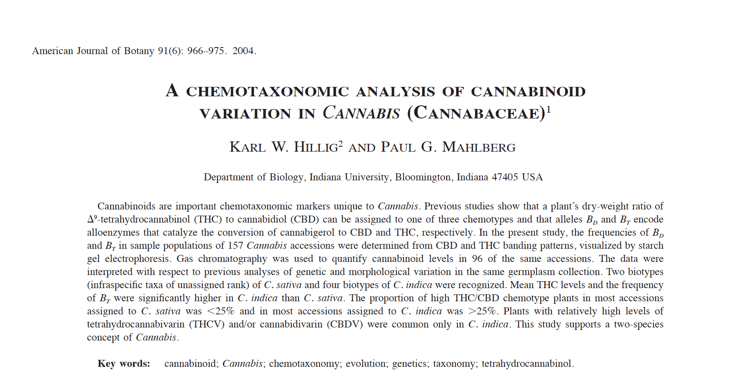
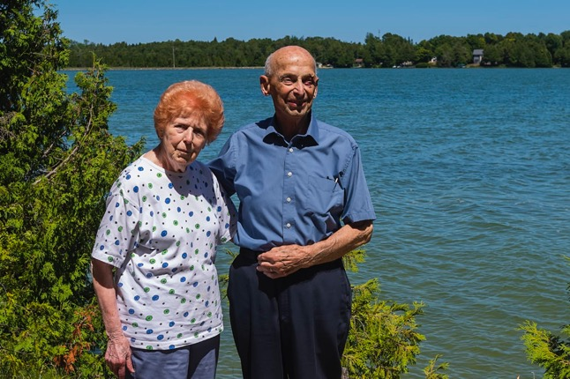
To Karl and Paul – THANKS!
Notes:
Two brave pioneers in the field were Karl Hillig and Paul Mahlberg. We owe Karl and Paul for being one of the first to really have the guts to work with Cannabis, utilizing science to generate facts. They worked endlessly to accumulate a worldwide collection of strains for population studies.
Story is - they were raided by the DEA and everything was confiscated, including the DNA. It was huge loss of an extensive germplasm collection.
Karl has been hiding out ever since, but I did get him to return an email once. He’s probably at an off grid cabin in the woods of Northern Minnesota.
Sadly enough Paul passed away in October of 2018. He was a Cannabis expert to the end helping get hemp production legalized in Wisconsin.
His work laid the groundwork for those of us following in his footsteps by doing real science.

Slide 5
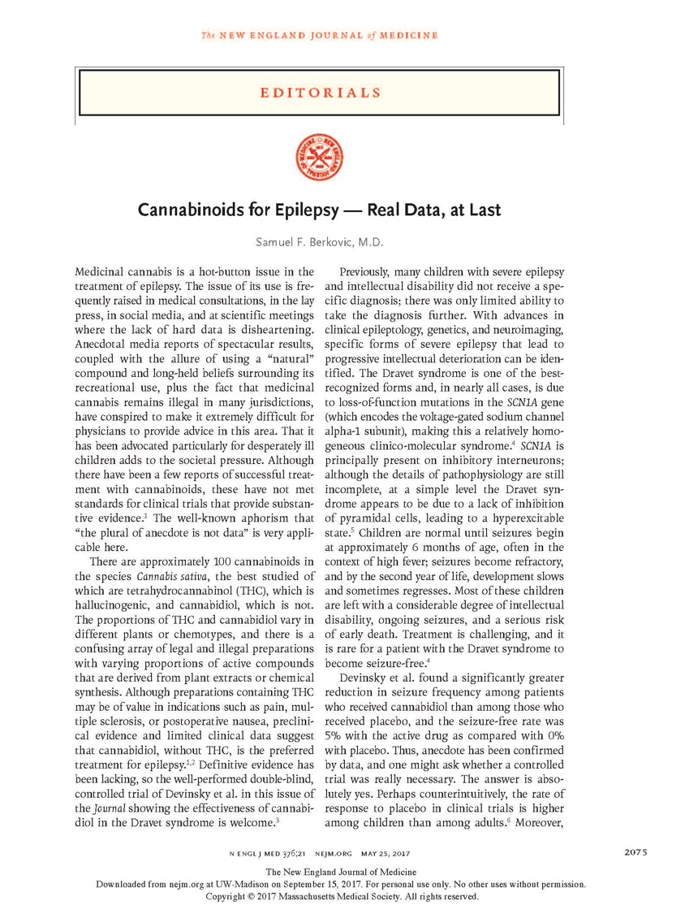
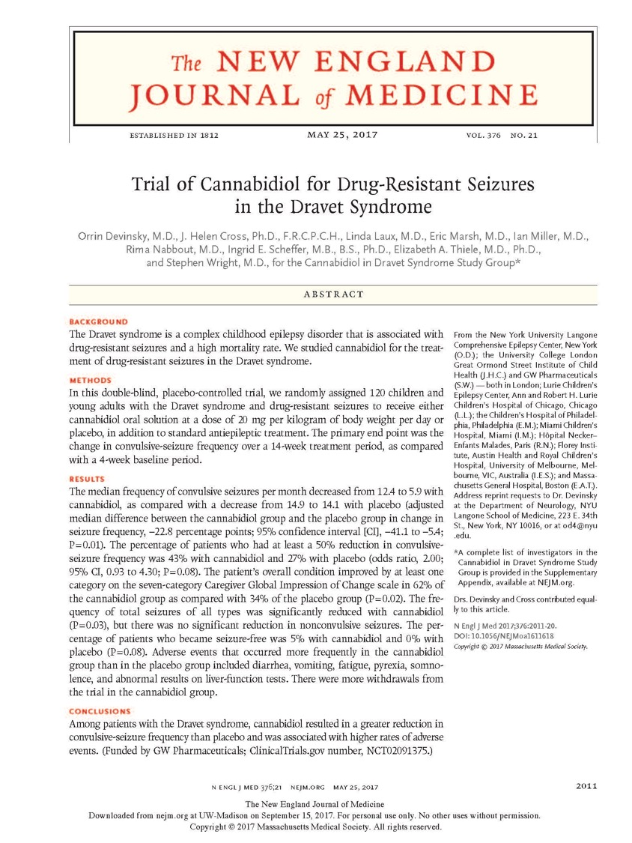
Notes:
I was overjoyed to see this article published in 2017, and the editorial in the same issue says it all.
REAL DATA, AT LAST
Dravet syndrome is a loss of function mutation that results in severe seizures in children, causing intellectual deterioration and early death.
CBD (Cannabidiol) a component of Cannabis greatly relieves the symptoms of this disease.
These are the type of studies which are required, and they are hindered by bad laws not based on science.
There are plenty of jokes about getting high, but there is nothing funny about a child having a seizure.
This work along with other studies makes it a fact that Cannabis is NOT a schedule I narcotic. Schedule 1 means it has no medical uses.

Slide 6
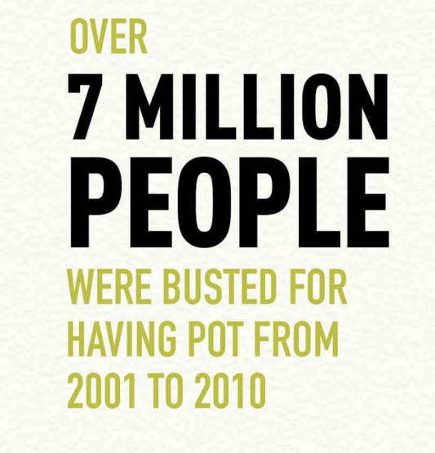
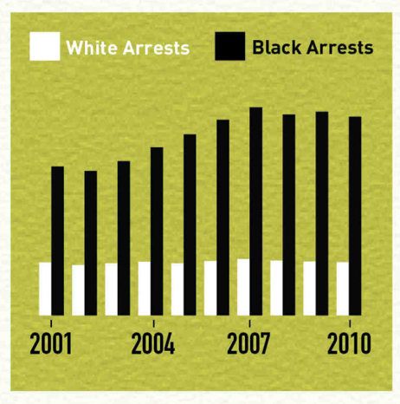
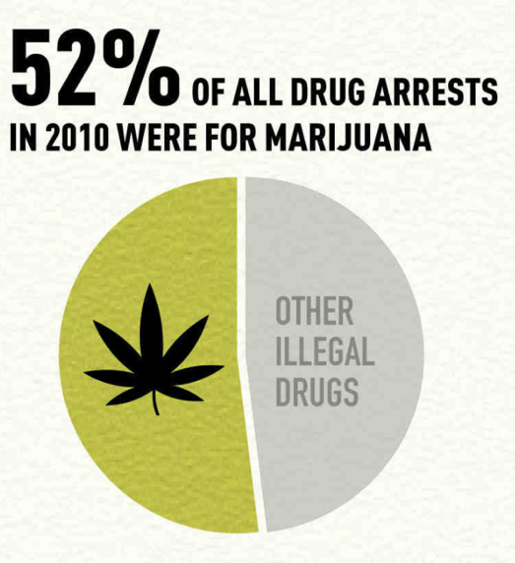
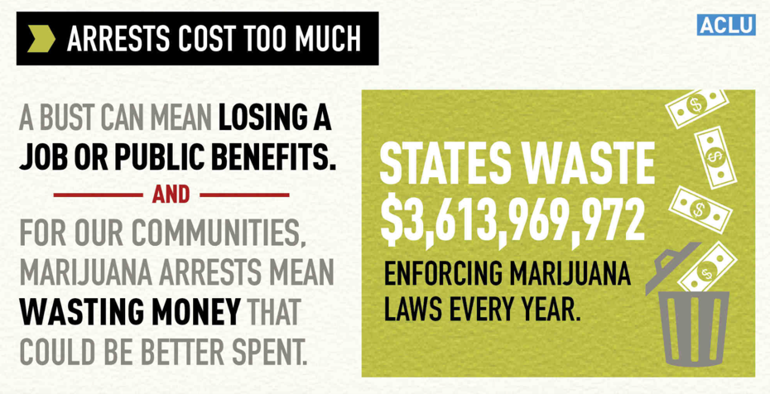
You may not agree with science, but science doesn’t care
Never an overdose
Little science…it’s prohibited
Lifelong repercussions That can span generations
ACLU
Notes:
In a 9 year period 7 million people in this country were punished for possession of Cannabis.
During the same 9 year period people of color were arrested at a rate 3 times that of their Caucasian counterparts.
Even though there has never been an overdose of marijuana, 52% of all drug arrests are for cannabis, costing states over 3 and a half BILLION dollars a year.
The worst thing of all is the fact that being arrested for marijuana has lifelong repercussions that can span generations

Slide 7
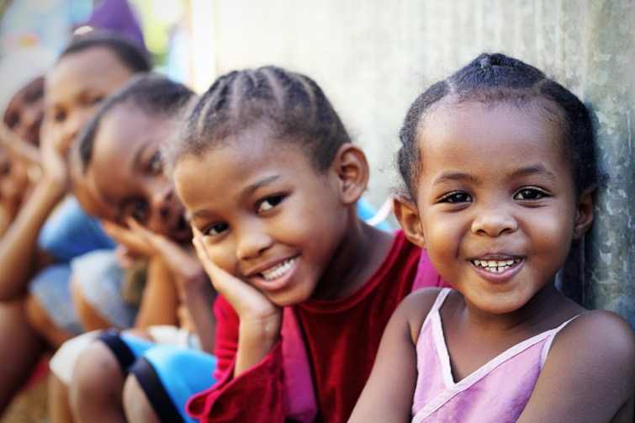
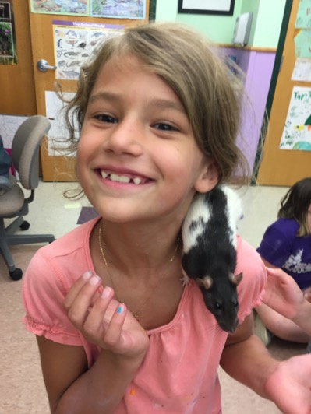
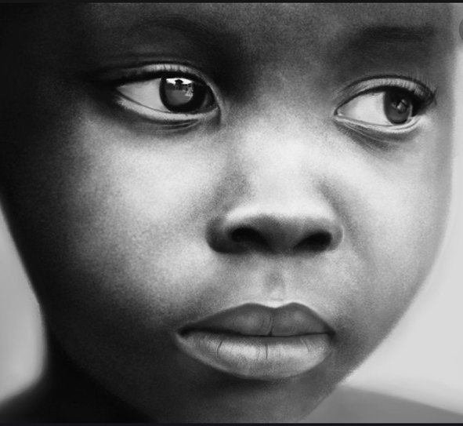
http://conscioushearts.foundation/wp-content/uploads/2014/08/06-juin.-Photo-37-Petite-bouille-redim.jpg, https://www.livehappy.com/sites/default/files/styles/article_featured/public/main/articles/TWO-Happy-Kids.jpg?itok=Sej0MxyK, http://volumeone.org/uploads/image/event/249/445/249445/header_custom/249445_49887_284_Kids.jpg, https://slodive.com/wp-content/uploads/2012/02/smiling-children-pics/baby-boy.jpg, https://i.pinimg.com/474x/c2/fd/b2/c2fdb20181d3a0027ab70c5b8340a3ad--syrian-kid-happy-smile.jpg
Notes:
Here are the true victims of marijuana prohibition.
Children have to burden the consequences of missing a parent due to incarceration which creates financial hardship & emotional distress
Perhaps the most significant consequence is that these children’s parents are unable to find good jobs due to a conviction. And this doesn’t go away, condemning many of these innocent children to a lower quality of life.
Life long repercussions - for a joint.
It isn’t based on science, and it is immoral. The crime does not fit the punishment
I ask you all to stand up for science and facts. It is a constant, it’s reproducible, it is fact.

Slide 8
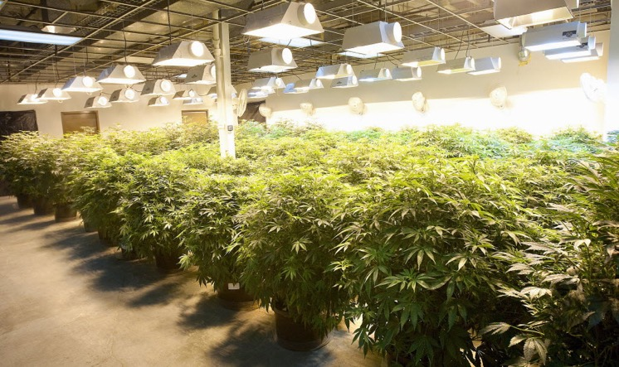
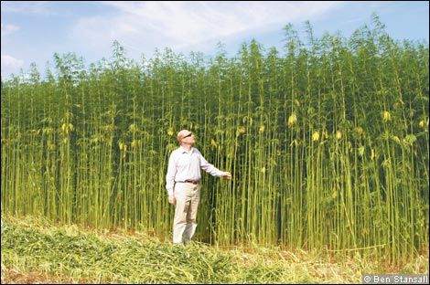
Genus: Cannabis
Marijuana
-Recreational (THC)
-Medical (CBD & THC)
Hemp (below 0.3% THC)
-fiber
-seed = food & oil
-CBD
THC- Tetrahydrocannabinol
CBD- Cannabidiol
Ganjababy & U of kentucky
Notes:
OK. Lets move on to some science! Something more pleasurable.
Cannabis is generally split into two groups; Marijuana and hemp. Hemp is defined legally as containing less that 0.3% THC.
The top picture shows a standard marijuana grow operation, while the bottom image is of an agricultural hemp field.
For marijuana, chemical composition, predominantly THC and CBD has been the focus. CBD does not have the psychoactive properties of THC, and may actually counteract THC, presumably by competing for the receptors in the brain.
Traditionally, hemp is used for rope, paper, clothing, oil, and food.
Oil from grain can serve as a petroleum replacement. Henry Fords first car ran on hemp oil.
Hemp seed is quite nutritious and can be feed for humans or animals.
Hemp fibers are some of the longest found in nature making them ideal for such things as rope, and clothing.
Finally, there is potential to use hemp as a biofuel. It grows robustly with a thick canopy eliminating the need for herbicides.
Making hemp competitive requires an infrastructure to process products from farmer to consumer. Without this infrastructure, hemp fiber has little value, compared to hemp seed, which has little value compared to hemp CBD. Currently the only way for farmers to make a profit from hemp is as a source of CBD
But CBD production in hemp has clouded the issue because the definition of hemp based upon THC doesn’t reflect the science and I will show you the evidence shortly

Slide 9
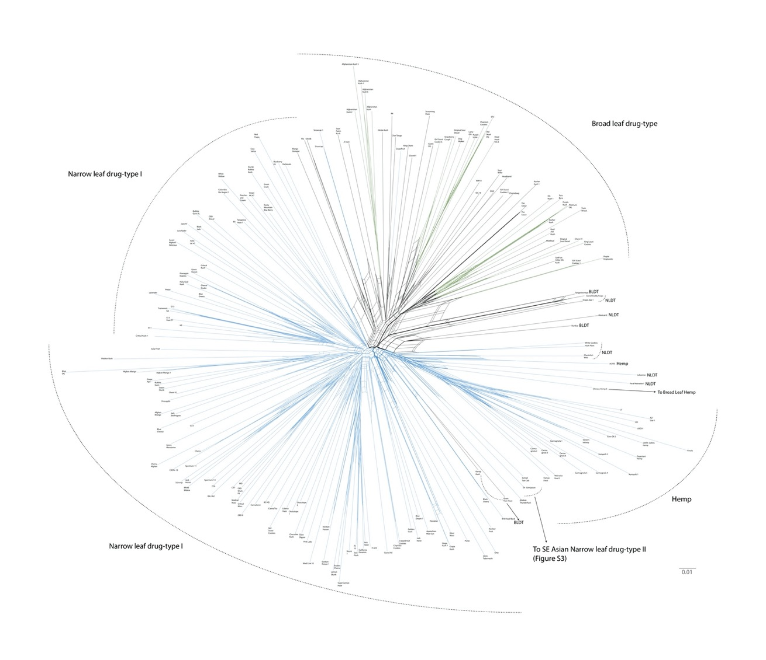
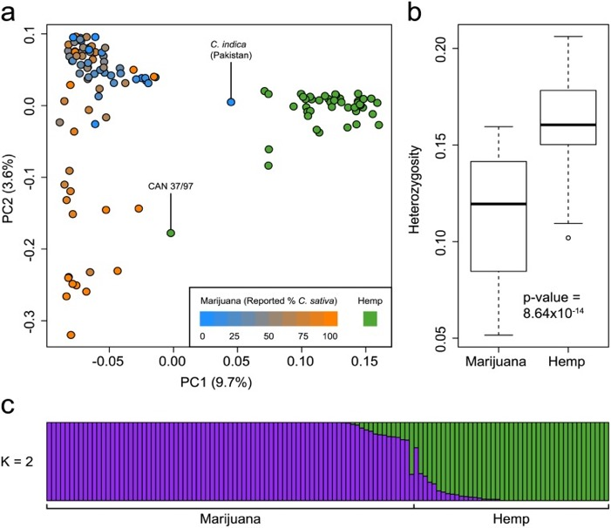
Star-Chart – 371 varieties (GBS), 69 varieties WGS
Four Classes
HEMP
Narrow Leaf Drug Type I
Narrow Leaf Drug Type II
Broad Leaf Drug Type
BLDT I
CBD
NLDT I
NLDT II
Sawler, et al. 2015; Lynch, et al. 2016
Notes:
Showing relatedness or ancestors, like a family tree. A major task has been to classify Cannabis types
Two major divisions
In the figure on the right from a paper we published with Nolan Kane’s group we used 440 varieties, to 4 groups
Within the oval are high-CBD varieties.
-confusion.
Scientifically high-CBD varieties are marijuana, but legally they are hemp

Slide 10
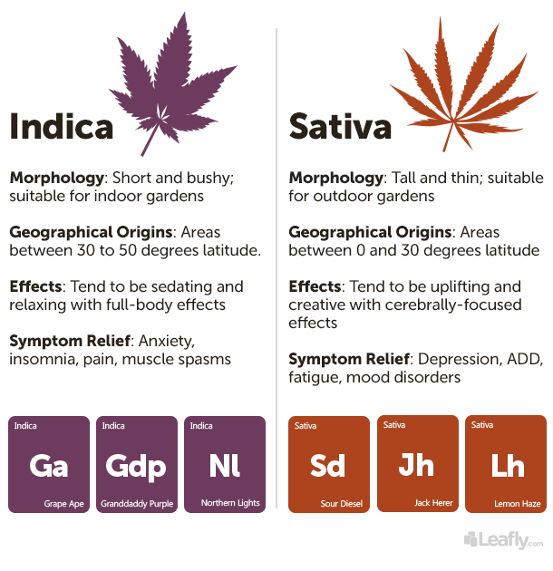
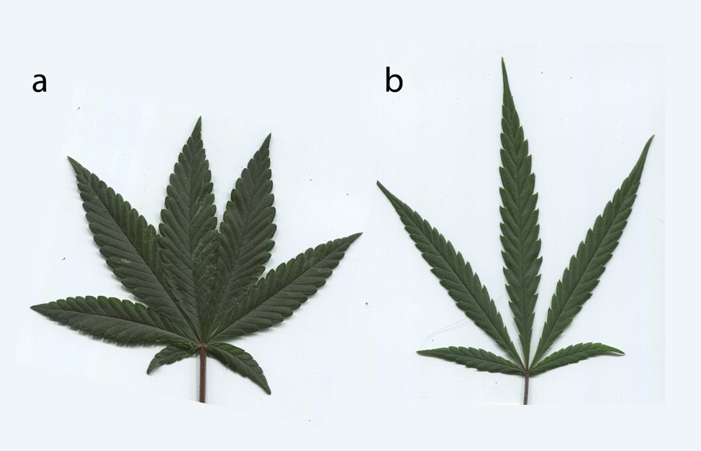
Broad leaf and narrow leaf drug types
Lynch, et al. 2016, Leafly
Notes:
BLDT or what people generally call indica
-short bushy,
-originate from higher latitudes and sensitive to photoperiod for flowering
-the general phenotype is sedating with whole body effects. Some people describe the phenotype as couch-lock. Which is self explanatory.
-Because of these effects BLDT are used more for anxiety and insomnia
NLDT
-are generally taller, similar to hemp
-are more equatorial, with the phenotype being more uplifting and cerebrally focused
-Medically NLDT are used for depression and fatigue.

Slide 11
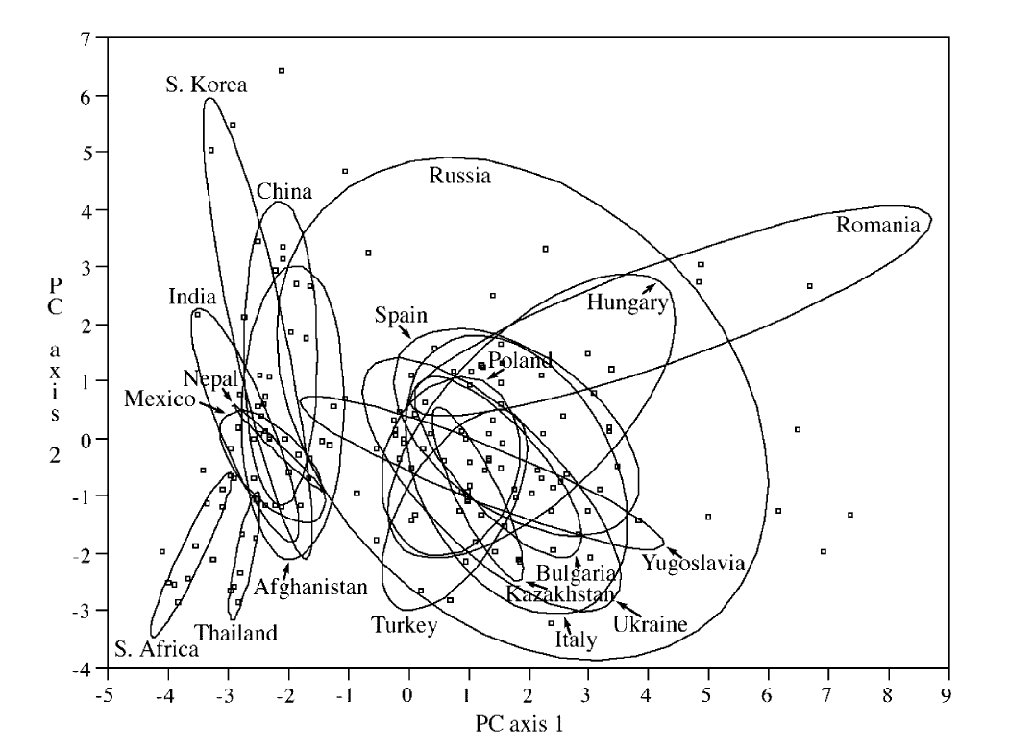
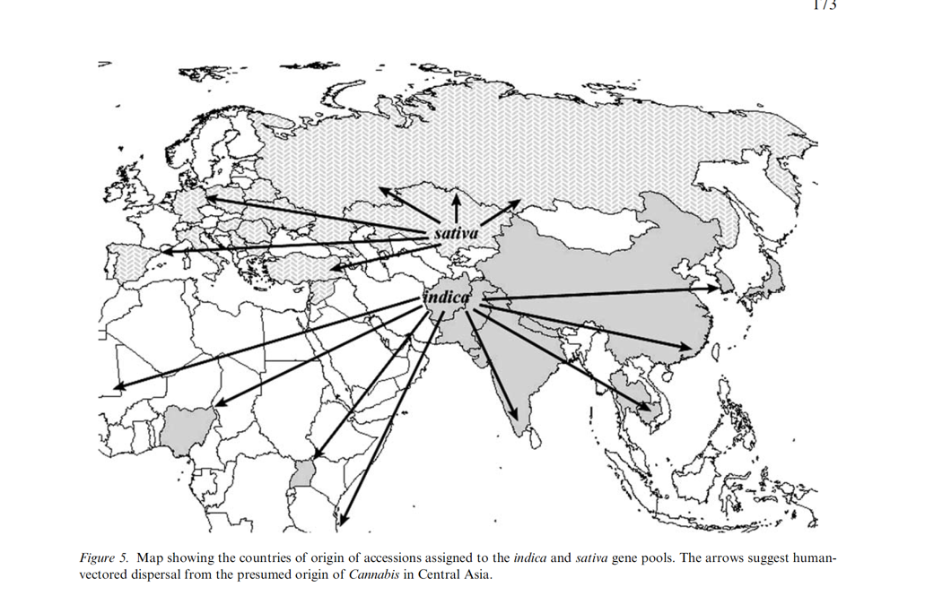
First large scale scientific evaluation of Cannabis germplasm for pools of diversity
Hillig 2004
Notes:
In this paper Hillig and Mahlberg – PCA plot based upon terpenes or phenotypes
Two groups Europe and Asia
Genotype information also two groups - Right
migration and admixture

Slide 12
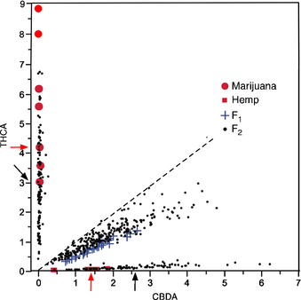
The CBDAS andTHCAS genes are tightly linked genetically
Hemp X MJ
CBDA→CBD
THCA→THC
Heat
Phenotype segregates as 1 locus
But multiple copies of each gene
CBDAS leaky
22:1 CBDA:THCA
THCAS specific
200:1 THCA:CBDAS
CBD/THC
2:1 CBDA wins
Weiblen 2015
Notes:
cannaboid synthase genes.
Segregates as a single gene, but multiple copies
Enzymes have different mixes of products

Slide 13
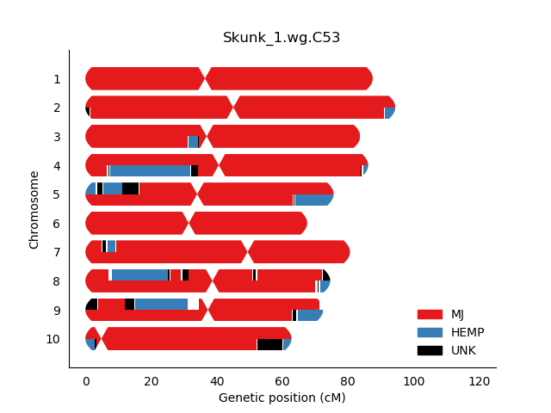
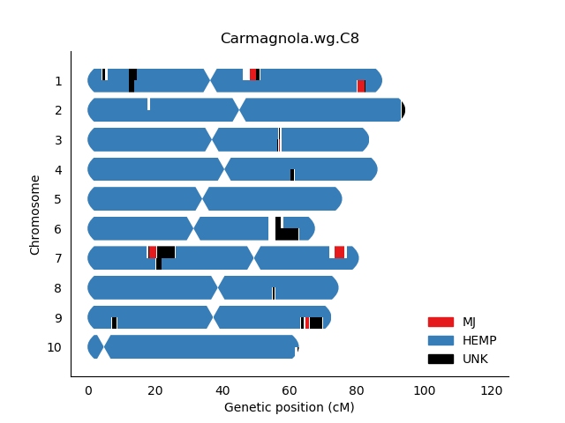
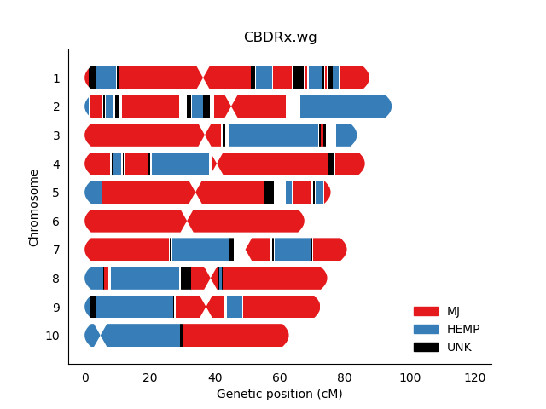
High-CBDA varieties are a combination of hemp and marijuana
High cannabinoid
production gene
High cannabinoid
production gene
Low cannabinoid
production gene
MJ
Hemp
High-CBDA
THCAS
CBDAS
CBDAS
Notes:
high-CBD varieties, which are legally hemp, are actually mostly of marijuana heritage.
MJ very high production
Hemp CBDAS gene
Law says hemp
Science says MJ

Slide 14
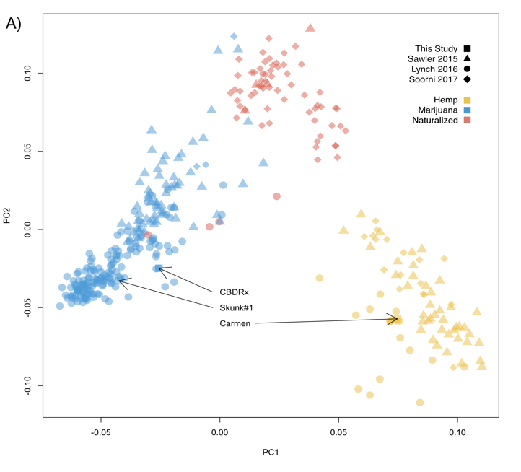
CBDRx from Functional Remedies was chosen as the canonical high CBDA variety for further study
Notes:
When we look at a PCA based upon genotype
The high-CBD strain, CBDRx, groups with the marijuana clade.
On the bottom we see CBDRx has just a bit of hemp ancestry.
We did whole genome sequencing and assembly of CBDRx, and I will present those results later in the talk.

Slide 15
What does Sunrise Genetics Inc (SGI) do?
This year we are teaming up with;
-Cornell,
-UW-Madison
-North Dakota State University
-Northern Michigan University
-North Carolina State University
-Texas A&M University
Farmers in;
-Iowa,
-Minnesota,
-Colorado.
-UC-Davis?
-Purdue?
First Light – highly inbred high CBD varieties
Collect Germplasm
Genetic fingerprints – 23&Me of Cannabis
Breeding and Breeding Consulting
QTL Mapping
Genomic Selection…soon
Inbreeding for stable germplasm
Main focus is agricultural hemp - Field trials
Main Goal is Stable Seed!!

Slide 16
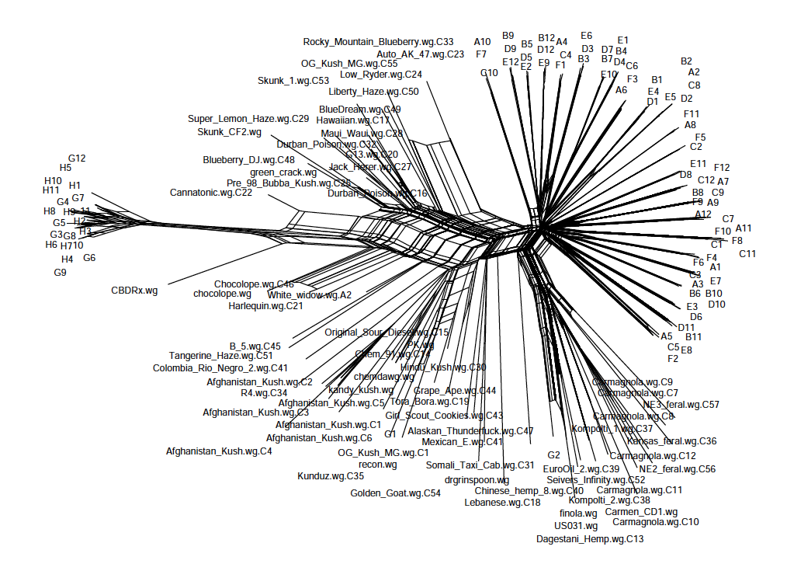
Breeding stable Cannabis varieties
“Sativa” heritage
Unstable Outcrossed Lines
Stable Inbred Lines
First Light (FL)
*
CBD varieties
Hemp
”Indica” heritage
*
Last common parent (seed)
Notes:
Using DNA evidence
-transparency
My Major goal.
The names generally mean nothing.
But DNA does not lie
At SGI we breed strains for consistency and high yields of the desired end product. An example is illustrated here…..
Retain some variation for breeding

Slide 17
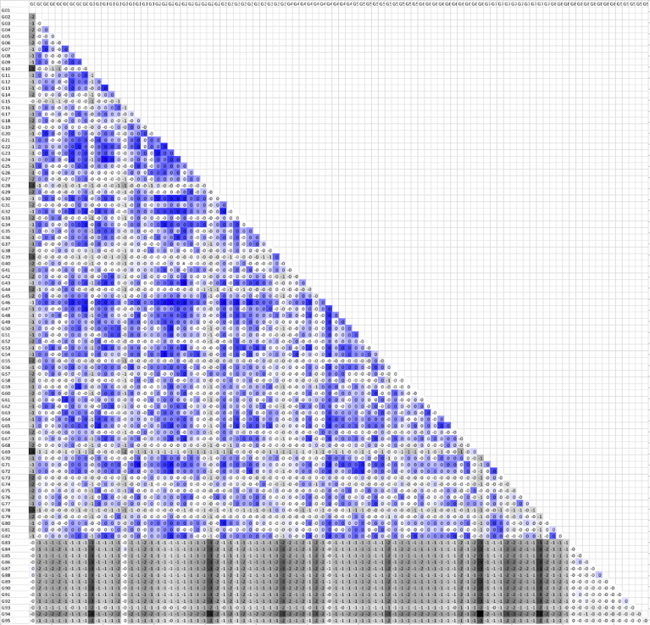
Putative First Light development and relatedness.
True self
True self
ACDC
Cannatonic
Z7
Cherry
CBDRx
True self
Charlotte’s web
ruderalis
Z7-fem1 (high CBD) S1
X
Z7-fem2 (low THC) S1
Masculinization
Relatedness Matrix
F1S1- fem, sib
True self?
-Multiple females
-Contamination
First Light seed (F2S2) segregating
SGI First Light 1-83
2 plants THC/THC
16 plants CBD/THC
Notes:
The history of the high-CBD varieties is a bit of a mystery.
Explain Selfed. Masculinization
Cherry is the original variety bred in Colorado
Cannatonic & Ruderalis
Charlotte's Web is named after Charlotte Figi whose story had led to her being described as "the girl who is changing medical marijuana laws across America."^{[6]} Her parents and physicians say she experienced a reduction of her epileptic seizures brought on by Dravet syndrome after her first dose of medical marijuana at five years of age. Her usage of Charlotte's Web was first featured in the 2013 CNN documentary "Weed". Charlotte died on April 7, 2020 from what were suspected to be complications from COVID-19.^{[7][8]}
Media coverage increased demand for Charlotte's Web and similar products high in CBD, which has been used to treat epilepsy in toddlers and children. It was originally called "Hippie's Disappointment" as it was a strain that had high CBD and could not induce a "high".^{[9][10]}
Masculinization
Siblings to make an F1
Repeated again, but multiple females and contamination
-F2S2 inbred but segregating seeds.
83 plants
-2 were THC/THC
-16 THC/CBD
Some contamination-Pollen

Slide 18
FL plants contain lineage from all four of the cannabis types
Selfed is 5% Het
Selfed = seed
Seed allows progeny testing
Notes:
One missing hemp-segregation or computational

Slide 19
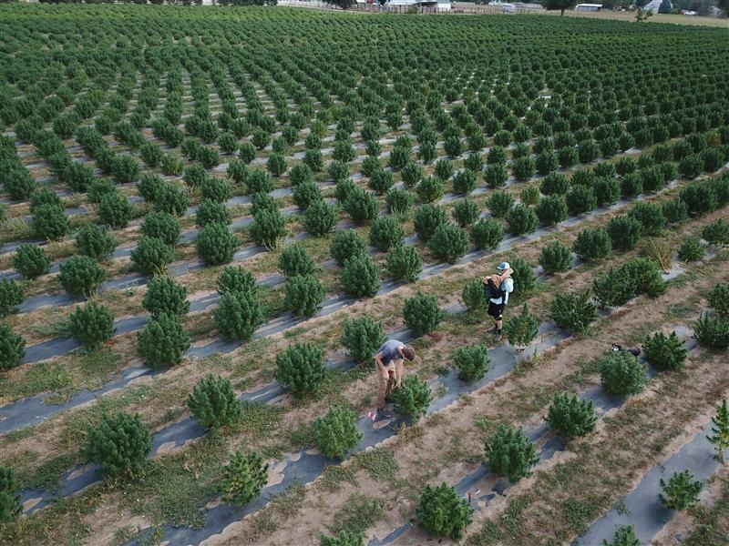
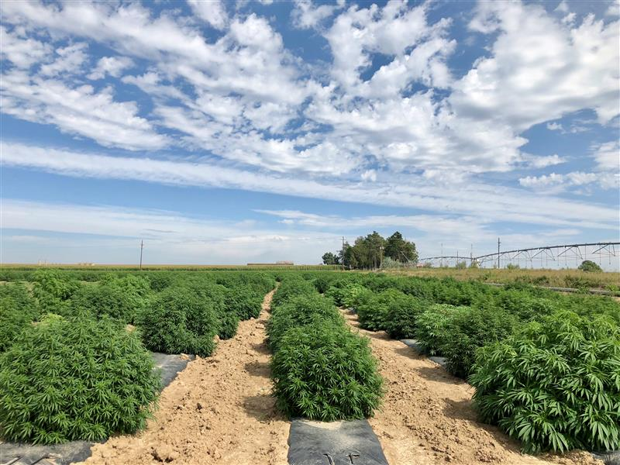
SGI field plots 2019 – First Light clones
Notes:
From clones
Labor intensive
Well spaced
Irrigation

Slide 20
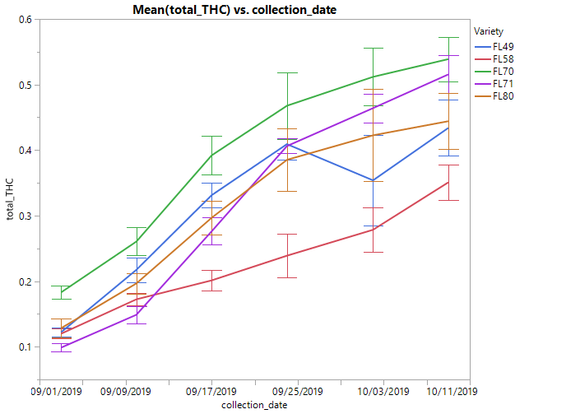
First Light clones THCA production in the field (2019)
Notes:
Accumulation of THCA over the last 6 weeks
0.39 is actually still considered compliant in CO
By the fourth week most went HOT. The term used in the industry to describe a plant as non-compliant

Slide 21
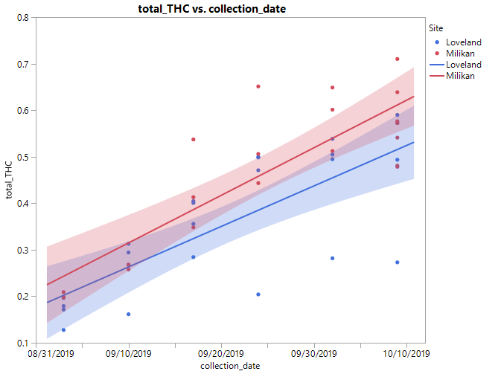
FL70 and FL58 at two sites with 95% confidence intervals
Notes:
Allows farmers to evaluate their risk as when to harvest. Often the test is done by the states 2 weeks before harvest. Might go hot after ==MJ
Arrows show 0.39
FL58 compliant, but loss CBD too. Since 22:1
Gene editing

Slide 22
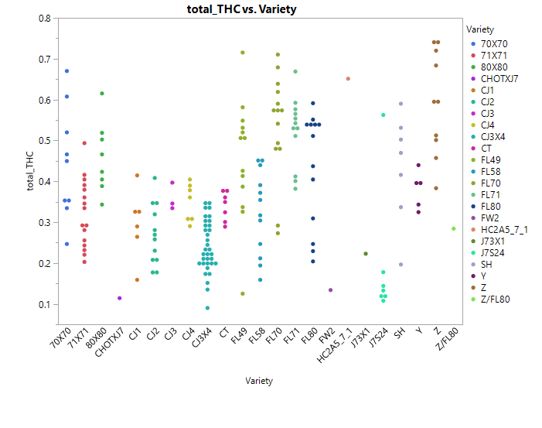
In common garden experiments clones are highly variability
All are clones except for CJ3x4 (F2)
CJ3 heterozygous CBD/THC
C = First Light
J = Hemp
Hemp
Parent
Notes:
The graphs have different scales on the y-axis.
Clones
Environmental effects – increases risk

Slide 23
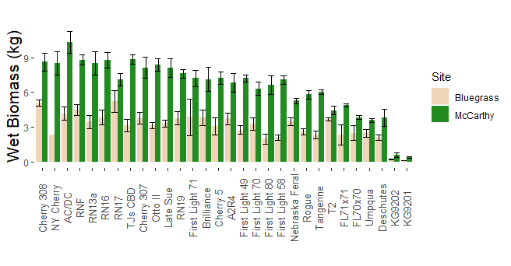
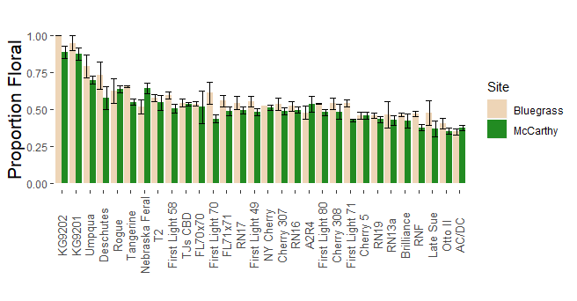
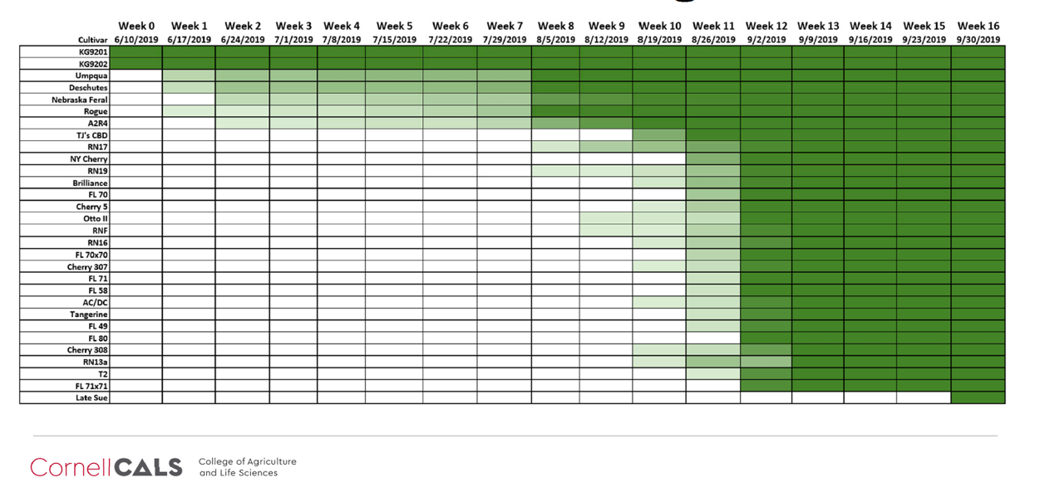
Cornell Field Trials 2019 – CBD varieties
Inbreeding depression ?
FL70xFL70
FL71 & FL58
FL49 & FL80
FL71xFL71
Notes:
In collaboration with Cornell we tested the first light varieties and the performance of some selfed seed
One major focus of SGI is flowering time
-growth at different latitudes
-consistency for harvest both agricultural hemp and marijuana indoor grow operations for logistic purposes
-possibly two harvest in a season. California

Slide 24
Evaluation of CBD production (Cornell)
FL80 is a large plant but not a great CBD producer
2-fold variation
Proportion of whole plant to shoot tip CBD%
Notes:
Apical flower compared to peripheral flowers
Expression experiments cannabinoid production from the top to the bottom of the plant

Slide 25
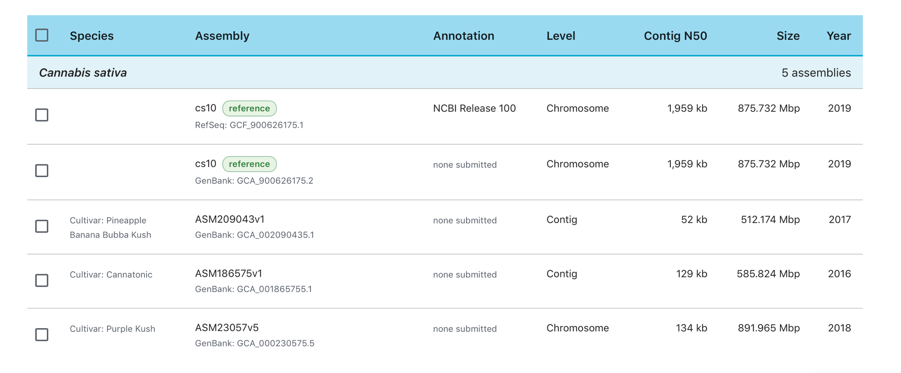
SGI, UMN and JCVI sequenced a high CDB variety (CBDRx;cs10)
CBDRx chosen as the Cannabis reference sequence by NCBI
Notes:
Genome assembly-Why important
-Like a Map of the US
-Genes and combinations
-Used CBDRx
-UM and JCVI
-N50 – Measure of quality of
-NCBI

Slide 26
The Cannabis genome contains multiple copies of the two synthase genes
Cultivar | GenBank | Research Group | Date | Contigs | Coverage | N50 | Synthase copy number | Method
Purple Kush | GCA_000230575.1 | University of Toronto | 2011/10/18 | 135,164 | 130x | 16,377 | 5 | Illumina GA II; HiSeq
LA Confidential | GCA_001510005.1 | Courtage Life Sciences | 2016/01/11 | 311,039 | 50x | 2,649 | 6 | 454
Chemdog91 | GCA_001509995.1 | Courtage Life Sciences | 2016/01/11 | 175,088 | 300x | 2,250 | 1 | Illumina GA II
Cannatonic | GCA_001865755.1 | Phylos | 2016/11/03 | 11,110 | 10x | 128,718 | 12 | PacBio
Pineapple Banana Bubba Kush | GCA_002090435.1 | Steep Hill Genetics/ CU Boulder, CGRI | 2017/04/13 | 18,355 | 72x | 51,819 | 12 | PacBio
Purple Kush | GCA_000230575.4 | University of Toronto | 2018/11/30 | 12,836 | 79x | 133,904 | 13 | PacBio/genetic map
Finola | GCA_003417725.2 | University of Toronto | 2018/11/26 | 5,303 | 97x | 370,471 | 16 | PacBio/genetic map
CBDRx | GCA_900626175.1 | Sunrise Genetics / U of Minnesota | 2019/02/14 | 1,051 | 100x | 1,959,202 | 14 | Nanopore, Illumina, genetic map
Resolution of the synthase loci required long reads
Notes:
CBDRx CONTIGS -- 1000 while other exceed 100,000. Pieces of a puzzle.
-synthase copy number increases.
-synthase tandem repeat regions are in cassettes– Long reads

Slide 27
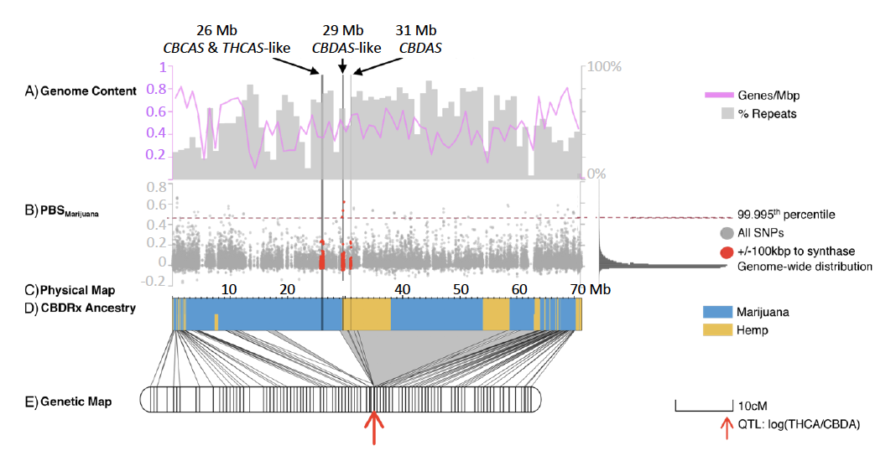
The CBDRx genome is 89% marijuana and the synthase loci are on chromosome 7
CBDRx does not contain a bonafide THCAS
Notes:
The genome is 89% MJ
Hemp genes introgressed into a marijuana variety.
The clusters are present at 26Mb, 29MB, and 31 MB and are in a centromeric region where gene content, the blue line, being low compared to regions outside of the centromere, and there are more repeats, grey bars, in the centromeric region
Recombination is also suppressed as can be seen by the gray triangle comparing the genetic and physical maps.
Two of the gene clusters lie in the region of hemp ancestry, while the cluster at 26Mb is located in a region of marijuana ancestry. However, CBDRx does not have an active THCA synthase

Slide 28
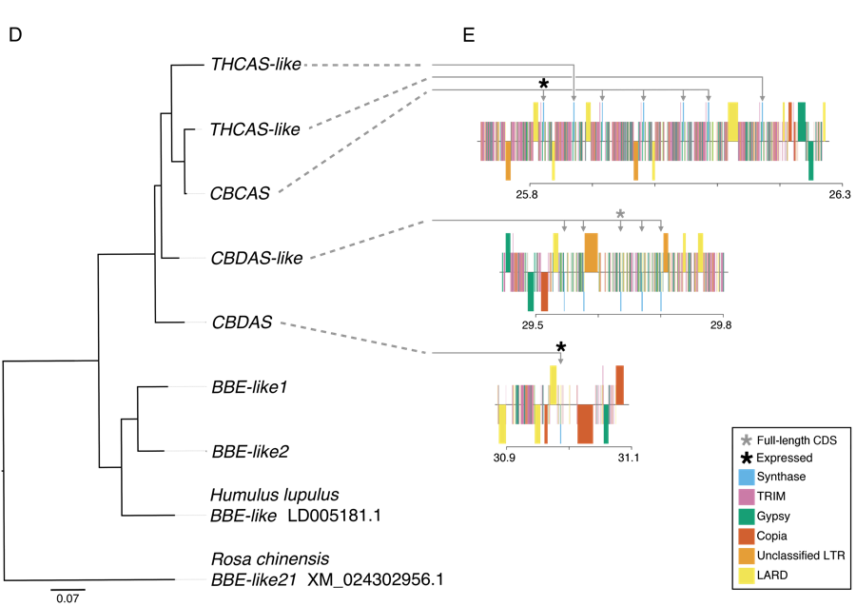
Synthase genes are arranged in tandem arrays and flanked by LTR
THCAS-like
CBCAS-like
Seven THCAS/CBCAS-like
CBCAS
25.8 26.3
CBDAS-like
CBDAS
29.5 29.8
Five CBDAS-like
BBE-like
BBE-like
30.9 31.1
Humulus lupulus
BBE-like LD005181
Three full length CDS, but only one is expressed (CBDAS)
Rosa chinensis
BBE-like XM024302956
0.07
Notes:
A closer look at the synthase clusters reveals some surprises.
-seven syntyhase sequences 26
-five at 29
-one at 31- only one expressed…..From Hemp
LTR
-type 1 = THCAS – MJ region
-type 8 = CBDAS – Hemp region
In CBDRx type 1 ubiquitous possibly due to it’s marijuana origin

Slide 29
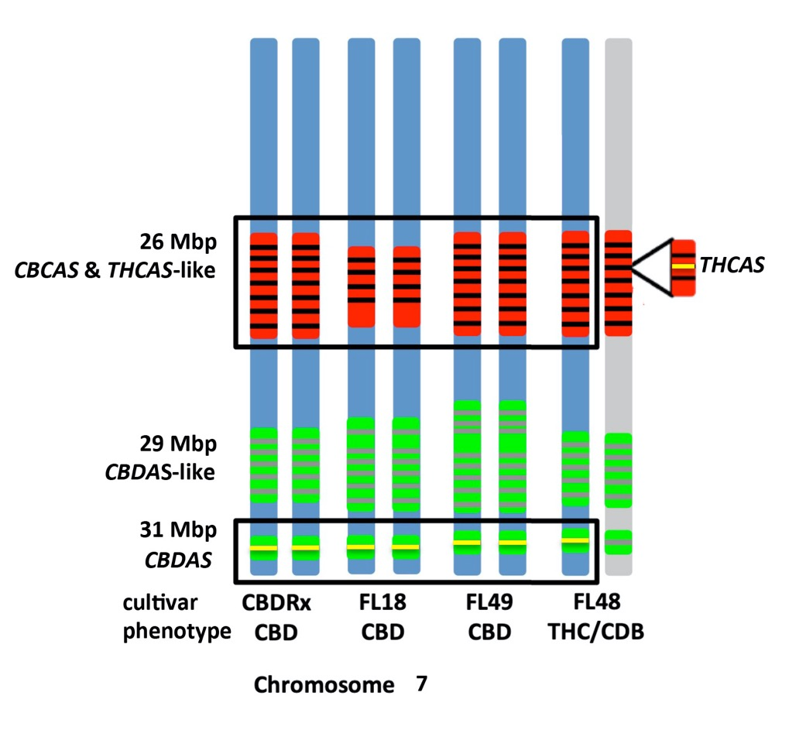
Physical structure of the tandemly repeated synthase genes
Notes:
Sequenced 3 FL lines
Red=THCAS genes
Green=CBDAS genes
-one heterozygous producing both CBDA and THCA
Interesting question:
26 Mb in THCAS region (RED), but in CBDRx there is not an active THCAS
Perhaps FL48 is progenitor and high-CBD arose by illegitimate recombo and selection.
So to summarize, in all four plants CBDAS is expressed and is located at 31Mb. For FL48, both synthases are expressed with THCAS coming from the cluster at 26Mb

Slide 30
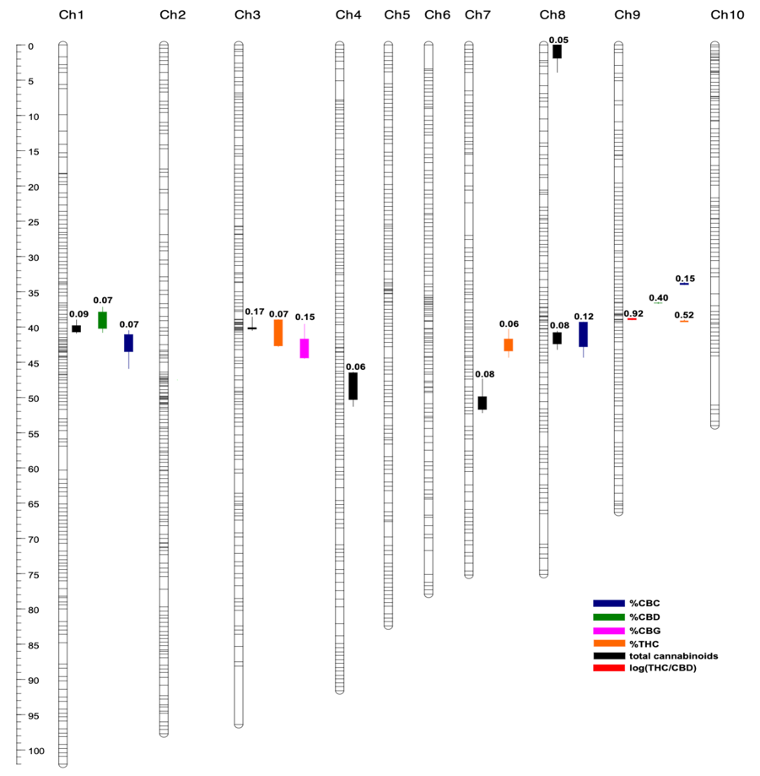
QTL map of a Marijuana (Skunk#1) X Hemp (Carmen) cross
Major Conclusion
92% of the variation in the ratio of CBD/THC is
Controlled by the tandem repeated synthase loci on Chromosome 7/9
Major Conclusion
Potency is NOT related to CNV of the synthase genes, but instead to QTL on other chromosomes controlling total cannabinoid production
Notes:
Used Inbred parents to make an F2 population for a genetic map and QTL mapping.
The chromosome numbering system is inaccurate due to an initial mix up, thus the synthase loci are on chromosome 9 in this figure. Blue box.
Besides the high quality genome assembly, our work resulted in two major conclusions.
The ratio of CBD/THC is almost exclusively due to the tandem gene cassettes -92% of the variation
Cannabinoid concentrations, or potency, is independent of the synthase genes, and instead is attributed to 5 QTL located on other chromosomes. Black arrows
This has been a point of contention among various groups, where the hypothesis was that potency was selected for and resulted in synthase gene duplications, but as I have presented today, nearly all the extra copies are non-functional and the QTL map provides an explaination as to the mechanism and variation of cannabinoid production

Slide 31
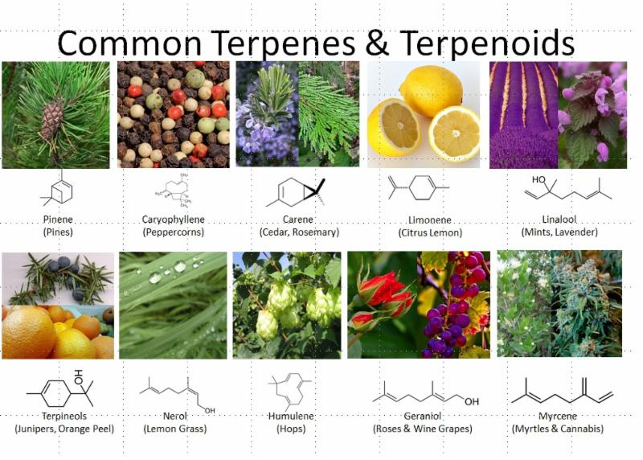
Common Terpenes – The entourage effect
https://static1.squarespace.com/static/54a6e638e4b02cb3ce0c7c29/t/59d80f81f9a61eab9bae2c62/1507331981580/terpenes.jpg
Notes:
CBD and THC are not the only chemicals of interest in Cannabis.
Other cannabinoids
Terpenes
Entourage effect – or as we being scientist would say synergy
What are the true effects of these compound either individually or in some combination? We need more science.
Myrcene-is the most common terpene in many Cannabis strains and studies have shown that myrcene itself has sedative effects.
Different varieties of marijuana flavor and smells are terpene dependent variation and terpenes also give hops different flavors and hops is closest relative to Cannabis.

Slide 32
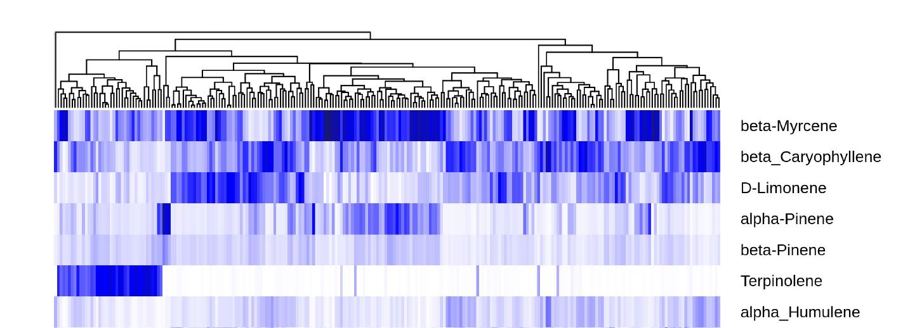
“Chemovars” of marijuana strains and correlations of terpene production
Allen KD, McKernan K, Pauli C, Roe J, Torres A, et al. (2019)
Notes:
One popular term to describe Cannabis varieties is Chemovars which classifies varieties based upon the chemotype.
In this slide a number of marijuana strains are grouped according to their terpene composition.
Many terpene synthase genes actually produce more than a single terpene, thus certain terpenes are correlated. For example caryophyllene and humulene….
Terpinolene is bvery interesting being present in only a subset of varieties and almost completely absent in most varieties.
Myrcene…alpha pinene
Limonene somewhat independent
The genes are present in clusters making it challenging to genetically manipulate terpene content, but we are working to make Near-Isogenic-Lines Thus we would have nearly an identical variety plus and minus myrcene, one for the morning and one for the night.

Slide 33
Conclusions
Cannabis research is in it’s infancy.
-Held back by money and laws
-Prohibition has negatively affected millions
Cannabis has legitimate medical and industrial uses.
New medical strains high in CBD are of hemp and marijuana ancestry
Intense breeding efforts are required for better medical and industrial varieties
A high quality genome is now available for modern breeding techniques
CBDAS and THCAS genes are present in tandemly duplicated cassettes
Potency is controlled by numerous loci independent of CBDAS/THCAS
Terpenes and other cannabinoids may mediate the effects of CBD/THC

Slide 34
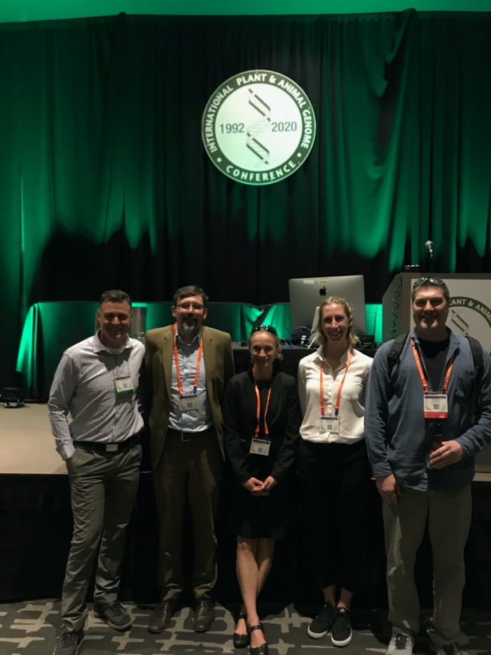
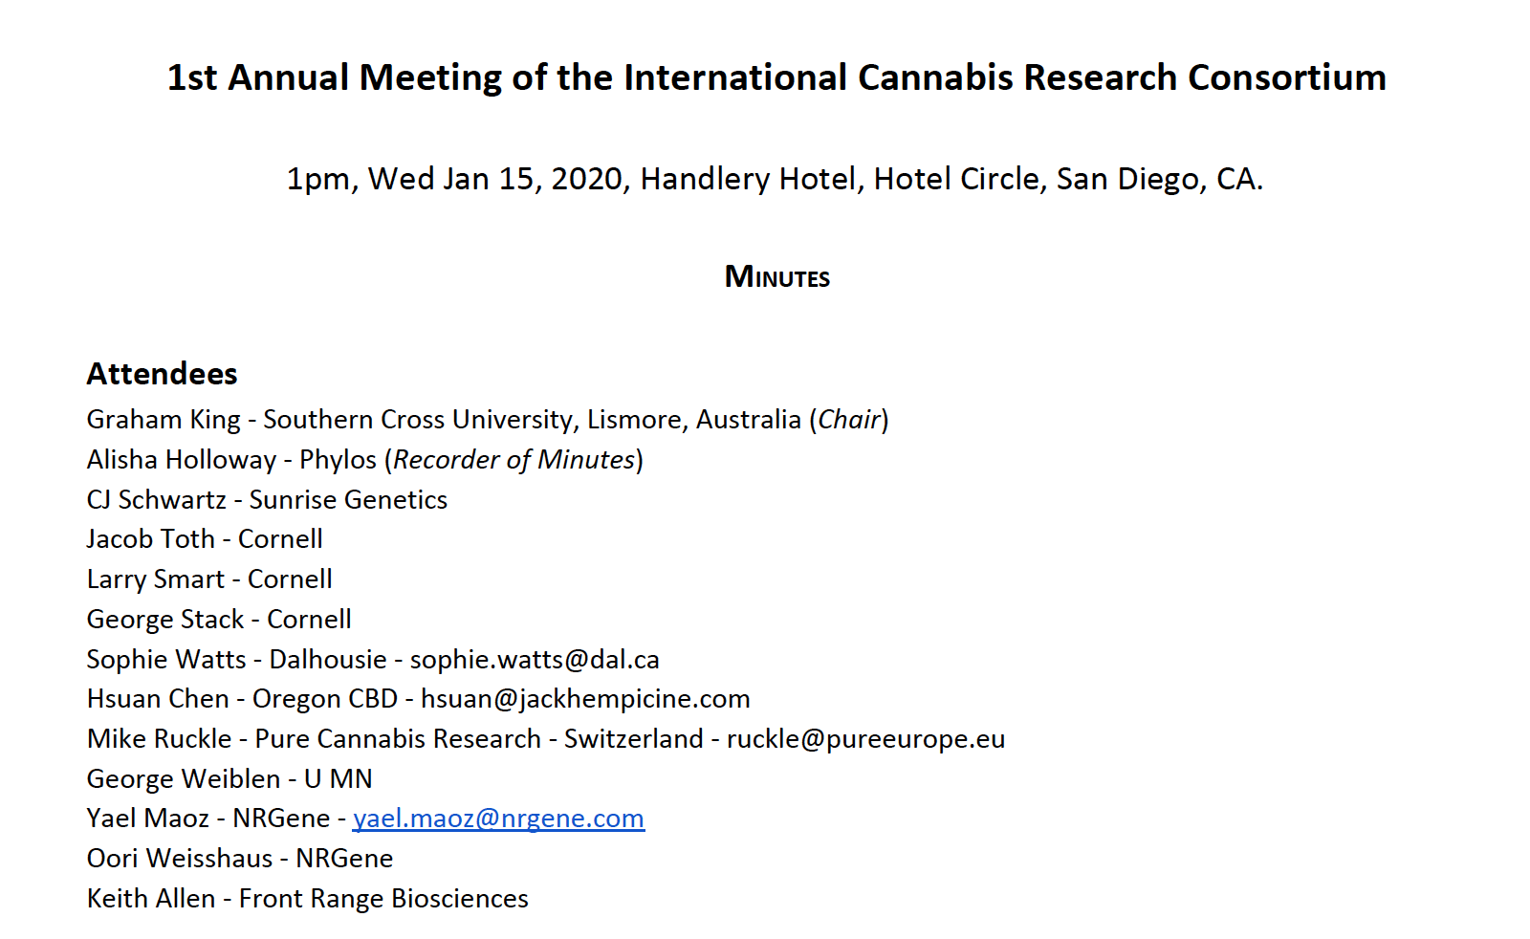
Cannabis workshop added to PAG in 2018
ICRC – International Cannabis Research Consortium - 2020
ICRC
PAG
Notes:
PAG
I’m organizer, please send an email if you would mlike tomspeak. Students and post-docs are encouraged
ICRC

Slide 35
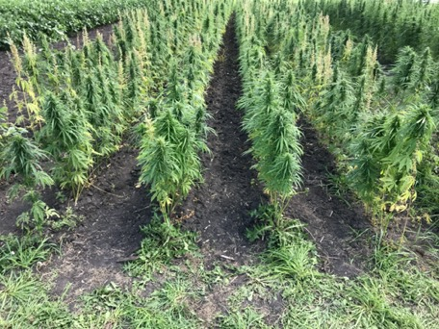
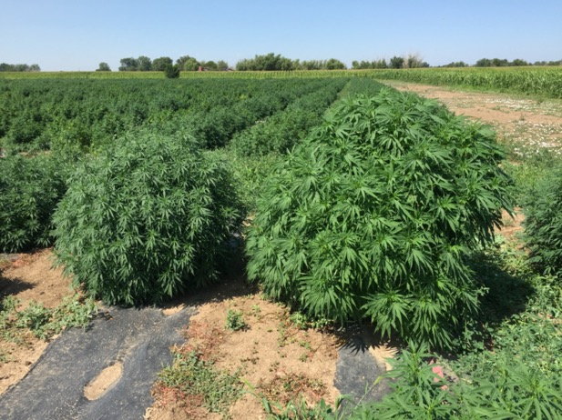
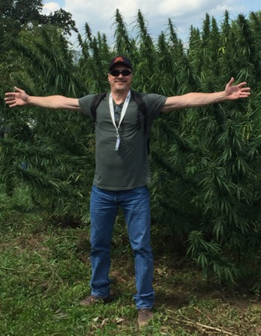
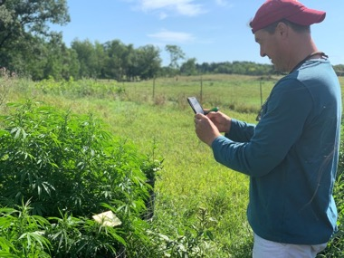
Acknowledgements
Sunrise Genetics - Hempgene & Marigene
Matt Gibbs
Jason Schwartz
Scott Morton
Marie Turner
Lexi Valenti
Hunter Konchan
U of Minnesota
George Weiblen
Jonathon Wenger
Clemon Dabney
JCVI/SALK
Todd Michael
Cornell
Larry Smart
Craig Carlson
George Stack
Jacob Toth
Deanna Gentner
Craig Carlson
George Stack
cj.schwartz@sunrisegenetics.com

