Slide 2
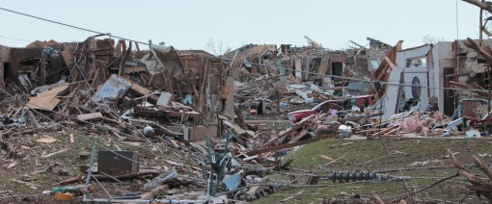
Hazard Vulnerability and Business Impact Analysis Meeting Template
Presented by:
William C. Gonzalez, MPA, MCP, AEM, PMC
President | Chief Operations Officer | Principle

Slide 3
HVA BIA (Year) AGENDA
HVA/BIA Scope & Purpose
Data Collection & Methodology
(Current Year) HVA BIA Review

Slide 4
HVA BIA AGENDA
Analysis of Statistical Risk
Analysis of Observed Risk
Analysis of Assumed Risk (Premise Risk)
Mitigation Strategies
Follow-up Items
Committee Discussion
Next Steps

Slide 5
Scope and Purpose
In Accordance with the Joint Commission
EM 11.01.01 : The organization conducts a hazard vulnerability analysis using an all-hazards approach.
Rationale: Organizations should continually evaluate their known risks and prioritize them to understand their vulnerabilities and prepare to respond to emergencies. The risk assessment includes an evaluation of the natural hazards, human-caused hazards, technological hazards, hazardous materials, and emerging infectious diseases that could impose a significant risk to a health care organization and its off-site locations. The risks are prioritized to determine which of the hazards present the highest likelihood of occurring and the impacts those hazards will have on the operating status of the organization and its ability to provide services.

Slide 6
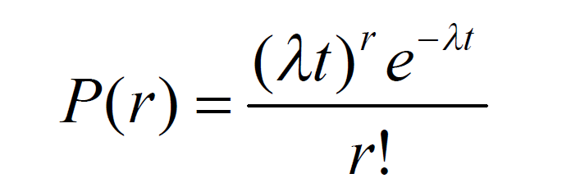
Methodology of Risk Calculations
Probability Definition based on Poisson Distribution results.
5 = 0.001 < P($r$) < 0.2
4 = 0.21 < P($r$) < 0.4
3 = 0.41 < P($r$) < 0.6
2 = 0.61 < P($r$) < 0.8
1 = 0.81 < P($r$) < 1.0
Predictions will always be conservative in nature.
Calculations using P(r) formula represents the “At Most” occurrence.

Slide 7
Natural Hazards (Sample)
Natural Flood Risk is Low
Outside identified Flood Zone
Elevation: 17.5 Feet
Hurricane / Tropical Storm Risk is Medium. Data compiled for 10 years (source: NOAA)
P(1) in 202X = .366 (37%)
P(2) in 202X = .166 (17%)
P(3) in 202X = .05 (5%)
t = 182 days out of the Year
Snow Fall Risk is Medium (based on 10-year seasonal snow fall)
P(30 inches) in 202X Season: .06 (6%)
t = 212 days out of the Year

Slide 8
Human Hazards (Sample)
Assaults, Internal Risk is High (does not include Keep Safe data)
Data submitted to Security Desk
Average Employee Assaults (2 years): 22
P(22) in 202X .08 (8%)
P(X) in 202X = .99 (99%) [likelihood of an event occurring)
Mass Casualty Incident (medical/infectious) Risk is High (202X Admitting data)
Average monthly COVID-19 admittance (202X): 233 per month
Average daily COVID-19 admittance (202X) 9 per day
P(233) in 2021 = Extremely low (1.2854…….e-509)
P(X) in 2021 = 1.0 [likelihood of an event occurring)
Qualitative factors: social disobedience, new COVID-19 strain

Slide 9
Technological Hazards (Sample)
Fire, Internal Risk is Medium (conservative rating) based on 202X occurrences.
Average Fire Occurrences: .25 (for 3 occurrences throughout the year).
P(1) in 202X = .16 (16%)
T = 366 Days
Generator Failure, Risk is Medium based on 202X occurrences.
Average Gen Failure Occurrences: .083 (for 1 occurrence throughout the year).
P(1) in 202X = .37 (37%)
T = 366 Days

Slide 10
HVA BIA REVIEW & DISCUSSION
CREATE HYPERLINK TO THE HVA BIA OR EMBED DOCUMENT HERE

Slide 11
MITIGATION STRATEGIES (HAZARDS)
Hazard | Mitigation Plan | POC

Slide 12
MITIGATION STRATEGIES (CONTINUITY)
Continuity Element & Risk | Mitigation | POC

Slide 13
Committee Discussion (Guided)
Statistical Risk (Probability of Occurrence within the last 5-10 years)
Any questions?
Observed Risk (for 202X):
What have you observed that was not mentioned?
Assumed Risk (for 202X)
What upcoming projects do we (collectively) need to know about?

Slide 14
QUESTIONS

Slide 15
Disaster Never Waits

