Slide 1

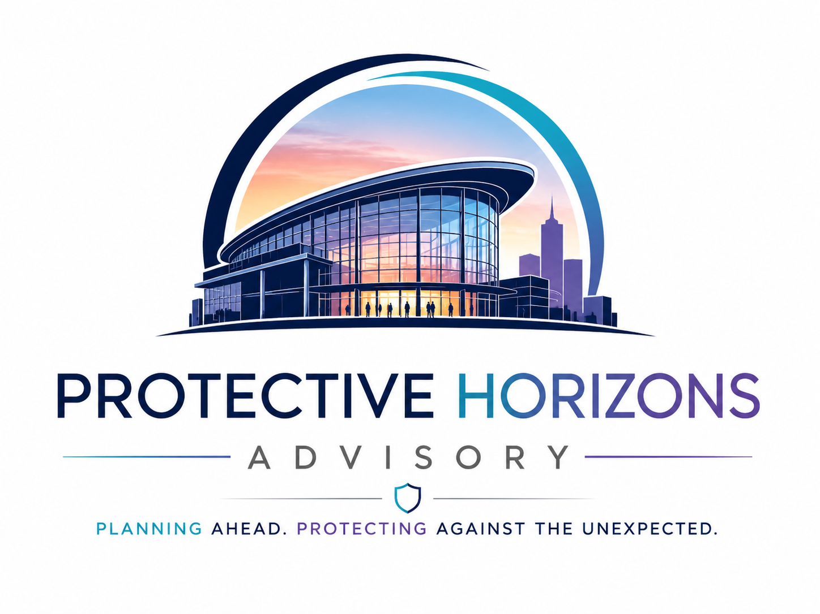
VENUE READINESS PRESENTATION
Martyn's Law
Self‑Assessment
A practical, venue-neutral framework for scope, ownership, risk, evidence and readiness.
Planning Ahead. Protecting Against the Unexpected.
Security Provider × Client

Slide 2
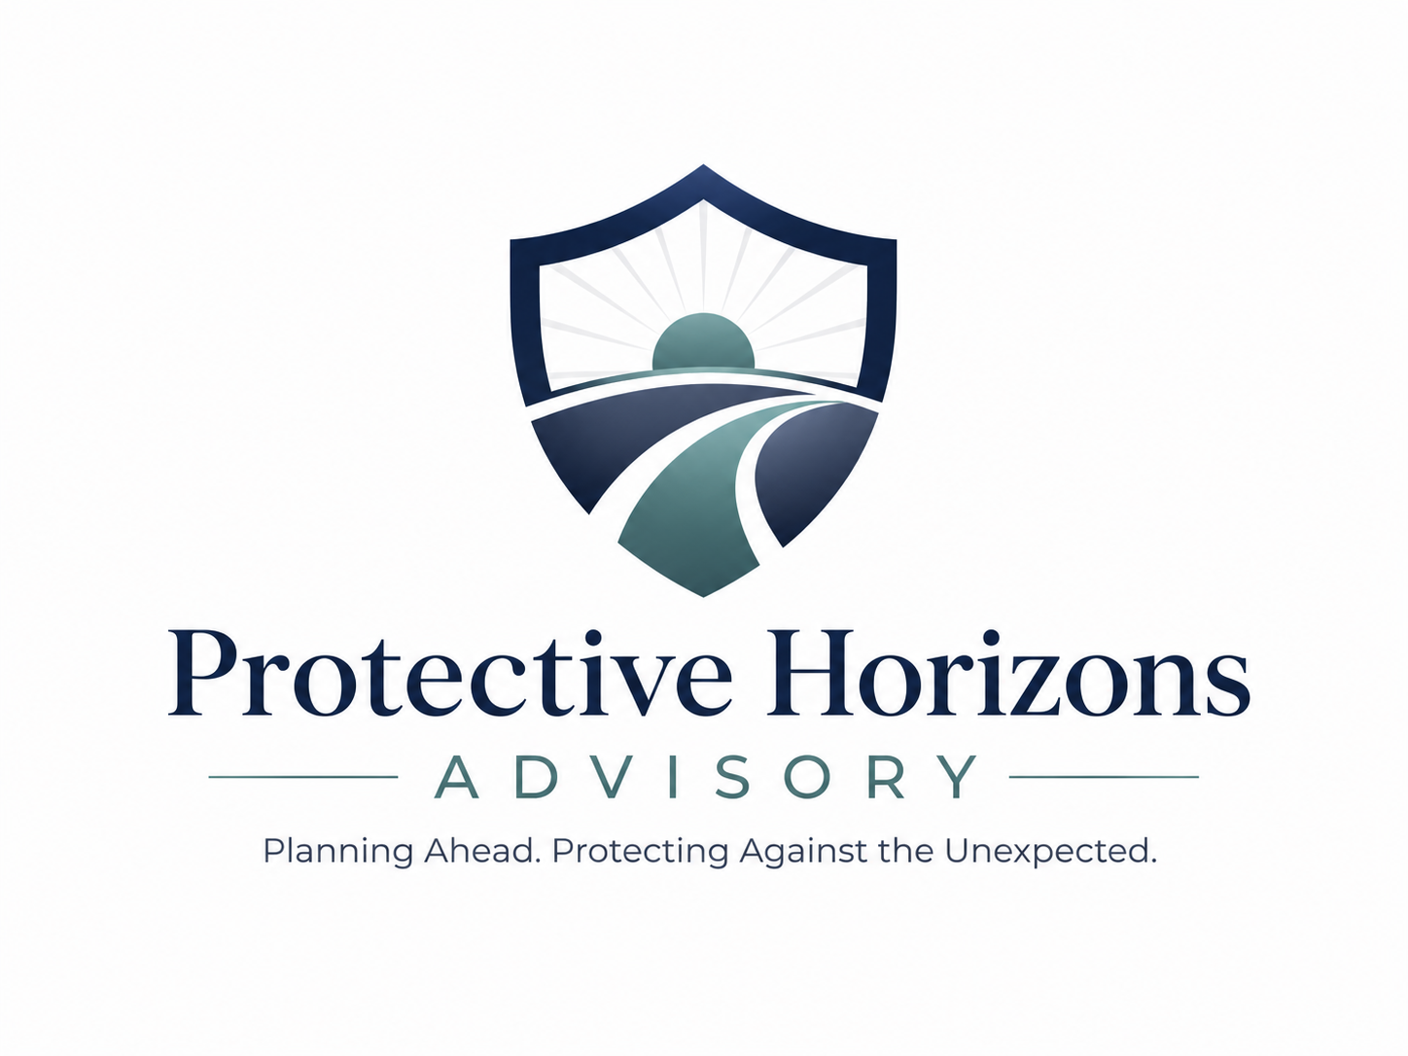
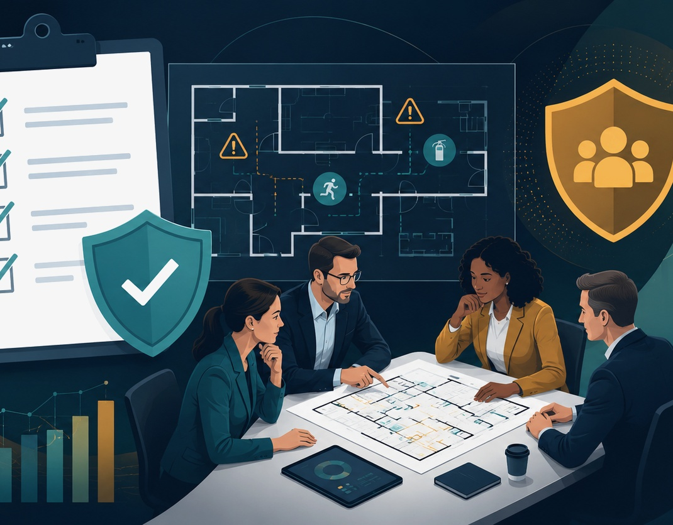
Why this document is required
It turns a broad legal duty into a clear, auditable venue-level action plan.
01
Creates one auditable record
Scope, ownership, actions, status, risk score and evidence requirements are held in one place.
02
Confirms who owns what
The Client and Security Provider can agree clear responsibility for delivery and support.
03
Prioritises the gaps
High-risk items such as lockdown, invacuation and communication move to the top.
04
Supports repeatable assurance
The same format can be used across different venues without rebuilding the process.
Best used as a live assurance tool — updated as actions close, evidence improves and venue risks change.
Protective Horizons Advisory
Planning Ahead. Protecting Against the Unexpected.
02

Slide 3
Martyn's Law — brief overview
Terrorism (Protection of Premises) Act 2025.
The purpose
Regulator
Improve organisational preparedness and protective security so venues and events can help keep people safe during a terrorist attack.
Security Industry Authority
The SIA will support, assess and enforce compliance.
Public protection procedures
Evacuation
get people safely away
Invacuation
move people to safer areas inside
200+
800+
standard tier begins
enhanced tier begins
Lockdown
secure the premises or event
Communication
clear instructions and alerts
The workbook converts these duties into local venue actions, evidence requirements and clear accountable owners.
Sources: GOV.UK statutory guidance; SIA Martyn’s Law guidance.
Protective Horizons Advisory
Planning Ahead. Protecting Against the Unexpected.
03

Slide 4

Which venues are likely to qualify?
The key test is use, public access, occupancy and exclusions.
1
Premises
2
Use
building or part of a building
wholly or mainly Schedule 1 use
3
Capacity
4
Not excluded
200+ people from time to time
check Schedule 2 exclusions
Likely examples
Conference and exhibition centres, theatres, arenas, large hospitality spaces, visitor attractions, museums/galleries, sports venues, education places of worship and public events. Always confirm exclusions and special rules.
Standard Tier
200–799 people
Appropriate public protection procedures
Enhanced Tier
800+ people
Procedures, measures, documentation and senior accountability
Qualifying Events
Usually 800+ with public access and entry checks — confirm details early
Sources: GOV.UK statutory guidance criteria; SIA premises and events guidance.
Protective Horizons Advisory
Planning Ahead. Protecting Against the Unexpected.
04

Slide 5
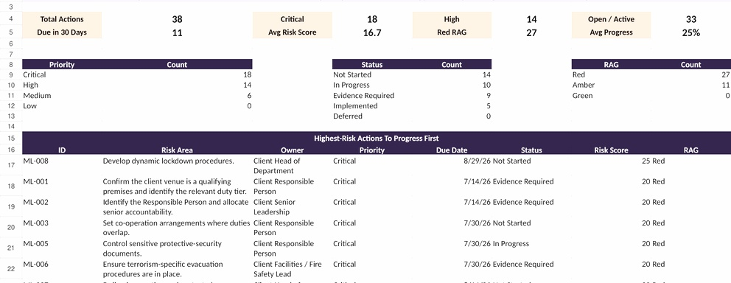
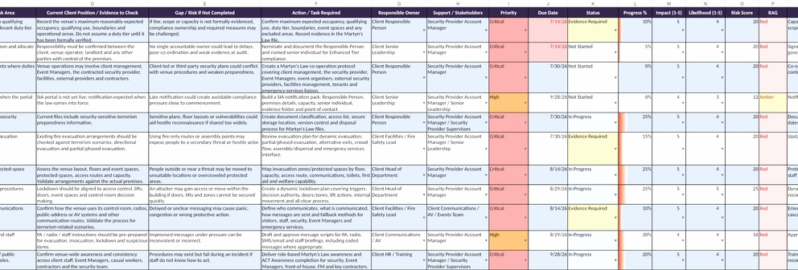
How the self-assessment supports compliance
A simple structure for scope, ownership, risk, evidence and progress.
01
Confirm scope
capacity, duty tier, boundaries and exclusions
02
Assign owners
Client and Security Provider roles are clear
03
Assess procedures
evacuation, invacuation, lockdown, communication
04
Track evidence
outputs, dates, RAG status and residual risk
Live dashboard + risk register
The format gives leadership a single view of readiness, action ownership and evidence status across any venue.
Protective Horizons Advisory
Planning Ahead. Protecting Against the Unexpected.
05

Slide 6
Recommended presentation message
Position the workbook as an assurance tool, not just a compliance checklist.
Why venues should use it now
Suggested next steps
Build readiness before commencement.
Complete an initial venue assessment.
Evidence that venue-specific risk has been considered.
Agree Client and Security Provider ownership.
Create a practical record for inspections, governance and tracking.
Review high-risk gaps with management.
Use one scalable framework across different venues.
Create an evidence pack and review cycle.
Core sources: Home Office statutory guidance | SIA Martyn’s Law guidance | ProtectUK guidance.
Protective Horizons Advisory
Planning Ahead. Protecting Against the Unexpected.
06

