Slide 1
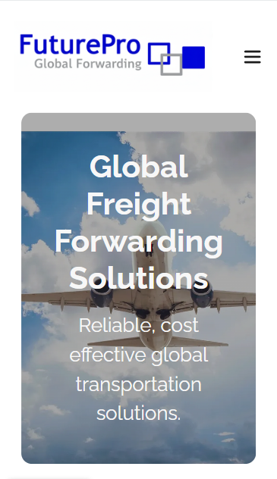
FuturePro Global Forwarding Ltd
International Solutions

Slide 2
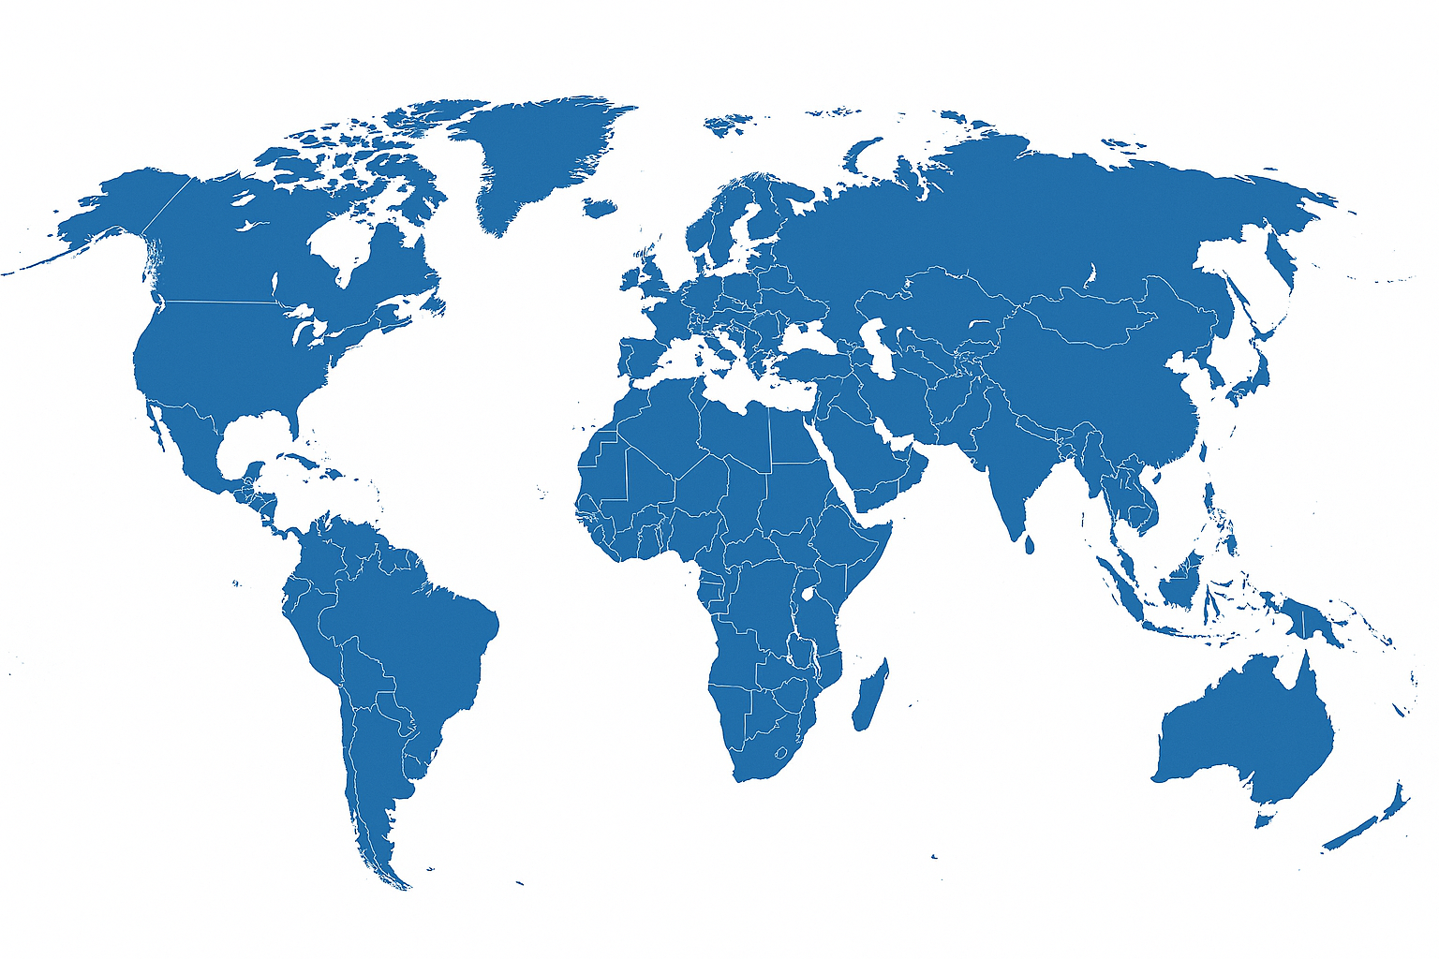
Agenda
1
Global Air
2
Global Ocean
3
Global Road
4
Additional Services
5
XXX
6
XXX

Slide 3
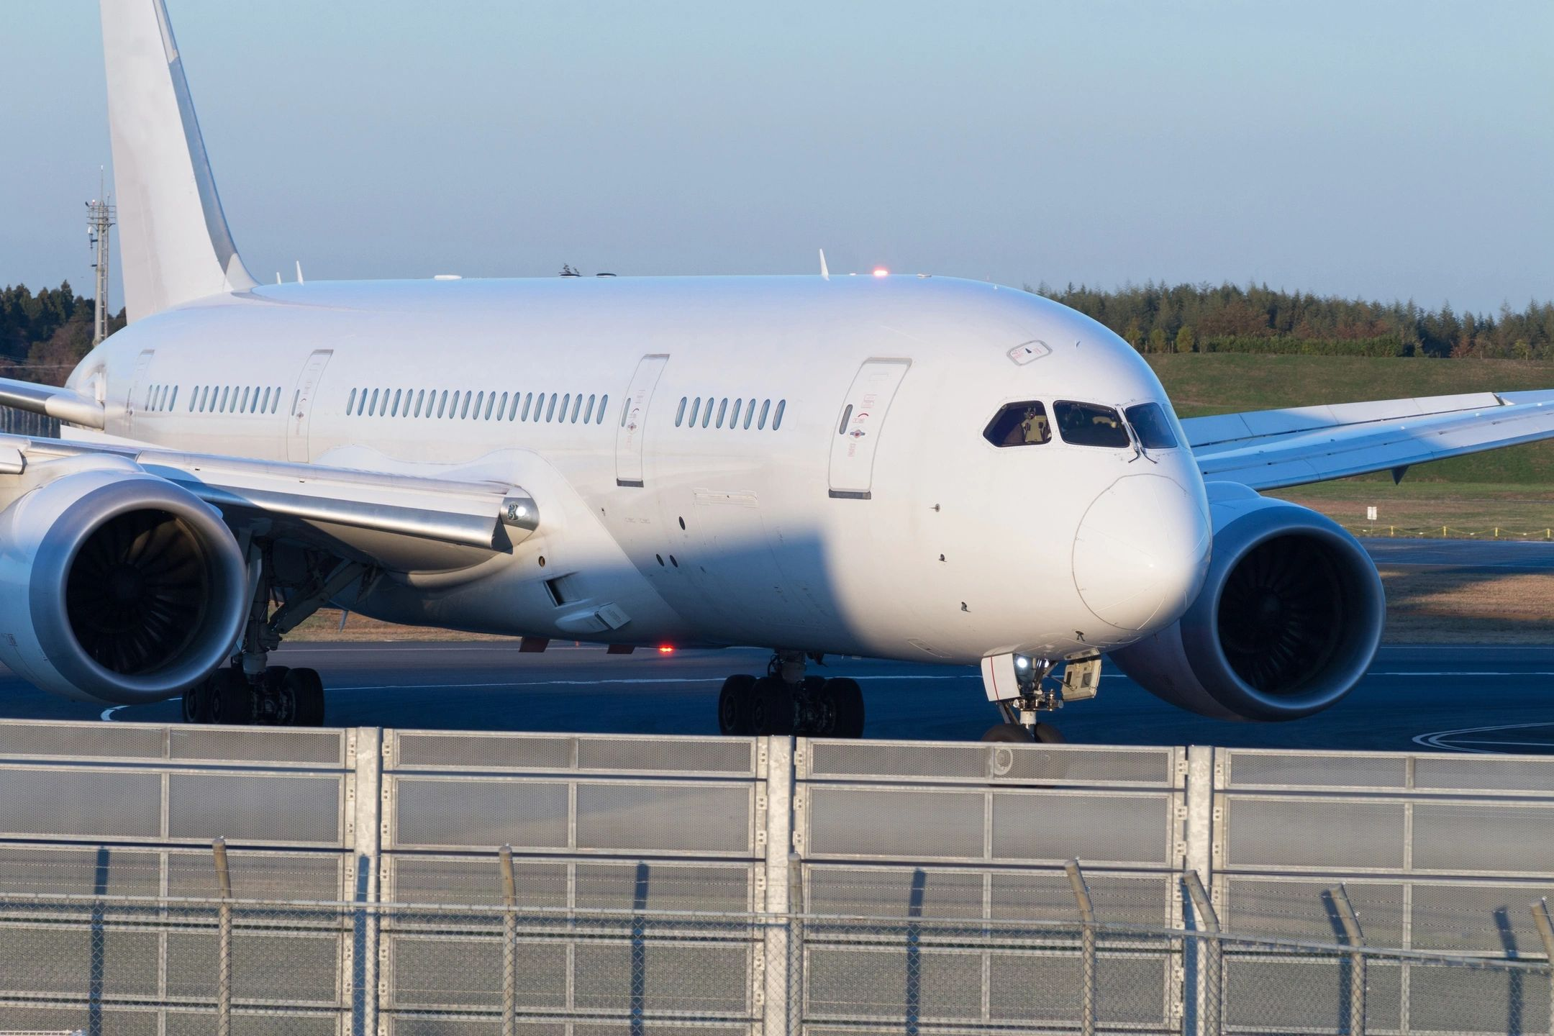
XXXXX
Global Air
Whether SPEED or COST is the key, we have the solution.
FPA Critical
Rapid collection, earliest possible flight to destination.
FPA Express
Same day collection, 48-72 hr delivery to destination.
FPA Eco
Lower cost, consolidated service, 120-168 hr delivery to destination.
FPA Charter
Project, large consignments, dedicated aircraft.

Slide 4
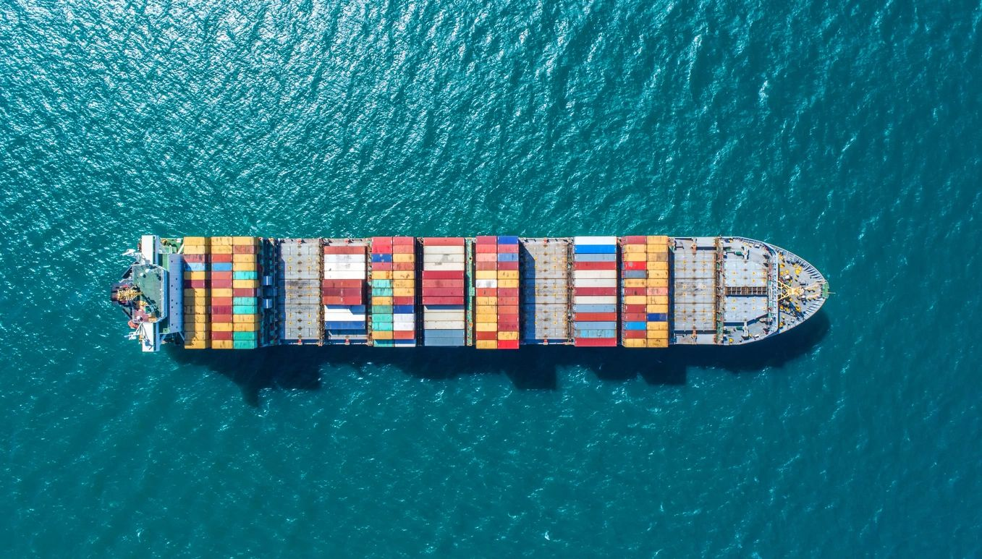
XXXXX
Global Ocean
Flexible options to suit your cargo.
FPO FCL
Shipper loaded, door to door, consignee offload. Max security.
FPO LCL
Smaller loads, consolidated service.
FPO PRO
Project moves, flat rack, top load for larger loads.

Slide 5
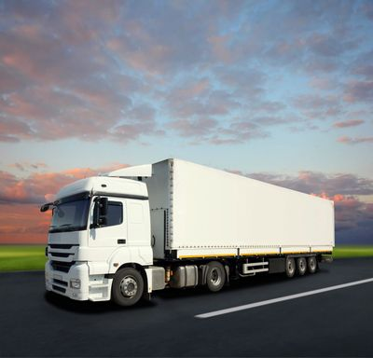
XXXXX
Global Road
Direct to client or groupage services.
FPR Critical
Rapid collection, dedicated vehicle to your customer.
FPR Express
Same day collection, rapid road service to customer.
FPR Eco
Lower cost, consolidated service, groupage service.
FPR Scheduled
To your schedule, direct to customer.

Slide 6
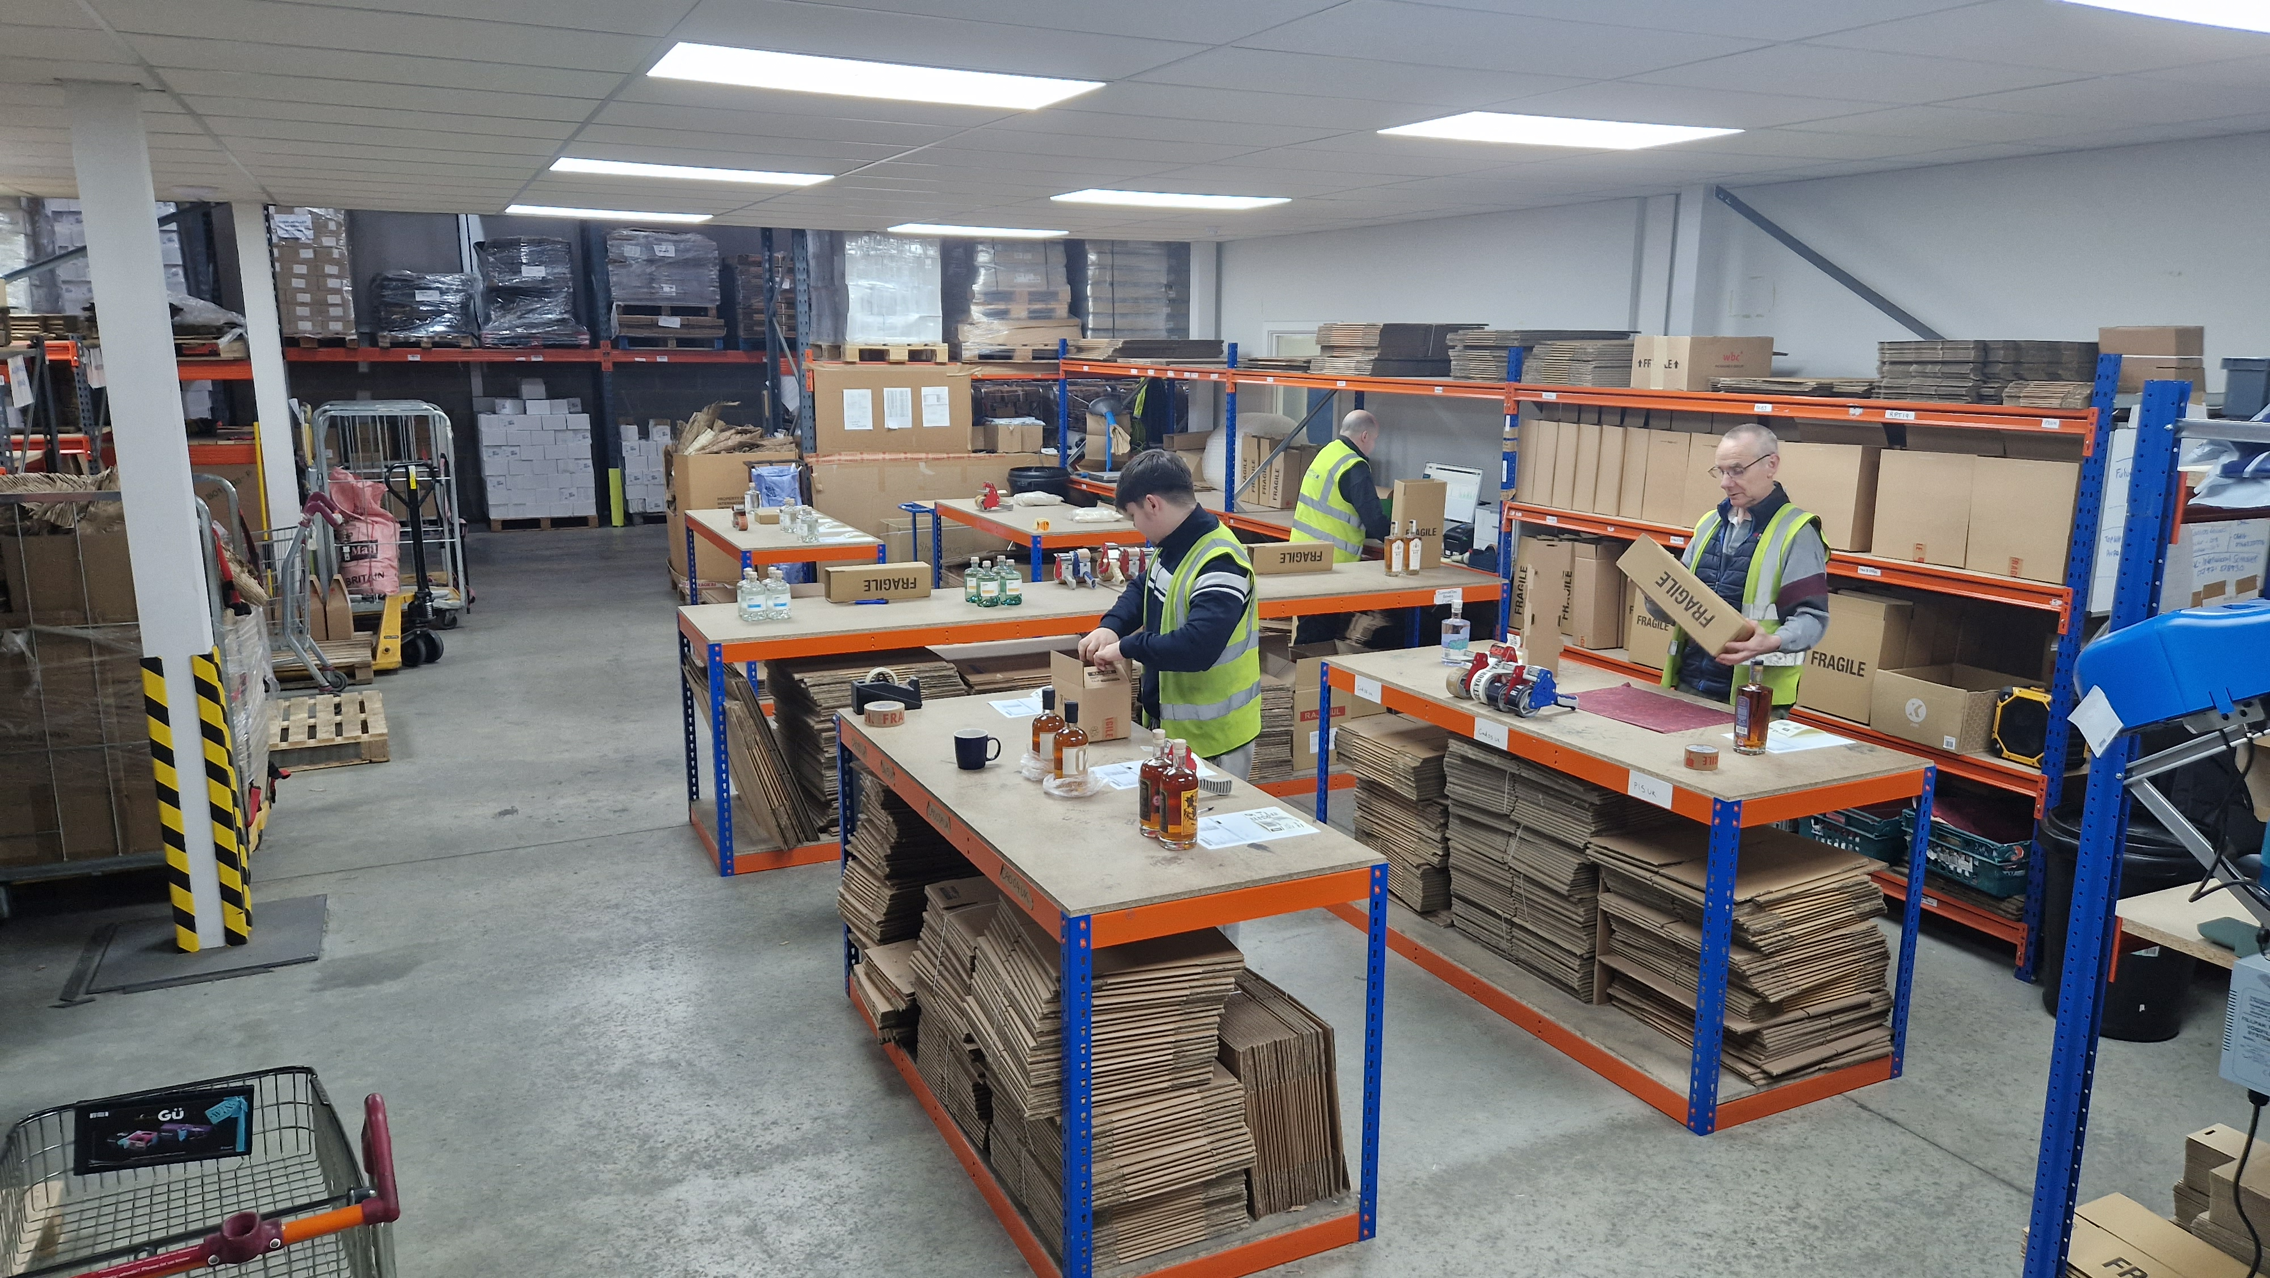
XXXXX
Additional Services
Seamless integration with FuturePro Logistics 3PL operations.
Origin and/or destination customs clearance services.
Full compliance with local requirements, with advice if required.
Complete door to door, duty paid services available.
www.futureprologistics.com

