Slide 1
Firearm Safety for the Stage
Never an Injury
Never an Excuse

Slide 2

John Spiegel, President/CEO
john@spiegelfilms.com
USDoD, US Army, GANG, GADoD, NRA, AGI, BSA

Slide 3
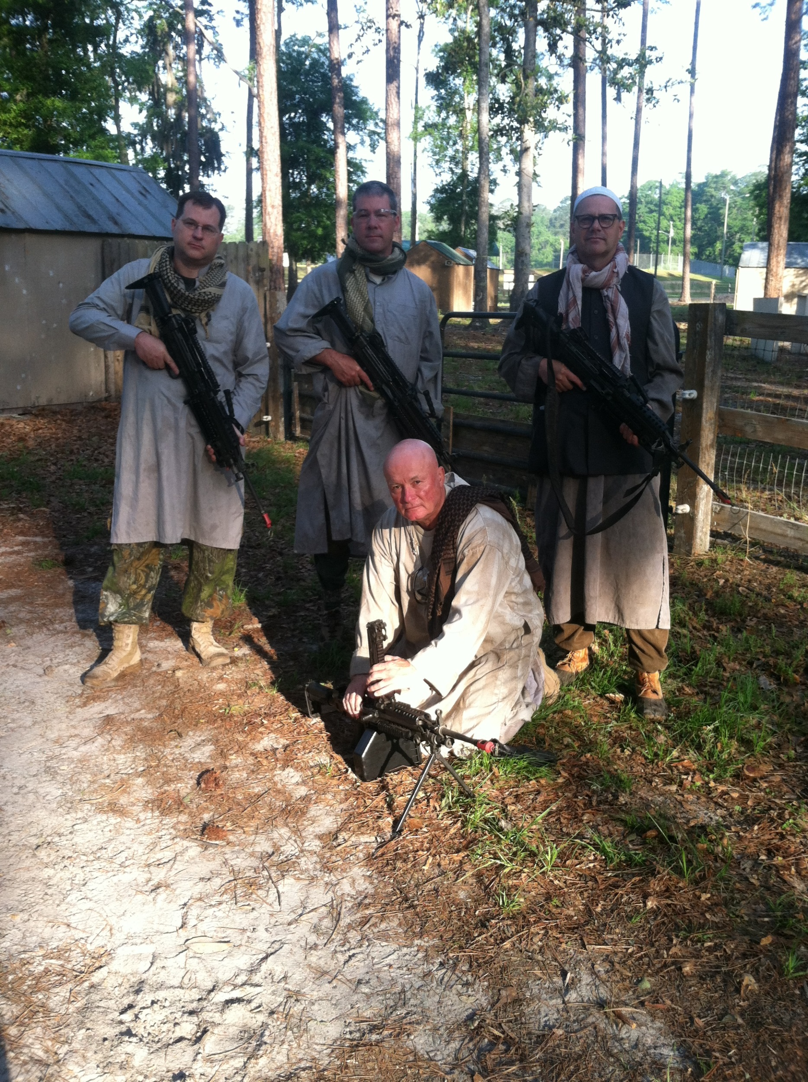

Slide 4
Why is production using a Firearm?
Is it REQUIRED?
Is it the BEST Answer
Are We Using the SAFEST Option

Slide 5
The Negatives
They are Scary
Audience Watch Firearms/Guns
Risk Increases Significantly
Guns = Expense
Safety = Expense
Are They REALLY Necessary

Slide 6
The Positives
Uhm… Yep

Slide 7
Stage Combat
This is a Dance NOT a Fight!

Slide 8
ALWAYS SAFETY FIRST
ALWAYS keep your gun pointed in a safe direction
ALWAYS keep your finger off the trigger until ready to shoot
ALWAYS keep your gun unloaded until ready to use

Slide 9
Types of Stage Firearms

Slide 10
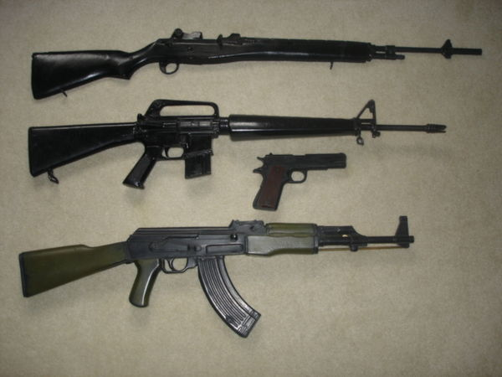
Types of Stage Firearms
1 Replica
  Non firing Rubber, Plastic or Metal

Slide 11
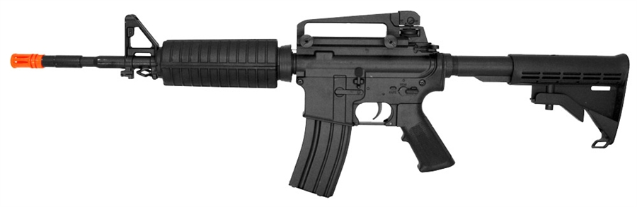
Types of Stage Firearms
2 Shrapnel Gun
  Airsoft or Toy that can discharge a projectile

Slide 12
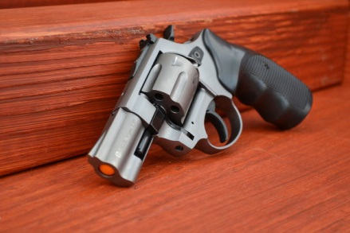
Types of Stage Firearms
3 Plug Fire
  Manufactured to be only a blank gun

Slide 13
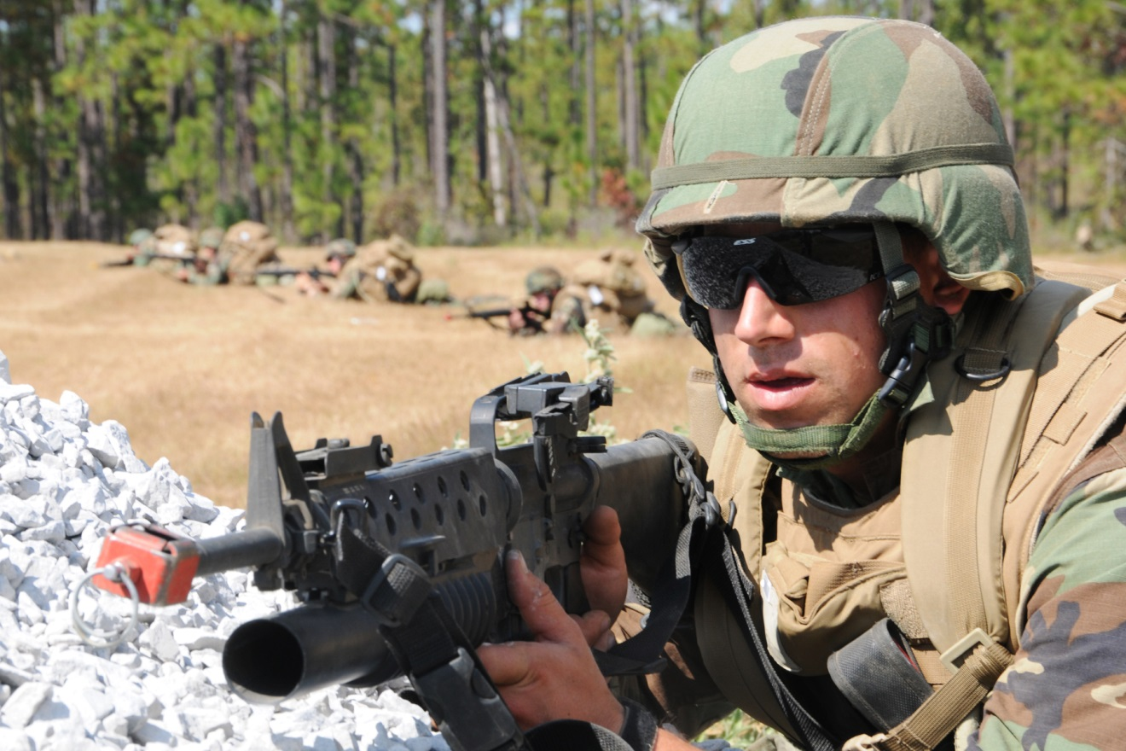
Types of Stage Firearms
4 BFA- Adapted Real Weapon

Slide 14
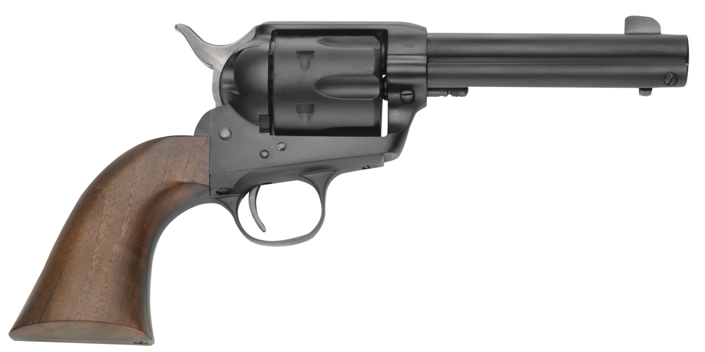
Types of Stage Firearms
5 Real Weapon with Blank

Slide 15
Some Other Options
Electronic Ignition
Coolfire
Green Gas
CO2 BB
Magic Fireball with Plug and Flashpaper
Pyrodex?

Slide 16
Action Types
Single Action- Hammer Must be Reset each Time
Double Action- Pulling Trigger Sets Hammer
Bolt/Lever/Pump Action- Action must be worked each time to reset firearm
Semi-Automatic- Pulling Trigger Discharges Round
Select Fire- Safety Switch determines rate of fire
Fully Automatic- Pulling trigger discharges rounds until trigger pull is ceased

Slide 17
Inspection- Always and Constant
Always Assume Firearm is Loaded
Never Rush
Always Keep Breach Open
Look at ALL Parts

Slide 18
Inspection- What to Look for…
Foreign Objects in barrel
Discharged Powder
Loose Parts
Missing Parts
Oiled and Clean

Slide 19
Types of Blanks

Slide 20
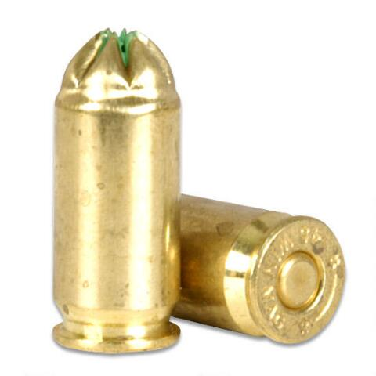
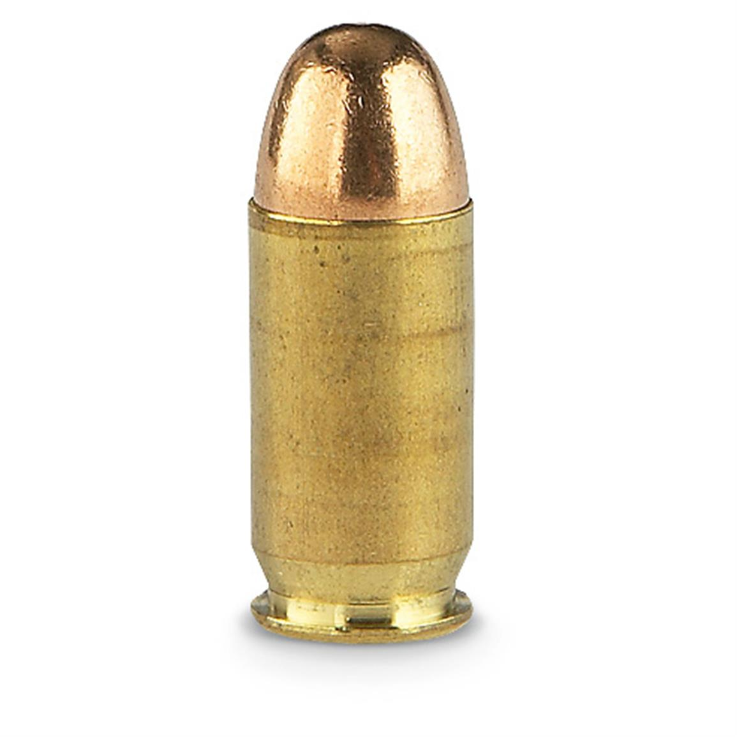
Cartridge ID
Crimped Real

Slide 21
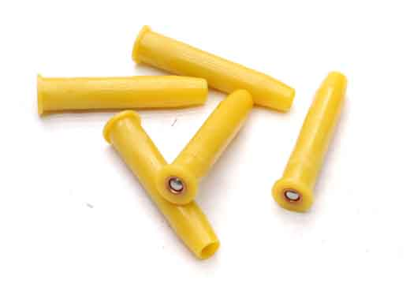
Cartridge ID
Molded Real

Slide 22
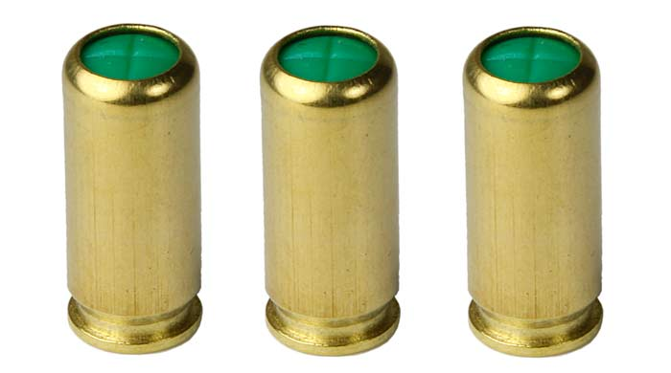
Cartridge ID
Plug Free Real

Slide 23
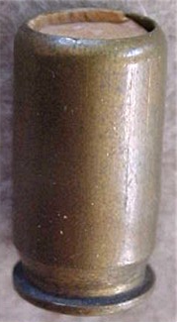
Cartridge ID- NO!!!!!!!
Wadded Real

Slide 24
Ready to Discharge

Slide 25
Discharging
Never Underestimate Discharge Pattern
Depends on Weapon
Never Stand directly In-front
There is Always a Discharge Pattern
  Front
  Side
  Top

Slide 26
So, What is the Dangerous Part?
High Pressure Gasses
High Velocity Debris
“Hot” Brass
Action of the Weapon

Slide 27
Who is Responsible?
You
Armourer/ Properties/ Gun Wrangler
Director
Producer
Weapon Operator

Slide 28
Safety Protocols
Always Written
Log Everything
Waivers
NEVER LIVE USE
Sign-Out with Inspection
Sign-In with Inspection
The Theatrical Firearms Handbook- Inouye

