Slide 1
Jaime & Friends
A
Story

Slide 2
It’s All About Me!
Name: Jaime Lauren Flora
Age: 17 years old
Birthday: March 18, 1992
Location: Laveen, Arizona
School: Arizona Agribusiness & Equine Center
South Mountain Community College
Club: Laveen Pathfinders 4-H Club
Current Mission: compilation of experiences throughout the year
Bio: Cloverkid – 4 years (1997-2001)
Junior – 4 years (2002-2005)
Senior – 4 years (2006-2009)
Offices Held This Year:
Club Secretary
Horse Committee Secretary & Teen Representative
FFA President

Slide 4
4-H & my life
I’ve been involved in 4-H nearly all my life. My mom was a 4-H member growing up before she became a leader. I got involved in 4-H as soon as I was old enough. I’ve always enjoyed my many years serving the community and my fellow members and leaders. Without 4-H I wouldn’t be as prepared for my life as I am right now.

Slide 5
My Club
I have been a member of the Laveen Pathfinders 4-H club for 12 years. Over the years I’ve seen the club continue to grow and change with each new face that joins. I got to share this wonderful year with my life-long friends to whom I dedicate this record book. Sure they drive me crazy but I love them.
Jaime Cohen, Alyssa LeDuc, and Hana Izuka this book is for you.

Slide 6
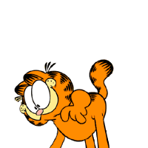

Slide 7
Skills, Learning, & Leadership
Over the years I have learned about a variety of projects including horses, sheep, photography, veterinary science, arts and crafts, and leadership. I have studied these subjects in books, at club workshops, and through various activities with my fellow club members. In the future I hope to work in a scientific field being either a large livestock veterinarian or a crime scene investigator. I also enjoy learning the science behind horses. I helped to teach equine anatomy to members of my Quiz Bowl Team who accompanied me to the Denver Western Horse Classic this year. Through 4-H I have also gained leadership and public speaking skills. Often I am called upon to conduct clinics and help the younger members of our club learn to take care of and ride the horses.

Slide 8
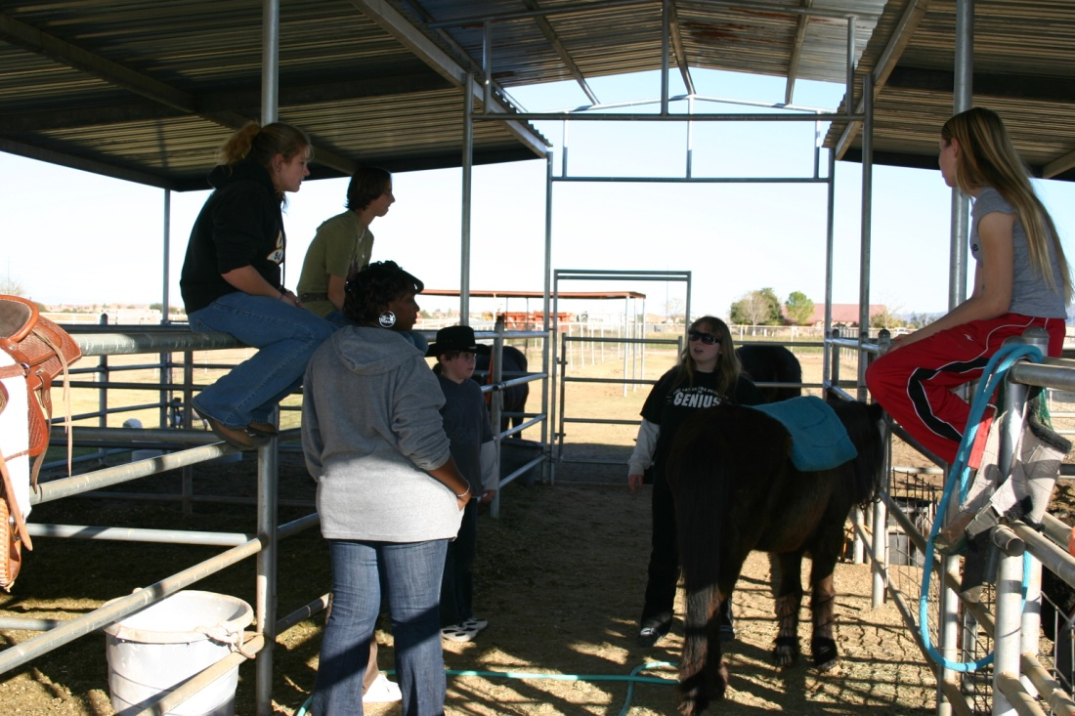
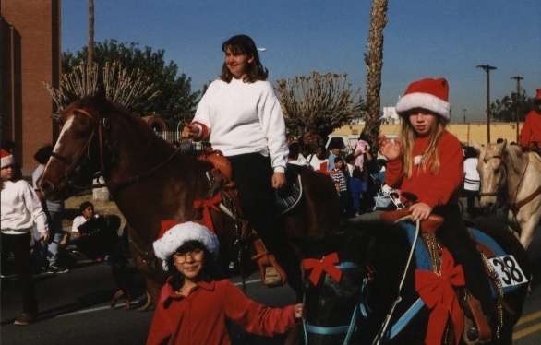
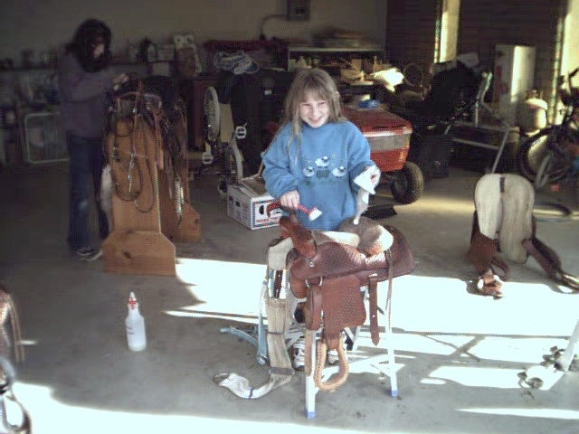
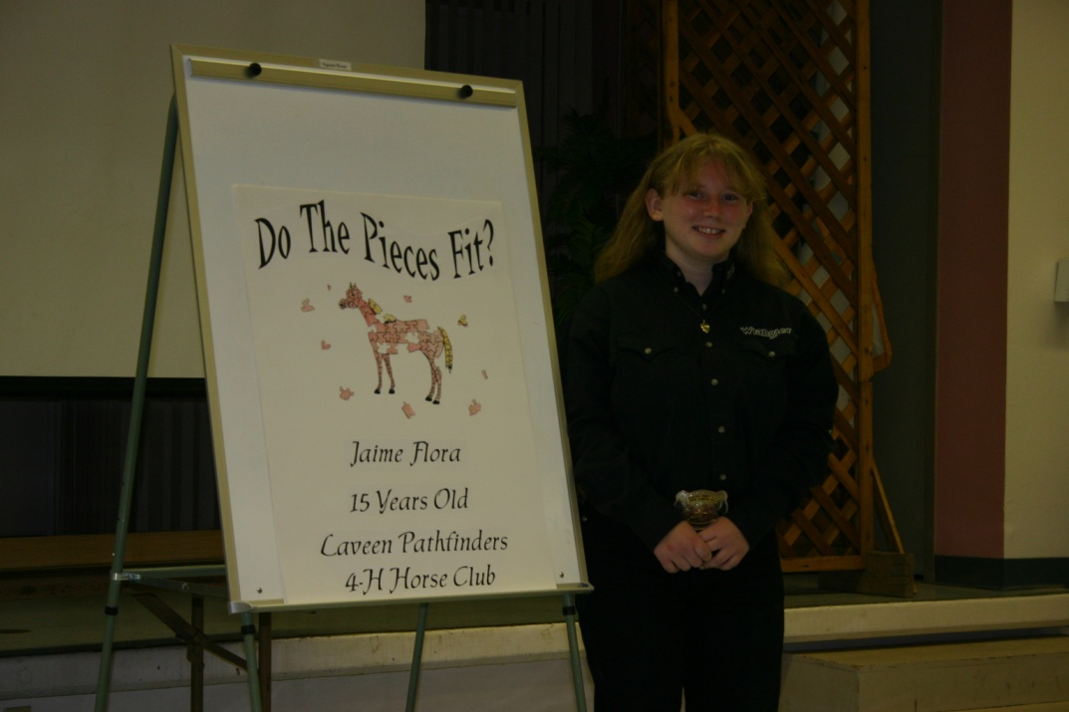
Mad Skills

Slide 10
Horse Committee
This year I continued to have the immense pleasure of serving on the Maricopa County Horse Committee. After serving for three years as a Teen Representative and holding the position of Secretary I can fully appreciate how large our 4-H horse organization is and how much our volunteers sacrifice to keep it running to benefit the many youths that are eager to learn new things. I look forward to continuing to volunteer for the committee next year.

Slide 12
Denver Horse Bowl
My greatest accomplishment this year was winning a trip to go compete at the Western Horse Classic for Quiz Bowl. Our group worked hard from summer break all the way up to the day of the competition studying and practicing, putting in hours upon hours of time to prepare. Our state team placed 8th and I placed 7th individually over-all.

Slide 13
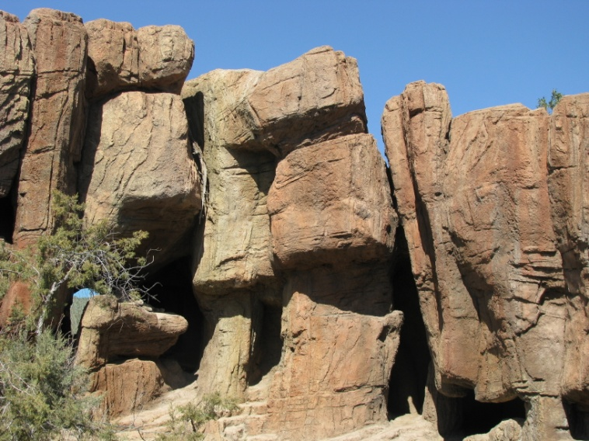
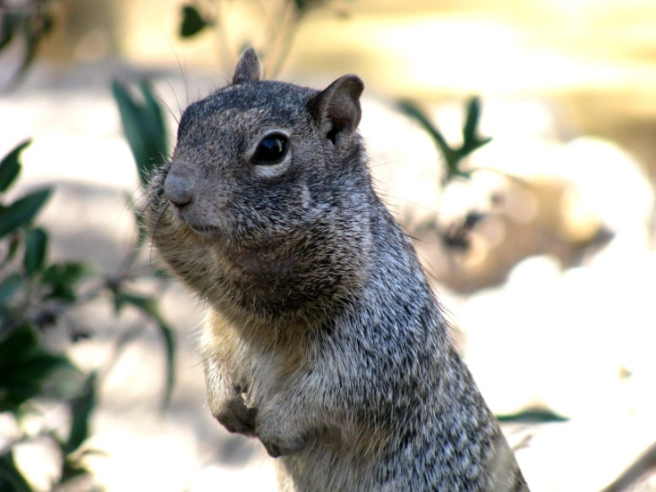
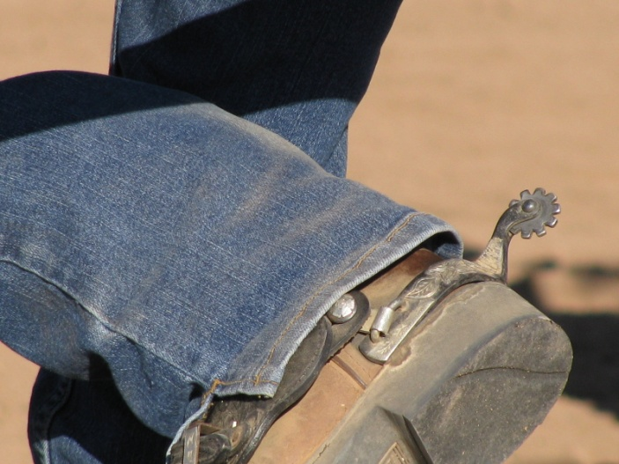
Maricopa County Fair Pics
This year I entered my many pictures in the Maricopa County Fair in both the 4-H and Open Divisions. I am proud to say they did well. I placed 1st, 2nd, and 3rd in different categories with these pictures in open.
Can you read the mountain? It says EEK!

Slide 14
4-H Congress
This summer I was selected to participate in the 4-H National Congress coming up this November. I look forward to representing our state proudly and using the opportunity to learn more about how I can serve 4-H in the future. Hopefully this will be my next greatest accomplishment.

Slide 16
Helping others
I love to help anyone I can. 4-H has provided me with many opportunities to not only serve my community but to help people and animals on a personal level. I love the satisfied feeling of knowing that I helped to make a difference in someone’s life.

Slide 18
Trick or Treat So Others Can Eat
Ever since the Trick or Treat So Others Can eat food drive was started I have always participated in it with my club. Usually we pick one night to get dressed in our Halloween costumes early and go out to walk the neighborhood to collect non perishable food for needy families. Its always a lot of fun and we usually collect about 100-150 pounds of food.

Slide 20
Christmas Angels
For the last few years our club has shopped for Channel 3’s Christmas Angels every December. I love to pick out a child’s wish that has similar interests to mine so I can get them something I think they would really enjoy. Each year we usually buy gifts for 5-10 children and drop the gifts off at the booth in the mall.

Slide 21
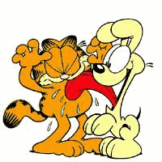

Slide 22
South Mountain Trail Cleaning
Every year our club always goes to clean the trails at the South Mountain Park. We volunteer to do all sorts of work for the rangers including removing debris from the trails, creating footpaths for the visitors, repairing stalls for the rangers horses, and raking around the corrals and ramadas.

Slide 23
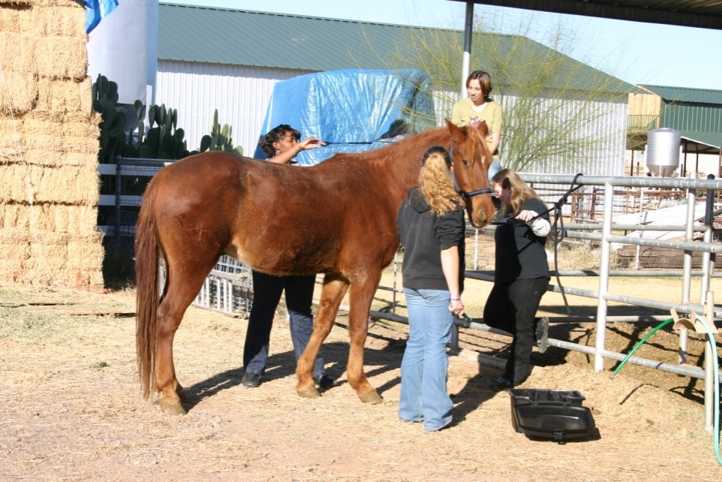
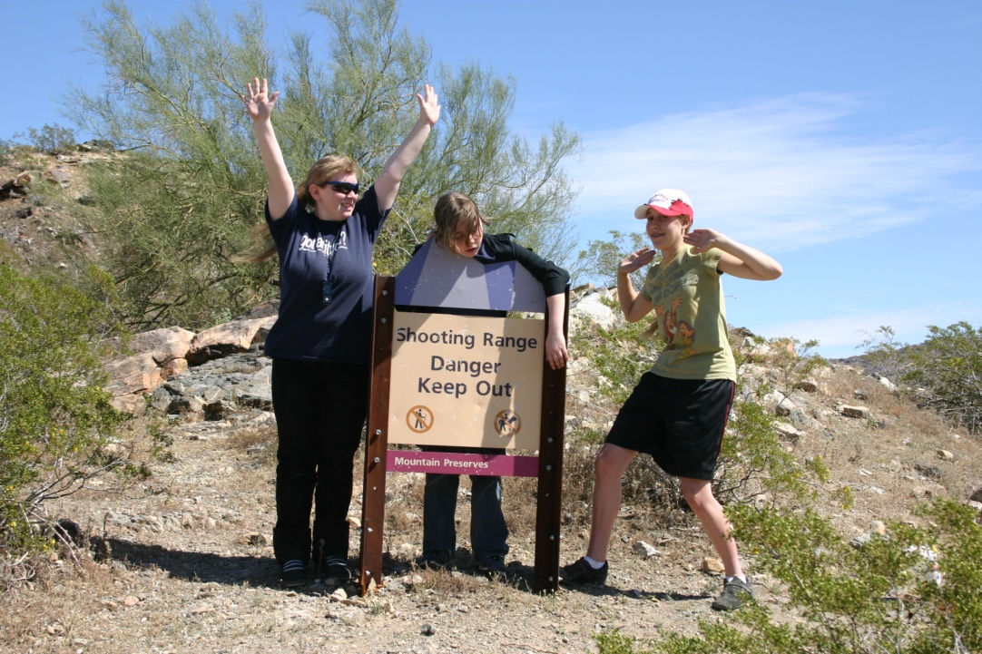
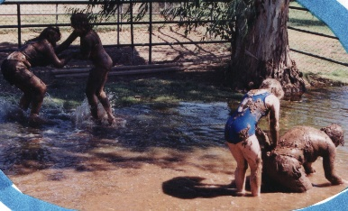
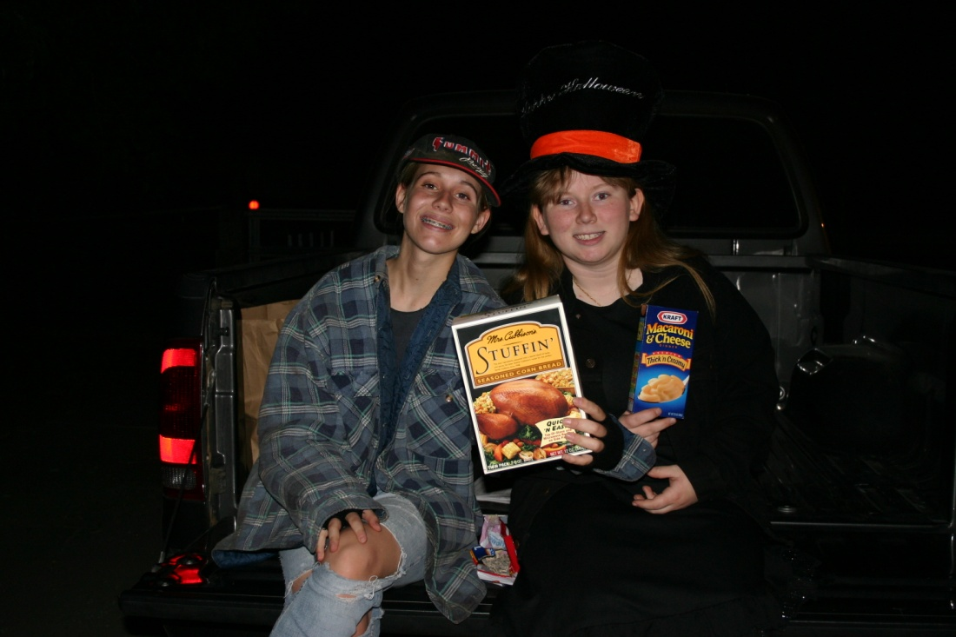
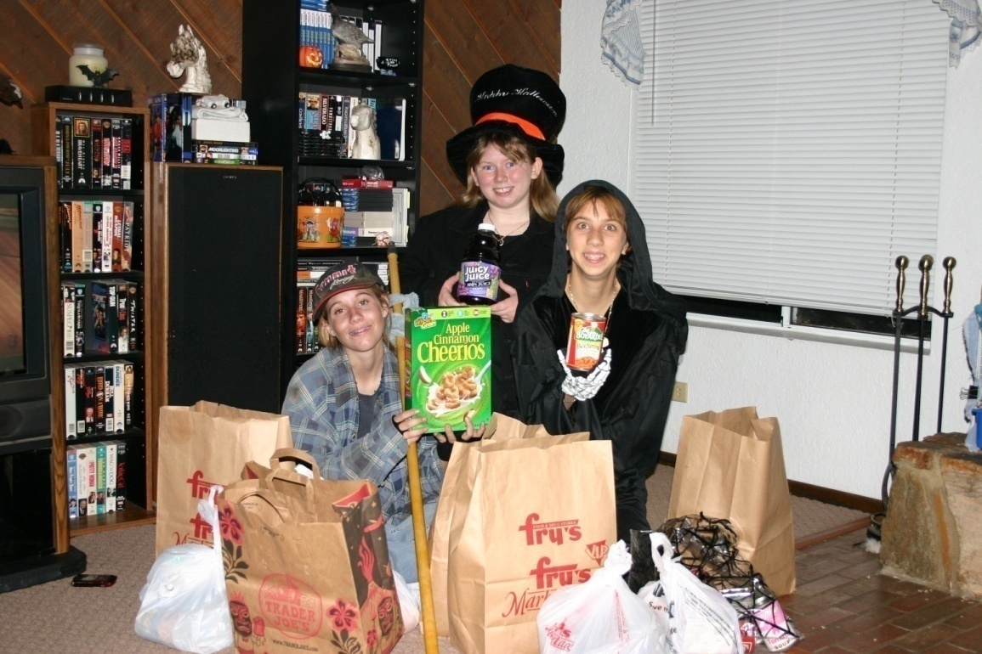
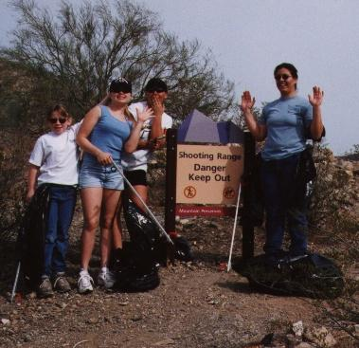
We do have fun though!

Slide 24
Teen Issue
Helping my fellow students receive a higher education and to make the most of their capabilities has always been what I’ve strived for. In the past I have helped the teens in my club and at school learn how to plan and schedule their college classes to not only make the most out of their money but to help them better themselves through that educational experience. I continue to make myself available for anyone who has questions about college classes or their schedules, making my advice free to everyone.

Slide 25
Coming in November
Here I come!
4-H
National
Congress

Slide 26
The Man Behind the Cat…
Jim Davis grew up in Marion, Indiana as a member of his father’s founded 4-H club. Many of the people he knew from the club and the surrounding farm community Davis still uses in his Garfield comic strips today.
Davis created the lazy fat cat Garfield, naming him after his own grandfather James Garfield Davis, to represent what people commonly see in their own selves. Despite what many might call Garfield’s shortcomings (being undertall, overweight, and lazy) Garfield is still happy with himself.
Davis believes that being happy with yourself is something we all need.
“The benefit of 4-H is that instead of competing with others, you found how to compete with yourself, how to make the best better. That is what it was all about for me growing up.” - Jim Davis
Despite growing up on a small black angus cattle farm, Davis was unable to do much actual farming due to severe bouts of asthma growing up. He turned to drawing as a way to while about the hours.

Slide 28
Tune in again
next year!!

Slide 29
