Slide 1
Synergize it! Engaging Strategies for RLA Learning
Jennifer Martin, Literacy Consultant
Jmeducate.com
jmeducationpd@gmail.com

Slide 2
What does it mean to “synergize”?
Synergy — Working together to create something greater than what an individual could do alone.
The word synergy comes from the Greek sun, "together," and ergon, "work."
When one thing magnifies the effect of another, together they have synergy.

Slide 3
Synergize to Synthesize!
Combine different elements
Make connections
Create new understanding
Let’s learn and experience some strategies to synergize your RLA classroom!

Slide 4
Sentence Scramble
Next Level!
In the classroom:
Write on the board or project the words and punctuation of a sentence that is connected to what you are learning. I give them the words in a parts of speech grouping.
Students receive enough small slips of paper on which to write each word.
Students write one word or punctuation mark on each small slip of paper.
Students begin unscrambling the sentence in pairs.
. an an of
are always not
Good attractive
mind indication looks

Slide 5
Sentence Scramble
In the classroom:
Give students enough time to create a correct answer. (I used a timer for classes that needed structure)
Reveal the original sentence
Open a discussion about how students determined the order/position of the words, use of punctuation, and so on.
Good looks are not always an indication of an attractive mind.

Slide 6
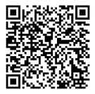
Today’s Presentation

Slide 7
Sentence Scramble
Build on this strategy:
Give each student a Ziplock bag to store word squares.
After each sentence scramble (I strive for once a week), students continue to add their word squares to the bag.
After a few times, they will have quite a collection of words and punctuation marks.
Give them time periodically to use all of their cumulative words to create amazing sentences! My students would beg to do this!
Good looks are not always an indication of an attractive mind.

Slide 8
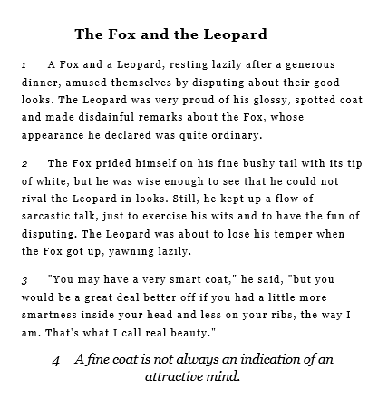
Placemat Activity—Synthesis
A reading stimulus is needed to initiate the Placemat Strategy.
Use a brief selection that has enough layers for analysis.

Slide 9
Placemat Activity—Synthesis
Read the selection.
Guide students through analysis.
Both characters are arrogant.
Select two different colored highlighters—one to represent each character.
As I read, highlight text evidence that supports how each character is arrogant.

Slide 10








Slide 11

Pick your partner! Let’s break into pairs.

Slide 12
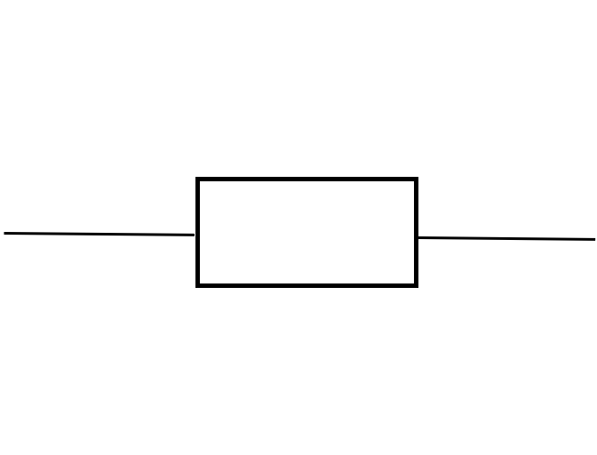
This is a variation if you want to keep students working in pairs.

Slide 13
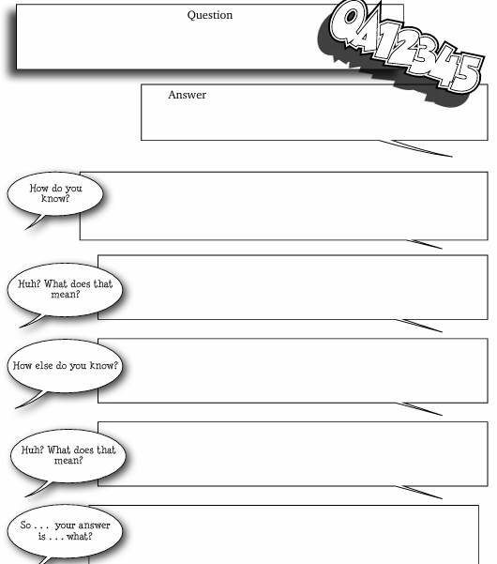


I use several text structures for responding, but today we are using a variation of QA12345- QA12-5.
Go to TrailofBreadCrumbs.net for more exciting text structures!!!

Slide 14
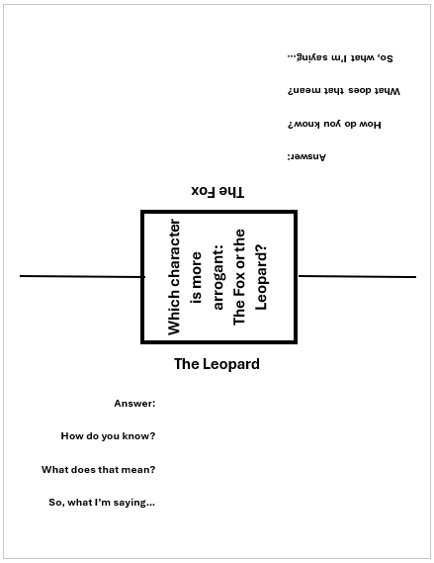
I use several text structures for responding, but today we are using a variation of QA12345-- QA12-5.

Slide 15
Which character is more arrogant: the Fox or the Leopard?
Look at your section of the graphic organizer and see which character you have been assigned.
Next to “Answer,” answer the question with a complete sentence.
Provide sentence stems: The ___________ is more arrogant than ___________.

Slide 16




Now each participant has responded to the “Answer.”

Slide 17
Turn the graphic organizer one time to face your partner.
You now have your partner’s answer. Read it.
How do you know this is true? Answer with a complete sentence that provides text evidence from the selection.
Remember that you have highlighted text evidence on your selection for support.
Provide sentence stems/frames: I think this because in the text it says, __________________________.

Slide 18


At this point, you and your partner have continued the response to each other’s original answer.

Slide 19
Turn the graphic organizer again.
Read what you and your partner have written in the space.
What does this mean? Explain in your own words.
Provide sentence starters: What this means is…

Slide 20

Almost done! You have both contributed to this response.

Slide 21
Turn the graphic organizer once more.
Read the three previous statements.
Tie it all together with a final statement.
Sentence starters: As a result…

Slide 22


You did it! Now decide which response is the strongest.

Slide 23
Rotate the graphic organizer back to the original writer.
Read what your team developed from your original answer.
As a team, read all responses and decide which one is the best.
You may use this time to add or delete anything to improve your final answer.
Be ready to share!

Slide 24
Variations of Placemat Activity
Use any genre of literature
Change the number in each group
Create new text structures
Refer to Gretchen Bernabei’s Text Structures online and in her many books!

Slide 25


In the classroom, I like to arrange students into groups of four.

Slide 26
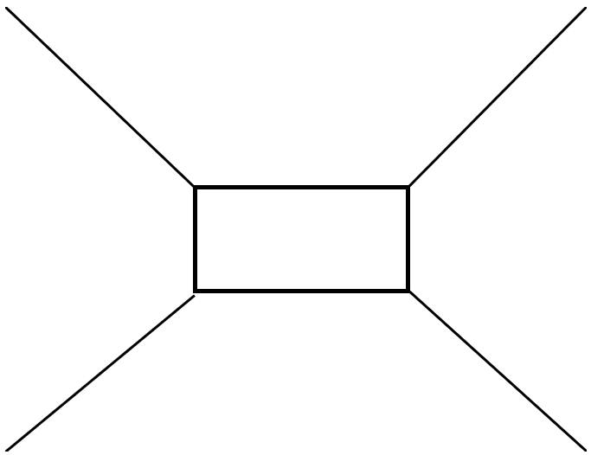
Provide a graphic organizer or instruct students how to create one.
An example of a graphic organizer for a group of four.

Slide 27
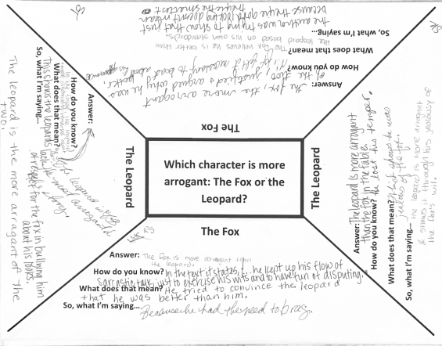
An example of a graphic organizer for a group of four.

Slide 28
Synergize to Synthesize--
Did we work together to create new learning?
Did we use multiple sources to create new learning?

Slide 29


