Slide 1
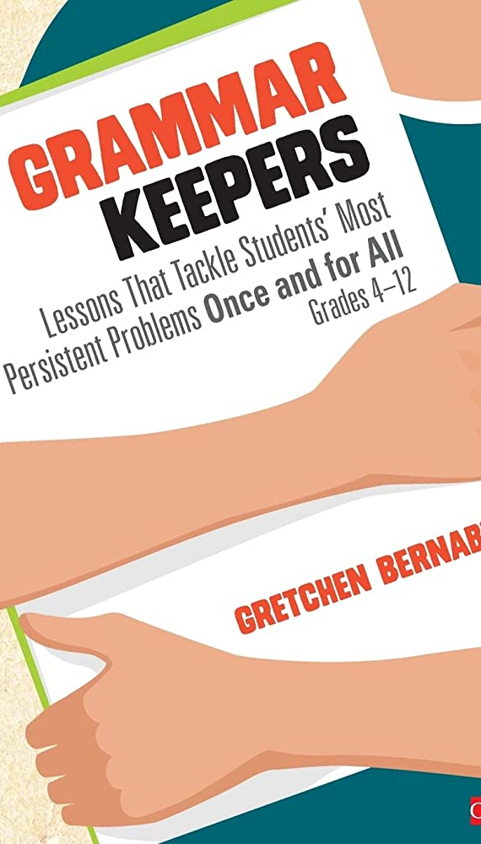
Trail of Breadcrumbs Grammar & Writing Workshop
Mineral Wells ISD
June 20, 2023
9:00 am to 3:30 pm

Slide 2
Make a table tent with your name and what grade you teach. Thanks!
Jennifer Martin
Instructional Strategist
RLA and Social Studies
Trail of Breadcrumbs Presenter

Slide 3
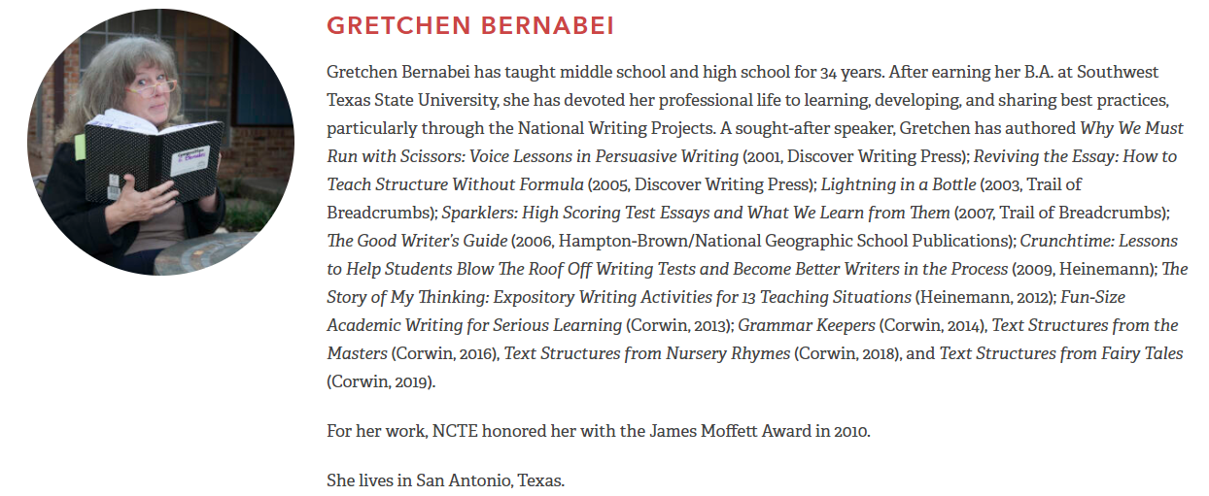
Meet the Authors (Gretchen and Judi)

Slide 5
Let’s start with a Quick List—Number your paper 1-10.
Three interesting things about you:
1.
2.
3.
Three memories that are important to you:
4.
5.
6.
Three people or literary characters that you think are smart or wise:
7.
8.
9.
One place that makes you happy:
10.
Three interesting things about Jenny:
1. No birth certificate for the first 5 years
2. Nearly kidnapped by a band of hippies at 5
3. Kissed George Strait
Three memories that are important to you:
4. Going to cemeteries with my grandparents
5. The day I lost my mother
6. Holding our newborn babies
Three people or literary characters that you think are smart or wise:
7. Grandparents
8. Atticus Finch
9. Violet Crawley
One place that makes you happy:
10. My Kitchen

Slide 6
Share some of your “interesting things” with those at your table.
Image from Shutterstock.com

Slide 7
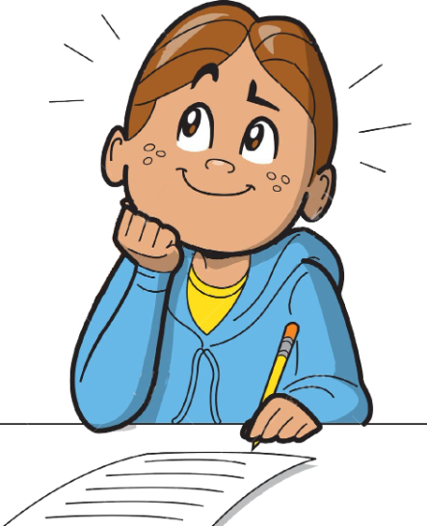
Select one of your important memories that you feel that you could write about.
Take a moment to reflect on the details, feelings, conversations, actions, and so on that are connected to this special memory.
Image from Clipartmag.com

Slide 8
On a clean sheet of paper, create this graphic organizer.
Name_________________
Topic__________________________
My Structure ______________________
Kernel Essay:
1)
2)
3)
4)
5)

Slide 9
Fill in your name and the memory that you chose for the topic.
Name___Jenny______________
Topic__Going to cemeteries with grandparents__
My Structure ______________________
Kernel Essay:
1)
2)
3)
4)
5)

Slide 10
#1 Where were you and what were you doing?
#2 What happened first?
#3 What happened next?
#4 What happened last?
#5 What did you think or learn from this experience?

Slide 11
Write one complete sentence for each of the following questions for the “kernel essay.”
Name___Jenny______________
Topic__Going to cemeteries with my grandparents__
My Structure ______________________
Kernel Essay:
1) My grandparents would load their gardening tools into their old truck, and we
would all pile into the front sitting on laps.
2) When we got to the cemetery of choice, all of us would grab a garden tool and
gloves to clean up around the headstones.
3) While we were pulling weeds and cleaning up debris, my grandparents would
tell us stories about the people buried there.
4) Our imaginations brought these people to life, and we learned the history of
our family and community.
5) I learned that cemeteries are full of memories and lessons.

Slide 12
Fill in your structure along with the kernel questions.
Name___Jenny______________
Topic__Going to cemeteries with my grandparents__
My Structure __Memory Reflection___
Kernel Essay:
1) My grandparents would load their gardening tools into their old truck, and we
would all pile into the front sitting on laps.
2) When we got to the cemetery of choice, all of us would grab a garden tool and
gloves to clean up around the headstones.
3) While we were pulling weeds and cleaning up debris, my grandparents would
tell us stories about the people buried there.
4) Our imaginations brought these people to life, and we learned the history of
our family and community.
5) I learned that cemeteries are full of memories and lessons.

Slide 13
On the back of your kernel essay, write the following: Read by: __________________________ Read by: __________________________

Slide 14
Share your kernel essay with at least two other people. Have them sign the back of your paper.

Slide 15
Let’s share!

Slide 16
How does this look in your classroom?

Slide 17
Let’s explore Gretchen and Judi’s Fun-Size Academic Writing for Serious Learning

Slide 18
Digital Resources – Corwin and Trailofbreadcrumbs.net
Corwin Fun-Size
https://trailofbreadcrumbs.net/
Password: imagination

Slide 19
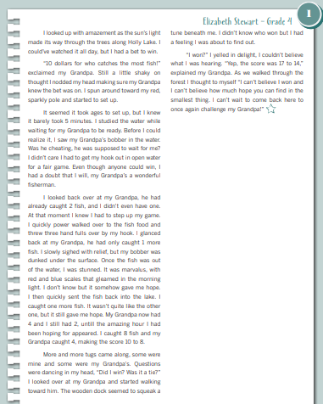
Lesson #1 “Color It Up” Pages 14-15 in Fun-Size
You will need four colors (highlighters, crayons, gel pens, etc.).

Slide 20
Before we “color it up,” let’s “Rope and Brand.”
First, read the piece.
Using the text structure “Memory Reflection,” block off the paragraphs to represent each part or chunk of the structure.

Slide 21
Before we “color it up,” let’s “Rope and Brand.”
First, read the piece.
Using the text structure “Memory Reflection,” block off the paragraphs to represent each part or chunk of the structure.
Write short summary sentences for each chunk of text by answering the text structure questions.
Read the short sentences aloud to hear the kernel essay.

Slide 22
Kernel Essay = one sentence for each part of the structure
“Roping and Branding” helps our students create text structures for what they are reading as well as what they are writing.

Slide 23
Text structures can work both ways--
Your students can use a quick list to brainstorm ideas and then answer the questions for each “chunk” of the structure. They will then have the framework to begin fleshing out a fuller composition.
Your students can also “chunk” the parts of a text to discover the organization and framework of the selection.

Slide 24
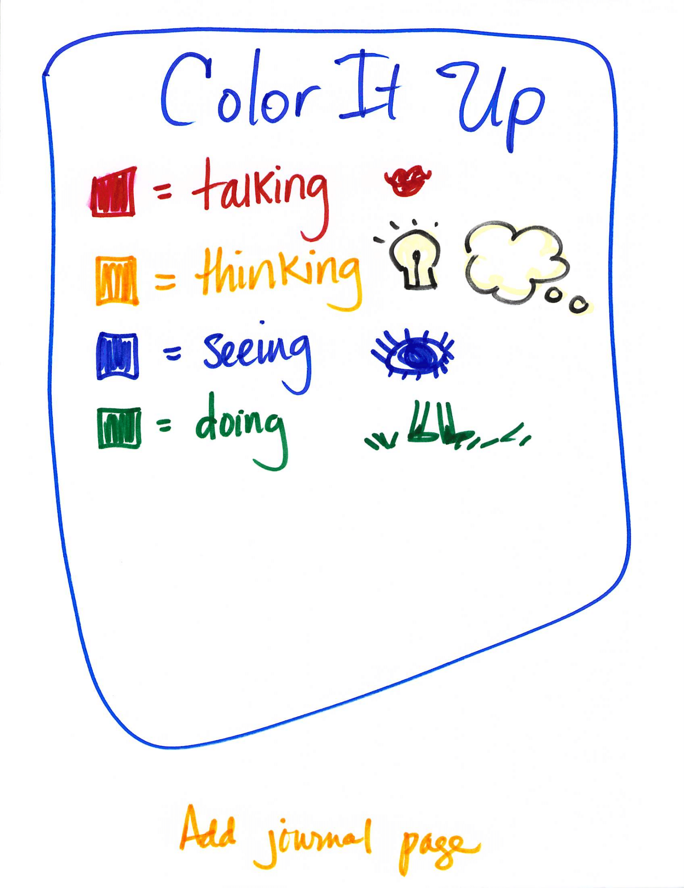
Color It Up

Slide 25
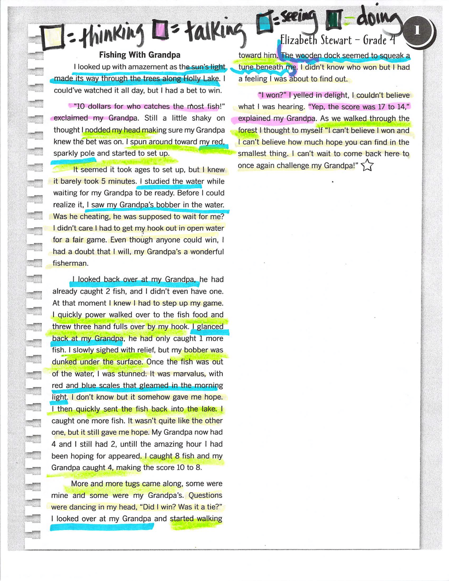
Color It Up

Slide 26
What do students gain through these strategies?
Quick Lists
Kernel Essays
Text Structures
Roping & Branding
Color It Up

Slide 27
Back to your kernel essay!
Name___Jenny______________
Topic__Going to cemeteries with my grandparents__
My Structure __Memory Reflection___
Kernel Essay:
1) My grandparents would load their gardening tools into their old truck, and we
would all pile into the front sitting on laps.
2) When we got to the cemetery of choice, all of us would grab a garden tool and
gloves to clean up around the headstones.
3) While we were pulling weeds and cleaning up debris, my grandparents would
tell us stories about the people buried there.
4) Our imaginations brought these people to life, and we learned the history of
our family and community.
5) I learned that cemeteries are full of memories and lessons.
Let’s add a Ba-Da-Bing sentence to your kernel.

Slide 28
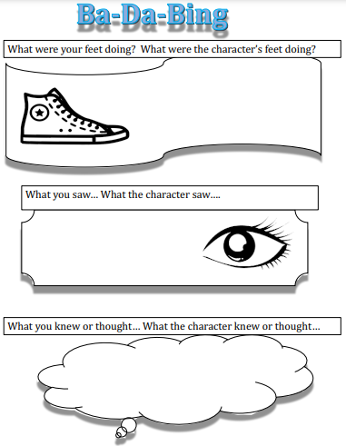
You will need your kernel essay and a copy of the Ba-Da-Bing graphic organizer.
Let’s watch Stephen Briseno’s helpful video.
Ba-Da-Bing Video
Ba-Da-Bing Graphic Organizer created by Tara Temprano

Slide 29
Kernel Essay:
1) My grandparents would load their gardening tools into their old truck, and we would all pile into the front sitting in laps.
2) When we got to the cemetery of choice, all of us would grab a garden tool and gloves to clean up around the headstones.
3) While we were pulling weeds and cleaning up debris, my grandparents would tell us stories about the people buried there.
4) Our imaginations brought these people to life, and we learned the history of our family and community.
5) I learned that cemeteries are full of memories and lessons.
While we were pulling weeds and cleaning up debris,
my grandparents would tell us stories about the people buried there,
and I would wonder, “Is this like being a time traveler?”
Ba-Da-Bing Graphic Organizer created by Tara Temprano

Slide 30
Improved sentence:
3) While we were pulling weeds and cleaning up debris, my grandparents would tell us stories about the people buried there, and I would wonder, “Is this like being a time traveler?”
Create a Ba-Da-Bing sentence for your kernel essay!

Slide 31
What to do with kernel essays--
Flesh out the essay by expanding each chunk.
Work a bit each day making changes and learning new writing crafts.
Grow a variety of writing modes for a student portfolio/writer’s notebook.
Help students add to their writer’s toolbox.
Support skills connected to paraphrasing, summarizing, and organization.
What are some other ideas?

Slide 32
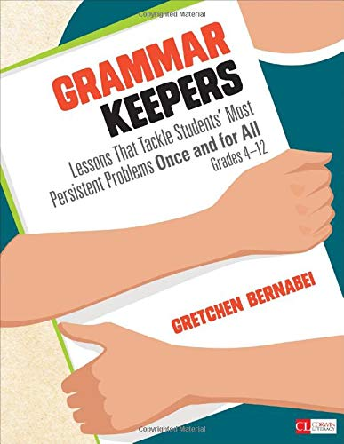
Let’s shift over to Grammar Keepers!

Slide 33
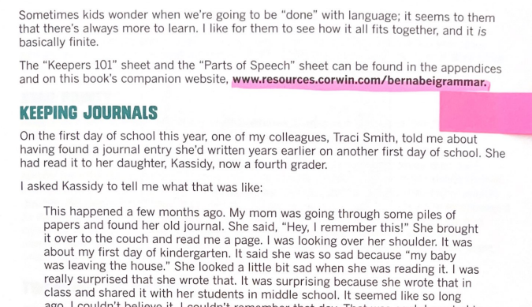
Digital Resources—Grammar Keepers
Corwin Grammar Keepers Resources
Page 7 of the book’s introduction
https://trailofbreadcrumbs.net/

Slide 34
Let’s check out Gretchen’s introductory PowerPoint for Grammar Keepers!
Grammar Keepers Intro Bernabei

Slide 35
Putting It All Together-

Slide 36
Reading with Lenses:
Selecting lenses or filters through which we focus our reading gives us purpose.
Reading with Lenses Fables Student.pptx

Slide 37
Let’s look at our new writing rubrics!

Slide 38
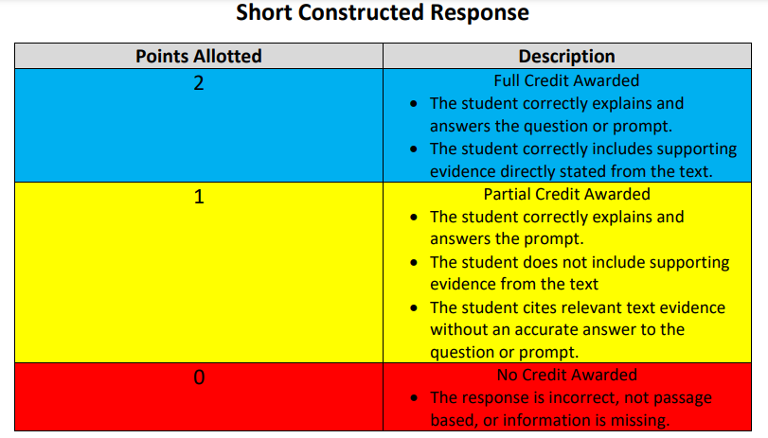

Slide 39
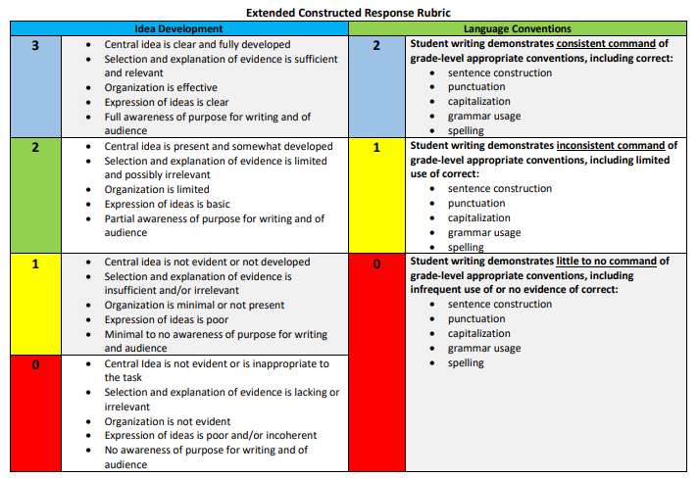

Slide 40
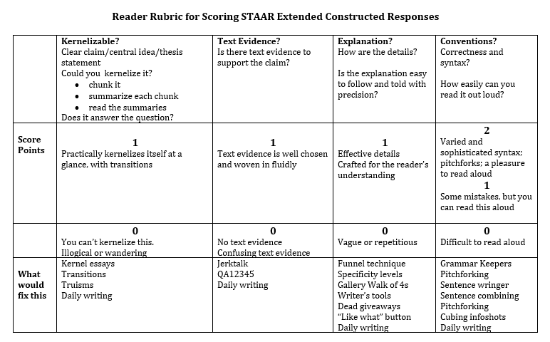

Slide 41
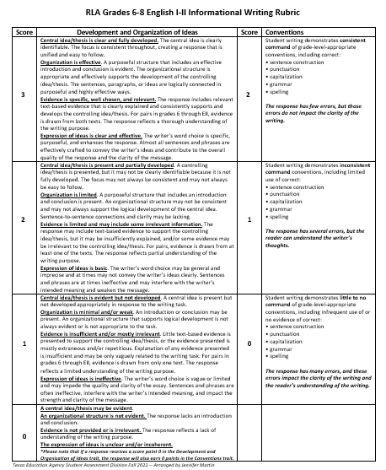

Slide 42
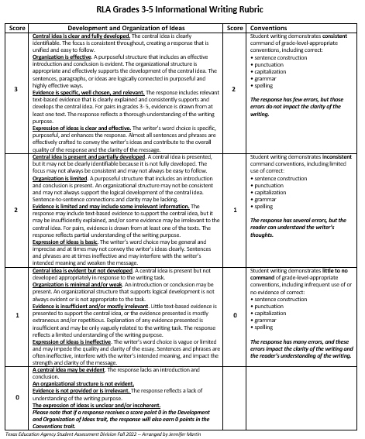

Slide 43
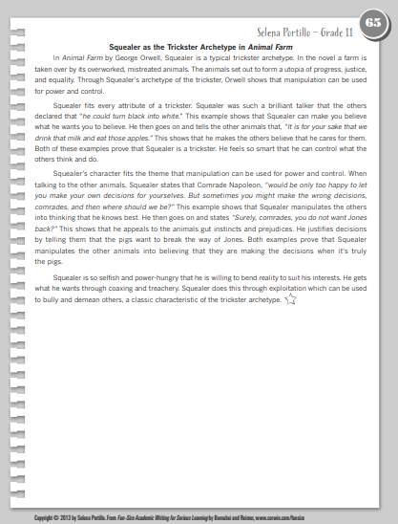
Fun-Size Academic Writing for Serious Learning
Lesson 65 on pages 144-145

Slide 44
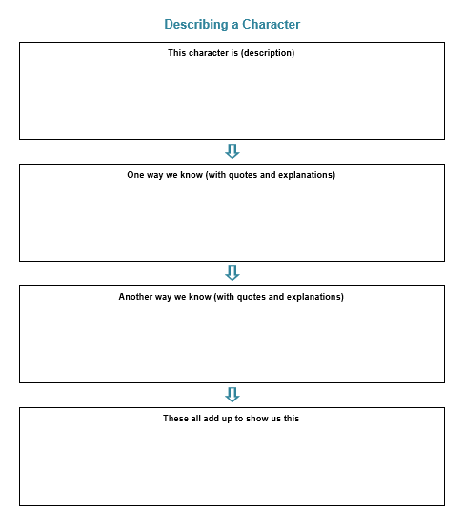
This text structure would support some STAAR prompts that analyze literature.

Slide 46
Let’s use the “Describing a Character” text structure to create a kernel essay.
Show one of the proofs from Grammar Keepers.
Add a
Ba-Da-Bing sentence.
Your Quick List
What about the three people/characters that you thought were smart? Could a comparison be made?
Take time to expand your essay and then use the “Color It Up” activity as shown in lesson #65.

Slide 47
These two resources along with the online support will not only fill your reading and writing toolboxes, but they will help you add more authentic learning to your classroom.

Slide 48
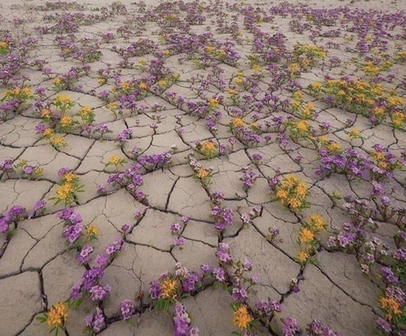
Think about our students who “slip through the cracks”-
We can still help them grow where they are and blossom as they learn.

Slide 49
Remember that special place that you mentioned in your quick list?

Slide 50
Reach out with questions and share your successes!

Slide 51
Reach out anytime!
Jennifer Martin
jmedcationpd@gmail.com
Jmeducate.com
903-217-2613

