Slide 1

Reading Lenses 101—Focus on Fiction
Jennifer Martin
Instructional Specialist
jmeducationpd@gmail.com
903-217-2613
This Photo by Unknown Author is licensed under CC BY

Slide 2




Today’s
Teachers will gain several strategies to strengthen instruction in bridging reading and writing using deep analysis. gain

Slide 3

Reading with Lenses:
Selecting lenses or filters through which we focus our reading gives us purpose.

Slide 4
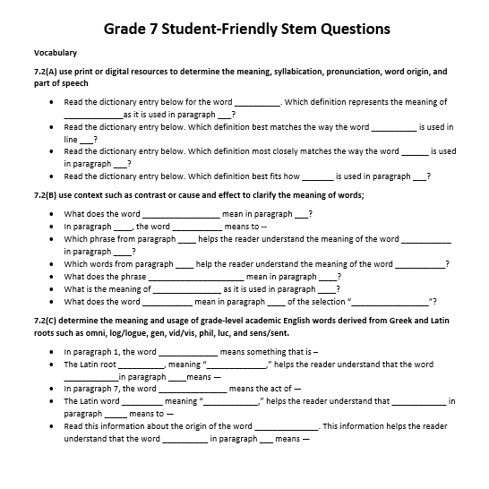
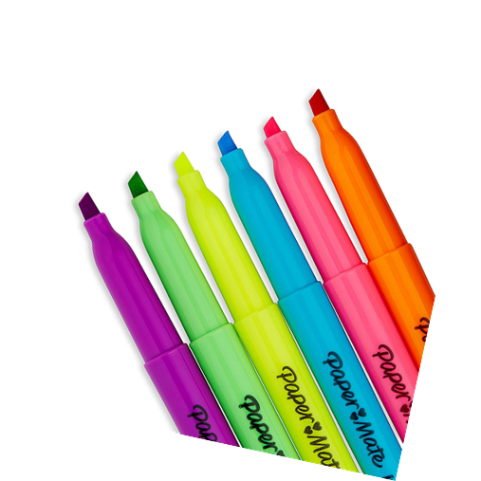
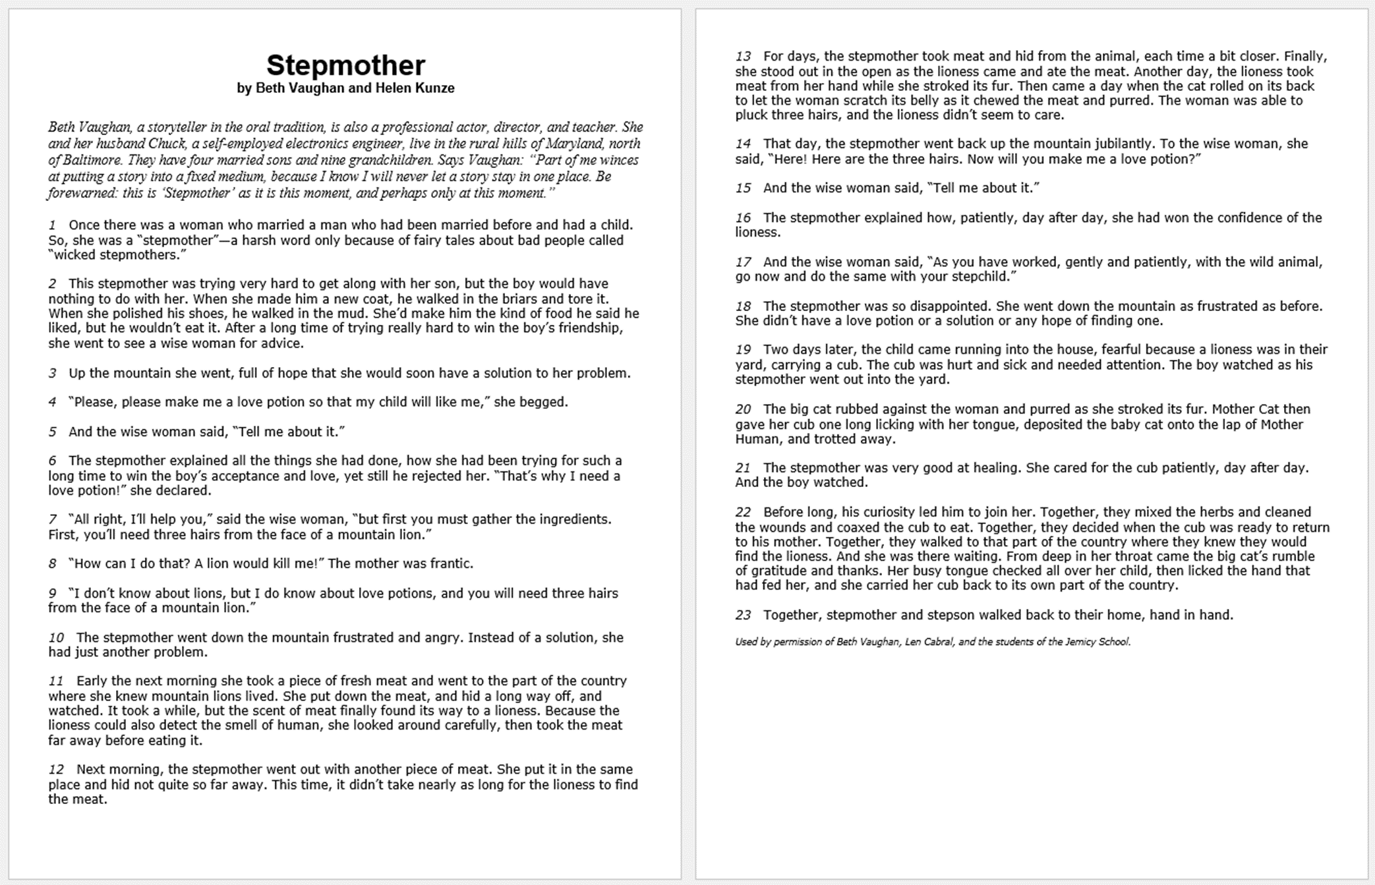

You will need: copy of text, STAAR stem question bank, highlighters, and paper & pen for your thoughts.

Slide 5
Using your curriculum documents, decide which TEKS are to be taught. From there, determine the skills that compose the TEKS and which resources you will need to build your lesson.
In our first activity today, we are going to use the TEKS associated with vocabulary, characterization, and plot elements such as dialogue. Before this lesson, you would have directly taught these skills.

Slide 6

Used with permission from the Vaughan Family.

Slide 7
1st Read:
Read the selection aloud for the 1st time through the vocabulary lens.
*Note any words that particularly address the skills in the assessed TEKS.

Slide 8
Vocabulary Skills—Remember the BIG THREE:
Let’s try some examples!
Context Clues 7.2(B) use context such as definition, analogy, and examples to clarify the meaning of words;
Greek/Latin Roots—7.2(C) determine the meaning and usage of grade-level academic English words derived from Greek and Latin roots such as omni, log/logue, gen, vid/vis, phil, luc, and sens/sent.
Multi-meaning Words and Origins--Vocabulary
7.2(A) use print or digital resources to determine the meaning, syllabication, pronunciation, word origin, and part of speech
Grade 7 TEKS from the Texas Education Agency.

Slide 9
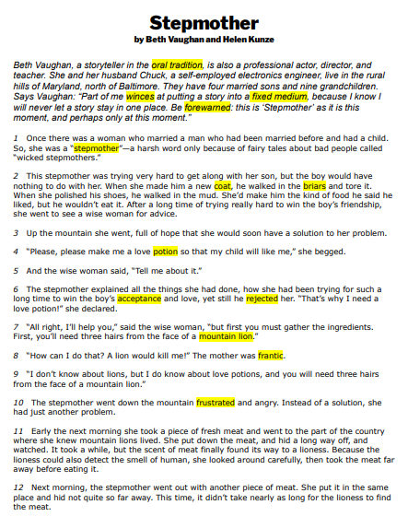
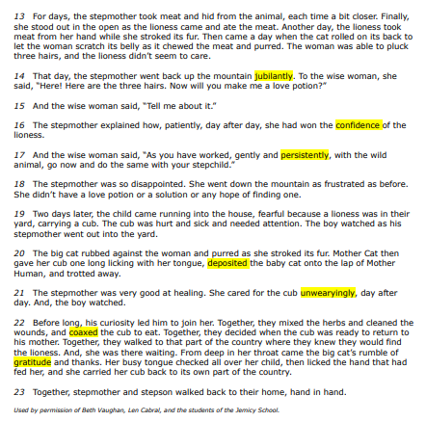

Slide 10
7.6(F) make inferences and use evidence to support understanding;
7.7(C) use text evidence to support an appropriate response
Remember:
What you know (schema)
+What you read (text evidence)
Inference (your conclusion,
guess, thought result)

Slide 11
2nd Read:
Read through the excerpt again using the lens of inferences in dialogue.
*Note and/or highlight any text that is spoken and presented in quotation marks.

Slide 12
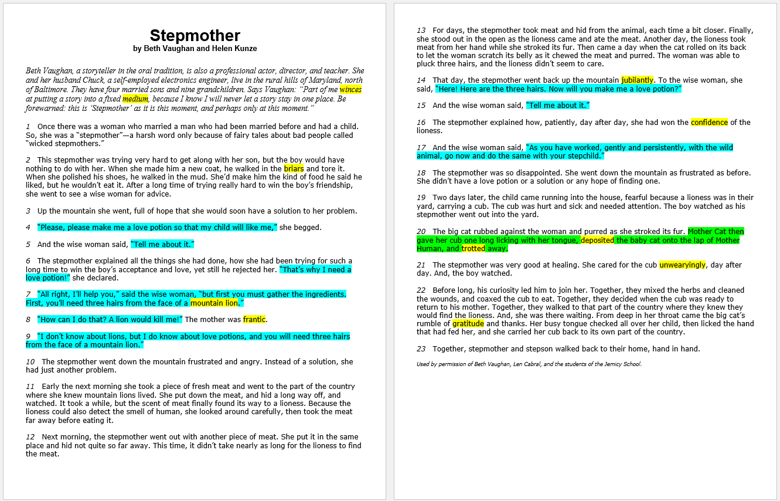
Read only the dialogue. What do you notice? What can be inferred about the characters?

Slide 13
3rd Read:
Read through the excerpt again using the lens of characterization.
*Note and/or highlight any text evidence that develops the characters.

Slide 14
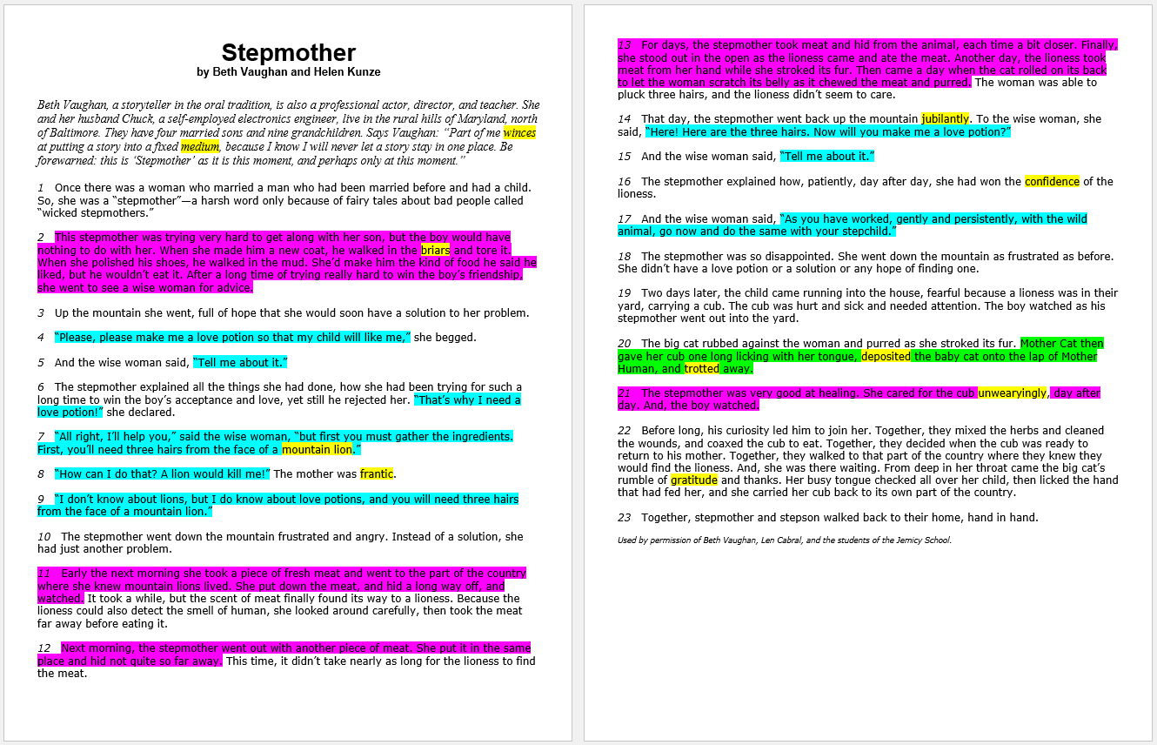

Slide 15

The Wise Woman
The Stepson
The Stepmother
Good listener
Patient
Insightful
Controlled
Perceptive
Understanding
Clever
Desperate
Pleading
Frantic
Determined
Hopeful
Loving
Frustrated
Anxious
Brave
Resistant
Difficult
Hateful
Bitter
Stubborn

Slide 16
difficult & hateful
determined
pleading & desperate

Slide 17

Do you understand why you highlighted your text?
Do you feel like the activity had purpose?
Now that you have found answers, let’s match them with some questions!

Slide 18

With a partner, create questions for the following lenses:
Vocabulary
Inferences through Dialogue
Characterization

Slide 19
Vocabulary Lens—Students are tested over three areas of vocabulary: Greek/Roman roots, context clues, and dictionary skills.
With a partner, select one of the words that you highlighted to create a STAAR-level question using the stem bank.
The stem questions will serve as models of how to craft your question.

Slide 20
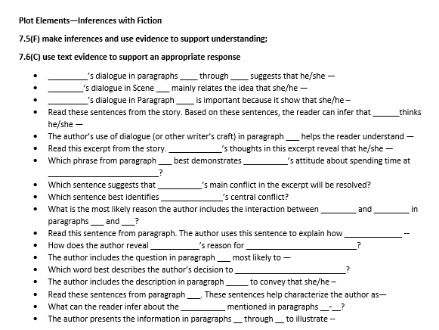
Dialogue Skill Lens—Students are tested over various elements of fiction.
Select a question stem that you could craft to ask about this particular skill based on what you learned from the text.

Slide 21
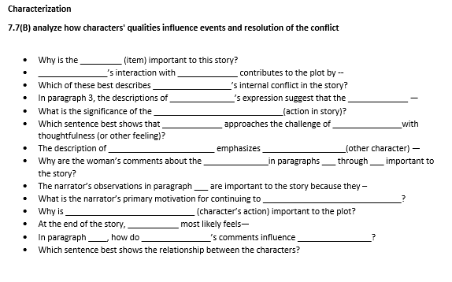
Characterization Lens—Students must not only make inferences about characters, but they must use text evidence to form support.
With your partner, create a third question that connects with the information that you highlighted and the inference skill.

Slide 22


Let’s share out some of the questions that you created based on our short story—

Slide 23

Which words from paragraph 2 help us understand the meaning of petulant?
The alliteration in paragraph 15 creates a feeling of—
What if we could teach our students to write their own STAAR-level questions in response to their reading?
Academic conversations are heavenly!!!!
What do the details from paragraphs 8-13 reveal about the little boy?
Explain the inner conflict that the narrator faces.
I can tell from the dialogue that…
“Snow-covered heap”—imagery?

Slide 24

What does this look like in your classroom?

Slide 25
So far, we have…
read a selection,
used purposeful lenses based on TEKS,
created STAAR-level questions based on the text and TEKS,
and we have discussed how this strategy can carry over into our classrooms.
Using the same text and building upon the analysis that we have hammered out, we will now respond with a composition that will continue to develop rigorous learning!

Slide 26

Go to my website: jmeducate.com

Slide 27
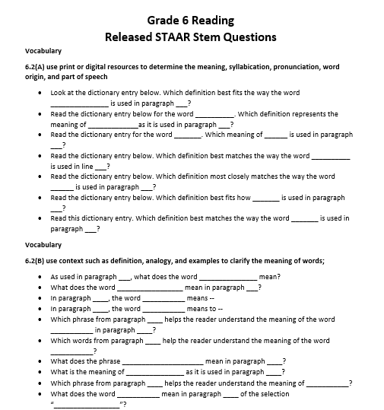
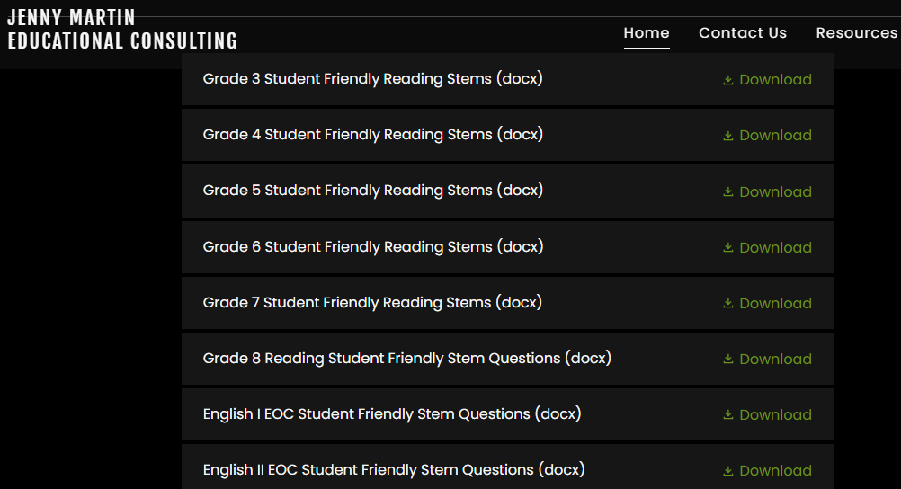
Student-Friendly Reading Stem Questions
*Go to JMEducate.com and scroll down to the page that is titled “Student-Friendly STAAR Stems.”

Slide 28

Thoughts?
We must teach our students to suck the marrow from reading and writing by modeling it. Once they taste the marrow, they will want more.

Slide 29

Time to share!

Slide 30

Think about our students who “slip through the cracks”-
We can still help them grow where they are and blossom as they learn.

Slide 31

Reach out anytime!
Jennifer Martin
jmedcationpd@gmail.com
Jmeducate.com
903-217-2613

