Slide 1
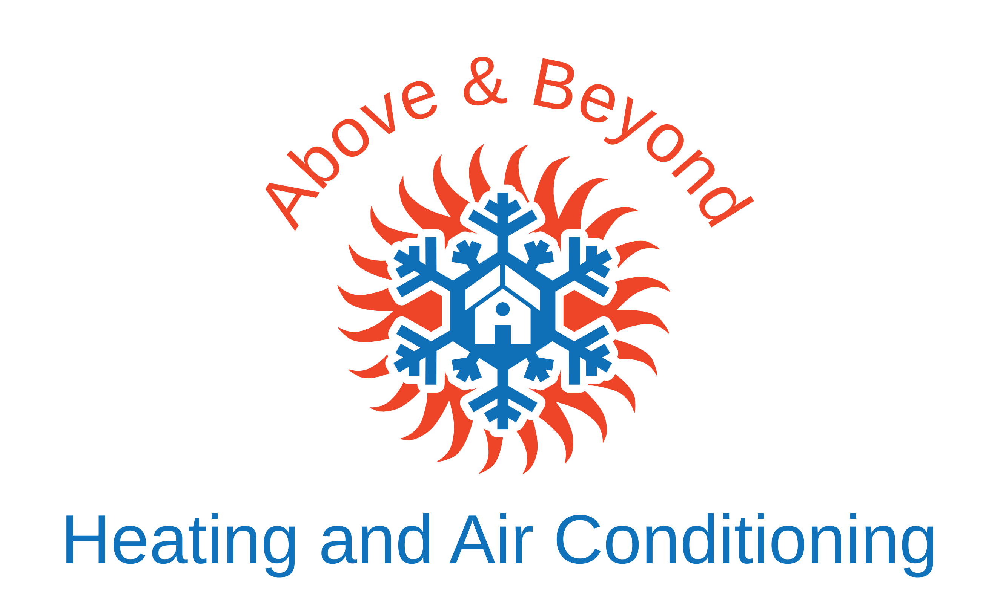
NEW EMPLOYEE ONBOARDING
Welcome to the Team
Above & Beyond Heating and Air Conditioning, LLC

Slide 2
Today's Agenda
1. Welcome & Company Overview
2. Customer Interaction Expectations
3. Professional Conduct & NDA
4. Safety Basics
5. Tools, Vehicle & Appearance
6. Active Listening & De-escalation
7. Conflict Resolution Skills
8. Support & Next Steps
Above & Beyond Heating and Air Conditioning, LLC
2 / 11

Slide 3
Welcome to Above & Beyond
We are a local HVAC company serving Eastern Iowa. Our reputation is built on quality work, reliable service, and professional conduct in every interaction.
Quality Work
Professionalism
Customer Focus
Do the job right the first time
Represent the company well at all times
Listen, communicate clearly, solve problems
Above & Beyond Heating and Air Conditioning, LLC
3 / 11

Slide 4
Customer Interaction Expectations
▸ Communicate courteously and respectfully with every customer and tenant
▸ Remain calm even when faced with challenging or critical comments
▸ De-escalate conflicts — do not argue or escalate
▸ Never make threats or retaliatory statements (including regulatory agencies)
▸ Represent the company positively in the truck, on site, and in public
▸ Report legitimate concerns through proper internal channels
Above & Beyond Heating and Air Conditioning, LLC
4 / 11

Slide 5
Professional Conduct & NDA
Unprofessional Conduct Policy
Aggressive, argumentative, or retaliatory behavior toward customers, tenants, or the public is not acceptable. Violations can result in disciplinary action up to and including termination.
Non-Disclosure Agreement
You signed an NDA upon hiring. You may not disclose company trade secrets, practices, or methods of operation during or after employment. Legal action may be taken for violations.
Key Reminder: Your behavior in the company vehicle, on job sites, and with customers directly affects the company’s reputation and your employment.
Above & Beyond Heating and Air Conditioning, LLC
5 / 11

Slide 6
Safety Basics
PPE
Ladders & Heights
Wear required personal protective equipment on every job
Inspect ladders, use proper setup, maintain three points of contact
Electrical
Heat Stress
Follow lockout/tagout procedures; treat all systems as live until verified
Stay hydrated, take breaks, watch for signs of heat illness
Refrigerant
Report Hazards
Follow EPA Section 608 rules; never vent refrigerant
Report unsafe conditions or near-misses to your supervisor immediately
Above & Beyond Heating and Air Conditioning, LLC
6 / 11

Slide 7
Tools, Vehicle & Appearance
Company Vehicle
Tools & Appearance
You represent the company every time you are in the truck
No aggressive driving or road confrontations
Keep the vehicle clean and stocked
Complete daily inspections as required
Sign for tools issued — you are responsible for them
Wear clean, company-appropriate attire
Maintain a professional appearance on every call
Report damaged or missing tools promptly
The truck is a rolling billboard. Your behavior in and around it reflects directly on Above & Beyond.
Above & Beyond Heating and Air Conditioning, LLC
7 / 11

Slide 8
Active Listening & De-escalation
Active Listening Sequence
De-escalation Keys
1. Let the customer finish
2. Pause briefly
3. Reflect content + emotion
4. Check accuracy (“Did I get that right?”)
5. Then move to next steps
Keep your voice lower and calmer
Do not match their energy
Never make threats or sarcastic remarks
When in doubt, step away and call your supervisor
Document the interaction factually
Useful closer: “I want to help, but I can see we’re not going to resolve this right now. I’m going to step away and have my supervisor contact you today.”
Above & Beyond Heating and Air Conditioning, LLC
8 / 11

Slide 9
Conflict Resolution Skills
Empathy Statements
“I can see why this would be frustrating.”
Reframing
“I want the same thing you do — a system that works reliably.”
Professional Boundaries
“I need us to keep this conversation respectful so we can move forward.”
Time-Out
“I’m going to step outside and call my supervisor.”
Above & Beyond Heating and Air Conditioning, LLC
9 / 11

Slide 10
Support & Next Steps
Who to Contact
Supervisor / Manager — day-to-day questions, job issues, escalation
Liz Kelly — payroll, paperwork, administrative questions
Your assigned mentor / buddy — practical guidance in the first weeks
Your First Weeks
You will shadow experienced technicians, complete safety orientation, and review company policies. Use the Onboarding Checklist to track progress. Ask questions early and often.
Above & Beyond Heating and Air Conditioning, LLC
10 / 11

Slide 11
Welcome Aboard
Represent the company well. Stay professional. Ask for help when you need it.
Questions?

