Slide 1
Presentation to United Beverage
Retailers of Arkansas (UBRA)
Dale Szyndrowski
V.P. of Government Relations
Distilled Spirits Council
October 15, 2018

Slide 2
Distilled Spirits Council Key Issues
2018 - 2019
Craft Beverage Modernization and Tax Reform Act
  Pass permanent extension beyond 2019
  Speed up implementation of rates and rules by TTB
De-escalate trade war and retaliatory tariffs
  After years of successful work to reduce trade barriers, alcohol industry now caught in crossfire
  25 percent EU tariffs hurting both large and small distillers
Work with agencies to implement duty drawback rules as Congress intended
Marijuana legalization happening rapidly at state level
  Advocates ask to “tax and regulate it like alcohol”
  What does that look like? Any impact on alcohol sales?

Slide 3
Marijuana Legalization Taking Shape
21 percent live in states legal for sale & personal use
  New York, New Jersey and Michigan could legalize by 2019
Cannabis tax rates appear roughly equivalent with alcohol
Growers are highly regulated to prevent contaminants like mold, mites and pesticides
Distribution rules vary; some states allow vertical integration
Retailers cannot sell both cannabis and alcohol
Health claims are not permitted but standards are lax
Marijuana users are generally alcohol consumers, as well
  They tend to view alcohol and cannabis “occasions” separately
  No credible evidence that pot use is cutting into spirits sales

Slide 4
Distilled Spirits Council
Guiding Principles on Marijuana Policy

Slide 5
Summary:
So what do we do know?

Slide 6
Meeting Consumer Demand
Spirits consumers are making informed choices
Spirits consumers want to purchase what they want, when they want, and how the want it
Spirits need to be treated fairly and equitably relative to beer and wine and other regulated consumable products
Spirits continue to be the leader in advancing moderation and responsibility
Sunday sales – Colorado model for sales (2016 compromise)
What does that mean for a changing marketplace for beverage alcohol?

Slide 7
States Allowing Grocery Store
Alcohol Sales - 2018
3.2% beer
3.2% beer
3.2% beer until 2019
3.2% beer until 2019
46 some form of beer, wine, spirits or combination
46 beer sales
39 wine sales
27 spirits sales
4 states have no form of alcohol in grocery stores
  AK, DE, MD, RI
Note: Other restrictions (e.g., retail license caps and local ordinances) will limit
the availability of grocery stores sales in certain states
States allowing beer and wine sales
States allowing beer only
States allowing beer, wine and spirits

Slide 8
Recent Changes to State Grocery
Store Alcohol Sales Laws
2014
Tennessee: 2014 legislation signed into law to allow local-option wine in grocery stores. Local elections began in November 2014 and wine sales began July 1, 2016.
2016
Colorado: 2016 legislation signed into law to allow additional all-alcohol licenses for grocery stores and phase out 3.2% beer by Jan. 2019.
Oklahoma: On November 8, 2016, 66% of Oklahoma voters approved a ballot measure to allow full-strength beer and wine in grocery and convenience stores. The measure took effect October 1, 2018.
Pennsylvania: 2016 legislation signed into law allows off-premise wine sales at restaurant licenses, including grocery stores with restaurants attached, effective August 8, 2016.
2017
Arkansas: 2017 legislation signed into law to allow all wine in grocery stores sales, effective Oct. 1, 2017.
Kansas: 2017 legislation signed into law will allow grocery and convenience stores to sell beer containing 6% ABV. Full-strength beer sales will begin April 1, 2019 and a market impact study will be required after 10 years.

Slide 9
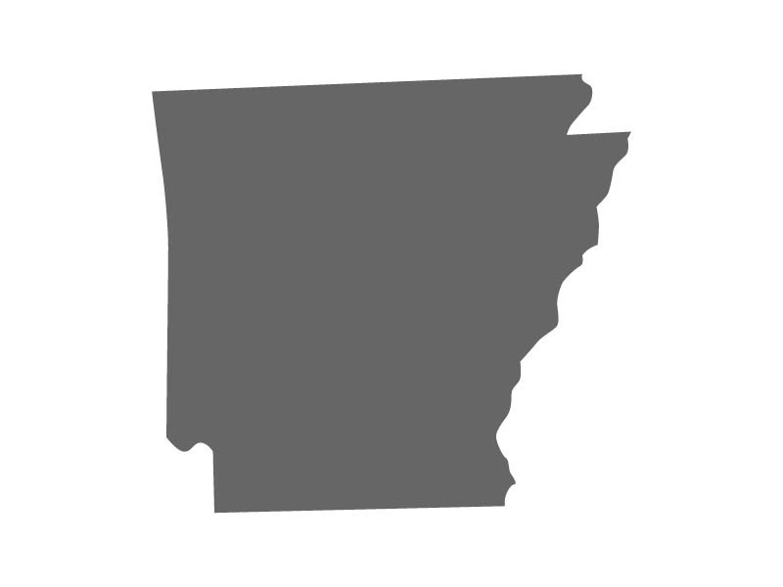
Designing your own destiny

